Slide 1


Slide 2




Course Overview
Welcome
Welcome
Lecture 0 - Overview. Dr. Israa Lewaa Mathematics 1

Slide 3
Who I am?
Who Am I?
Dr. Israa Lewaa
  Lecturer in Statistics and Mathematics
    Ph.D from Faculty of Economics and Political Science, Cairo University, Statistics Department.
    Thesis: “Statistical data integration Using A latent Class Model”.
    M.Sc from Faculty of Economics and Political Science, Cairo University, Statistics Department.
    B.Sc from Faculty of Economics and Political Science, Cairo University, Statistics Department.

Slide 4

The course that will be taught
The course that will be taught
Mathematics

Slide 5
Primary Goal of This Course
Primary Goal of This Course
This course aims to:
  Provide students with concepts of
Function,
Continuity and limits,
Derivatives,
Integration,
Calculus by Python,
  and other Mathematical topics.

Slide 6
Learning Resources
Learning Resources:
Credit Hours:
3 credit hours.
  Required Textbook:
Introductory Mathematical Analysis/ Ernest Haeussler, Richard Paul and Richard Wood.
Doing Math with Python: Use Programming to Explore Algebra, Statistics, Calculus, and More!/ Amit Saha.
  Essential References:
Mathematics and Its Logics/Geoffrey Hellman, University of Minnesota
Calculus, 6th-edition/ james stewart

Slide 7
What This Course is About
What This Course is About
  The course will help students to
  Understand different types of functions and how to graph it ,
Compute limits, derivatives, and definite & indefinite integrals of algebraic, logarithmic and exponential functions,
Analyze functions and their graphs as informed by limits and derivatives, and
Solve applied problems using differentiation and integration.
Determine the continuity and differentiability of a function at a point and on a set;
Use the derivative of a function to determine the properties of the graph of the function and use the graph of a function to estimate its derivative;
Use appropriate modern technology to explore calculus concepts.

Slide 8
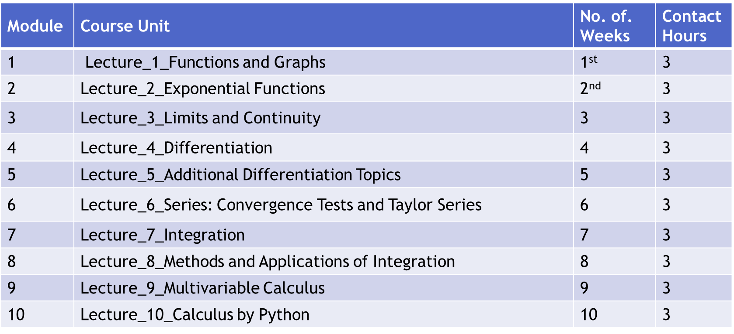
Units of Course Contents
Units of Course Contents
  Lecture Structure:

Slide 9

Course Information
Course Information
Short Exam
  80% marks
    Count of short Exam 10 (Weekly)
    8 Marks for each of short Exam.
  20% Final Examination

Slide 10
Assessment Method
Academic Calendar
-- اللغة الأساسية في المحاضرات هي:
اللغة الإنجليزية
-- الاختبارات باللغة الإنجليزية مع وجود
ترجمة للسؤال.

Slide 11
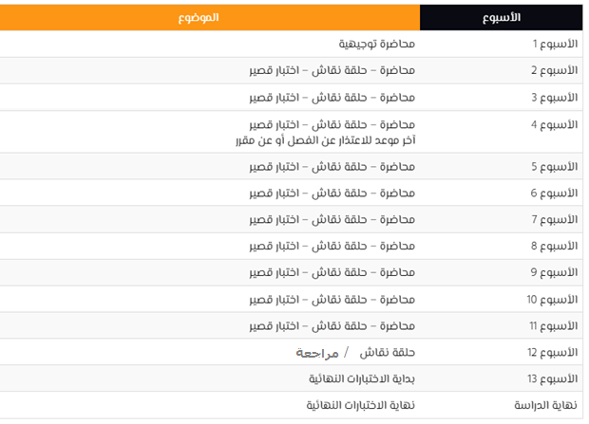
Academic Calendar

Slide 12

Lecture Timing
Academic Calendar
عبر برنامج ZOOM
سيتم تثبيت رابط حلقة النقاش على صفحة المقرر
رابط حلقة النقاش وموعدها مرفوع على صفحة المودل ستكون حلقة وحيدة كل أسبوع

Slide 13


