Slide 1


Essential CMS-1500 Claim Instructions
Prepared by Dr. Hayat Farag
MHA631
Health Insurance
Lecture 9

Slide 2

Objectives
Explore Insurance Billing Guidelines.
Discuss Reporting Diagnoses: ICD-9-CM Codes & Reporting Procedures and Services: CPT Codes.
Examine Final Steps in Processing Claims.

Slide 3
It is important to remember the familiar phrase “If it wasn’t documented, it wasn’t done.”
It is important to remember the familiar phrase “If it wasn’t documented, it wasn’t done.”
Insurance Billing Guidelines

Slide 4
Chapter
Insurance Billing Guidelines
09
General billing guidelines common to most payers include:
1. Provider services for inpatient care are billed on a fee-for-service basis.
Each physician service results in a unique and separate charge designated by a CPT service/procedure code.

Slide 5
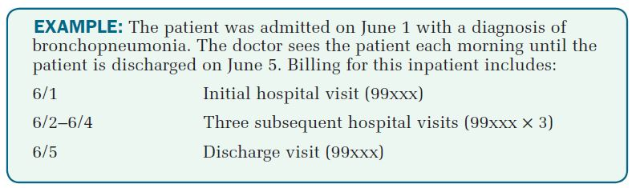
Chapter
Insurance Billing Guidelines
09

Slide 6
Chapter
Insurance Billing Guidelines
09
NOTE: Members of the same practice cannot bill for inpatient services on the same day unless circumstances are documented that justify medical necessity and modifiers are assigned to reported code number(s).
Otherwise, this is considered duplication of services.

Slide 7
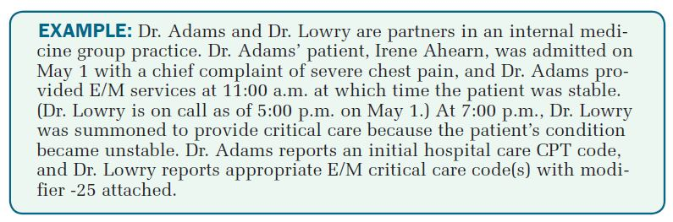
Chapter
Insurance Billing Guidelines
09

Slide 8
Chapter
Insurance Billing Guidelines
09
2. Appropriately report observation services.
Observation care is “a well-defined set of specific, clinically appropriate services, which include ongoing short-term treatment, assessment, and reassessment before a decision can be made regarding whether patients will require further treatment as hospital inpatients or if they are able to be discharged from the hospital.

Slide 9
Chapter
Insurance Billing Guidelines
09
Observation status is commonly assigned to patients who present to the emergency department and who then require a significant period of treatment or monitoring before a decision is made concerning their admission or discharge.
Observation services are covered only when provided by the order of a physician or another individual authorized by state licensure law and hospital staff bylaws (policies) to admit patients to the hospital or to order outpatient tests.

Slide 10
Chapter
Insurance Billing Guidelines
09
In the majority of cases, the decision whether to discharge a patient from the hospital following resolution of the reason for the observation care or to admit the patient as an inpatient can be made in less than 48 hours, usually in less than 24 hours.
In only rare and exceptional cases do reasonable and necessary outpatient observation services span more than 48 hours.

Slide 11
Chapter
Insurance Billing Guidelines
09
Hospitals may bill for patients who are direct admissions to observation. A direct admission occurs when a physician in the community refers a patient to the hospital for observation, bypassing the clinic or emergency department (ED).”

Slide 12
Chapter
Insurance Billing Guidelines
09
NOTE: Observation services are reimbursed as an alternative to inpatient admission under the Outpatient Prospective Payment System (OPPS). Medicare coverage is limited to not more than 48 hours unless the Medicare administrative contractor grants an exception.
Although outpatient observation care can progress to inpatient admission, an inpatient admission cannot be converted to outpatient observation. If an inpatient admission is warranted, observation services are not billed separately and are reported on the inpatient claim!

Slide 13
Chapter
Insurance Billing Guidelines
09
3. The surgeon’s charges for inpatient and outpatient surgery are billed according to a global fee (or global surgery package), which means that one charge covers presurgical evaluation and management, initial and subsequent hospital visits, surgical procedure, the discharge visit, and uncomplicated postoperative follow-up care in the surgeon’s office.

Slide 14
Chapter
Insurance Billing Guidelines
09
4. Postoperative complications requiring a return to the operating room for surgery related to the original procedure are billed as an additional procedure. (Be sure to use the correct modifier, and link the additional procedure to a new diagnosis that describes the complication.)

Slide 15
Chapter
Insurance Billing Guidelines
09
5. Combined medical/surgical cases in which the patient is admitted to the hospital as a medical case but, after testing, requires surgery, are billed according to the instructions in items 3–4.
NOTE: No subsequent hospital visits or discharge day codes are reported because the global surgery package concept applies.

Slide 16
Chapter
Insurance Billing Guidelines
09
6. Some claims require attachments, such as operative reports, discharge summaries, clinic notes, or letters, to aid in determination of the fee to be paid by the insurance company.
Attachments are also required when CPT unlisted codes are reported. Each claims attachment (medical report substantiating the medical condition) should include patient and policy identification information.

Slide 17
It is important to remember the familiar phrase “If it wasn’t documented, it wasn’t done.”
It is important to remember the familiar phrase “If it wasn’t documented, it wasn’t done.”
National Provider Identifier (NPI)

Slide 18
Chapter
National Provider Identifier (NPI)
09
The national provider identifier (NPI) is a unique 10-digit number issued to individual providers (e.g., physicians, dentists, pharmacists) and healthcare organizations (e.g., group physician practices, hospitals, nursing facilities).
Even if an individual provider moves, changes specialty, or changes practices, the provider will keep the same NPI (but must notify CMS to supply the new information).
The NPI will identify the provider throughout his or her career. The NPI issued to a healthcare organization is also permanent except in rare situations when a healthcare provider does not wish to continue an association with a previously used NPI.

Slide 19
It is important to remember the familiar phrase “If it wasn’t documented, it wasn’t done.”
It is important to remember the familiar phrase “If it wasn’t documented, it wasn’t done.”
Reporting Diagnoses: ICD-9-CM Codes

Slide 20
Chapter
Reporting Diagnoses: ICD-9-CM Codes
09
A maximum of four ICD-9-CM codes may be entered on a single claim.
If more than four diagnoses are required to justify the procedures and/or services on a claim, generate additional claims.
In such cases, be sure that the diagnoses justify the medical necessity for performing the procedures/services reported on each claim.
Diagnoses must be documented in the patient’s record to validate medical necessity of procedures or services billed.

Slide 21
Chapter
Reporting Diagnoses: ICD-9-CM Codes
09
Sequencing Multiple Diagnoses:
The first-listed code reported is the major reason the patient was treated by the healthcare provider.
Secondary diagnoses codes are entered in numbers 2 through 4 and should be included on the claim only if they are necessary to justify procedures/services reported.
Do not enter any diagnoses stated in the patient record that were not treated or medically managed during the encounter.

Slide 22
Chapter
Reporting Diagnoses: ICD-9-CM Codes
09
Accurate Coding
For physician office and outpatient claims processing, never report a code for diagnoses that include such terms as “rule out,” “suspicious for,” “probable,” “ruled out,” “possible,” or “questionable.”
Code either the patient’s symptoms or complaints, or do not complete this block until a definitive diagnosis is determined.
Be sure all diagnosis codes are reported to the highest degree of specificity known at the time of the treatment.

Slide 23
Chapter
Reporting Diagnoses: ICD-9-CM Codes
09
NOTE: Coders should be aware that some chronic conditions always affect patient care because they require medical management and should, therefore, be coded and reported on the CMS-1500 claim.
Examples include diabetes mellitus and hypertension.

Slide 24
It is important to remember the familiar phrase “If it wasn’t documented, it wasn’t done.”
It is important to remember the familiar phrase “If it wasn’t documented, it wasn’t done.”
Reporting Procedures and Services: CPT Codes

Slide 25
Chapter
Reporting Procedures and Services: CPT Codes
09
All payers require entry of a date of service and place of service (POS) code on the claim.
A maximum of six procedures and/or services may be reported on one claim. If the reporting of additional procedure and/or service codes is necessary, generate additional CMS-1500 claim(s).
NOTE: Do not report procedure and/or service codes if no fee was charged.

Slide 26
Chapter
Reporting Procedures and Services: CPT Codes
09
When reporting more than one code on a CMS-1500 claim, enter the code with the highest fee, and then enter additional codes in descending order of charges.
Multiple procedures: Enter the procedure code that will be reimbursed highest first, and then enter secondary procedure codes in descending order of charges.

Slide 27
Chapter
Processing Secondary Claims
09
The secondary insurance claim is filed only after the remittance advice generated as a result of processing the primary claim has been received by the medical practice.
As a general rule, the secondary claim cannot be filed electronically because the remittance advice must be attached to the claim sent to the secondary payer.

Slide 28
Chapter
Processing Secondary Claims
09
Multiple claims are generated when the patient is covered by multiple insurance policies with different companies (e.g., Aetna and United Healthcare).
For example, if the patient has both primary and secondary insurance with different payers, two claims are generated.

Slide 29
It is important to remember the familiar phrase “If it wasn’t documented, it wasn’t done.”
It is important to remember the familiar phrase “If it wasn’t documented, it wasn’t done.”
Final Steps in Processing Claims

Slide 30
Chapter
Final Steps in Processing Claims
09
STEP 1 Double check each claim for errors and omissions.
Verify all fields for accuracy, including:
Patient demographics (name, policy number)
Correct CPT/ICD codes
Dates of service
Provider information

Slide 31
Chapter
Final Steps in Processing Claims
09
STEP 2: Add any necessary attachments
Attach supporting documents:
Operative reports (e.g., for surgery claims)
Referral authorizations
Progress notes for complex cases

Slide 32
Chapter
Final Steps in Processing Claims
09
STEP 3: Obtain the provider’s signature if required
Some payers mandate wet/electronic signatures to attest:
Services were actually rendered
Documentation is accurate

Slide 33
Chapter
Final Steps in Processing Claims
09
STEP 4: Post submission to patient’s account/ledger
Update financial records to track:
Claim submission date
Expected reimbursement
Patient responsibility (copay/deductible)

Slide 34
Chapter
Final Steps in Processing Claims
09
STEP 5: Place a copy of the claim in the practice’s claims files.
Maintain an audit trail by:
Storing physical/digital copies
Organizing by date or claim number

Slide 35
Chapter
Final Steps in Processing Claims
09
STEP 6: Submit the claim to the payer
Choose the appropriate method:
Electronic Data Interchange (EDI) for faster processing
Paper mail if mandated

Slide 36

Key Takeaways
Chapter
09
General billing guidelines common to most payers.
The national provider identifier (NPI) is a unique 10-digit number issued to individual providers (e.g., physicians, dentists, pharmacists) and healthcare organizations (e.g., group physician practices, hospitals, nursing facilities).
A maximum of four ICD-9-CM codes may be entered on a single claim.
Diagnoses must be documented in the patient’s record to validate medical necessity of procedures or services billed.

Slide 37
Chapter
Key Takeaways
09
5. A maximum of six procedures and/or services may be reported on one claim.
6. Do not report procedure and/or service codes if no fee was charged.
7. Final steps in processing claims (6 steps).

Slide 38



Thank You

