Slide 1
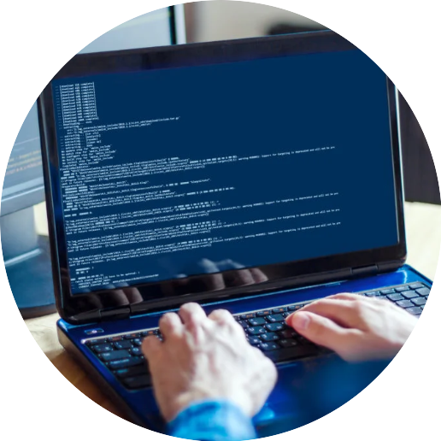


Orientation
Lecture
Dr. Hamada I. AbdulWakel
Lecture 0

Slide 2



Network Programming
in Python
Prepared by
Dr. Hamada I. AbdulWakel
www.midocean.ae

Slide 3


Slide 4
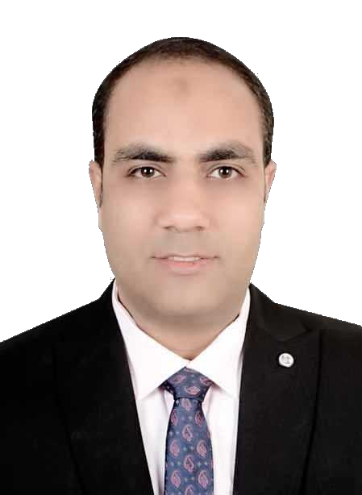
Lecture
WHO AM I?
0
Name
Hamada Ibrahim AbdulWakel
B.Sc. degree
Faculty of Computers and Information, Minia University, Minia, Egypt.
M.Sc. degree
In Computer Science from Faculty of Computers and Artificial Intelligence, Cairo University.
Semantic web & Social networking.
www.midocean.ae

Slide 5
Lecture
WHO AM I?
0
Cont'd
Ph.D. degrees
In Computer Science from Faculty of Computers and Artificial Intelligence, Cairo University.
Internet of Things.
Jobs
Lecturer at Faculty of Computers & Information, Minia University, Minia, Egypt.
Lecturer at Midocean university.
www.midocean.ae

Slide 6

Lecture
YOUR TURN
0
www.midocean.ae

Slide 7
Lecture
COURCE DETAILS
0
Course name
Network Programming – CYB615.
University
Midocean University.
Department unit
Cybersceurity.
www.midocean.ae

Slide 8
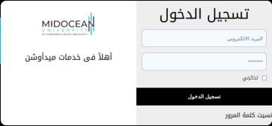
Lecture
COURSE CONTACT
0
Via the sis platform.
Via Midocean university email:
  hamada@midocean.ae
    Subject:
    "Network Programming Course: Question"
    If problem:
      The message must include student ID.
www.midocean.ae

Slide 9
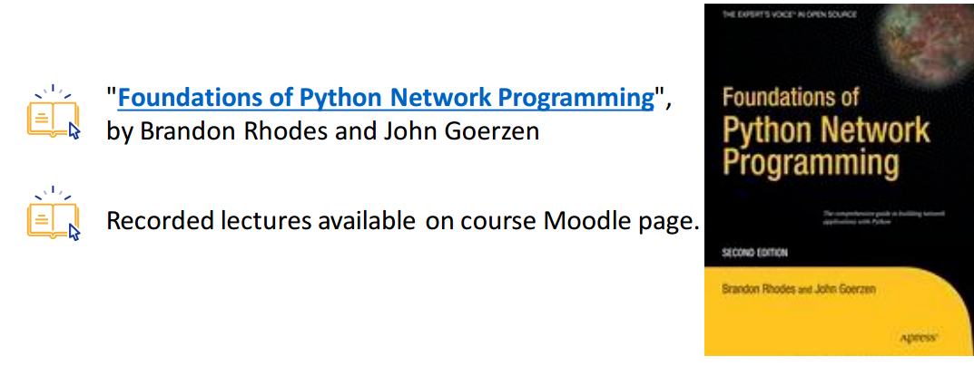
Lecture
COURSE MATERIALS
0
The main materials:
www.midocean.ae

Slide 10

Lecture
LEARNING OBJECTIVES
0
What you'll learn?
Network and programming.
Using "Python" to program network applications.
The use of TCP, UDP, and IP networks and interfaces in programming.
Using sockets programming.
www.midocean.ae

Slide 11

Lecture
COURSE TOPICS
0
The course content:
Introduction to networks.
Introduction to network basic programming in python.
TCP and UDP applications programming.
Sockets and DNS programming.
Network error handling.
www.midocean.ae

Slide 12
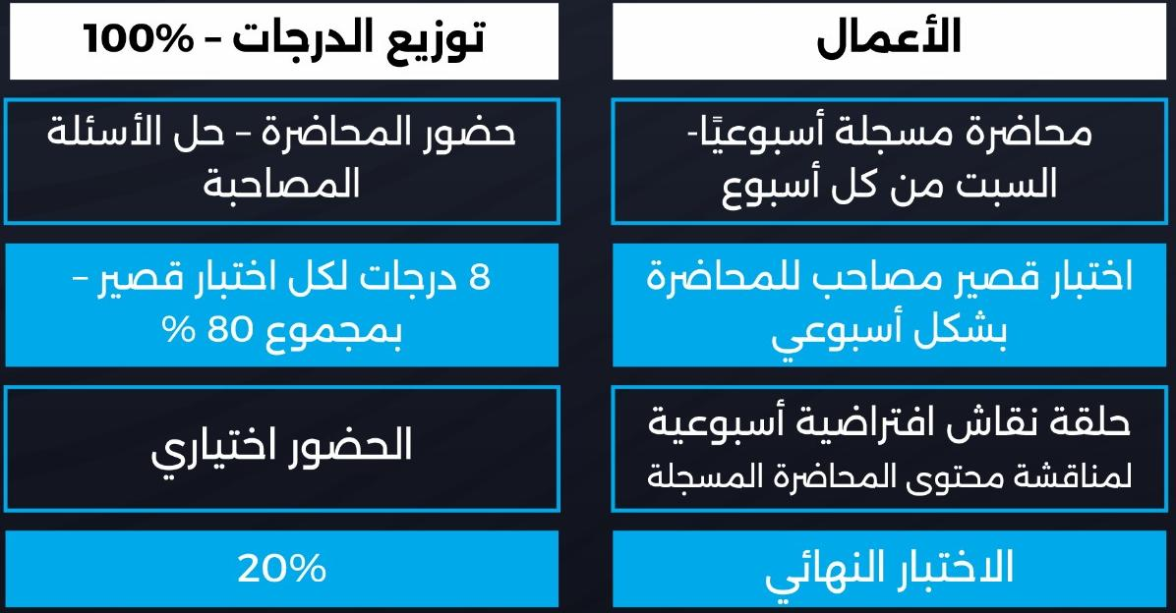
Lecture
0
COURSE ASSESSMENT
www.midocean.ae

Slide 13
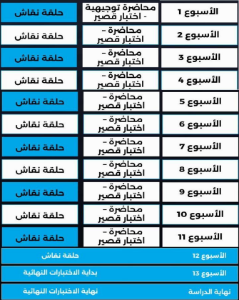
Lecture
0
COURSE ACADEMIC CALENDAR
www.midocean.ae

Slide 14


Lecture
0
COURSE EXAMS
Exam rules:
All exam password is agree.
Each exam includes eight questions.
You have only one-try for each exam.
Each exam duration is 24 minutes.
www.midocean.ae

Slide 15
Lecture
0
COURSE EXAMS
Cont'd
Exam rules:
You must sure of your question answer before
going to the next question.
Each exam begins on Saturday 10:00 PM
to next Saturday 9:00PM.
Each exam has different question types.
www.midocean.ae

Slide 16
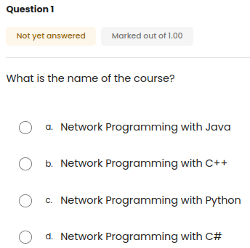
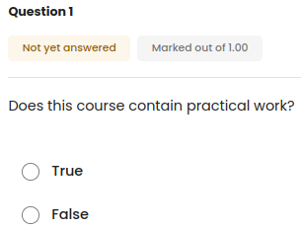
Lecture
0
EXAM QUESTION TYPES
www.midocean.ae

Slide 17
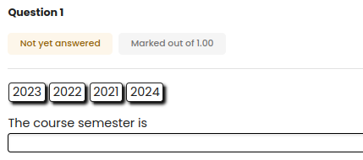
Lecture
0
EXAM QUESTION TYPES
Cont'd
www.midocean.ae

Slide 18
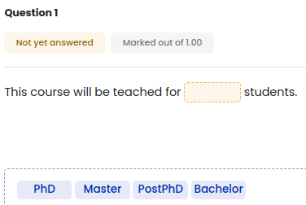
Lecture
0
EXAM QUESTION TYPES
Cont'd
www.midocean.ae

Slide 19
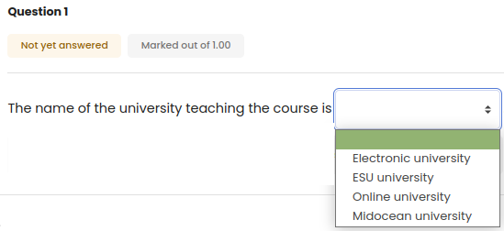
Lecture
0
EXAM QUESTION TYPES
Cont'd
www.midocean.ae

Slide 20
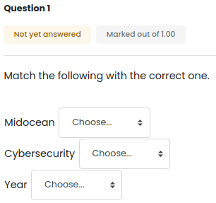
Lecture
0
EXAM QUESTION TYPES
Cont'd
www.midocean.ae

Slide 21
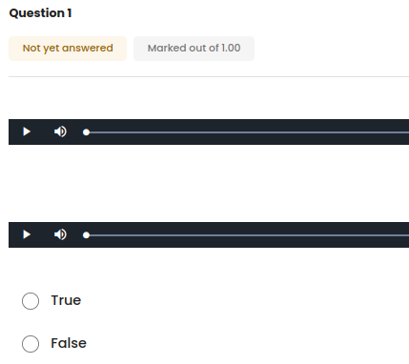
Lecture
0
EXAM QUESTION TYPES
Cont'd
www.midocean.ae

Slide 22



Slide 23

Thank You

