Slide 1

CCNA - Introduction to Networks v7.0 (ITN)
Prepared by Dr. Abdelrhman Ahmed
Lecture 5
Module 9: Address Resolution

Slide 2
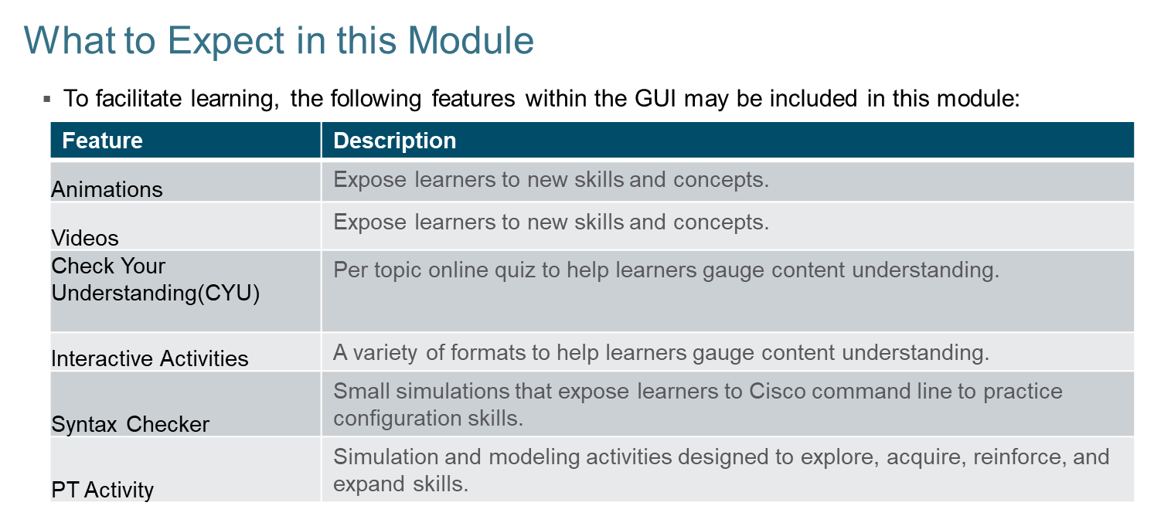

Chapter 5

Slide 3
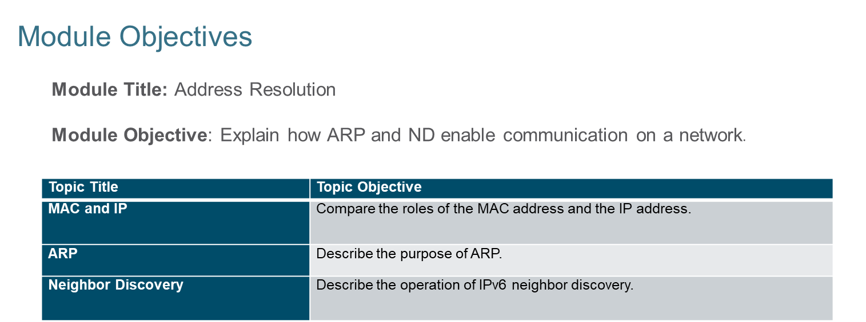
Chapter 5
Address Resolution

Slide 4
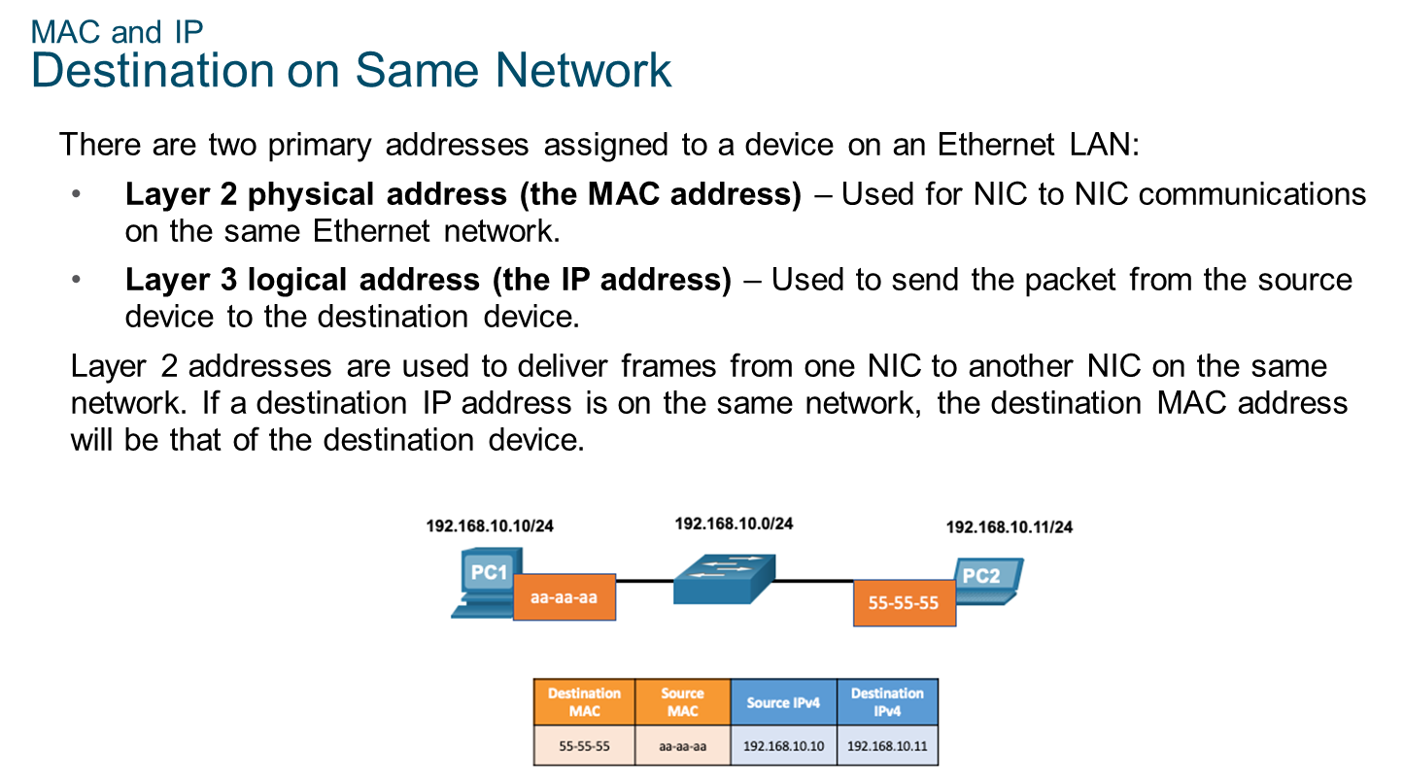
Chapter 5
MAC and IP

Slide 5
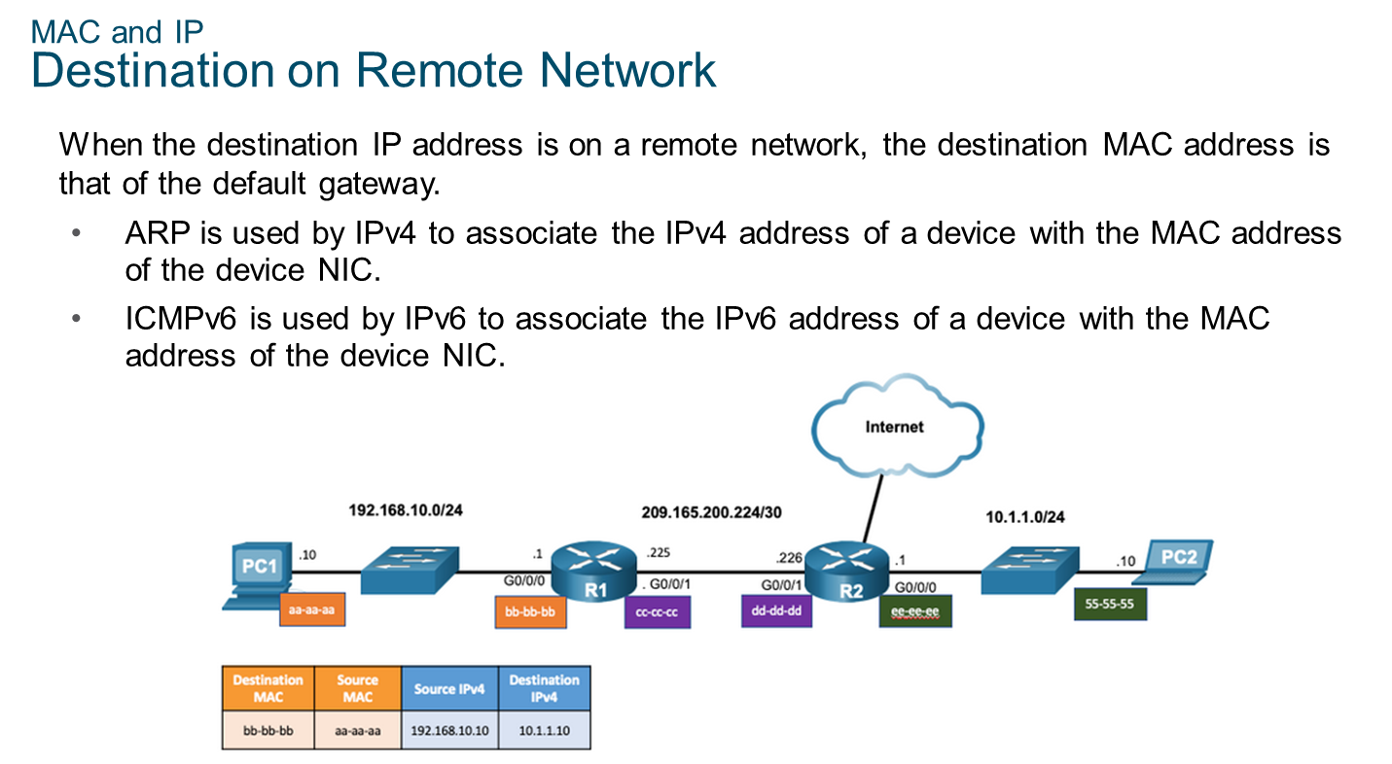
Chapter 5
MAC and IP

Slide 6
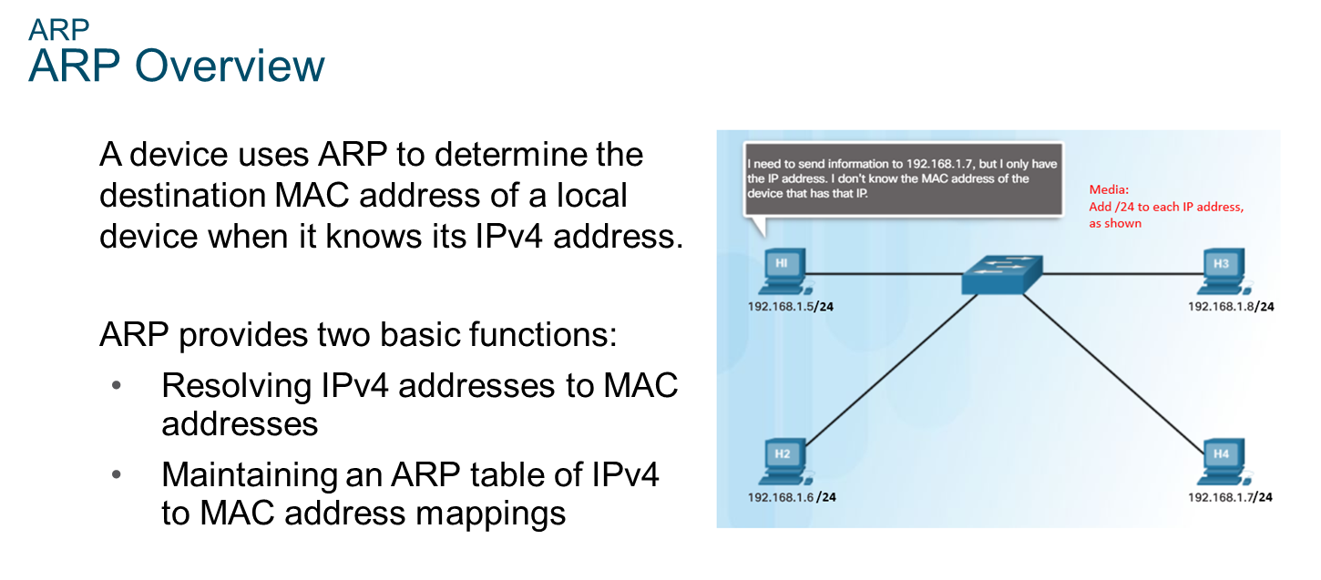
Chapter 5
ARP

Slide 7
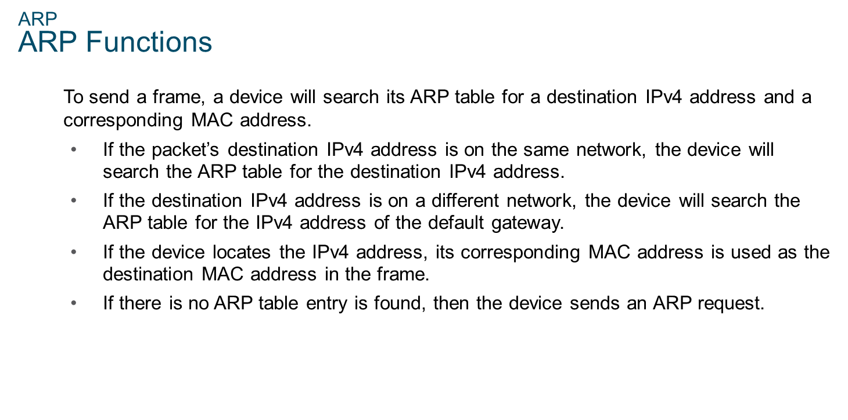
Chapter 5
ARP

Slide 8
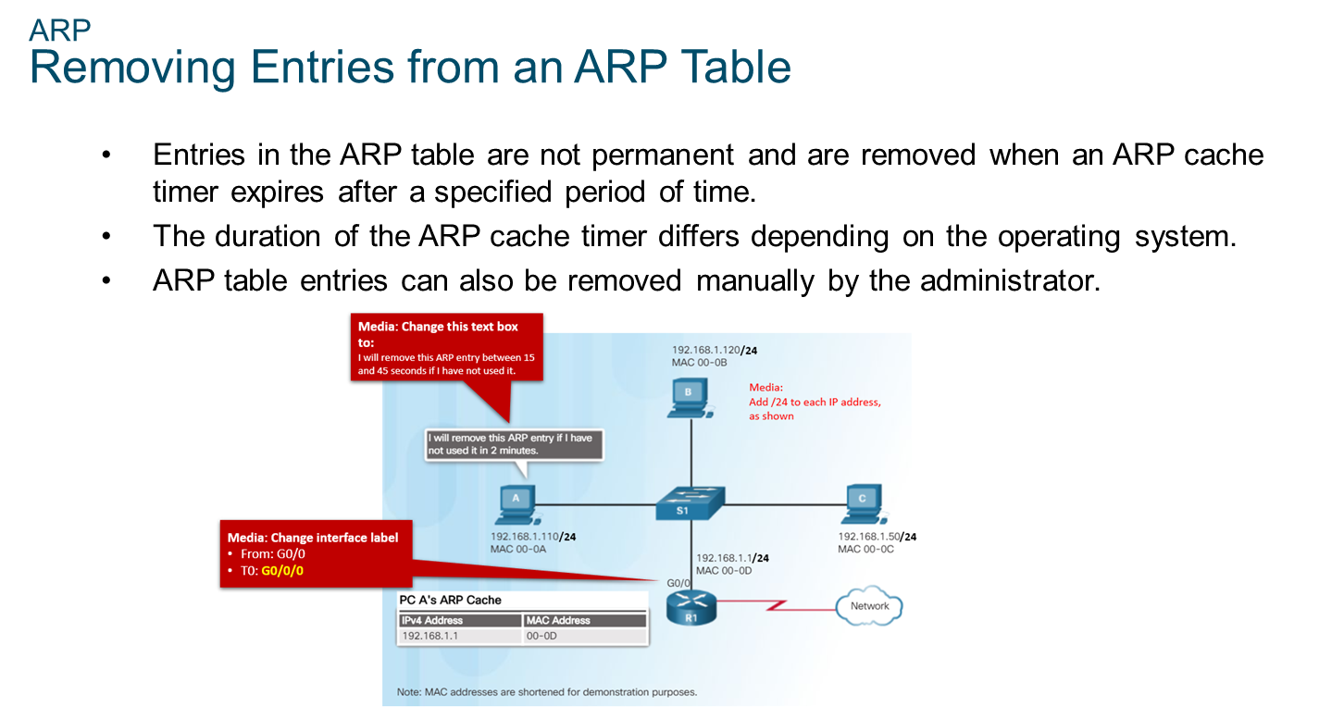
Chapter 5
ARP

Slide 9
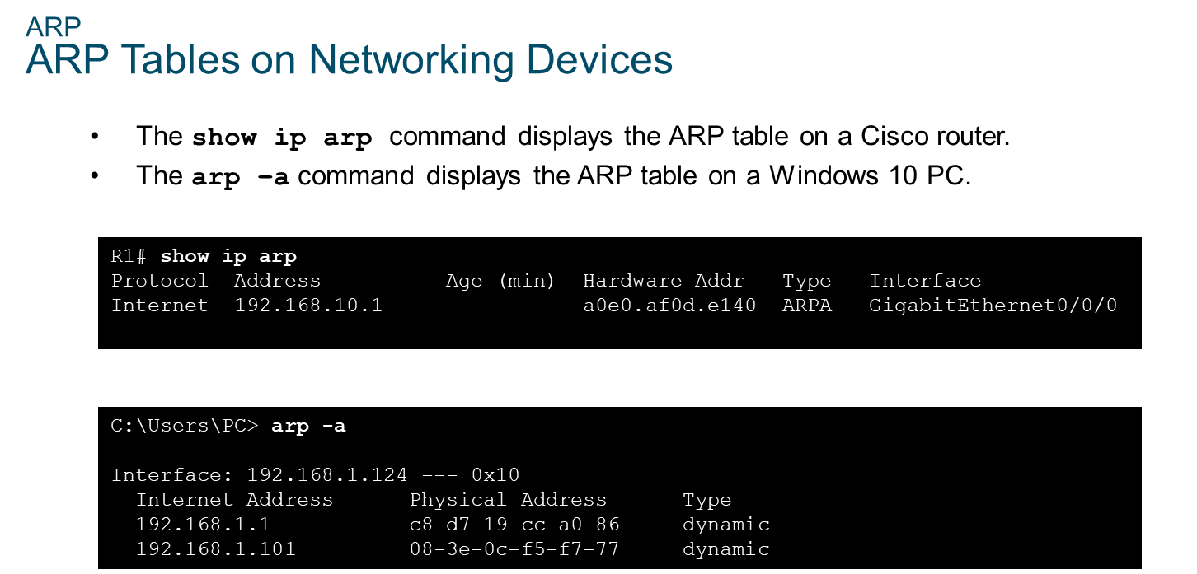
Chapter 5
ARP

Slide 10
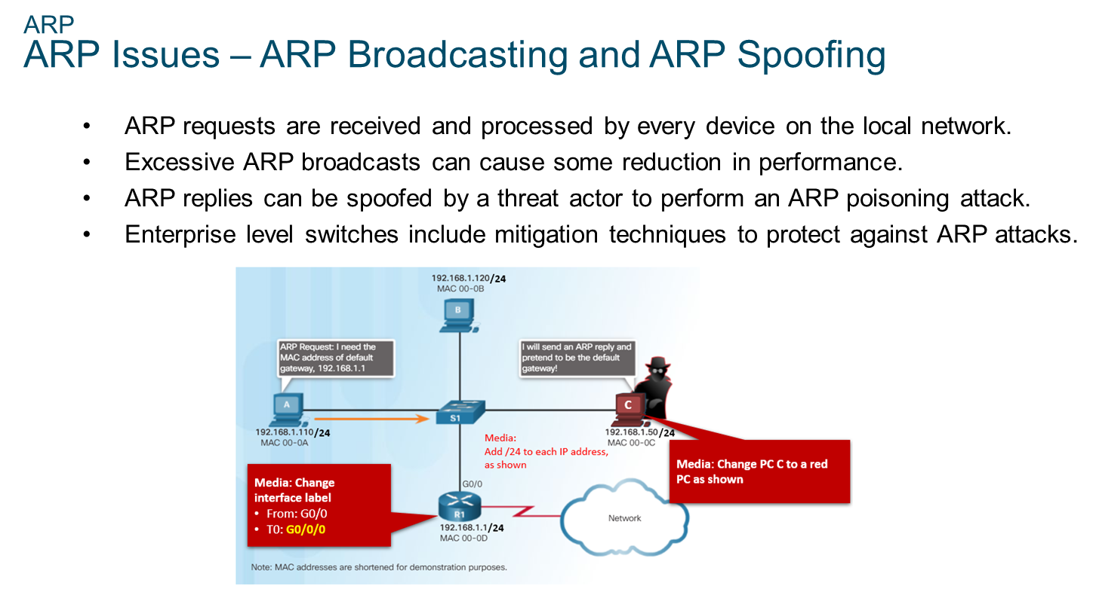
Chapter 5
ARP

Slide 11
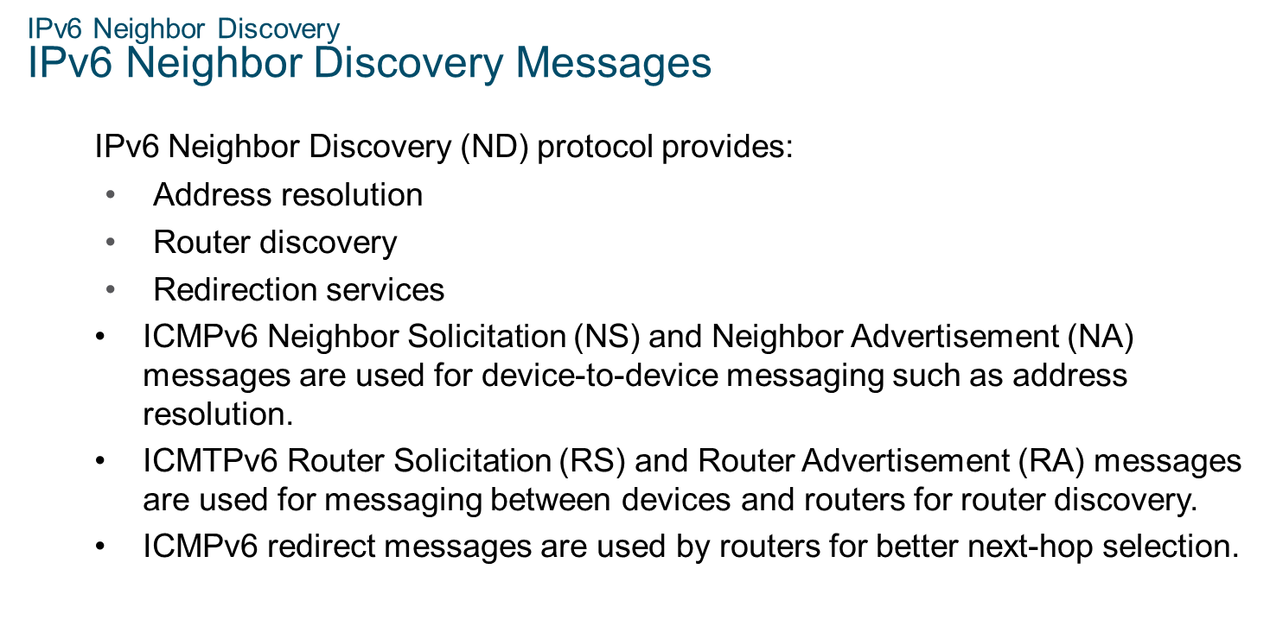
Chapter 5
IPv6 Neighbor Discovery

Slide 12
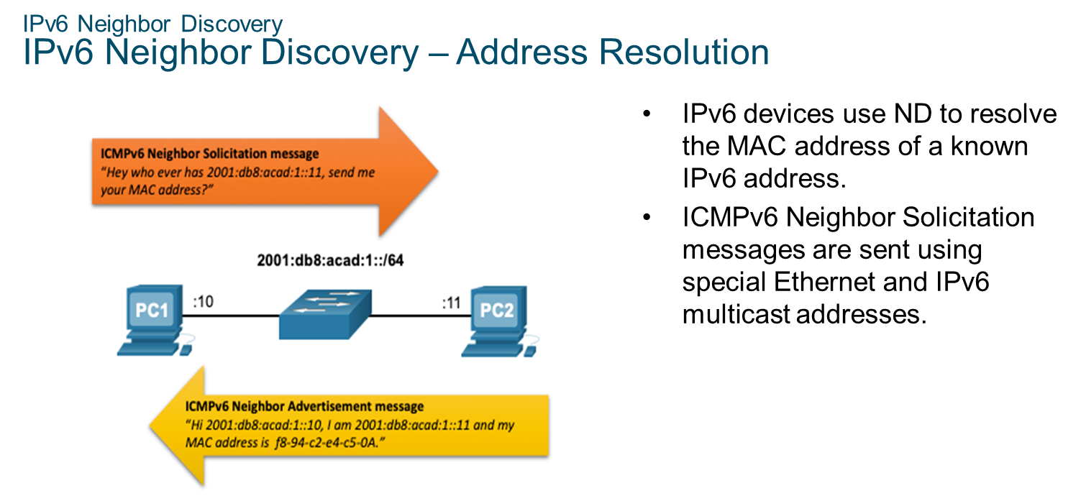
Chapter 5
IPv6 Neighbor Discovery

Slide 13


