Slide 1


Project Monitoring
Lecture 1
PMG 333
Introduction to modern
project management
Prepared by
Dr. Mohammed Mustafa

Slide 2
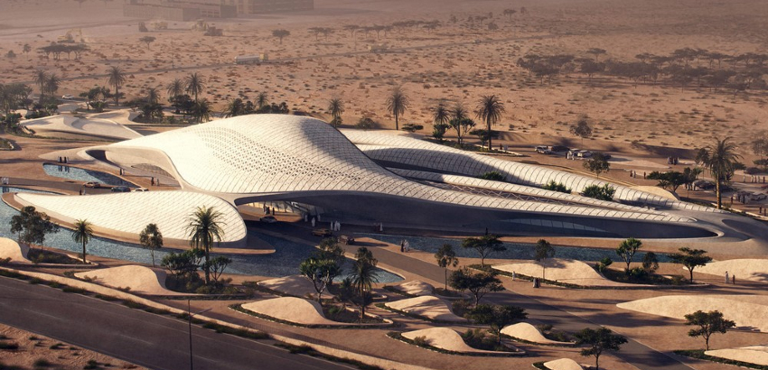
Learning objectives
Understand why project management is crucial in today’s world.
Distinguish a project from routine operations.
Identify the different stages of project life cycle.
Understand the importance of projects in implementing organization strategy.
Understand that managing projects involves
balancing the technical and sociocultural
dimensions of the project.

Slide 3

Introduction to modern project management
Contents
What Is a Project?
Current Drivers of Project Management
Project Governance
Project Management Today—A Socio-Technical Approach

Slide 4
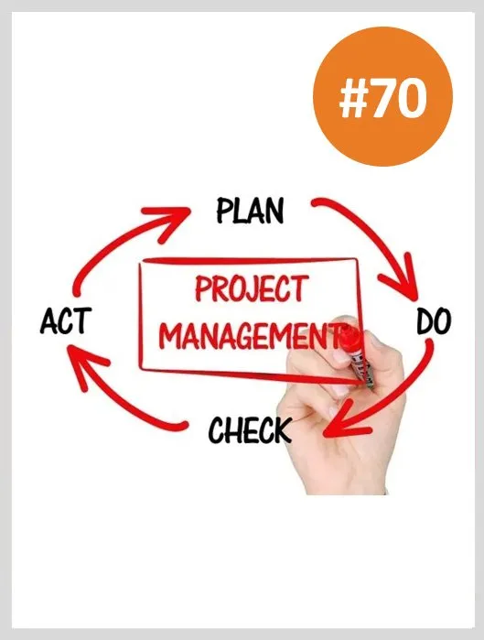
Understanding the Project
Business leaders and experts have proclaimed that project management is critical to sustainable economic growth.
New jobs and competitive advantage are achieved by constant innovation, developing new products and services, and improving both productivity and quality of work.
Project management provides; people with a powerful set of tools that improves their ability to plan, implement, and manage activities to accomplish specific objectives.

Slide 5
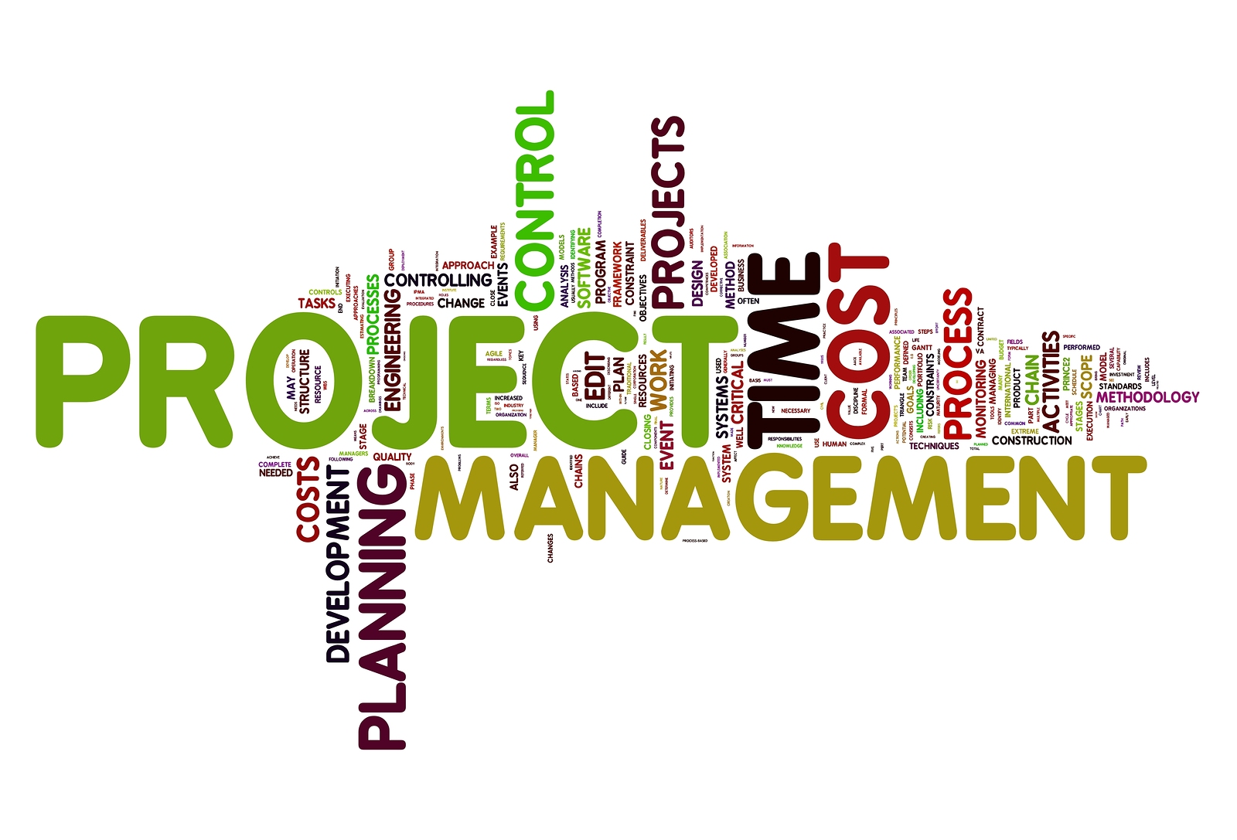
Understanding the Project - Continued
But project management is more than just a set of tools; it is a results-oriented management style that places a premium on building collaborative relationships among a diverse cast of characters.
The project approach has long been the style of doing business in the construction industry,
U.S. Department of Defense contracts, and Hollywood, as well as big consulting firms.

Slide 6

Understanding the Project - Continued
Now project management has spread to all avenues of work.
Today, project teams carry out everything from port expansions to hospital restructuring to upgrading information systems.
Exciting opportunities await people skilled in project management.
Project management is not limited to the private sector.
Project management is also a vehicle for doing good deeds and solving social problems.

Slide 7

Understanding the Project - Continued
Endeavors such as providing emergency aid to areas hit by natural disasters, devising a strategy for reducing crime and drug abuse within a city,
or organizing a community effort to renovate a public playground would and do benefit from the application of modern project management skills and techniques.

Slide 8

Nature of the projects
Most of the people who excel at managing projects never have the title of project manager.
They include accountants, lawyers, administrators, scientists, contractors, public health officials, teachers, and community advocates whose success depends upon being able to lead and manage project work.

Slide 9

Nature of the projects - Count..
For some, the very nature of their work is project driven. Projects may be cases for lawyers, audits for accountants, events for artist and renovations for contractors.
projects may be a small, but critical part of their work.
For example; A high school teacher who teaches four classes a day is responsible for coaching a group of students to compete in a national debate competition.

Slide 10

Nature of the projects - Count..
A store manager who oversees daily operations is charged with developing an employee retention program.
A sales account executive is given the additional assignment of team lead to launch daily deals into a new city.
A public health official who manages a clinic is also responsible for organizing a Homeless Youth Connect event.

Slide 11
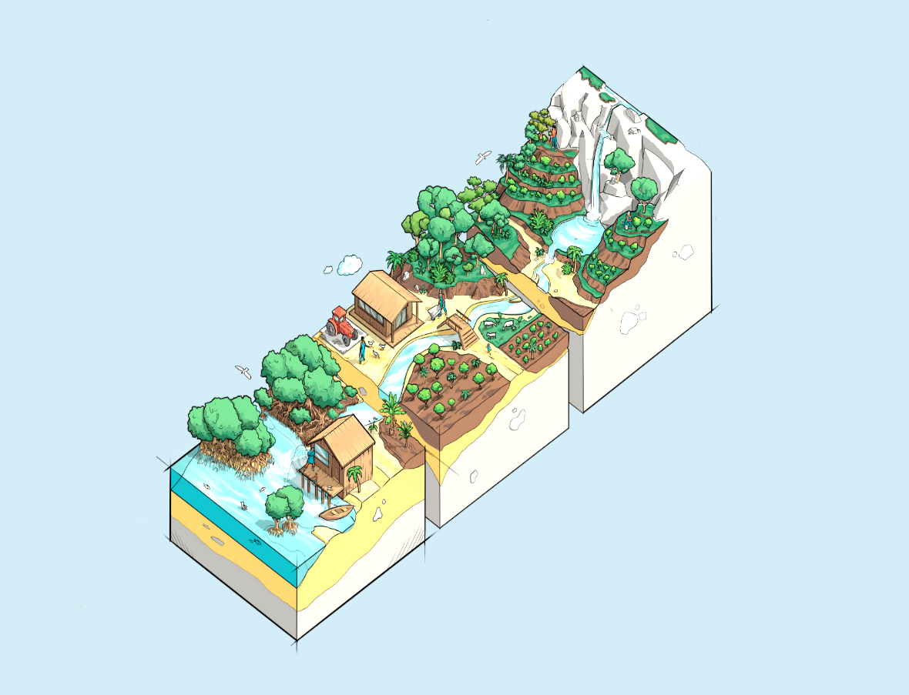
Nature of the projects - Count..
For these and others, project management is not a title, but a critical job requirement.
It is hard to think of a profession or a career path that would not benefit from being good at managing projects.

Slide 12

Examples for projects (1)
Business information: Join a project team charged with installing new data security system.
Physical education: Design and develop a new fitness program for senior citizens that combines principles of yoga and aerobics.

Slide 13

Examples for projects (2)
Marketing: Execute a sales program for new home air purifier.
Industrial engineering: Manage a team to create a value chain report for every aspect of key product from design to customer delivery.
Chemistry: Develop a quality control program for organization’s drug production facilities.

Slide 14

Examples for projects (3)
Management: Implement a new store layout design.
Pre-med neurology student: Join project team linking mind mapping to an imbedded prosthetic that will allow blind people to function near normally.
Sports communication: Join Olympic project team that will promote women’s sports products for the 2016 Games in Rio de Janeiro, Brazil.

Slide 15
Defining the project
According to the Project Management Institute (PMI) provides the following definition of a project:
A project is a temporary endeavor undertaken to create a unique product, service, or result.
Like most organizational efforts, the major goal of a project is to satisfy a customer’s need.
Beyond this fundamental similarity, the characteristics of a project help differentiate it from other endeavors of the organization.

Slide 16
The major characteristics of a project are as follows:
An established objective.
A defined life span with a beginning and an end.
Usually, the involvement of several departments and professionals.
Typically, doing something that has never been done before.
Specific time, cost, and performance requirements.

Slide 17
What a Project Is Not?
Projects should not be confused with everyday work.
A project is not routine, repetitive work! Ordinary daily work typically requires doing the same or similar work over and over,
while a project is done only once; a new product or service exists when the project is completed.

Slide 18
Comparison of Routine Work with Projects
Routine & Repetitive Work
Taking class notes
Daily entering sales receipts into the accounting ledger
Responding to a supply-chain request
Practicing scales on the piano
Routine manufacture of an Apple iPod
Attaching tags on a manufactured product
Projects
Writing a term paper
Meeting
Developing a supply-chain information system
Writing a new piano piece
Designing an iPod that is approximately 2 × 4 inches, interfaces with PC, and stores 10,000 songs.
Wire-tag projects for GE and Walmart

Slide 19
The Project Life Cycle
Some project managers find it useful to use the project life cycle as the cornerstone for managing projects.
The life cycle recognizes that projects have a limited life span and that there are predictable changes in level of effort and focus over the life of the project.

Slide 20
The Project Life Cycle – Count..
There are a number of different life-cycle models in project management literature.
Many are unique to a specific industry or type of project.
For example, a new software development project may consist of five phases: definition, design, code, integration/ test, and maintenance.

Slide 21
Project Life Cycle Stages:
Defining stage: Specifications of the project are defined; project objectives are established; teams are formed; major responsibilities are assigned.
Planning stage: The level of effort increases, and plans are developed to determine what the project will entail, when it will be scheduled, whom it will benefit, what quality level should be maintained, and what the budget will be.

Slide 22
Project Life Cycle Stages – Cont..
3. Executing stage: A major portion of the project work takes place—both physical and mental.
  The physical product is produced (a bridge, a report, a software program).
  Time, cost, and specification measures are used for control.
  Is the project on schedule, on budget, and meeting specifications? What are the forecasts of each of these measures? What revisions/changes are necessary?

Slide 23
Project Life Cycle Stages – Cont..
4. Closing stage:
Closing includes three activities: delivering the project product to the customer, redeploying project resources, and post-project review.

Slide 24
The Project Life Cycle

Slide 25
The Project Manager
At first glance project managers perform the same functions as other managers.
That is, they plan, schedule, motivate, and control.
However, what makes them unique is that they manage temporary, non-repetitive activities, to complete a fixed life project.
Unlike functional managers, who take over existing operations

Slide 26
Current Drivers of Project Management
Project management is no longer a special-need management. It is rapidly becoming a standard way of doing business.
An increasing percentage of the typical firm’s effort is being devoted to projects.
The future promises an increase in the importance and the role of projects in contributing to the strategic direction of organizations.

Slide 27
Several Drivers are briefly discussed below:
(1) Compression of the Product Life Cycle
One of the most significant driving forces behind the demand for project management is the shortening of the product life cycle.
For example, today in high-tech industries the product life cycle is averaging six months to three years.
Only 30 years ago, life cycles of 10 to 15 years were not uncommon.
Time to market for new products with short life cycles has become increasingly important.

Slide 28
Compression of the Product Life Cycle – Cont..
A common rule of thumb in the world of high-tech product development is that a six-month project delay can result in a 33 percent loss in product revenue share. Speed, therefore, becomes a competitive advantage;
more and more organizations are relying on cross-functional project teams to get new products and services to the market as quickly as possible.

Slide 29
Current Drivers – Cont..
(2) Knowledge Explosion
The growth in new knowledge has increased the complexity of projects because projects encompass the latest advances.
For example, building a road 30 years ago was a somewhat simple process.
Today, each area has increased in complexity, including materials, specifications, codes, aesthetics, equipment, and required specialists.
Similarly, in today’s digital, electronic age it is becoming hard to find a new product that does not contain at least one microchip. Product complexity has increased the need to integrate divergent technologies.
Project management has emerged as an important discipline for achieving this task

Slide 30
Current Drivers – Cont..
(3) Triple Bottom Line (Planet, People, Profit)
The threat of global warming has brought sustainable business practices to the forefront. Businesses can no longer simply focus on maximizing profit to the detriment of the environment and society.
Efforts to reduce carbon imprint and utilize renewable resources are realized through effective project management.
The impact of this movement toward sustainability can be seen in changes in the objectives and techniques used to complete projects. See Snapshot from Practice 1.5: Dell Children’s Becomes World’s First “Green” Hospital.

Slide 31
Increased Customer Focus
Increased competition has placed a premium on customer satisfaction.
Customers no longer simply settle for generic products and services.
They want customized products and services that cater to their specific needs.
This mandate requires a much closer working relationship between the provider and the receiver.

Slide 32
Increased Customer Focus – Count..
Account executives and sales representatives are assuming more of a project manager’s role as they work with their organization to satisfy the unique needs and requests of clients.
Increased customer attention has also prompted the development of customized products and services.

Slide 33
Example for Increased Customer Focus
For example, 15 years ago buying a set of golf clubs was a relatively simple process:
You picked out a set based on price and feel. Today, there are golf clubs for tall players and short players, clubs for players who tend to slice the ball and clubs for those who hook the ball, high-tech clubs with the latest metallurgic discovery guaranteed to add distance, and so forth.
Project management is critical both to development of customized products and services and to sustaining lucrative relationships with customers

Slide 34
Conclusion of Drivers
There are a variety of environmental forces interacting in today’s business world that contribute to the increased demand for good project management across all industries and sectors.
Project management appears to be ideally suited for a business environment requiring accountability, flexibility, innovation, speed, and continuous improvement.
These environmental and other factors have created the necessity for major oversight of all organization projects

Slide 35
Project governance
Competing in a global market influenced by rapid change, innovation, and time to market means organizations manage more and more projects.
Some means for coordinating and managing projects in this changing environment is needed.
Centralization of project management processes and practices has been the practical outcome.
For example, Google, Apple, General Electric, and Sony all have over 1,000 projects being implemented concurrently every day of the year across borders and differing cultures.

Slide 36
Governance is designed to improve project management in the whole organization over the long haul.
The rationale for integration of project management was to provide senior management with:
An overview of all project management activities;
A big picture of how organizational resources are being used;
An assessment of the risk their portfolio of projects represents;
A rough metric for measuring the improvement of managing projects relative to others in the industry;
Linkages of senior management with actual project execution management.

Slide 37
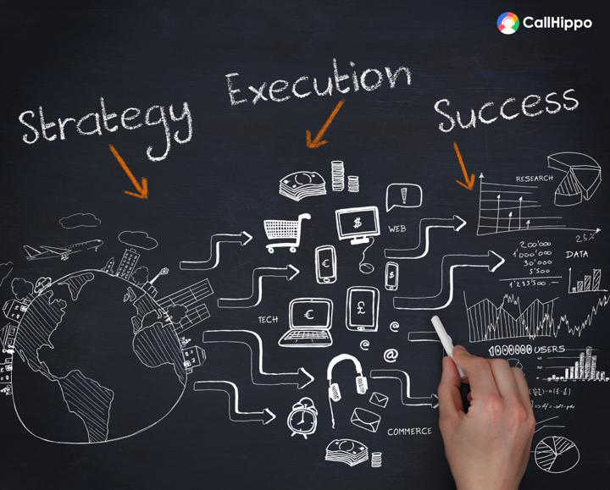
Alignment of Projects with Organizational Strategy
Today, projects are the modus operandi for implementing strategy.
Yet in some organizations, selection and management of projects often fail to support the strategic plan of the organization.
Strategic plans are written by one group of managers, projects selected by another group, and projects implemented by another.

Slide 38

Alignment of Projects with Organizational Strategy
These independent decisions by different groups of managers create a set of conditions leading to conflict, confusion, and frequently an unsatisfied customer.
Under these conditions, resources of the organization are wasted in non-value-added activities/projects.

Slide 39
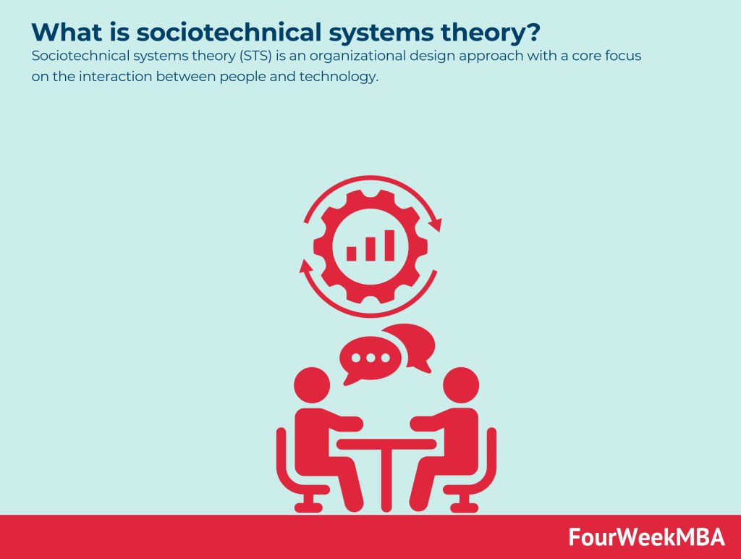
A Socio-Technical Approach to Project Management

Slide 40



Thank You

