Slide 1


Data collection methods
Final Project
Prepared by Walid Soliman
Lecture 7

Slide 2

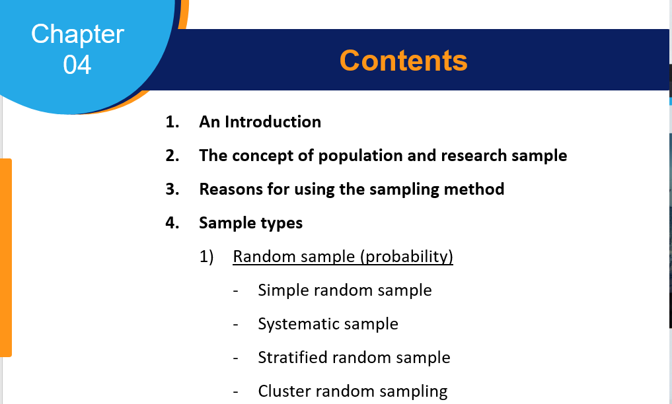

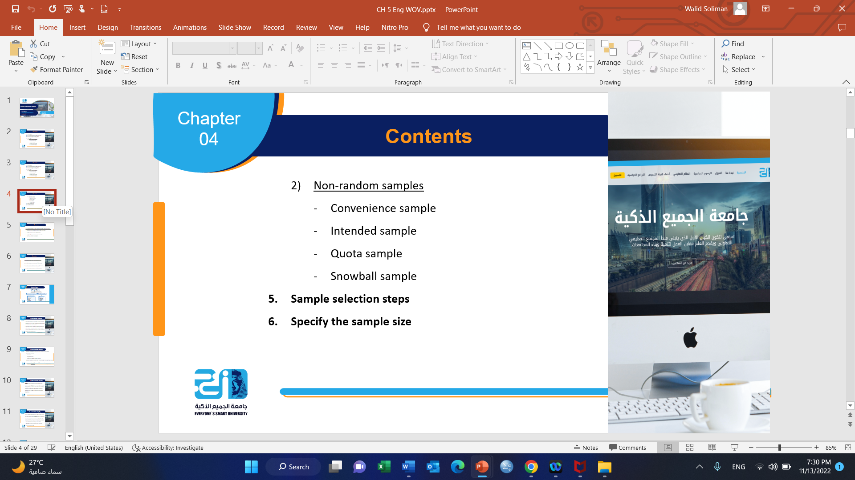

Slide 3
Contents
Introduction
Primary data and secondary data
Methods for collecting primary data
  Questionnaire.
  The interview
  Observation
  Focus groups.

Slide 4
Contents
By the end of this chapter, you will be able to understand the following knowledge:
Recognize the difference between primary and secondary data and the sources of each.
Identify the different methods of data collection (questionnaire - interview - observation - focus groups) and their most important advantages and disadvantages.

Slide 5
Contents
By the end of this chapter, you will possess the following Skills:
The ability to distinguish between primary data and secondary data.
The ability to compare different means of collecting primary data.
Gain the necessary skills to design a good questionnaire.
Gain the skills needed to conduct an effective interview.
Gain the skills to conduct unbiased observation.
Ability to collect data through focus groups method.

Slide 6
Introduction of Data Collection
It is a systematic process of gathering observations or measurements. Whether performing research for business, governmental, or academic purposes, data collection allows you to gain first-hand knowledge and original insights into your research problem.
While methods and aims may differ between fields, the overall data collection process remains the same. Before you begin collecting data, you need to consider:
The aim of the research
The type of data that you will collect
The methods and procedures you will use to collect, store, and process the data
(Bhandari, P , 2022)

Slide 7
Introduction
In the data collection stage, the researcher must consider two types of data that he can use to identify and analyze the various aspects of the phenomenon, which are primary and secondary data.
To collect high-quality data relevant to your purposes, follow these four steps.
Step 1: Define the aim of your research
Step 2: Choose your data collection method
Step 3: Plan your data collection procedures
Step 4: Collect the data

Slide 8
Primary & Secondary Data
Primary Data
«Data that is collected by the researcher directly for the first time about the phenomenon under study»
Sources: observation, interview, questionnaire, and Focus group.
Secondary Data
“Information and data collected by someone earlier.”

Slide 9
Secondary Data
Internal sources:
Data in the company's records (number of employees, production volume, profits, etc.)
External Sources:
(books - periodicals - bulletins - statistics - reports .........)
Advantages: including low cost - speed of obtaining - accuracy - ........
Disadvantages include obsolescence of secondary data and problems collecting secondary data from several sources, ………

Slide 10
Secondary Data
Internal sources:
Data in the company's records (number of employees, production volume, profits, etc.)
External Sources:
(books - periodicals - bulletins - statistics - reports .........)
Advantages: including low cost - speed of obtaining - accuracy - ........
Disadvantages, including obsolescence of secondary data, problems of collecting secondary data from several sources, ……… include obsolescence of secondary data and problems

Slide 11
Methods for Collecting Primary Data
Questionnaire.
Interview
Observation
focus groups.
Factors influencing the choice of primary data collection method:
The nature of the research.
The Research Methodology.
The definition of the population and sample.
Researcher’s time and financial capabilities.
Researcher's knowledge of the tool used to collect data.

Slide 12
1. The Questionnaire
A questionnaire is a research instrument consisting of a set of questions to collect information from a respondent. Methods of distributing the questionnaire: Direct distribution Regular mail E-mail Website

Slide 13
1. The Questionnaire
Structured Questionnaires: Structured questionnaires collect quantitative data. The questionnaire is planned and designed to gather precise information. It also initiates a formal inquiry, supplements data, checks previously accumulated data, and helps validate any prior hypothesis. Unstructured Questionnaires: Unstructured questionnaires collect qualitative data. They use a basic structure and questions but nothing that limits a respondent’s responses. The questions are more open-ended to collect specific data from participants.

Slide 14
1. The Questionnaire
Some of the widely used types of questions are: A) Closed Questions: each question specifies a set of answers. Such as yes-no questions, multiple-choice questions, or answers. Examples of these questions: (1) Do you buy one of the company's products? (Yes / No) (2) If yes, which of the following is an influencing factor in purchasing the commodity? (more than one answer can be chosen) Price. The quality. The Packing. The color.

Slide 15
1. The Questionnaire
Multiple-Choice Questions: Multiple-choice questions are a close-ended question type in which a respondent has to select one (single-select multiple-choice question) or many (multi-select multiple-choice question) responses from a given list of options. The multiple-choice question consists of an incomplete stem (question), correct answers, incorrect answers, close alternatives, and distractors. Of course, not all multiple-choice questions have all of the answer types. For example, you probably won’t have the wrong or right answers if you’re looking for customer opinion.

Slide 16
1. The Questionnaire
Open-Ended Questions: Open-ended questions help collect qualitative data in a questionnaire where the respondent can answer in an accessible form with little to no restrictions.

Slide 17
1. The Questionnaire
Closed-open questions: Example: What are the appropriate policies to develop the performance of the company's employees? Staff training. Material incentives. Reducing working hours. Decentralize decision-making. Other ............................

Slide 18
1. The Questionnaire
Steps Involved in Questionnaire Design Identify the scope of your research: Think about what your questionnaire will include before you start designing its look. The clarity of the topic is of utmost importance as this is the primary step in creating the questionnaire. Once you are clear on the purpose of the questionnaire, you can begin the design process.

Slide 19
1. The Questionnaire
Steps Involved in Questionnaire Design Identify the scope of your research: Think about what your questionnaire will include before you start designing its look it. The clarity of the topic is of utmost importance as this is the primary step in creating the questionnaire. Once you are clear on the purpose of the questionnaire, you can begin the design process.

Slide 20
1. The Questionnaire
Be flexible with your options: While designing, the survey creator needs to be flexible regarding “option choice” for the respondents. Sometimes, the respondents may not necessarily want to choose from the answer options provided by the survey creator. An “other” option often helps keep respondents engaged in the survey. The open-ended or closed-ended question is a tough choice: If the questionnaire requires the respondents to elaborate on their thoughts, an open-ended question is the best choice. If the surveyor wants a specific response, close-ended questions should be their primary choice. The key to asking closed-ended questions is to generate easy data to analyze and spot trends.

Slide 21
1. The Questionnaire
It is essential to know your audience: A researcher should know their target audience. For example, if the target audience speaks primarily Spanish, sending the questionnaire in any other language would lower the response rate and accuracy of the data. Something that may seem clear to you may be confusing to your respondents. Use simple language and terminology that your respondents will understand, and avoid technical jargon and industry-specific language that might confuse your respondents.

Slide 22
1. The Questionnaire
Questionnaire letter: A letter from the researcher before starting the questionnaire. It should include several points, including: The research problem and objectives. The importance of respondent participation. The scientific purpose of the questionnaire. The type of information required. Confidentiality of the information.

Slide 23
1. The Questionnaire
Personal data of the respondents: Such as age, gender, marital status, income, .... etc. Questionnaire topics: Each part includes questions that reflect one of the study variables and help in data collection and analysis.

Slide 24
1. The Questionnaire
Questionnaire design skills: Follow the questions logically Avoid embarrassing questions Avoid open-ended questions whenever possible The validity of the questionnaire questions Keywords No overlap between alternatives Avoid suggestive questions Avoid questions that begin with the negative

Slide 25
1. The Questionnaire
METHODS FOR TESTING AND EVALUATING SURVEY QUESTIONS : Small sample Experts (arbitrators) Validity and reliability tests

Slide 26
2. The Interview
An interview is a qualitative research method that relies on asking questions to collect data. Interviews involve two or more people, one of whom is the interviewer asking the questions.
There are several types of interviews. Interview types:
Structured interviews have predetermined questions asked in a predetermined order.
Unstructured interviews are more free-flowing.
semi-structured interviews fall in between.

Slide 27
2. The Interview
Interview types:
Personal interview - Telephone interview - Computer interview.
Effective Interviewing Skills:
Define the purpose of the interview, such as setting and introducing the interview objectives.
Pre-interview preparation, such as identification of persons and entities involved in the interview – identification and preparation of a list of questions......

Slide 28
2. The Interview
Implementation and conduct of the interview, such as:
Inform people for the purpose of the interview - Set an appropriate date - Speak out loud - Avoid denying the respondent ............................
Record information, such as:
Recording information with the exact words used - Informing the respondent of recording the interview - ……………………………………………………………

Slide 29
3. The Observation
Watching and carefully observing a particular behavior or phenomenon under certain environmental conditions and factors to obtain accurate information to diagnose this behavior or phenomenon and to determine the relationship between variables and predict their behavior in the future.
Observation types:
Simple Observation
Structured observational

Slide 30
3. The Observation
The observation process, including:
Determining the goal.
Identify the persons involved.
Determine the period
Time and Place
Observation tools

Slide 31
4. The Focus Group
A group that usually consists of 7 to 10 people (experts) with a general supervisor
Discussions aimed at exchanging ideas and observations.
Low-cost method
Provides descriptive data, not quantitative data
It is challenging to perform statistical operations on this data.

Slide 32


Thank You

