Slide 1



Flow chart
IT111 - Introduction to Information Technology
Bachelor of Science in Information Technology
Eng. Eman Hamdy
Flow Chart
ENG. : EMAN HAMDI

Slide 2
Flow Chart component
A computer program is a set of instructions that the computer can understand which it will obey sequentially one after the other.
A program must be planned and written down as a set of steps to follow.
One method is using visual tools such as Flowcharts.

Slide 3
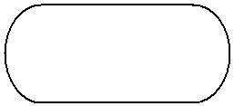
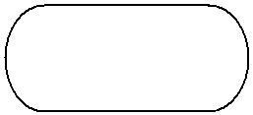
Flow Chart component
Flowchart Symbols
a. Start and end symbols, represents start and end of a process
Start
end
b. Arrows, showing what's called "flow of control". An arrow coming from one symbol and ending at another symbol represents that control passes to the symbol the arrow points to.
c. Processing, represented as rectangles. Examples: "Add 1 to X"; "replace identified part"; "save changes" or similar.

Slide 4
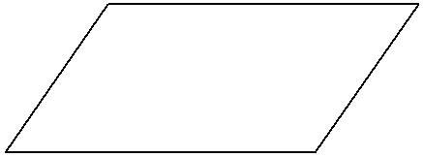
Flow Chart component
Flowchart Symbols
d. Input/output, represented as a parallelogram. Examples: Get X from the user; display X.
e. Conditional (or decision), represented as a diamond. These typically contain a Yes/No question or True/False test. This symbol is unique in that it has two arrows coming out of it, usually from the bottom point and right point, one corresponding to Yes or True, and one corresponding to No or False. The arrows should always be labeled. More than two arrows can be used.

Slide 5
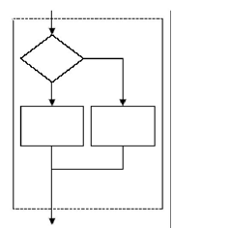
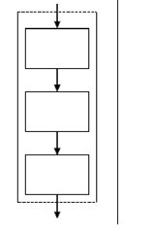
Flow Chart component
Introduce the different structures in flowcharts
a. Sequence Structure
b. If‐ then‐else structure

Slide 6
Flow Chart
a. Sequence Structure
Read radius (R) and calculate circle area
start
Input r
A = 0
A = 3.14 * r *r
print A
End

Slide 7
Flow Chart
Calculate sum of 2 numbers
start
Input n1,n2
sum = 0
Sum = n1+ n2
Print sum
End

Slide 8
Flow Chart
Calculate average of 2 numbers
start
Input n1,n2
sum = 0 , avg =0
Sum = n1+ n2
Avg= sum/ 2
Print Avg
End

Slide 9
Flow Chart
Read distance in millimeter and print distance centimeters and meters.
start
Input mm
cm = 0 , m =0
cm= mm/10
m= mm/1000
Print cm
Print m
End

Slide 10
Flow Chart
b. If‐ then‐else structure
Display student pass or fail
start
Input grade
No
yes
Print fail
Grade >= 50
Print pass
End

Slide 11
Flow Chart
Draw flowchart to simulate a state police radar gun , the program should take a car speed
And display the message “speeding” if the speed exceeds 65 mph , “Not speeding” otherwise
start
Input speed
No
yes
Print “not speeding”
Speed >65
Print ”speeding”
End

Slide 12
Flow Chart
Get sum of numbers from 1 to 10
start
Set x = 1 , sum = 0
No
yes
Print sum
X <= 10
Sum=sum + x
End
x = x +1

Slide 13
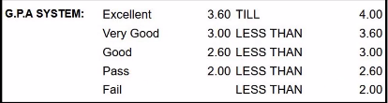
Flow Chart
Draw flowchart to display GPA Grade based on the following:

Slide 14
Flow Chart
start
Input GPA
No
yes
GPA>= 3.6
Print “Excellent”
No
yes
GPA>= 3
Print “Very Good”
No
yes
GPA>= 2.6
Print “Good”
No
yes
Print “fail”
GPA>= 2
Print “pass”
End

Slide 15
THANK YOU ☺

