Slide 1

Computer Vision,
and Digital Image
Processing
Prepared by Dr. Mohamed Mostafa
AI 612
Lecture 5

Slide 2




Spatial Filtering
Lecture 5
AI 612
Prepared by
Dr. Mohamed Mostafa
www.midocean.ae

Slide 3

Spatial Filtering
Chapter
03
Resources for this lecture
Chapter 3:
Gonzalez, Rafael C. Digital image processing. Pearson education, India, 2009.
www.midocean.ae

Slide 4
Smoothing filter
Linear Filters
Box Filter
Gaussian Filter
Non-linear Filters
Median Filter
Max Filter
Weighted Filter
Min Filter

Slide 5
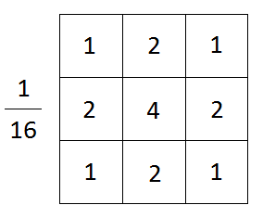
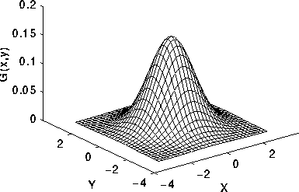

Gaussian Smoothing filter
The filter is implemented as an Odd sized Symmetric Kernel
This process smooths the image by reducing high-frequency noise and preserving low-frequency components.
The Gaussian filter is characterized by a bell-shaped curve, with higher weights assigned to the central pixel and gradually decreasing weights towards the outer pixels.

Slide 6
Gaussian Smoothing filter
1 | 2 | 1
2 | 4 | 2
1 | 2 | 1
10 | 20 | 60 | 70
10 | 20 | 60 | 70
10 | 20 | 60 | 70
10 | 20 | 60 | 70

Slide 7
Gaussian Smoothing filter
1 | 2 | 1
2 | 4 | 2
1 | 2 | 1
10 | 20 | 60 | 70
10 | 20 | 60 | 70
10 | 20 | 60 | 70
10 | 20 | 60 | 70
7.5

Slide 8
Gaussian Smoothing filter
1 | 2 | 1
2 | 4 | 2
1 | 2 | 1
10 | 20 | 60 | 70
10 | 20 | 60 | 70
10 | 20 | 60 | 70
10 | 20 | 60 | 70
7.5 | 19.4

Slide 9
Gaussian Smoothing filter
1 | 2 | 1
2 | 4 | 2
1 | 2 | 1
10 | 20 | 60 | 70
10 | 20 | 60 | 70
10 | 20 | 60 | 70
10 | 20 | 60 | 70
7.5 | 19.4 | 39.4

Slide 10
Gaussian Smoothing filter
1 | 2 | 1
2 | 4 | 2
1 | 2 | 1
10 | 20 | 60 | 70
10 | 20 | 60 | 70
10 | 20 | 60 | 70
10 | 20 | 60 | 70
7.5 | 19.4 | 39.4 | 37.5

Slide 11
Gaussian Smoothing filter
10 | 20 | 60 | 70
10 | 20 | 60 | 70
10 | 20 | 60 | 70
10 | 20 | 60 | 70
7.5 | 19.4 | 39.4 | 37.5
 | 27.5
1 | 2 | 1
2 | 4 | 2
1 | 2 | 1

Slide 12
Gaussian Smoothing filter
10 | 20 | 60 | 70
10 | 20 | 60 | 70
10 | 20 | 60 | 70
10 | 20 | 60 | 70
7.5 | 19.4 | 39.4 | 37.5
 | 27.5 | 52.5
1 | 2 | 1
2 | 4 | 2
1 | 2 | 1

Slide 13
Sharpening Filters
Sharpening highlights transitions in intensity.
Image blurring could be accomplished in the spatial domain by pixel averaging (smoothing) in a neighborhood, averaging is analogous to integration.
Sharpening can be accomplished by spatial differentiation.
Derivatives of a digital function are defined in terms of differences
sharpening is often referred to as highpass filtering.
High frequencies (which are responsible for fine details) are passed, while low frequencies are attenuated or rejected.

Slide 14
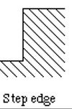
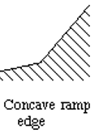
Sharpening Filters
Step Discontinuity:
  A step discontinuity occurs when there is an sudden change in intensity from one region of an image to another.
  It appears as a sharp edge or boundary between two distinct areas of different intensity levels.
  Examples include the edge of an object in an image or the border between two contrasting regions.
Ramp Discontinuity:
  A ramp discontinuity is characterized by a gradual change in intensity across an image.
  It can occur when the intensity changes smoothly across an area, such as a gradient or slope in brightness.

Slide 15
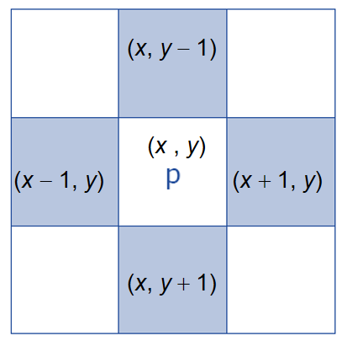
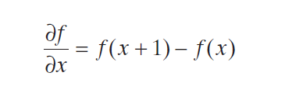
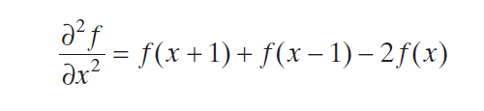
Sharpening Filters
first-order derivative
second-order derivative

Slide 16
Sharpening Filters
40 | 50 | 70 | 100 | 100
first-order derivative
10 | 20 | 30 | 0
second-order derivative
 | 10 | 10 | -30

Slide 17
Sharpening Filters
use for a first derivative:
1. Must be zero in areas of constant intensity.
2. Must be nonzero at the onset of an intensity step or ramp.
3. Must be nonzero along intensity ramps.
Similarly, any definition of a second derivative
1. Must be zero in areas of constant intensity.
2. Must be nonzero at the onset and end of an intensity step or ramp.
3. Must be zero along intensity ramps.

Slide 18
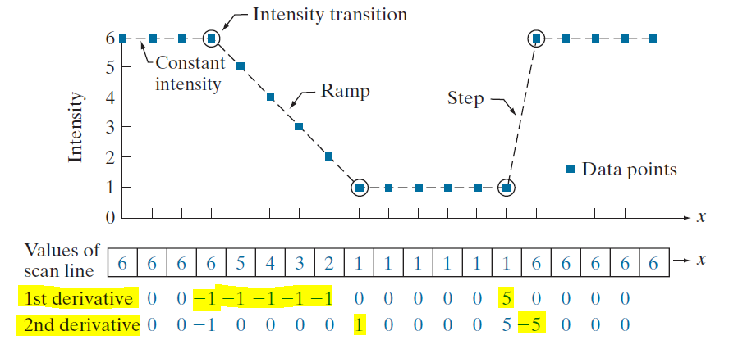
Sharpening Filters

Slide 19
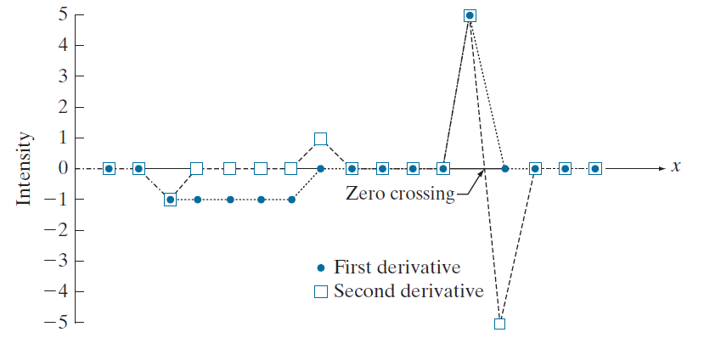
Sharpening Filters

Slide 20
Sharpening Filters
The 2ndderivative is more useful for image enhancement than the 1stderivative
Stronger response to fine detail, because it provides information about the rate of change of the image intensity.
we can detect edges and other significant features more effectively compared to the first derivative.

Slide 21
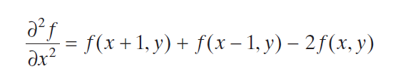
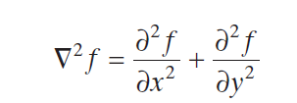

Sharpening Filters- The Laplacian

Slide 22
Sharpening Filters- The Laplacian
20 | 50 | 30 | 0
20 | 40 | 60 | 70
30 | 20 | 60 | 70
67 | 60 | 75 | 80
=
-10

Slide 23
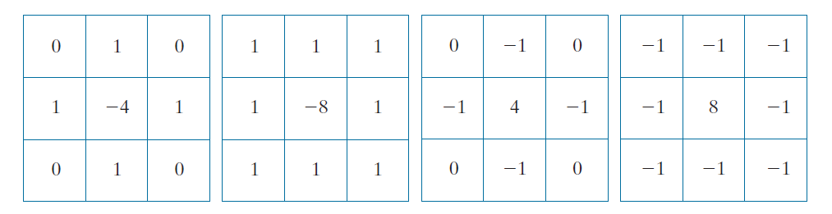
Sharpening Filters- The Laplacian

Slide 24
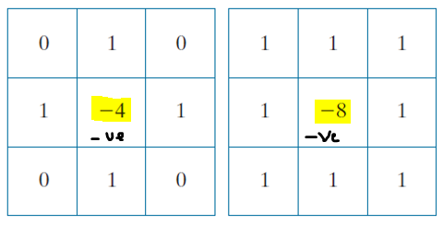

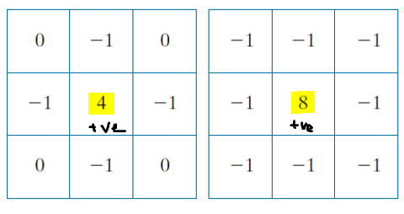
Sharpening Filters- The Laplacian
-

Slide 25
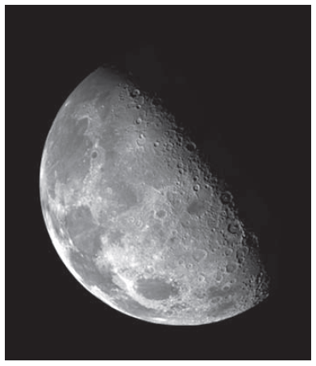

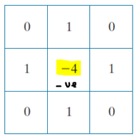
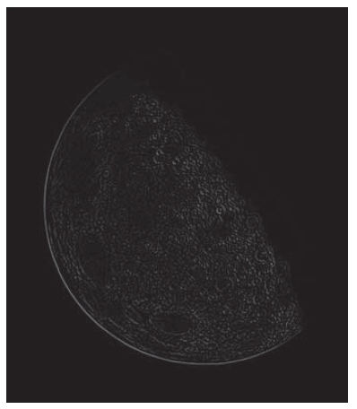

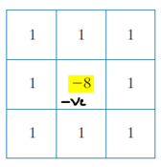
Sharpening Filters- The Laplacian
Original Image
2nd derivative
-
Laplacian
Subtract
2nd derivative

Slide 26

Sharpening Filters- The Composite Laplacian
Step 1
-
Step 2
--------------------------------------------------------------------------

Slide 27
Sharpening Filters- The Composite Laplacian
0 | -1 | 0
-1 | 5 | -1
0 | -1 | 0
-1 | -1 | -1
-1 | 9 | -1
-1 | -1 | -1
--------------------------------------------------------------------------

Slide 28


Sharpening Filters- The Laplacian vs The Composite
0 | -1 | 0
-1 | 4 | -1
0 | -1 | 0
10 | 20 | 60 | 70
10 | 20 | 60 | 70
10 | 20 | 60 | 70
10 | 20 | 60 | 70

Slide 29
Sharpening Filters- The Laplacian vs The Composite
0 | -1 | 0
-1 | 4 | -1
0 | -1 | 0
10 | 20 | 60 | 70
10 | 20 | 60 | 70
10 | 20 | 60 | 70
10 | 20 | 60 | 70
10
20

Slide 30
Sharpening Filters- The Laplacian vs The Composite
0 | -1 | 0
-1 | 4 | -1
0 | -1 | 0
10 | 20 | 60 | 70
10 | 20 | 60 | 70
10 | 20 | 60 | 70
10 | 20 | 60 | 70
10 | -10
20 | 10

Slide 31
Sharpening Filters- The Laplacian vs The Composite
0 | -1 | 0
-1 | 4 | -1
0 | -1 | 0
10 | 20 | 60 | 70
10 | 20 | 60 | 70
10 | 20 | 60 | 70
10 | 20 | 60 | 70
10 | -10 | 30 | 150
20 | 10 | 90 | 220

Slide 32
Sharpening Filters- The Laplacian vs The Composite
0 | -1 | 0
-1 | 4 | -1
0 | -1 | 0
10 | -10 | 90 | 150
 |  | 30
20 | 10 | 150 | 220
 |  | 90
10 | 20 | 60 | 70
10 | 20 | 60 | 70
10 | 20 | 60 | 70
10 | 20 | 60 | 70

Slide 33
Sharpening Filters- The Laplacian vs The Composite
0 | -1 | 0
-1 | 4 | -1
0 | -1 | 0
10 | -10 | 90 | 150
 |  | 30
20 | 10 | 150 | 220
 |  | 90
10 | 20 | 60 | 70
10 | 20 | 60 | 70
10 | 20 | 60 | 70
10 | 20 | 60 | 70

Slide 34
Sharpening Filters- The Laplacian vs The Composite
0 | -1 | 0
-1 | 5 | -1
0 | -1 | 0
10 | 20 | 60 | 70
10 | 20 | 60 | 70
10 | 20 | 60 | 70
10 | 20 | 60 | 70
The Composite

Slide 35
Sharpening Filters- The Laplacian vs The Composite
0 | -1 | 0
-1 | 5 | -1
0 | -1 | 0
10 | 20 | 60 | 70
10 | 20 | 60 | 70
10 | 20 | 60 | 70
10 | 20 | 60 | 70
20
The Composite

Slide 36
Sharpening Filters- The Laplacian vs The Composite
0 | -1 | 0
-1 | 5 | -1
0 | -1 | 0
10 | 20 | 60 | 70
10 | 20 | 60 | 70
10 | 20 | 60 | 70
10 | 20 | 60 | 70
20 | 10
The Composite

Slide 37
Sharpening Filters- The Laplacian vs The Composite
0 | -1 | 0
-1 | 5 | -1
0 | -1 | 0
10 | 20 | 60 | 70
10 | 20 | 60 | 70
10 | 20 | 60 | 70
10 | 20 | 60 | 70
20 | 10 | 150
The Composite

Slide 38
Sharpening Filters- The Laplacian vs The Composite
0 | -1 | 0
-1 | 5 | -1
0 | -1 | 0
10 | 20 | 60 | 70
10 | 20 | 60 | 70
10 | 20 | 60 | 70
10 | 20 | 60 | 70
20 | 10 | 150 | 220
The Composite

Slide 39
Sharpening Filters- The Laplacian vs The Composite
0 | -1 | 0
-1 | 5 | -1
0 | -1 | 0
20 | 10 | 150 | 220
10 | -10
10 | 20 | 60 | 70
10 | 20 | 60 | 70
10 | 20 | 60 | 70
10 | 20 | 60 | 70
The Composite

Slide 40
Sharpening Filters- The Laplacian vs The Composite
0 | -1 | 0
-1 | 5 | -1
0 | -1 | 0
20 | 10 | 150 | 220
10 | -10
10 | 20 | 60 | 70
10 | 20 | 60 | 70
10 | 20 | 60 | 70
10 | 20 | 60 | 70
The Composite

Slide 41
Sharpening Filters- The Laplacian vs The Composite
0 | -1 | 0
-1 | 5 | -1
0 | -1 | 0
20 | 10 | 150 | 220
10 | -10 | 90
10 | 20 | 60 | 70
10 | 20 | 60 | 70
10 | 20 | 60 | 70
10 | 20 | 60 | 70
The Composite

Slide 42
Sharpening Filters- The Laplacian vs The Composite
0 | -1 | 0
-1 | 5 | -1
0 | -1 | 0
20 | 10 | 150 | 220
10 | -10 | 90 | 150
10 | 20 | 60 | 70
10 | 20 | 60 | 70
10 | 20 | 60 | 70
10 | 20 | 60 | 70
The Composite

Slide 43
Sharpening Filters- Unsharp Masking
A process used many years in the publishing industry to sharpen images
Sharpened image: Subtracting a blurred version of an image from the image itself

Slide 44


Sharpening Filters- Unsharp Masking
1. Blur the original image.
2. Subtract the blurred image from the original (the resulting difference is called the mask.)
3. Add the mask to the original.
Original Image
Blurred image
When k = 1 → unsharp
When k > 1, →highboost filtering

Slide 45

Sharpening Filters- Unsharp Masking
Original Image
Blurred image
Mask
Unsharped image
Highboost

Slide 46
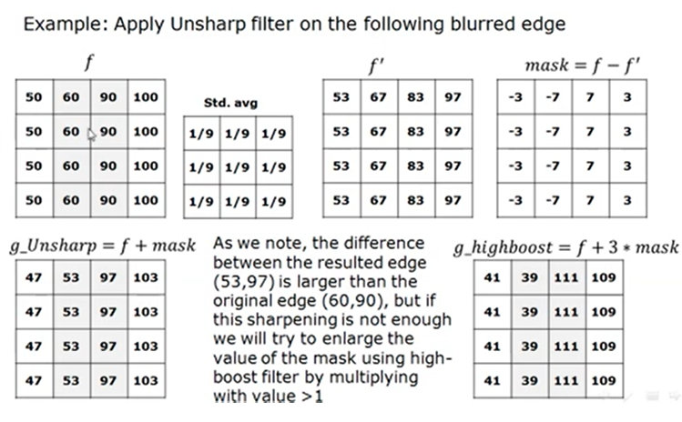
Sharpening Filters- Unsharp Masking
Source: Dr. Hoda Karajah lectures

Slide 47
Exercise
Show the result of applying the following operators to the image. Consider padding the edges with 0s.
  Box filter 3x3
  The Laplacian operator
10 | 20 | 110 | 110
10 | 20 | 110 | 110
10 | 20 | 110 | 110
10 | 20 | 110 | 110
0 | 1 | 0
1 | -4 | 1
0 | 1 | 0

Slide 48


Thank You

