Slide 1

PMG 622
Agile Project Management
ZOOM MEETING: 08 (25-07-22)
Everyone’s Smart
University
دكتور مهندس استشاري ادارة المشروعات
Eng. Dr. Akram Mustafa Suliman Ali,
PhD. AU, BEng. & MSc. AAST, CEng CMarEng MIMarEST, PE, PMP®,
ASQ CSSBB, ISO Lead Auditor, NDT Level II,

Slide 2
Quick Review and Introduction

Slide 3
Lecture 1 : An introduction to agile
Lecture 2: Life Cycle Selection
Lecture 3: Implementing Agile: Creating an Agile Environment
Lecture 4: Implementing Agile: Delivering in an Agile Environment [1/2]
Lecture 5: Implementing Agile: Delivering in an Agile Environment [2/2]
Lecture 6: Organizational Considerations for Project Agility

Slide 4
Lecture 07: Annex A3 Overview of Agile and Lean Frameworks [1/2]
Lecture 08: Annex A3 Overview of Agile and Lean Frameworks [2/2]
Lecture 09: Agile Planning
Lecture 10: ACP

Slide 5
Warm up
Leaders are readers.
Residual Knowledge
IT DEPENDS!
  5 M
EAR 433
Notes:
4 Events
3 Artifacts
3 Roles

Slide 6
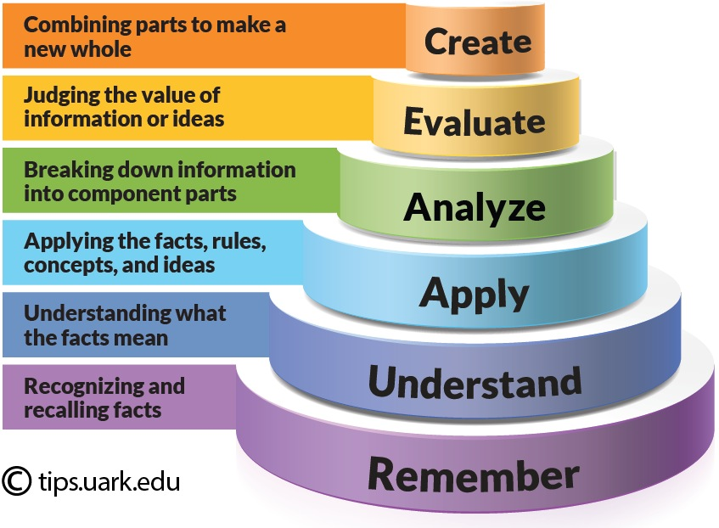
Bloom’s taxonomy

Slide 7
5 M
Man
Machine
  Maintenance
Material
  Information
  Money
Mother Nature/ Medium/ Environment
Method
  Measurement
  Mission
  Management

Slide 8
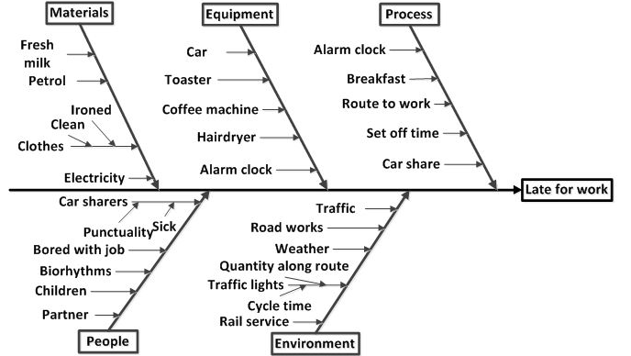
5 M Example

Slide 9


Slide 10
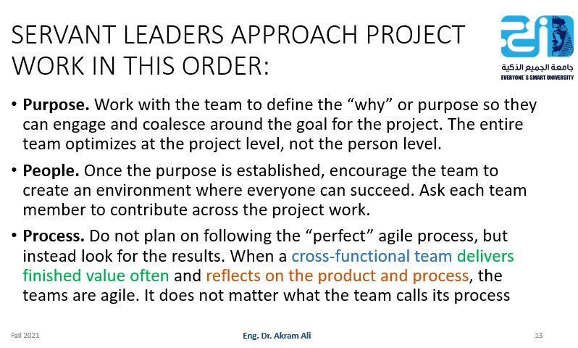
Topics
Situational Leadership and Its Relation to Creating Agile Environment (Lecture 03)
Agile Games
Notes:
PMI Skill Triangle
Leadership For Projects Management
Servant Leadership
Situational Leadership

Slide 11
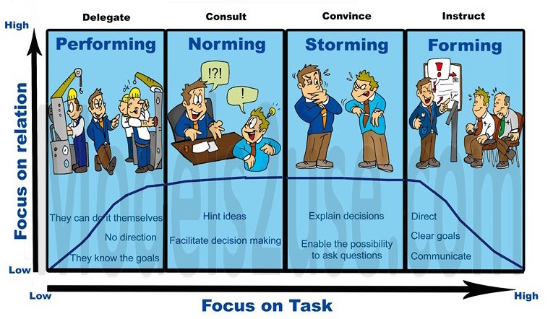
Team Situational Leadership

Slide 12
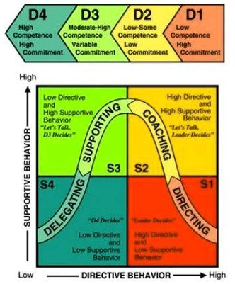
Situation Leadership model

Slide 13


Slide 14

Fish philosophy
The Fish! Philosophy (styled FISH! Philosophy), modeled after the Pike Place Fish Market, is a business technique that is aimed at creating happy individuals in the workplace.
John Christensen created this philosophy in 1998 to improve organizational culture.

Slide 15
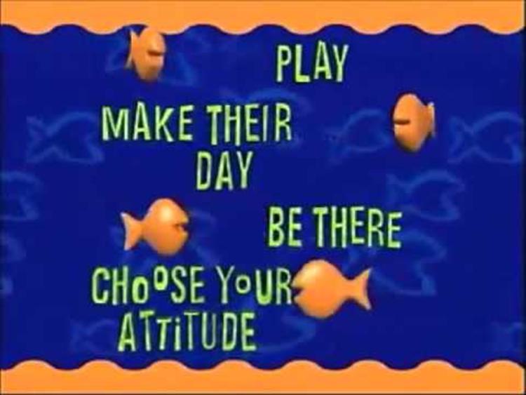
The central 4 ideas of FISH!
The central four ideas are: "Be There", “Play", "Make Their Day" and the "Choose Your Attitude".

Slide 16
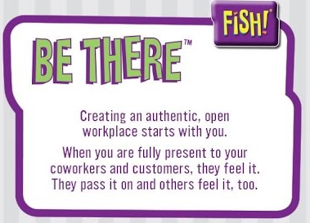
Be There
Be emotionally present for people. It’s a powerful message of respect that improves communication and strengthens relationships

Slide 17
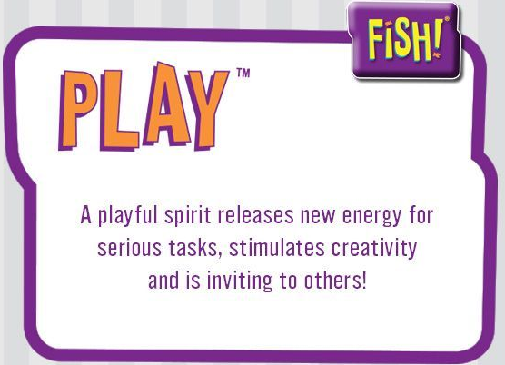
Play
Tap into your natural way of being creative, enthusiastic and having fun. Play is the spirit that drives the curious mind, as in “Let’s play with that idea!” You can bring this mindset to everything you do.

Slide 18
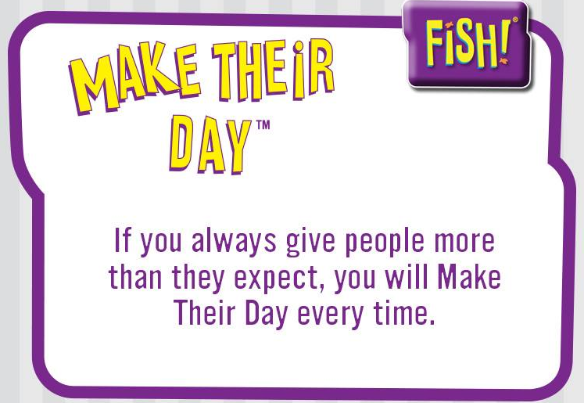
Make Their Day
Find simple ways to serve or delight people in a meaningful, memorable way. It’s about contributing to someone else’s life—not because you want something, but because that’s the person you want to be.

Slide 19
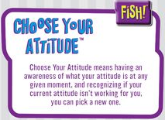
Choose Your Attitude
Take responsibility for how you respond to what life throws at you. Your choice affects others. Ask yourself: “Is my attitude helping my team or my customers? Is it helping me to be the person I want to be?”

