Slide 1


Master Of Real Estate
Management
Prepared by Dr. Ahmad Muhammad
MKT600
Digital Marketing Concepts
Lecture 6

Slide 2



Master Of Real Estate
Management
Lecture 6
MKT600
Digital Marketing Concepts
Prepared by
Dr. Ahmad Muhammad

Slide 3

Chapter
Analytics and Performance Measurement
06

Slide 4

Chapter
Lecture Objectives
06
Analyze the competitive landscape using specialized digital tools and techniques, deriving actionable marketing insights from competitor performance. Evaluate common technical errors on websites and their impact on search engine optimization and user experience, proposing appropriate solutions. Design a comprehensive landing page according to best practices, utilizing its core elements (such as Unique Selling Proposition, social proof, and Call-to-Action) to maximize conversion rates. Explain the A/B testing methodology and its implementation steps, identifying testable areas within marketing campaigns. Differentiate between various marketing attribution models (e.g., first/last touch, linear, time decay) and apply the appropriate model to analyze the customer journey. Apply key marketing performance calculations, including Customer Acquisition Cost (CAC), Customer Lifetime Value (CLTV), Return on Ad Spend (ROAS), and Return on Investment (ROI). Construct trackable marketing campaigns using UTM parameters and interpret data from digital analytics tools to optimize marketing performance and make data-driven decisions.

Slide 5
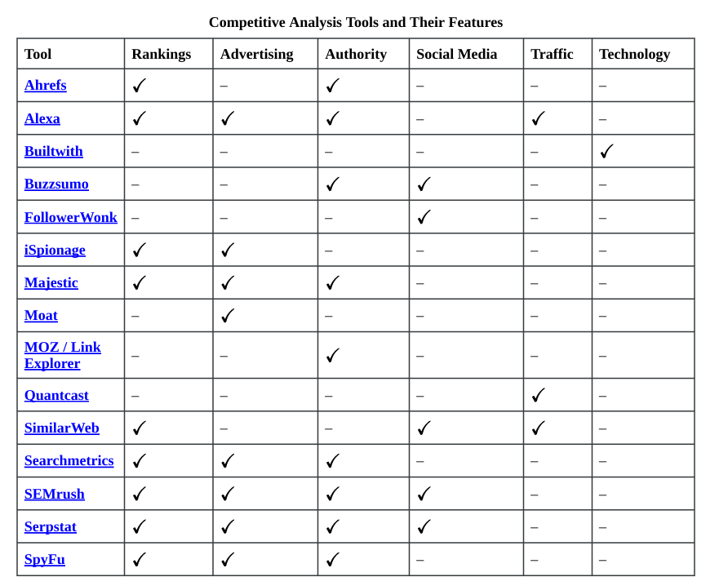
Chapter
Competitive Analysis
06
Before optimizing your own website, do take time to review your competitors’ websites. Marketers can glean a great deal of information from this process. For example, it can be beneficial to understand the keywords your competitors are using, how content is organized and presented, who is visiting their website, and provide additional digital marketing ideas to better market your own solutions.
To perform a competitive analysis, there are many free competitor analysis tools. These can give you quick and valuable insights, and many services offer paid, premium versions, as well. The following table presents several competitive analysis tools and lists their features across a variety of areas: search optimization, digital advertising, link authority, social media, traffic, and technology.

Slide 6

Each tool evaluates different aspects of digital marketing and website criteria. So, let’s look at each one of these in more detail:
Keyphrases and Search Engine Rankings
What do they rank for?
Seeing what your competitors rank for and how high will immediately provide ideas for content and keyphrases. Without using a tool, the only way to find this information would be to search for every conceivable keyphrase.
Pay Per Click and Digital Advertising
What phrases are they bidding on? Where are they investing their ad budgets? What do their ads look like?
Like organic rankings, understanding a competitor’s ad spending will provide insights into what might be a good investment for you. Assuming they have well-managed, well-optimized ad campaigns, you can see which words and phrases are getting traction with your target audiences.
Chapter
06

Slide 7
Authority and Link Popularity
Do they have higher quality and more authoritative links than us?
As discussed in the SEO chapter, links can signal a website’s value. Sites with many links from other relevant and related websites will likely have higher authority, especially if the links are from sites that have high authority themselves.
Beyond the number, you can also use these reports to find marketing opportunities. For example, if a media site or blog has mentioned and linked to a competitor, it may be a good site to promote or write about your solutions.
There are many tools that track links and provide authority metrics. Each service has a distinct name for the number, but essentially, they all measure the same thing: the likelihood of ranking on a scale from 1 – 100.
◦ MOZ: Domain Authority ◦ SEMrush: Domain Score ◦ Alexa: Competitive Power ◦ Ahrefs: Domain Rating ◦ Searchmetrics: Page Strength
Chapter
06

Slide 8
Chapter
Competitive Analysis
06
Social Media
Which of their articles is getting shared the most?
Who is sharing their content? Social media accounts are easy to follow, but hard to analyze. You may be able to see which specific posts are getting engagement, but the bigger picture is difficulty to see without tools. So, using these tools can be very useful and spark ideas for what to write about, where to be active, and who to collaborate with.
Traffic
Are they getting more traffic?
There are no tools that will provide an accurate look into your competitor’s analytics. But there are ways to get website traffic estimates. Some of the above tools can provide an overview into who is getting more visitors, when they visit, demographics and behaviour data. This data can be quite helpful in completing your customer personas.

Slide 9
Technology
What technology is their site built on and what tools are they using?
Website technology is surprisingly visible, and there are services that can find out exactly what is powering your competitor’s website, as well as what additional tools and plugins are being used. This can potentially provide information about what tactics your competitors are using and what might work well for you.
Chapter
06

Slide 10
Chapter
Technical Errors
06
Now that you have reviewed your competitors’ websites and possibly have ideas about how to improve your website, let’s take a look at the most common technical errors that might exist on your own website:
• HTTPs Status: Make sure that your website has a TLS/SSL certificate. Websites secured with a TLS/SSL certificate will display HTTPS and the small padlock icon in the browser address bar. An HTTPS connection indicates that your website is secure and that communications between your web browser and the web application are encrypted. Having a secured website impacts your search engine ranking because websites with TLS/SSL certificates rank higher.
• Page Speed Test: According to recent research, if your site takes more than 3 seconds to load, you lose 75% of your potential readers. Therefore, it is crucial to make sure your webpages load quickly. A recommended tool to test for webpage load speeds is Google Page Speed Insights.
• Broken Images and Links Links: are quite important to your SEO. However, broken links undermine these efforts and decrease your site’s search engine ranking and user-friendliness. So, removing any broken images and links, i.e., links that no longer resolve to a valid webpage, is an easy way to improve your search engine ranking.
• Mobile Optimization: Is your website optimized for a mobile experience? Being mobile friendly improves the user experience and increases your site’s ranking.

Slide 11
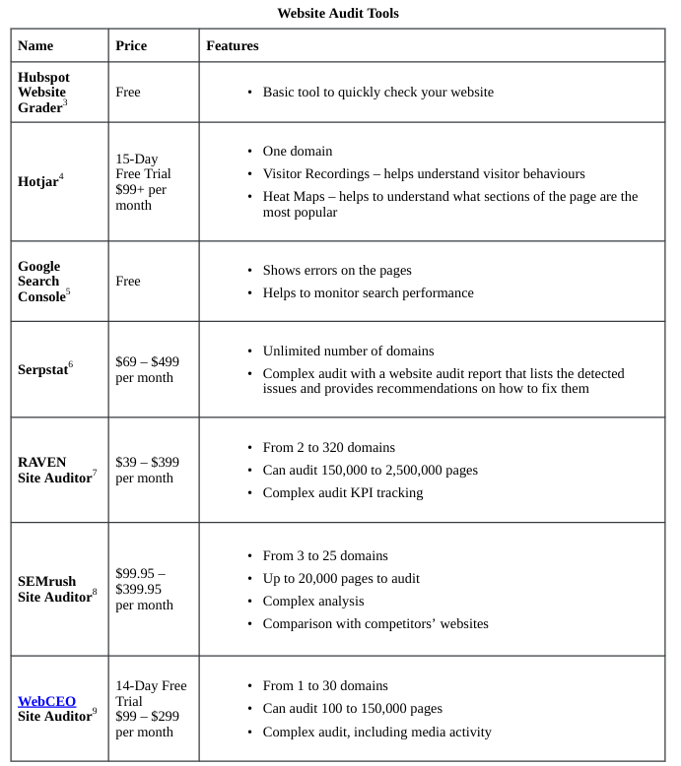

Chapter
Technical Errors
06
Since these technical errors are easy to detect, using a site auditor tool is highly recommended. Once again, here is a list of website audit tools that can be useful:

Slide 12
Chapter
Landing Pages
06
Landing Pages
In digital marketing, a landing page is typically a standalone webpage, created specifically for a marketing or advertising campaign. A landing page is where a visitor “lands” after clicking on an ad or a link. Landing pages can be existing pages on your website, but when planning a marketing campaign, marketers usually prefer to have a landing page with specific messaging, imagery, and often, a unique call-to-action, e.g., book an XYZ demo, etc.
Landing pages are designed to maximize conversion. As a result, they often minimize the number of links and other website navigation options. This is referred as the attention ratio. The attention ratio is the number of things a visitor can do on a page relative to the number of things they should be doing. In an optimized marketing campaign, the attention ratio of a landing page should be 1:1. Since every campaign has one conversion goal, every corresponding landing page should only have one call to action, i.e., one place to click. In comparison, a typical home page, may have 10 – 15 calls-to-action. But, as the attention ratio goes up, i.e., more links to click on, conversions go down. So, for an optimal conversion experience, marketers will want to limit the number of click options on their landing pages.

Slide 13
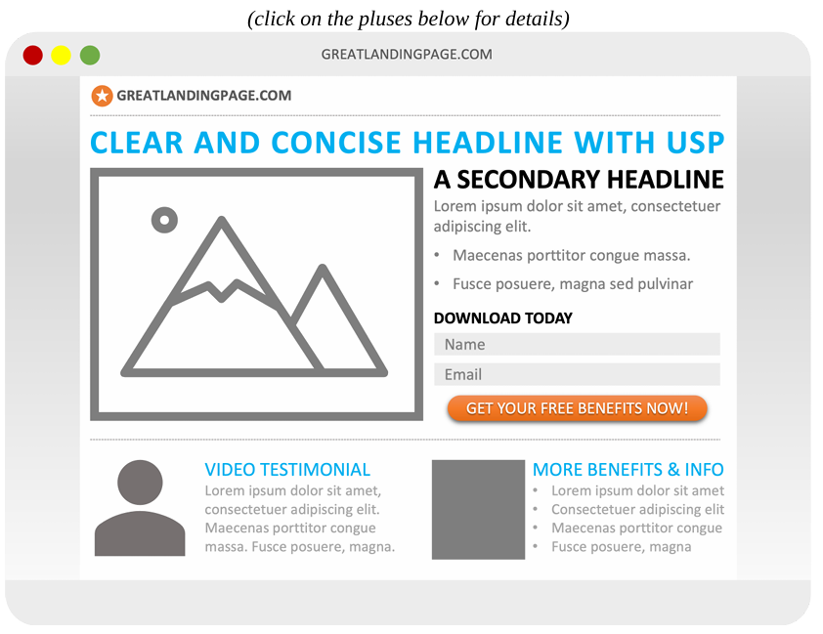
06
Building on this optimization strategy, let’s look at which elements should be included in an optimized landing page. Generally speaking, there are five key elements to any successful landing page. The following image presents these elements on a generic landing page:

Slide 14
Chapter
Landing Pages
06
1. Clear unique selling proposition (USP): Your unique selling proposition differentiates your offer from the competition’s and should highlight what is compelling about your offer. To ensure your target audience understands your USP, be sure to include it in your main headline, any supporting headlines (if present), and in a closing argument before asking for the conversion / call-to-action.
2. Engaging hero shot: A hero shot is a visual element that represents your offer and helps your target audience better understand what you are offering or what it looks like. It could be an image, video, or any other visual media type.
3. Compelling benefits: Often marketers will list the features of their offer. Try to rework your features and present them as benefits your target audience will receive. A feature is what something is, and a benefit is what users can do or accomplish with it. On your landing page, answer how your target audience will benefit from your product or service. Let’s walk through a quick feature benefit example:
Product: Residential apartment
Feature: A spacious 25 square meter living room
Advantage: A comfortable and versatile living space suitable for multiple uses
Customer Benefit: Enjoy a larger, more flexible living area that allows you to host family gatherings, set up a dedicated workspace, or create a relaxing environment without feeling constrained by limited space.

Slide 15
4. Inspirational social proof: As discussed, social proof highlights other people or organizations that have bought, consumed, read, participated in, and ideally, succeeded using what you are offering. Common social proof examples include testimonials, customer logos, industry certifications, awards, etc.
5. Strong call-to-action (CTA): The goal of every landing page is to convert; always ask for the conversion with a strong call-to-action that highlights the benefits the visitor will receive.
Chapter
06
Landing Pages

Slide 16
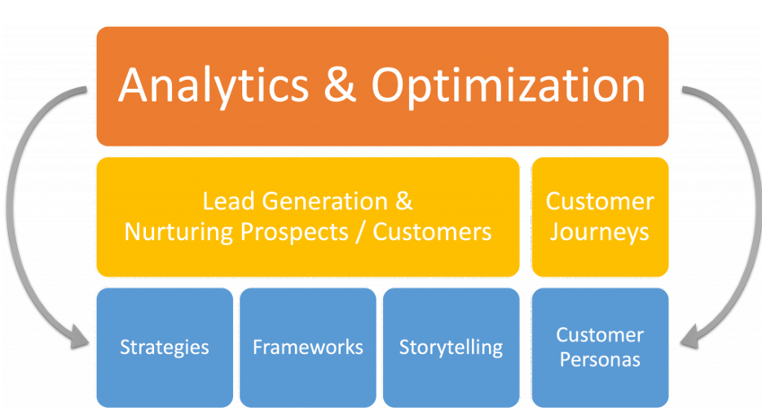
Analyzing and Optimizing Your Digital Marketing Performance
we will focus on analyzing and optimizing your digital marketing results and outcomes. To accomplish this, we will cover:
• the fundamentals of A/B testing,
• digital marketing attribution models,
• conversion rate optimization, and
• common digital marketing analytics and calculations.
Chapter
06
Analyzing and Optimizing Your Digital Marketing Performance

Slide 17
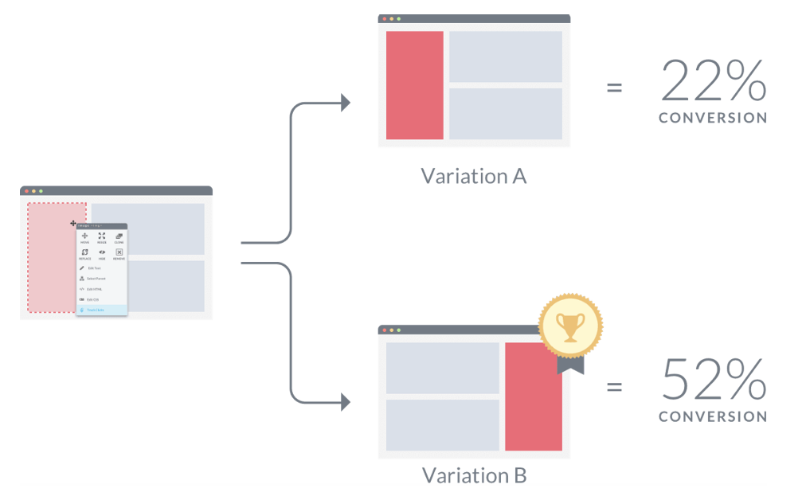
A/B Testing
In its simplest form, A/B testing (also known as split testing) is the process of comparing two variations of a marketing asset, e.g., a webpage element, call-to-action, landing page, email, etc., usually by testing users’ responses to Variant A vs. Variant B and concluding which of the two variants is more effective (see figure above).
Chapter
06
Analyzing and Optimizing Your Digital Marketing Performance

Slide 18
Chapter
A/B Testing
06
Why You Should A/B Test Your Marketing Activities
Many marketing departments rely on A/B testing because it is one of the most effective ways to tailor your approach to customers. While data and trend analyses are important elements in designing engaging web pages, A/B testing provides practical, tangible evidence of your most impactful marketing techniques.
Modern online metrics and analytics also make it easy for you to evaluate the results of your A/B testing. With analytics, you can easily monitor key metrics, including:
• how many people were exposed to each version,
• how long they interacted and engaged and most importantly,
• what percentage completed the campaign goal and converted.
An A/B test takes a significant amount of guesswork out of marketing. For example, if you think of a new marketing approach that could improve your company’s performance, you can set up an A/B test and then monitor the data. If you’re right and the new option gets better results, you can move forward with your new plan. If the original technique still performs better, you can continue with your regular routine and think of different marketing approaches in the future. Ultimately, A/B testing helps you make decisions based on data. This way you know when a particular marketing tactic or campaign is working. Or, more importantly, when one is failing.
Since every organization is different, don’t assume that what worked for others will automatically work for you. When you A/B test your marketing activities and content, experiment with different ideas. This is useful because sometimes a small change can make a big difference in the results you get.

Slide 19
Chapter
A/B Testing
06
Common Areas to A/B Test
While not exhaustive, the following list presents several common key areas where marketers A/B test:
• Headlines and subheadings: Whether it is the “titles” on a webpage, headlines for a piece of content, or the subject line of your email, you may want to experiment with these to see if small changes make a difference in engagement rates.
• Copy: Copy is simply the text that you have written in your marketing materials. While copy can include the words and text itself, copy can also include the location of your text. Presenting two options and seeing which version is more engaging and/or converts more people could be an area to explore.
• Form design: When you look at your forms and the fields to be filled out, think about the number of fields and the information requested to see what potential leads submit and when completion rates drop significantly.
• Calls to action (CTA): As marketers, having compelling calls-to-action (CTAs) is critical to getting leads to convert. Testing a variety of options provides data on which words deliver the best results.
• Images: Like CTAs, you can test different images and image types. For example, try different photos to see which one(s) capture your audience’s interest more. You might even explore different types of imagery, e.g., photos, icons, clip art, etc.
• Colours: And, finally, sometimes colour can have an impact in how your target audience behaves. Testing contrasting colours, brighter colours, etc. can often provide insights as to what catches your target audience’s attention and what they prefer.

Slide 20
Chapter
A/B Testing
06
How to Conduct an A/B
Test Now that you know what an A/B test is and several potential areas to test, let’s discuss how to conduct an A/B test. If you’re ready to begin taking advantage of A/B testing to find the best marketing activities for your organization, here is what we recommend:
1. Gather insights: Before starting your split tests, gather any information you have about your customers. This can include both direct observations about your customers and industry insight data about ideal characteristics related to your target audience’s preferences. The more detailed your understanding of potential customers, the easier it will be to get positive results from your campaigns. Remember your customer personas?!
2. Set your goals: Not all marketing activities have the same goals. For example, the metrics you will monitor for a brand awareness campaign will be different than those for a campaign focused on maximizing sales. Having a clear goal in mind makes it easier to know which metrics to focus on.
3. Create a theory: Once you have your target audience defined and a goal in mind, you can create a marketing theory. This is often called your “hypothesis”. Determine what you think will be an effective method for your target audience to achieve the goal you are seeking. This theory will set the framework for your different testing options. For example, your hypothesis might be that the colour of the CTA button affects the number of clicks and conversions.
4. Build your variations: Although most content systems will allow you to perform A/B tests with many different variants, it is usually best to limit each round of testing to two or three variations. This allows you to quickly hit sufficient traffic numbers or volume for each option so you can compare them. It also makes it easier to isolate differences in the options to determine which technique led to better results.

Slide 21
Chapter
A/B Testing
06
How to Conduct an A/B
5. Run A/B tests: After building your variants, it is time to launch them and allow the A/B tests to run. There is no perfect sample size. Instead, the right size depends on your marketing priorities. Targeting a smaller sample size will allow you to analyze your results and adjust more quickly and at a lower cost, while targeting a larger sample size provides you with more information to support larger-scale decisions. Clearly, there are pros and cons to each approach. So, the decision will be based largely on your goals, objectives, and levels of confidence required.
6. Analyze the results: Once you have gathered enough data to make an informed decision, you can begin looking at the data gathered. Make note of the key metrics you are tracking as a priority, but do not entirely ignore other metrics. For example, if you are running a campaign to build brand awareness and discover that one version is generating significantly higher sales numbers, while this may not make it the ideal option for the current campaign, it still provides valuable information you can use to monetize other campaigns. The winning option is the one that is performing best, and that version should become the basis for your activities as you move forward.
7. Make adjustments as needed: After you discover which option won the A/B test, adjust your activities as needed. If the metrics for the winning variant are clear, expose your entire target audience to that option. If it is somewhat unclear which option is clearly the winner, perform a new A/B test by adding in new options and test against the leading variation. When testing new versions against the previously leading variation, take results from the first test into account when deciding on the best option.

Slide 22
8. Continue monitoring: Even after multiple rounds of A/B testing, you will still need to regularly monitor your marketing activities to ensure they are still effective. Marketing tactics will commonly reach points of diminishing returns, either as the content becomes less relevant or you begin to run out of potential ideas for a specific campaign. Make a habit of monitoring the campaign’s performance even after you have found a winning variant and exposed the entire audience to it. Should performance begin to slip, you can end the campaign or return to Step 1 and go through a new round of A/B testing.
Chapter
06
Analyzing and Optimizing Your Digital Marketing Performance

Slide 23
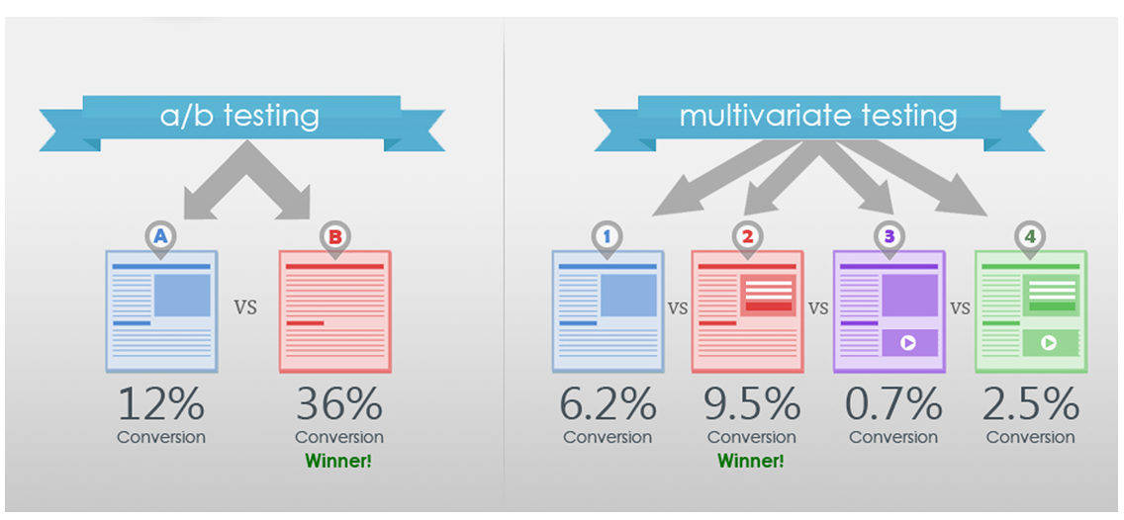
One additional term you should be aware of is multivariate testing. Multivariate testing is a technique for testing a hypothesis in which multiple variables are modified. The goal of multivariate testing is to determine which combination of variations performs the best out of all of the possible combinations (see image).
Chapter
06
Analyzing and Optimizing Your Digital Marketing Performance

Slide 24
Chapter
A/B Testing
06
Tools for A/B Testing
Now that you understand what A/B testing is and how to conduct one, the following links provide a few frequently used tools for A/B testing: (Please note that the tools listed below are all free or offer free trials.)
• Google Optimize – Google Optimize is a Google tool that lets you test and tailor different variations of your website. The main selling point of Google Optimize is its native integration with Google Analytics, allowing you to gain automatic access to rich behavioural insights. You will also be able to target the valuable segments you have already discovered using Analytics. Try out Google Optimize for free and upgrade to Google Optimize 360 for enterprise-level website testing and personalization.
• Kameleoon – Kameleoon is an advanced optimization platform that offers a variety of features. Using Kameleoon, can run advanced A/B, split, and multivariate tests quickly and easily. You can also see key user insights with their navigation analysis tool and test different user segments with over 40 targeting criteria. Dynamic traffic allocation algorithms also make sure your traffic is optimally divided in order to shorten your decision cycle and improve return on investment. You can get started on Kameleoon by creating a free account and upgrade to an enterprise plan if the tool suits your needs.
• Symplify (formerly SiteGainer) – Symplify is a company that offers a full suite of conversion optimization tools, including A/B testing, multivariate testing, personalization, heat maps, popups, and surveys. They also have a team of experts to assist you with test ideas, design, programming, analytics, and personalization. Symplify offers a free trial. Pricing plans are based on monthly traffic, payment schedule, and additional services.

Slide 25
Chapter
A/B Testing
06
Tools for A/B Testing
• The Best Solutions for Large Businesses:
1. Symplify
2. Optimizely
3. Google Optimize 360 (the integrations alone make this a great option)
• The Best A/B Testing Tools for Marketing Teams:
1. VWO (if you have the budget)
2. Convertize
3. Freshmarketer
• The Best A/B Testing Tools for Small and Medium-Sized Business:
1. Convertize
2. Zoho Pagesense
3. OmniConvert
• The Best Landing-Page Tools:
1. Unbounce
2. Clickthroo
The A/B testing software market is in a healthy place, with solutions for every size and type of business. Most of the options in the above list1 include a free trial (some as long as 60 days), so there is no reason not to try them for yourself.

Slide 26
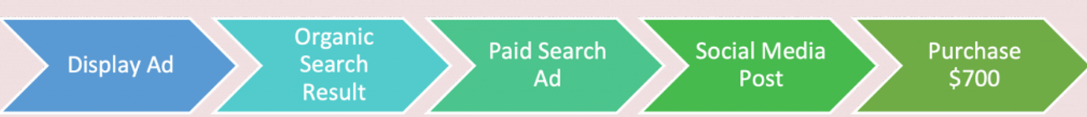
Chapter
Marketing Attribution
06
Marketing attribution is the practice of evaluating the marketing touch points a customer encounters on their path to a desired marketing outcome. A desired outcome is often a purchase but could also include other outcomes and actions such as a signing up for an email newsletter sign-up, downloading a research paper, booking a demo, etc. The goal of attribution is to determine which marketing channels and messages have had the greatest impact on a customer’s decision to convert or take the desired next step. Once marketers understand which channels and messages are most successful, they can optimize their efforts and budgets.
To make this clear, let’s walk through a fictitious scenario.
Let’s assume that a customer was exposed to several marketing campaigns and marketing messages across a variety of marketing channels, such as:
In the simplified customer journey above, we see that a customer made a $700 purchase after seeing: • a display ad, • an organic search result, • a paid ad, and • a social media post.
Now, the question comes up, to which channel or activity do we attribute this $700 purchase?
Or, how much of that $700 do we credit to each marketing activity, campaign, or touchpoint? Unfortunately, even with our current digital marketing analytics systems, it is difficult to precisely answer these questions. However, there are a few common industry models and practices that marketers can use to approximate the contributions these campaigns made to the ultimate purchases or conversions: • First or last touch attribution • Even (linear) attribution • Time decay attribution • Starter / Player / Closer / “U” attribution • Custom attribution.
Let’s take a closer look at each of these different attribution approaches.

Slide 27
Chapter
Marketing Attribution
06
First or Last Touch (or Interaction) Attribution
First or Last Touch (or Interaction) Attribution
First touch attribution gives full credit to the first touchpoint in the customer journey. In the above scenario, this would mean that the marketer would credit their “Display Ad” campaign with the entire $700 purchase amount.
Similarly, last touch attribution gives full credit to the last touchpoint in the customer journey. In our scenario, that would give “Social Media” full credit for the $700 purchase.
The main benefit of this model is that it is simple to calculate and track. That said, it under represents the branding, influence, and sales effects the other campaigns may have had in convincing that customer to purchase.

Slide 28
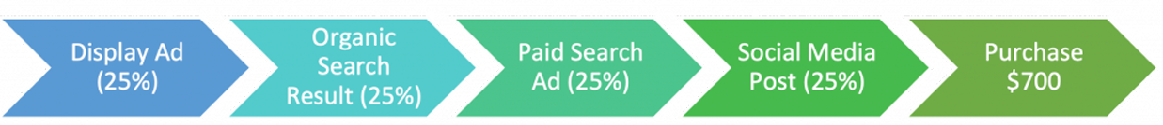
Chapter
Marketing Attribution
06
Even (Linear) Attribution
Even (Linear) Attribution
Even (linear) attribution recognizes that each touchpoint plays a part in the customer’s purchase decision and therefore, distributes the $700 equally across all the touchpoints. So, in our scenario, each marketing activity / campaign would be credited with $175 (= $700 ÷ 4) – display ad, organic search, paid ad, and social media. Once again, the main benefit of this model is that it is simple to calculate. However, when we think about our own purchasing habits, we know that each marketing message does not carry the same weight. For example, more recent marketing messages and campaigns, i.e., closer to the purchase date, may have more influence in converting the customer, which brings us to the next attribution model.

Slide 29
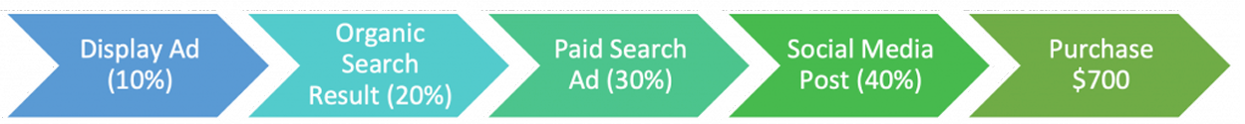
Chapter
Marketing Attribution
06
Time Decay Attribution
Time Decay Attribution
Time decay attribution gives the lowest percent of credit to the first touch, with increasing values as you move towards the last touch. For example, in the image above, the marketer has decided to credit display ads with 10% of the purchase amount ($70), organic search with 20% ($140), paid ads with 30% ($210) and social media with 40% ($280). Please note that these percentages are only examples. Another marketer in a different organization may choose to split up their purchase amounts differently, e.g., 5%, 15%, 30%, 50%. This simply means that the time decay model you use within your organization can be customized to best approximate what is happening with your customer journeys.

Slide 30
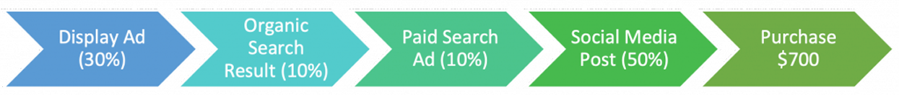
Chapter
Marketing Attribution
06
Starter / Player / Closer / Position-based / “U” Attribution
Starter / Player / Closer / Position-based / “U” Attribution
The final model assigns different percentages depending on where the touchpoint is in the customer journey. The starter (initiating) touch receives a set percent of credit for the conversion. Usually, this is relatively high since the initiating touch makes the customer aware of your brand and offering. In other words, without this starter touch, there would not even be a purchase. The closer (last) touch also receives a set percentage of credit for the conversion. And, again, this percentage is somewhat higher because it is the final “trigger” that got the customer to purchase. Player touches are those touches in the middle of the customer journey, and each receive a percentage of the remaining credit for the conversion. While player touches have not initiated the action, they do contribute to keeping your brand alive in the mind of the customer and should therefore receive some credit for that role.
In our scenario above, display ad and social media get credit for a total of 80% of the purchase amount and the remaining two campaigns get 10% each. Sometimes this model is referred to as a “U” attribution because the starter and closer touchpoints receive higher percentages than the player touchpoints in the middle. So, the percentage amounts look a bit like a “U”. Once again, these percentages are just examples. As a marketer, you can decide how best to distribute the purchase amounts across your marketing activities and touchpoints.

Slide 31
As you can see, there is not one specific way to attribute credit for a conversion. That said, what is critical is to be consistent and use the same model for all conversions within your customer journey. This means using the same model for all your marketing attribution calculations. While the specific model may not be 100% accurate, all marketing activities will be evaluated similarly. And, when a model is applied consistently, you can ultimately compare and analyze the effectiveness of your marketing campaigns and activities against each other.
Chapter
06

Slide 32
Chapter
Marketing Attribution
06
Custom Attribution
Depending on your organization, you may want to consider creating a “custom attribution” model. This model may be a hybrid of the previously mentioned models or it may be a model that you develop from scratch. Please note that building a marketing attribution model from scratch requires a significant amount of resources and time. So, you want to make sure that it will be worth your investment.
You should build a custom attribution model if you:
• Have a large marketing team and access to more resources
• Use multiple online and offline marketing channels
• Previously tried one or more standard marketing attribution models without success
• Need to provide stakeholders with a more comprehensive or detailed report

Slide 33
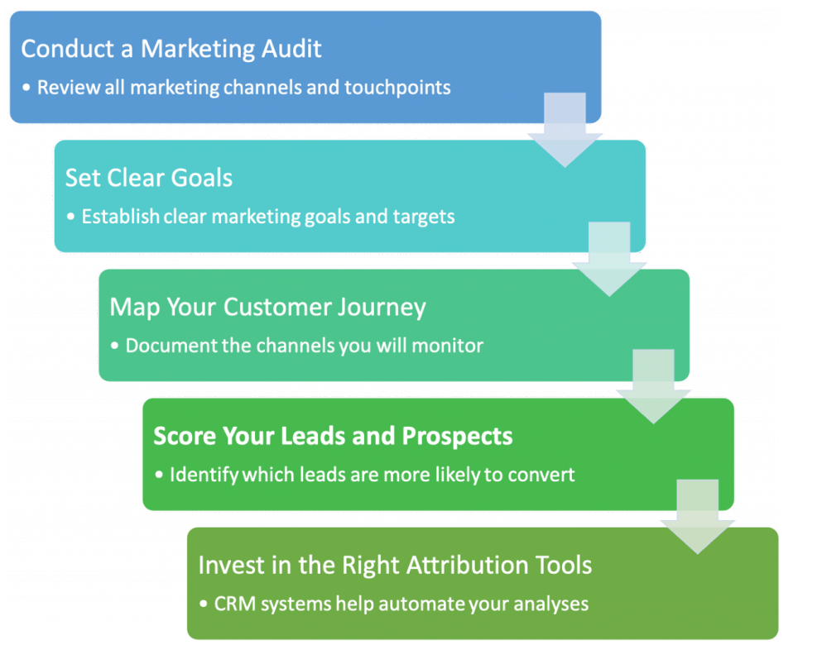
Chapter
Marketing Attribution
06
How to Build an Attribution Model
Now, that you know what attribution model options are available to you. How do you build one for your organization? Here are 5 steps that will help you identify and develop an appropriate attribution model:

Slide 34
Marketing Attribution
Chapter
How to Build an Attribution Model
1. Conduct a Marketing Channel / Touchpoint Audit: As discussed in the customer journey chapter, customer journeys should document all the marketing channels and touchpoints your potential and existing customers encounter. Performing a formal audit, where you list and identify all the potential touchpoints that apply to your specific product or service, is an important starting point. You may want to do this with an expanded team via a brainstorming session to ensure you get a variety of perspectives and ideas. And, you should also note that there may be different customer journeys for different products or services within the same organization. Do make sure the customer journey you are reviewing applies to the products or services you want to analyze.
2. Set Clear Goals: One of the reasons to create attribution models is to ensure your marketing efforts are delivering the results needed by your organization. Without clear goals and targets, it is difficult to assess how well your marketing efforts are doing. So, it is critical to set specific goals and expectations for the marketing team.
3. Map Your Customer Journey: In mapping your customer journey, you can see which channels and campaigns you will be monitoring. And, when you analyze the customer journey, you will be able to assess which touchpoints have more impact and should be weighted accordingly.
4. Score Your Leads and Prospects: Lead scoring will help you identify which leads are more likely to convert, as well as which ones may need additional convincing and messaging to convert.
5. Invest in the Right Attribution Tools: Tracking and monitoring the information for every touchpoint manually can be extremely tedious and taxing. And, unfortunately, it is likely to introduce mistakes. Using a industry standard, customer relationship management (CRM) systems makes it easier to track and automate your attribution model analyses. It also allows you to collect data across multiple advertising and marketing campaign networks throughout your customer journey and to create dashboards and reports of all essential performance metrics.
06

Slide 35
Chapter
Marketing Attribution Tools
06
Benefits of Marketing Attribution Tools:
If you are tracking your conversions using Google Analytics, the following tools can help. There are some key advantages to automated marketing attribution solutions. Below are 3 common benefits:
• Better understand what is working and what is not: Marketing attribution tools can help you quickly recognize your most reliable advertising and marketing channels. When evaluating your spending budgets, you will be able to invest even more resources into those networks that have the most influence and decrease spending on those that are not delivering results.
• Discover the number of touches your leads need before converting: If you just released a new ad campaign or released a brand new piece of content, it can be discouraging if you do not see conversions happen immediately. Marketing attribution tools can help you prove the ROI of your activities at the beginning or middle of a customer journey.
• Get data-driven insights to enhance marketing activities: With marketing attribution tools, you can expose which lead generation methods are having the best impact on your ROI and also allocate your spending plan accordingly.

Slide 36
Chapter
Marketing Attribution Tools
06
Some marketing attribution applications can also assist with inquiries often asked by executives and clients, such as:
• How does marketing help bring in clients?
• How can we drive more sales with our marketing?
• Which campaigns are most or least effective in converting customers?
• What is my return on investment on the XYZ project?
• Which marketing activities drive the highest customer lifetime value?
• Where should we be investing our money?

Slide 37
Chapter
Marketing Attribution Tools
06
List of Marketing Attribution Tools
The following list of marketing attribution tools offer either a free version or are inexpensive:
• Google Attribution Model: Use Google’s advanced machine learning to more accurately distribute credit to all ad clicks that led to a conversion. This service is available to all eligible Google advertisers for free.
• Google Analytics: Google Analytics works with its own advertising and publishing products to tell marketers how its products are performing.
• Ruler Analytics: Ruler Analytics is a closed-loop multi-channel attribution tool that helps marketers gain insight into their marketing ROI.
• HubSpot: Marketing attribution is a part of the HubSpot CRM platform, which is full of many tools and integrations – from customer service assistance to website building.
• AppsFlyer (Mobile Apps): AppsFlyer focuses on attribution for mobile app installs and the media sources that drove them, e.g., TV, as well as uninstall attribution (customers lost).
• Chartable (Podcasts): Chartable provides podcast analytics and attribution tools to help publishers grow and brands and agencies understand their spend.

Slide 38
A/B Testing is a subset of conversion rate optimization. Conversion rate optimization (CRO) is the practice of increasing the percentage of users who perform a desired action. Desired actions can include: • Purchasing a product or service, • Clicking ‘add to cart’, • Signing up for a service or newsletter, • Filling out a form, or• Simply clicking on a link.
While A/B testing looks to optimize specific marketing campaigns or activities, conversion rate optimization looks at the entire customer journey and tries to identify areas along the customer journey where optimization can happen.
Chapter
06
Conversion Rate Optimization

Slide 39
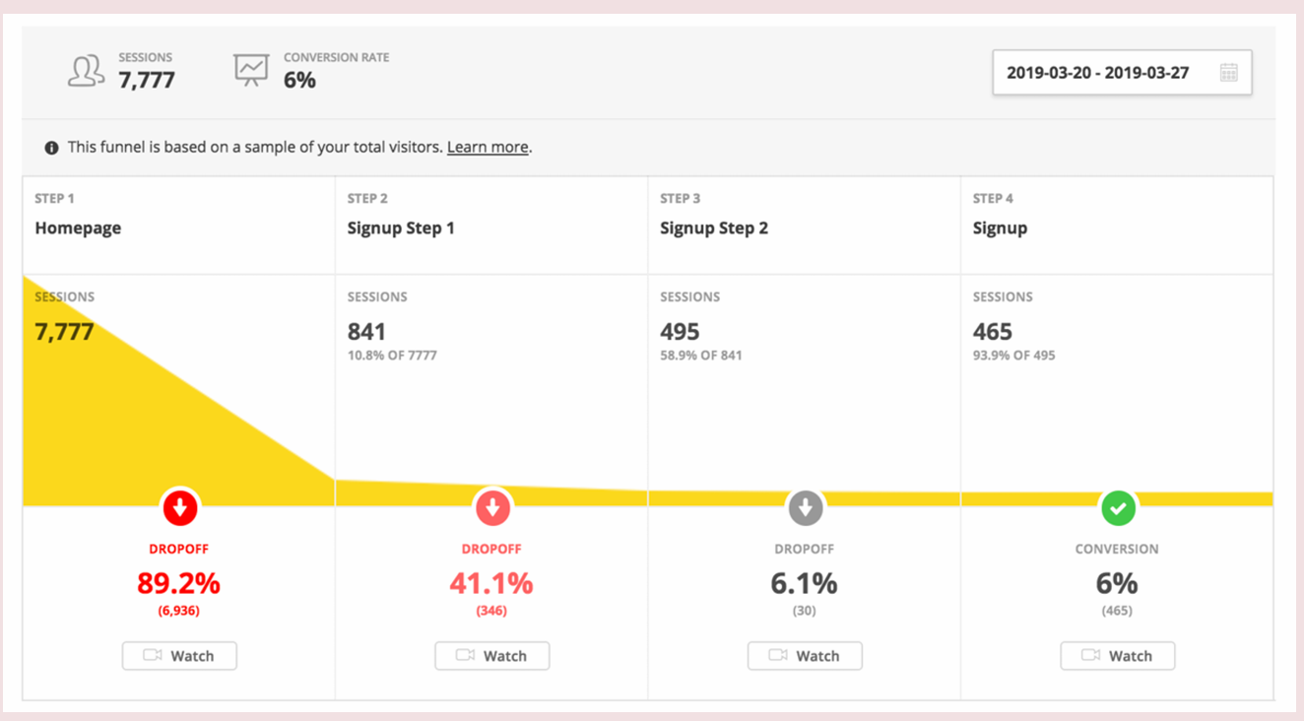
Conversion Rate Optimization
Chapter
06
In the customer journey image above, there are two significant drop-offs in Steps 1 and 2. In Step 1, there is a 89.2% drop-off, which means almost 90% of all session are ending after visiting the homepage. From those that remain, 41% drop off in Step 2. This is concerning since there are only 495 sessions left by Step 3, which represents only 6.4% (495/7,777) of all sessions that arrived on the homepage.
As a marketer focused on conversion rate optimization, this would immediately highlight the need to reduce the drop-off rates in Steps 1 and 2 and look at what marketing could do to increase retention from Step 1 through to Step 3.
This might involve reviewing the calls-to-action on the homepage (Step 1) and in the Signup Step 1 (Step 2) or possibly tweaking the marketing activities and campaigns to better qualify those who arrive on the homepage. These tweaks may also require some additional A/B testing. However, the goal of conversion rate optimization is to maximize the number of potential leads that convert.

Slide 40
Conversion Rate Optimization
Generally speaking, there are four key areas that marketers will analyze when engaging in CRO:
• Target Audience: Sometimes the reason for a lack of conversion is that the target audience is not the appropriate one. For example, if you drive lots of traffic to your website via a marketing campaign, but the visitors who end up on your website are not the type of customers interested in your solutions, your conversions may be low.
• Content: Alternatively, or maybe additionally, if the content you present does not meet the needs of your target audience, you may see drop-offs, as well. In this case, you may want to conduct some A/B tests to compare different content options.
• Landing Pages: ensure that your landing pages include:
◦ Unique selling propositions: What is unique about your offer?
◦ Specific customer benefits: Be sure to include the actual benefits to your target audience not just your product or service features.
◦ Clear calls-to-action: Do your calls-to-action create urgency?
◦ Appropriate visuals / imagery: Do your visuals support your calls-to-actions, unique selling proposition, and customer benefits? And, if visitors have landed on this page based on an advertisement, make sure that the visuals and content match those in the ad, i.e., what the visitors expect to see and read when they land on your page.
◦ Social proof and credibility elements: These elements reassure your visitors of your organizational authority and credibility. This might include testimonials, previous client logos, case studies, etc.
• Budget: And, finally, if you are using paid advertising to drive your traffic, your budgets or bidding strategy may not be appropriate for the goals and objectives you seek. Once again, you can experiment with bidding strategies or increase your budget to see if that impacts your overall conversion funnel and attracts your target audience.
Chapter
06

Slide 41

Digital Marketing Analytics and Calculations
Common Digital Marketing KPIs
In the Lead Generation chapter, we discussed the importance of setting your goals and objectives, for example:
• Primary conversions
◦ Purchase
◦ Donate
• Secondary conversions
◦ Sign up / provide contact information for:
▪ Free or Limited Trial
▪ Webinar / Demo
▪ Newsletter
▪ Downloadable content, e.g., whitepapers, research, etc.
• Tertiary goal (not a conversion!)
◦ Brand awareness and exposure
• Specific KPIs and Targets: Setting specific and measurable key performance indicators (KPIs) and targets for your marketing activities. For example, how many purchases do you want to get? Or how many people do you want to sign up for your newsletter or to attend your webinar?
When it comes to digital marketing analytics, the most frequently asked question by marketers is:
which KPIs, analytics, metrics should I be monitoring? While this chapter will review several
common digital marketing KPIs, each organization will have different goals and objectives. So, the
most important analytics to monitor and capture will be those that help measure, meet, and exceed your
organizational goals and objectives. That said, in this chapter, we will review:
• The purpose of several common marketing KPIs,
• How these metrics are calculated, and
• What these marketing KPIs signify.
Chapter
06

Slide 42
Chapter
Digital Marketing Analytics and Calculations
06
However, before diving into what marketers may want to monitor or track, let’s briefly discuss vanity metrics. Vanity metrics are those metrics that do NOT: • Impact your bottom line • Increase revenues • Decrease costs.
In other words, vanity metrics are metrics that you cannot act on or affect. Often marketers will track metrics because they are easy to capture or are simply available. But if an organization cannot connect those metrics, directly or indirectly, to increases in the organization’s overall performance, those analytics should not be followed. In some marketing cases, like brand awareness, the connection may be indirect, e.g., by increasing brand awareness, the likelihood of conversion also increases; but there may be difficulty in tying brand awareness directly to increased revenues or decreased costs. Indirect connections are fine; they simply need to be understood and explained.
Ideally, digital marketers will want to quantify how an increase in brand awareness translates to better performance. For example, for every X number of people who become aware of our product and/or services, Y number of new customers convert. Most organizations are not at this stage, but once marketers start closely tracking their data and analytics, these connections and models can be developed over time.
Now that we know which KPIs not to monitor, which KPIs do most marketers track? Here are some of the most common KPIs split into a few categories:

Slide 43
Digital Marketing Analytics and Calculations
General Marketing & Revenue KPIs:
General marketing KPIs are KPIs that should be tracked by all marketers. These analytics provide valuable customer and revenue feedback that influence marketing budgets, activities, and performance.
• Customer Acquisition Cost (CAC): Customer acquisition cost represents how much is spent to acquire a new customer. This KPI is important in comparison to how much revenue is being generated by new customer. For example, if an organization knows that it receives, on average, $150 from a new customer and marketing / sales is spending, on average, $175 to advertise, promote, and convert a new customer, the organization is losing $25 on that new customer when the customer initially signs up. For the sake of this example, we have only looked at the marketing / sales costs, but to fully calculate the total Customer Acquisition Cost, an organization might add in other costs. However, for marketing and sales, here is the most common way to calculate this number:
◦ Customer Acquisition Cost – Calculation = (All Sales Expenses + All Marketing Expenses in the Period, e.g., month, quarter, etc.) / Number of New Customers in the Period.
• Customer Lifetime Value (LTV or CLTV): While an organization may lose money when a customer initially signs up, that may be marginally okay if an organization calculates this next metric, the customer lifetime value. The customer lifetime value calculates, on average, the total amount of revenue an organization will generate from a customer over time. Returning to our previous example, if the organization recognizes that the average customer lifetime value is $275, it can make up that initial $25 loss in subsequent months, years, etc.
A simple way to calculate this is to take the average monthly revenue per user (customer) and divide that by the average monthly churn rate. The monthly churn rate is the number of customers who have “left” by the end of the month divided by the number of customers at the beginning of the month. Suppose you had 200 customers at the beginning of the month and 150 customers at the end of the month. Your churn rate would be: churn rate (%) = (200 – 150) / 200 = 50 / 200 = 0.25, or 25%. And, if your Average Monthly Revenue per User was $125, your estimated customer lifetime value would be $125 / 0.25 = $500.
◦ Customer Lifetime Value – Simple Calculation = Average Revenue per User (ARPU) in the Period / Churn Rate in the Period.
Chapter
06

Slide 44
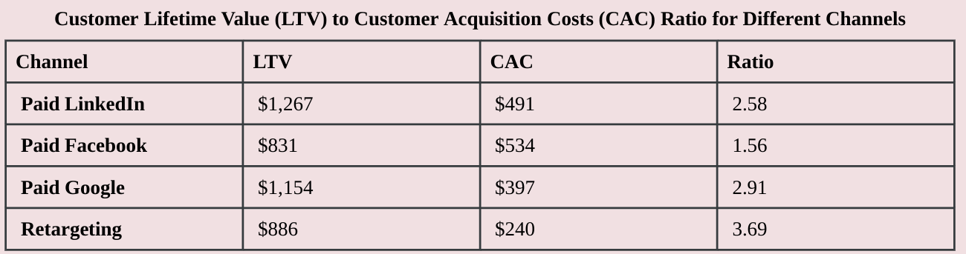
Digital Marketing Analytics and Calculations
• LTV to CAC Ratio (Return on CAC): Now that we have calculated the customer acquisition cost and customer lifetime value, it can be helpful to look the ratio of the two. This helps an organization understand their return on customer acquisition costs. In other words, how much revenue will an organization generate from a customer for every $1 spent to acquire them. For example, software-as-a-service (SaaS) companies generally aim to have an LTV to CAC ration that is higher than three (3), meaning the customer lifetime value of a customer is at least three times (3x) that of the cost to acquire them. Another way to look at this is that for every dollar spent on customer acquisition those companies receive $3 in revenues (3:1 LTV to CAC ratio).
◦ LTV to CAC Ratio – Calculation = LTV / CAC
Example:
In the following example, an organization split up the LTV and CAC values by paid advertising channel. At first glance, it might appear that LinkedIn is the best marketing channel given that it has the highest customer lifetime value (LTV). However, when considering the customer acquisition costs (CAC) and calculating the LTV to CAC ratio, marketers can quickly see that, in fact, Retargeting provides the highest ROI because the LTV to CAC ratio is 3.69:
Chapter
06
As a result of this analysis, marketers can adapt future paid advertising activities and allocate their budgets accordingly.

Slide 45
Digital Marketing Analytics and Calculations
• Conversion Rate: conversion rate refers to the number of people who complete a desired conversion (primary or secondary) out of the “total audience” that was exposed to that opportunity / possible action. For example, for email, the audience could be the total number of delivered or opened emails; for a website, the audience would be the total number of website visitors over a specified time. On social media, the total audience could be the reach or total views for a specific post. Using the website example, conversion rate would be calculated as follows:
◦ Conversion Rate – Calculation = Number of Visitors Who Converted in the Period / Total Website Visitors in the Period x 100.
• Revenue per Visitor (RPV): Revenue per visitor represents the average amount of revenue generated for every visitor. This KPIs is interesting because it ties visitor traffic directly to revenues. So, if a marketer can show that a specific campaign increased website traffic by 5%, they should be able to calculate a specific $-increase related to that additional traffic.
Example: Suppose an organization had a revenue per visitor value of $1.50 in Month 1. Then, after a marketing campaign, the website saw an increase of 10,000 additional website visitors (compared to the previous month). Based on these two numbers, the marketer could argue that the campaign brought in 10,000 x $1.50 = $15,000 in additional revenues, provided the revenues per visitor remained the same for Month 2. If the RPV in Month 2 increased to $1.75, this increase in traffic would represent 10,000 x $1.75 = $17,500. In addition to the increase in traffic and revenues, a marketer might also argue that the additional, new visitors helped and contributed to the raise in the Month 2 RPV value from $1.50 to $1.75.
Another reason RPV is significant is because it represents the most a marketer should spend to acquire a visitor, without losing money. In other words, if a marketer were bidding on paid advertising, the RPV value would represent the maximum CPC they would be willing to pay to avoid an initial customer acquisition cost (CAC) loss. Once again, if the organization believes that it can recover a loss based on the customer lifetime value, marketers may be able to bid higher. However, as a rule of thumb, it is recommended to use RPV as a bidding ceiling.
◦ Revenue per Visitor (RPV) – Calculation = Revenue in the Period / Visitors in the Period
Chapter
06

Slide 46
Digital Marketing Analytics and Calculations
• Monthly Recurring Revenue (MRR) Churn Rate: With more companies offering monthly subscription payment plans, there is a lot of discussion about monthly recurring revenue (MRR) and similarly the MRR churn rate. The MRR churn rate highlights the percentage decrease in MRR from one month to the next. In other words, compared to the previous month’s MRR, what percentage of MRR was lost due to customers leaving in the current month?
◦ Monthly Recurring Revenue (MRR) Churn Rate – Calculation = Churned (or lost) MRR / Previous Month’s MRR x 100
• Customer Churn Rate: Similar to the previous calculation, this one tracks the percentage of lost customers.
◦ Customer Churn Rate – Calculation = Number of Customers Lost in the Period / Number of Customers at the Start of the Period x 100
Please note that a healthy churn rate is around 5-7% annually, which translates to between 0.45% and 0.55% monthly.
• Revenue Renewal Rate: For many organizations retention and renewal of subscriptions can be critical to growth. Therefore, looking at what percentage of recurring revenues get renewed is a valuable metric to monitor. The reason this is something that marketers will want to track is because many communications, e.g., email newsletters, promotions, etc., happen with existing customers and those communications should be promoting the value and benefits the organization is providing. If renewal rates go down, there may be room for improvement in the marketing messages to those existing customers.
◦ Revenue Renewal Rate – Calculation = (MRR Up for the Renewal at Start of Period – MRR Not Renewed at the End of Period)/MRR Up for Renewal at Start of Period x 100
Chapter
06

Slide 47
Digital Marketing Analytics and Calculations
Return on Investment (ROI) KPIs
In addition to general marketing KPIs, there are a couple of specific return-on-investment calculations that every marketer should understand:
• Return on Ad Spend (ROAS): Return on Ad Spend shows the marketing team how well their ad-specific spending is performing. This does not take into consideration any other marketing or organizational costs. So, this KPI highlights the impact of specific ad spending on the marketing budget and, from a paid advertising perspective, can provide important benchmarks as to what is working and what is not.
◦ Return on Ad Spend (ROAS) – Calculation = Revenue Generated by Ad / Cost of Ad
• Return on Investment (ROI): While similar, return on investment incorporates all expenses related to revenues and highlights the impact to the overall organizational costs.
◦ Return on Investment (ROI) – Calculation = Total Revenues – Total Expenses Related to those Revenues (Net Profit) / Total Expenses Related to those Revenues
Example: Your company spends $100 on LinkedIn ads in a single month which generates $600 in revenue. But the following costs are also associated with these revenues: • Cost to create LinkedIn ad: $25 • Salary and Overhead (pro-rated) for the marketing person: $225 • Cost of Goods Sold: $50.
ROAS = Revenue Generated by Ad / Cost of Ad = 600/100 = 6 = 6x, 6:1, 600%, or $6 in revenue for every $1 in spent on LinkedIn Ads.
ROI = Total Revenues – Total Expenses Related to those Revenues (Net Profit) / Total Expenses Related to those Revenues = 600 – (100 + 25 + 225 + 50)/(100 + 25 + 225 + 50) = 600 – 400 / 400 = 200 / 400 = 1/2x, 0.5:1, 50%, or $0.50 for every $1 spent on expenses, which now represents a 50% loss to the organization.
The difference between ad centric ROAS and ROI is that ROI is a macro metric that measures how a specific ad affects the organization’s overall profits, while ROAS is a micro metric that evaluates the effectiveness of the ad itself regardless of the impact it has on an organization’s profits. As you can see, it is important to calculate both these returns since something that looks profitable at the micro (e.g., project or campaign) level may not be profitable at the macro (organizational) level.
Chapter
06

Slide 48
Digital Marketing Analytics and Calculations
Channel-Specific KPIs
In addition to the above categories, there are also many channel-specific KPIs. Most of these have been discussed in previous chapters, but make sure you are combining these with the appropriate general marketing KPIs and organizational KPIs, as well:
• Search Engine Optimization / Website: Many of the following were discussed in the SEO chapter: ◦ Leads ◦ Organic traffic (visitors) ◦ Keyword ranking ◦ Search visibility (also called organic market share, SEO visibility, organic visibility, etc.) ◦ Referral links / backlinks ◦ Domain authority / domain ranking ◦ Organic CTR (from search engine results pages) ◦ Bounce rates ◦ Average session duration ◦ Page load speed ◦ Device type.
• Paid Advertising: Many of the following were discussed above or in the Paid Advertising chapter: ◦ Impressions and reach ◦ Clicks ◦ Click-through rates ◦ Conversions and conversion rate ◦ Customer Acquisition Cost (CAC) / Cost per Action (CPA) ◦ ROAS.
• Social Media: Many of the following KPIs can be tracked using built-in social media analytics tools, e.g., Facebook Insights, Twitter Analytics, etc.: ◦ Impressions and reach ◦ Active followers / connections, i.e., those who are engaging with your content ◦ Audience growth rates ◦ Reactions (likes, comments, mentions, shares) ◦ Click-through rates ◦ Conversions and conversion rates.
• Mobile: For mobile websites, the metrics will primarily be similar to the website metrics, just filtered for mobile devices. That said, many of the following KPIs apply to mobile apps: ◦ Downloads ◦ Installs ◦ Uninstalls ◦ Load time ◦ Crash rate ◦ Screen resolutions ◦ Operating systems ◦ Daily active users (DAU) ◦ Session length and frequency ◦ Retention and churn rates ◦ Reviews and ratings.
• Email: Again, these were covered in the Email Marketing chapter: ◦ Delivered (or bounced) emails ◦ Opened emails ◦ Click-through rates ◦ Click-to-open rates ◦ Unsubscribe rates ◦ Spam rates ◦ Conversion rates ◦ Conversion-to-open rates
Chapter
06

Slide 49
Digital Marketing Analytics and Calculations
Tracking Digital Marketing Campaigns: Now that you know what KPIs to track, let’s briefly discuss preparing your digital marketing campaigns so that you can better track your results. One area many marketers neglect is creating customized URLs that can identify exactly where a click came from. Fortunately, there is way to easily create customized ad campaign parameters so that you can track campaigns using analytics tools like Google Analytics.
UTM Parameters: Urchin Tracking Module (UTM) parameters can be added to any URL without affecting where the person clicking on the link ends up. There are five URL parameters that marketers can customize to track the effectiveness of their digital marketing campaigns across a variety of media sources. These five parameters include:
• UTM Medium: This field is used to identify the top-level marketing channel being used in the campaign, e.g., social, organic, paid, email, mobile, referral / affiliate, etc. Example: utm_medium=social
• UTM Source: This identifies the specific site within the above channel. For example, “Facebook” could be a source within your “social” medium for any unpaid / organic links posted on Facebook. However, if you were running a paid Facebook ad or boosting a post, “Facebook” would be a source within your “paid” medium. And, if you were building a link for an email campaign, the source might be the specific email list you used. Example: utm_source=facebook
• UTM Campaign: This refers to a specific campaign name. Here marketers can enter any name or description they want, e.g, names that easily identify product launches, promotional campaigns, individual emails, social media posts, etc. Example: utm_campaign=Manarat_2027_promotion
• UTM Content: This is an optional field. If you have multiple links in the same campaign, like two links in the same email, you can fill this in to differentiate between the two links. For many marketers, this field may be more detailed than needed, but it is available as an additional level of tracking detail.
• UTM Term: This field is also optional and can track specific keywords used for paid campaigns. Since Google Ads has its own tracking methodology and is deeply integrated with Google Analytics, marketers tend to only use this field when creating paid campaigns on other systems, e.g., Facebook, LinkedIn, etc. Example: utm_term=digital+marketing
For optimal tracking purposes, all marketers should add UTM parameters to their URLs whenever embedding links on external sites or in emails. Then, when someone clicks on that link and lands on the destination page, marketers know exactly which campaign, post, or email the visitors came from, and that data automatically appears in their marketing and analytics tools.
Chapter
06

Slide 50
Digital Marketing Analytics and Calculations
How do UTM parameters work?
In this hypothetical example, we will be sending an email about a specific product to a group of active users.
The campaign will not be sent to all email subscribers, but rather those the organization has defined / segmented out as “active.”
Within the email, there is a call-to-action link that sends people to the pricing page. Here’s the standard URL without any tracking:
• www.companysite.com/pricing
If subscribers clicked on the above link, there would not be any information related to where they came from once they landed on the pricing page. However, here’s the same URL with four UTM parameters added:
•www.companysite.com/
pricing?utm_source=active%20users&utm_medium=email&utm_campaign=feature%20launch&utm_content=bottom% 20cta%20button
Please note that by adding these additional UTM parameters, people will still end up on the same pricing page. These variables simply make it easier for marketers to track the specific source of traffic to the pricing page.
Let’s break down each individual element of this customized URL to really understand it:
www.yoursite.com/
pricing?utm_source=active%20users&utm_medium=email&utm_campaign=feature%20launch&utm_content=bottom%20c ta%20button
• yoursite.com/pricing – Same page as the standard URL
• ? – this tells your browser that everything after this point is just data
• utm_source=active%20users – we have defined “active users” as our UTM Source. Since spaces cannot be used in a URL, the space is replaced with “%20”. As a recommendation, use dashes (-) or underscores (_) instead for better readability.
• & – this instructs our marketing analytics tools that the previous UTM parameter is complete and a new one is beginning
• utm_medium=email – the UTM Medium is defined as “email”
• utm_campaign=feature%20launch – the UTM Campaign is defined as “feature launch”
• utm_content=bottom%20cta%20button – the UTM Content has “bottom cta button” so we can track specific links within the campaign
While you do not need to use all of the UTM fields, do get in the habit of using Medium, Source, and Campaign consistently. Many analytics tools assume these three will be used together. And by skipping one, you can create data gaps in your reporting. To easily create these customized URLs, Google has a free UTM Campaign Builder that will automatically build these URLs based on the descriptions and information you type in.
Chapter
06

Slide 51
Digital Marketing Analytics and Calculations
Analytics Tools
Now that we have created customized URLs, let’s briefly discuss the analytics tools that marketers use to analyze and review the results and KPIs from their marketing efforts. Most analytics tools track clicks, webpage visits, paid advertising clicks, email clicks, SEO performance, mobile app activities, and much more. However, the main reason marketers use analytics tools is to track and understand:
• Who are our visitors and customers?
• Where did they come from?
• How do they behave?
• What did they do?
• What is their customer journey?
• How relevant is our online content?
• Which devices are they using?
• Did they convert? And what prompted their conversion?
The data captured by these analytics tools feeds back into customer personas and customer journeys, allowing marketers to further hone and tweak their activities to better meet the needs and preferences of their target audiences. Analytics tools are critical in understanding how people behave online, how to connect with them, and how to deliver what they want. It is specifically these key insights that make digital marketing so powerful in meeting, and hopefully exceeding, the needs and demands of today’s customers.
Chapter
06

Slide 52
Digital Marketing Analytics and Calculations
Here is a list of several common analytics tools that marketers use:
• Google Analytics: Google Analytics (GA) is, by far, the most popular analytics tool. It is used by most marketers primarily because it has a powerful, free version that usually covers more than most marketers need. However, since it covers so many areas, it can be overwhelming to learn. For beginners, Google offers a free course, Google Analytics for Beginners, that provides a nice overview of what Google Analytics can do and how to begin using it.
• Statcounter: Statcounter is a simplified version of Google Analytics and can work well for individuals and small organizations. It offers a simple interface for basic site analytics and reports on web page views, sessions, site visitors, and new visitors. This basic dashboard is free for up to 500 page views. Statcounter also provides advanced paid features, which include reports for bounce rate, conversion rate, and paid traffic.
• Clicky: Clicky is another simple, real-time analytics solution. While the tool offers all the basic analytics, such as site referrers and visitors, it also includes some surprising additional features, including heat mapping and uptime monitoring. They offer both free and paid plans.
• Matomo: Matomo (formerly known as Piwik) is a downloadable, privacy-focused free analytics platform that provides detailed data on your website visitors, including the languages they speak, pages they visit, files they download, keywords they used to find your website, and the referral search engine. This open-source software can be downloaded and installed on your own web servers for free. And the installation process is fairly intuitive for users with no developer skills. For those without access to their own servers, Matomo does provide a paid Cloud solution.
• Adobe Analytics: Adobe Analytics is part of the Adobe Experience Cloud suite designed for large, enterprise organizations. It is a robust marketing tool that tracks website and mobile app traffic and real time user behavior. It uses this data to create product recommendations and customized landing pages. The platform also enables data across all Adobe Cloud products. Since Adobe Analytics is primarily an enterprise solution, it is expensive and may require specialists to use and harness its full potential.
• Hubspot: From a marketing perspective, Hubspot needs to be included on this list. While some areas overlap between Hubspot and Google Analytics, many of Hubspot’s capabilities are best described as complementary to Google Analytics. Hubspot shines as an all-in-one customer lifecycle analytics tool. Hubspot has a lot of functionality, from landing page creation to social media mention tracking, email performance measurement, and lead nurturing. So, when it comes to managing your digital marketing activities across multiple channels, Hubspot can be a powerful analytics and automation tool.
Chapter
06

Slide 53



Thank You

