Slide 1

CCNA - Introduction to Networks v7.0 (ITN)
Prepared by Dr. Abdelrhman Ahmed
Lecture 9
Module 16: Network Security
Fundamentals

Slide 2

Chapter 9
Module Objectives
Module Objectives
Module Title: Network Security Fundamentals
Module Objective: Configure switches and routers with device hardening features to enhance security.
Topic Title | Topic Objective
Security Threats and Vulnerabilities | Explain why basic security measure are necessary on network devices.
Network Attacks | Identify security vulnerabilities.
Network Attack Mitigation | Identify general mitigation techniques.
Device Security | Configure network devices with device hardening features to mitigate security threats.

Slide 3
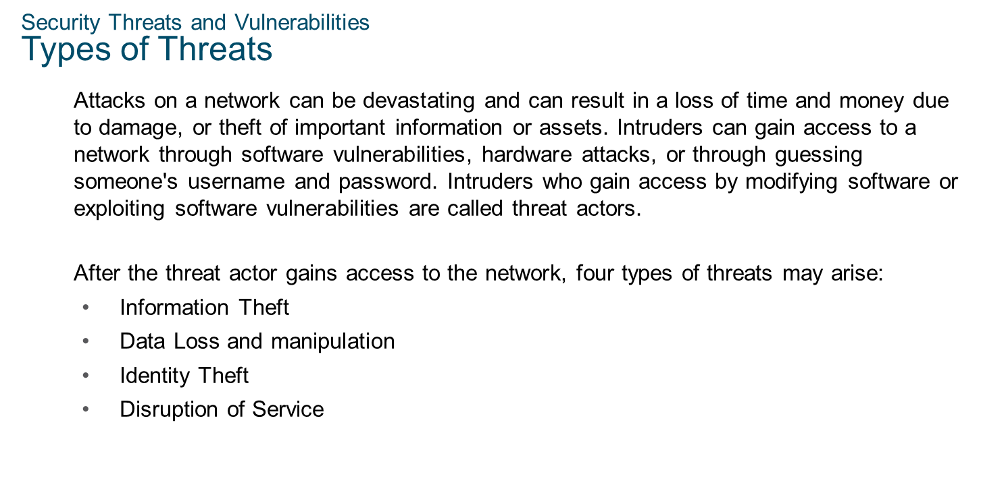
Chapter 9
Network Security Fundamentals

Slide 4
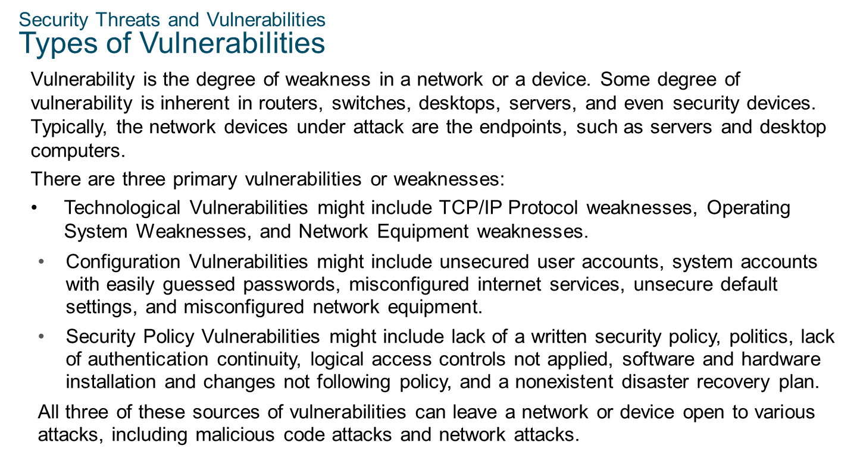
Chapter 9
Network Security Fundamentals

Slide 5
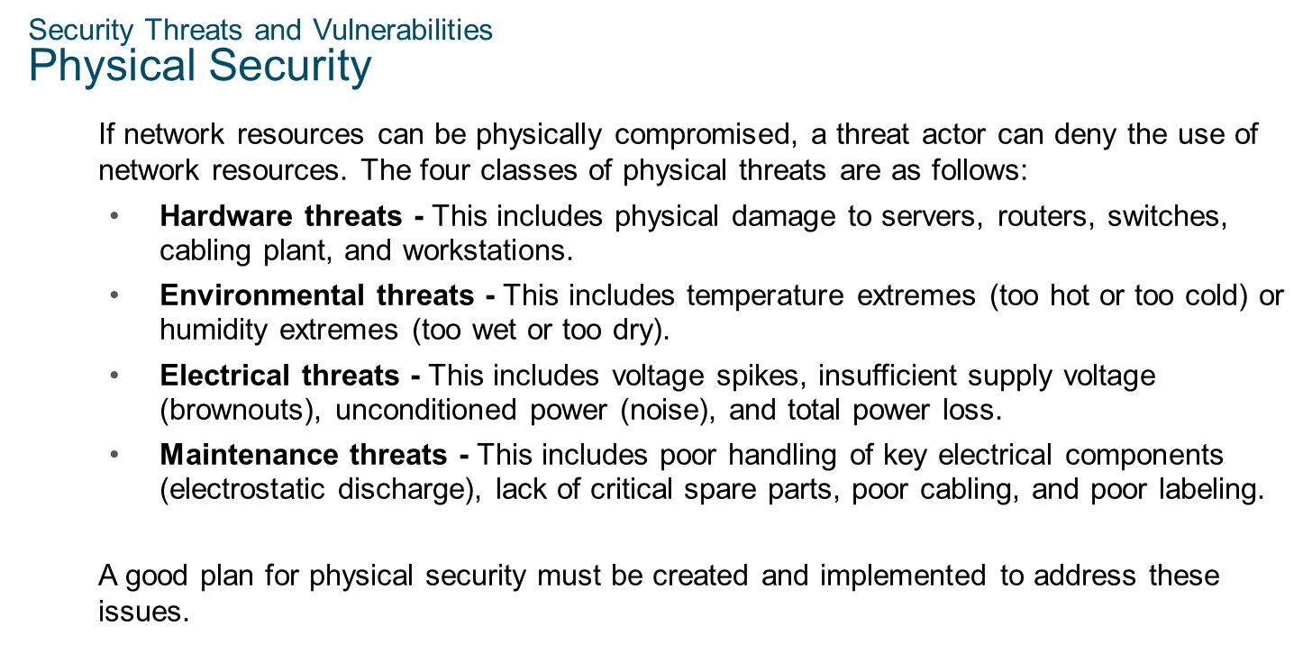
Chapter 9
Network Security Fundamentals

Slide 6
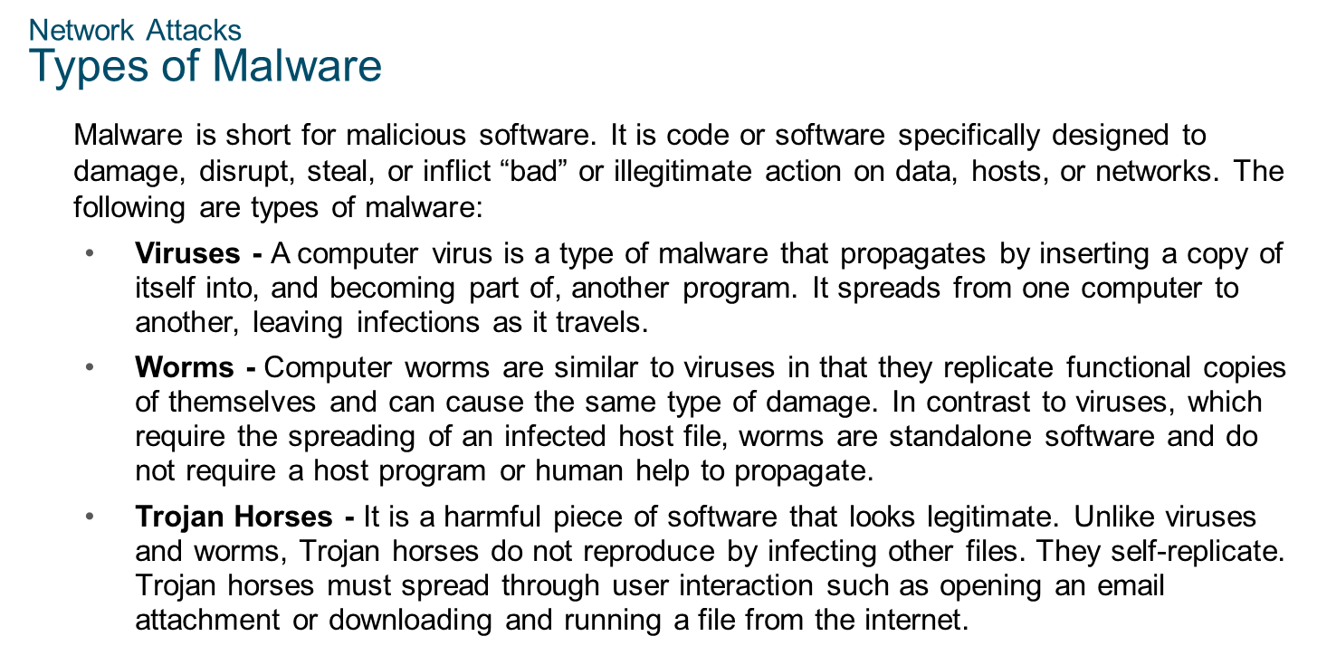
Chapter 9
Network Security Fundamentals

Slide 7
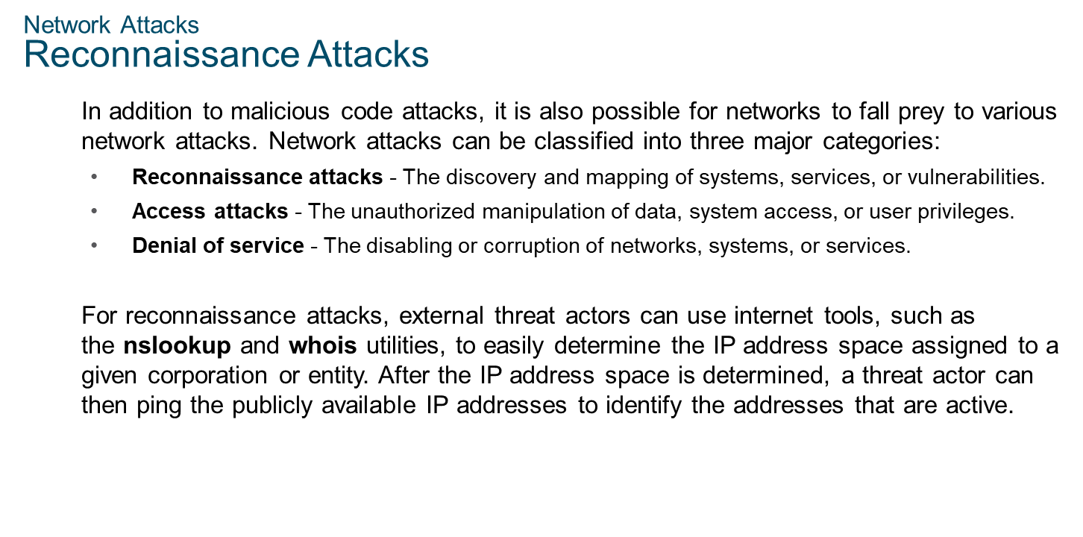
Chapter 9
Network Security Fundamentals

Slide 8
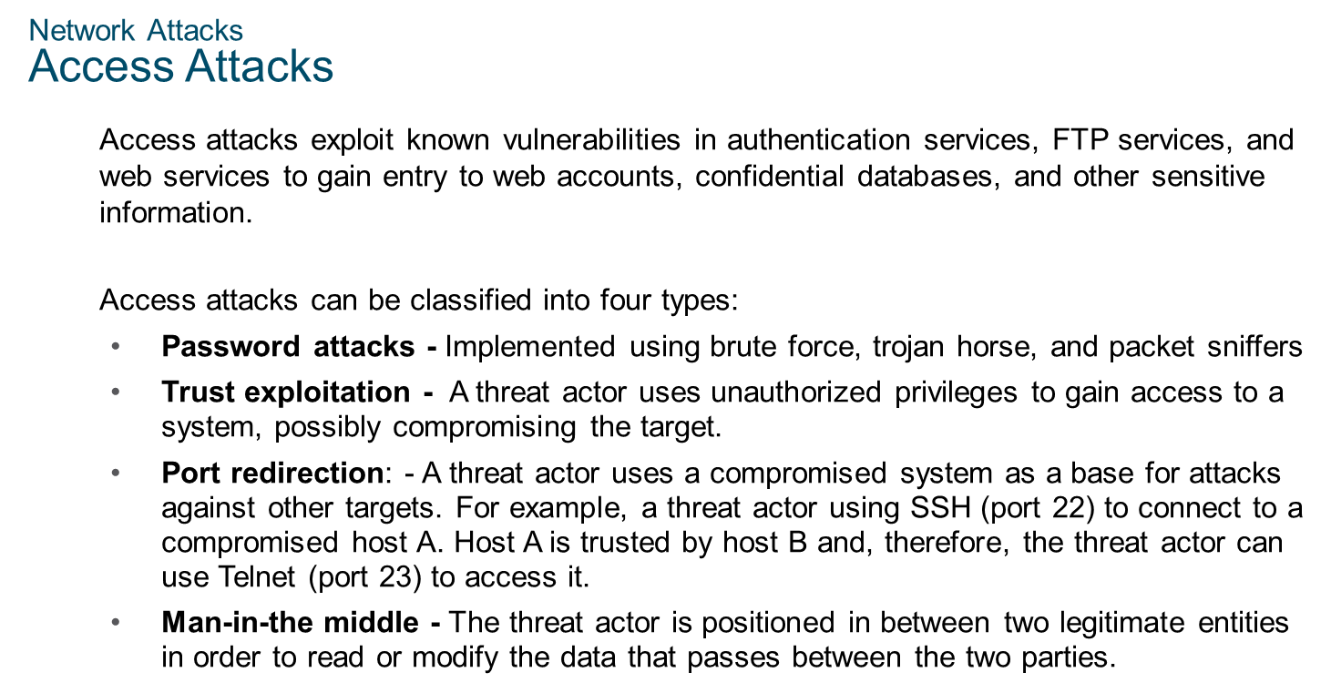
Chapter 9
Network Security Fundamentals

Slide 9
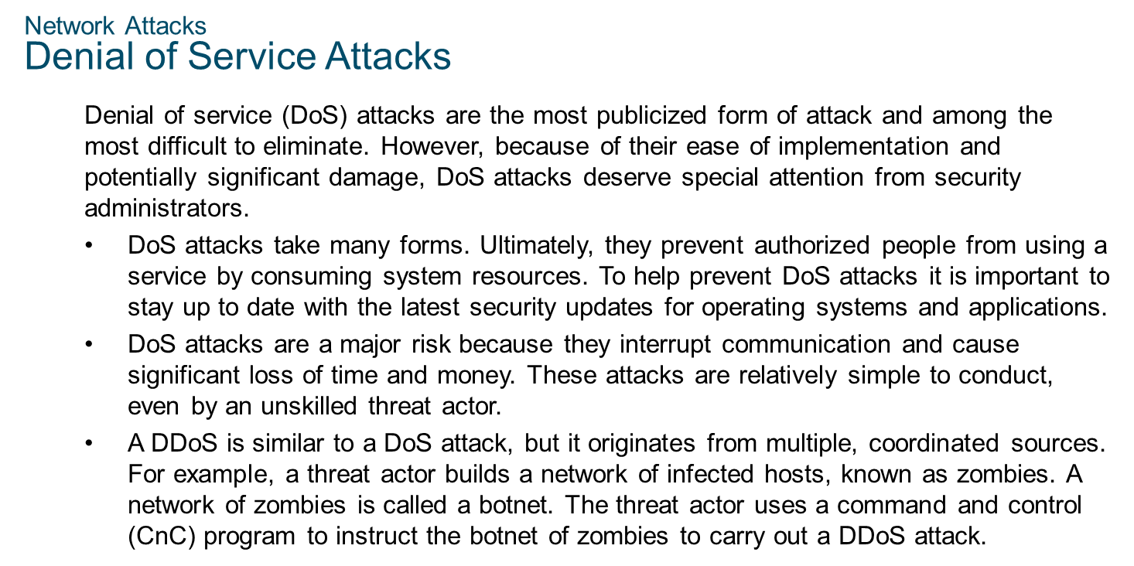
Chapter 9
Network Security Fundamentals

Slide 10
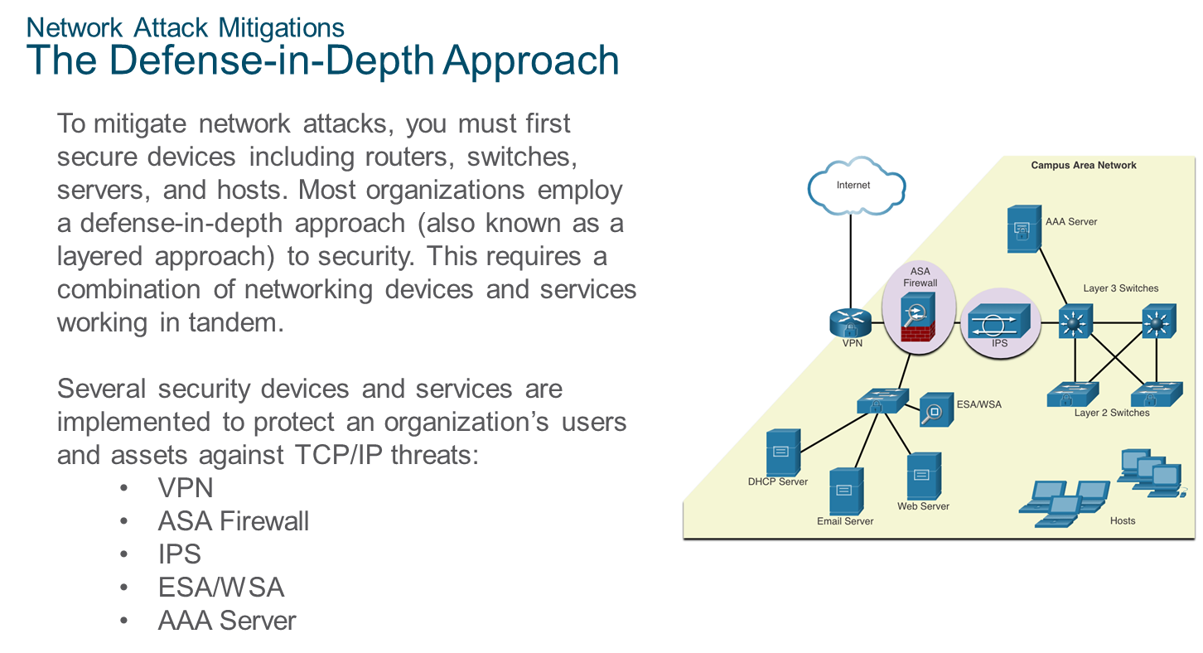
Chapter 9
Network Security Fundamentals

Slide 11
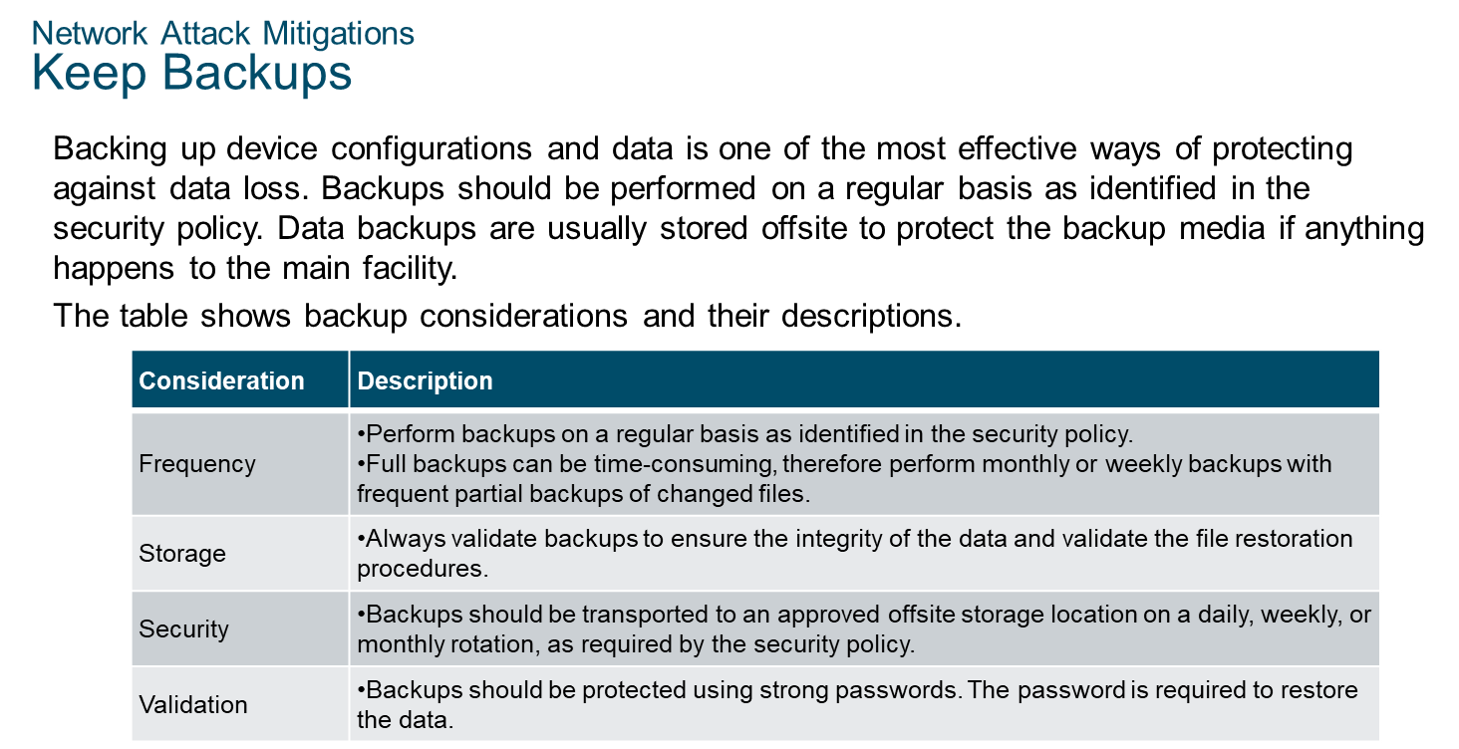
Chapter 9
Network Security Fundamentals

Slide 12
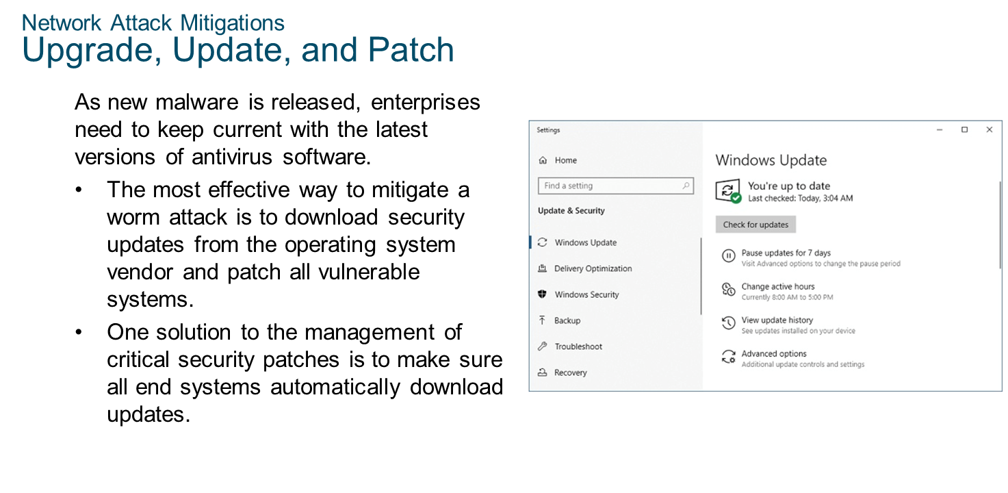
Chapter 9
Network Security Fundamentals

Slide 13
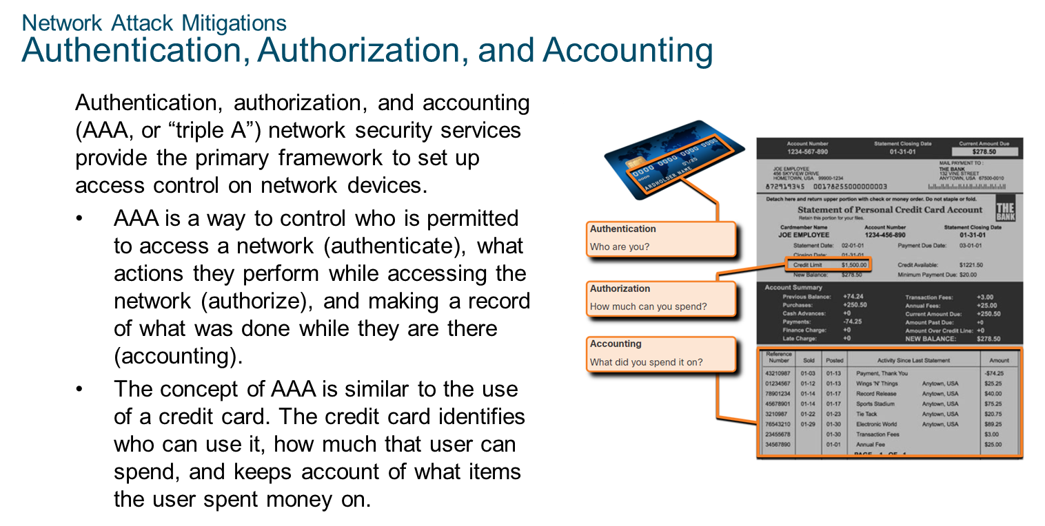
Chapter 9
Network Security Fundamentals

Slide 14
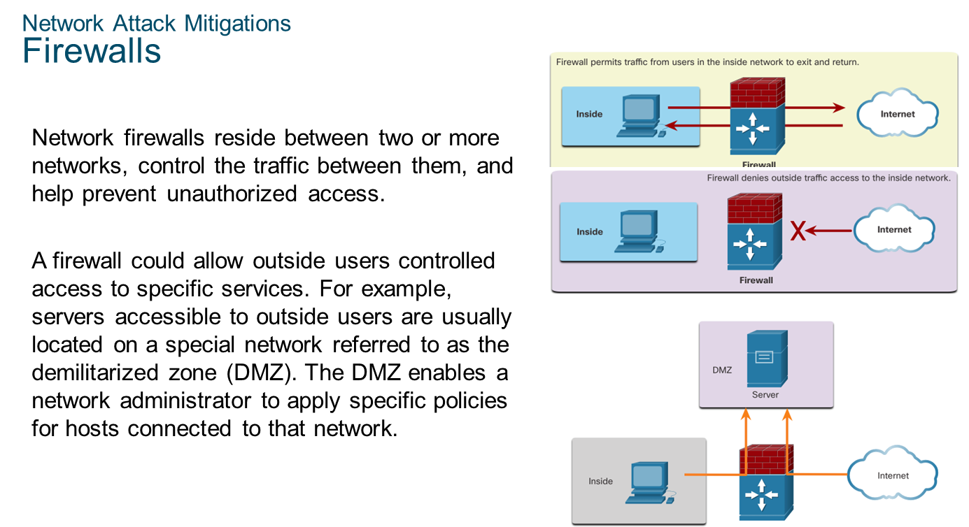
Chapter 9
Network Security Fundamentals

Slide 15
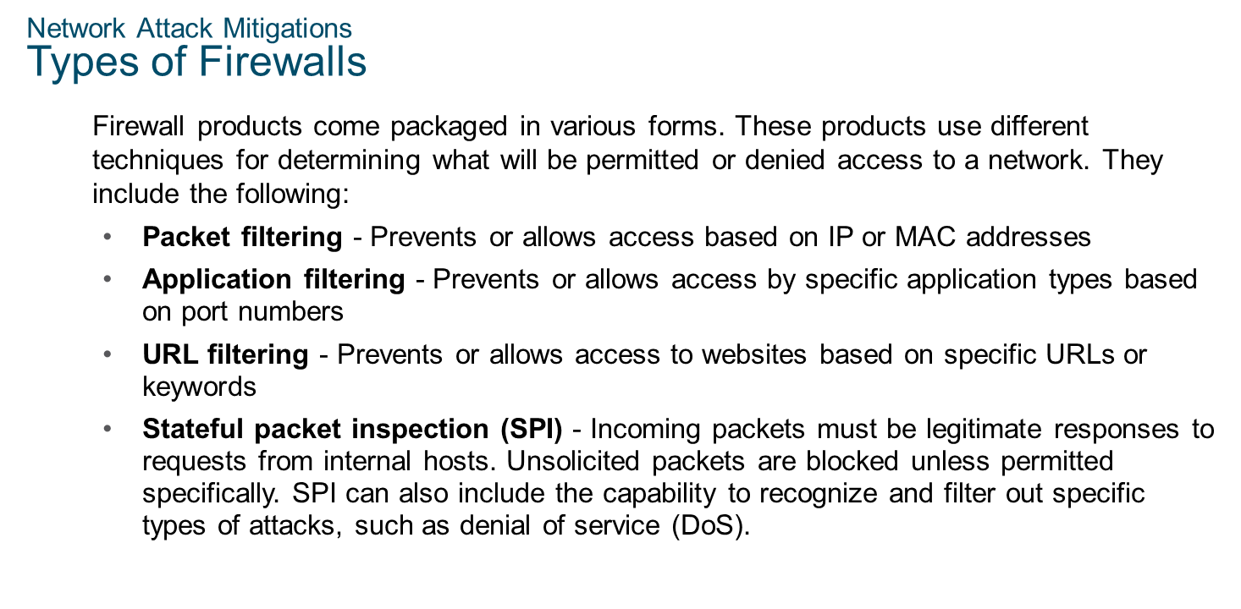
Chapter 9
Network Security Fundamentals

Slide 16
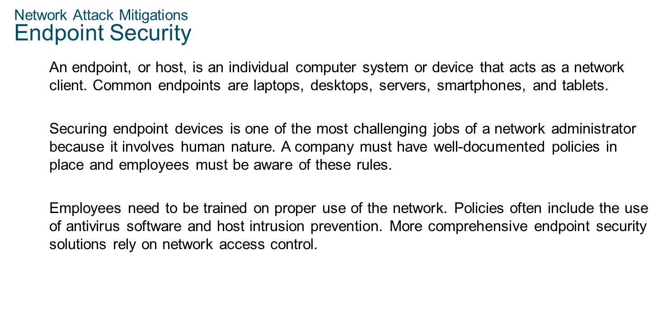
Chapter 9
Network Security Fundamentals

Slide 17
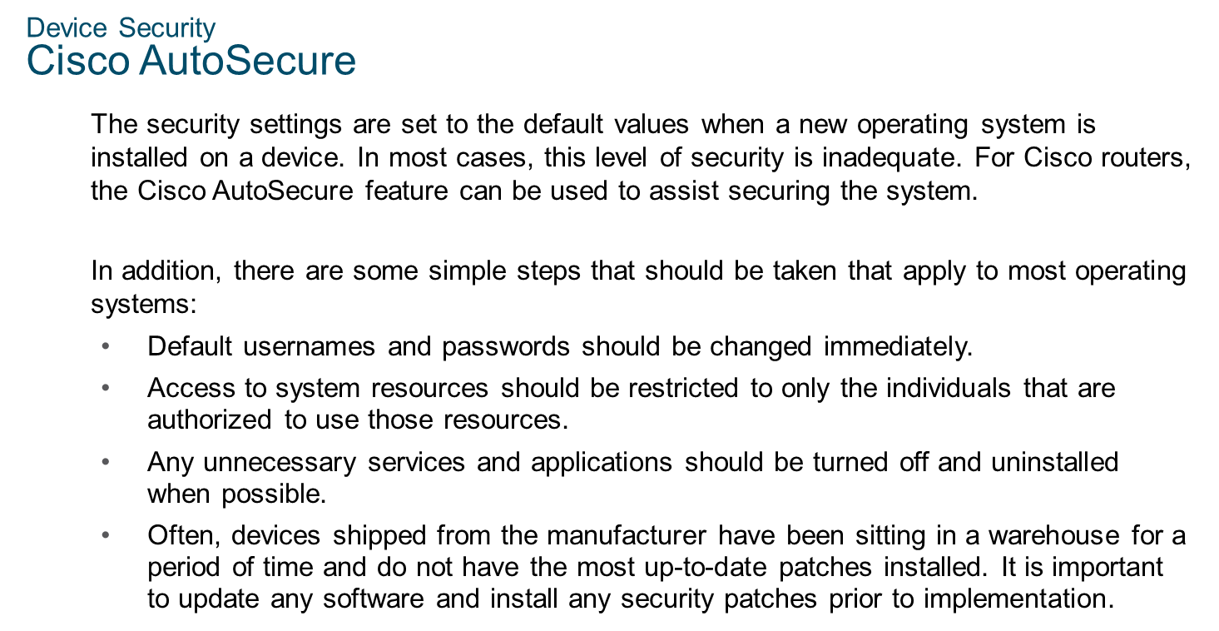
Chapter 9
Network Security Fundamentals

Slide 18
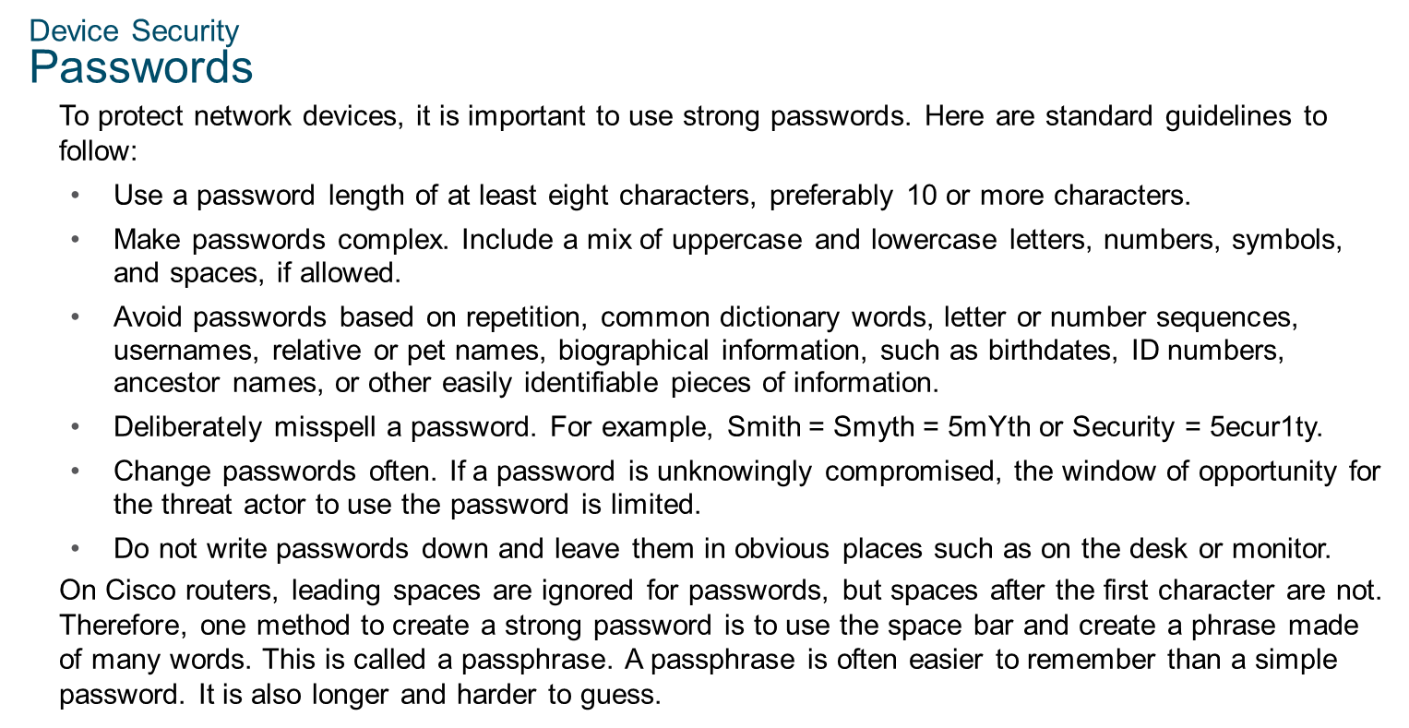
Chapter 9
Network Security Fundamentals

Slide 19
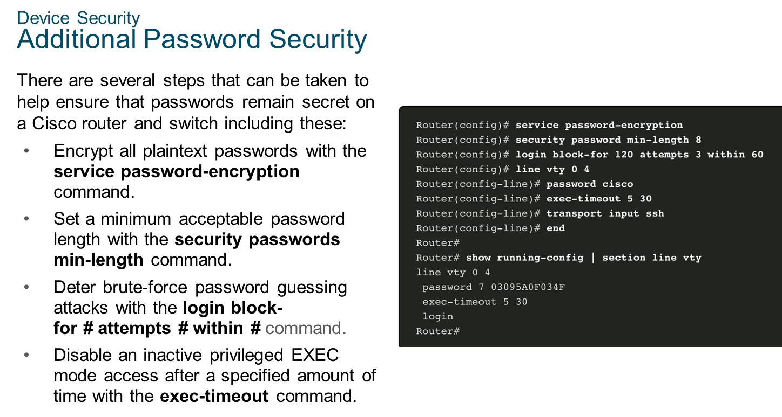
Chapter 9
Network Security Fundamentals

Slide 20
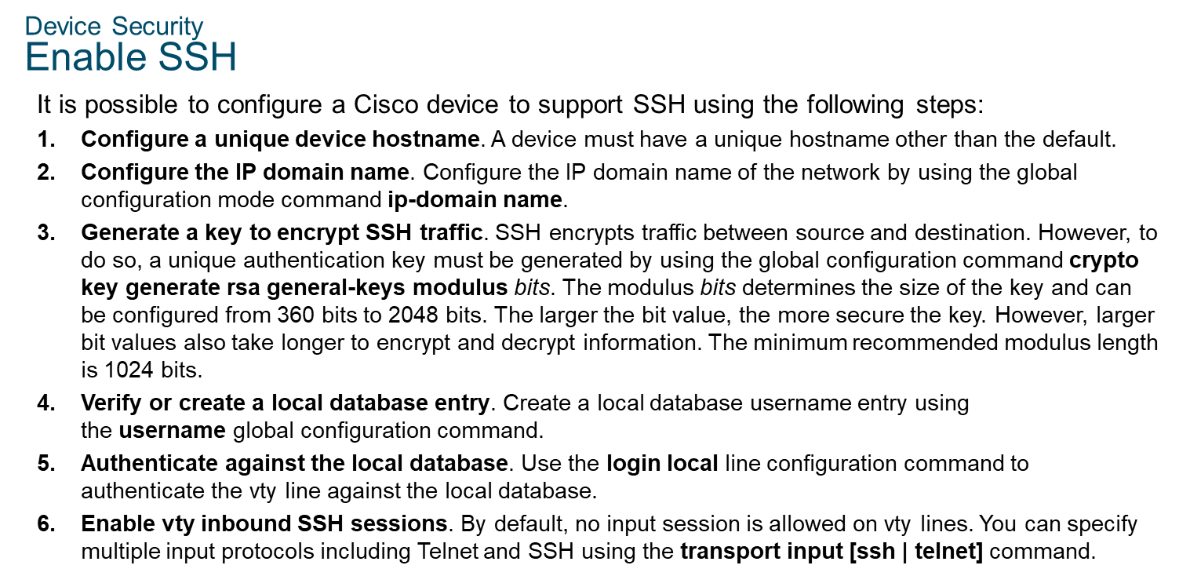
Chapter 9
Network Security Fundamentals

Slide 21

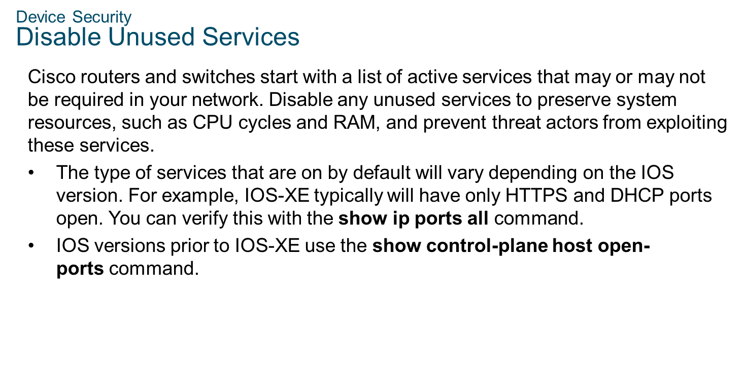
Chapter 9
Network Security Fundamentals

