Slide 1


Health Law and Ethics
Prepared by Dr. Aya Mohamed
MHA 633
Doctor – Patient Relationship
Lecture 6

Slide 2

Chapter
In the previous Lecture: Doctor – Patient Relationship
04
Ethical Analysis……… Different Approaches
Doctor – Patient Relationship
Oath of Muslim Doctor
Why does it matter?
Types of relationship
What is the ideal patient-physician relationship

Slide 3
In this Lecture: Doctor- Patient Relationship
Chapter
04
Introduction
Duties of a good doctor
Doctor competencies
7 Principal elements that are essential to the relationship
Etiquette Based Medicine
Communication skills
Consultation styles
Four Models of Decision Making
Patient Education
Improving Doctor-patient relationship

Slide 4
Introduction
This is a unique social relationship where bonding is planned with the ultimate objective of assisting the patient to achieve treatment goals.
This approach requires the doctor (care provider) to take on the responsibility of directing , effecting and maintaining the therapeutic relationship, exhibiting a professional and ethical approach.

Slide 5
Introduction
Doctor –Patient relationships express the values of medical profession
The relationship should not be the fish & fisherman
It should be always like fish and water
The doctor-patient relationship has been defined as “a consensual relationship in which the patient knowingly seeks the physician’s assistance and in which the physician knowingly accepts the person as a patient.”

Slide 6

ROOTs of DPR
The physician-patient relationship has at least three roots:
  A root of social contract relying upon a mutual perception of profession;
  A root developing out of the historical tradition of society and profession; and
  A personal root which gains its strength from the specific personality of both physician and patient and from that unique relationship.

Slide 7
DPR ….Why does it matter ?
The patient-physician relationship is fundamental for providing
excellent care
to the healing process
to improved outcomes
Therefore, it is important to understand what elements comprise the relationship and identify those that make it "good."

Slide 8
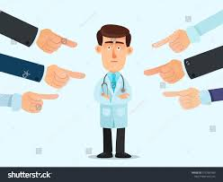
DPR …. Shocking findings from research
During interviews between doctor and patient :
60% of taped interviews showed interruption in first 20 seconds
In 50 % of the cases: doctors and patients did not agree on the key problem
80% of the cases could not adequately repeat the prescription

Slide 9
Duties of a good doctor
Patients must trust doctors with their life and death. To justify that the Doctor must show respect for human life:
Knowledge, skills and performance *
  Make the care of your patient the first concern.
  Provide a good standard of practice and care.
Safety and quality
  Protect and promote the health of patients.
  Take prompt action for patient safety, dignity.
* Skills all doctors should possess : E.g.
  Recognize when a patient needs to be transferred to the ICU.
  Deliver bad news compassionately, yet honestly.
  Explain a disease or procedure to patients in plain, understandable terms.
  Know when to speak, and when to listen

Slide 10
Duties of a good doctor
Communication, partnership and teamwork
  Treat patients as individuals and respect their dignity.
  Respect patient’s right to confidentiality.
  Work in partnership with patient
  Work with colleagues in the ways that best serve patient’s interests
Maintaining trust
  Be honest and open and act with integrity
  Never discriminate unfairly against patients or colleagues
  Never abuse your patient’s trust

Slide 11
Being a doctor today is not easy!
  too much work
  too much hassle
  too much competition
  too much despair; and
  too little reimbursement ?

Slide 12

Doctor Competencies
Patient Care
Medical Knowledge
Practice-Based Learning (EBM) and Improvement
Interpersonal Skills
Communication Skills
Professionalism
Systems-Based Practice
Notes:
Presenter
2014-07-30 11:12:58
--------------------------------------------
Patient Care that is compassionate, appropriate, and effective for the treatment of health problems and the promotion of health
Medical Knowledge about established and evolving biomedical, clinical, and cognate (e.g. epidemiological and social-behavioral) sciences and the application of this knowledge to patient care Practice-Based Learning and Improvement that involves investigation and evaluation of their own patient care, appraisal and assimilation of scientific evidence, and improvements in patient care Interpersonal and Communication Skills that result in effective information exchange and teaming with patients, their families, and other health professionals
Professionalism, as manifested through a commitment to carrying out professional responsibilities, adherence to ethical principles, and sensitivity to a diverse patient population
Systems-Based Practice, as manifested by actions that demonstrate an awareness of and responsiveness to the larger context and system of health care and the ability to effectively call on system resources to provide care that is of optimal value

Slide 13
7 Principal elements that are essential to the relationship:
- in Physician-Patient Communication
  Build the doctor-patient relationship
  Open the discussion
  Gather information
  Understand the patient’s perspective
  Share information
  Reach agreement on problems and plans
  Provide closure
1-COMMUNICATION
2-OFFICE EXPERIENCE
3-HOSPITAL EXPERIENCE
4-EDUCATION
5-INTEGRATION
6-DECISION-MAKING
7-OUTCOMES

Slide 14
Etiquette Based Medicine
Checklist for first meeting with a hospitalized patient:
Ask permission to enter the room /interrogation ; wait for an answer
Introduce yourself, showing ID badge
Shake hands /greeting (wear gloves if needed)
Sit down, Smile if appropriate (relax your self and make patient relaxed)
Briefly explain your role on the team
Ask the patient how he/she is feeling about being in the hospital & about the treatments

Slide 15
Communication Skills
Advice reassurance and support from the doctor can have a significant effect on recovery
The placebo effect
Communication skills in clinical practice: “Its an art to talk medicine in the language of a non medical men”!
Separates successful doctors from unsuccessful ones!
Include ability to engage with patients at emotional level, to listen, to convey information with clarity & sympathy

Slide 16
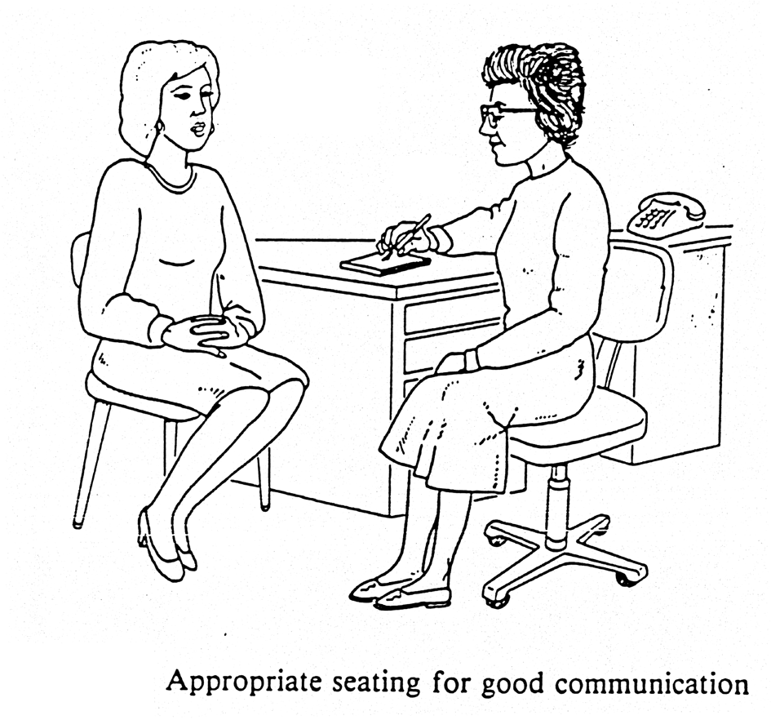
Communication Skills
Polish your bedside manner
Non-verbal communication – SOFTEN
    S - Smile
    O - Open posture
    F - Forward lean
    T - Touch. This is a privilege – use it !
    E - Eye contact
    N – Nod
Communication
  7% - Spoken words !
  38% - Voice quality like Tone, Tempo, intonation !
  55% - Body language !
Nonverbal skills
  Attentive and interested body posture
  Facial expression
  Appropriate eye contact
  Touch

Slide 17
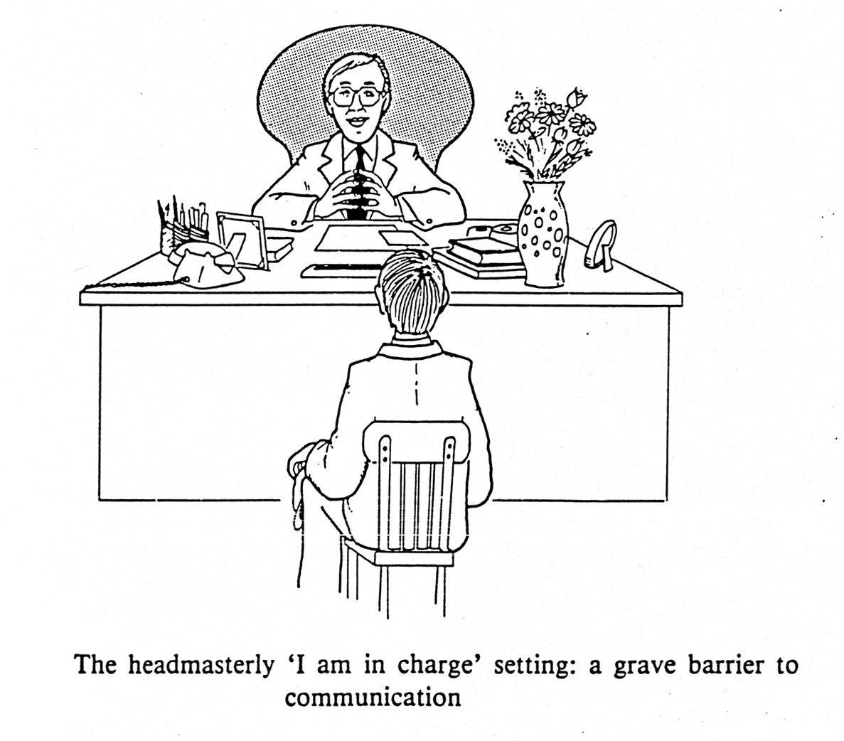
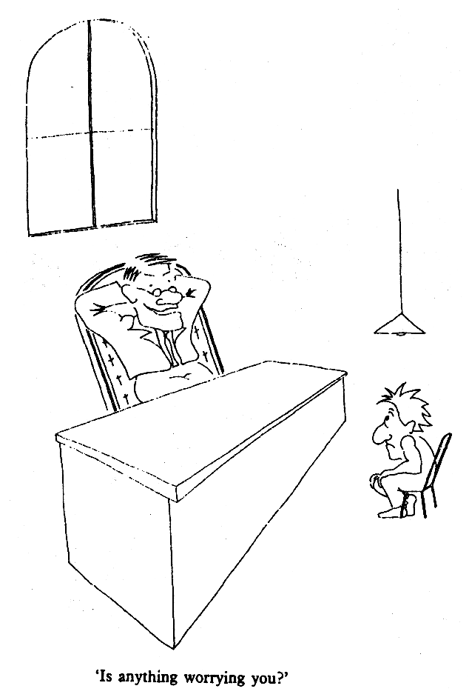

Slide 18
Communication Skills
Patients perception of inadequacies of communication arise from
Content skills – what doctors say, e.g., the substance of the questions asked, the answers received, the information given, the differential diagnosis list, and the doctors medical knowledge base
The content of communication is influenced by a number of practical and situational factors (time available, initial or subsequent visit, private patient)
Process skills – how doctors say it, e.g., how the doctor asks questions, how well he listens, how he sets up explanation and planning with the patient, how he structures his interaction and makes that structure visible to the patient through signposting or transitions &how he build relationships with patients

Slide 19
Communication Skills
Communication skills and steps to be achieved in consultation
Initiating the session (establishing the initial rapport and identifying the reason(s) for theconsultation).
Gathering information (exploring the problem, understanding the patients’ perspective, providing structure to the consultation).
Building the relationship (developing rapport and involving the patient).
Explanation and planning (providing the appropriate amount and type of information, aiding accurate recall and understanding, achieving a shared understanding and planning)
Closing the session.

Slide 20
Consultation Styles
1. Doctor centered
Paternalistic - doctor is the expert and patient expected to cooperate
Tightly controlled interviewing style aimed at reaching an organic diagnosis.
Closed questions
‘Voice of medicine’- focus on biomedical diagnosis and treatment as quickly as possible

Slide 21
Consultation Styles contd..
2. Patient centered
Mutuality
Less authoritarian - encourages patient to their own feelings and concerns
Open questions
‘Voice of the patient’ - communication of patients beliefs, feelings & psychosocial context (bio psychosocial)
Key aspects of a of patient-centred consultation
Biopsychosocial perspective
Patient-as-a-person
Sharing power and responsibility
Therapeutic alliance
Doctor-as-a-person

Slide 22
BARRIERS IN COMMUNICATION
A) Doctor’s barrier to effective communication
Lack of specific knowledge
Lack of counseling skills
Lack of time
Lack of appropriate resources
B) Patient’s barrier to effective communication
Sex
Social and educational level
Different languages
Minority

Slide 23
Four Models of Decision Making:
1) The paternalistic model
Similar relationship as father and child , hence paternalism
  father overriding decision of child .
Doctor has the patient's best interest in mind , and overrides the patient's choice
  may be appropriate in emergencies patient cannot voices wishes .
This is in contrast to ethical principle of autonomy .
  much in favour of ethical principle of beneficence .
  allows for uncertain patient to " allow the doctor to decide what's best "
Doctor seen as a father figure

Slide 24
Four Models of Decision Making:
1) The paternalistic model
Principle
  The doctor should make all the decisions for a patient.
Assumptions
  People are not always rational/mature.
  Experts know better about the needs of patients.
  Qualified doctors have good will.
Sources
  Hippocratic Oath.
Problems
  Are the needs of patients objective?
  How can we be sure that doctors have good will?
Objection and modification
  liberal principle

Slide 25
The informative model
Doctor provides patient with facts regarding treatment .
Patient makes decision based upon these facts provided , and doctor follows through with the patient's plan.
  informed patient decision .
  Increased patient autonomy , potentially decreased beneficence .
  patients may not make a decision that is in their best interest .
  opposite of paternalistic model .
Concept here is that the doctor is an expert

Slide 26
The informative model
Principle
  The doctor should provide all the relevant information for the patient to make a decision, and provide the selected intervention on this basis.
Assumptions
  A fact/value division of labor yields the best medical result.
  What is good for a patient depends on what his/her personal values.
  Consumerism.
Problems
  What if the patient is unconscious, incompetent, and making choices totally unacceptable by our ethical standards?

Slide 27
The deliberative model
Discussion of patient values , by doctor , to clarify and challenge them
Doctor tries to challenge patient views and attempt to guide patient towards values doctor believes is in the patients best interests .
Concept here is that the doctor is a friend .
The interpretive model
Doctor discusses patient management , in order to clarify patients values , and promote patient understanding of the consequence of their decisions .
Development of deliberative model , respects patient autonomy by informing patient rather than manipulating of their views .
Doctor is seen as an advisor .

Slide 28
The deliberative model
Principle
  The doctor should help the patient to deliberate well through dialogue and discussion, and so develop values which are objective and truly worthy.
Assumptions
  The objectivity of values.
  The patient’s good life consists not in the satisfaction of desires, but maturity and rationality.
Source
  Aristotelian ethics
Problems
  Is the model different from the paternalistic model?
  What is the difference between dialogue and persuasion?

Slide 29
4) The interpretive model
Principle
  The doctor should help the patient to articulate his/her values through interpretation, and provide intervention which is truly wanted.
Assumptions
  Patients have unconscious and inconsistent desires.
  Their conscious decisions may not reflect their deepest values.
Sources
  Sigmund Freud.
Limitation
  All that a doctor can do is to help the patient see his/her own desires/values more clearly, but not to criticize them.

Slide 30
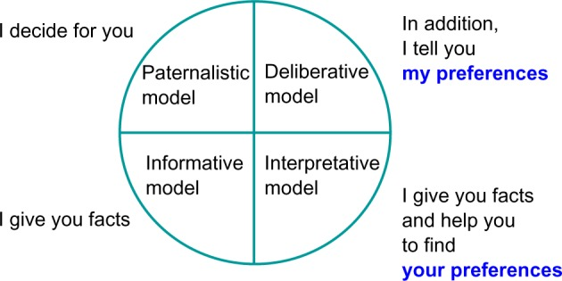

Slide 31
Take on Consideration …..
Patient Autonomy
  Autonomy = freedom to decide !
  Doctors need to :
    1. present the options to the patients and
    2. allow patients to choose for themselves
  Informed choice means patients need
Educating patients
  Most doctors do not spend much time educating their patients!
  Primary role of a doctor should not be merely treating an illness, but helping people remain healthy
  Patients are the practice !

Slide 32
Patient Education
Key component of informed consent
Don’t tell the patient what to do
Present the information and the treatment options – and allow them to make up their own mind !
Empower patients with information – they will respect you for this !
Information therapy - “ Prescribing the Right Information to the Right Person at the Right Time” is the best way of bridging the doctor-patient communication gap today !
Benefits of patient education :
  Happier patients practice promoter
  Increase patient compliance
  Improve public health
  Overall :Helps to improve empathy
  Reduce risk of complications

Slide 33
Take on Consideration …..
Intervention---
Teach back method.
Ask Me 3" is designed to bring public and physician attention to this issue, by letting patients know that they should ask three questions each time they talk to a doctor, nurse, or pharmacist:
What is my main problem?
What do I need to do?
Why is it important for me to do this?

Slide 34
Patient Expectation From Their Doctors?
Expertise ( be well-informed and UpToDate)!
Professionalism – look out for the patient’s best interests!
Accountability – be answerable; say Sorry ( if there is a mistake)!
Transparency – no unnecessary tests and referrals!
Respect their desires and their time!
Treat them as intelligent human beings
Experience + Needs + Communication = Expectation !
If Perception exceeds expectations: Satisfaction!
If Expectations are less than perception: Dissatisfaction!

Slide 35
Doctor Expectation from His Patients?
Patient’s will :
  Deal with Doctor with respect
  Will say “Thank You” when things go well
  Will have realistic expectations of treatment
  Will not unfairly blame doctor anytime there is a problem
  Will pay their professional fees promptly and gracefully
  Many patients, furthermore, are not ill: they see physicians to have their health evaluated or certified, to be examined for employment, or to meet a number of other requirements not directly associated with illness.
  In the last 50 years, the patient-physician relationship has become complicated beyond imagination.
  And yet, there remains that unavoidably deeply private relationship still reflecting a slowly evolving traditional vision, the patient-physician relationship remains inevitably based on trust, fear, and hope.

Slide 36
Doctor Expectation from His Patients?
Physicians are capable of acting unprofessionally, but cannot act unethically, as ethical standards are part of their profession.
Therefore, it behooves all patients to educate themselves on what constitutes “professional” and “unprofessional” behaviour for those involved in health care.
Notes:
4. Jackson JL, Kroenke K. Difficult patient encounters in the ambulatory clinic. Arch Intern Med. 1999;159:1069-1075.
5. Hahn SR, Thompson KS, Wills TA et al. The difficult doctor-patient relationship: somatization, personality and psychopathology. J Clin Epidemiol. 1994:47:647-657.
6. Hinchey, SA, Jackson AL. A cohort study assessing difficult patient encounters in a walk-in primary care clinic, predictors and outcomes. J Gen Intern Med. 2011 Jan 25.

Slide 37
Influences On The Doctor–patient Relationship
1. Influence of time –
Average 8 minutes (avg 2-20 min)
Pressures of time- doctor centered consultation
However, doctors own style & approach influences than the time available.
Patient centric approach needs more time but overall reduces the number of return visits & thus the total consultation time .
2. The patient’s characteristics and behaviour depends on a number of factors:
Age
Social and educational level
Sex
Different languages
3. Influence of structural context
Hospital situation/ Ward
Fee-for service

Slide 38
Improving Doctor–patient Relationship
Active Listening
Nonverbal Communication
Agendas
Empathize
Educating Patients
Reassurance
Agreeing on a treatment plan
Taking responsibility
Avoid overreacting
Establishing boundaries
SO, what makes a GOOD Doctor Listening
Interest – concern
Respect
Flexibility
Knowledge
Subject matter
General examination
  interview techniques
Symptomatic reading of the patient
Relationship reading

Slide 39
Proof of Negligence …. Lodge a Complain
The essentials of negligence are four "D"s:
      1. There was a Duty towards patients
      2. There was Deficiency in duty
      3. This Directly resulted in the problem
      4. Damage which may be physical, mental or financial loss to patient or relatives

Slide 40
Conclusion
The doctor-patient relationship is at the core of the practice of healthcare.
Essential for the delivery of high-quality health care in the diagnosis and treatment of disease.
The Doctor-Patient Relationship itself is part of the therapeutic process.
Many issues may complicate or negatively affect the doctor-patient relationship if not taken properly into consideration.

Slide 41
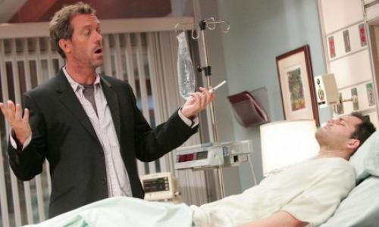

Slide 42
Chapter
In this Lecture: Doctor – Patient Relationship
04
Introduction
Duties of a good doctor
Doctor competencies
7 Principal elements that are essential to the relationship
Etiquette Based Medicine
Communication skills
Consultation styles
Four Models of Decision Making
Patient Education
Improving Doctor-patient relationship

Slide 43



Thank You

