Slide 1



Branding
lecture-6
Marketing Management
MGM612
Dr. Magdy alhaj

Slide 2
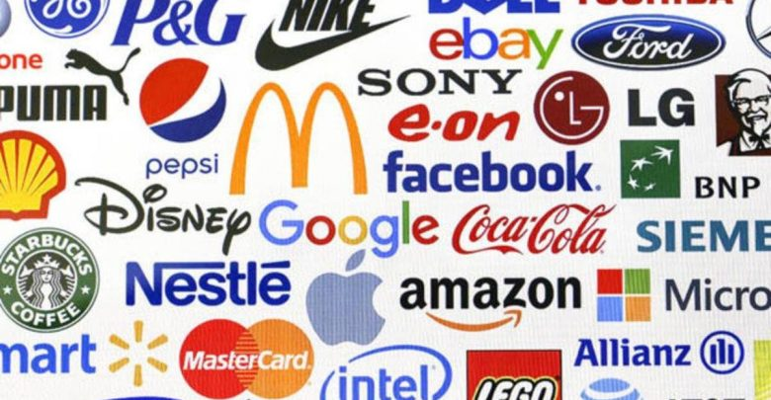
Learn outcomes
After studying this chapter, you should be able to:
Brand Definition
The Importance Of Branding
Forms Of Brands
Elements Of A Brand
Types Of Brands
Branding Mechanisms

Slide 3
Branding
Branding:
The use of a name, design, symbol, or a combination of those elements that at organization uses to help differentiate its products from the competition
Branding
describes a company’s or event’s efforts to develop a personality and make its products or services different from the competition

Slide 4
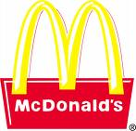
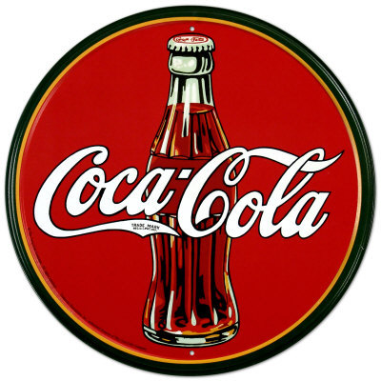

Brand definition
“A brand is a name, term, design, symbol, or any other feature that identifies one seller’s good or service as distinct from those of other sellers” (American Marketing Association(
Branding is endowing products and services with the power of a brand” (Kotler & Keller, 2015)

Slide 5
Brand definition
“Branding is the process of giving a meaning to specific organization, company, products or services by creating and shaping a brand in consumers’ minds. It is a strategy designed by organizations to help people to quickly identify and experience their brand, and give them a reason to choose their products over the competition’s, by clarifying what this particular brand is and is not.

Slide 6
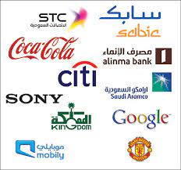
THE IMPORTANCE OF BRANDING
To build product recognition and customer loyalty
To ensure quality and consistency
To capitalize on brand exposure
Branding builds confidence
Branding builds an emotional connection
Branding tells your story in an instant

Slide 7
benefits of a Strong Brand
There are a number of benefits associated with the development of a strong brand:
Strong brands have the power to create business value and impact more than just corporate revenues and profit margins
Strong brands also create competitive advantage, command price premiums and decrease cost of entry into new markets
Strong brands reduce business risk and attract and retain talented staff

Slide 8
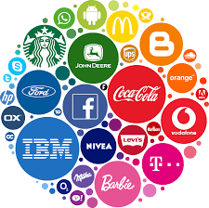
Characteristics of a successful brand include:
Positive, distinctive and generate positive feelings
and association
Easy to remember and pronounce
Logo is easily recognizable
Implies the benefits the product delivers
Consistent with the image of the rest of the product
lines, organization, and/or city
Legally and ethically permissible

Slide 9
How can it be done?
Companies tend to use different tools to create and shape a brand. For example, branding can be achieved through:
Brand definition: purpose, values, promise
Brand positioning statement
Brand identity: name, tone of voice, visual identity design (which includes the logo design, color palette, typographies…)
Advertising and communications: TV, radio, magazines, outdoor ads, website, mobile apps…
Sponsoring and partnerships

Slide 10
How can it be done?
6. Product and packaging design
7. In-store experience
8. Workspace experience and management style
9. Customer service
10. Pricing strategy

Slide 11
Forms of Brands
The Forms of brand used depends on the particular entity using it. The following are some of the most common forms of brands:
Corporate Brands: Corporate branding is a way for companies to market themselves in order to give themselves an edge against their competition. They make a series of important decisions in order to accomplish this, such as pricing, mission, target market, and values.
Personal Brands: As mentioned above, branding isn't just for companies anymore. People use tools like social media to build their own personas, thereby boosting their brands. This includes regular social media posts, sharing images and videos, and conducting meet-and-greets.

Slide 12
Forms of Brands cont. …
Product Brands: This type of branding, which is also known as merchandise branding, involves marketing one particular product. Branding a product requires market research and choosing the proper target market.
Service Brands: This kind of branding applies to services, which often requires some creativity, as you can't actually show services in a physical way

Slide 13

UNDERSTANDING BRANDING
BRAND
a name, term, design, symbol, or combination of these elements that identifies a product and distinguishes it from its competitors

Slide 14

ELEMENTS OF A BRAND
Brand Name
Brand Mark
Trade Name
Trade Character
Trade Mark

Slide 15
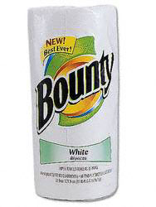

BRAND ELEMENT
BRAND NAME
(or product brand) a word, group of words, letters, or numbers that represents a product that can be spoken
  Should be easily pronounced, distinctive, and recognizable

Slide 16


BRAND ELEMENT
BRAND MARK
the part of a brand that is a symbol or design
  It may include distinctive colors or lettering
Brand marks can come in a variety of forms, including the following:
Logos
Colors
Pictures
Icons

Slide 17


BRAND ELEMENT
TRADE NAME
(or corporate brand) identifies and promotes a company or a division of a particular corporation
  The legal name used while conducting business
  Used to promote a positive image of the organization (quality, value, reliability)

Slide 18


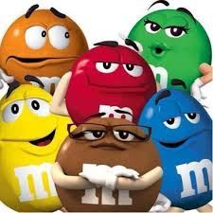

BRAND ELEMENT
TRADE CHARACTER
a brand mark with human form or characteristics

Slide 19

BRAND ELEMENT
TRADE MARK
a brand name, brand mark, trade name, trade character, or a combination of these that is given legal protection by the federal government

Slide 20
PRODUCT RECOGNITION
It is important that customers who are satisfied with a product can easily recognize and find a company’s branded products when they want to buy them again

Slide 21

QUALITY AND CONSISTENCY
Companies communicate to customers that they can expect consistent quality and performance, before purchase and after purchase

Slide 22

BRAND EXPOSURE
Helps companies extend their products into new target markets, new product lines, and new categories
  Customers are more willing to try new products that carry a name they are familiar with
  Example: GLAD family of products
    Started with trash bags and has now moved into food storage containers and baggies

Slide 23

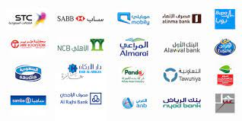


TYPES OF BRANDS
National Brands
(producer brands) owned by national manufacturers
  Generate the majority of sales for most categories
  Examples: Hershey Foods, Whirlpool, Ford, Hilton, American Airlines, Kraft and Nestle
  Internet based national brands
    Amazon.com, eBay, Monster

Slide 24


TYPES OF BRANDS
Private Distributor Brands
private brands, store brands, or dealer brands
  Developed and owned by wholesalers and retailers
  Examples: Arizona for JC Penney, George for Wal-Mart, Villager for Kohl's
Both are private distributor brands from SEARS

Slide 25
TYPES OF BRANDS
Generic Brands
Does not carry a company identity
  Packaging usually features a description of the product
    Example: Pancake Mix, Paper Towels
  Usually sold in supermarkets and discount stores
  Often sold for 30 – 50% less than name brands

Slide 26
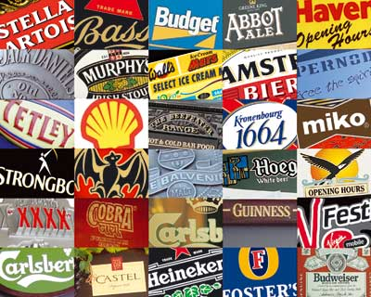
BRAND STRATEGIES
Brand Extension
Brand Licensing
Mixed Brands
Co-Branding

Slide 27
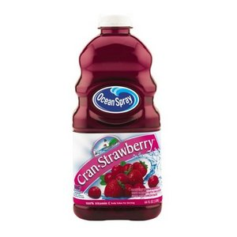
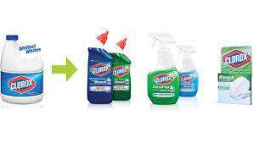
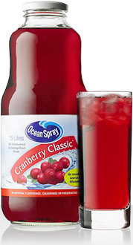
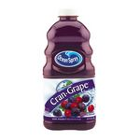
BRAND EXTENTION
A branding strategy that uses an existing brand name to promote a new or improved product in a company’s product line
Brand extension refers to the use of a successful brand name to launch a new or modified product or service in a new market

Slide 28
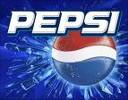
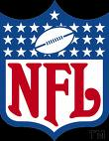
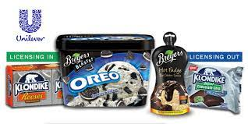

BRAND LICENSING
Some companies allow other organizations to use their brand, brand mark, or trade character through brand licensing
Licensing company gets a fee (royalty) in return for authorization

Slide 29
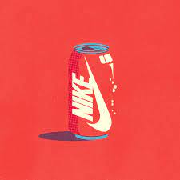

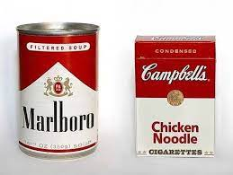
MIXED BRANDS
Offer a combination of manufacturer, private distributor, and generic brands
Their own National Brand tires
Private Brand for SEARS

Slide 30
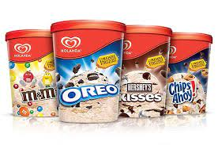
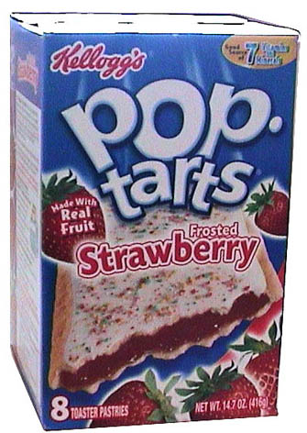
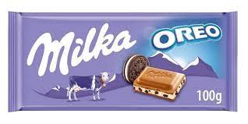

Co-BRANDING
Combines one or more brands in the manufacture of a product or in the delivery of a service
Co-branding is the practice of using multiple brand names to jointly promote or market a single product or service

Slide 31
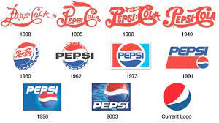
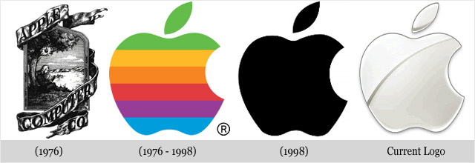
Re-Branding
Rebranding - a change to the brand name, logo, or image of a product or company
brand owner revisits the brand with the purpose of updating or revising
Rebranding is the updating or creation of a new name, term, symbol, design, or a combination thereof for an established brand with the intention of developing a differentiated (new) position in the mind of stakeholders and competitors

Slide 32
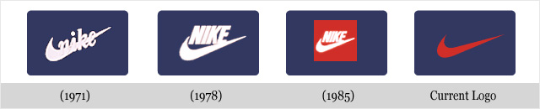
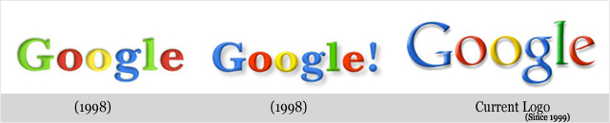
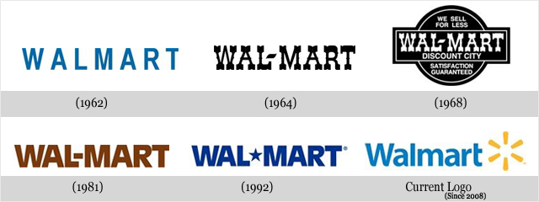
Re-Branding

Slide 33
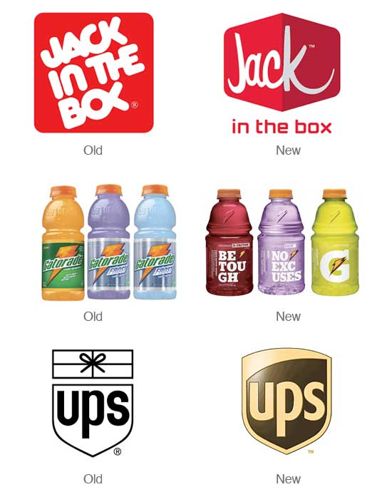
Partial Rebrand
Situations when a brand has been firmly established yet is simply outdated or needs to be refreshed.

Slide 34

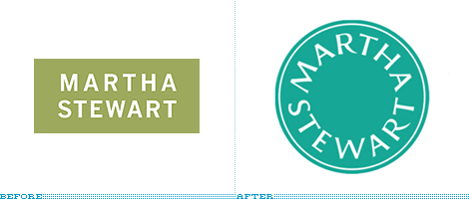
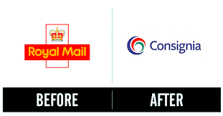
Total Rebrand
Situations when a brand’s intent to erase any previous brand identity and replace it with completely new imagery

Slide 35
Why Rebrand?
Rebranding can help change a businesses:
  Quality
  Target Market
  New Product Line
  Repositioning and Image
  Altered Public Image

Slide 36
Branding Mechanisms
Branding Efforts Often Include the Use Of:
Slogan
Brand Mark
Logo
Trademark
Graphics

Slide 37
Brand Building
Brand awareness
Brand image
Brand equity
Brand loyalty

Slide 38

Branding
Brand awareness is the process of working toward maximizing recognition of a particular brand
Brand image refers to consumer perceptions linked to a particular brand such as health, excitement, fun or family
For example, the Disney brand is associated with family fun and entertainment

Slide 39

Branding
Brand equity is the value placed on a brand by consumers
For example, Nike has strong brand equity because consumers have long associated the brand with top level athletes and quality products
Brand loyalty is a consumer preference for a particular brand as compared to competitor products or services

Slide 40
Event branding opportunities may include
Naming, Event Offerings
Promotions and Co-Promotions
Sponsorship Opportunities
Merchandising Opportunities
Hospitality

Slide 41
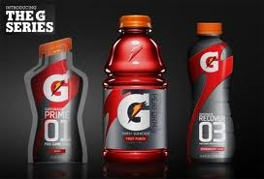
Branding
Re-establishing brand position and strengthening the brand is a critical component for maintaining a strong brand

Slide 42
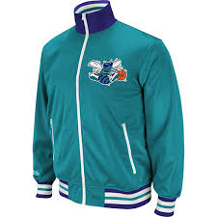
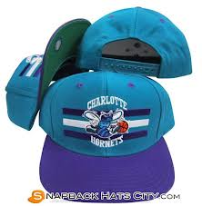
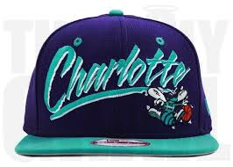
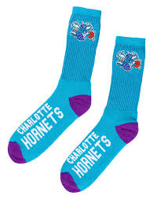
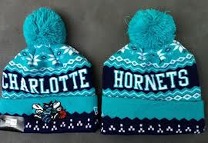
Branding
Re-branding requires careful planning and exceptional attention to detail
According to the Charlotte Observer, Charlotte’s rebranding effort cost the franchise nearly $3 million but has resulted in an immediate uptick in sales, with an increase of 59% in new ticket sales and a significant boost in sponsorship and merchandise sales

