Slide 1


College of Management
Business Ethics
Lecturer: Dr. Raef Baraka
PMG 750
Lecture 08

Slide 2

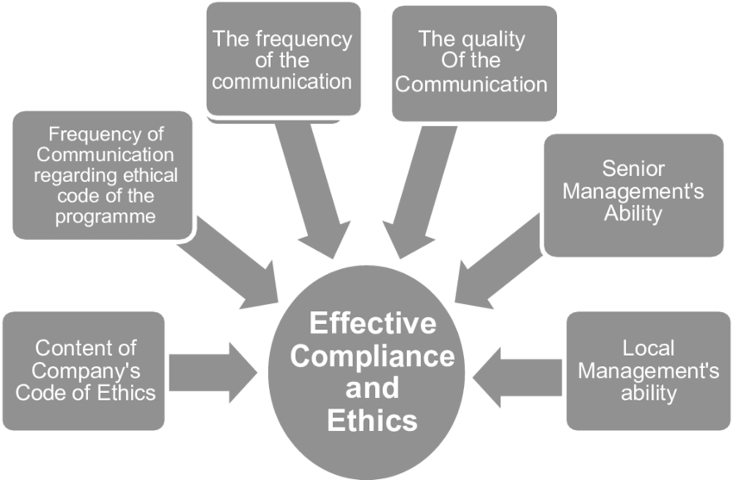
Chapter 8: DEVELOPING AN EFFECTIVE ETHICS PROGRAM
CHAPTER OBJECTIVES:
Understand the responsibility of the corporation to stakeholders.
Understand why businesses need ethics programs.
List the minimum requirements for an ethics program.
Describe the role of codes of ethics in identifying key corporate risk areas.
Identify factors in successful ethics training, program types, and goals.
Examine the ways ethical standards are monitored, audited, and enforced.

Slide 3
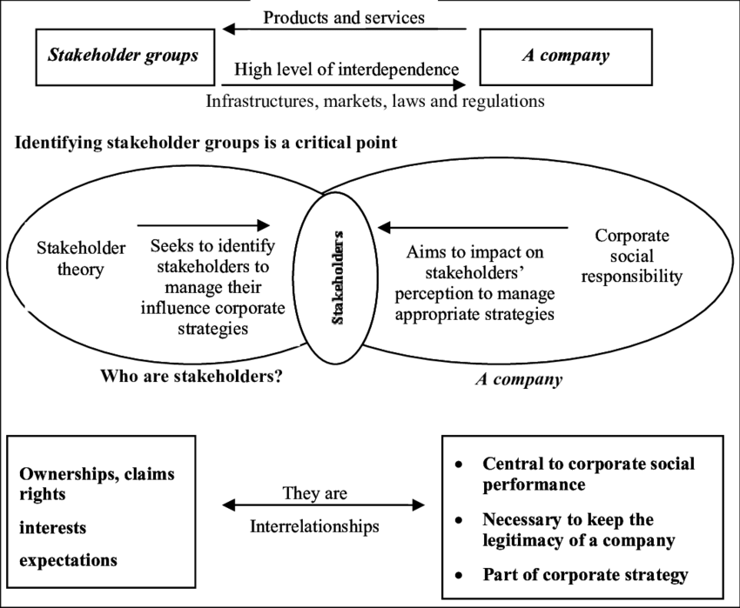
DEVELOPING AN EFFECTIVE ETHICS PROGRAM
THE RESPONSIBILITY OF THE CORPORATION TO STAKEHOLDERS

Slide 4
DEVELOPING AN EFFECTIVE ETHICS PROGRAM
The Responsibility of the Corporation to Stakeholders
Increasingly, corporations are viewed not merely as profit-making entities but also as moral agents accountable for their conduct to their stakeholders, including employees, investors, suppliers, governments, and customers.
Companies are more than the sum of their parts or participants.
Because corporations are chartered as citizens of a state and/or nation, they generally have the same rights and responsibilities as individuals.
Through legislation and court precedents, society holds companies accountable for the conduct of their employees as well as for their decisions and the consequences of those decisions.

Slide 5
DEVELOPING AN EFFECTIVE ETHICS PROGRAM
The Responsibility of the Corporation to Stakeholders
Coverage in the news media of specific issues such as employee benefits, executive compensation, defective products, competitive practices, and financial reporting contributes to a firm’s reputation as a moral agent.
As moral agents, companies are required to obey the laws and regulations that define acceptable business conduct.
However, it is important to acknowledge that they are not human beings who can think through moral issues. Because companies are not human, laws and regulations are necessary to provide formal structural restraints and guidance.
Employees have an ethical obligation to responsibly think through complex ethical issues to contribute to the ethical conduct of the corporation as a whole.

Slide 6
DEVELOPING AN EFFECTIVE ETHICS PROGRAM
The Responsibility of the Corporation to Stakeholders
Though not a person, a corporation can be considered a moral agent in society, created to perform specific social functions.
It is therefore responsible to society for its actions.
Because corporations have characteristics of agents, responsibility for ethical behavior is assigned to them as legal entities, as well as to individuals or work groups they employ.
A corporate culture without values and appropriate communication about ethics can facilitate individual misconduct.

Slide 7
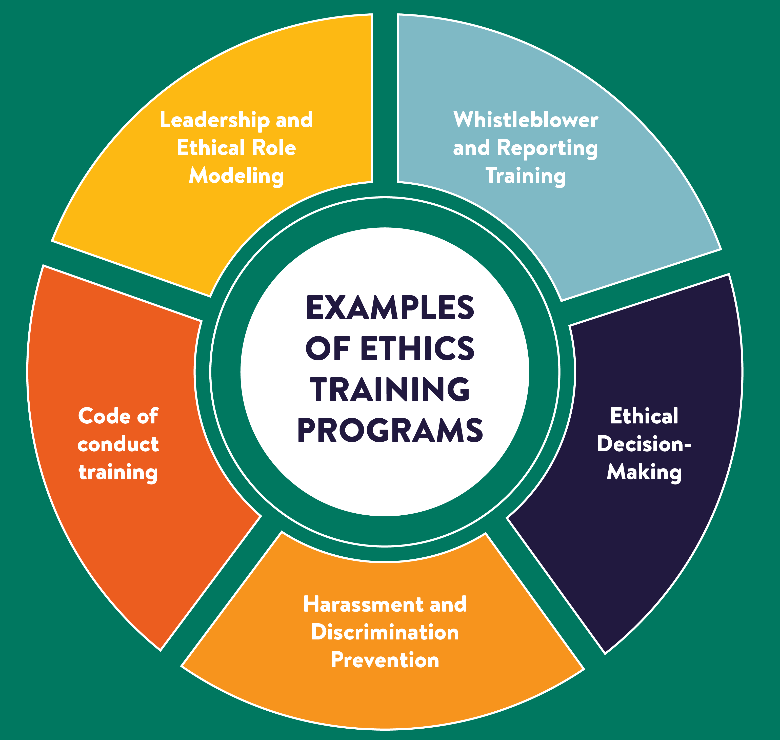
DEVELOPING AN EFFECTIVE ETHICS PROGRAM
THE NEED FOR ORGANIZATIONAL ETHICS PROGRAMS

Slide 8
DEVELOPING AN EFFECTIVE ETHICS PROGRAM
The Need For Organizational Ethics Programs
To understand why companies need to develop ethics programs, judge whether each of the following actions is unethical versus illegal:
You want to skip work to go to a baseball game, but you need a doctor’s excuse. You make up symptoms so that your insurance company pays for the doctor’s visit. (unethical, illegal)•
While having a latte at a local cafe, you run into an acquaintance who works as a salesperson for a competing firm. You wind up chatting about future product prices. When you get back to your office, you tell your supervisor what you heard. (unethical, illegal).

Slide 9
DEVELOPING AN EFFECTIVE ETHICS PROGRAM
The Need For Organizational Ethics Programs
To understand why companies need to develop ethics programs, judge whether each of the following actions is unethical versus illegal:
You are fired from your company, but before leaving for a position with another company, you copy a confidential list of client names and telephone numbers you compiled for your former employer. (unethical, illegal)
You receive a loan from your parents to make the down payment on your first home, but when describing the source of the down payment on the mortgage application, you characterize it as a gift. (unethical, illegal).
Your manager asks you to book some sales revenue from the next quarter into this quarter’s sales report to help the firm reach target sales figures. You agree to do so. (unethical, illegal).

Slide 10
DEVELOPING AN EFFECTIVE ETHICS PROGRAM
The Need For Organizational Ethics Programs
To promote legal and ethical conduct, an organization should develop a program by establishing, communicating, and monitoring the ethical values and legal requirements that characterize its history, culture, industry, and operating environment.
Without such programs, uniform standards, and policies of conduct, it is difficult for employees to determine what behaviors are acceptable within a company.
Although there are no universal standards that can be applied to organizational ethics programs, most companies develop codes, values, or policies to provide guidance on business conduct.

Slide 11
DEVELOPING AN EFFECTIVE ETHICS PROGRAM
The Need For Organizational Ethics Programs
If a company’s leadership fails to provide the vision and support needed for ethical conduct, then an ethics program will not be effective.
Ethical responsibility is not something to be delegated to lower-level employees.
To satisfy the public’s escalating demands for ethical decision making, companies need to develop plans and structures for addressing ethical considerations.
Some directions for improving ethics are mandated through regulations, but companies must be willing to put in place a system for implementing values and ethics that exceeds the minimum requirements.

Slide 12
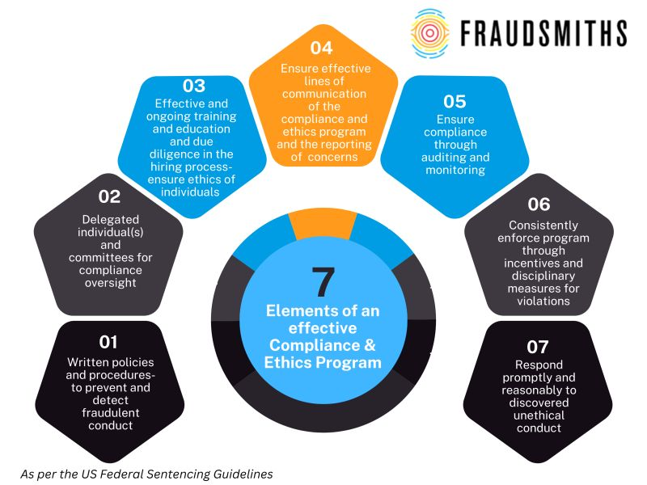
DEVELOPING AN EFFECTIVE ETHICS PROGRAM
AN EFFECTIVE ETHICS PROGRAM

Slide 13
DEVELOPING AN EFFECTIVE ETHICS PROGRAM
An Effective Ethics Program
A company must have an effective ethics program to ensure all employees understand its values and comply with the policies and codes of conduct.
If the culture encourages unethical conduct, then misconduct is likely to occur even if the company has ethical guidelines in place.
Because we come from diverse business, educational, and family backgrounds, it cannot be assumed that we know how to behave appropriately when we enter a new organization or job.

Slide 14
DEVELOPING AN EFFECTIVE ETHICS PROGRAM
An Effective Ethics Program
An Ethics Program Can Help Avoid Legal Problems
Some corporate cultures provide opportunities for or reward unethical conduct because management is not sufficiently concerned about ethics or the company has failed to comply with the minimum requirements of the Federal Sentencing Guidelines for Organizations (FSGO; Table 8-1).
Companies may face penalties and the loss of public confidence if one of their employees breaks the law.
Table 8-2 shows the percentage of CFOs and other financial people who would justify unethical and illegal behavior.
Table 8-3 reports on the specific actions these individuals would take.

Slide 15
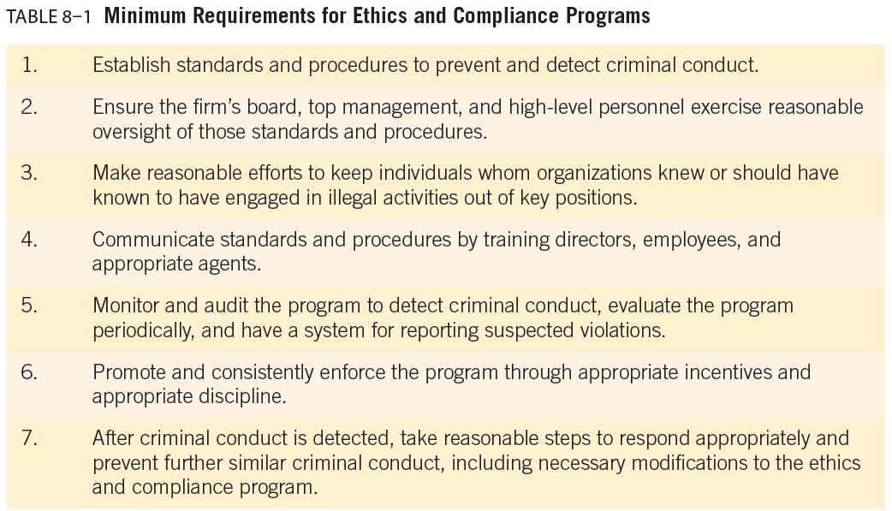
DEVELOPING AN EFFECTIVE ETHICS PROGRAM

Slide 16
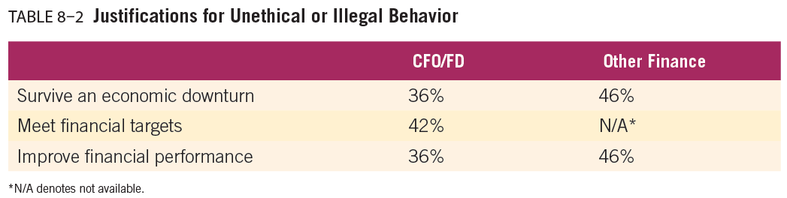
DEVELOPING AN EFFECTIVE ETHICS PROGRAM

Slide 17
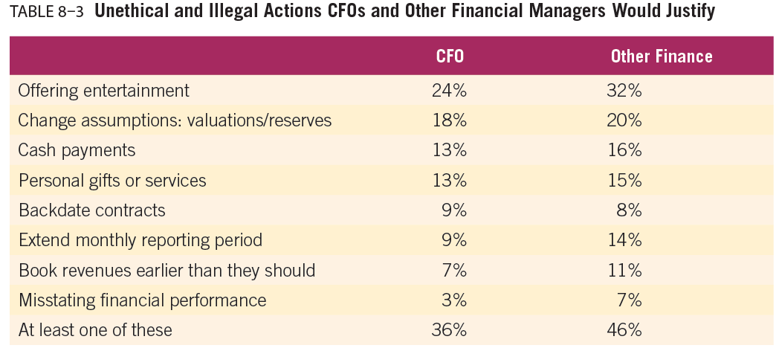
DEVELOPING AN EFFECTIVE ETHICS PROGRAM

Slide 18
DEVELOPING AN EFFECTIVE ETHICS PROGRAM
An Effective Ethics Program
Values versus Compliance Programs
No matter what their goals, ethics programs are developed as organizational control systems, with the aim of creating predictability in employee behavior.
Two types of control systems can be created.
A compliance orientation creates order by requiring employees to identify with and commit to specific required conduct. It uses legal terms, statutes, and contracts that teach employees the rules and penalties for noncompliance.
A values orientation strives to develop shared values.
Although penalties are attached, the focus is more on an abstract core of ideals such as accountability and commitment.

Slide 19
DEVELOPING AN EFFECTIVE ETHICS PROGRAM
An Effective Ethics Program
Values versus Compliance Programs
The advantage of a value’s orientation is that it gives employees a clearly defined basis on which to make decisions, one in which fairness, compassion, respect, and transparency are paramount.
At the same time, diversity in employees’ experience and personal values requires explicit communication and training on subject matter areas such as financial reporting, use of company resources, and intellectual property.
Establishing compliance standards helps employees understand the rules of conduct when there are identified risks.

Slide 20
DEVELOPING AN EFFECTIVE ETHICS PROGRAM
An Effective Ethics Program
Values versus Compliance Programs
Research into compliance- and values-based approaches reveals both types of programs can interact or work toward the same end, but a values orientation has the added benefit of sparking ethical reasoning among employees.
Values-based programs increase employees’ awareness of ethics at work, integrity, willingness to deliver information to supervisors, use of reporting mechanisms, and perception that ethical decisions are being made.
Compliance-based programs are linked to employees’ awareness of ethical risks at work and a clear understanding of rules and expectations that facilitate decision making.

Slide 21
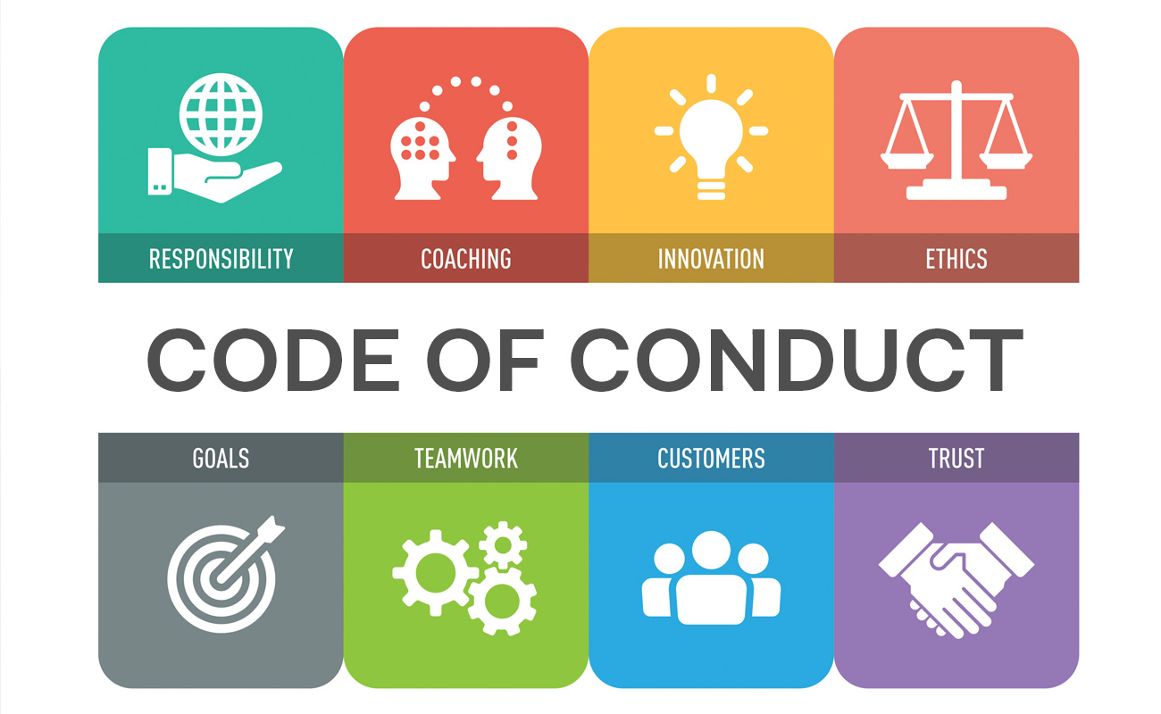
DEVELOPING AN EFFECTIVE ETHICS PROGRAM
CODES OF CONDUCT

Slide 22
DEVELOPING AN EFFECTIVE ETHICS PROGRAM
Codes of Conduct
The perception of business accountability has changed over the years; expectations for organizational codes of ethics have grown.
Today, society expects to see employees adhere to ethical principles and standards specified through company ethics programs.
Most companies begin the process of establishing organizational ethics programs by developing codes of conduct or formal statements that describe what an organization expects of its employees.
Such statements may take three different forms: 1. a code of ethics, 2. a code of conduct, and 3. a statement of values.

Slide 23
DEVELOPING AN EFFECTIVE ETHICS PROGRAM
1. Code of ethics
A code of ethics is the most comprehensive and consists of general statements, sometimes altruistic or inspirational, that serve as principles and as the basis for rules of conduct.
A code of ethics generally specifies methods for reporting violations, disciplinary action for violations, and a structure of due process.
Table 8-4 describes some benefits of having a comprehensive code of ethics.
A code of conduct is a written document that may contain some inspirational statements but mainly specifies acceptable and unacceptable types of behavior.

Slide 24
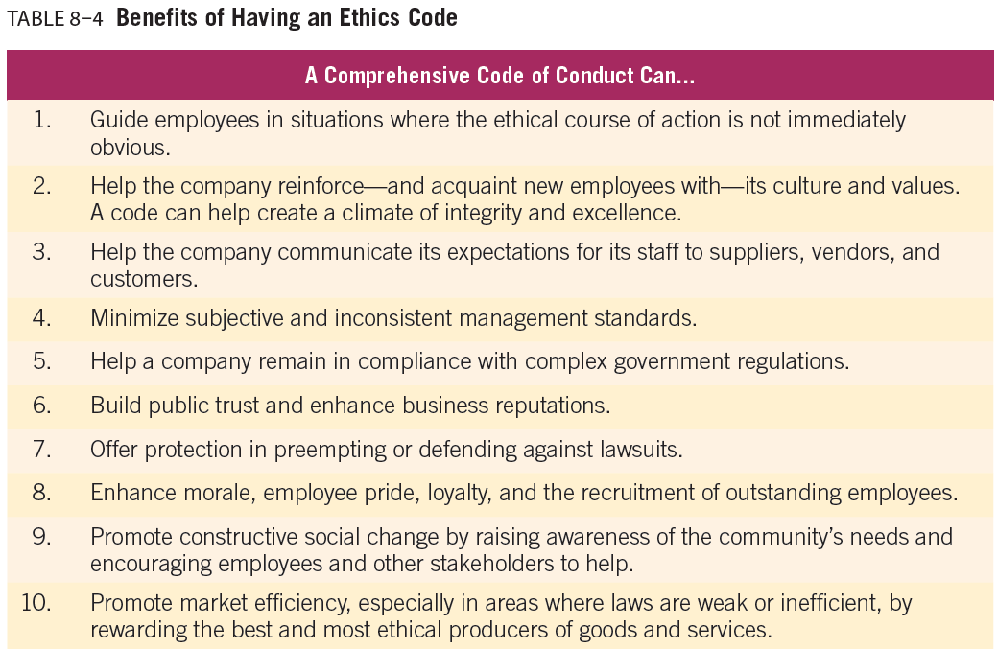
DEVELOPING AN EFFECTIVE ETHICS PROGRAM

Slide 25
DEVELOPING AN EFFECTIVE ETHICS PROGRAM
1. Code of ethics
Some of the key reasons that codes of ethics fail:
(1) Top code is not promoted, and employees do not read it;
(2) Top code is not easily accessible;
(3) Top code is written too legally and therefore is not understandable by average employees;
(4) Top code is written too vaguely, providing no accurate direction; and
(5) Top management never refers to the code in body or spirit.

Slide 26
DEVELOPING AN EFFECTIVE ETHICS PROGRAM
3. Statement of values
The final type of ethical statement is a statement of values that serves the general public and also addresses distinct groups, such as stakeholders.
Value statements are conceived by management and are fully developed with input from all stakeholders.
Despite the distinction made in this book between a code of ethics and a values statement, it is important to recognize that these terms are often used interchangeably.
Table 8-5 shows factors to consider when developing and implementing a code of ethics.

Slide 27
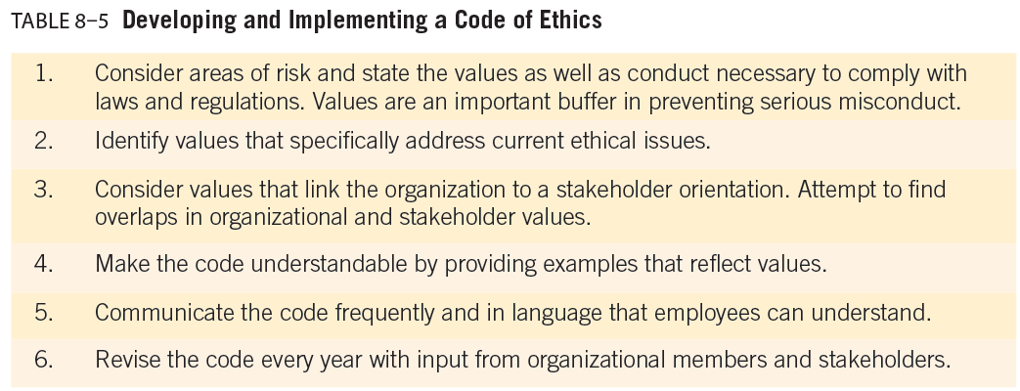
DEVELOPING AN EFFECTIVE ETHICS PROGRAM

Slide 28
DEVELOPING AN EFFECTIVE ETHICS PROGRAM
Codes of Conduct
Codes of ethics may address a variety of situations, from internal operations to sales presentations and financial disclosure practices.
Research found that corporate codes of ethics often contain about six core values or principles in addition to more detailed descriptions and examples of appropriate conduct. The six values are:
(1) trustworthiness,
(2) respect,
(3) responsibility,
(4) fairness,
(5) caring, and
(6) citizenship

Slide 29
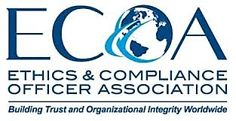
DEVELOPING AN EFFECTIVE ETHICS PROGRAM
ETHICS OFFICERS

Slide 30
DEVELOPING AN EFFECTIVE ETHICS PROGRAM
Ethics Officers
Organizational ethics programs must have oversight by high-ranking persons known to respect legal and ethical standards.
These individuals—often referred to as ethics officers— are responsible for managing their organizations’ ethics and legal compliance programs.
Ethics officers are also responsible for knowing thousands of pages of relevant regulations as well as communicating and reinforcing values that build an ethical corporate culture.

Slide 31
DEVELOPING AN EFFECTIVE ETHICS PROGRAM
Ethics Officers
Ethics officers are usually responsible for:
Assessing the needs and risks an organization-wide ethics program must address
Developing and distributing a code of conduct or ethics.
Conducting training programs for employees.
Establishing and maintaining a confidential service to answer employees’ questions about ethical issues.
Making sure the company is in compliance with government regulations.
Monitoring and auditing ethical conduct.
Taking action on possible violations of the company’s code, and
Reviewing and updating the code.

Slide 32

DEVELOPING AN EFFECTIVE ETHICS PROGRAM
ETHICS TRAINING AND COMMUNICATION

Slide 33
DEVELOPING AN EFFECTIVE ETHICS PROGRAM
Ethics Training and Communication
A major step in developing an effective ethics program is implementing a training program and communication system to educate employees about the firm’s ethical standards.
Training programs can also make employees aware of available resources, support systems, and designated personnel who can assist them with ethical and legal advice.
Training can empower employees to ask tough questions and make ethical decisions.
Many organizations are now incorporating ethics training into their employee and management development training efforts

Slide 34
DEVELOPING AN EFFECTIVE ETHICS PROGRAM
Ethics Training and Communication
Training and communication initiatives should reflect the unique characteristics of an organization: its size, culture, values, management style, and employee base.
To be successful, business ethics programs should educate employees about formal ethical frameworks and models for analyzing business ethics issues.
Then, employees can base ethical decisions on their knowledge of choices rather than on emotions.
A key component of managing an effective and efficient ethics and compliance program is a firm grasp of techniques that clearly 1. communicate the company’s values, culture, and policies for dealing with ethical issues to employees.

Slide 35
DEVELOPING AN EFFECTIVE ETHICS PROGRAM
Ethics Training and Communication
Another training device is the 2. behavioral simulation, which gives participants a short, hypothetical ethical issue situation to review.
Each participant is assigned a role within a hypothetical organization and provided with varying levels of information about the scenario. Participants must then interact to develop recommended courses of action representing short-, mid-, and long-term considerations.
These exercises help participants gain awareness of the ethical, legal, and social dimensions of business decision making; develop analytical skills for resolving ethical issues; and gain exposure to the complexity of ethical decision making in organizations. Table 8-6 lists the goals for successful ethics training.

Slide 36
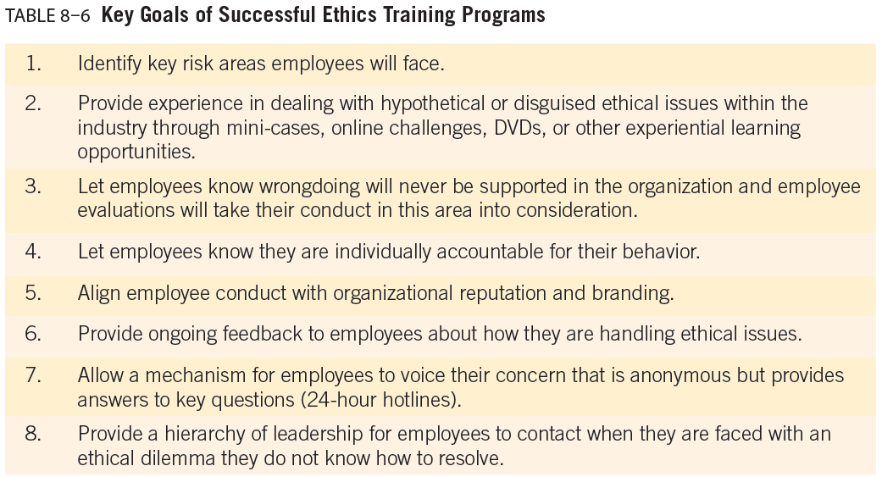
DEVELOPING AN EFFECTIVE ETHICS PROGRAM

Slide 37
DEVELOPING AN EFFECTIVE ETHICS PROGRAM
Ethics Training and Communication
When measuring the effectiveness of an ethics program, it is important to get input from employees.
Employee surveys and the incorporation of ethics measurements in performance appraisal systems are two ways to help determine the effectiveness of a firm’s ethics training.
If ethical performance is not a part of regular performance appraisals, employees get the message that ethics is not an important component of decision-making in their company.
For ethics training to make a difference, employees must understand why it is conducted, how it fits into the organization, and what their own role in implementing it is.

Slide 38

DEVELOPING AN EFFECTIVE ETHICS PROGRAM
COMMON MISTAKES IN DESIGNING AND IMPLEMENTING AN ETHICS PROGRAM

Slide 39
DEVELOPING AN EFFECTIVE ETHICS PROGRAM
Common Mistakes In Designing And Implementing An Ethics Program
Common Mistakes In Designing And Implementing An Ethics Program:
Lack of Clear Goals: Many companies fail to define the objectives of their ethics programs, such as preventing unethical behavior, improving stakeholder relationships, and fostering a unified corporate culture.
Unrealistic or Non-Measurable Objectives: Programs often lack measurable goals or employee input, making it difficult to assess effectiveness.
Lack of Senior Management Commitment: Without top-level leadership support and board oversight, maintaining an ethical culture is challenging.

Slide 40
DEVELOPING AN EFFECTIVE ETHICS PROGRAM
Common Mistakes In Designing And Implementing An Ethics Program
Common Mistakes In Designing And Implementing An Ethics Program:
Complex and Legalistic Program Materials: Ethics materials written mainly by lawyers can be confusing; employee-friendly content with practical tools is essential.
Failure to Adapt Internationally: Using a U.S.-centric program globally can cause misunderstandings; involving local personnel early ensures alignment with international standards.
Overly Lecture-Based Training: Passive lectures are ineffective; interactive methods such as case studies and group exercises improve retention.

Slide 41



Thank You

