Slide 1

Writing in Organizations
Prepared by Dr. Adam Yagoub
Lecture 1
MGM 202
Writing and Your Career

Slide 2
Course Outline
Lecture 1: Getting Started: Writing and Your Career.
Lecture 2: The Writing Process and Collaboration at Work.
Lecture 3: Writing Routine Business Correspondence.
Lecture 4: Writing Letters: Some Basics for Communicating with Audiences Worldwide.
Lecture 5: How to Get a Job: Searches, Dossiers, Portfolios, Résumés, Letters, and Interviews.
Lecture 6: Designing Successful Documents, Visuals, and Websites.
Lecture 7: Writing Instructions and Procedures.
Lecture 8: Writing Effective Short Reports.
Lecture 9: Writing Proposals.
Lecture 10: Writing Careful Long Reports.

Slide 3

Lecture 1
Lecture Outline
1- Writing—An Essential Job Skill.
2- Writing for the Global Marketplace.
3- Four Keys to Effective Writing.
4- Characteristics of Job-Related Writing.
5- Ethical Writing in the Workplace.
6- Successful Employees Are Successful Writers

Slide 4
Lecture 1
Writing and Your Career
1- Writing—An Essential Job Skill:
Writing is a part of every job, from your initial letter of application conveying first impressions to memos, e-mail, blogs, letters, websites, proposals, instructions, and reports. Writing keeps businesses moving. It allows employees to communicate with one another, with management, and with the customers, clients, and agencies a company must serve to stay in business.

Slide 5
Lecture 1
Writing and Your Career
Clearly, then, writing is an essential skill for employees and employers alike. According to Don Bagin, a communications consultant, most people need an hour or more to write a typical business letter. Mistakes in letters are costly for workers as well for as employers. As David Noble cautions in his book Gallery of Best Cover Letters, “The cost of a cover letter (in applying for a job, for instance) might be as much of a third of a million dollars—even more if you figure the amount of income and benefits you don’t receive, say, in a 10 year period for a job you don’t get because of an error that got you screened out.”

Slide 6
Lecture 1
Writing and Your Career
Chapter 1 gives you some basic information about writing in the global marketplace and raises major questions you need to ask yourself to make the writing process easier and the results more effective. It also describes the basic functions of on-the-job writing and introduces you to one of the most important requirements in the business world—writing ethically.

Slide 7
Lecture 1
Writing and Your Career
2- Writing for the Global Marketplace:
The Internet, e-mail, teleconferencing, blogging, and e-commerce have shrunk the world into a global village. Accordingly, it is no longer feasible to think of business in exclusively regional or even national terms. Many companies are multinational corporations with offices throughout the world. In fact, many U.S. businesses are branches of international firms. A large, multinational corporation may have its products designed in Japan; manufactured in Bangladesh; and sold in Detroit, Atlanta, and Los Angeles. Its stockholders may be in Mexico City as well as Saudi Arabia—in fact, anywhere. In our global economy, every country is affected by every other one.

Slide 8
Lecture 1
Writing and Your Career
- Competing for International Business
Companies must compete for international sales to stay in business. Every business, whether large or small, has to appeal to diverse international markets to be competitive. Each year a larger share of the U.S. gross national product (GNP) depends on global markets in China, Saudi Arabia, India, Eastern Europe, and elsewhere. Some U.S. firms estimate that 40 to 50 percent of their business is conducted outside of the United States. Wal-Mart, for example, has expanded into hundreds of stores in mainland China, and General Electric has opened plants in more than 60 countries.

Slide 9
Lecture 1
Writing and Your Career
- Communicating with Global Audiences
To be a successful employee in this highly competitive global market, you have to communicate clearly and diplomatically with a host of readers from different cultural backgrounds. As a result, don’t presume that you will be writing only to native speakers of American English. As a vital part of your job, you may be communicating with readers in Singapore, Jamaica, and South Africa, for example, who speak varieties of English quite different from American English. You will also very likely be writing to readers for whom English is not their first (or native) language. These individuals, who may reside either in the United States or in a foreign country, will constitute a large and important audience for your work.

Slide 10
Lecture 1
Writing and Your Career
- Seeing the World Through Their Eyes
Writing to these international readers with proper business etiquette means first learning about their cultural values and assumptions—what they value and also what they regard as communication taboos. They may not conduct business exactly the way it is done in the United States, and to think they should is wrong. Your international audience is likely to have different expectations of how they want a letter addressed or written to them, whether they allow you to use their first name, how they prefer a business meeting to be conducted, or how they think questions should be framed and asked and agreements reached.

Slide 11
Lecture 1
Writing and Your Career
Their concepts of time, family, money, the environment, managers, and communication itself may be nothing like those in the United States. Visuals, including icons, which are easily understood in the United States, may be baffling elsewhere in the world. If you misunderstand your audience’s culture by inadvertently writing, creating, saying or illustrating something inappropriate can cost your company a contract and you your job.

Slide 12
Lecture 1
Writing and Your Career
- Cultural Diversity at Home
Cultural diversity exists inside as well as outside the company you work for. Don’t conclude that your boss or co-workers are all native speakers of English, either, or that they come from the same cultural background that you do.

Slide 13
Lecture 1
Writing and Your Career
3- Four Keys to Effective Writing:
Effective writing on the job is carefully planned, thoroughly researched, and clearly presented. Its purpose is always to accomplish a specific goal and to be as persuasive as possible. or a commissioned report to the president of the company, your writing will be more effective if you ask yourself these four questions:

Slide 14
Lecture 1
Writing and Your Career
1. Who will read what I write? (Identify your audience.)
2. Why should they read what I write? (Establish your purpose.)
3. What do I have to say to them? (Formulate your message.)
4. How can I best communicate? (Select an appropriate style and tone.)

Slide 15
Lecture 1
Writing and Your Career
The questions who? why? what? and how? do not function independently; they are all related. You write (1) for a specific audience (2) with a clearly defined purpose in mind (3) about a topic your readers need to understand (4) in language appropriate for the occasion. Once you answer the first question, you are off to a good start toward answering the other three.

Slide 16
Lecture 1
Writing and Your Career
4- Characteristics of Job-Related Writing:
Job-related writing characteristically serves six basic functions: (1) providing practical information, (2) giving facts rather than impressions, (3) supplying visuals to clarify and condense information, (4) giving accurate measurements, (5) stating responsibilities precisely, and (6) persuading and offering recommendations. These six functions tell you what kind of writing you will produce after you successfully answer the who? why? what? and how?

Slide 17
Lecture 1
Writing and Your Career
1. Providing Practical Information.
2. Giving Facts, Not Impressions.
3. Supplying Visuals to Clarify and Condense Information
Visuals are indispensable partners with your words to convey information to your readers. On-the-job writing makes frequent use of visuals such as tables, charts, photographs, flow charts, and drawings to clarify and condense information. Thanks to various software packages, you can easily create and insert visuals into your writing.
Visuals play an important role in the workplace.

Slide 18
Lecture 1
Writing and Your Career
4. Giving Accurate Measurements.
5. Stating Responsibilities Precisely
Because it is directed to a specific audience, job-related writing should make absolutely clear what it expects of, or can do for, that audience. Misunderstandings waste time, cost money and can result in injuries. Directions on order forms, for example, should indicate how and where information is to be listed and how it is to be routed and acted on.

Slide 19
Lecture 1
Writing and Your Career
6. Persuading and Offering Recommendations
Persuasion is a crucial part of writing on the job. In fact, it is one of the most crucial skills you can learn in the business world. Persuasion means trying to convince your reader(s) to accept your ideas, approve your recommendations, or order your products. Convincing your reader to accept your interpretation or ideas is at the heart of the world of work, whether you are writing to someone outside or inside your company.

Slide 20
Lecture 1
Writing and Your Career
- Writing Persuasively to Clients and Customers
Much of your writing in the business world will promote your company’s image by persuading customers and clients (a) to buy a product or service or (b) to adopt a plan of action endorsed by your employer. You will have to convince readers that you (and your company)—your products and services—can save them time and money, increase efficiency, reduce risks, or improve their image, and that you can do this better than your competitors can.

Slide 21
Lecture 1
Writing and Your Career
Expect also to be called on to write convincingly about your company’s image, as in the case of product recalls or discontinuances , customer complaints, or damage control after a corporate mistake affecting the environment. You may also have to convince customers around the globe that your company respects cultural diversity and upholds specific ethnic values.

Slide 22
Lecture 1
Writing and Your Career
A large part of persuasion, too, is supporting your claims with evidence. You will have to conduct research; provide logical arguments; supply appropriate facts, examples, and statistics; and identify the most relevant information for your particular audience(s). Notice how the advertisement in Figure 1.6 below offers a bulleted list of persuasive reasons—based on cost, time, safety, efficiency, and convenience— to convince correctional officials that they should use General Medical’s services rather than those of a hospital or clinic.

Slide 23
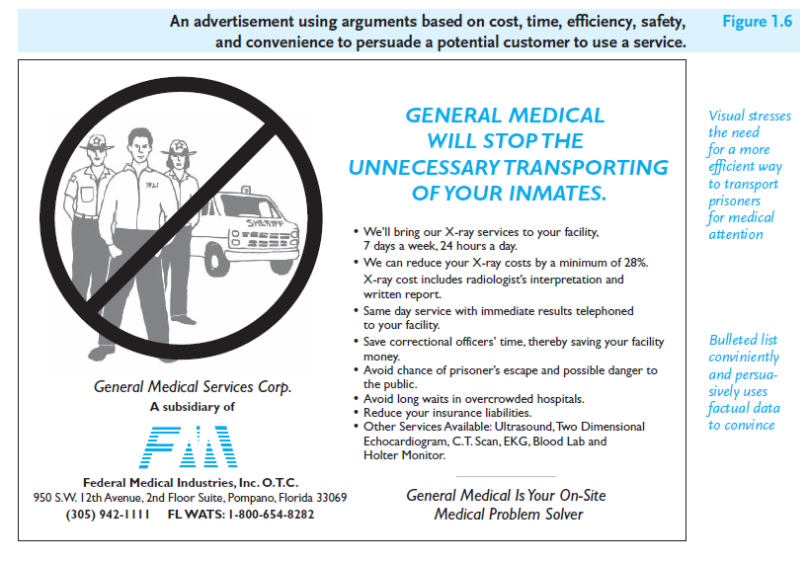
Lecture 1
Writing and Your Career

Slide 24
Lecture 1
Writing and Your Career
- Writing Persuasively In-House
As much as 60 percent of your writing may be directed to individuals you work with and for. In fact, your very first job-related writing will likely be a persuasive letter of application to obtain a job interview with a potential employer.
On the job, you may have to persuade a manager to buy a new technology or lobby for a change in your office or department. To be successful, you will have to evaluate various products or options by studying, analyzing, and deciding on the most relevant one(s) for your boss. Your reader will expect you to offer clear-cut, logical, and convincing reasons for your choice, backed up with persuasive facts.

Slide 25
Lecture 1
Writing and Your Career
As part of your job, too, you will be asked to write convincing memos, e-mails, letters, blogs, and websites to boost the morale of employees, encourage them to be more productive, and compliment them on jobs well done. You can also expect to write persuasively to explain and solve budget, safety, or marketing problems your company faces.

Slide 26
Lecture 1
Writing and Your Career
Figure 1.7 is a persuasive e-mail from an employee to a manager reporting a payroll mistake and persuading the reader to correct it. The e-mail contains many of the other characteristics of job-related writing we have discussed. Note how the writer provides factual, not subjective, information; attaches a time sheet (a type of visual); gives accurate details; and identifies her own and her immediate supervisor’s responsibilities. The writer’s tone is suitably polite yet direct.

Slide 27
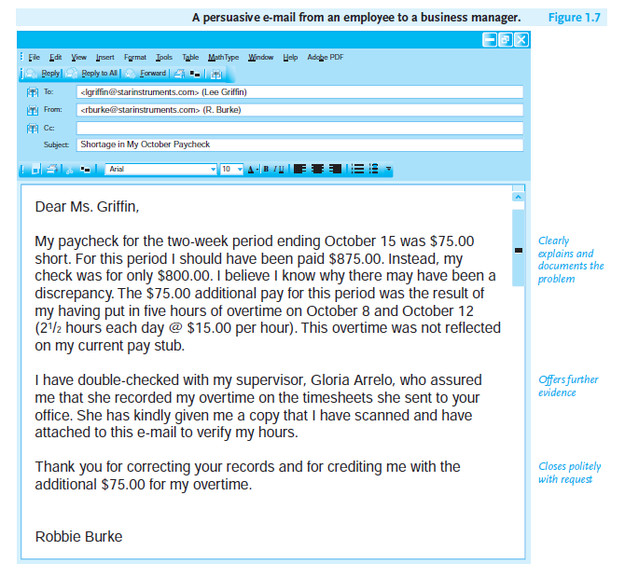
Lecture 1
Writing and Your Career

Slide 28
Lecture 1
Writing and Your Career
5- Ethical Writing in the Workplace:
One of your most important job responsibilities is to ensure that your writing and behavior are ethical. Writing ethically means choosing language that is right and fair, honest and just with your employer, co-workers, and customers. Your reputation and character plus your employer’s corporate image will depend on your following an ethical course of action. Many companies are proud of their ethical commitments to the environment, the community, and the global marketplace.

Slide 29
Lecture 1
Writing and Your Career
- Ethical Requirements on the Job
In the workplace, you will be expected to meet the highest ethical standards by fulfilling the following requirements:
■ Supplying honest and up-to-date information about yourself in your résumé and job applications.
■ Respecting co-workers, customers, and suppliers in conduct that avoids bullying, discrimination, or any other unfair or unprofessional behavior.

Slide 30
Lecture 1
Writing and Your Career
■ Refusing to use language that makes false claims or tries to deceive readers with ambiguous words, jargon, or misleading visuals.
■ Avoiding language that excludes others on the basis of gender, race, national origin, religion, age, physical ability, or sexual orientation.
■ Maintaining accurate and current records at work.
■ Complying with all local, state, and federal regulations.

Slide 31
Lecture 1
Writing and Your Career
■ Adhering to your profession’s code or standard of ethics, internal audits, licenses, and certificate requirements.
■ Following your company’s policies and procedures.
■ Honoring guarantees and warranties and meeting customers’ needs impartially.
■ Cooperating fairly and on a timely basis with your collaborative team.
■ Respecting all copyright obligations and privileges.

Slide 32
Lecture 1
Writing and Your Career
- Computer Ethics
Computer ethics are essential in the e-commerce world of work. A good rule to follow is never to do anything online that you wouldn’t do offline. Never use a company computer for any activity not directly related to your job. It would be grossly unethical to erase a computer program intentionally, violate a software licensing agreement, or misrepresent (by fabrication or exaggeration) the scope of a database. Also, posting anything that attacks a competitor, colleagues, your boss, or your company is considered unethical.

Slide 33
Lecture 1
Writing and Your Career
- Employers Insist On and Monitor Ethical Behavior
Ethical behavior is crucial to your success in the workplace. Your employer will insist that you are honest, show integrity, and exhibit loyalty in your professional relationships with clients, co-workers, supervisors, inspectors, and vendors.
To make sure you are acting responsibly on the job, employers can legally monitor your work—electronically, through cameras, or by personal visits. Some of these visits are not announced (such as the secret shopper who reports on the customer service he/she received at a store).

Slide 34
Lecture 1
Writing and Your Career
Employers can monitor the behavior of their employees for several reasons:
■ to determine if a worker is doing his/her job correctly
■ to identify wrongdoing on the employee’s part
■ to improve service, production, communication, transportation
■ to ensure legal compliance with state and federal codes
■ to heighten security measures

Slide 35
Lecture 1
Writing and Your Career
- Some Guidelines to Help You Reach Ethical Decisions
The workplace presents conflicts over who is right and who is wrong, what is best for the company and what is not, and whether a service or product should be changed and why. You will be asked to make a decision and justify it. While this book cannot cover all kinds of ethical problems, here are a few guidelines to help you respond ethically on the job.
1. Follow your conscience and “to thine own self be true.”
2. Be suspicious of convenient (and false) appeals that go against your beliefs.

Slide 36
Lecture 1
Writing and Your Career
3. Meet your obligations to your employer, your co-workers, your customers, and the global community.
4. Take responsibility for your actions. Saying “I do not know” when you do know can constitute a serious ethical violation.
5. Honor confidentiality at work. Never share sensitive/confidential information with individuals who are not entitled to see or hear it.
6. Document your work carefully and honestly. Rely on hard evidence: documentation, tests, testimony, valid precedents.

Slide 37
Lecture 1
Writing and Your Career
7. Keep others in the loop. Confer regularly with your collaborative writing team and report to your boss as often as you are instructed to give progress reports and to alert him or her about problems.
8. Treat company property respectfully. Use company supplies, networks/ computers, equipment, technology, and vehicles responsibly and only for work-related business.
9. Think green in the workplace.
10. Weigh all sides before you commit to a conclusion.

Slide 38
Lecture 1
Writing and Your Career
- Writing Ethically on the Job
Your writing as well as your behavior must be ethical. Words, like actions, have implications and consequences. If you slant your words to conceal the truth or gain an unfair advantage, you are not being ethical. False reporting and advertising are false writing. Bias and omission of facts are wrong. Strive to be fair, reliable, and accurate in reporting events, statistics, and trends.

Slide 39
Lecture 1
Writing and Your Career
6- Successful Employees Are Successful Writers:
As this chapter has stressed, being a successful employee means being a successful writer at work. The following guidelines, which summarize the key points of this chapter, will help you to be both.
1. Know your job—assignments, roles, responsibilities, goals, what you need to write, and what you shouldn’t, and to whom.

Slide 40
Lecture 1
Writing and Your Career
2. Analyze your audience’s needs and what they will expect to find in your written work.
3. Write clearly and appropriately for your international readers.
4. Respect the cultural diversity of co-workers, managers, customers, and vendors whether they live in the United States or in another country.
5. Make sure your written work is accurate, relevant, and practical, and include culturally appropriate visuals to help readers understand your message.

Slide 41
Lecture 1
Writing and Your Career
6. Document, document, document. Submit everything you write with clear-cut evidence based on factual details and persuasive, logical interpretations.
7. Keep your computer safe from viruses and other computer emergencies.
8. Be prepared to give and to receive feedback from co-workers, managers, and customers to meet all deadlines.
9. Follow your company’s policy, and promote your company’s image and traditions.
10. Be ethical in what you say, write, illustrate, and do.

Slide 42

Lecture 1
Writing and Your Career
References:
Successful Writing at Work, Concise Third Edition,
By: Philip C. Kolin
University of Southern Mississippi
Chapter 1

