Slide 1


System Administration (2)
IT401
Prepared by
Dr. Ahmed El-Douh
Lecture 4

Slide 2



System Administration 2
Lecture 4
IT401
Managing Text Files, Users, and Password Policies
Prepared by
Dr. Ahmed El-Douh

Slide 3
Objectives
Upon completion of this lecture, you will be able to:
  Learn how to create, view, and edit text files using command output or a text editor.
  Understand how to manage local users and groups on the system.
  Gain knowledge of local password policies, including creation, management, and deletion of users/groups.

Slide 4
Chapter
Outlines
04
Part 1: Create, view, and edit text files
  • Manage text files from command output or in a text editor.
Part 2: Manage local users and groups
• Create, manage, and delete local users and groups, as well as administer local password policies.

Slide 5


Chapter
04
Create, view, and edit text files

Slide 6
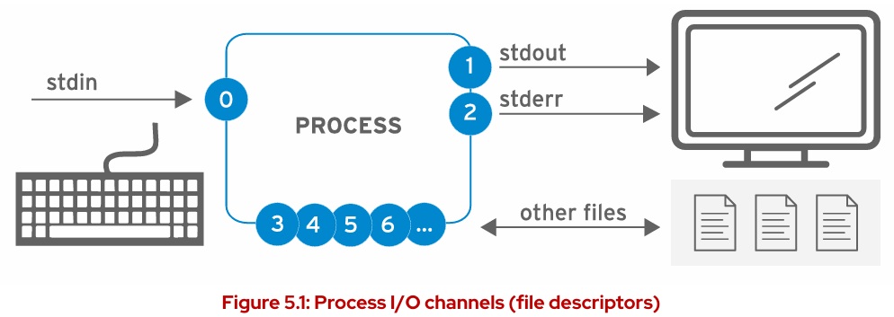
Standard Input, Standard Output, and Standard Error
A running program, or process, needs to read input from somewhere and write output either to the screen or to files. When a command is run from the shell prompt, it normally receives its input from the keyboard and sends its output to the terminal window.
A process uses numbered channels called file descriptors to get input and send output.
Every process will have at least three file descriptors to start with:
  Standard Input (stdin) - Channel 0: Reads input from the keyboard.
  Standard Output (stdout) - Channel 1: Sends normal output to the terminal.
  Standard Error (stderr) - Channel 2: Sends error messages to the terminal.
  If a program opens separate connections to other files, it may use higher-numbered file descriptors (channel 3, 4, 5, etc.).

Slide 7
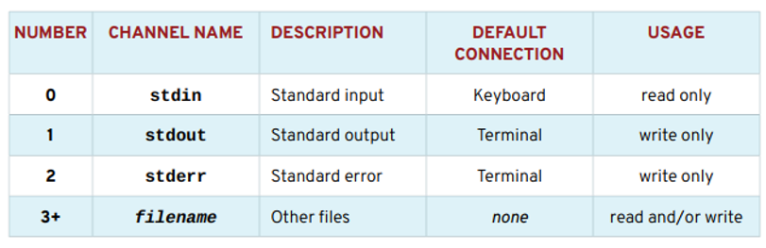
Channels (File Descriptors)

Slide 8
Redirecting Output to a File
Core Concept: I/O Redirection
  Definition: Changes the destination of a process's output and errors.
  The process reads from or writes to files instead of the keyboard or terminal.
  Key Uses:
    Save messages and command output to a file.
    Discard unwanted output or errors (prevent them from being displayed or saved).
2. Handling Standard Output (stdout)
  Redirecting stdout suppresses output from appearing on the terminal.
  File Creation: If the destination file doesn't exist, it is created.
  Content Replacement: If the file exists, redirection overwrites the file's contents (it does not append).
3. Discarding Output & Standard Error (stderr)
  To quietly discard a process's output, redirect it to the special file: /dev/null.
  Crucial Point: Redirecting only stdout does NOT suppress stderr (standard error) messages from displaying on the terminal.

Slide 9
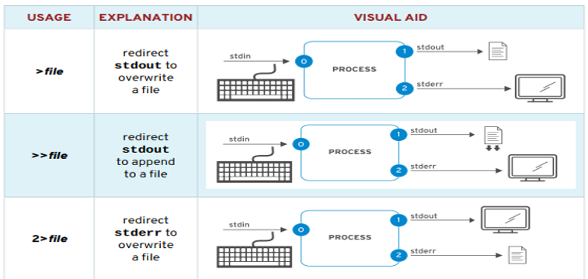
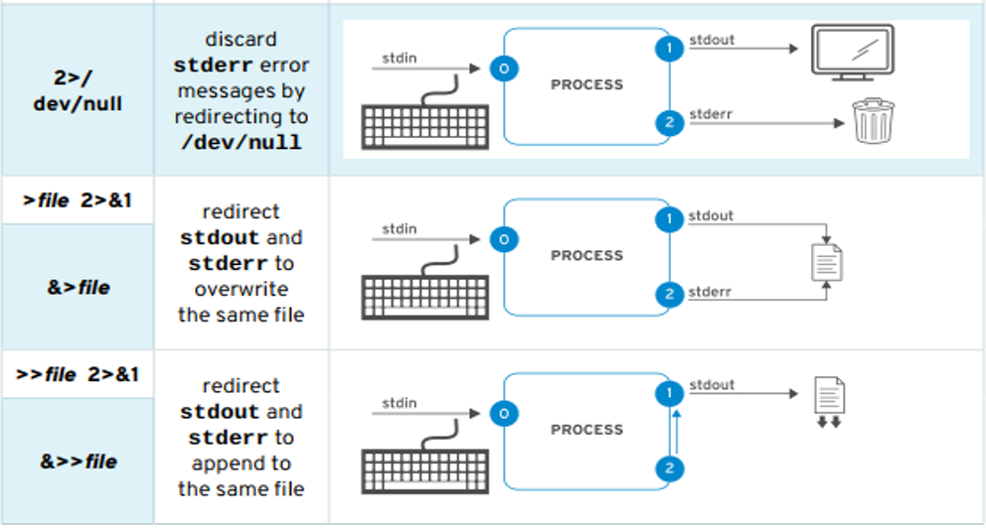
Output Redirection Operators

Slide 10
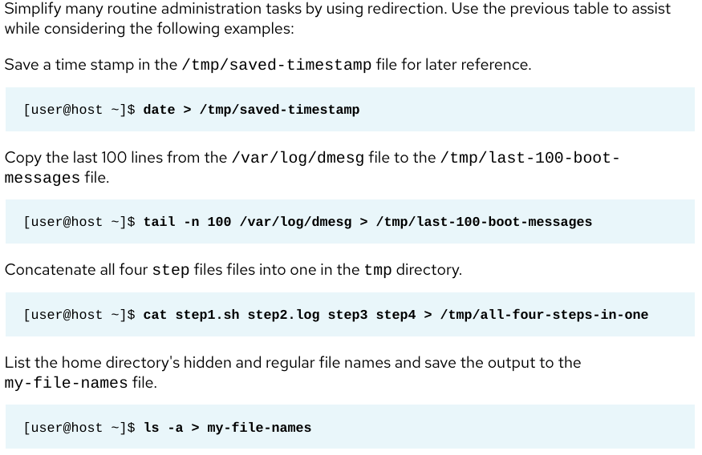
Examples for Output Redirection

Slide 11
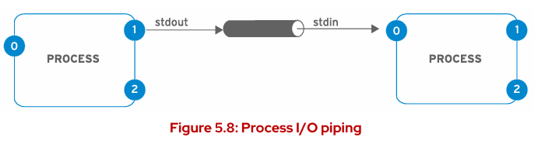
Construct Pipelines
Core Concept: Data Flow → Terminal
  A Pipeline is a sequence of two or more commands separated by the Vertical Bar (∣) character.
  Data Flow: Data "flows" through the pipeline, where each command manipulates or formats the output before it reaches the terminal.
How the Pipe (∣) Works
  The Pipe (∣) character connects the commands.
  It takes the Standard Output (stdout) of the first command and connects it directly to the Standard Input (stdin) of the next command.
  Analogy: Think of it as a factory conveyor belt where the output of one station becomes the raw material for the next.
Pipelines are used to manipulate and format data efficiently using multiple processes before final output.

Slide 12
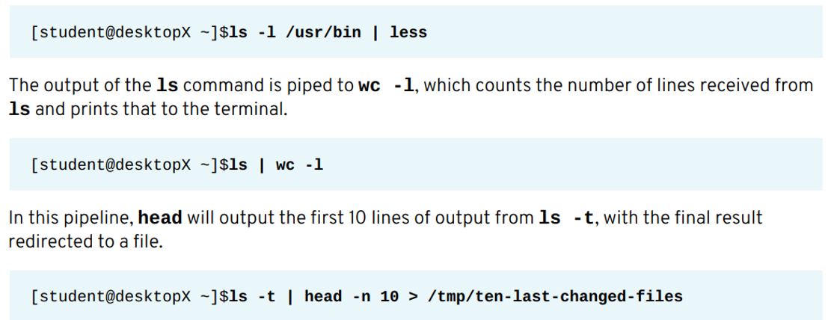
Pipeline Examples

Slide 13

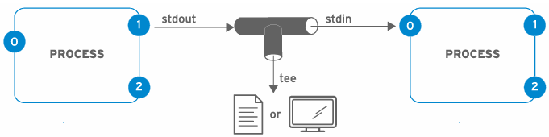

Pipelines, Redirection, and Tee
The Challenge: Output Interception
When Output Redirection (>) is placed inside a Pipeline (∣), the shell sends the output entirely to the file, intercepting the data flow and preventing it from reaching the next command for processing.
The Solution: The tee command solves this by acting as a "T" joint: it copies the output to the file for saving while simultaneously directing it to the Standard Output, so the pipeline continues to process the data.

Slide 14
Chapter
04
EDITING TEXT FILES WITH A GRAPHICAL EDITOR

Slide 15
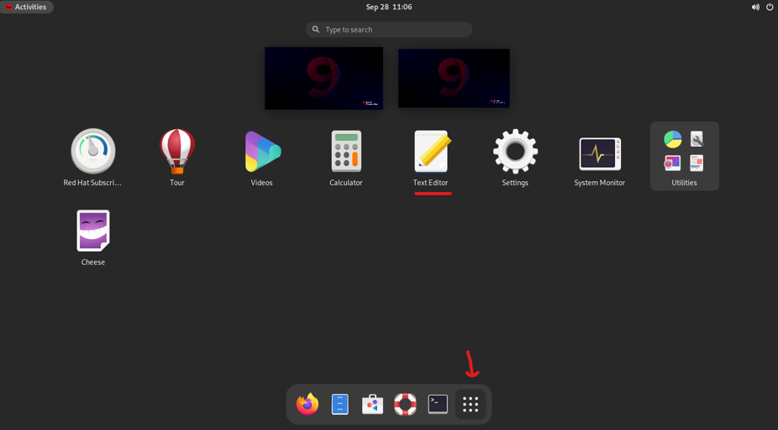
gedit/TextEditor
Alt+F2

Slide 16
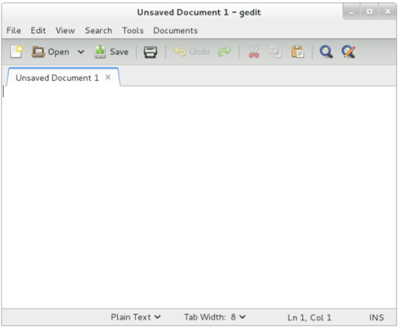
EDITING FILES WITH GEDIT The gedit application is a full-featured text editor for the GNOME desktop environment. Launch gedit by selecting Applications → Accessories → gedit from the GNOME menu.
Like other graphical applications, gedit can be started without navigating the menu. Press Alt+F2 to open the Enter a Command dialog box. Type gedit and press Enter.

Slide 17
Chapter
04
EDITING TEXT FILES FROM THE SHELL PROMPT

Slide 18
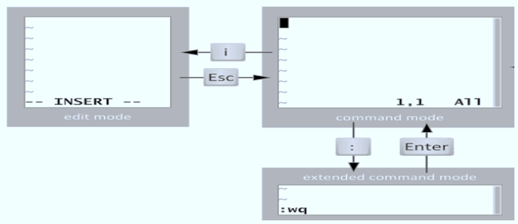
Edit Files with Vim
Linux File Principle: Information is primarily stored in text-based files (including flat files and XML files), allowing them to be easily edited and shared without conversion.
Vim Definition: Vim is an improved and efficient version of the standard vi text editor. Key Features: It is highly configurable and includes features like split screen editing, color formatting, and syntax highlighting.
Vim Modes (See Diagram):
  Command Mode: The default mode for navigation and issuing commands.
  Insert Mode (Edit Mode): Entered by pressing i, used for typing and editing text. Exited by pressing Esc.
  Extended Command Mode: Entered from Command Mode by pressing : (colon), used for saving, quitting, and file operations (e.g., :wq to write and quit).

Slide 19
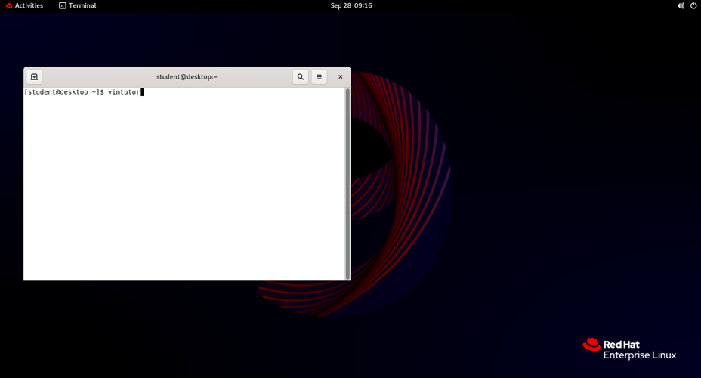
Vimtutor

Slide 20
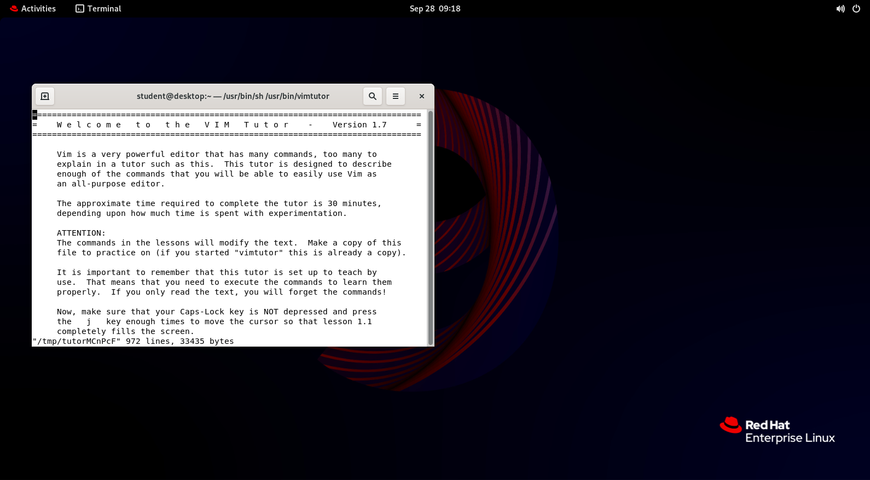
Vim → Terminal →:shell
Terminal → Vim → Exit , then Enter

Slide 21
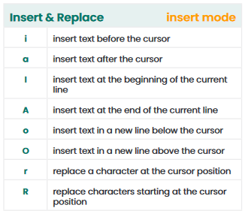
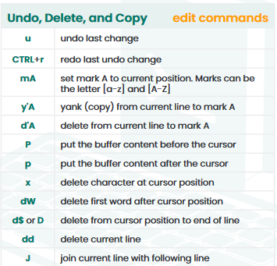

Slide 22
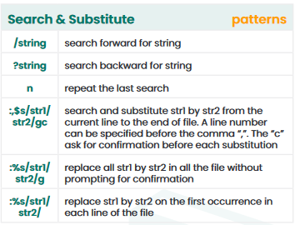
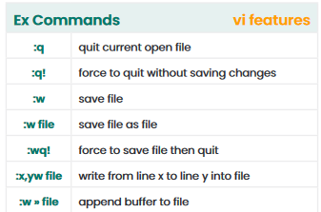

Slide 23
Chapter
04
Manage Local Users and Groups

Slide 24
Linux Users and Groups
Linux is a multi-user operating system that provides robust mechanisms for managing user access, permissions, and security through its user and group system.
This fundamental aspect of Linux administration ensures that multiple users can safely and securely share system resources while maintaining appropriate levels of access control and data protection.

Slide 25
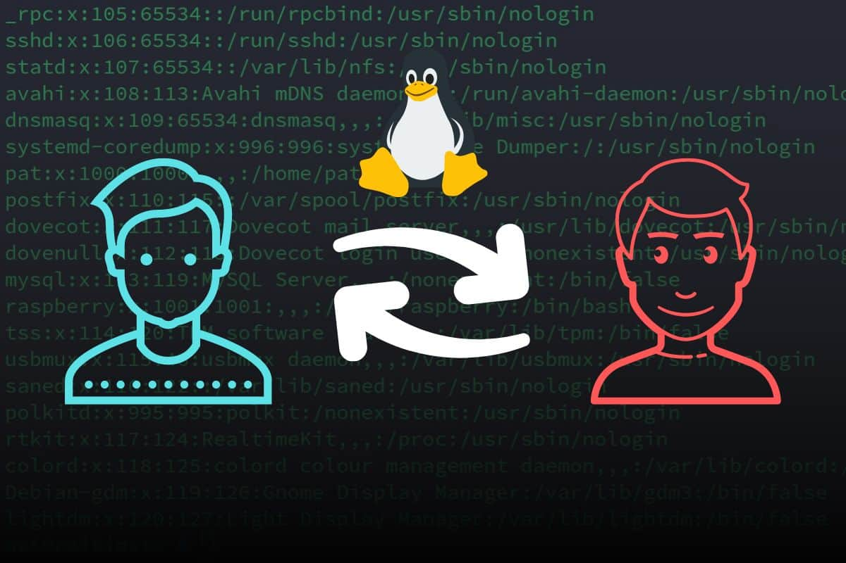

Linux Users and Groups
Fundamental entities for identity and access management in Linux
  Users
  Groups

Slide 26
Linux Users and Groups
The concept of users and groups in Linux serves several critical purposes.
  First, it provides identity management by uniquely identifying each person or process that interacts with the system.
  Second, it enables access control by determining what resources each user can access and what operations they can perform.
  Third, it facilitates resource allocation by allowing administrators to assign system resources to specific users or groups of users.
  Finally, it supports accountability by maintaining logs and audit trails that track user activities on the system.

Slide 27
Linux Users and Groups
Users
A user in Linux is an account that can log into the system and perform operations. Each user has:
Username: Human-readable identifier
User ID (UID): Numeric identifier assigned by the system
Home directory: Personal directory (usually /home/username)
Shell: Command interpreter (like /bin/bash)
Password: Authentication credential

Slide 28
Linux Users and Groups
Types of Users
Root User: Superuser with UID 0, has complete system access
System Users: Used by system services and daemons (UIDs typically 1-999)
Regular Users: Normal user accounts for people (UIDs typically 1000+)

Slide 29
Linux Users and Groups
System Users
also known as service accounts, are created for system processes, daemons, and services that need to run with specific privileges. These accounts typically have UIDs below 1000 and are not intended for human login.
Examples include the www-data user for web servers, the mysql user for database services, and the mail user for mail services. System accounts often have restricted shells or no shell at all, preventing direct login while still allowing processes to run under their identity.

Slide 30

Linux Users and Groups
WHAT IS A USER?
  Process Identity: Every process (running program) on the system runs as a particular user.
  File Ownership: Every file is owned by a particular user.
  Access Control: Access to files and directories are restricted by user. The user associated with a running process determines its accessible files and directories.
THE id COMMAND
  The id command is used to show information about the current logged-in user.
  Other Users: Basic information about another user can be requested by passing in the username as the first argument to the command.

Slide 31

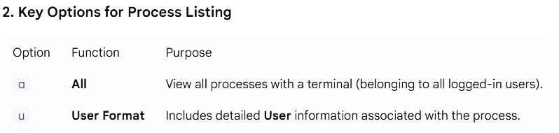

Linux Users and Groups
VIEWING PROCESS INFORMATION (ps COMMAND)
1. The ps Command (Process Status)
  The ps command is used to view process information.
  Default: Shows only processes in the current shell.

Slide 32
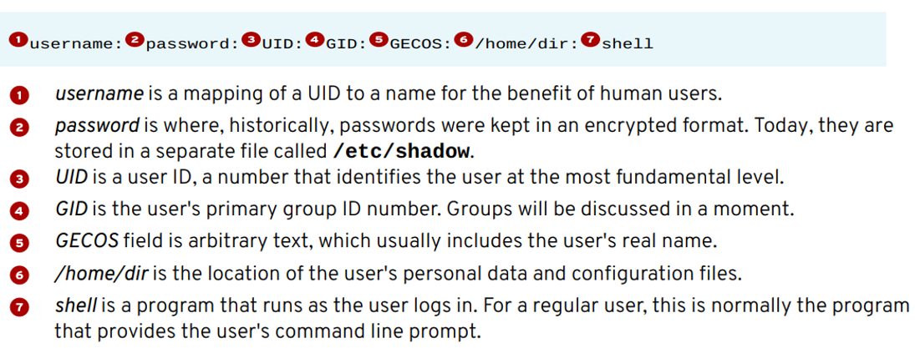
Linux Users and Groups
USER ACCOUNT INFORMATION (/etc/passwd)
1. Internal User Tracking
  Users vs. IDs: While commands display names (e.g., student), the OS internally tracks users by a UID number.
  Database: The mapping of names to numbers is stored in account information databases.
  Location: For local users, this information resides in the simple "flat file," /etc/passwd.
  2. The format of /etc/passwd file is divided into seven colon-separated fields.

Slide 33
Linux Users and Groups
Groups
Group accounts in Linux provide a powerful and flexible mechanism for managing permissions and access control for multiple users simultaneously.
Instead of assigning permissions to individual users, which can become cumbersome in environments with many users, groups allow administrators to define permissions once for a group and then assign users to that group. This simplifies administration, enhances security, and improves scalability.

Slide 34
Linux Users and Groups
Groups
A group is a collection of users that share certain permissions. Each group has:
  Group name: Human-readable identifier
  Group ID (GID): Numeric identifier
  Member list: Users belonging to the group
Types of Groups
  Primary group: Every user has one primary group (usually matches username)
  Secondary groups: Additional groups a user can belong to
Key Files
  /etc/passwd: Contains user account information
  /etc/group: Contains group information
  /etc/shadow: Contains encrypted passwords (restricted access)

Slide 35
Linux Users and Groups
Gaining Superuser Access: means obtaining the privileges of the root user, with complete access to all commands and files. This level of access is necessary for administrative tasks but also carries significant risks.
The Root User: Power and Responsibility:
1. The Risk of Unlimited Power
The root user has unlimited power in the system.
This power brings responsibility; the user can damage the system (e.g., remove files or user accounts).
If the root account is compromised, the attacker gains administrative control of the entire system.
2. Best Practice for Administrators
Recommendation: Always log in as a normal user (unprivileged account).
Escalate privileges to root only when needed to perform administrative tasks (e.g., using the sudo command).

Slide 36
Linux Users and Groups :Managing Privileges (su vs. sudo)
Switching Users with su
  Purpose: Allows a user to switch to a different user account (e.g., become root).
  Implication: If no username is specified, the root account is implied.
  Authentication: Requires the password of the target account (usually the root password).
  Drawback: Sharing the root password is a major security disadvantage.
Running Commands as Root with sudo (Recommended)
  Goal: Permits a user to execute a specific command with root privileges (or another user's privileges).
  Configuration: Access is controlled by settings in the /etc/sudoers file.
  Authentication: Requires the user's own password for validation. It does not require the root password.
  Benefit: Enables administrators to grant fine-grained permissions to specific users for specific tasks.
  Security: Enhances system security by avoiding the distribution of the root password.

Slide 37
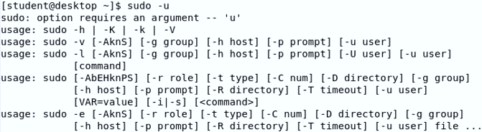


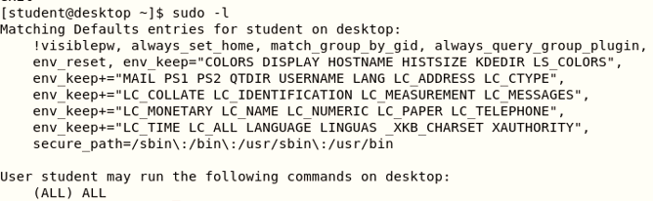
Linux Users and Groups
Basic syntax: sudo command
sudo -u username command
Open root shell: sudo -i or sudo – s # without using root password
Check available permissions: sudo -l

Slide 38


Linux Users and Groups
(Using Command-Line Tools for User Accounts)
I. Creating Users: useradd
Basic Syntax: useradd username sudo useradd ali
  Creates the user with default settings (read from /etc/login.defs).
  Does NOT set a valid password by default.
  The user cannot log in until a password is set (using the passwd command).
II. Checking Options & Help
  useradd - -help
  Displays options to override system defaults (e.g., set a specific home directory or shell).
  Most of these options can also be used with usermod to modify existing users

Slide 39
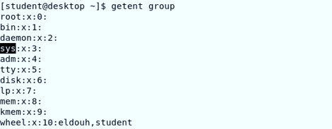

Linux Users and Groups
1. Inspecting Existing Groups
To list all groups currently defined on the system, use the getent group command.
This command checks the system database to show you all existing group names.
2. Add User to the Group: To add the user ali to an existing supplementary group (e.g., Sys): sudo usermod -aG Sys ali
3. Verify Membership: Check that ali is now a member of the group: id ali
4. Deleting Users and Groups:
Delete the User and their Data: To remove the user (e.g., ali) and delete their home directory along with all files: sudo userdel -r ali The -r (recursive) flag ensures the user's home directory is removed.
Delete the Group: To permanently remove a group (e.g., Sys): sudo groupdel Sys
  Note: You cannot delete a group if it is currently set as the primary group for any user.

Slide 40



Thank You

