Slide 1


Design Thinking
Prepared by Dr. Aya Mohamed
ENT 621
Master of Entrepreneurship
Lecture 4

Slide 2

In The previous Lecture: Design Thinking
Topics
v
Principles of Design Thinking
The process of Design Thinking
The Problem space- The solution space
The Design Thinking phases
How to plan a Design Thinking project
Examples of Design solutions using DT
Process
Problem Space
Solution Space

Slide 3
In This Lecture: Design Thinking
Topics
v
Co-design, co-production and co-creation
Innovation in Business
Innovation Frameworks
Co-design
Co-production
Co-creation

Slide 4
In This Lecture: Design Thinking
Topics
v
Co-design, co-production and co-creation
Innovation in Business
Innovation Frameworks
What makes co-design work or fail, and what co-production really is ?
Co creation and co production in Education
Co-design
Co-production
Co-creation

Slide 5
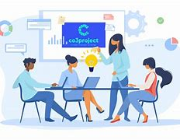
CO-production, CO-design and CO-creation
1-
v
CO from the word co-operation meaning doing together
Co-production, co-design and experience-led design (UX design) are forms of Innovation
Co-production is the latest in a series of innovation frameworks

Slide 6
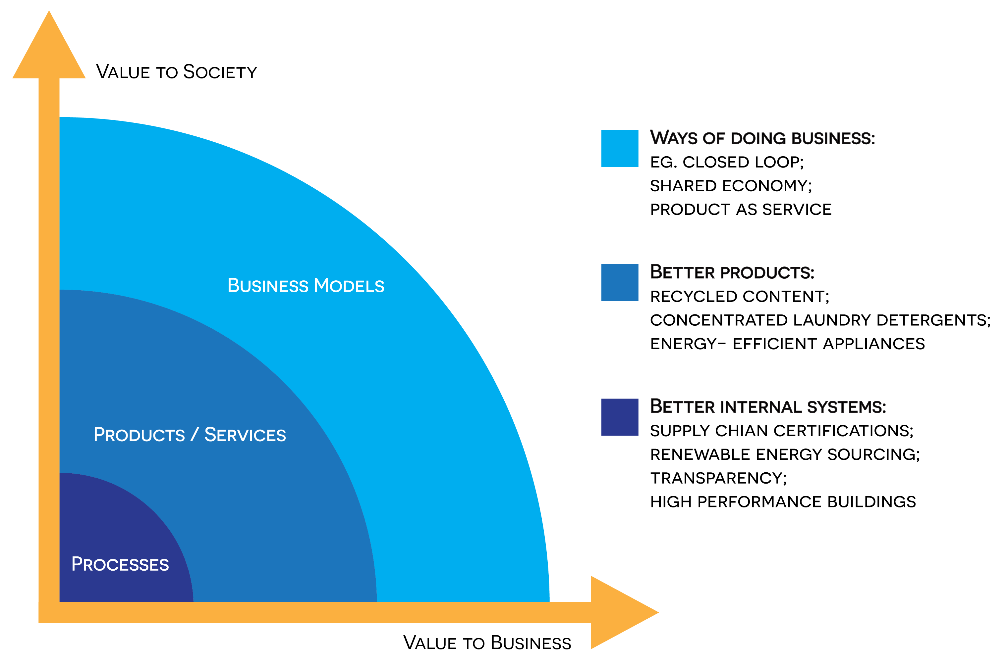
Co-production, co-design and co-creation
1-
v

Slide 7
Co-production, co-design and co-creation
1-
v

Slide 8
1-
Co-production, co-design and co-creation
v
Innovation in business is the ability to create and deliver new value for customers.
It can involve new products, services, processes, or business models that are both novel and useful.
Innovation can be major or minor, but it should always aim to generate net new growth.

Slide 9
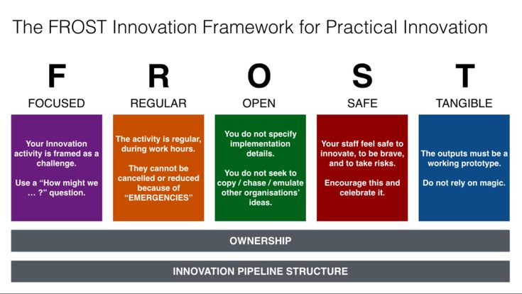
Co-production, co-design and co-creation
1-
v

Slide 10
Co-production, co-design and co-creation
1-
v
An innovation framework is a strategic structure designed to give organizations the ability to tap into ideas, evaluate the strengths and weakness of each, make informed decisions and build strategies to turn ideas into value-generating opportunities for the business.
It sets the parameters, processes, and practices that foster innovation, and applies organization-wide Vision.

Slide 11
Co-production, co-design and co-creation
1-
v
An innovation framework is a strategic structure designed to give organizations the ability to tap into ideas, evaluate the strengths and weakness of each, make informed decisions and build strategies to turn ideas into value-generating opportunities for the business.
It sets the parameters, processes, and practices that foster innovation, and applies organization-wide Vision.
The framework provides a sustainable structure for innovating in line with corporate strategy and ultimately creating tangible business outcomes.

Slide 12

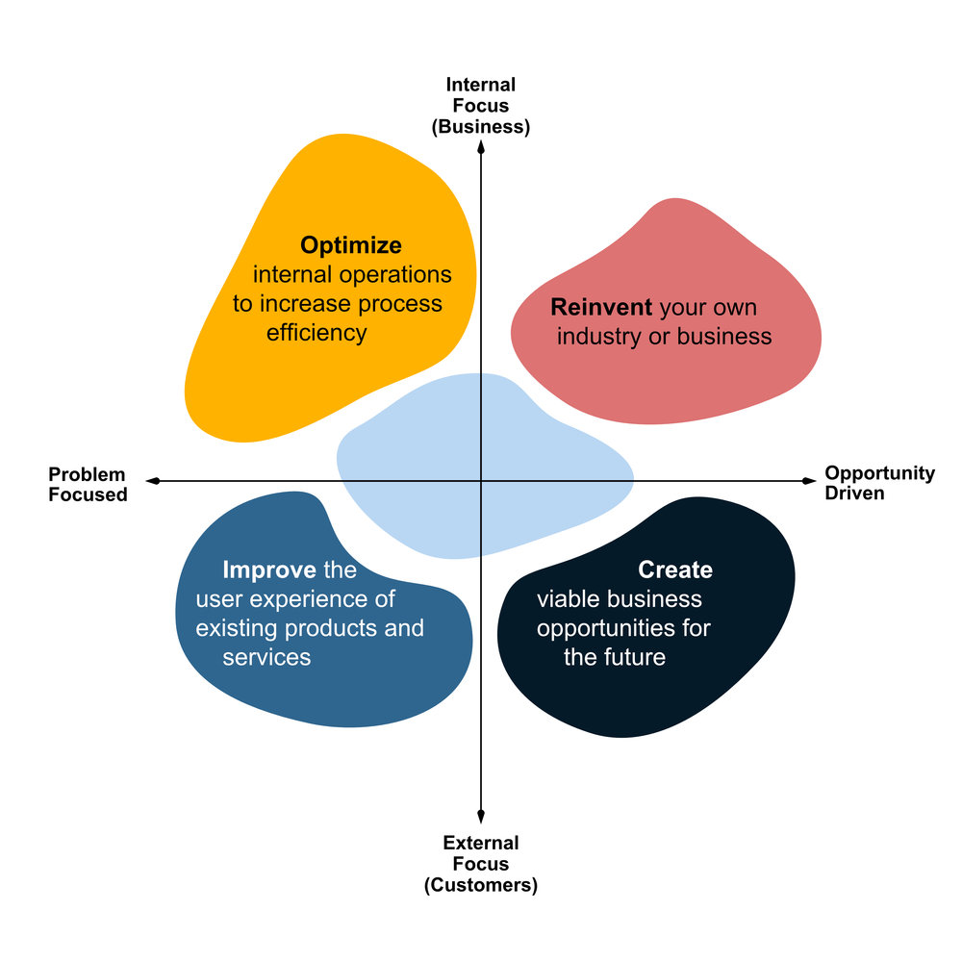
1-
Sustainable Innovation Structure
v

Slide 13

The Difference between Co-production, co-design and co-creation

Slide 14
The Innovation Frameworks
v
Innovation frameworks:
- Supplier-centered design (“You can have any color you like, as long as it is black”)
- User-led design (in which designers guide people through the process of describing and solving problems for themselves, thus putting the user in charge)

Slide 15
The Innovation Frameworks
v
Innovation frameworks:
- Supplier-centered design (“You can have any color you like, as long as it is black”)
- User-led design (in which designers guide people through the process of describing and solving problems for themselves, thus putting the user in charge)
- User-centred design (innovation occasioned by watching people and then designing something on their behalf, thus putting the designer in charge)

Slide 16
The Difference between Co-production, co-design and co-creation
Innovation frameworks:
- Co-design (the idea that understanding of a problem and/or solution can be improved if designers, suppliers and consumers look at it together)
Co-production (a fairly new concept,)
Running alongside co-production we also have user experience-led design ( UX design)

Slide 17
The Difference between Co-production, co-design and co-creation
The user experience (UX) :
is how a user interacts with and experiences a product, system or service.
It includes a person's perceptions of utility, ease of use, and efficiency.
Improving user experience is important to most companies, designers, and creators when creating and refining products because negative user experience can diminish the use of the product and, therefore, any desired positive impacts; conversely, designing toward profitability often conflicts with ethical user experience objectives and even causes harm.

Slide 18
The Difference between Co-production, co-design and co-creation
The user experience (UX) :
is how a user interacts with and experiences a product, system or service.
It includes a person's perceptions of utility, ease of use, and efficiency.
Improving user experience is important to most companies, designers, and creators when creating and refining products because negative user experience can diminish the use of the product and, therefore, any desired positive impacts; conversely, designing toward profitability often conflicts with ethical user experience objectives and even causes harm.
User experience is subjective. However, the attributes that make up the user experience are objective

Slide 19
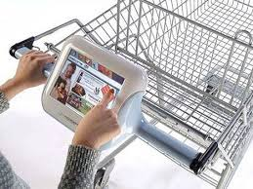
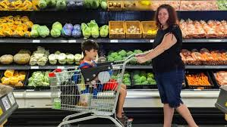
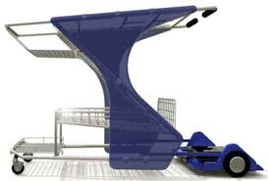
The Difference between Co-production, co-design and co-creation
The shift from supplier-centred design to user-centred design really began in the 1970s with companies like IDEO. They began by watching people wander round supermarkets, then ran back to their studios where they designed trolleys that could seat a baby. At some point, they also noticed that people were walking past the biscuits, putting some coffee in the shopping trolley, then having to turn round and go back to the biscuits – so they encouraged managers to change the layout of the shop.

Slide 20
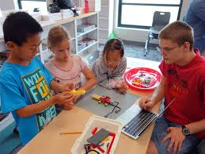
1-
The Difference between Co-production, co-design and co-creation
The Design Council in 2003 think to build a process by which end users could define both problems and solutions in different areas of the public sector in education.
We wondered what would happen if we stopped designing around the needs and preferences of teachers (supplier-centred design) and instead asked the service users (children) to map out new approaches to teaching and learning that would secure their full engagement.
What Do You Think ……. What will be the situation??

Slide 21
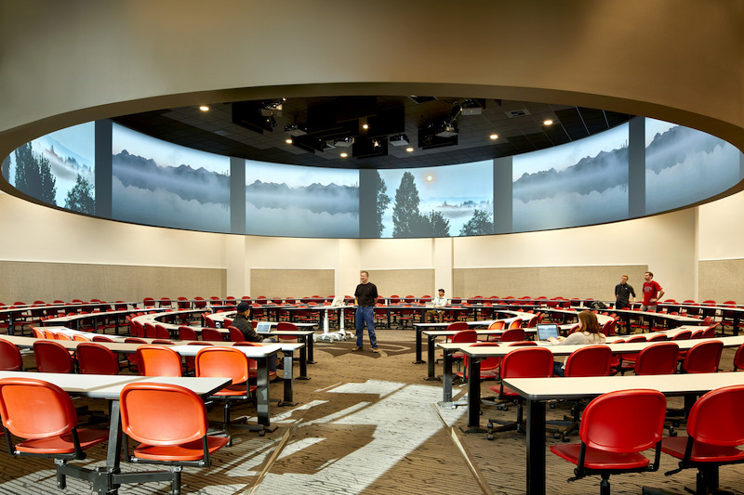
The Difference between Co-production, co-design and co-creation
We had some incredible successes, like the 360-degree flexible classroom and the Designmyschool prototype, but we also came to the realization that user-led design was not the answer.
Too often, we saw end-users who lacked training in design and innovation seek to fix known problems of the recent past rather than addressing emerging problems of the future. This led us to the concept of co-design.

Slide 22
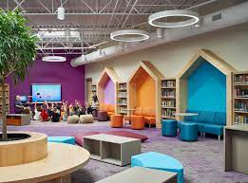
The Difference between Co-production, co-design and co-creation
We had some incredible successes, like the 360-degree flexible classroom and the Designmyschool prototype, but we also came to the realization that user-led design was not the answer.
Too often, we saw end-users who lacked training in design and innovation seek to fix known problems of the recent past rather than addressing emerging problems of the future. This led us to the concept of co-design.

Slide 23
The Difference between Co-production, co-design and co-creation
Co-design, created opportunities for designers to push suppliers and consumers to go further than they might by themselves. It was, in effect, an attempt to reduce the likelihood that a user-led design would have a low order and short impact timeframe.
Designers came to the conclusion that people were engaging in co-production, which is something very different.

Slide 24
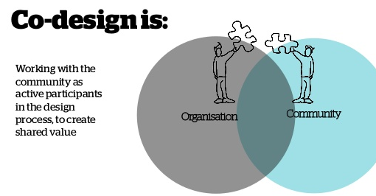
The Difference between Co-production, co-design and co-creation
Co-design: a design is a plan or method for doing something. The person who discovered that rubbing sticks over tinder can make fire was a designer, and the process was the design. Equally, a person who produces architectural drawings for an office block is a designer, and the plans are the design. Co-design, therefore, occurs when more than one person is involved in drawing up a plan for doing something.

Slide 25
The Difference between Co-production, co-design and co-creation
Co-production: production is what happens when the raw materials needed to do something are brought together and combined to generate something new.
Working out what to do is design work; doing it is production.
So the person who invented airplanes is a designer, but a person who assembles them is a producer. Co-production occurs when more than one person is involved in making something happen.

Slide 26
The Difference between Co-production, co-design and co-creation
Co-production: production is what happens when the raw materials needed to do something are brought together and combined to generate something new.
Working out what to do is design work; doing it is production.
So the person who invented airplanes is a designer, but a person who assembles them is a producer. Co-production occurs when more than one person is involved in making something happen.
It is for this reason that some designers have begun to use the term co-creation to encompass the entire process of design and production.

Slide 27
what makes co-design work or fail, and what co-production really is ?
Co-design is an attempt to define a problem and then define a solution; co-production is the attempt to implement the proposed solution; co-creation is the process by which people do both
Co-design will fail where one of the parties lacks either the willingness or ability to think like a designer. This happens far too often and is best remedied by using something like Stakeholder Design’s Innovation Readiness Indication Scale (IRIS).
Co-production offers huge scope for reducing the failure rate of particular scenarios.

Slide 28
what makes co-design work or fail, and what co-production really is ?
Co-design is an attempt to define a problem and then define a solution; co-production is the attempt to implement the proposed solution; co-creation is the process by which people do both
Co-design will fail where one of the parties lacks either the willingness or ability to think like a designer. This happens far too often and is best remedied by using something like Stakeholder Design’s Innovation Readiness Indication Scale (IRIS).
Co-production offers huge scope for reducing the failure rate of particular scenarios. For instance, in a GP’s surgery, a patient and the doctor can agree a program for weight loss that includes some dieting, some tablets and some exercise. If this prescription for change is generated by a process of dialogue and agreement, it has far more chance of succeeding than if the doctor simply instructs the patient to adopt it.

Slide 29
what makes co-design work or fail, and what co-production really is ?
If a transport chief tries waiting at a bus stop for an unknown number of minutes, the outcome may well be a display that says how far away the next bus is in minutes. Both examples improve the end user’s experience of a service.
Experience-led design is the process by which a group or an individuals' experience of a space, system, product or service is enhanced. It may or may not require the active involvement of those groups and individuals, or those who are shaping their experiences. The caveman who rubbed the sticks together to make fire was either cold or hungry – he wanted a different experience of life, so he designed one.

Slide 30
what makes co-design work or fail, and what co-production really is ?
If a transport chief tries waiting at a bus stop for an unknown number of minutes, the outcome may well be a display that says how far away the next bus is in minutes. Both examples improve the end user’s experience of a service.
Experience-led design is the process by which a group or an individuals' experience of a space, system, product or service is enhanced. It may or may not require the active involvement of those groups and individuals, or those who are shaping their experiences. The caveman who rubbed the sticks together to make fire was either cold or hungry – he wanted a different experience of life, so he designed one.
Imagine how different your world could be if that was how we approached public service design.

Slide 31
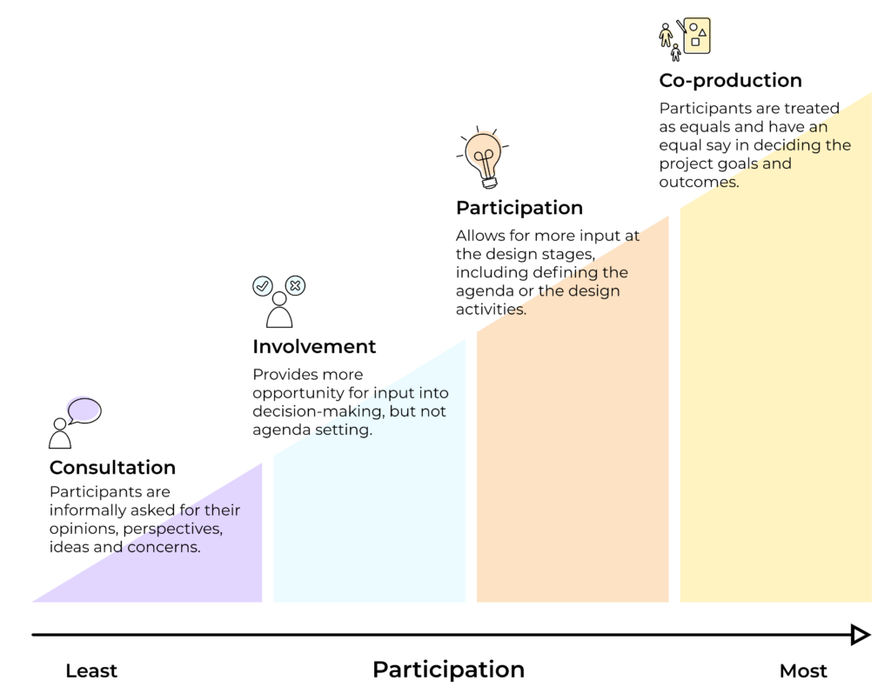

what makes co-design work or fail, and what co-production really is ?

Slide 32
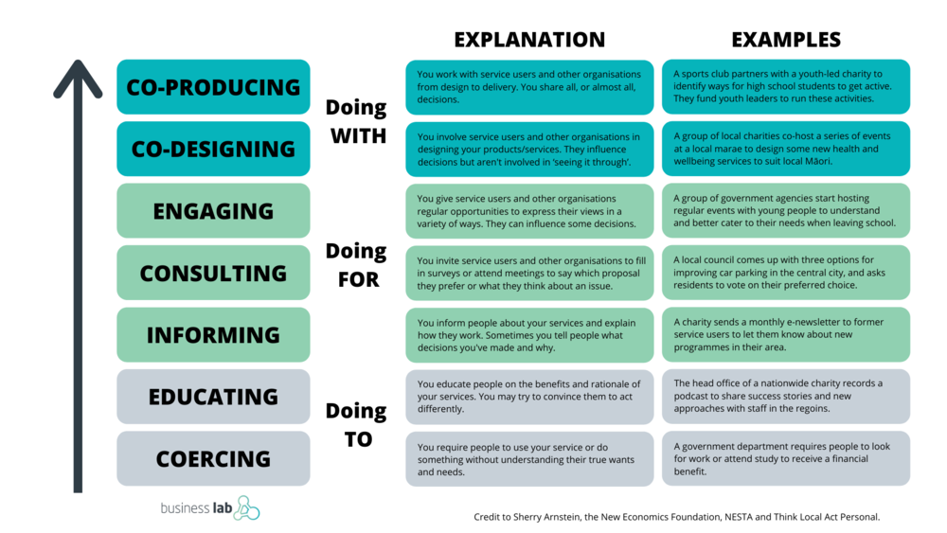
what makes co-design work or fail, and what co-production really is ?

Slide 33
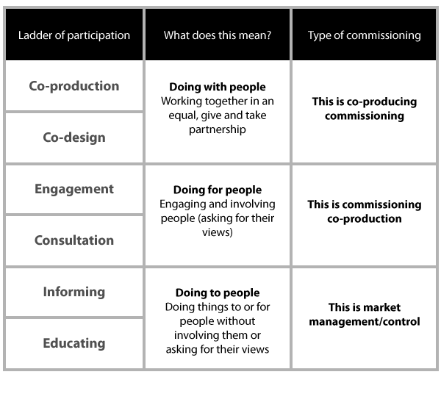
what makes co-design work or fail, and what co-production really is ?

Slide 34
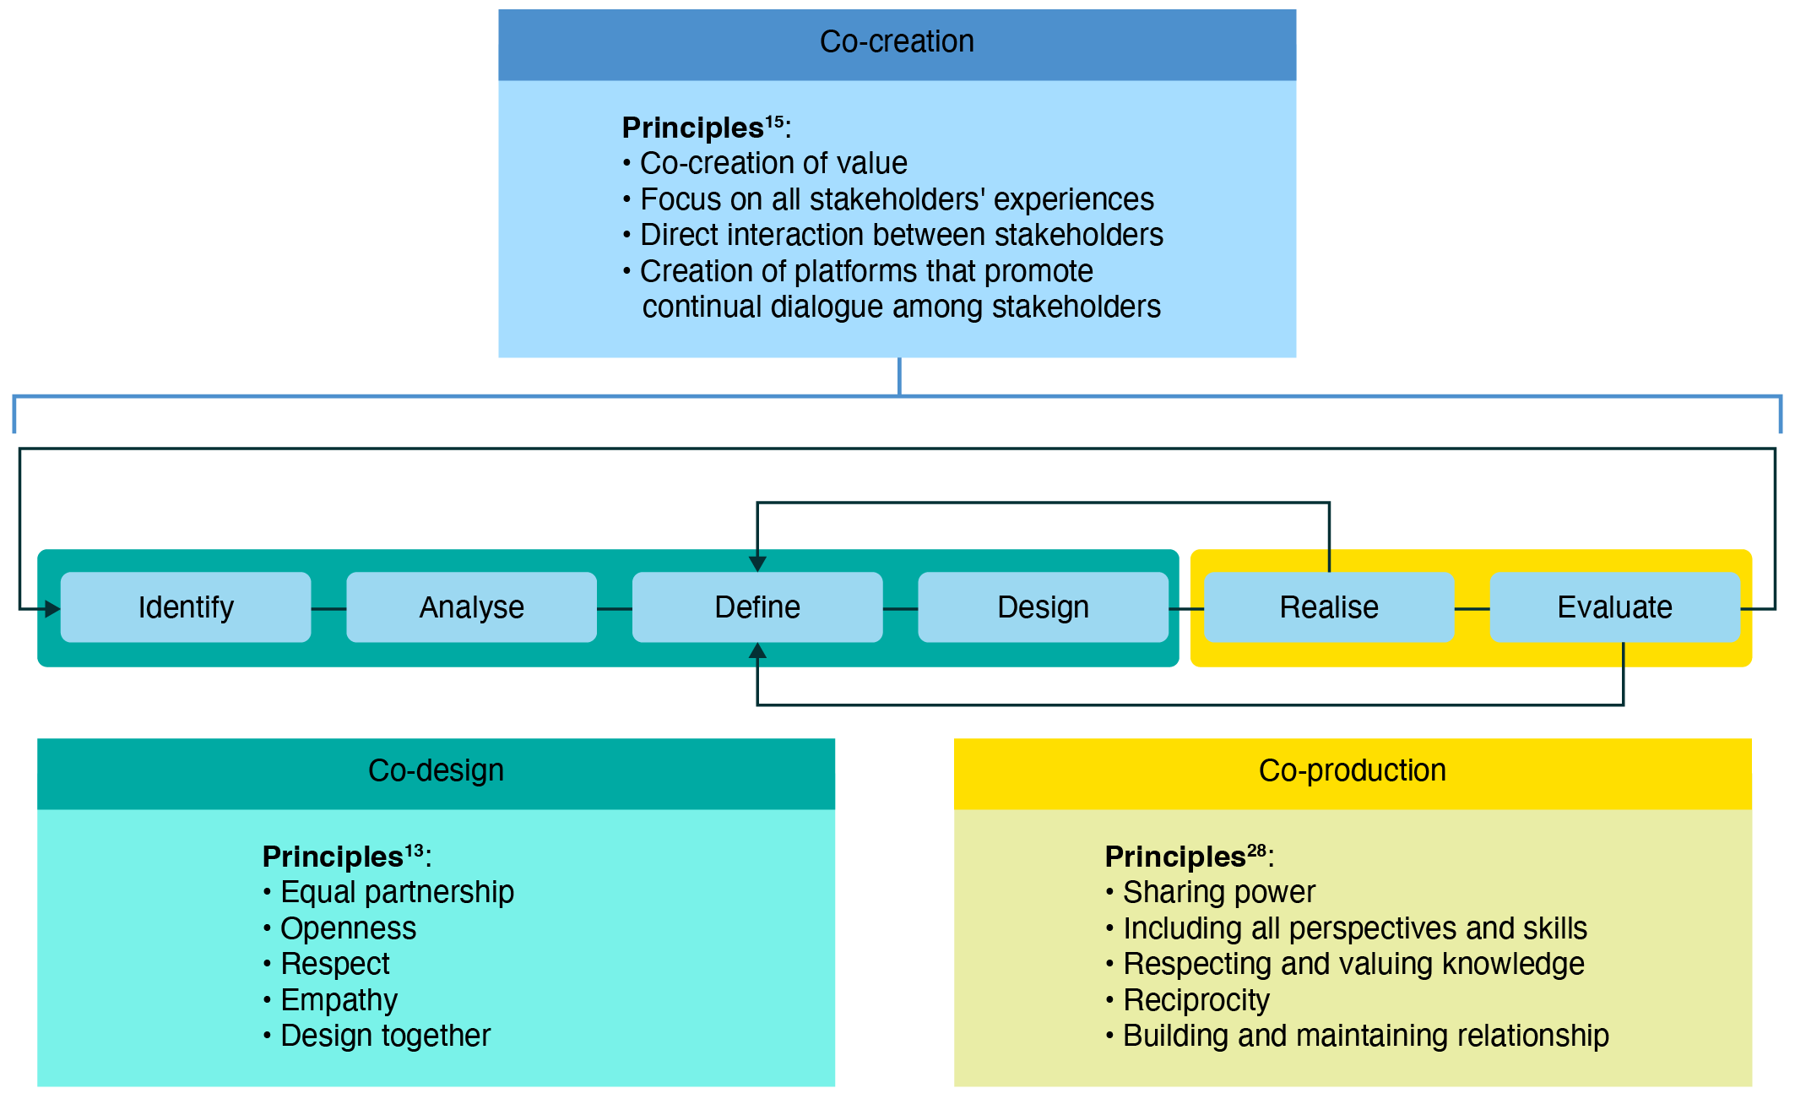
what makes co-design work or fail, and what co-production really is ?

Slide 35
Co-creation co- production
For instance, in the education service provided by the schools, co-creation is practiced when the parents (or parent associations) meet the assigned tutor of their children to set the next steps.
Co-production is natural and inherent in the case of class sessions. This condition is given by the fact that the subject’s program progression depends on a high degree in student capabilities/advancement.

Slide 36
Co-creation co- production
For instance, in the education service provided by the schools, co-creation is practiced when the parents (or parent associations) meet the assigned tutor of their children to set the next steps.
Co-production is natural and inherent in the case of class sessions. This condition is given by the fact that the subject’s program progression depends on a high degree in student capabilities/advancement.
In this scenario, the student co-produces what the teacher has to conduct in the next sessions.

Slide 37
Conclusion
Co-creation: turns customers into inventors
Co-creation is a new form of cooperation that allows customers to participate in innovation processes in a targeted way. It is a form of crowdsourcing concept for the purpose of ideation. Regardless of whether it is an ergonomic desk design, an e-mobility app or flexible new insurance: co-creation ideally adapts new products and services to the needs of customers, reduces development costs and strengthens customer retention.

Slide 38
Conclusion
Co-creation: turns customers into inventors
Co-creation is a new form of cooperation that allows customers to participate in innovation processes in a targeted way. It is a form of crowdsourcing concept for the purpose of ideation. Regardless of whether it is an ergonomic desk design, an e-mobility app or flexible new insurance: co-creation ideally adapts new products and services to the needs of customers, reduces development costs and strengthens customer retention.
Co-creation makes innovation an open process. That is why it is also known as open or co-innovation. The advantages are clear: customer expectations and consumer insights can be identified in real time without laborious research.

Slide 39
Wrap up
In This Lecture: Design Thinking
Co-design, co-production and co-creation
Innovation in Business
Innovation Frameworks
What makes co-design work or fail, and what co-production really is ?
Co creation and co production in Education
Co-design
Co-production
Co-creation

Slide 40




Thank You
Thank You

