Slide 1

Supervised Learning, Intro to Decision Trees Algorithm
Dr. Mohamed Mostafa
AI 511
Foundations of Artificial Intelligence
Lecture 8

Slide 2


01
  Outline
Machine Learning Concept
Machine Learning Approaches
What is Decision Tree
    Basic Decision Tree Algorithm
    Computing purity: Information Measure
    Information Entropy
    Information Gain
    Examples
    Advantage and Disadvantages of Decision Tree Algorithm

Slide 3
Resources for this lecture
  Data Mining And Knowledge Discovery Handboook, Published at https://www.researchgate.net/publication/225237661_Decision_Trees.
  .. AND ..
  Introduction to Artificial Intelligence Course,. Dr. Amr S. Ghoneim

Slide 4
Machine Learning Concept
Input x
Traditional Programming
Output y
Rule = F(x)
Program
f(x)
Output y
Input x
Input x =2;
Rule= x*x;
y=f(x)= 2*2 =4

Slide 5
Machine Learning Concept
Input x
Machine Learning
Rule = g(x)
Output Y
Input x
g(x, β)
model
y
Evaluation: How much closer to the final output
β

Slide 6
Machine Learning Concept
Input x
f(x, β)
model
y
Evaluation: How much closer to the final output
β
Model Learned g(x)=x*4
y= 2*3 =6
eval= 8-6 =2 (difference is 2)
Input x =2;
Output y = 8
y= 2*β =8
y= 2*1 =2
eval= 8-2 =6 (difference is 6)
y= 2*2 =4
eval= 8-4 =4 (difference is 4)
y= 2*4 =8
eval= 8-8 =0 (difference is 0)

Slide 7
Machine Learning Concept
Evaluation: Test Data
g(x)=x*4
Input Testing Data
x1,
x2,
x3,
x4,
Output Testing Data
y1,
y2,
y3,
y4,

Slide 8
Machine Learning Approaches
Labeled Data
Classification and Regression
Supervised Learning
Unsupervised Learning
Unlabeled Data
Clustring and Dimensionality Reduction
Reward Based Learning
Value-based methods, or Policy-based methods, or Exploration strategies
Semi-supervised Learning
Labeled and Unlabeled Data
Classification and Regression
Reinforcement Learning

Slide 9
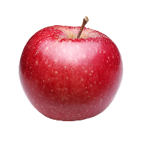
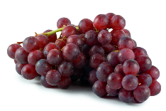
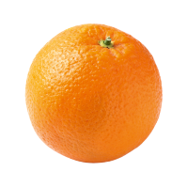
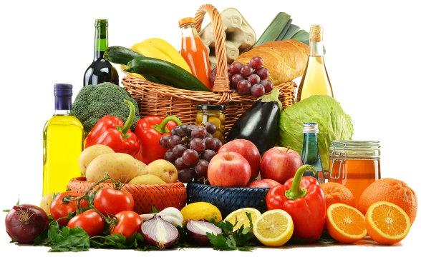
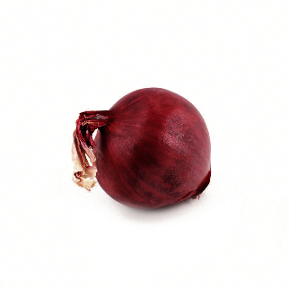
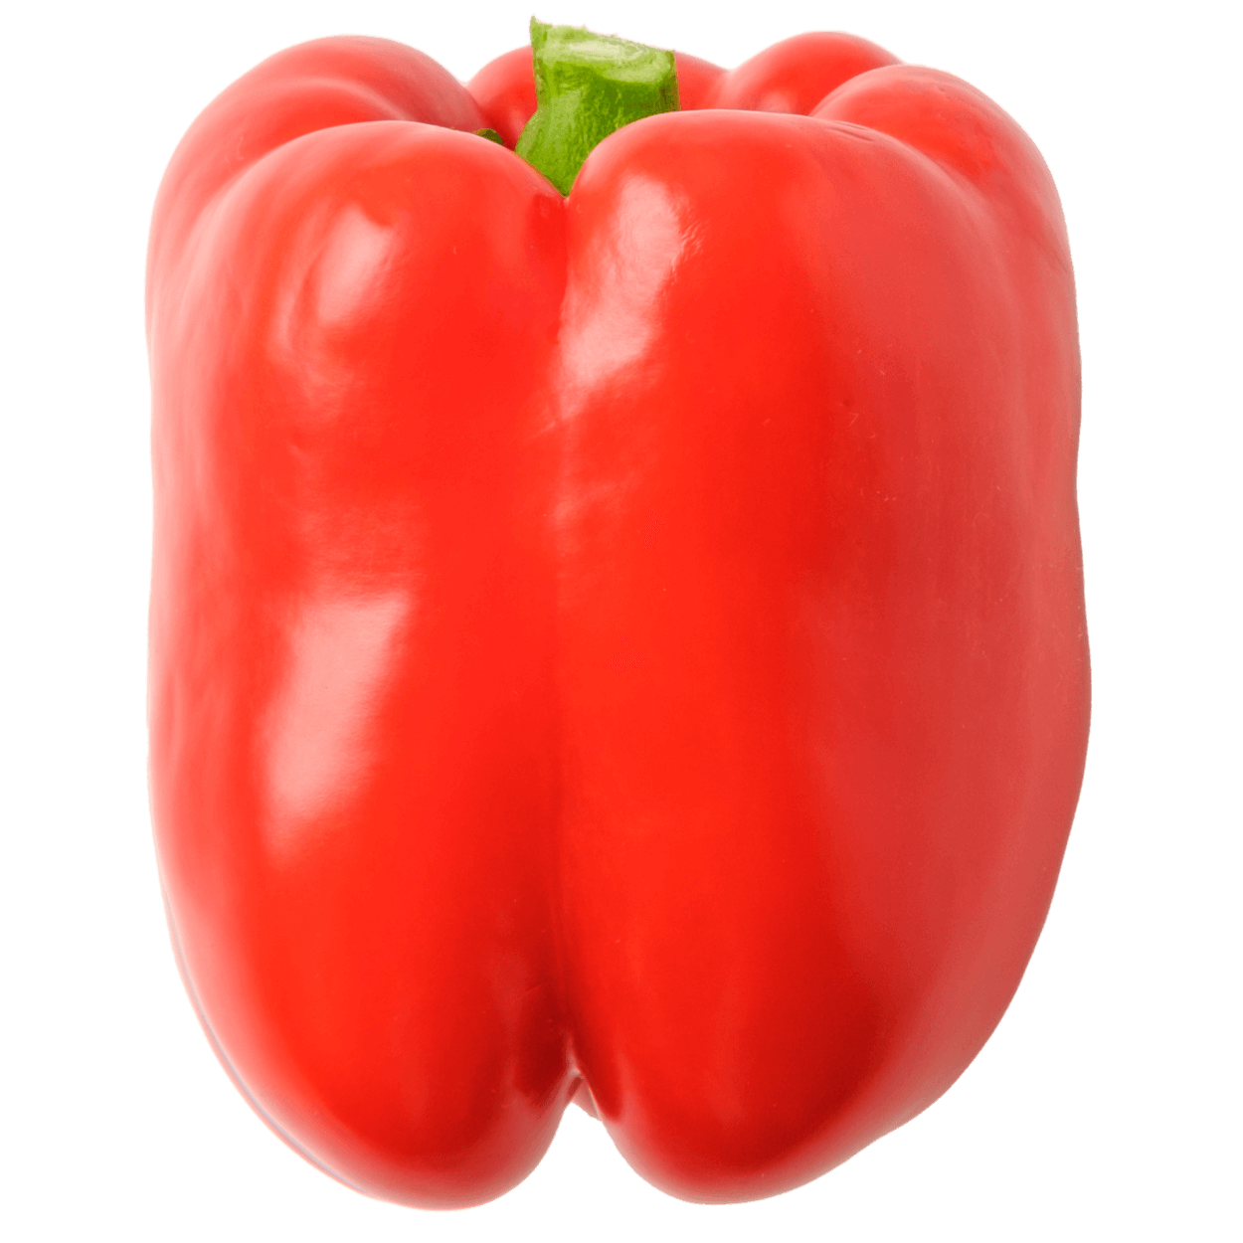
Classification Algorithms in Machine Learning
fruits
Classifier Model
vegetables
Unclassified Data
Classified Data

Slide 10


Clustering Algorithms in Machine Learning
Clustering Algorithm
Unclassified Data
Output

Slide 11
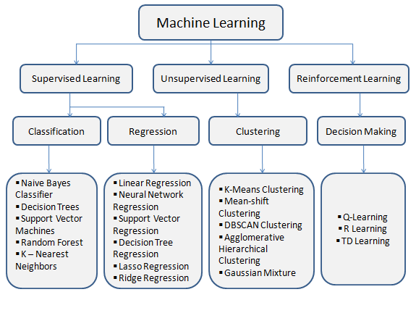

Slide 12
What is decision tree
A decision tree is a classification approach in machine learning.
Decision tree learning is a supervised learning method used in statistics, data mining, and machine learning to create a predictive model for classification or regression tasks.
Animal is breathing air
Classification Tree
Discrete values
Classify into classes (categories)
House size < 1500m²
no
yes
no
yes
Animal is laying eggs
Fish
Rooms < 3
House size < 2000m²
yes
no
yes
no
Regression Tree
Predict continuous values rather than discrete categories
Bird
Mammal
Price=2M EGP
Price=1M EGP

Slide 13
Components of decision tree classification
Nodes: test for the value of a certain attribute
Edges/ Branch: correspond to the outcome of a test and connect to the next node or leaf
Leaf nodes: terminal nodes that predict the outcome and represent class labels or class distribution
Shape is Round
Consider a dataset of fruits where:
An apple is represented as (color=red, shape=round)
A banana is represented as (color=yellow, shape=elongated)
An orange is represented as (color=orange, shape=round)
yes
no
Color is Red
Color Is Yellow
yes
no
yes
apple
orange
banana

Slide 14
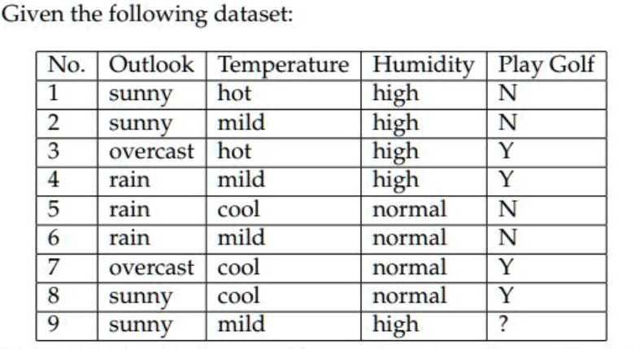
Basic Decision Tree Algorithm by Example
Features
  Outlook: { Sun, Overcast, Rain }
  Temperature: { Hot, Mild, Cool }
  Humidity: { High, Normal, Low }
  Wind: { Strong, Weak }
Labels
  Binary classification task = {Y, N}

Slide 15
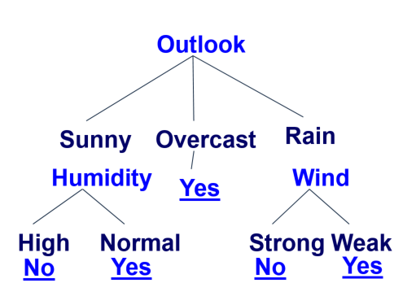
Basic Decision Tree Algorithm by Example
Let S be the set of Examples
  Label is the target attribute (the prediction)
  Attributes is the set of measured attributes
Iterative Dichotomiser 3 Algorithm - ID3( S, Attributes, Label )
If all examples are labeled the same return a single node tree with Label
Otherwise Begin
A = attribute in Attributes that best classifies S (Create a Root node for tree)
for each possible value v of A
Add a new tree branch corresponding to A = v
Let Sv be the subset of examples in S with A = v
if Sv is empty: add leaf node with the common value of Label in S
Else: below this branch add the subtree
ID3( Sv, Attributes - {a}, Label )
End
Return Root

Slide 16
Picking the Root Attribute
The goal is to have the resulting decision tree as small as possible.
The recursive algorithm is a greedy heuristic search for a simple tree, but cannot guarantee optimality.
The main decision in the algorithm is the selection of the next attribute to condition on.

Slide 17
Picking the Root Attribute
Consider data with two Boolean attributes (A,B).
< ( A = 0, B = 0 ), - >: 50 examples
< ( A = 0, B = 1 ), - >: 50 examples
< ( A = 1, B = 0 ), - >: 0 examples
< ( A = 1, B = 1 ), + >: 100 examples
What should be the first attribute we select?
  Splitting on A: we get purely labeled nodes.
  Splitting on B: we don’t get purely labeled nodes.
  What if we have: < ( A = 1, B = 0 ), - >: 3 examples?
(one way to think about it: # of queries required to label a random data point)
A
1
0
+
-
splitting on A
B
1
0
A
-
1
0
+
-
splitting on B
Source: Dr. Amro S. Ghoneim lectures
Notes:
One

Slide 18
Picking the Root Attribute
Consider data with two Boolean attributes (A,B).
< ( A = 0, B = 0 ), - >: 50 examples
< ( A = 0, B = 1 ), - >: 50 examples
< ( A = 1, B = 0 ), - >: 3 examples
< ( A = 1, B = 1 ), + >: 100 examples
What should be the first attribute we select?
Trees looks structurally similar;
which attribute should we choose?
One way to think about it: # of queries required to label a random data point. If we choose A we have less uncertainty about the labels.
A
B
1
0
1
0
B
-
A
-
1
0
100
1
0
53
+
-
+
-
100
3
100
50
splitting on A
splitting on B
Source: Dr. Amro S. Ghoneim lectures

Slide 19
Computing purity: Information Measure
In order to reduce uncertainty, features combinations needs to be measured.
The term represents the amount of information required to place a new instance in the branch. In other words, which best attribute to select in root nodes and its successors in order to reduce the tree size.
Methods include:
  Entropy
  Gini impurity

Slide 20
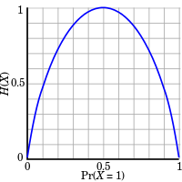
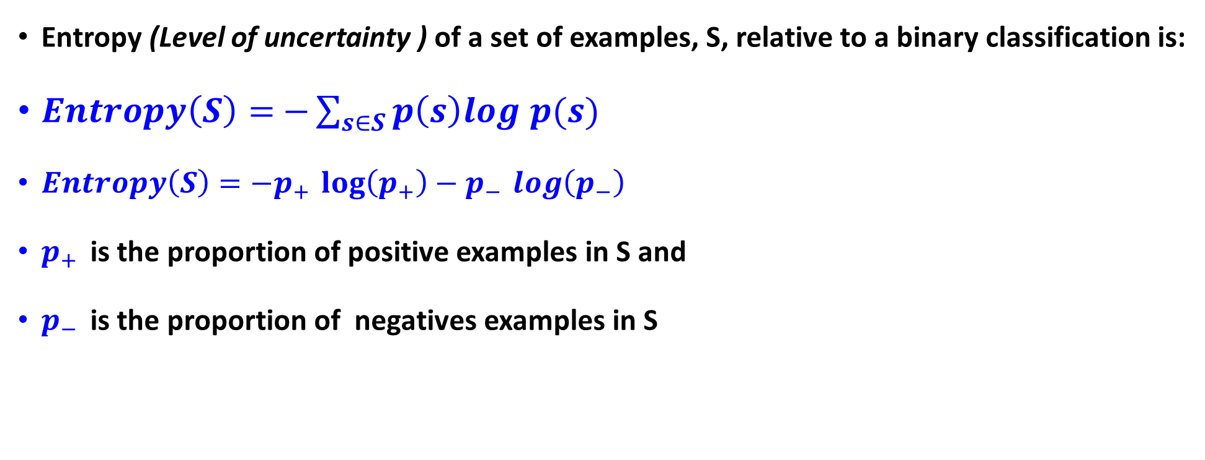
Entropy
Entropy (Level of uncertainty ) of a set of examples, S, relative to a binary classification is:
$Entropy\left(S\right)=$ $−\sum_{s∈S}{p\left(s\right)log p(s)}$
$Entropy\left(S\right)=−p_{+ }\log\left(p_{+}\right)−p_{− }\log\left(p_{−}\right)$
$p_{+ }$is the proportion of positive examples in S and
$p_{− }$is the proportion of negatives examples in S

Slide 21
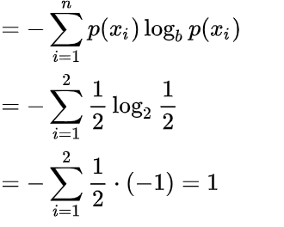
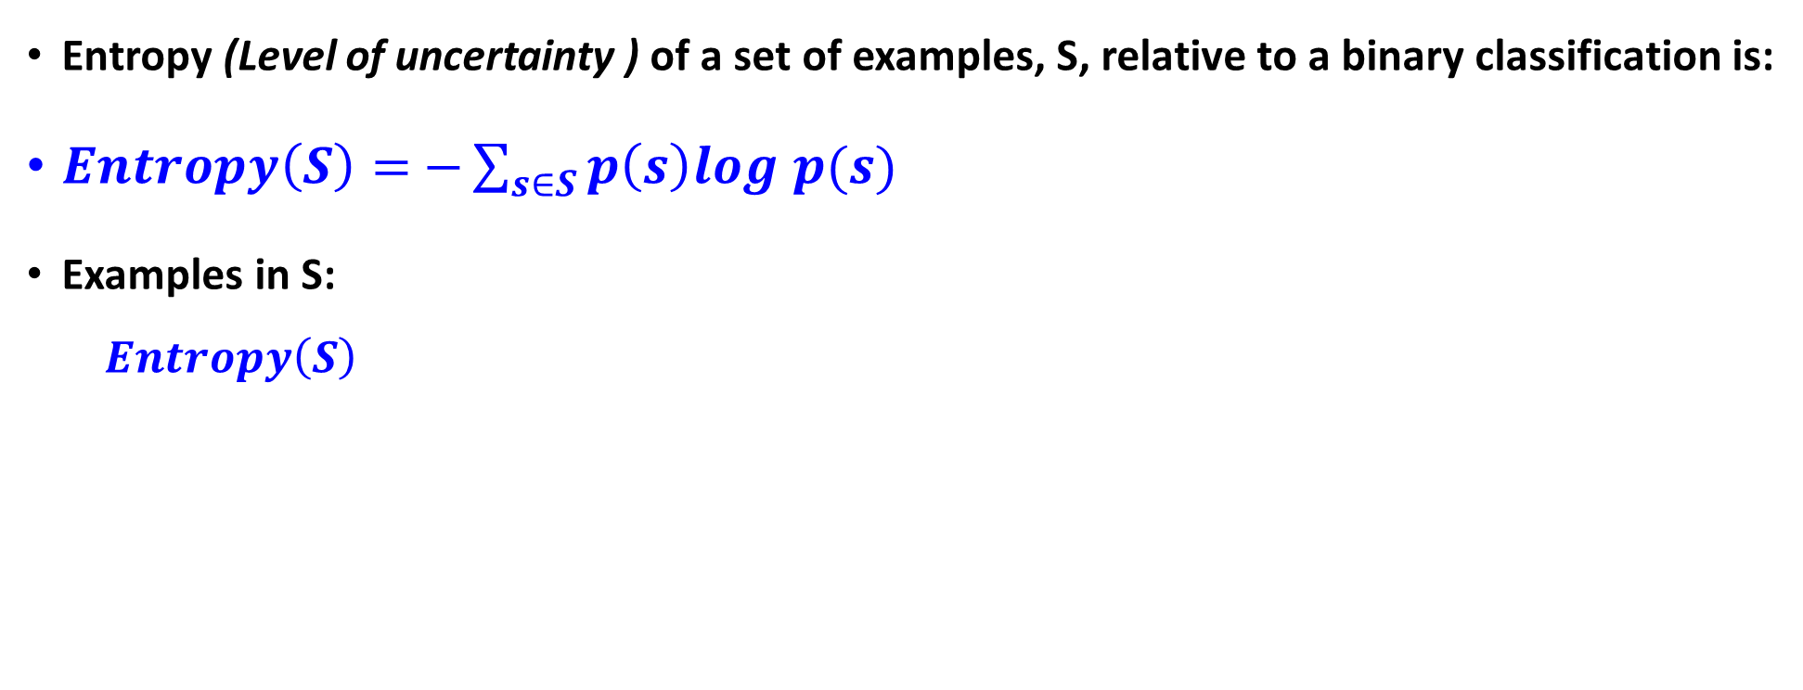
Entropy
Entropy (Level of uncertainty ) of a set of examples, S, relative to a binary classification is:
$Entropy\left(S\right)=$ $−\sum_{s∈S}{p\left(s\right)log p(s)}$
Examples in S:
$$Entropy\left(S\right)$$

Slide 22
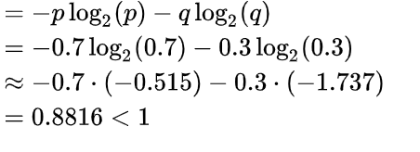
Entropy
Entropy (Level of uncertainty ) of a set of examples, S, relative to a binary classification is:
$Entropy\left(S\right)=$ $−\sum_{s∈S}{p\left(s\right)log p(s)}$
Examples in S:
$$Entropy\left(S\right)$$

Slide 23
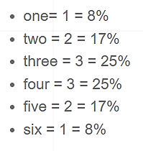
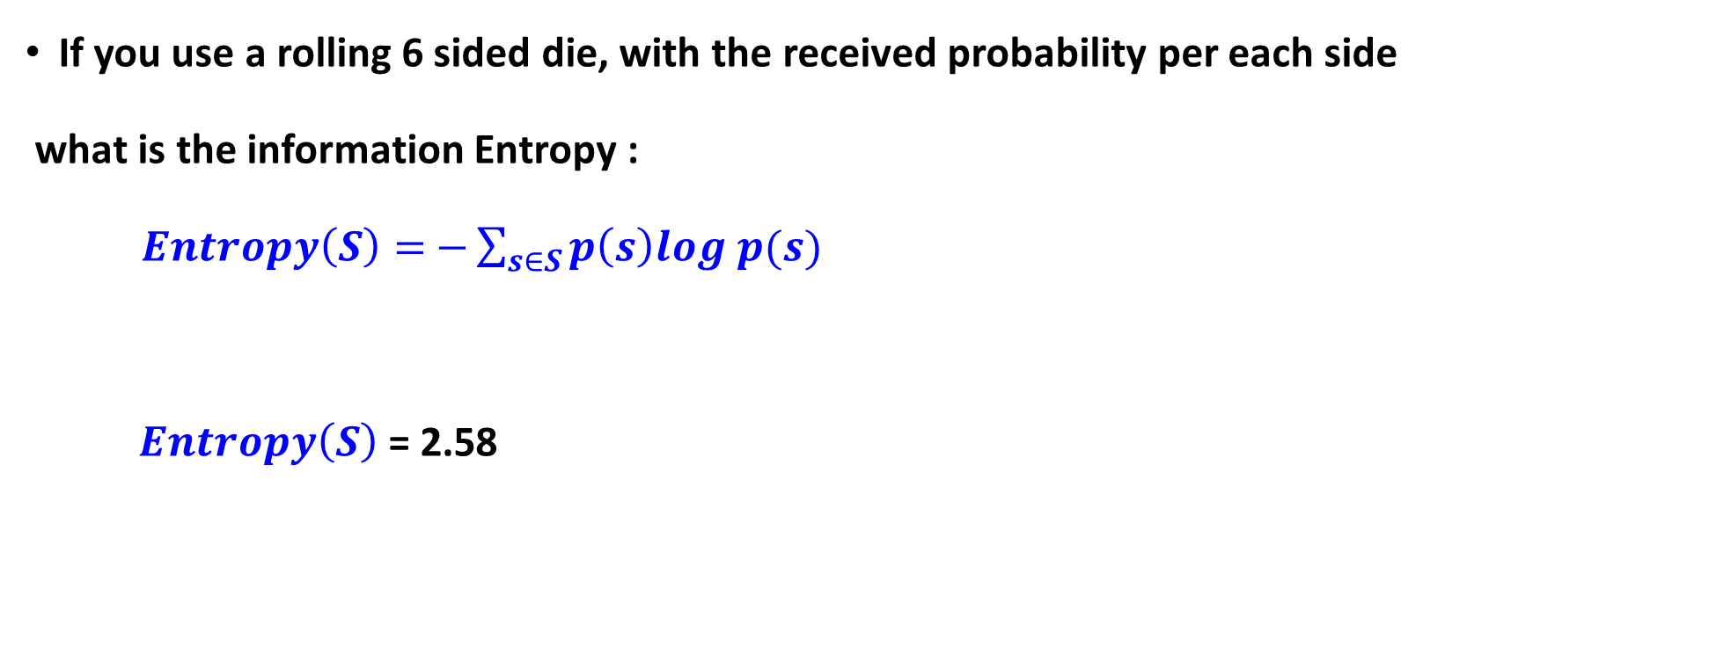
Practice
If you use a rolling 6 sided die, with the received probability per each side
what is the information Entropy :
$Entropy\left(S\right)=$ $−\sum_{s∈S}{p\left(s\right)log p(s)}$
$Entropy\left(S\right)$ = 2.58

Slide 24
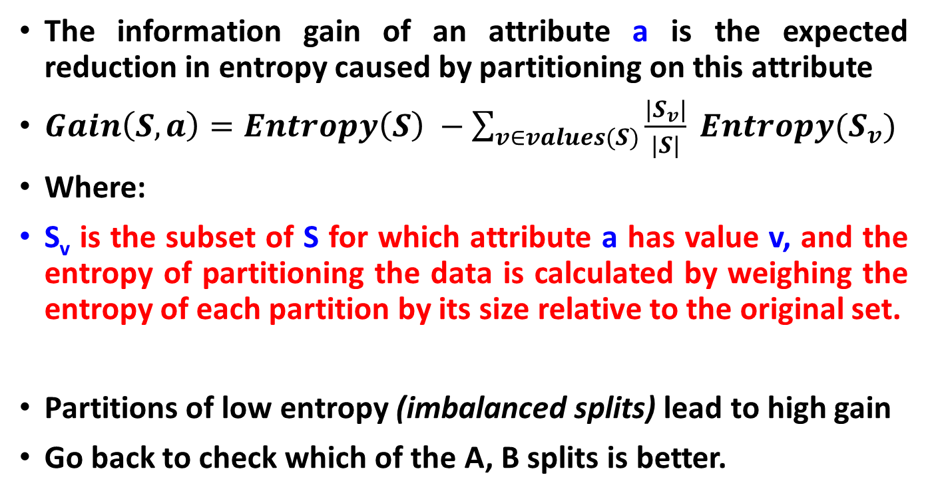
Information Gain
The information gain of an attribute a is the expected reduction in entropy caused by partitioning on this attribute
$Gain\left(S,a\right)=Entropy\left(S\right) −\sum_{v∈values(S)}{\frac{|S_{v}|}{|S|} Entropy(S_{v})}$
Where:
S_{v} is the subset of S for which attribute a has value v, and the entropy of partitioning the data is calculated by weighing the entropy of each partition by its size relative to the original set.
Partitions of low entropy (imbalanced splits) lead to high gain
Go back to check which of the A, B splits is better.
Outlook
Sunny
Overcast
Rain
High Entropy – High level of Uncertainty
Low Entropy – No Uncertainty.

Slide 25
Will I play tennis today?
 | O | T | H | W | Play?
1 | S | H | H | W | -
2 | S | H | H | S | -
3 | O | H | H | W | +
4 | R | M | H | W | +
5 | R | C | N | W | +
6 | R | C | N | S | -
7 | O | C | N | S | +
8 | S | M | H | W | -
9 | S | C | N | W | +
10 | R | M | N | W | +
11 | S | M | N | S | +
12 | O | M | H | S | +
13 | O | H | N | W | +
14 | R | M | H | S | -
Outlook: S(unny),
O(vercast),
R(ainy)
Temperature: H(ot), M(edium),
C(ool)
Humidity: H(igh),
N(ormal),
L(ow)
Wind: S(trong),
W(eak)

Slide 26
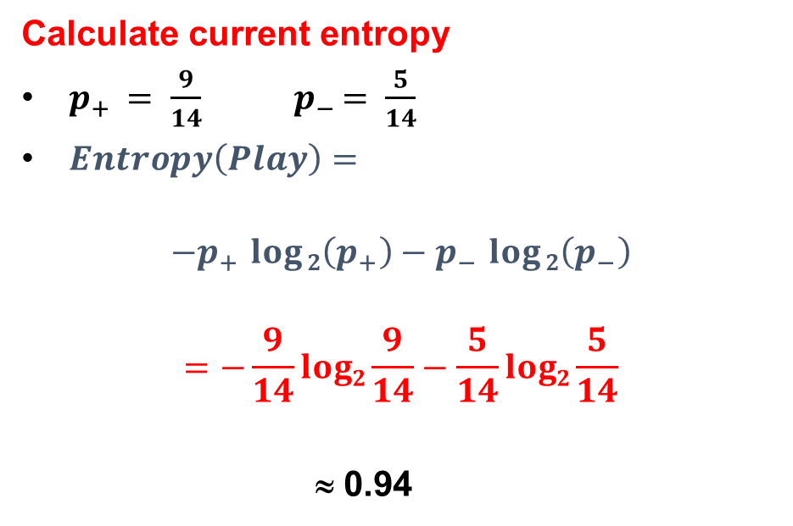
Will I play tennis today?
 | O | T | H | W | Play?
1 | S | H | H | W | -
2 | S | H | H | S | -
3 | O | H | H | W | +
4 | R | M | H | W | +
5 | R | C | N | W | +
6 | R | C | N | S | -
7 | O | C | N | S | +
8 | S | M | H | W | -
9 | S | C | N | W | +
10 | R | M | N | W | +
11 | S | M | N | S | +
12 | O | M | H | S | +
13 | O | H | N | W | +
14 | R | M | H | S | -
Calculate current entropy
$p_{+ }= \frac{9}{14}$ ${ p}_{− }= \frac{5}{14}$
$Entropy\left(Play\right)=$
$$−p_{+ }\log{2\left(p_{+}\right)}−p_{− }\log{2\left(p_{−}\right)}$$
$$=−\frac{9}{14}log2\frac{9}{14}−\frac{5}{14}log2\frac{5}{14}$$
≈ 0.94

Slide 27
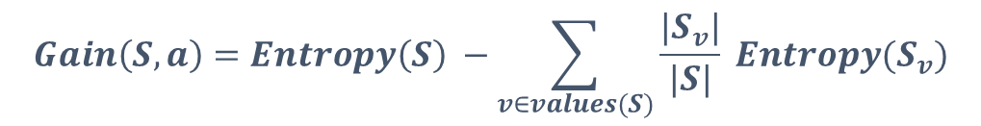
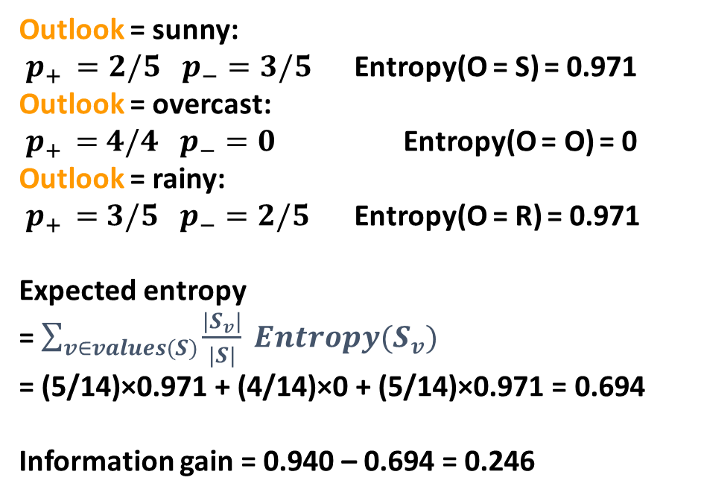
Information Gain: Outlook
 | O | T | H | W | Play?
1 | S | H | H | W | -
2 | S | H | H | S | -
3 | O | H | H | W | +
4 | R | M | H | W | +
5 | R | C | N | W | +
6 | R | C | N | S | -
7 | O | C | N | S | +
8 | S | M | H | W | -
9 | S | C | N | W | +
10 | R | M | N | W | +
11 | S | M | N | S | +
12 | O | M | H | S | +
13 | O | H | N | W | +
14 | R | M | H | S | -
$$Gain\left(S,a\right)=Entropy\left(S\right) −\sum_{v∈values(S)}{\frac{|S_{v}|}{|S|} Entropy(S_{v})}$$
Outlook = sunny:
$p_{+ }=2/5$ $p_{−}=3/5$ Entropy(O = S) = 0.971
Outlook = overcast:
${ p}_{+ } =4/4$ $p_{−}=0$ Entropy(O = O) = 0
Outlook = rainy:
${ p}_{+ } =3/5$ $p_{−}=2/5$ Entropy(O = R) = 0.971
Expected entropy
= $\sum_{v∈values(S)}{\frac{|S_{v}|}{|S|} Entropy(S_{v})}$
= (5/14)×0.971 + (4/14)×0 + (5/14)×0.971 = 0.694
Information gain = 0.940 – 0.694 = 0.246

Slide 28
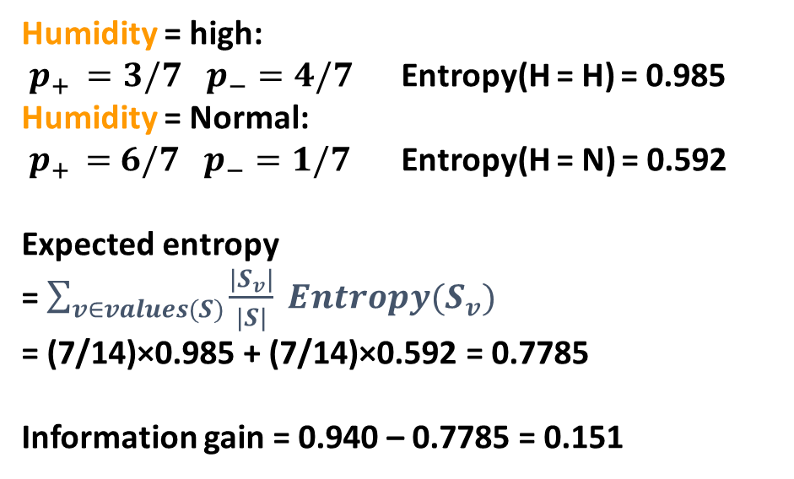
Information Gain: Humidity
 | O | T | H | W | Play?
1 | S | H | H | W | -
2 | S | H | H | S | -
3 | O | H | H | W | +
4 | R | M | H | W | +
5 | R | C | N | W | +
6 | R | C | N | S | -
7 | O | C | N | S | +
8 | S | M | H | W | -
9 | S | C | N | W | +
10 | R | M | N | W | +
11 | S | M | N | S | +
12 | O | M | H | S | +
13 | O | H | N | W | +
14 | R | M | H | S | -
$$Gain\left(S,a\right)=Entropy\left(S\right) −\sum_{v∈values(S)}{\frac{|S_{v}|}{|S|} Entropy(S_{v})}$$
Humidity = high:
$p_{+ }=3/7$ $p_{−}=4/7$ Entropy(H = H) = 0.985
Humidity = Normal:
${ p}_{+ } =6/7$ $p_{−}=1/7$ Entropy(H = N) = 0.592
Expected entropy
= $\sum_{v∈values(S)}{\frac{|S_{v}|}{|S|} Entropy(S_{v})}$
= (7/14)×0.985 + (7/14)×0.592 = 0.7785
Information gain = 0.940 – 0.7785 = 0.151

Slide 29
Which feature to split on?
 | O | T | H | W | Play?
1 | S | H | H | W | -
2 | S | H | H | S | -
3 | O | H | H | W | +
4 | R | M | H | W | +
5 | R | C | N | W | +
6 | R | C | N | S | -
7 | O | C | N | S | +
8 | S | M | H | W | -
9 | S | C | N | W | +
10 | R | M | N | W | +
11 | S | M | N | S | +
12 | O | M | H | S | +
13 | O | H | N | W | +
14 | R | M | H | S | -
Information gain:
Outlook: 0.246
Humidity: 0.151
Wind: 0.048
Temperature: 0.029
→ Split on Outlook

Slide 30
An Illustrative Example
Gain( S, Humidity ) = 0.151
Gain( S, Wind ) = 0.048
Gain( S, Temperature ) = 0.029
Gain( S, Outlook ) = 0.246
Outlook

Slide 31
An Illustrative Example
 | O | T | H | W | Play?
1 | S | H | H | W | -
2 | S | H | H | S | -
3 | O | H | H | W | +
4 | R | M | H | W | +
5 | R | C | N | W | +
6 | R | C | N | S | -
7 | O | C | N | S | +
8 | S | M | H | W | -
9 | S | C | N | W | +
10 | R | M | N | W | +
11 | S | M | N | S | +
12 | O | M | H | S | +
13 | O | H | N | W | +
14 | R | M | H | S | -
Outlook
Sunny
Overcast
Rain
1,2,8,9,11
3,7,12,13
4,5,6,10,14
2+,3-
4+,0-
3+,2-
?
Yes
?

Slide 32
An Illustrative Example
 | O | T | H | W | Play?
1 | S | H | H | W | -
2 | S | H | H | S | -
3 | O | H | H | W | +
4 | R | M | H | W | +
5 | R | C | N | W | +
6 | R | C | N | S | -
7 | O | C | N | S | +
8 | S | M | H | W | -
9 | S | C | N | W | +
10 | R | M | N | W | +
11 | S | M | N | S | +
12 | O | M | H | S | +
13 | O | H | N | W | +
14 | R | M | H | S | -
Outlook
Sunny
Overcast
Rain
1,2,8,9,11
3,7,12,13
4,5,6,10,14
2+,3-
4+,0-
3+,2-
?
Yes
?
Continue until:
Every attribute is included in path, or,
All examples in the leaf have same label.

Slide 33
An Illustrative Example
Outlook
 | O | T | H | W | Play?
1 | S | H | H | W | -
2 | S | H | H | S | -
4 | R | M | H | W | +
5 | R | C | N | W | +
6 | R | C | N | S | -
7 | O | C | N | S | +
8 | S | M | H | W | -
9 | S | C | N | W | +
10 | R | M | N | W | +
11 | S | M | N | S | +
12 | O | M | H | S | +
13 | O | H | N | W | +
14 | R | M | H | S | -
Sunny
Overcast
Rain
1,2,8,9,11
3,7,12,13
4,5,6,10,14
2+,3-
4+,0-
3+,2-
?
Yes
?
.97 - (3/5) 0 - (2/5) 0 = .97
.97 - 0 - (2/5) 1 = .57
.97 - (2/5) 1 - (3/5) .92= .02
Split on Humidity

Slide 34
An Illustrative Example
Outlook
Sunny
Overcast
Rain
1,2,8,9,11
3,7,12,13
4,5,6,10,14
2+,3-
4+,0-
3+,2-
Humidity
Yes
?
High
Normal
No
Yes

Slide 35
Advantages of Decision trees in classification
1. Cost-effective construction:
- Decision trees offer a budget-friendly option for model construction, requiring minimal resources compared to alternative classification methods.
2. Rapid classification of unknown records:
- Decision trees excel in quickly classifying new, unseen data instances.
3. Simple interpretation, especially for small trees.
4. Comparable accuracy to other classification techniques.
5. Automatic exclusion of irrelevant features:
- Decision trees inherently identify and exclude unimportant features during the classification process.

Slide 36
Disadvantages of Decision trees in classification
1. Prone to overfitting:
- Decision trees are susceptible to overfitting, where the model captures noise or anomalies in the training data instead of learning the underlying patterns. This can lead to poor generalization performance on unseen data.
2. Restriction to parallel decision boundaries:
- Decision boundaries in decision trees are constrained to be parallel to attribute axes, limiting their ability to capture complex relationships between features.
3. Bias towards features with many levels:
- Decision tree models tend to favor splits on features with a large number of levels or categories, potentially leading to biased predictions if certain features dominate the decision-making process.
4. Sensitivity to small changes in training data.
5. Difficulty interpreting large trees.

Slide 37
Real-World Applications of Decision Trees
Medical Diagnosis
Credit Risk Assessment and Fraud Detection
Customer Relationship Management (CRM)
Predictive Maintenance
Crop Yield Prediction
Churn Prediction
Sentiment Analysis

Slide 38
Additional Resources
  What is the C4.5 algorithm and how does it work?
  https://towardsdatascience.com/what-is-the-c4-5-algorithm-and-how-does-it-work-2b971a9e7db0#:~:text=3-,The%20C4.,(univariate%20or%20multivariate%20predictors).
  Decision trees : classification and regression trees (CART)
  https://www.niser.ac.in/~smishra/teach/cs460/23cs460/lectures/lec9.pdf

Slide 39


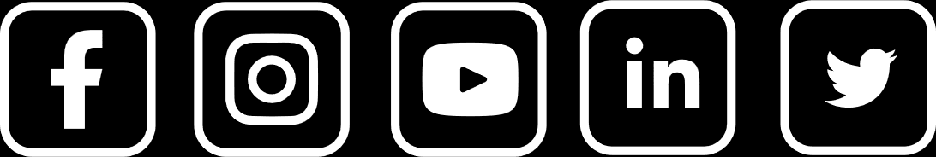
Thank You

