Slide 1



Human Resource Management
Lecture 8
MGM111
Principle of Management
Prepared by
Dr. Bothaina Mahmoud Fouad
www.midocean.ae
www.midocean.ae

Slide 2

Lec. 8
The main points:
Human resources define
Function of human resources
Human Resource Management
Human resource planning
Dynamic Human Resource Management Environment
Human Resource Management Functions
www.midocean.ae

Slide 3
Human Resource Definition
Human resources (HR)
is the department in every organization that is responsible for the hiring, managing, and exit-related functions in the organization. It focuses on the functions of people in business, following the best work practices.
www.midocean.ae

Slide 4
Human Resource, other Definition
Human Resources (HR) are the people an organization employs to carry out various jobs, tasks, and functions in exchange for wages, salaries, and other rewards.
www.midocean.ae

Slide 5
Function of Human Resources
Human resource planning
Recruitment and selection
Training and development
Maintenance of personnel records
Legislation التشريع والقواعد
Employee relations
Grievance and discipline التظلم والإنضباط
www.midocean.ae

Slide 6
Human Resource Management
The process of planning, organizing, directing (motivating), and controlling the procurement, development, compensation, integration, maintenance, and separation of organizational human resources to the end that organizational, individual, and societal needs are satisfied.
www.midocean.ae

Slide 7
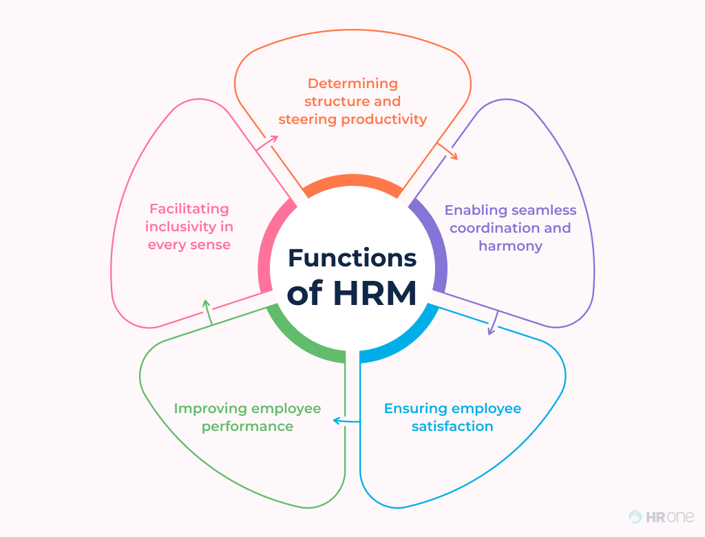
5 Main Human Resource Management Objectives
www.midocean.ae

Slide 8
5 Main Human Resource Management Objectives
Determining structure and steering productivity
To organize the structure, work policies and ethics must be defined clearly. Thereafter, to steer productivity, HRM helps in hiring the best fit for the vacant position and then works on polishing the resource with proper training, workshops, seminars
www.midocean.ae

Slide 9
5 Main Human Resource Management Objectives
Enabling seamless coordination and harmony
Every individual brings a set of interpersonal traits and values with them. Majority of them have different opinions and values which become a reason for conflict sometime or the other.
Even a slight disagreement on political views can disrupt the harmony. Additionally, coordination among various departments and within each department must be taken care of.
www.midocean.ae

Slide 10
5 Main Human Resource Management Objectives
Ensuring employee satisfaction
It is vital for the human resource professionals to keep the employees happy with the organization. Disgruntled employees can never contribute optimally.
So, strategies should be made and executed to keep the employees satisfied. Work environment, rewards and recognition in the form of incentives, must be planned to strengthen the bond and surge the happiness. All this is done to align the individual goals of the employees with that of the organization.
www.midocean.ae

Slide 11
5 Main Human Resource Management Objectives
Improving employee performance
Measuring performance of employees is another important HRM objective. To keep the employees fueled and the productivity soaring, HRs should evaluate the employee’s performance.
Frequent feedback and rewards help employees in staying focused and improving their work even more. They also help a lot at the time of appraisals as you don’t have to rely on your memory but the data
www.midocean.ae

Slide 12
5 Main Human Resource Management Objectives
Facilitating inclusivity in every sense
Making workplaces inclusive is the need of the hour. The objective may seem to be relatively new, The HRM must work to end the disparity based on caste, creed, and gender in salaries. There should also be no bias at the time of recruiting. If they deserve the position, they should get it.
Sessions for gender sensitization should be conducted and a check on behavior of employees towards each other should also be kept.
www.midocean.ae

Slide 13
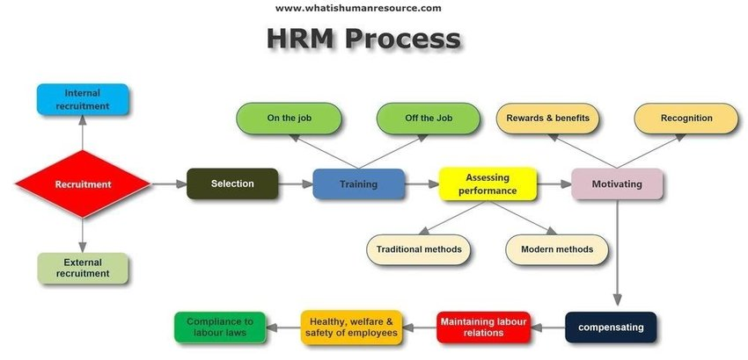
www.midocean.ae

Slide 14
In most organizations today, the role of human resource management has become quite important.
This results partly from a growing realization of the importance of people as a source of competitive advantage, but there are more practical reasons, such as: Human Resource Management in Larger and small Organizations
www.midocean.ae

Slide 15
Larger Organizations
Smaller Organizations
As the organization grows a separate human resource unit becomes a necessity.
When an organization reaches 200 to 250 employees, it generally establishes a self-contained human resource department.
As the organization continues to grow the human resource department grow as well into specialized departments.
Small organizations still use operating managers to handle their basic human resource functions.
Small independent businesses are generally operated in the same way as small organizations.
Very small organizations are exempt from many legal regulations.
www.midocean.ae

Slide 16
Human Resource Management includes all activities used to attract & retain employees and to ensure they perform at a high level in meeting organizational goals.
www.midocean.ae

Slide 17
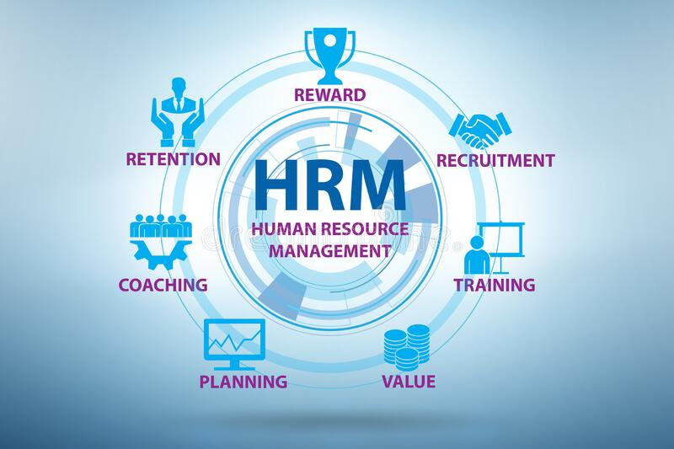
Human Resource Management
These activities are made up of:
    1. Recruitment & selection.
    2. Training and development.
    3. Performance appraisal and feedback.
    4. Pay and benefits.
    5. Labor relations.
www.midocean.ae

Slide 18
Human Resource Management Functions
1
Staffing
Human Resource Management
Human Resource Development
Employee Relations and Labor
Compensation
Safety and Health
www.midocean.ae

Slide 19
1
Staffing
Staffing
Human Resource Management
Human Resource Development
Process through which organization ensures it always has proper number of employees with appropriate skills in right jobs at right time to achieve organizational objectives
Employee Relations and Labor
Compensation
Safety and Health
www.midocean.ae

Slide 20
Staffing
Job Analysis
Selection
Human Resource Planning
Recruitment
Systematic process of determining skills, duties, and knowledge required for performing jobs in organization
Attracting individuals on a timely basis, in sufficient numbers, and with appropriate qualifications, to apply for jobs with an organization
Choosing from a group of applicants the individual best suited for a particular position in the organization
includes all activities managers do to forecast current and future HR needs
www.midocean.ae

Slide 21
Job Analysis
The act of examining positions within an organization
Job Description-narrative explaining the scope of a position
Job Characteristics-tasks involved in a position
Job Requirements-personal characteristics necessary to fill a position
www.midocean.ae

Slide 22
  After a pool of applicants are identified, qualifications related to the job requirements are determined:
  Background Information: includes education, prior employment, college major, etc.
  Interview: almost all firms use one of two types:
  Structured interview: managers ask each person the same job-related questions.
  Unstructured interview: held like a normal conversation.
  Physical Ability Test: measure strength & endurance )good for physically demanding jobs(
Selection
Background
Information
Interviews
References
Selection
Performance tests
Paper tests
Ability Physical
tests
www.midocean.ae

Slide 23
Ability test: assess if applicant has right skills for the job.
Personality test: seek traits relevant to job performance. ( Be sure test is a good predictor of job performance).
Performance Tests: measure job performance.( Typing speed test is one example).
References: outside people provide candid information about candidate. (Can be hard to get accurate information).
Background
Information
Interviews
References
Selection
Performance tests
Paper tests
Ability Physical
tests
www.midocean.ae

Slide 24
HR Planning
Must be done prior to recruitment and selection
Demand forecasts made by managers estimate the number & qualifications the firm will need.
Supply forecasts estimate the availability and qualifications of current workers and those in the labor market.
Factors affecting human resource planning
Competition
Changing goals of a business
Changes in market
Changes in technology
Population changes
Trades unions
Government legislation
www.midocean.ae

Slide 25
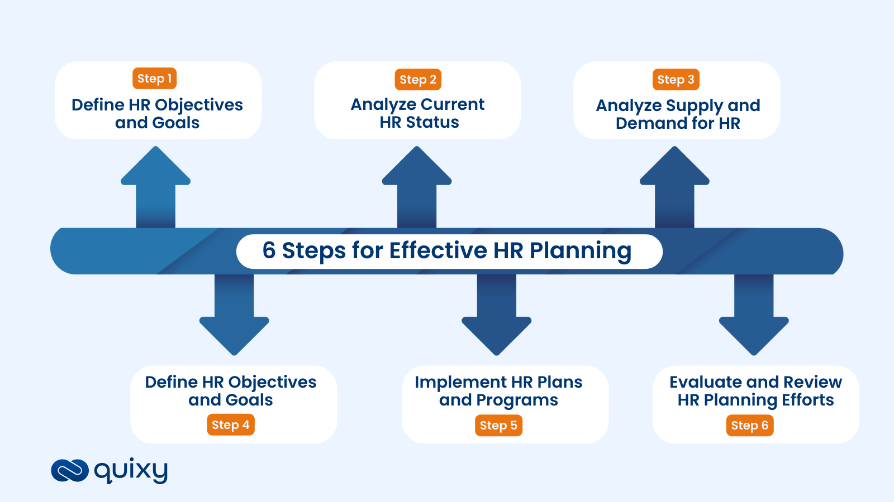
6 Steps for Effective HR Planning
Develop HR action plan
Step 4
www.midocean.ae

Slide 26
Recruitment
External recruiting
Managers look outside the firm for people who have not worked at the firm before.
Internal recruiting
positions filled within the firm.
Managers advertise in newspapers, hold open houses, recruit at universities, and on the Internet.
www.midocean.ae

Slide 27
Compare between External & Internal recruiting
External recruiting
is difficult since many new jobs have specific skill needs.
Internal recruiting
Workers know the firm’s culture, may not have new ideas.
Managers likely already know the candidates.
Internal advancement can motivate employees.
www.midocean.ae

Slide 28
Human Resource Development
1
Human Resource Development
Staffing
Training - Designed to provide learners with knowledge and skills needed for their present jobs
Development - Involves learning that goes beyond today's job; it has more long-term focus
Career planning - Ongoing process whereby individual sets career goals and identifies means to achieve them
Human Resource Management
Employee Relations and Labor
Compensation
Safety and Health
www.midocean.ae

Slide 29
Training
    Build worker’s skills to enable them to take on new duties.
Development
    Teach organizational members how to perform current jobs.
  Training used more often at lower levels of firm, development is common with managers.
www.midocean.ae

Slide 30
Human Resource Development
1
Human Resource Development
Staffing
Career development - Formal approach used by organization to ensure that people with proper qualifications and experiences are available when needed
Organization development - Planned process of improving organization by developing its structures, systems, and processes to improve effectiveness and achieving desired goals.
Human Resource Management
Employee Relations and Labor
Compensation
Safety and Health
www.midocean.ae

Slide 31
Human Resource Development
1
Human Resource Development
Staffing
Performance management - Goal-oriented process directed toward ensuring organizational processes are in place to maximize productivity of employees, teams, and ultimately, the organization
Performance appraisal - Formal system of review and evaluation of individual or team task performance
Human Resource Management
Employee Relations and Labor
Compensation
Safety and Health
www.midocean.ae

Slide 32
Process of evaluating employee performance
  job related strengths
  development needs
  progress toward goals
  determine ways to improve performance
  Pay an promotion decisions
More systematic is better, for the most part
www.midocean.ae

Slide 33
Compensation
1
All rewards that individuals receive as a result of their employment.
Direct Financial Compensation - Pay that person receives in form of wages, salaries, bonuses, and commissions.
Indirect Financial Compensation (Benefits) - All financial rewards not included in direct compensation such as paid vacations, sick leave, holidays, and medical insurance.
Nonfinancial Compensation - Satisfaction that person receives from job itself or from psychological and/or physical environment in which person works.
Staffing
Human Resource Development
Human Resource Management
Employee Relations and Labor
Compensation
Safety and Health
www.midocean.ae

Slide 34
Safety and Health
1
Staffing
Human Resource Development
Safety - Involves protecting employees from injuries caused by work-related accidents
Health - Refers to employees' freedom from illness and their general physical and mental well being
Human Resource Management
Employee Relations and Labor
Compensation
Safety and Health
www.midocean.ae

Slide 35
Remember
Employees who work in safe environment and enjoy good health are more likely to be productive and yield long-term benefits to organization.
www.midocean.ae

Slide 36
Employee Relations and Labor
1
Staffing
Human Resource Development
Business is required by law to recognize a union and bargain with it in good faith if the firm’s employees want the union to represent them
Human resource activity is often referred to as industrial relations
Most firms today would rather have a union-free environment
Human Resource Management
Employee Relations and Labor
Compensation
Safety and Health
www.midocean.ae

Slide 37
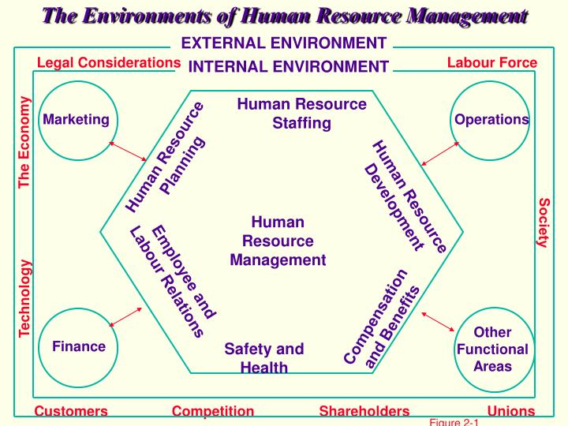
Environment of Human Resource Management
www.midocean.ae

Slide 38
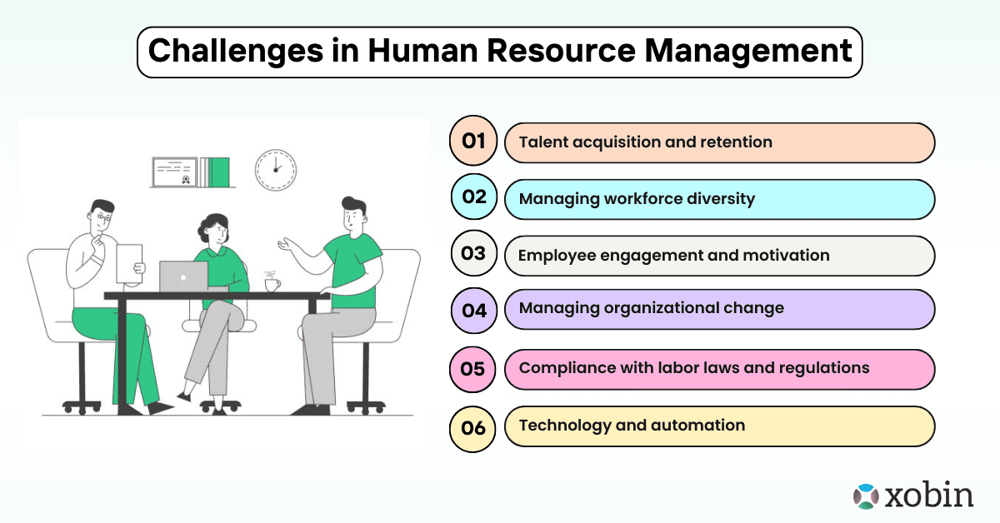
Trends Shaping Human Resource Management
www.midocean.ae

Slide 39
Trends Shaping Human Resource Management
Globalization
and Competition Trends
Indebtedness (“Leverage”) and Deregulation
Technological Trends
Trends in HR Management
Trends in the Nature of Work
Workforce and Demographic Trends
Economic Challenges and Trends
www.midocean.ae

Slide 40



Thank You

