Slide 1



Principles of Management Information Systems
MGM331
Lecture 9
Business Intelligence and Analytics
Prepared by
Dr. Eng. Youssef Ntefeh
www.midocean.ae

Slide 2
Chapter 9
We are living in the age of big data, with new data flooding us from all directions at the incomprehensible speed of nearly a zettabyte (1 trillion gigabytes) per year.
What is most exciting about this data is not its amount, but rather the fact that we are gaining the tools and understanding to do something truly meaningful with it.
Organizations are learning to analyze large amounts of data not only to measure past and current performance but also to make predictions about the future.
These forecasts will drive anticipatory actions to improve business strategies, strengthen business operations, and enrich decision making—enabling the organization to become more competitive.

Slide 3
Chapter 9
Business users need easier and faster ways to discover relevant patterns and insights into data to better support their decision making and to make their companies more agile.
Companies that have access to the same kind of data as their competitors but can analyze it sooner to take action faster will outpace their peers.
Providing BI tools and making business analytics more understandable and accessible to these users should be a key strategy of organizations.

Slide 4
Chapter 9
Members of financial services organizations use BI and analytics to better understand their customers to enhance service, create new and more appealing products, and better manage risk.
Marketing managers analyze data related to the Web-surfing habits, past purchases, and even social media activity of existing and potential customers to create highly effective marketing programs that generate consumer interest and increased sales.

Slide 5
Chapter 9
Health care professionals who are able to improve the patient experience will reap the benefits of maximized reimbursements, lower costs, and higher market share, and they will ultimately deliver higher quality care for patients.
Human resources managers use analytics to evaluate job candidates and choose those most likely to be successful. They also analyze the impact of raises and changes in employee-benefit packages on employee retention and long-term costs.

Slide 6
Chapter 9
Regardless of your field of study in school and your future career, using BI and analytics, will likely be a significant component of your job.
As you study this chapter, pay attention to how different organizations use business analytics.
This chapter starts by introducing basic concepts related to BI and analytics. Later in the chapter, several BI and analytics tools and strategies are discussed.

Slide 7
Principles
Business intelligence (BI) and analytics are used to support improved decision making.
There are many BI and analytics techniques and tools that can be used in a wide range of problem solving situations.

Slide 8
Learning Objectives
Define the terms business intelligence (BI) and analytics.
Provide several real-world examples of BI and analytics being used to improve decision making.
Identify the key components that must be in place for an organization to get real value from its BI and analytics efforts.
Identify several BI techniques and discuss how they are used.
Identify several BI tools.
Define the term self-service analytics and discuss its pros and cons.

Slide 9
Introduction
This chapter begins with a definition of business intelligence (BI) and business analytics and the components necessary for a successful BI and analytics program.
The chapter goes on to describe and provide examples of the use of several BI techniques and tools. It ends with a discussion of some of the issues associated with BI and analytics.

Slide 10
Chapter 9
Business Intelligence and Analytics
What Are Analytics and Business Intelligence?
Benefits Achieved from BI and Analytics
Components Required for Effective BI and Analytics
Business Intelligence and Analytics Tools
Spreadsheets
Reporting and Querying Tools
Data Visualization Tools
Drill-Down Analysis
Linear Regression
Data Mining
Dashboards
Self-Service Analytics

Slide 11
What Are Analytics and Business Intelligence?
Business analytics is the extensive use of data and quantitative analysis to support fact-based decision making within organizations.
Business analytics can be used to gain a better understanding of current business performance, reveal new business patterns and relationships, explain why certain results occurred, optimize current operations, and forecast future business results.
Business intelligence (BI) includes a wide range of applications, practices, and technologies for the extraction, transformation, integration, visualization, analysis, interpretation, and presentation of data to support improved decision making.

Slide 12

Benefits Achieved from BI and Analytics
Detect fraud: Life insurance company implemented analytical software to help its special investigations unit identify fraud.
Improve forecasting: Kroger serves customers in 2000 pharmacies. The company found that by better predicting pharmacy customer demand, it could reduce the number of prescriptions that it was unable to fill because a drug is out of stock. To do so, Kroger developed a sophisticated inventory management system that could provide employees with a visualization of inventory levels, adapt to user feedback, and support “what-if” analysis.
Increase in sales of $80 million per year
reduce its overall inventory costs by $120 million per year

Slide 13
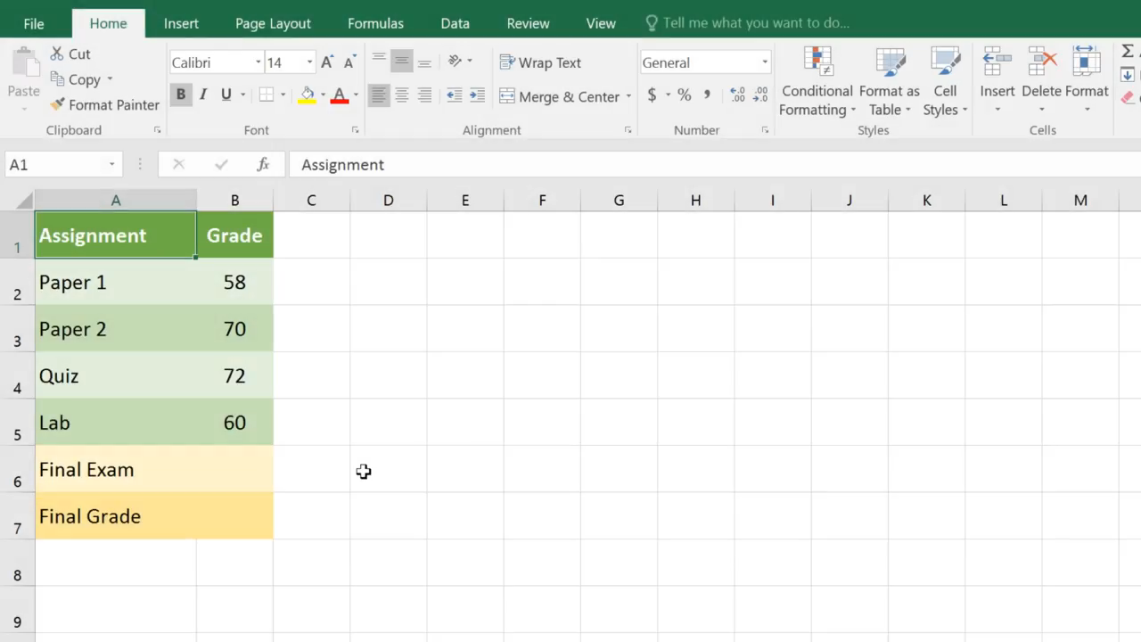
What-if analysis.

Slide 14

Benefits Achieved from BI and Analytics
Increase Sales: DaimlerChrysler set their suggested retail and wholesale prices for the year, then adjust pricing through seasonal incentives based on the impact of supply and demand. The firm estimates that use of the system has generated additional annual sales of $500 million.
Optimize operations: Chevron uses an analytical system called Petro to aid analysts in advising the refineries and oil traders on the mix of products to produce, buy, and sell in order to maximize profit.

Slide 15

Benefits Achieved from BI and Analytics
Reduce costs: Coca-Cola Enterprises is the world’s largest bottler and distributor of Coca Cola products. Its delivery fleet of 54,000 trucks
Using analytics software, the firm implemented a vehicle-routing optimization system that resulted in savings of $45 million a year from reduced gas consumption and reduction in the number of drivers required.

Slide 16
Chapter 9
Business Intelligence and Analytics
What Are Analytics and Business Intelligence?
Benefits Achieved from BI and Analytics
Components Required for Effective BI and Analytics
Business Intelligence and Analytics Tools
Spreadsheets
Reporting and Querying Tools
Data Visualization Tools
Drill-Down Analysis
Linear Regression
Data Mining
Dashboards
Self-Service Analytics

Slide 17
Components Required for Effective BI and Analytics
A number of components must be in place for an organization to get real value from its BI and analytics efforts.
First and foremost is the existence of a solid data management program, including data governance.
Recall that data management is an integrated set of functions that defines the processes by which data is obtained, certified fit for use, stored, secured, and processed in such a way as to ensure that the accessibility, reliability, and timeliness of the data meet the needs of the data users within an organization.

Slide 18
Components Required for Effective BI and Analytics
Data governance is the core component of data management; it defines the roles, responsibilities, and processes for ensuring that data can be trusted and used by the entire organization, with people identified and in place who are responsible for fixing and preventing issues with data.
Another key component that an organization needs is creative data scientists people who understand the business as well as the business analytics technology, while also recognizing the limitations of their data, tools, and techniques. A data scientist puts all of this together to deliver real improvements in decision making with an organization.

Slide 19
Components Required for Effective BI and Analytics
Finally, to ensure the success of a BI and analytics program, the management team within an organization must have a strong commitment to data driven decision making.
Organizations that can put the necessary components in place can act quickly to make superior decisions in uncertain and changing environments to gain a strong competitive advantage.

Slide 20
Chapter 9
Business Intelligence and Analytics
What Are Analytics and Business Intelligence?
Benefits Achieved from BI and Analytics
Components Required for Effective BI and Analytics
Business Intelligence and Analytics Tools
Spreadsheets
Reporting and Querying Tools
Data Visualization Tools
Drill-Down Analysis
Linear Regression
Data Mining
Dashboards
Self-Service Analytics

Slide 21
Business Intelligence and Analytics Tools
Spreadsheets
Business managers often import data into a spreadsheet program, such as Excel, which then can be used to perform operations on the data based on formulas created by the end user.
Spreadsheets are also used to create reports and graphs based on that data. End users can employ tools such as the Excel Scenario Manager to perform “what-if” analysis to evaluate various alternatives.
The Excel Solver Add-in can be used to find the optimal solution to a problem with multiple constraints (e.g., determine a production plan that will maximize profit subject to certain limitations on raw materials).

Slide 22
Business Intelligence and Analytics Tools
Reporting and Querying Tools
Most organizations have invested in some reporting tools to help their employees get the data they need to solve a problem or identify an opportunity.
Reporting and querying tools can present that data in an easy-to-understand fashion via formatted data, graphs, and charts.
Many of the reporting and querying tools enable end users to make their own data requests and format the results without the need for additional help from the IT organization.

Slide 23
Business Intelligence and Analytics Tools
Data Visualization Tools
Data visualization is the presentation of data in a pictorial or graphical format.
The human brain works such that most people are better able to see significant trends, patterns, and relationships in data that is presented in a graphical format rather than in tabular reports and spreadsheets.
As a result, decision makers welcome data visualization software that presents analytical results visually. In addition, representing data in visual form is a recognized technique to bring immediate impact to dull and boring numbers.

Slide 24
Business Intelligence and Analytics Tools
Data Visualization Tools
A wide array of tools and techniques are available for creating visual representations that can immediately reveal otherwise difficult-to-perceive patterns or relationships in the underlying data.
Many companies now troll Facebook, LinkedIn, Pinterest, Tumblr, Twitter, and other social media feeds to monitor any mention of their company or product.

Slide 25
Business Intelligence and Analytics Tools
Data Visualization Tools
Data visualization tools can take that raw data and immediately provide a rich visual that reveals precisely who is talking about the product and what they are saying
Techniques as simple as a word cloud can provide a surprisingly effective visual summary of conversations, reviews, and user feedback about a new product.

Slide 26
Business Intelligence and Analytics Tools
Data Visualization Tools
A word cloud is a visual depiction of a set of words that have been grouped together because of the frequency of their occurrence.
Word clouds are generated from analyses of text documents or a Web page.
Using the text from these sources, a simple count is carried out on the number of times a word or phrase appears.
Words or phrases that have been mentioned more often than other words or phrases are shown in a larger font size and/or a darker color, as shown in Figure 9.2.

Slide 27
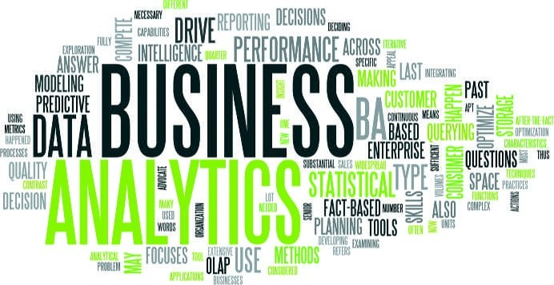
Business Intelligence and Analytics Tools
Data Visualization Tools
FIGURE 9.2
Word cloud: This Word cloud shows the topics covered in this chapter.

Slide 28
Business Intelligence and Analytics Tools
Data Visualization Tools
A conversion funnel is a graphical representation that summarizes the steps a consumer takes in making the decision to buy product and become a customer.
It provides a visual representation of the conversion data between each step and enables decision makers to see what steps are causing customers confusion or trouble.
Figure 9.3 shows a conversion funnel for an online sales organization. It shows where visitors to a Web site are dropping off the successful sales path.

Slide 29
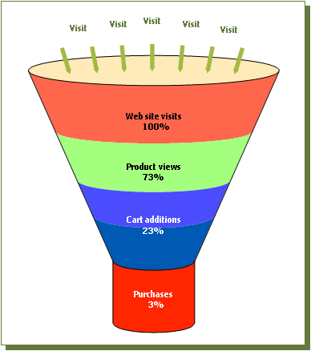
Business Intelligence and Analytics Tools
Data Visualization Tools
FIGURE 9.3: The conversion funnel shows the key steps in converting a consumer to a buyer.

Slide 30

Conversion Funnel

Slide 31
Business Intelligence and Analytics Tools
Drill-Down Analysis
The small things in plans and schemes that don’t go as expected can frequently cause serious problems later on—the devil is in the details.
Drill-down analysis is a powerful tool that enables decision makers to gain insight into the details of business data to better understand why something happened.
Drill-down analysis involves the interactive examination of high-level summary data in increasing detail to gain insight into certain elements—sort of like slowly peeling off the layers of an onion.

Slide 32
Business Intelligence and Analytics Tools
Drill-Down Analysis
For example, in reviewing the worldwide sales for the past quarter, the vice president of sales might want to drill down to view the sales for each country.
Further drilling could be done to view the sales for a specific country (say Germany) for the last quarter.
A third level of drill-down analysis could be done to see the sales for a specific country for a specific month of the quarter (e.g., Germany for the month of September).
A fourth level of analysis could be accomplished by drilling down to sales by product line for a particular country by month (e.g., each product line sold in Germany for the month of September).

Slide 33
Business Intelligence and Analytics Tools
Linear Regression
Simple linear regression is a mathematical technique for predicting the value of a dependent variable based on a single independent variable and the linear relationship between the two.
Linear regression consists of finding the best fitting straight line through a set of observations of the dependent and independent variables.
By far, the most commonly used measure for the best-fitting line is the line that minimizes the sum of the squared errors of prediction. This best fitting line is called the regression line (see Figure 9.6).
Linear regression does not mean that one variable causes the other; it simply says that when one value goes up, the other variable also increases or decreases proportionally

Slide 34
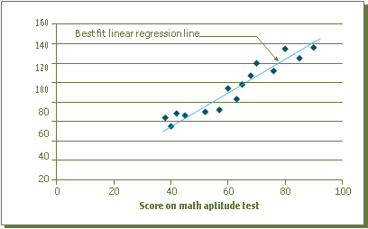
Business Intelligence and Analytics Tools
Linear Regression
FIGURE 9.6: Simple linear regression. This graph shows a linear regression that predicts students’ final exam scores based on their math aptitude test score.

Slide 35
Business Intelligence and Analytics Tools
Data Mining
Data mining is a BI analytics tool used to explore large amounts of data for hidden patterns to predict future trends and behaviors for use in decision making.
Used appropriately, data mining tools enable organizations to make predictions about what will happen so that managers can be proactive in capitalizing on opportunities and avoiding potential problems.
Among the three most commonly used data mining techniques are association analysis (a specialized set of algorithms sorts through data and forms statistical rules about relationships among the items), neural computing (historical data is examined for patterns that are then used to make predictions), and case-based reasoning (historical if-then-else cases are used to recognize patterns).

Slide 36
Business Intelligence and Analytics Tools
Data Mining
Here are a few examples showing how data mining can be used:
Based on past responses to promotional mailings, identify those consumers most likely to take advantage of future mailings.
Examine retail sales data to identify seemingly unrelated products that are frequently purchased together.
Monitor credit card transactions to identify likely fraudulent requests for authorization.

Slide 37
Business Intelligence and Analytics Tools
Data Mining
Here are a few examples showing how data mining can be used:
Use hotel booking data to adjust room rates so as to maximize revenue.
Analyze demographic data and behavior data about potential customers to identify those who would be the most profitable customers to recruit.
Study demographic data and the characteristics of an organization’s most valuable employees to help focus future recruiting efforts.
Recognize how changes in an individual’s DNA sequence affect the risk of developing common diseases such as Alzheimer’s or cancer.

Slide 38
Business Intelligence and Analytics Tools
Dashboards
Measures are metrics that track progress in executing chosen strategies to attain organizational objectives and goals.
These metrics are also called key performance indicators (KPIs) and consist of a direction, measure, target, and time frame.
To enable comparisons over different time periods, it is also important to define the KPIs and to use the same definition from year to year. Over time, some existing KPIs may be dropped and new ones added as the organization changes its objectives and goals. Obviously, just as different organizations have different goals, various organizations will have different KPIs.

Slide 39
Business Intelligence and Analytics Tools
Dashboards
The following are examples of well-defined KPIs:
For a university. Increase (direction) the five-year graduation rate for incoming freshman (measure) to at least 80 percent (target) starting with the class of 2024 (time frame).
For a customer service department. Increase (direction) the number of customer phone calls answered within the first four rings (measure) to at least 90 percent (target) within the next three months (time frame).

Slide 40
Business Intelligence and Analytics Tools
Dashboards
A dashboard presents a set of KPIs about the state of a process at a specific point in time.
Dashboards provide users at every level of the organization the information they need to make improved decisions.
Operational dashboards can be designed to draw data in real time from various sources, including corporate databases and spreadsheets, so decision makers can make use of up-to-the-minute data.

Slide 41
Business Intelligence and Analytics Tools
Self-Service Analytics
Self-service analytics includes training, techniques, and processes that empower end users to work independently to access data from approved sources to perform their own analyses using an endorsed set of tools.
In the past, such data analysis could only be performed by data scientists. Self service analytics encourages nontechnical end users to make decisions based on facts and analyses rather than intuition.

Slide 42
Business Intelligence and Analytics Tools
Self-Service Analytics
Self-service analytics eliminates decision-making delays that can arise if all requests for data analyses must be made through a limited number of data scientists and/or information system resources. It also frees up these resources to do higher-level analytics work.
Ideally, self-service analytics will lead to faster and better decision making.

Slide 43
Business Intelligence and Analytics Tools
Self-Service Analytics
An organization can take several actions to ensure an effective self-service analytics program.
First, to mitigate the risks associated with self-service analytics, data managers should work with business units to determine key metrics, an agreed-upon vocabulary, processes for creating and publishing reports, the privileges required to access confidential data, and how to define and implement security and privacy policies.

Slide 44
Business Intelligence and Analytics Tools
Self-Service Analytics
Training, on both the data and on the use of self-service applications, is critical for getting end workers up to speed on how they can use the information in the BI system.
Finally, data privacy and security measures should be in place to ensure that the use of the data meets legal, compliance, and regulatory requirements.

Slide 45
Business Intelligence and Analytics Tools
Table 9.3 presents the pros and cons associated with self-service BI and analytics.
Pros | Cons
Gets valuable data into the hands of the people who need it the most—end users. | If not well managed, it can create the risk of erroneous analysis and reporting, leading to potentially damaging decisions within an organization.
Encourages nontechnical end users to make decisions based on facts and analyses rather than intuition. | Different analyses can yield inconsistent conclusions, resulting in wasted time trying to explain the differences.
Accelerates and improves decision making. | Can lead to over spending on unapproved data sources and business analytics tools.
Business people can access and use the data they need for decision making, without having to go to technology experts each time they have a new question, thus filling the gap caused by a shortage of trained data scientists. | Can exacerbate problems by removing the checks and balances on data preparation and use. Without strong data governance, organizations can end up with lots of silos of information, bad analysis, and extra costs.

Slide 46
Summary
The goal of business intelligence (BI) and analytics is to support improved decision making.
Business intelligence (BI) includes a wide range of applications, practices, and technologies for the extraction, transformation, integration, visualization, analysis, and presentation of data to support improved decision making.
Business analytics is the extensive use of data and quantitative analysis to support fact-based decision making within organizations.

Slide 47
Summary
A data scientist is an individual who combines strong business acumen, a deep understanding of analytics, and a healthy appreciation of the limitations of their data, tools, and techniques to deliver real improvements in decision making.
A number of components must be in place for an organization to get real value from its BI and analytics efforts: a solid data management program (including a strong data governance element), creative data scientists, and a strong organizational commitment to data-driven decision making.

Slide 48
Summary
There are many BI and analytics techniques and tools that can be used in a wide range of problem-solving situations.
Spreadsheets, reporting and querying tools, data visualization, drill-down analysis, linear regression, data mining, and dashboards are examples of commonly used BI tools.
Business managers and end users often turn to spreadsheets to create useful reports and graphs, as well as to employ “what-if” analyses and find the optimal solution to a problem with multiple constraints.

Slide 49
Summary
Reporting and querying tools can present data in an easy-to-understand fashion—via formatted data, graphs, and charts.
Many of the reporting and querying tools enable end users to make their own data requests and format the results without the need for additional help from the IT organization.
Data visualization is the presentation of data in a pictorial or graphical format. A wide array of tools and techniques are available for creating visual representations that can immediately reveal otherwise difficult-to-perceive patterns or relationships in the underlying data.

Slide 50
Summary
Drill-down analysis involves the interactive examination of high-level summary data in increasing detail to gain insight into certain elements.
Simple linear regression is a mathematical procedure technique for predicting the value of a dependent variable based on a single independent variable and the linear relationship between the two.
Data mining is a BI analytics tools used to explore large amounts of data for hidden patterns to predict future trends and behaviors for use in decision making.

Slide 51
Summary
A dashboard presents a set of KPIs about the state of a process at a specific point in time.
Dashboards provide rapid access to information, in an easy to interpret and concise manner, which helps organizations run more effectively and efficiently.
Self-service analytics includes training, techniques, and processes that empower end users to work independently to access data from approved sources to perform their own analyses using an endorsed set of tools.
Self service analytics empowers end users to work independently.
A number of measures must be in place to ensure an effective self-serve analytics program and to reduce the risk of invalid analyses leading to poor decisions.

Slide 52


Reference

