Slide 1



Business Data Analysis
MGM509
Lecture 10
Strategic Data Science: Engineering Solutions, Advanced Techniques, and Business Strategy
Prepared by
Eng. Ahmed Hussein, MBA, PfMP©, PMP©, CMP APMG

Slide 2

Lecture
What we will cover
10
Other Data Science Tasks and Techniques
Analytical Engineering
Data Science and Business Strategy
10 – 2

Slide 3


Other Data Science Tasks and Techniques
Lecture
10
10 – 3

Slide 4
Lecture
Overview of Broader DS Tasks
10
Not all data science tasks are classification, clustering or regression.
Many problems focus on understanding structure, group behavior, or novelty.
Other valuable methods:
Co-occurrence grouping
Profiling
Link prediction
Casual Inference
Latent Information Discovery
10 – 4

Slide 5
Lecture
Co-Occurrence Grouping
10
Identifies items or events that tend to appear together in data, revealing meaningful associations or patterns.
When two or more elements (e.g., words, products, events) frequently appear together in the same context (e.g., document, transaction, session).
Classic examples:
  Market basket analysis (e.g., “customers who bought X also bought Y”)
  Text mining (e.g., identifying topic-related word pairs)
  Recommendation systems
Uses association rules (e.g., Apriori algorithm).
Applied in retail, recommendations, and content bundling.
10 – 5

Slide 6
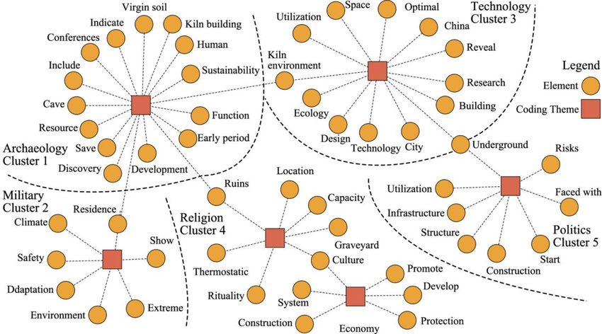
Lecture
Co-Occurrence Grouping
10
Techniques Used:
  Association Rule Mining: e.g., Apriori, FP-Growth
  Pointwise Mutual Information (PMI): for text
  Co-occurrence matrices and heatmaps
Insights Provided:
  Uncover latent relationships or groupings
  Support feature engineering and similarity detection
  Drive personalization and targeting strategies
10 – 6

Slide 7
Lecture
Profiling - Summarizing Behavior
10
Profiling involves creating a summarized representation of an individual, group, or entity’s behavior.
Uses statistical and categorical features to describe users/customers (e.g., average purchase value, churn rate, visit frequency).
Group entities with similar behavior (e.g., “frequent buyers,” “inactive users,” “deal seekers”).
Personalization and Targeting: Profiles inform tailored recommendations, offers, or communications.
10 – 7

Slide 8
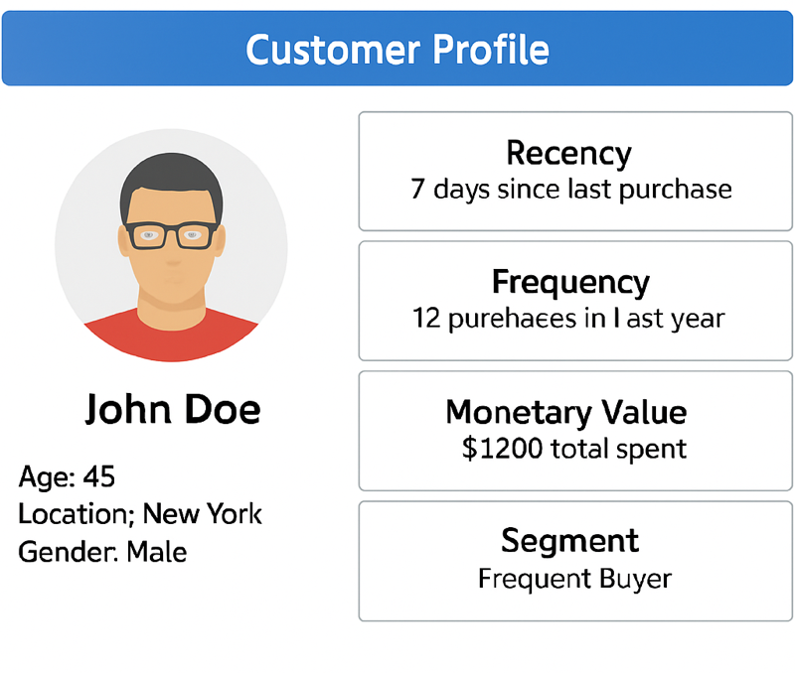
Lecture
Profiling - Summarizing Behavior
10
Use Cases:
  Customer relationship management (CRM)
  Fraud detection
  Risk profiling in finance
  Patient behavior tracking in healthcare
Techniques Involved:
  Aggregation (sums, averages, frequencies)
  Clustering (e.g., K-Means for customer segments)
  Feature extraction (e.g., recency, frequency, monetary value – RFM)
10 – 8

Slide 9
Lecture
Link Prediction
10
Predicts whether a connection (link) between two entities in a network should exist or will exist in the future.
Common in social networks, e-commerce, and citation analysis.
Example: Suggesting new friends on Facebook.
Common Techniques:
Heuristic-Based Common Neighbors, Jaccard Coefficient, Preferential Attachment
Embedding-Based
Node2Vec, DeepWalk, Graph Neural Networks (GNNs)
Matrix Factorization
Decompose adjacency matrix to predict unseen links
10 – 9

Slide 10
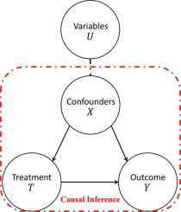
Lecture
Causal Inference
10
Determines whether and how one variable causes a change in another, not just whether they are correlated.
Moves beyond correlation to explain and predict interventions
Helps make strategic business decisions (e.g., “Did the ad campaign cause increased sales?”)
Essential in policy-making, medicine, economics, and A/B testing.
Techniques:
  Randomized Controlled Trials (RCTs):
  Observational Methods: Propensity Score Matching. Difference-in-Differences. Instrumental Variables, Causal Graphs (e.g., DAGs)
10 – 10

Slide 11
Lecture
Latent Information Discovery
10
Process of uncovering hidden patterns, structures, or relationships in data that are not immediately observable.
Reveals underlying drivers of behavior (e.g., user intent, hidden topics)
Supports personalization, clustering, and dimensionality reduction
Useful in NLP, marketing, and content analytics.
10 – 11

Slide 12
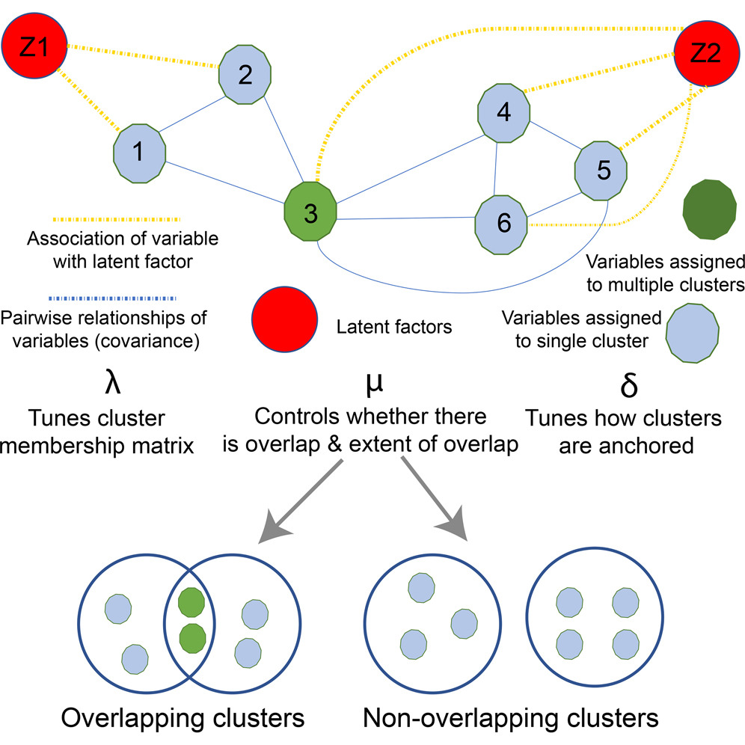
Lecture
Latent Information Discovery Techniques
10
Topic Modeling (e.g., LDA): Discover abstract topics in a collection of documents
Matrix Factorization (e.g., SVD, NMF): Used in recommender systems to uncover user preferences and product features
Embedding Models: Capture latent semantic meanings in text (e.g., Word2Vec, BERT)
Autoencoders / Deep Learning: Reduce dimensions and extract features from images, text, or tabular data
10 – 12

Slide 13
Lecture
Choosing the Right Task
10
Business Goal: What are you trying to improve or predict?
Data Type: Is the data labeled? Structured? Textual?
Desired Output: Category, number, group, pattern?
Interpretability Needs: Will decisions be audited or explained?
Deployment Context: Real-time vs. batch processing?
10 – 13

Slide 14
Lecture
Analytical Engineering
10
10 – 14

Slide 15
Lecture
From Ad Hoc to Engineering
10
Many data science projects are ad hoc, not reusable or scalable.
Analytical engineering aims to make data science solutions systematic and repeatable.
Think in terms of pipelines, standards, and operations.
Move from one-off insights to embedded decision systems.
10 – 15

Slide 16
Lecture
What is Analytical Engineering
10
Definition: Analytical Engineering is the design, implementation, and integration of data-driven solutions into operational systems that support real-world decision-making.
Key Characteristics:
System-Oriented Thinking
Focuses on building end-to-end analytical pipelines that connect data inputs to decision outputs.
Combines Logic + Prediction
Merges business rules with predictive models to automate or enhance decisions.
Operational Integration
Ensures that models and logic are embedded into business workflows, not left on the shelf.
Built for Scale and Sustainability
Prioritizes reliability, maintainability, and performance in real-world conditions (e.g., APIs, dashboards, alerts).
10 – 16

Slide 17
Lecture
Elements of Analytical Engineering
10
Input data pipelines: Clean, structured, timely data.
Decision logic integration: Rule-based + predictive.
Feedback loops: Capture outcomes and retrain.
Evaluation metrics: Tie model performance to business KPIs.
10 – 17

Slide 18
Principles of Decision-Centric
View of Modeling
Lecture
10
Start with the Decision
1
Clearly define the decision the model will inform (e.g., approve loan, target customer with offer).
Align Metrics with Impact
2
Evaluate models based on how they improve decision outcomes, not only accuracy.
Integrate with Business Processes
3
Ensure model outputs are actionable and embedded into workflows.
Balance Complexity vs. Usability
4
A slightly less accurate but easier-to-use model may be more valuable.
Consider Costs and Payoffs
5
Account for the economic or strategic consequences of correct vs. incorrect predictions.
10 – 18

Slide 19
Lecture
Modeling for Business Constraints
10
Designing predictive models that align with operational, financial, legal, and strategic limitations of the business.
Ensures that models are realistic, implementable, and cost-effective
Financial
Optimize for maximum ROI, balancing model accuracy with cost of action.
Operational
Model predictions must fit within available resources (e.g., only 500 customer service calls possible per week).
Regulatory & Ethical
Comply with privacy laws, fairness, and non-discrimination guidelines.
Strategic
Ensure that models align with the organization’s long-term vision, market positioning, and growth priorities,
10 – 19

Slide 20
Lecture
Operationalizing Data Science
10
The process of deploying, integrating, and managing data science models in real-world business environments.
Focuses on turning analytical insights into repeatable, scalable, and actionable outcomes
Key Steps:
Model Deployment
Integrate models into production systems, APIs, or applications for real-time or batch use.
Workflow Integration
Embed predictions into existing business processes and decision-making workflows.
Monitoring & Maintenance
Continuously track model performance, drift, and accuracy over time.
Feedback Loops
Collect outcome data to retrain and improve models for evolving conditions.
Governance & Compliance
Maintain documentation, audit trails, and controls to meet regulatory and business standards.
10 – 20

Slide 21
Lecture
Managing Uncertainty in Practice
10
All predictions and decisions are made with imperfect information.
Key Approaches:
Quantify Uncertainty
Use confidence intervals, probability distributions, or scenario ranges to represent prediction reliability.
Sensitivity Analysis
Test how changes in input variables affect outcomes to identify high-impact factors.
Scenario Planning
Develop “best-case,” “worst-case,” and “most likely” projections for decision-making.
Threshold Adjustment
Adapt decision thresholds based on business risk tolerance (e.g., fraud detection sensitivity).
Continuous Monitoring
Reassess uncertainty as new data arrives or market conditions shift.
10 – 21

Slide 22
Lecture
Managing Uncertainty in Practice
10
Example:
In loan approval modeling, a predicted default probability of 8% ± 3% may require different action than a precise 8%—uncertainty affects risk strategy
10 – 22

Slide 23
Lecture
Feedback Loops & Continuous Learning
10
Data science models degrade over time due to changes in data, behavior, or the market (data drift).
Feedback loops enable models to adapt and improve continuously.
Key Components:
Performance Monitoring
Track KPIs (e.g., accuracy, precision, ROI) in production.
Error Analysis
Identify misclassifications or poor predictions to guide retraining.
Data Refresh
Incorporate new, relevant data into model updates.
Model Retraining
Schedule regular or trigger-based retraining cycles.
Automated Pipelines
Use MLOps tools to automate feedback collection and model updates.
10 – 23

Slide 24
Lecture
Case Example – Targeted Marketing System
10
A telecom company wants to increase customer retention and boost upsell conversions.
Approach:
Data Collection
Customer demographics, purchase history, service usage, support interactions.
Segmentation
Cluster customers into groups (e.g., price-sensitive, high-value, at-risk).
Predictive Modeling
Use machine learning (e.g., logistic regression, random forest) to predict likelihood of purchase or churn.
Campaign Optimization
Match offers to segments (e.g., discounts for price-sensitive, premium features for high-value).
A/B Testing & Feedback
Test campaign versions, measure performance, and refine targeting rules.
10 – 24

Slide 25
Data Science and Business Strategy
Lecture
10
10 – 25

Slide 26
Lecture
Why Strategy Matters?
10
Data science doesn’t operate in a vacuum, Models are only as useful as the business impact they generate.
Predictive analytics should directly support goals like revenue growth, cost reduction, or customer retention
Focus on value creation, not just predictive accuracy: A less accurate model that drives higher profit or better decisions may be more valuable than a perfectly accurate one with no business impact.
Strategy provides direction and decision-making context, and ensures that analytics efforts are prioritized where they deliver the most ROI.
10 – 26

Slide 27
Lecture
Strategic Alignment Model
10
Ensures that data science initiatives directly contribute to the organization’s strategic goals.
Aligns technical execution with business priorities for maximum value.
Business Strategy
Define long-term objectives (e.g., growth, market share, innovation).
Data Science Strategy
Identify analytics capabilities needed to support the business strategy.
Organizational Capabilities
Build the skills, tools, and infrastructure to deliver on the data science strategy.
Execution Alignment
Ensure day-to-day analytics work aligns with both business and data science priorities.
10 – 27

Slide 28
Lecture
Embedding Data Science into Business
10
Integrate analytics into daily operations.
Embedding ensures faster decision-making, greater adoption, and continuous improvement
Key Practices:
Cross-Functional Collaboration
Involve domain experts, analysts, engineers, and decision-makers from the start.
Workflow Integration
Embed model outputs into existing systems (e.g., CRM, ERP, dashboards) so they directly support business actions.
Business Ownership
Ensure stakeholders understand and trust the models enough to act on their recommendations.
Change Management
Provide training and support to encourage adoption and address resistance.
Performance Measurement
Continuously track how embedded models impact business KPIs.
10 – 28

Slide 29
Lecture
Framing Strategic Questions
10
The quality of insights depends on the quality of the questions asked.
Well-framed strategic questions ensure analytics efforts target high-value business problems.
Key Guidelines
1. Align with Business Goals
  Start from the organization’s strategic objectives.
2. Be Specific & Action-Oriented
  Ask questions that lead to clear decisions (e.g., “Which customers are at risk of churn next quarter?”).
10 – 29

Slide 30
Lecture
Framing Strategic Questions
10
3. Incorporate Measurable Outcomes
  Define how success will be evaluated (e.g., “Increase upsell conversion rate by 10%”).
4. Prioritize by Impact & Feasibility
  Focus on areas where analytics can deliver significant value quickly.
5. Challenge Assumptions
  Ensure questions are not biased by existing beliefs or outdated data.
10 – 30

Slide 31
Lecture
Framing Strategic Questions
10
Examples
Retail:
“How can we reduce inventory costs without affecting availability?”
Telecom:
“Which customers should we proactively engage to prevent churn?”
Finance:
“What is the likelihood of default for new loan applicants?”
10 – 31

Slide 32
Lecture
Defining Data-Driven Objectives
10
Clear, measurable objectives ensure analytics projects stay focused and deliver tangible business value.
Principles:
Examples:
  Increase campaign ROI by 15%.
  Reduce fraud by 20% using anomaly detection.
  Link model outputs to business impact.
Align with Strategy
Be SMART
Link to Decisions & Actions
Quantify Expected Impact
Ensure Data Feasibility.
10 – 32

Slide 33
Lecture
Operationalizing Analytics
10
Operationalizing Analytics: Moving analytics from the lab (data science team) into day-to-day business operations.
Ensuring insights are delivered at the right time, to the right people, in the right format.
Steps:
Integrate with Business Processes
Automate Where Possible
Ensure User Adoption
Monitor and Refine
Build Feedback Loops
10 – 33

Slide 34
Lecture
Operationalizing Analytics
10
Examples:
Retail:
Dynamic pricing recommendations integrated into POS systems.
Finance:
Automated fraud alerts for transaction approval systems.
Telecom:
Churn risk scores embedded into customer service tools.
10 – 34

Slide 35
Lecture
Creating Competitive Advantage
10
How: Leveraging analytics to differentiate from competitors in a sustainable way.
Turning data into a strategic asset that others can’t easily replicate.
Key Strengths:
Unique Data Assets
Faster Decision-Making
Personalized Experiences
Operational Excellence
Innovation Enablement
10 – 35

Slide 36
Lecture
Examples
10
Amazon
Predictive product recommendations that drive repeat purchases.
Netflix
Personalized viewing suggestions to keep users engaged.
UPS
Route optimization saving millions in fuel costs.
10 – 36

Slide 37
Lecture
Building Organizational Capability
10
Data science maturity requires:
Skills development
Infrastructure investment
Change in mindset
Embed data science into strategy and culture.
10 – 37

Slide 38
Lecture
Building an Analytics Culture
10
Promote data-driven decision-making at all levels.
Celebrate data-informed wins across the org.
Invest in:
Training
Literacy
Leadership support
10 – 38

Slide 39
Lecture
Key Points
10
Data science covers diverse tasks beyond basic modeling, such as profiling, link prediction, and causal inference.
Analytical engineering integrates scalable, reliable models into operations.
Decision-centric models deliver actionable outputs, not just predictions.
Align analytics with business strategy to drive competitive advantage.
Use feedback loops and uncertainty management for sustainable value.
10 – 39

Slide 40

For Discussion Panel and Next Lecture:
Chapters 11, 12, and 13 in Text Book ”Business Data Analysis”
Lecture
10
For Discussion Panel and Next Lecture
10 – 40

Slide 41



Thank You

