Slide 1


Slide 2
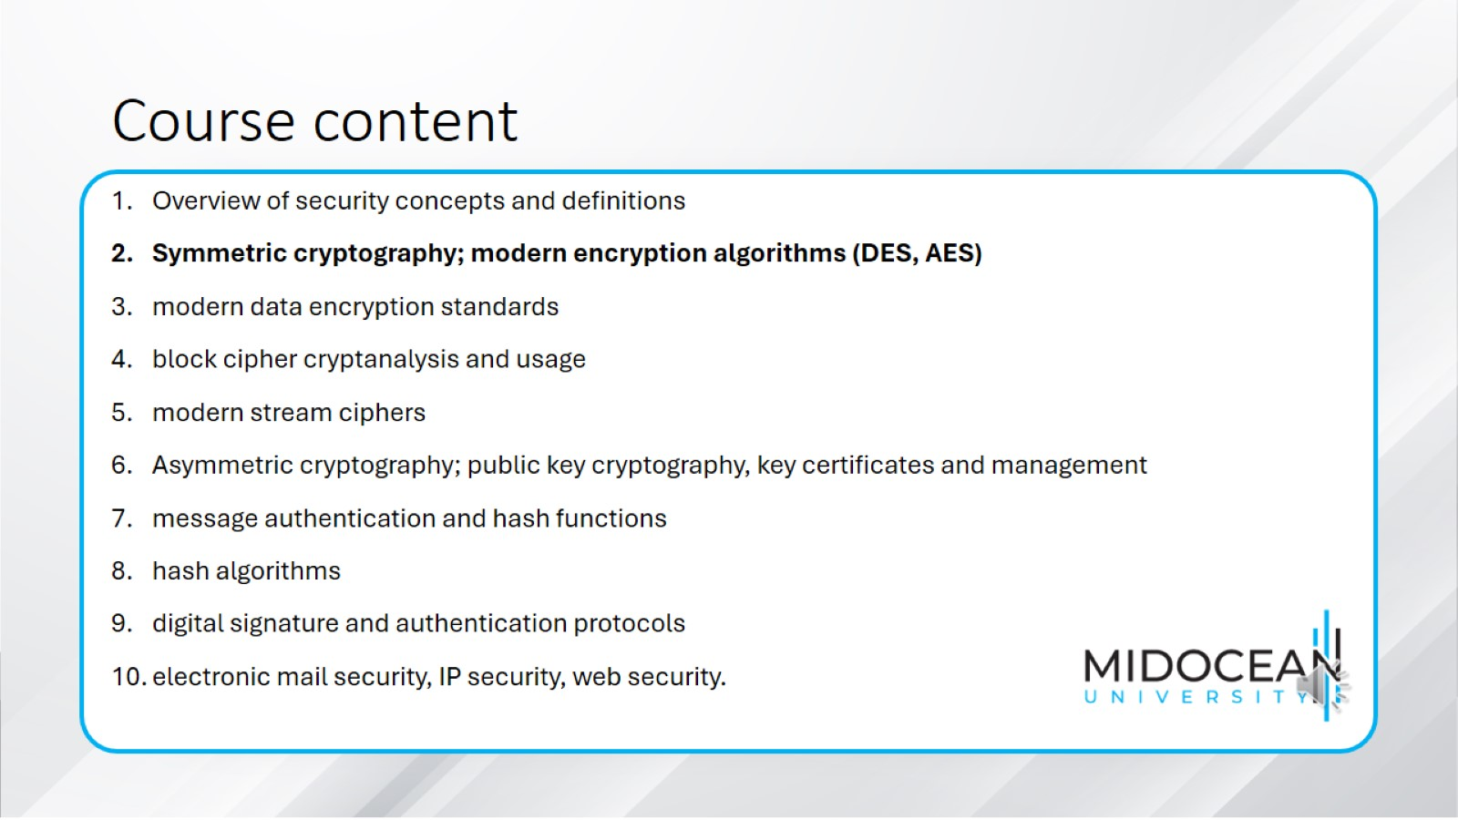
Course content

Slide 3
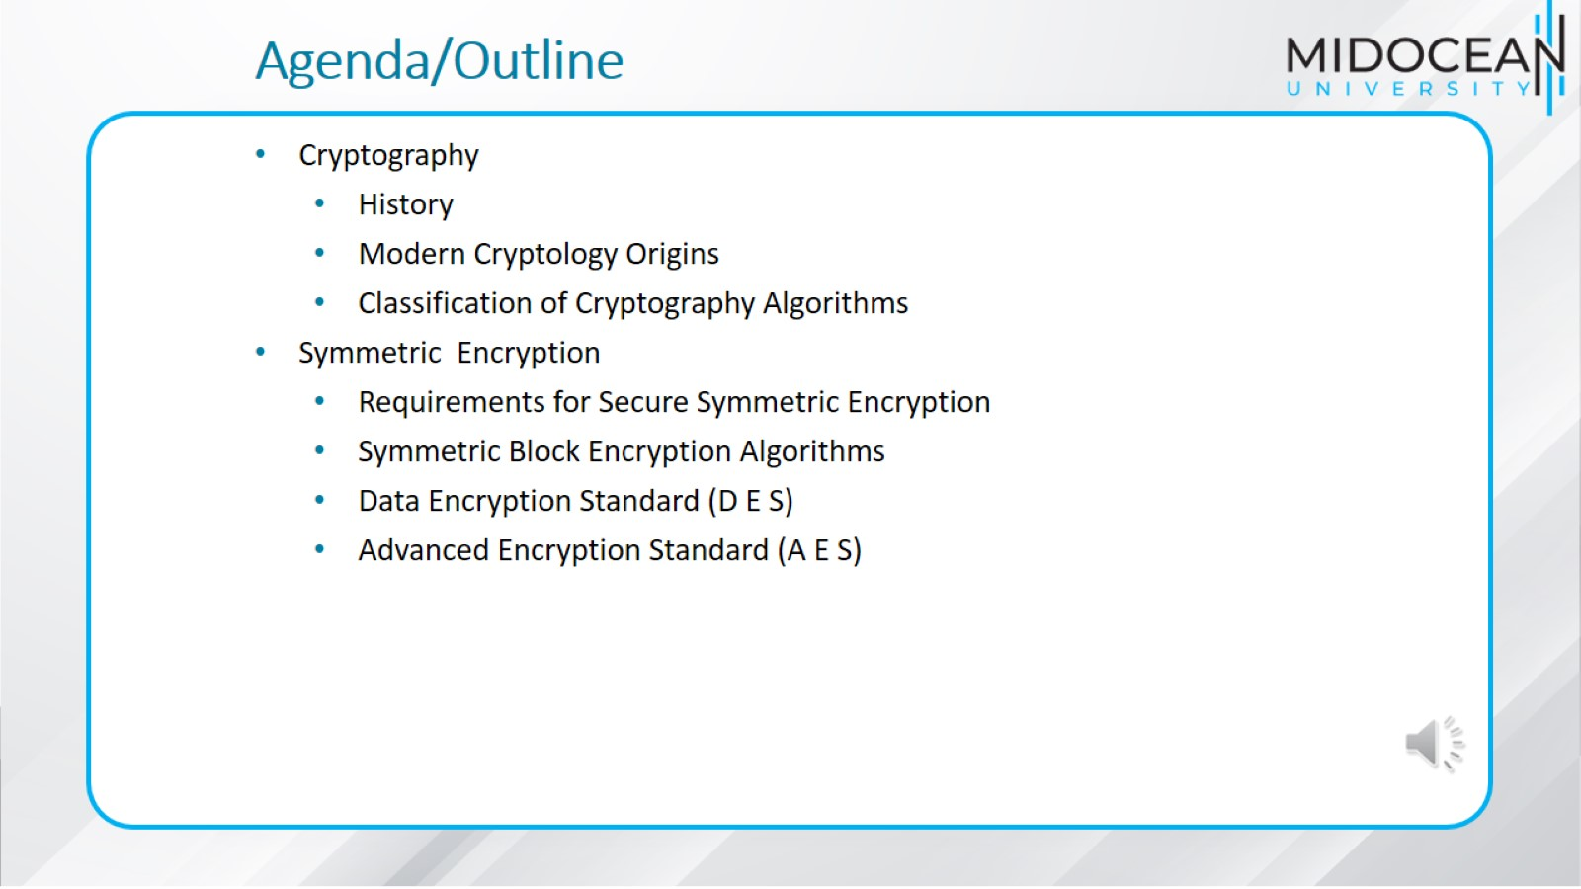
Agenda/Outline

Slide 4
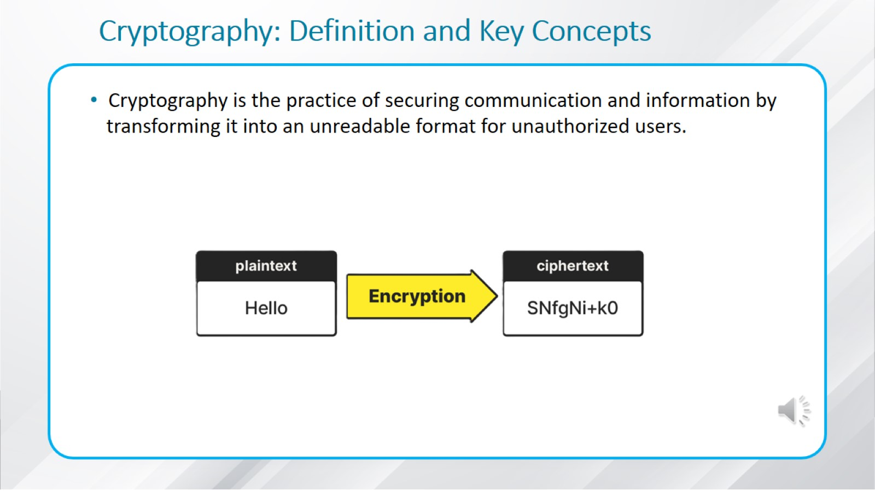
Cryptography: Definition and Key Concepts

Slide 5
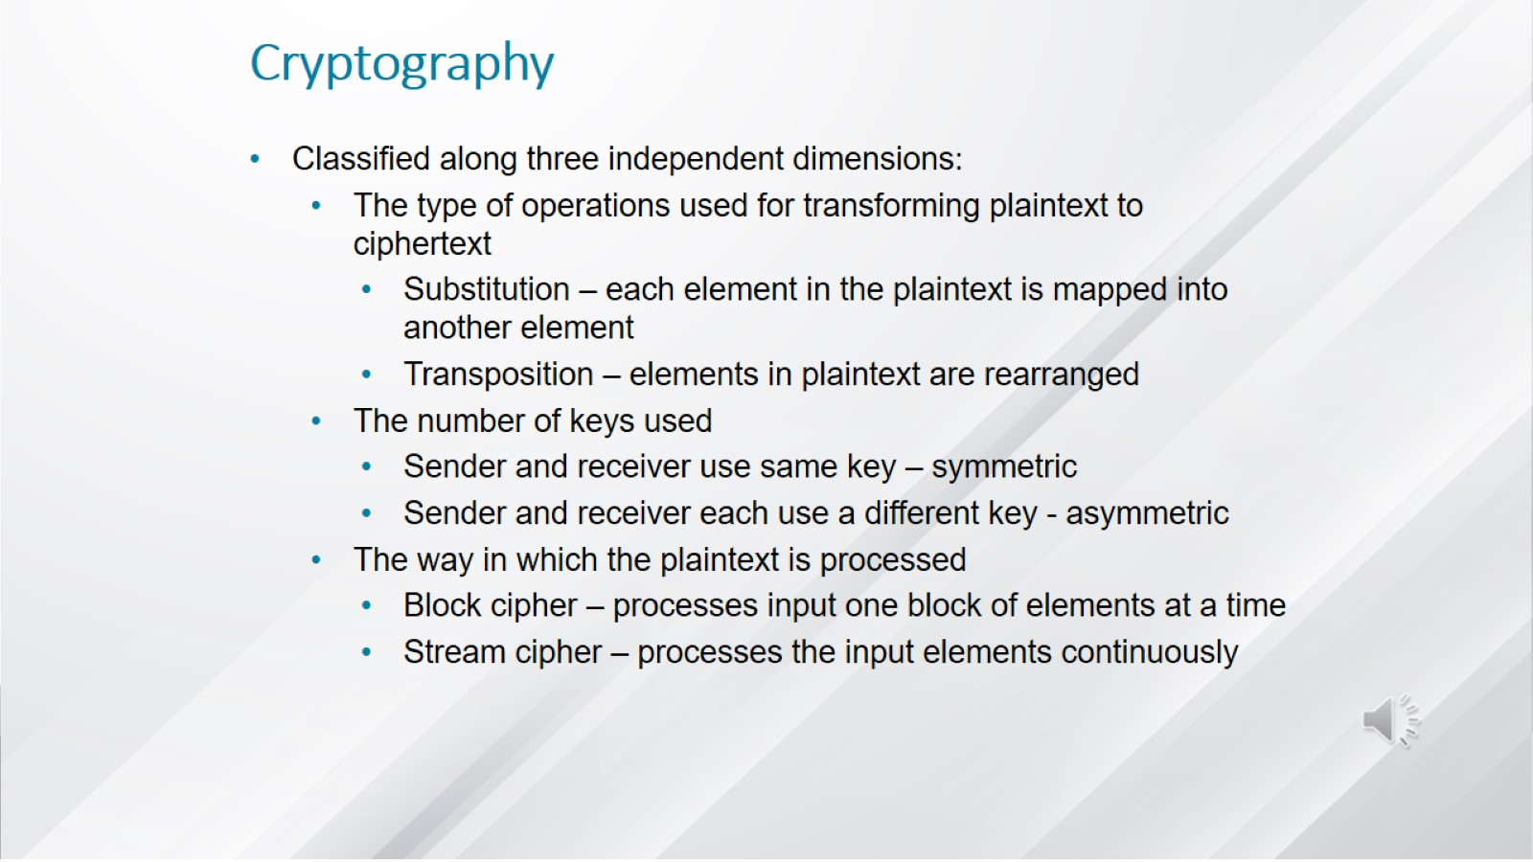
Cryptography

Slide 6
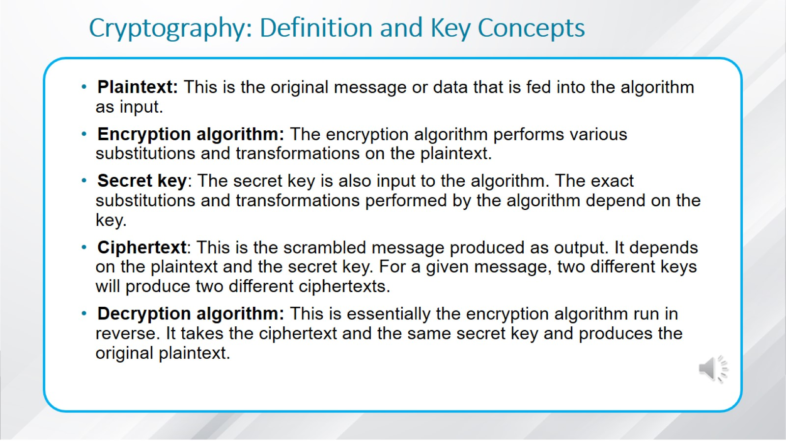
Cryptography: Definition and Key Concepts

Slide 7
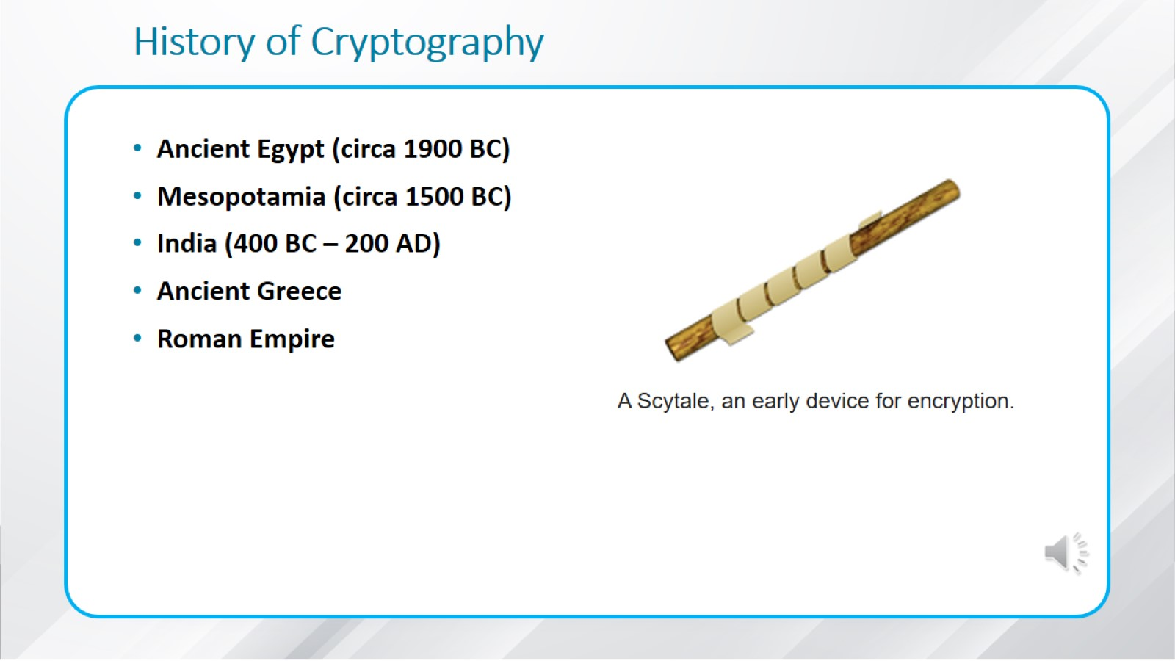
History of Cryptography

Slide 8
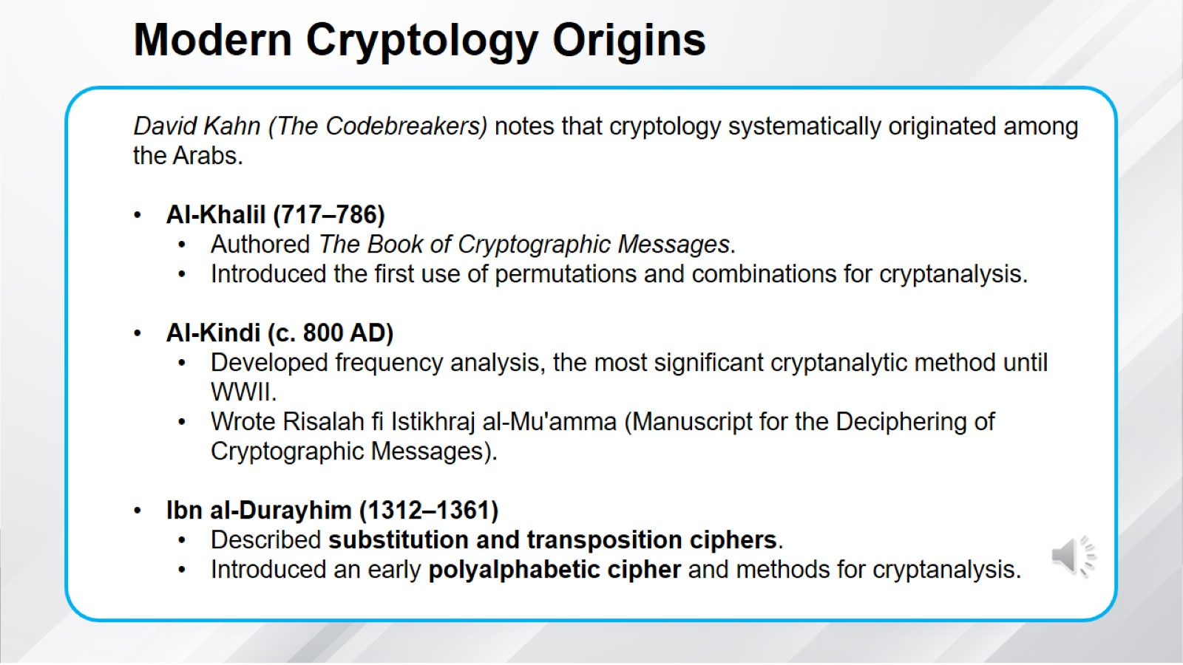
Modern Cryptology Origins

Slide 9
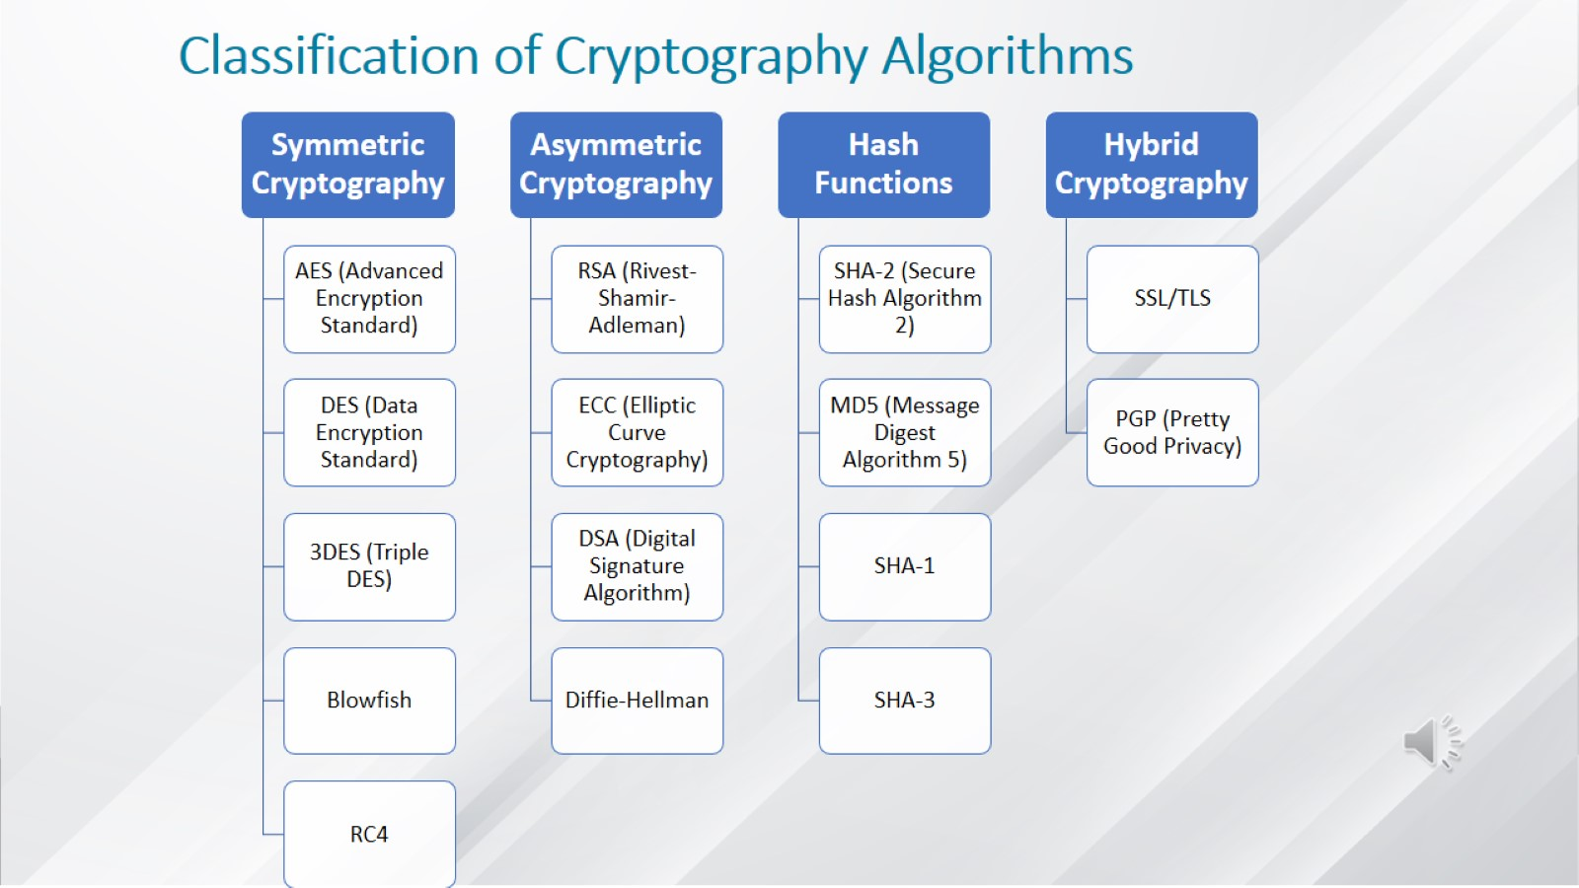
Classification of Cryptography Algorithms

Slide 10
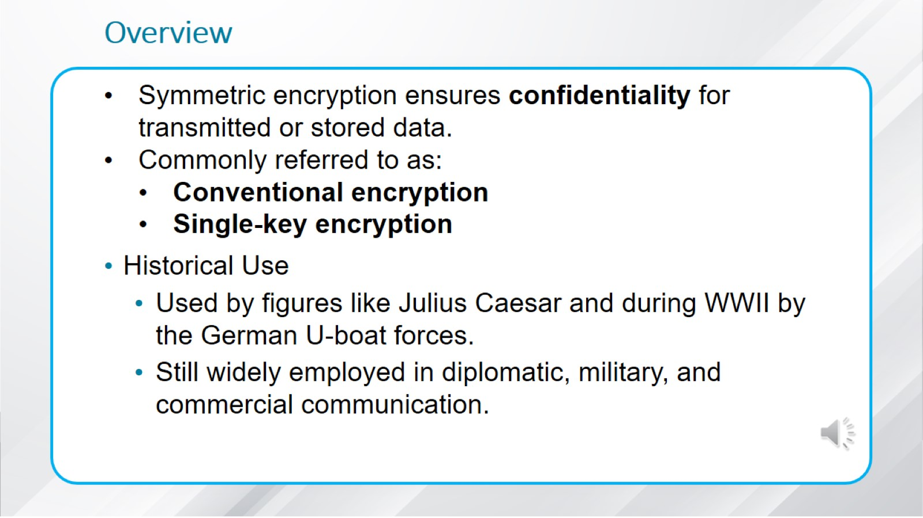
Overview

Slide 11
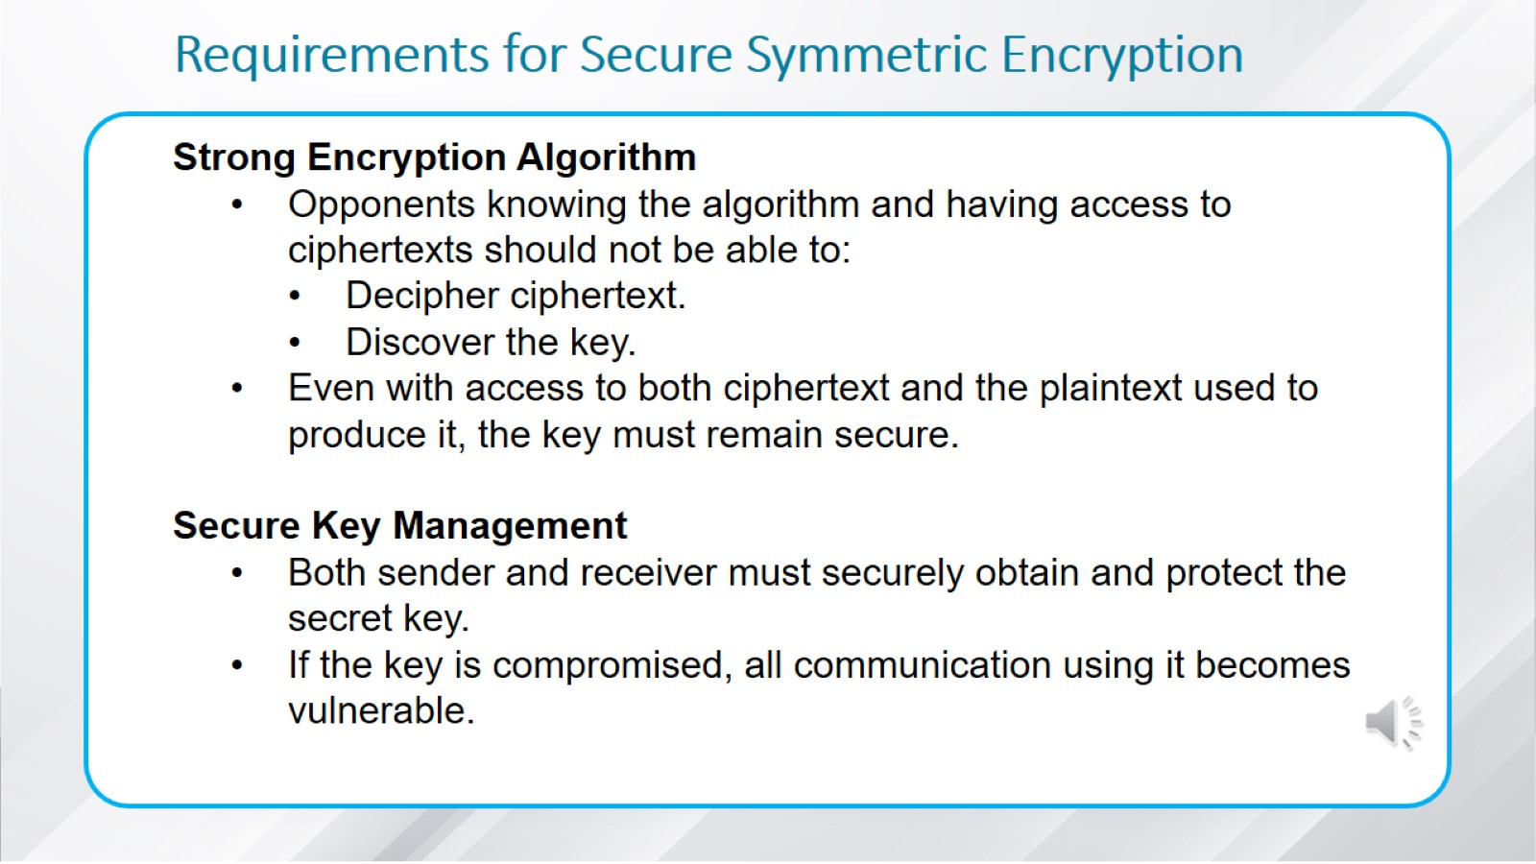
Requirements for Secure Symmetric Encryption

Slide 12
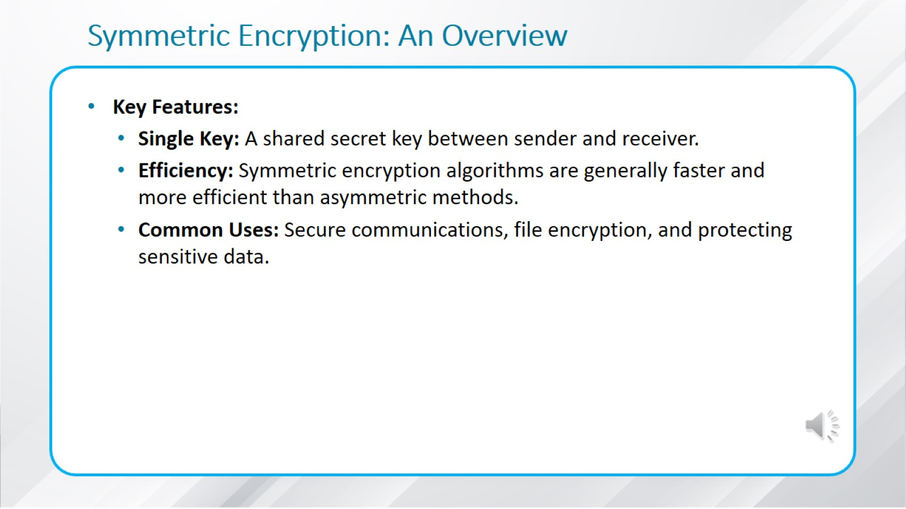
Symmetric Encryption: An Overview

Slide 13
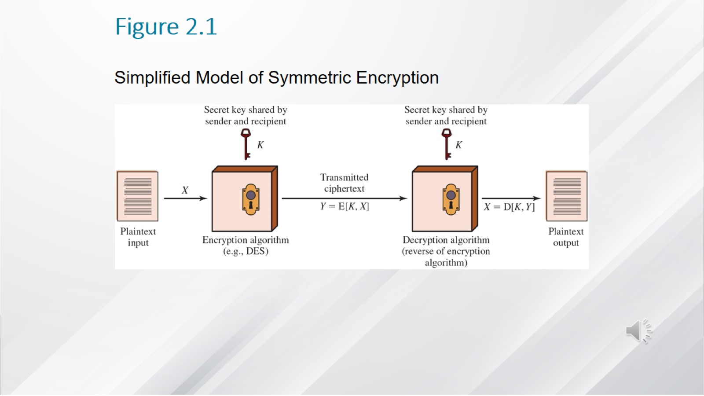
Figure 2.1

Slide 14
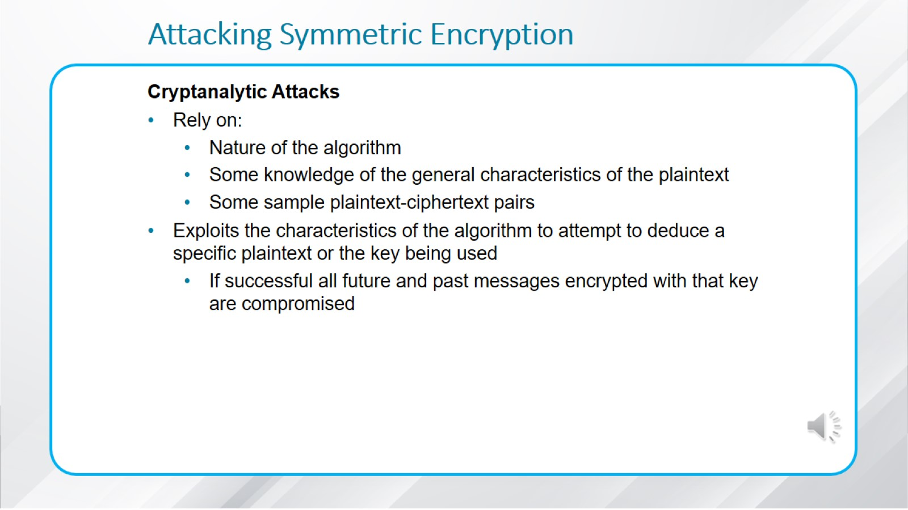
Attacking Symmetric Encryption

Slide 15
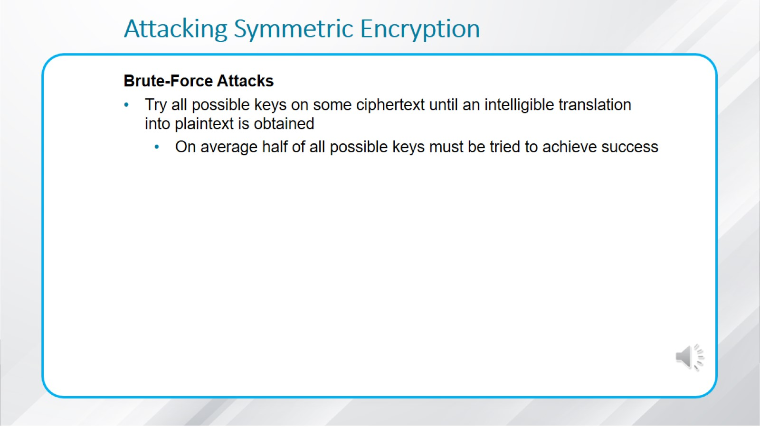
Attacking Symmetric Encryption

Slide 16
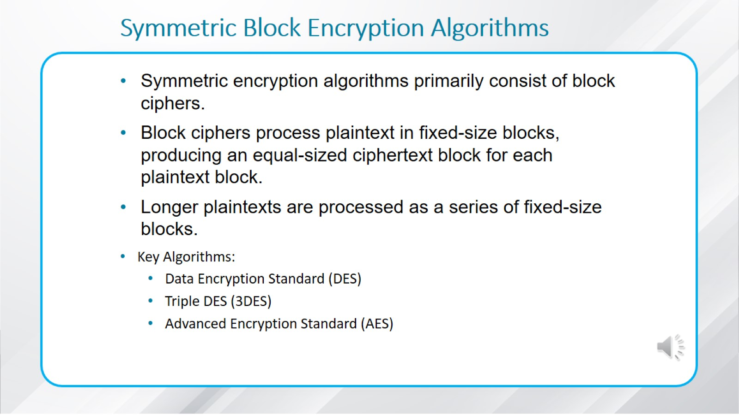
Symmetric Block Encryption Algorithms

Slide 17
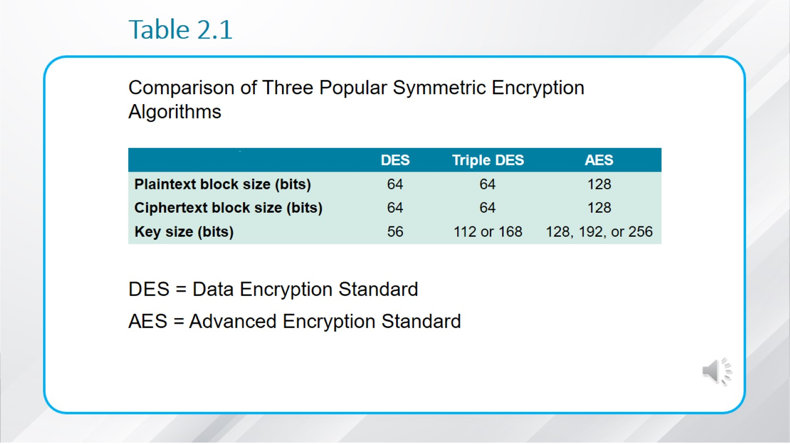
Table 2.1

Slide 18
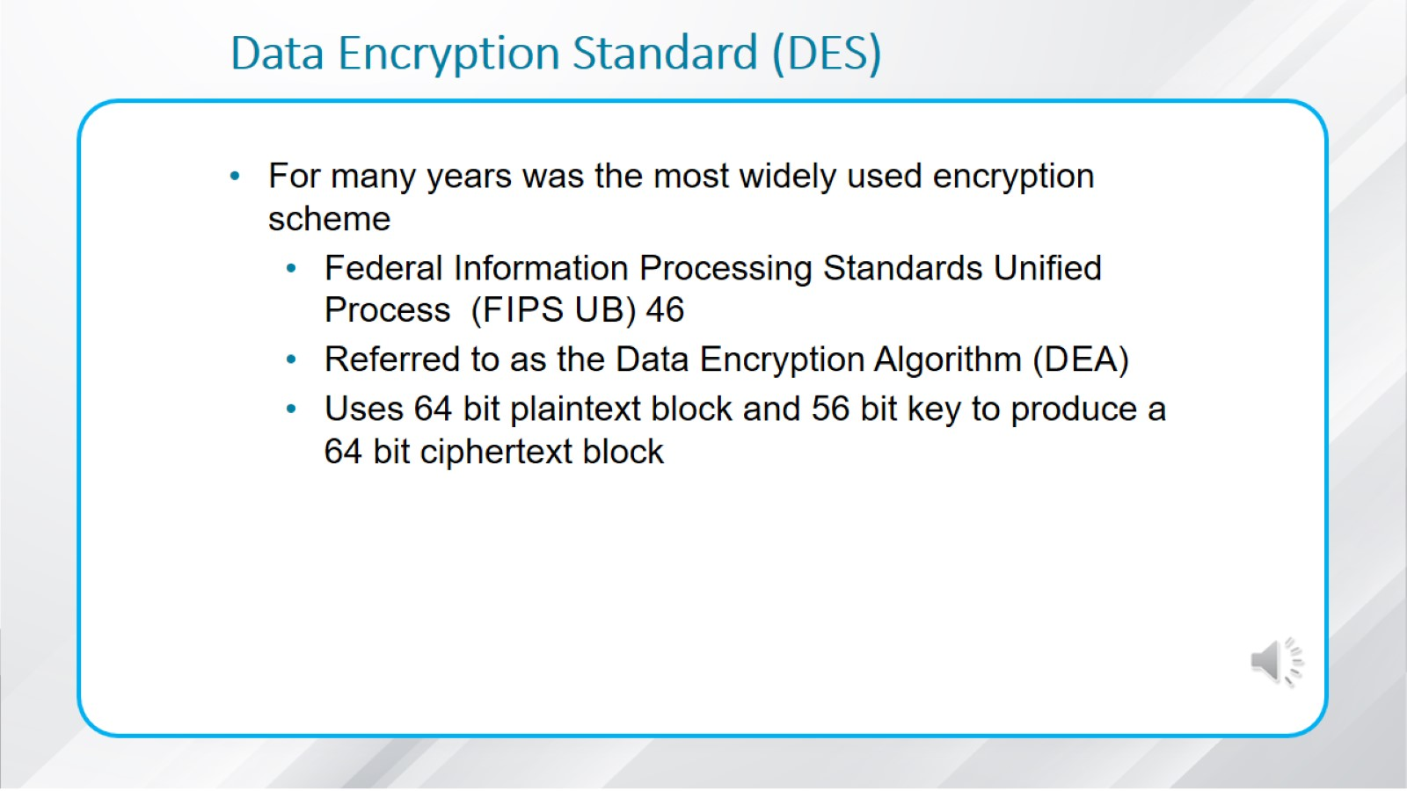
Data Encryption Standard (D E S)

Slide 19
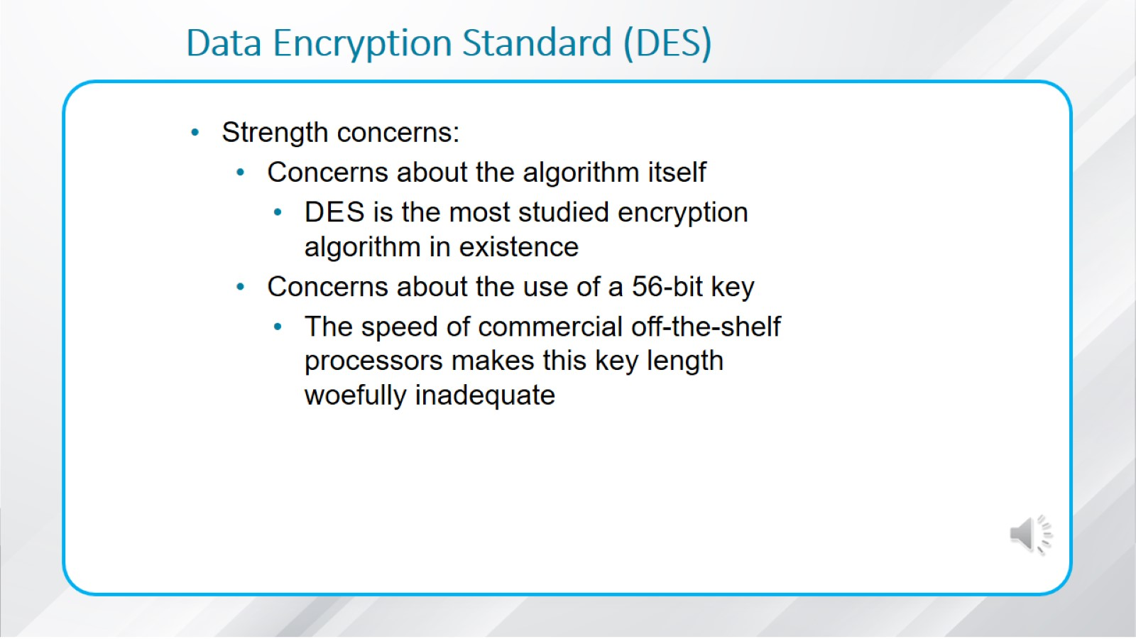
Data Encryption Standard (D E S)

Slide 20
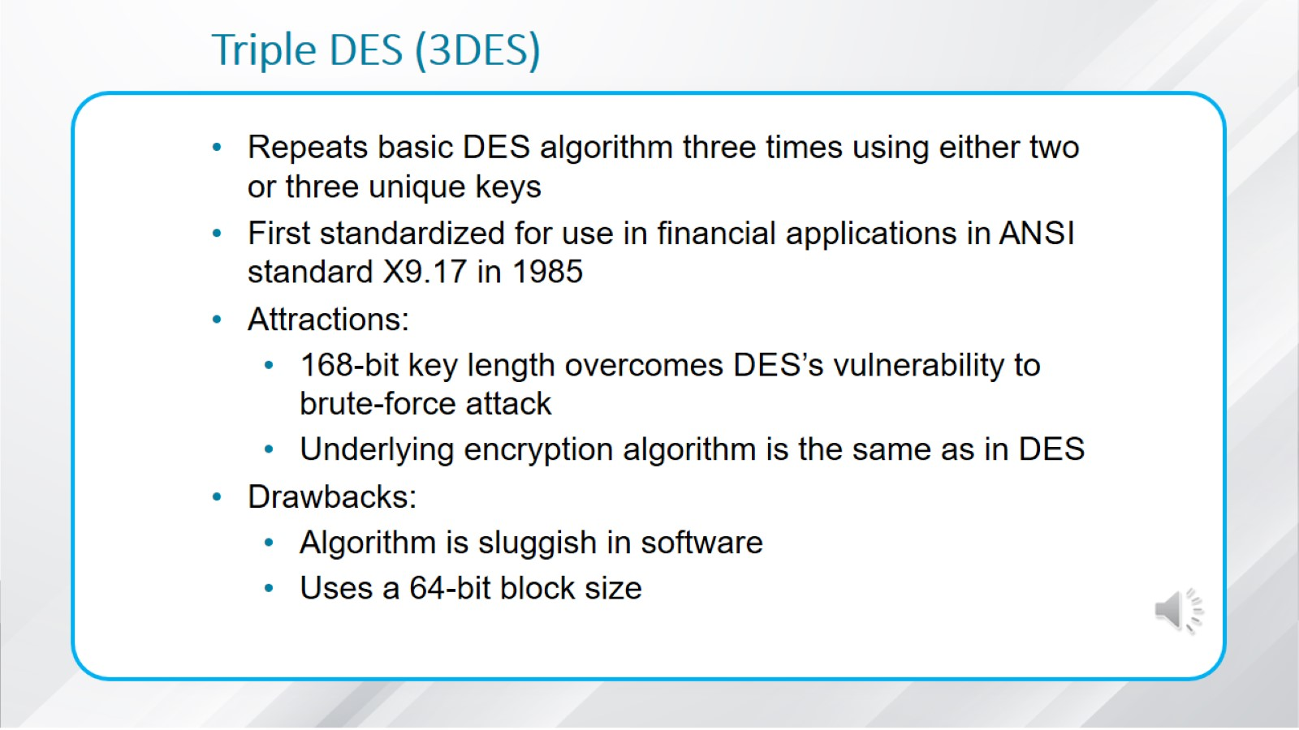
Triple D E S (3 D E S)

Slide 21
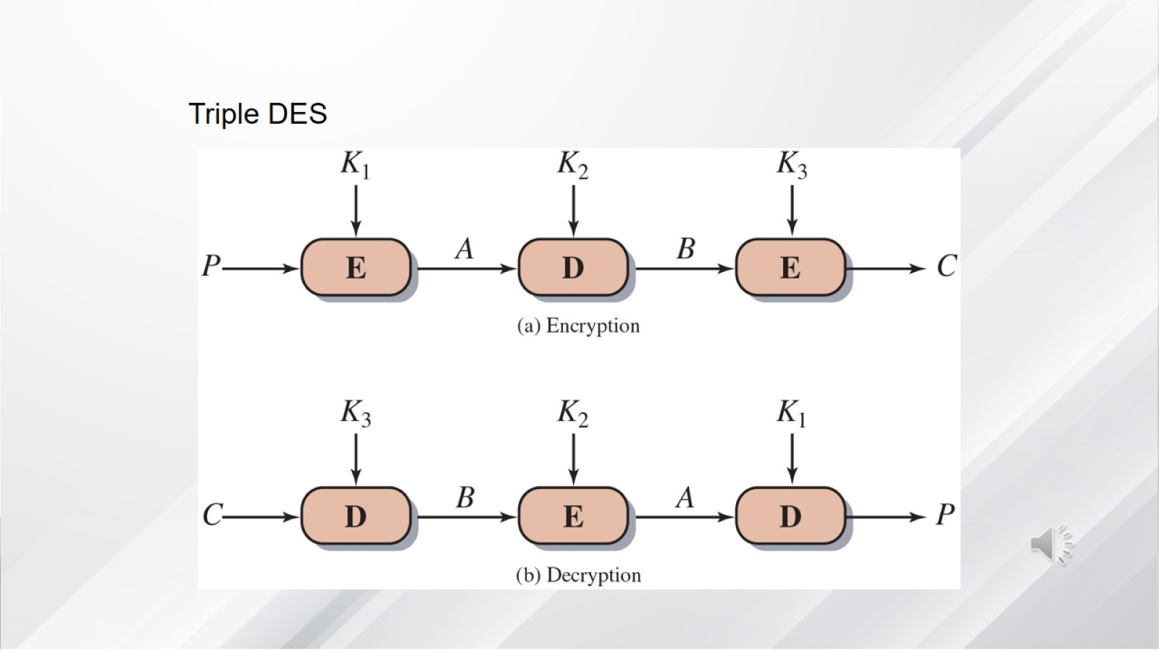

Slide 22
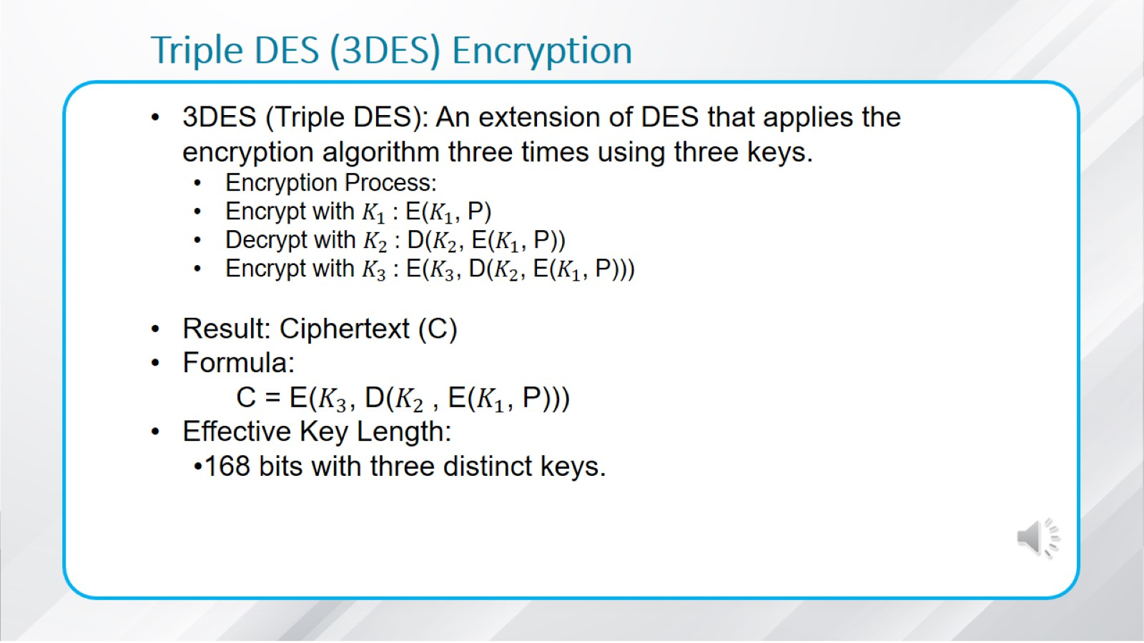
Triple D E S (3 D E S) Encryption

Slide 23
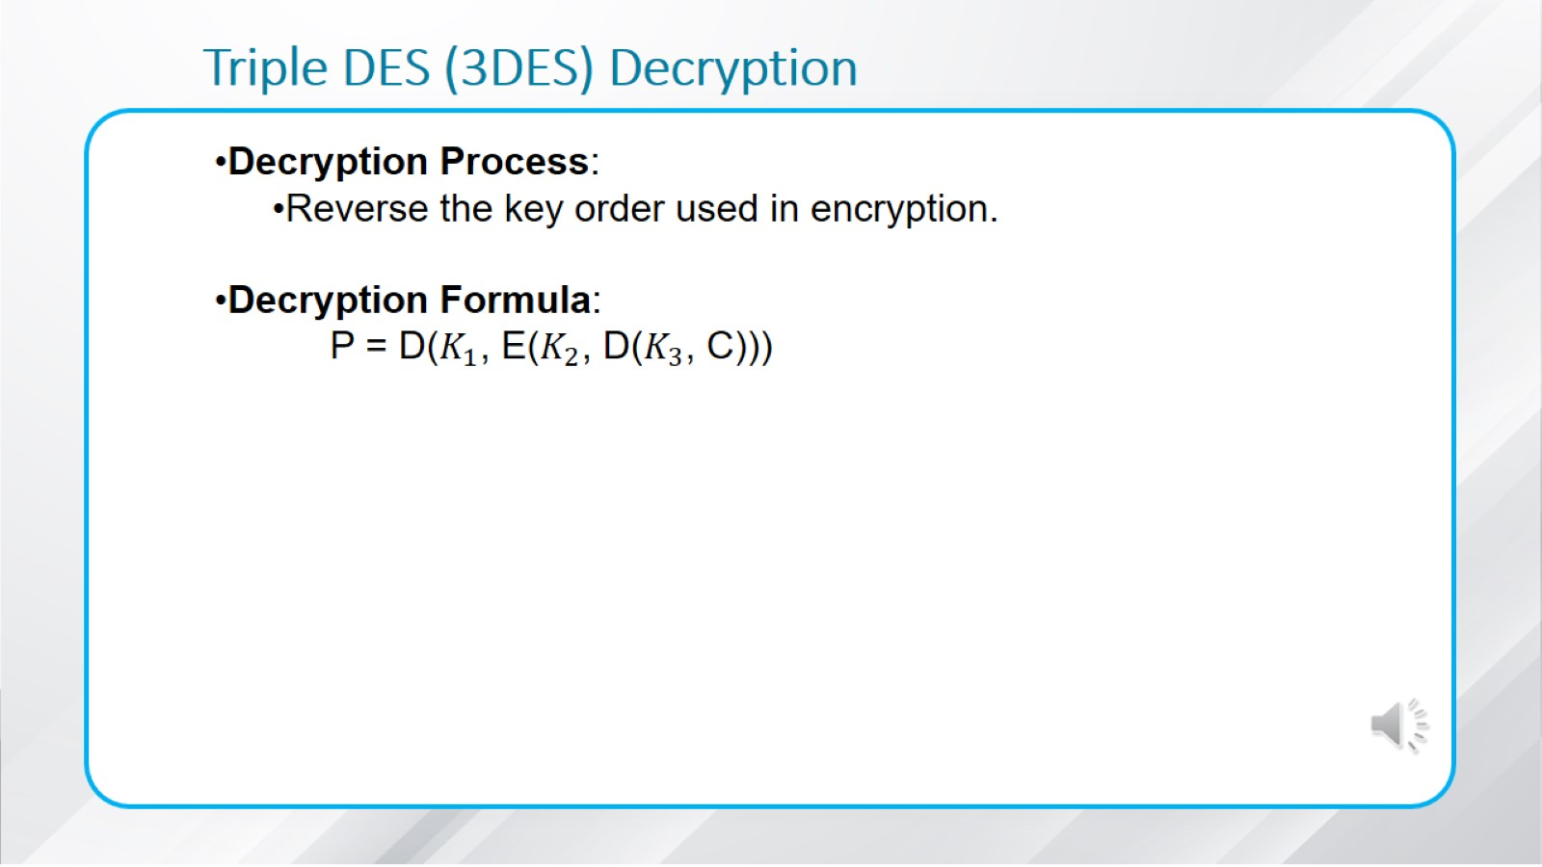
Triple D E S (3 D E S) Decryption

Slide 24
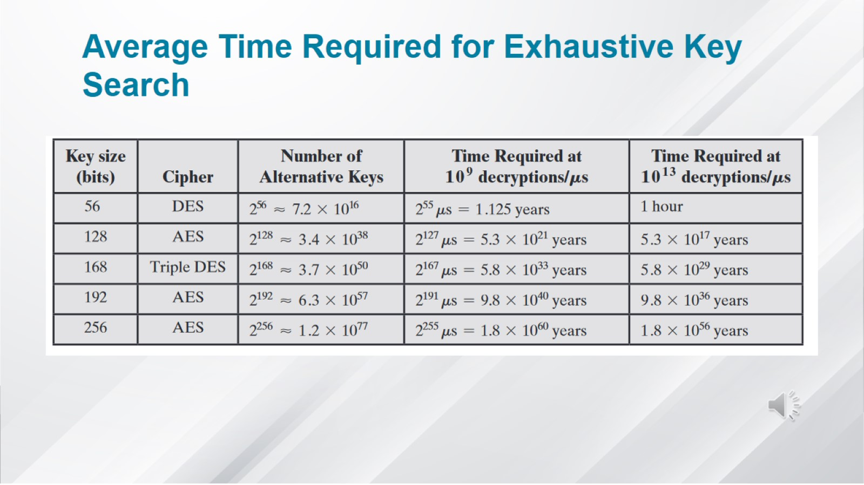
Average Time Required for Exhaustive Key Search

Slide 25
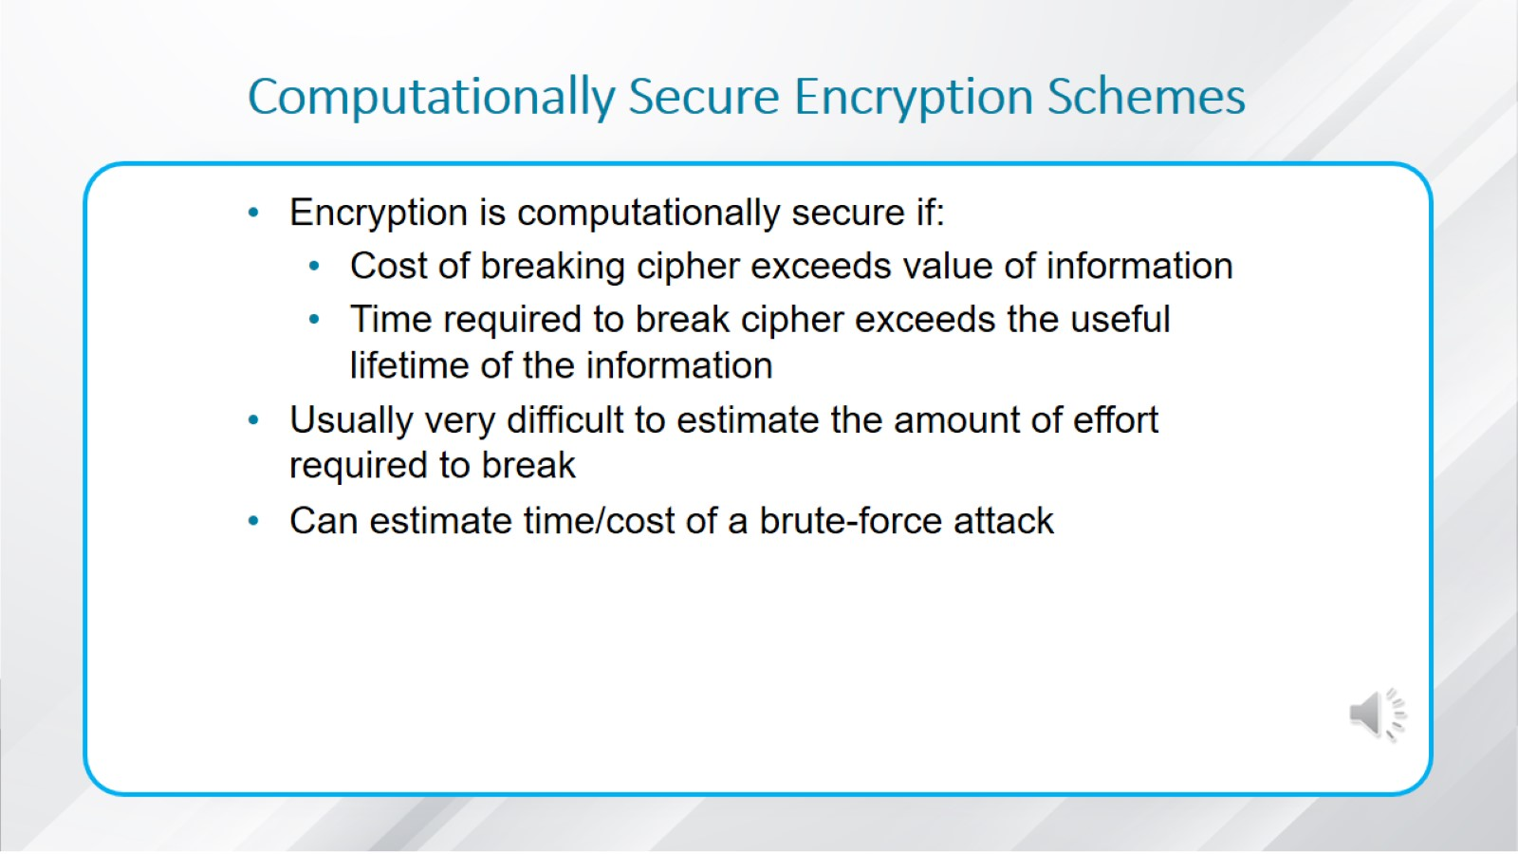
Computationally Secure Encryption Schemes

Slide 26
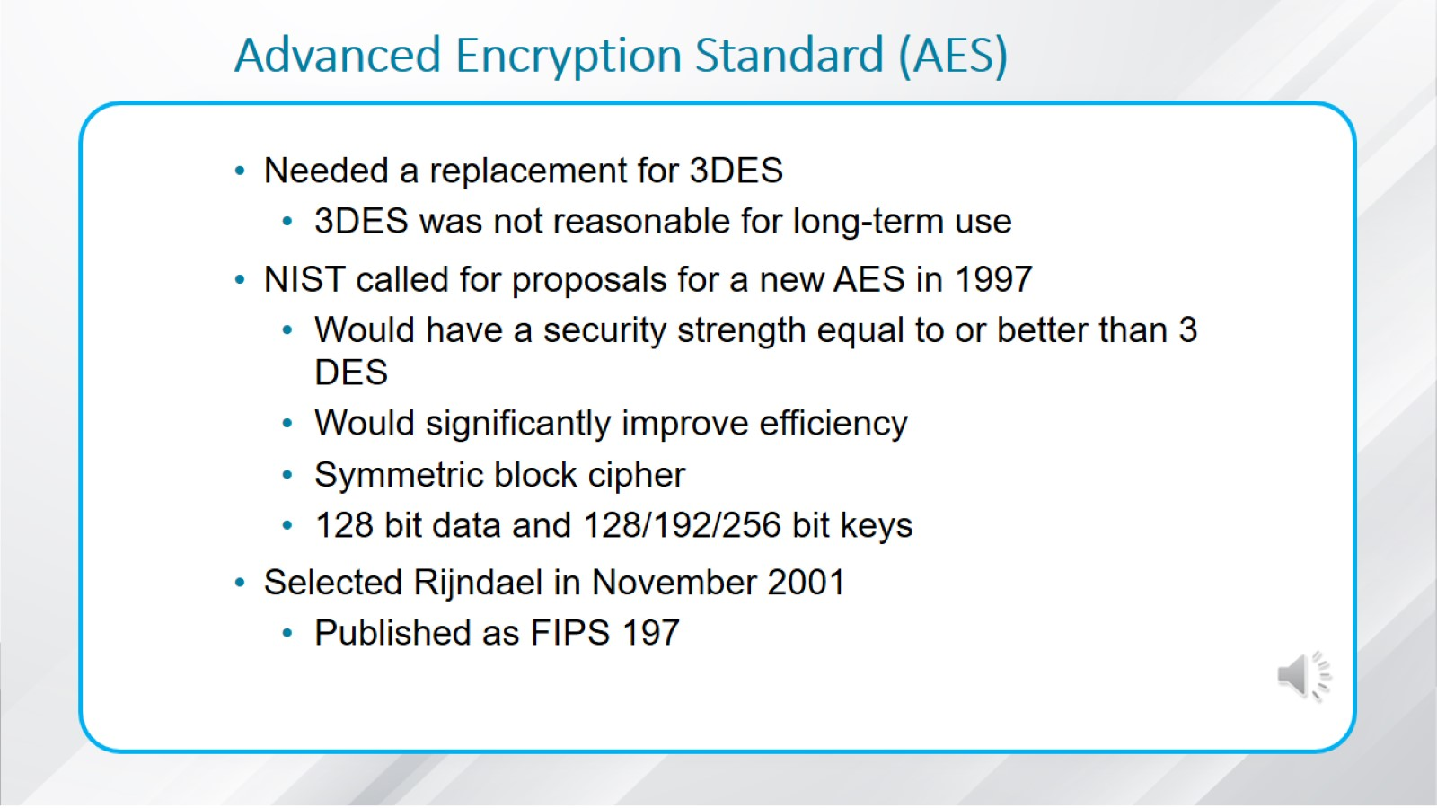
Advanced Encryption Standard (A E S)

Slide 27
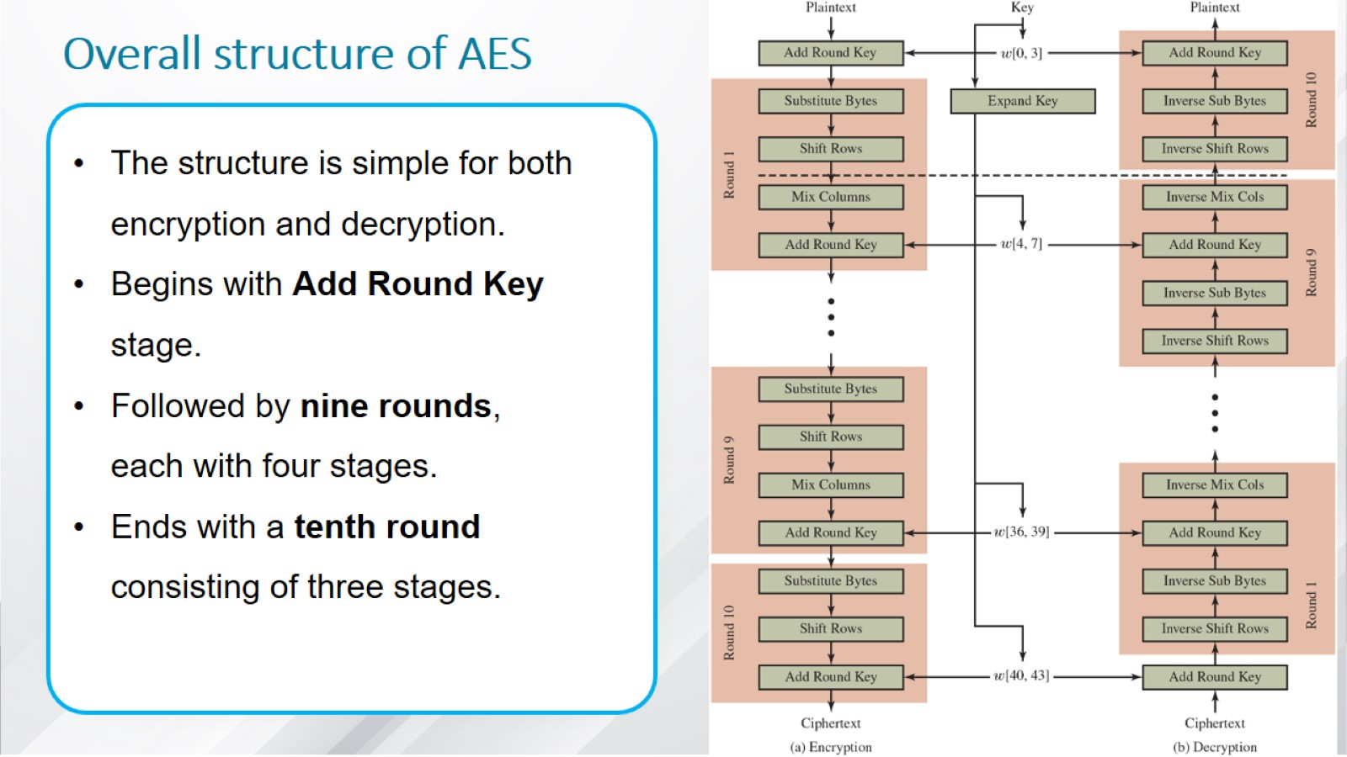
Overall structure of AES

Slide 28
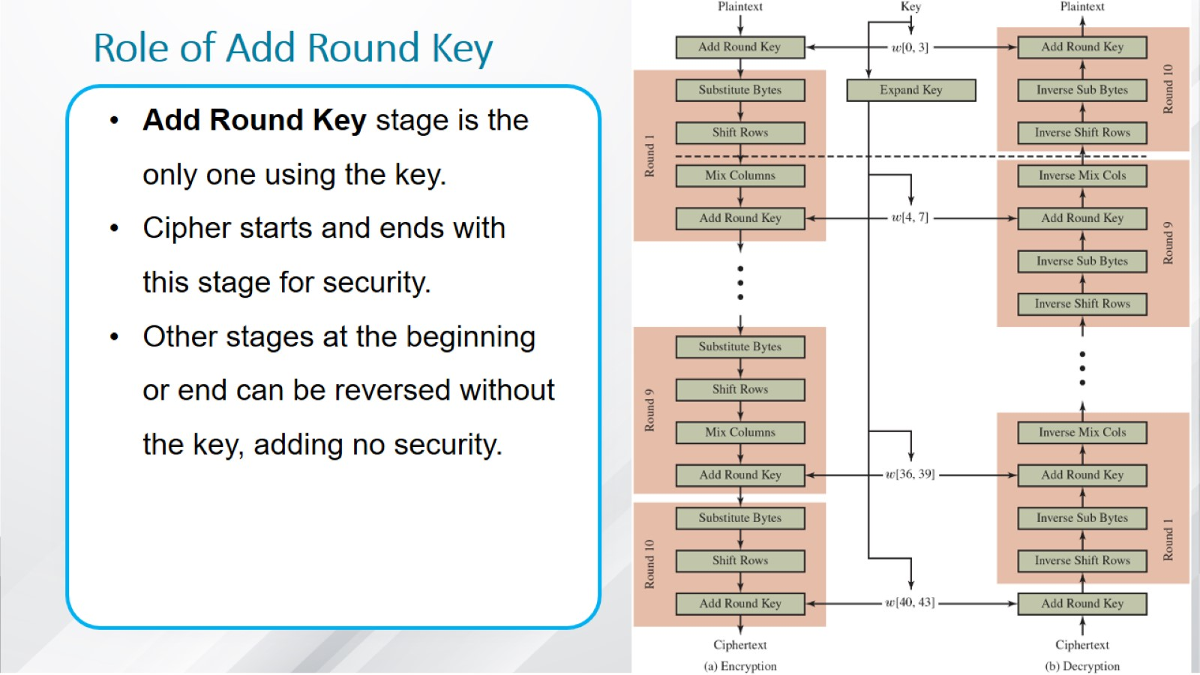
Role of Add Round Key

Slide 29
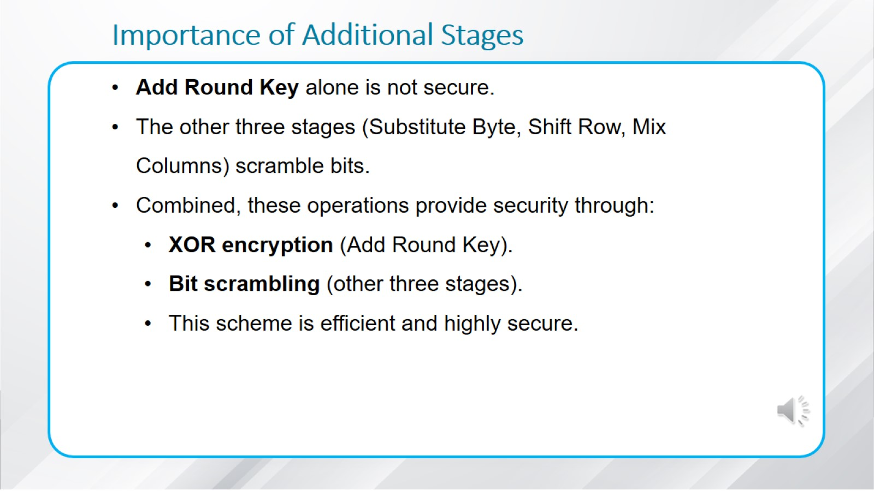
Importance of Additional Stages

Slide 30
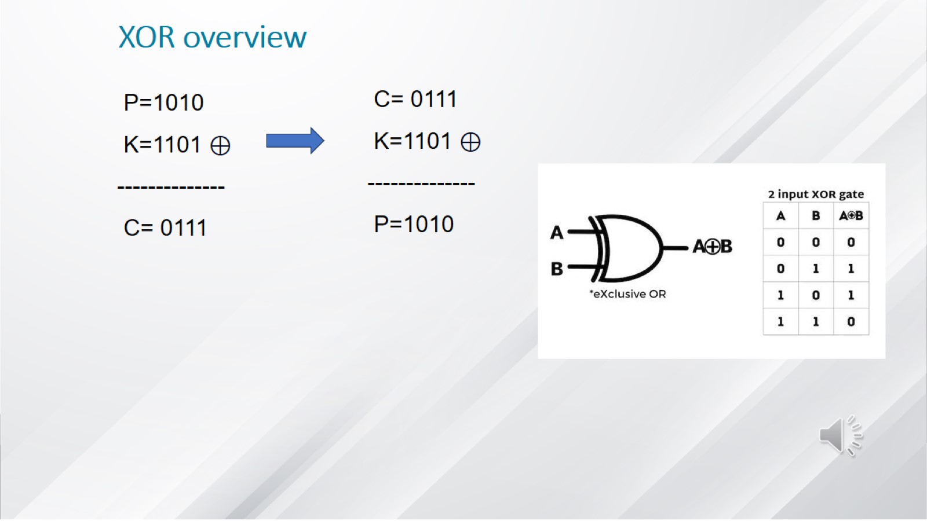
XOR overview

Slide 31
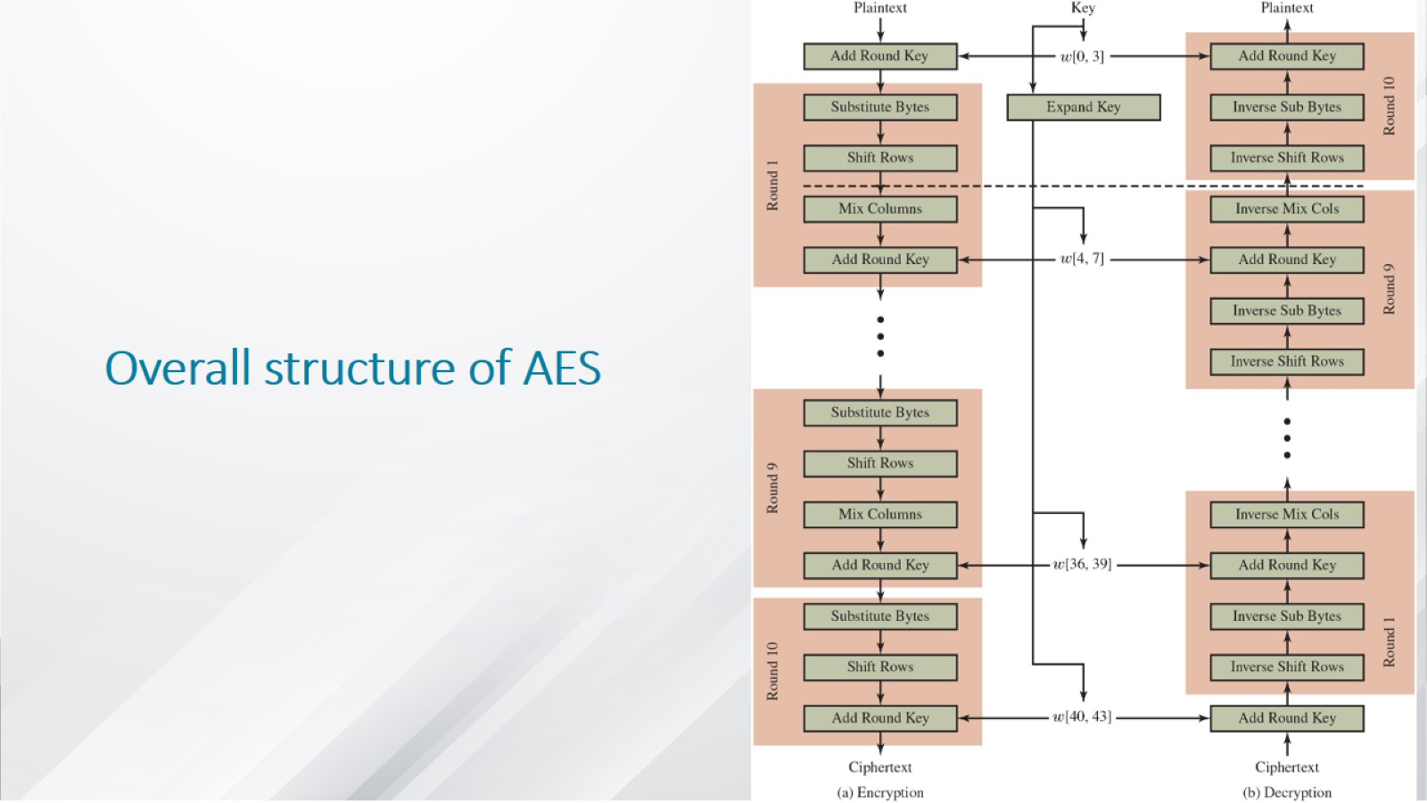
Overall structure of AES

Slide 32
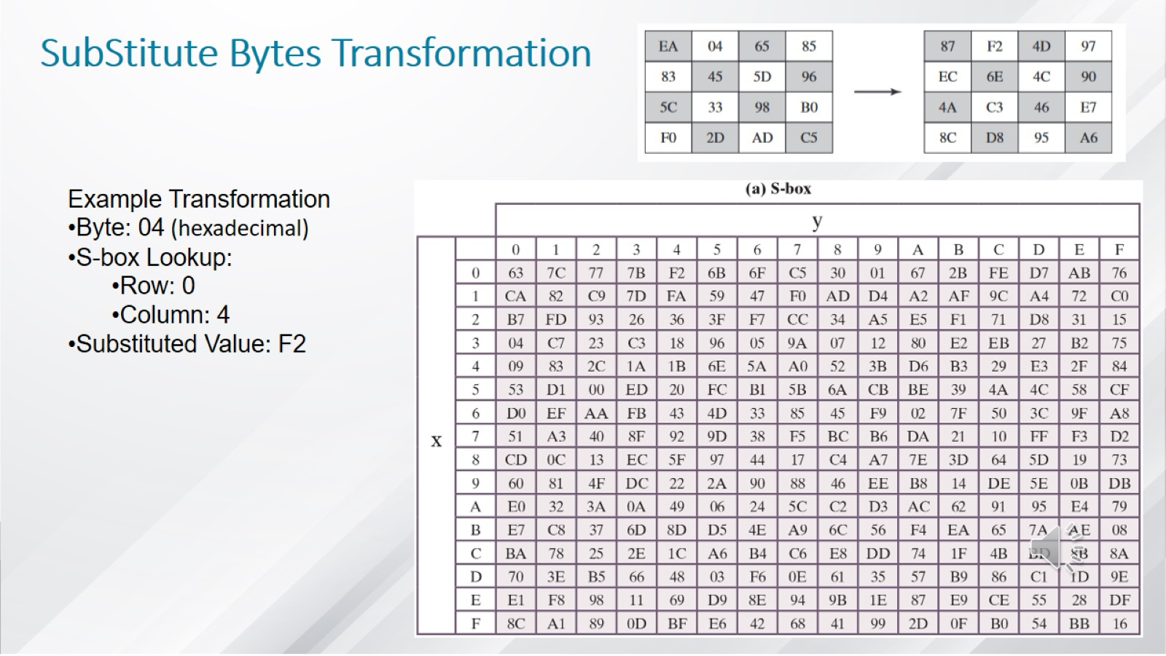
SubStitute Bytes Transformation

Slide 33
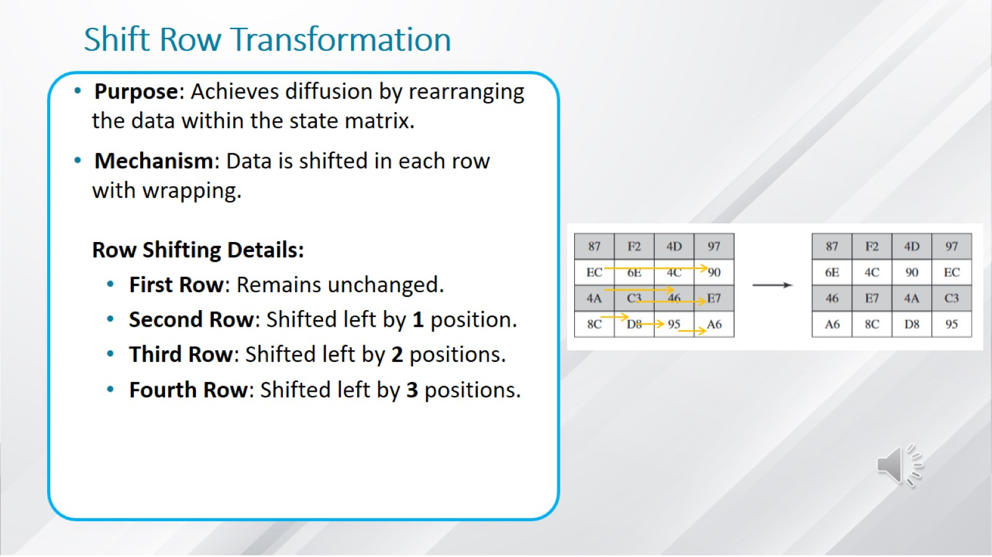
Shift Row Transformation

Slide 34
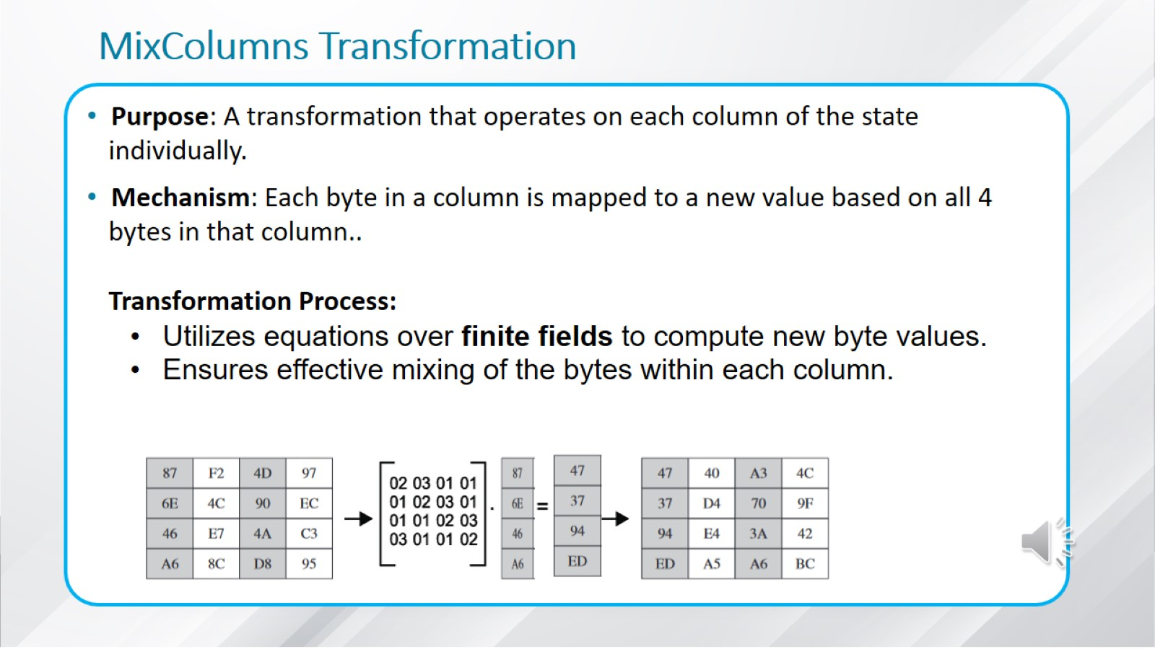
MixColumns Transformation

Slide 35
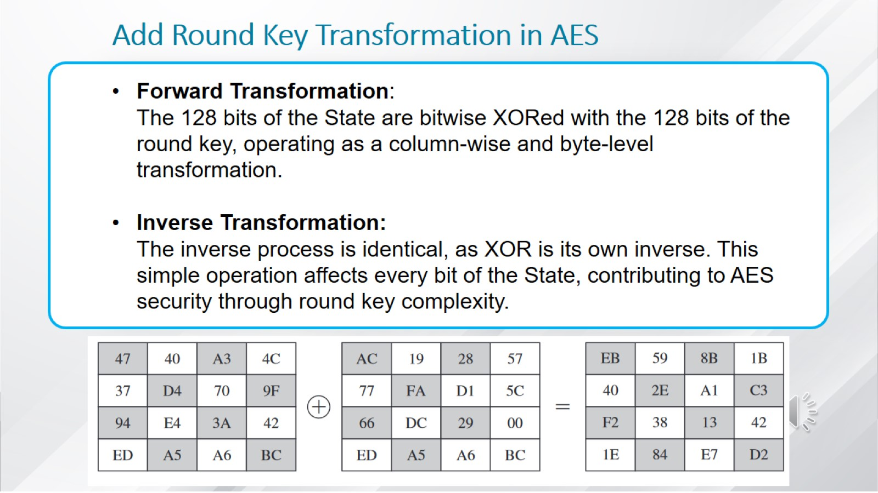
Add Round Key Transformation in AES

Slide 36
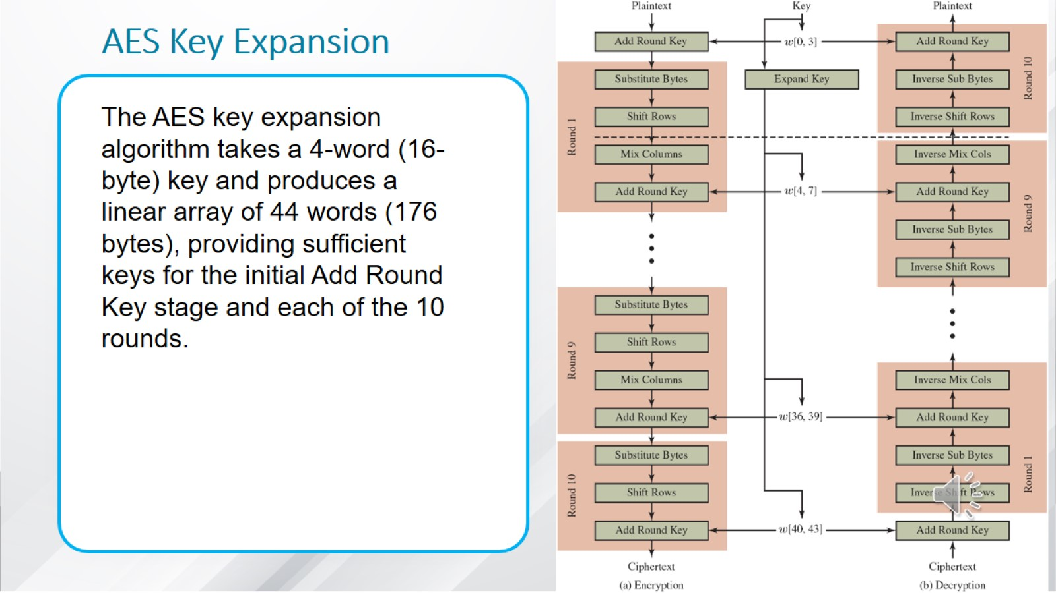
AES Key Expansion

Slide 37
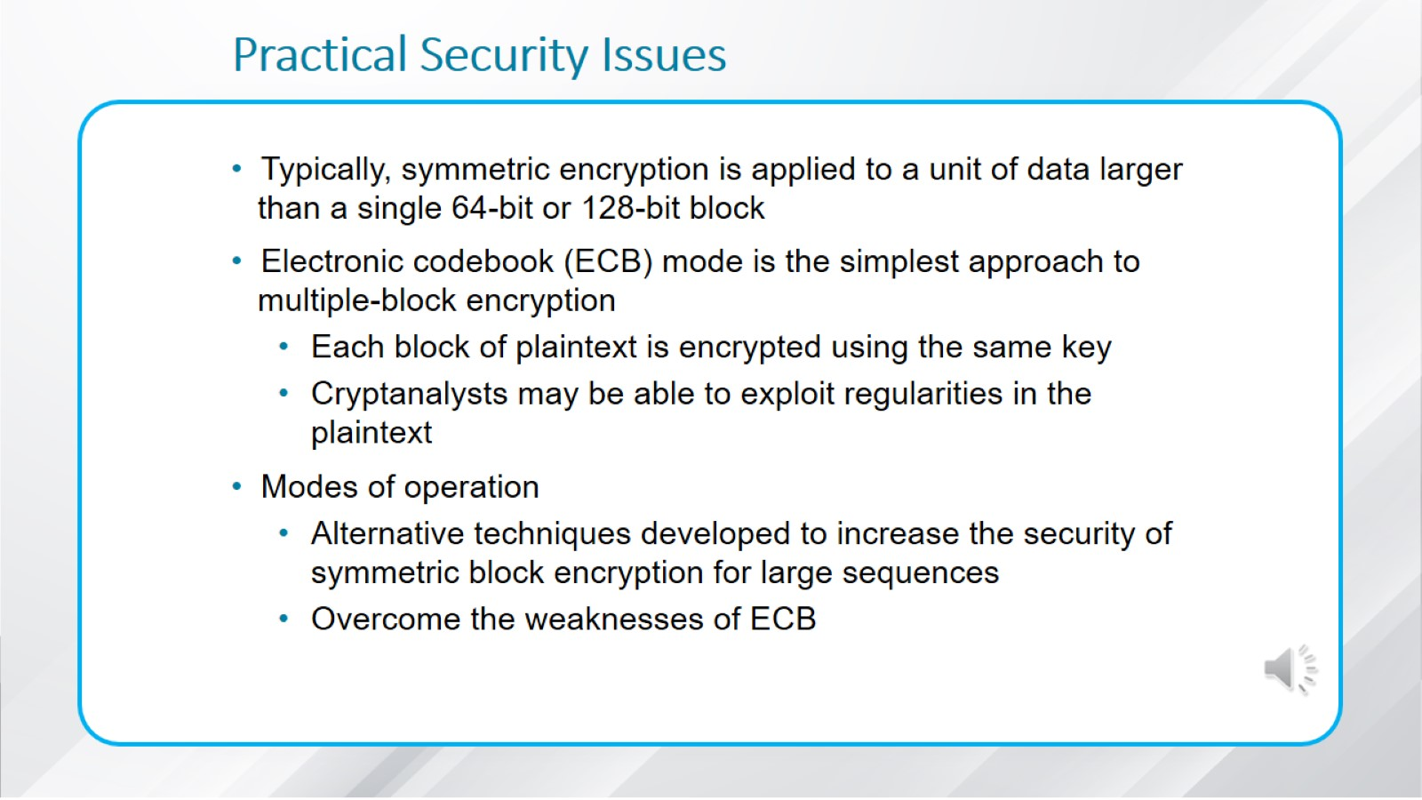
Practical Security Issues

Slide 38
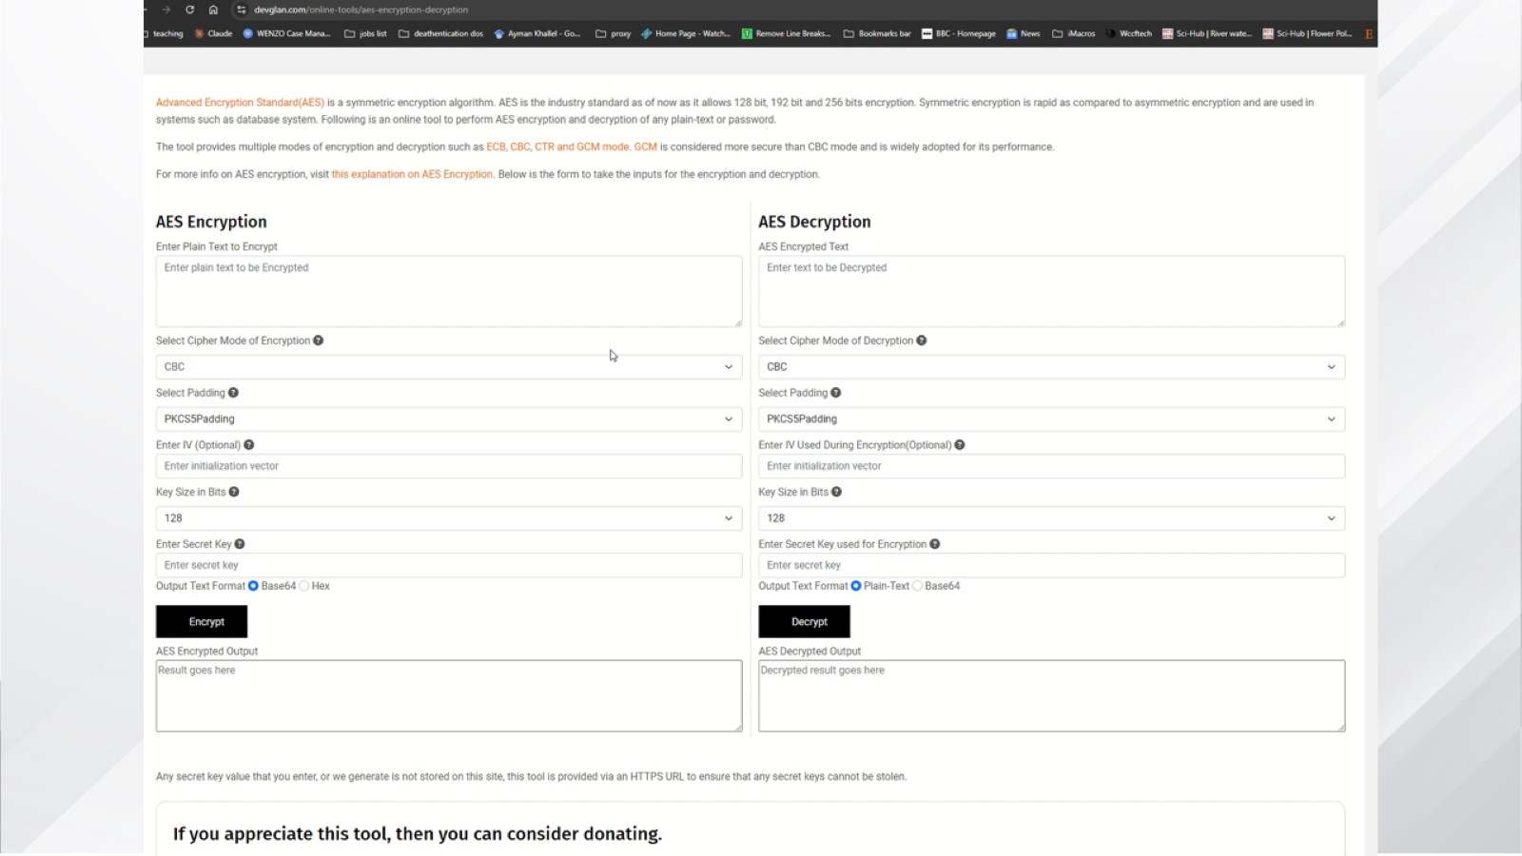
Video

Slide 39
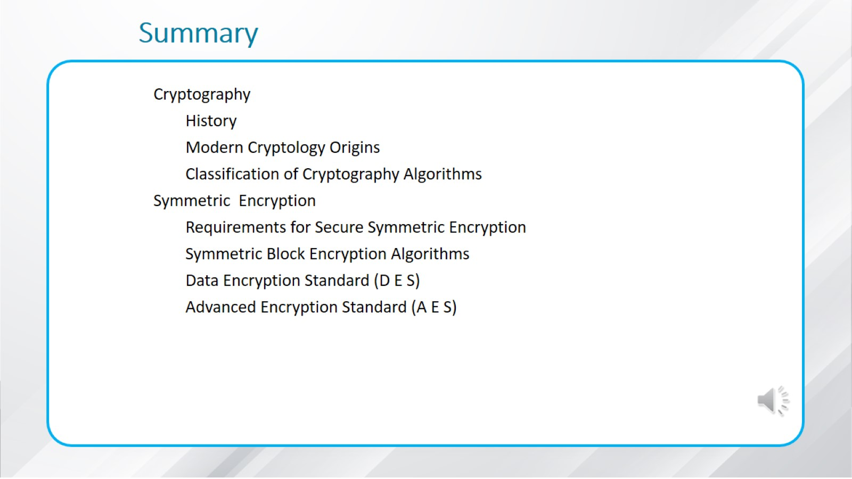
Summary

Slide 40


