Slide 1


Slide 2
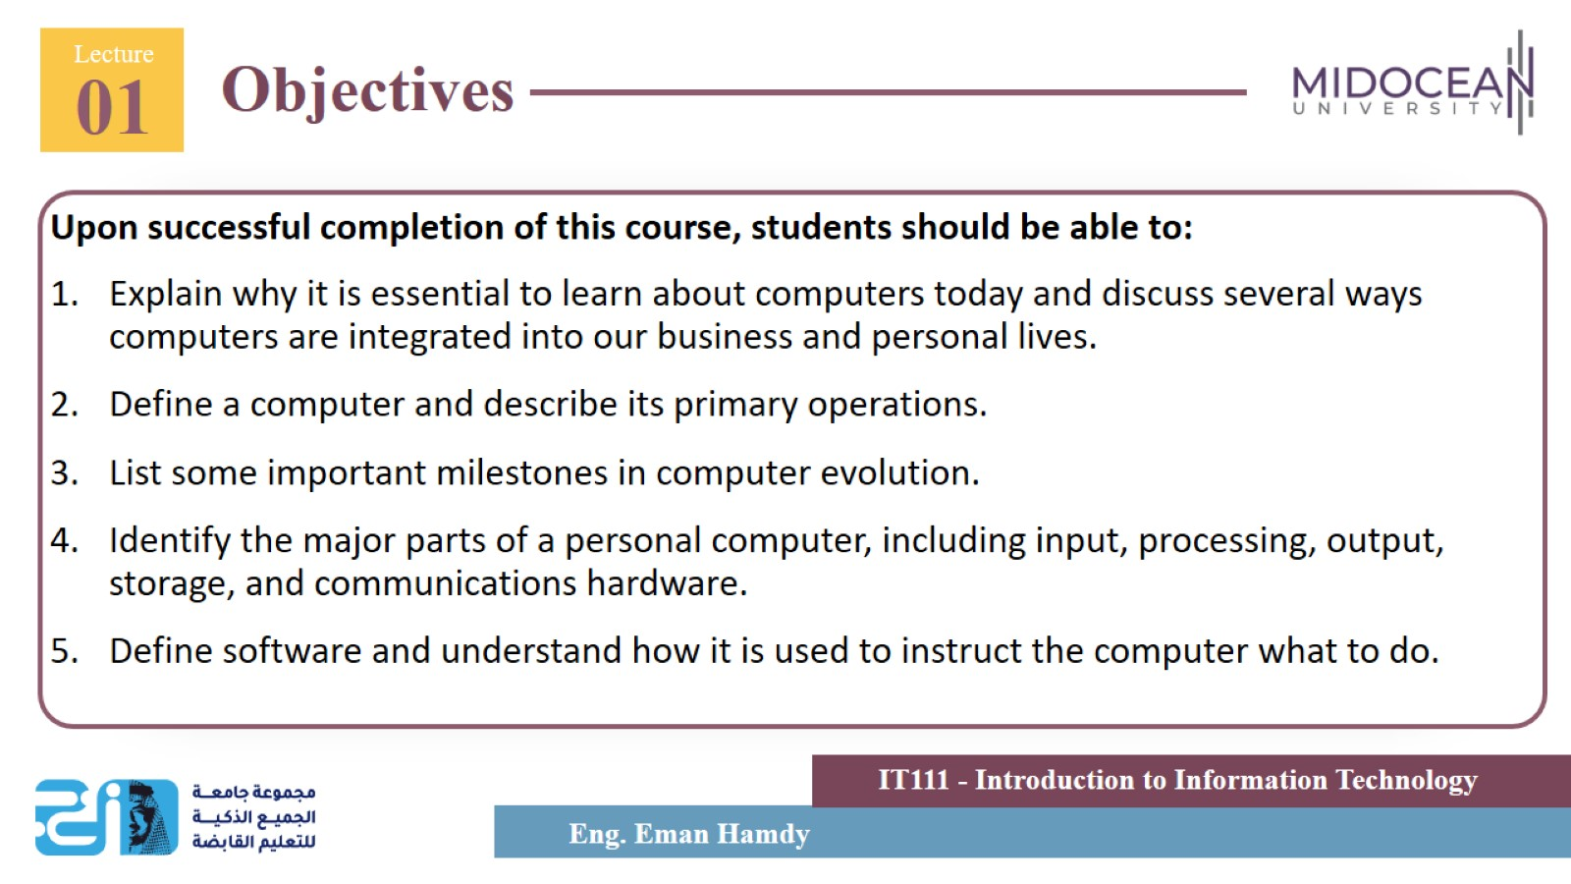

Slide 3
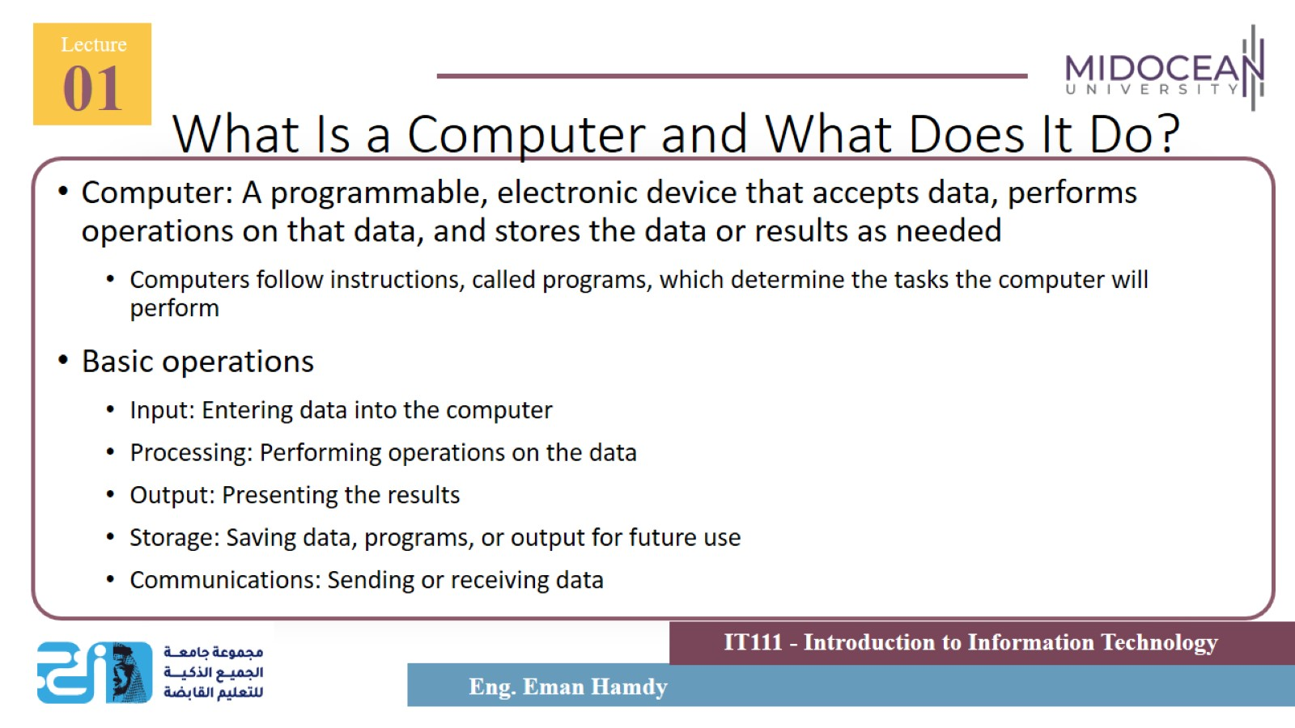
What Is a Computer and What Does It Do?

Slide 4
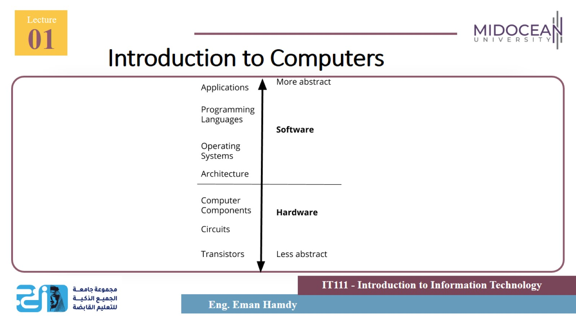
Introduction to Computers

Slide 5
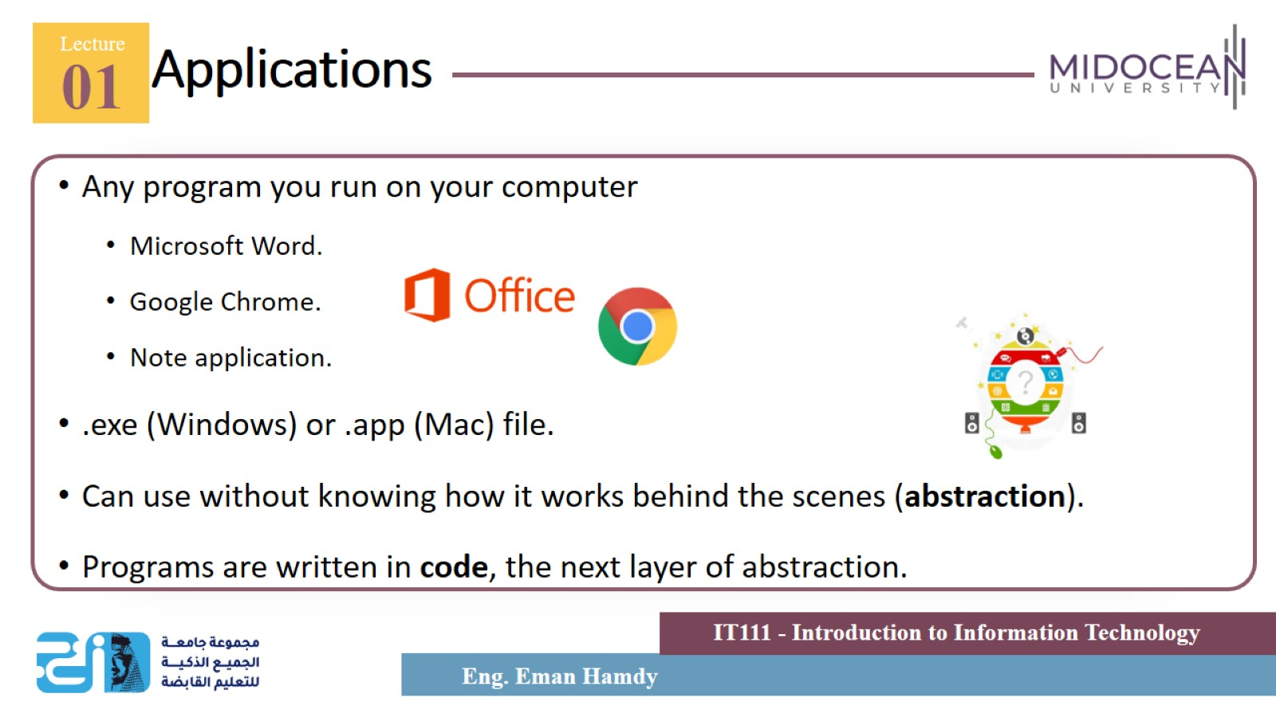
Applications

Slide 6
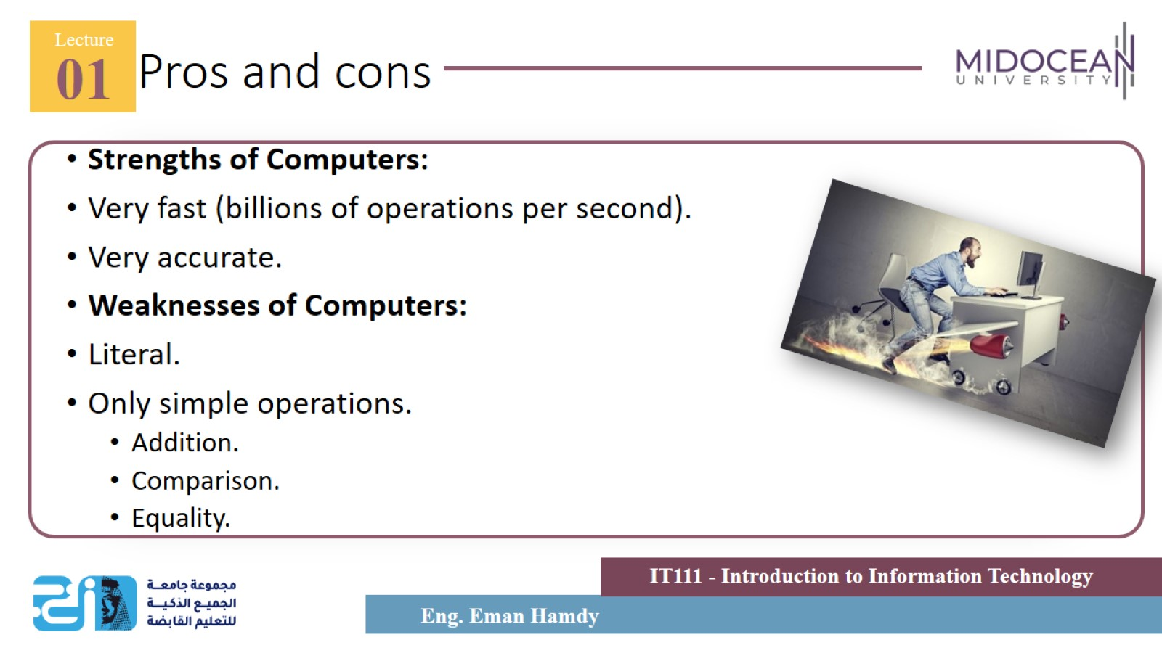
Pros and cons

Slide 7
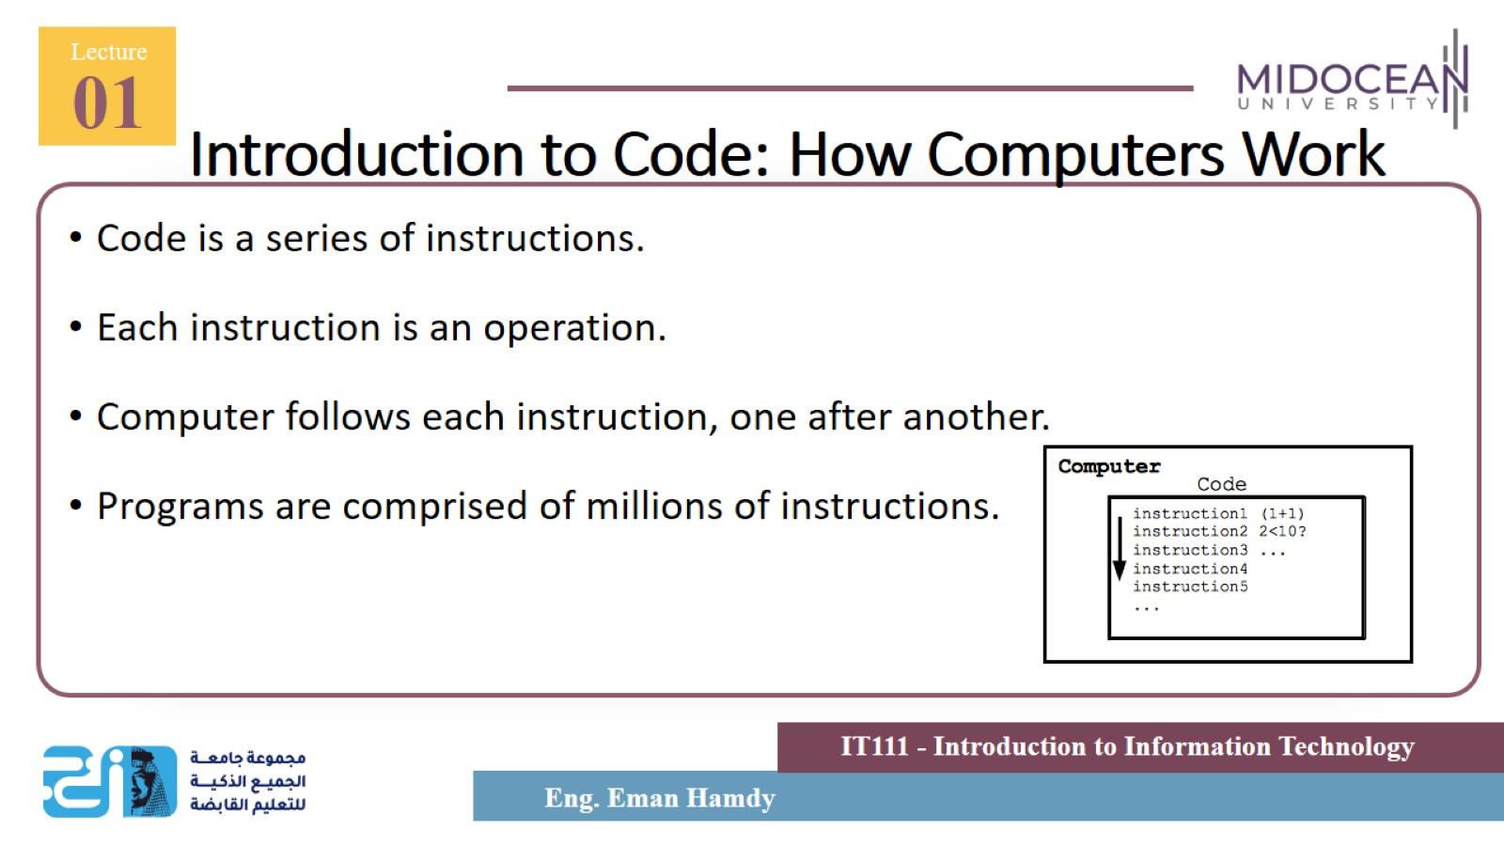
Introduction to Code: How Computers Work

Slide 8
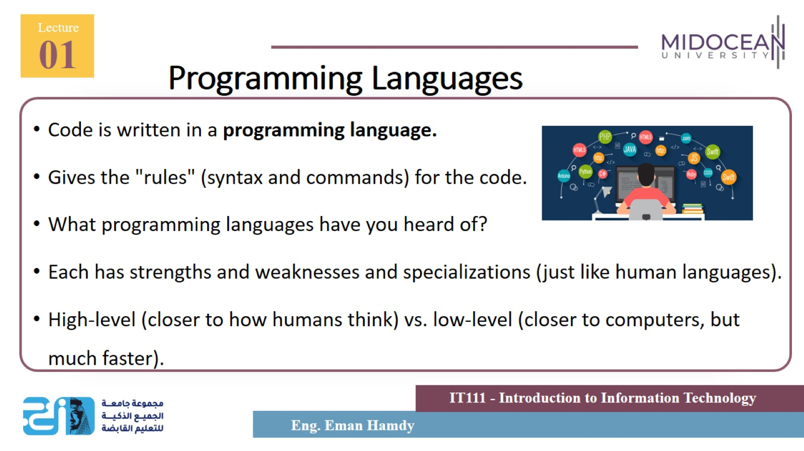
Programming Languages

Slide 9
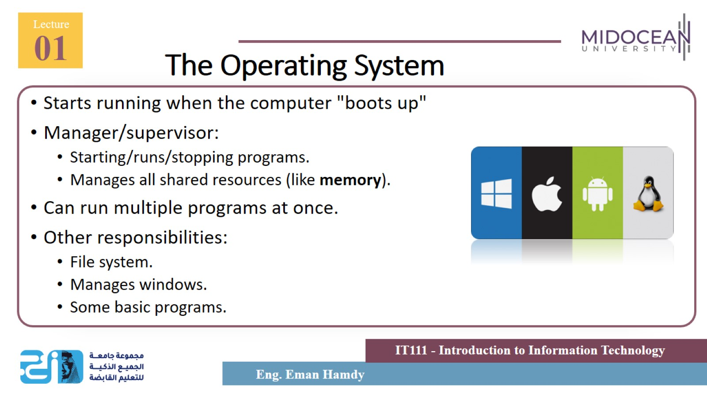
The Operating System

Slide 10
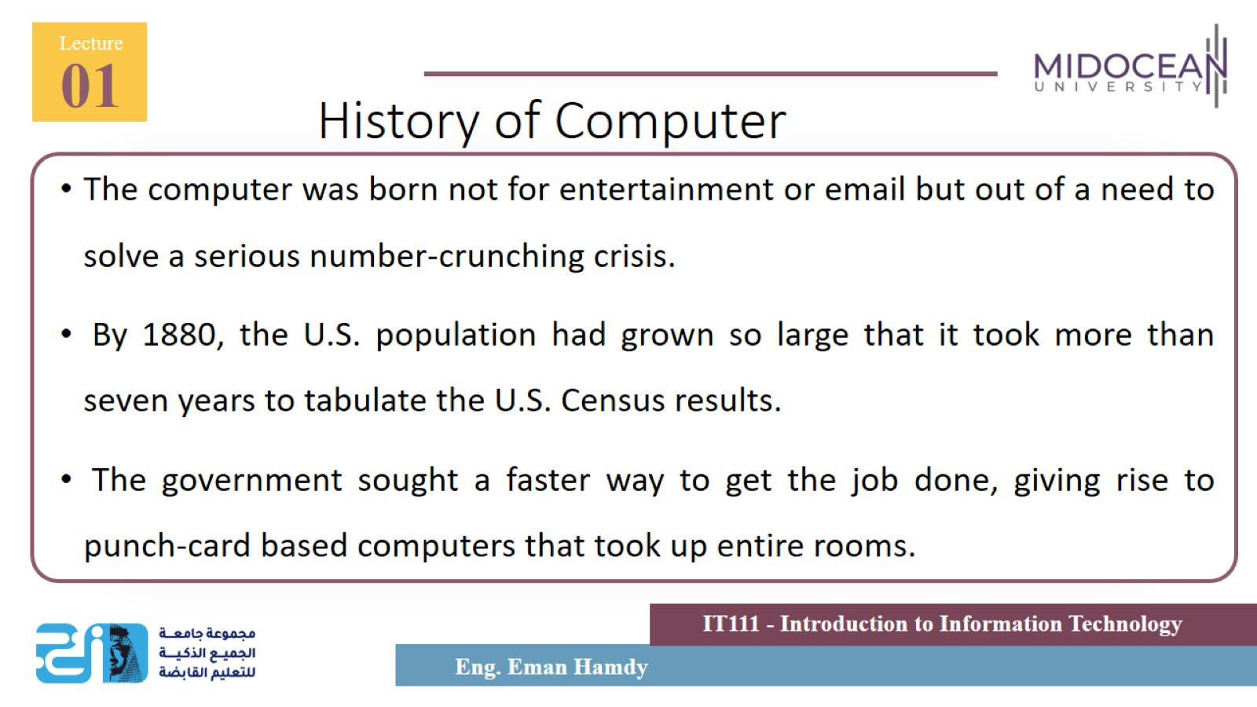
History of Computer

Slide 11
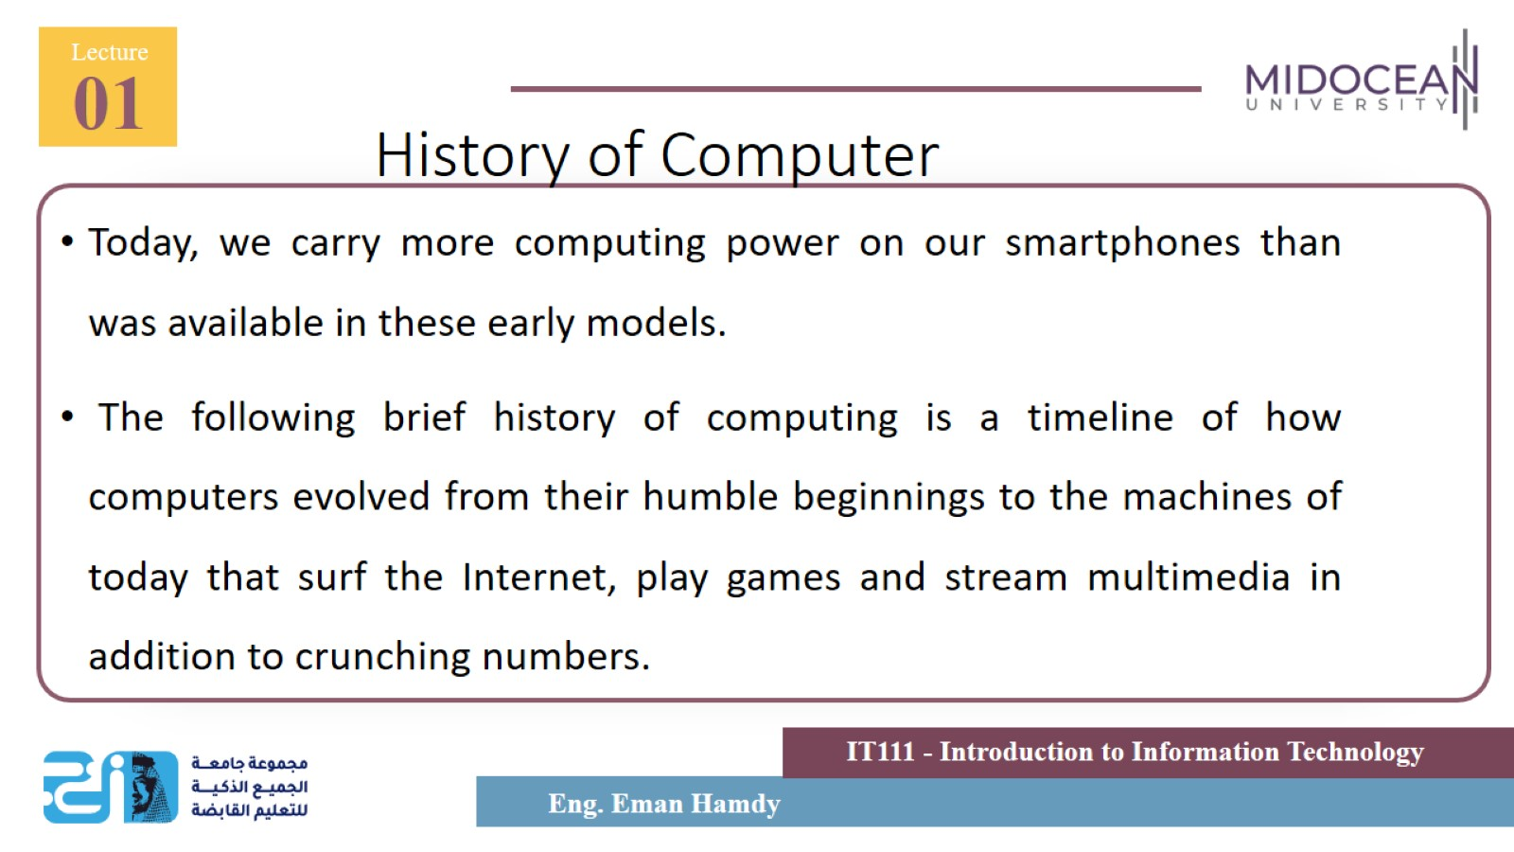
History of Computer

Slide 12
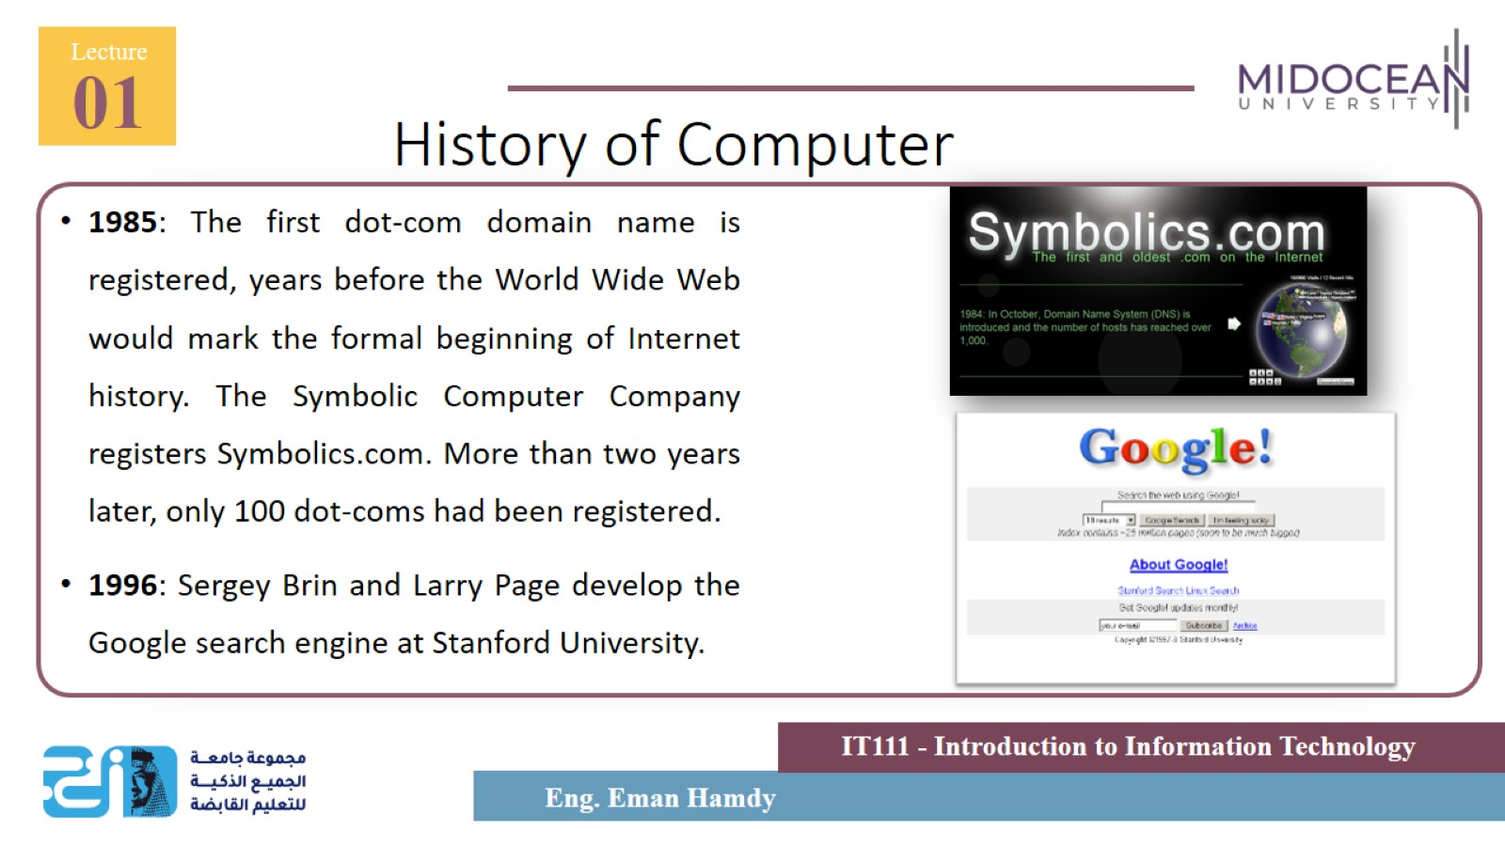
History of Computer

Slide 13
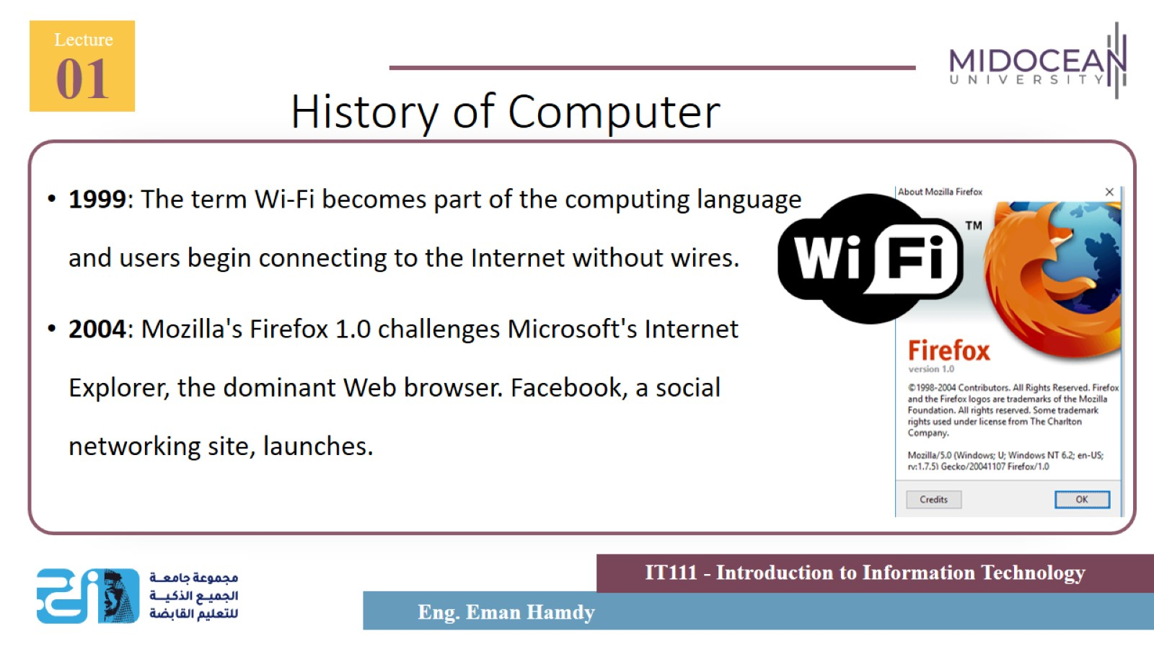
History of Computer

Slide 14
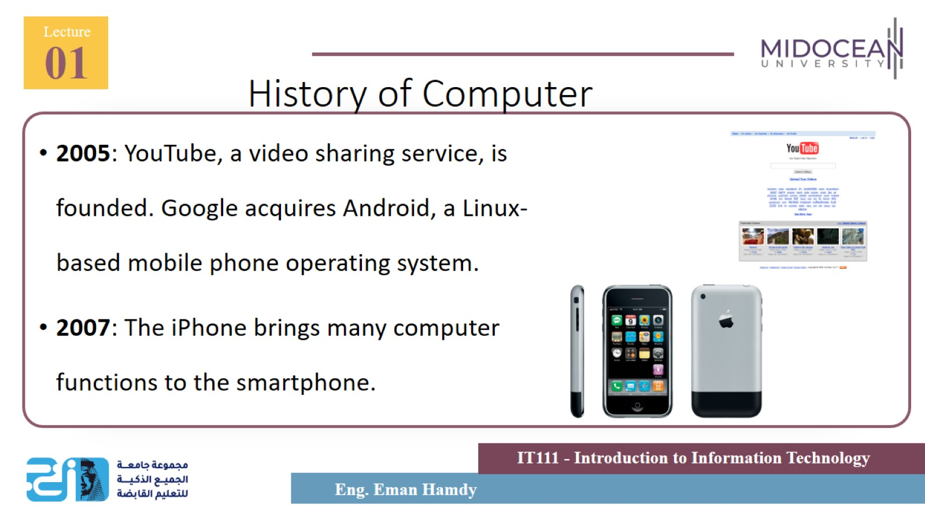
History of Computer

Slide 15
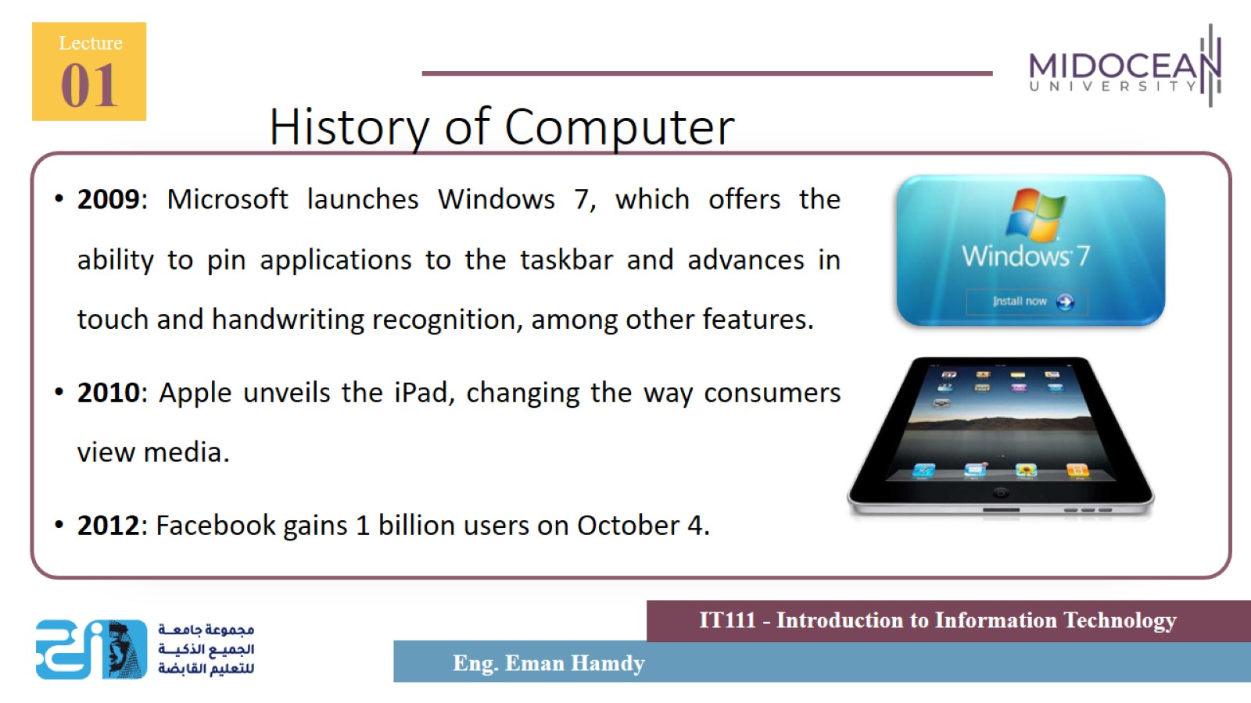
History of Computer

Slide 16
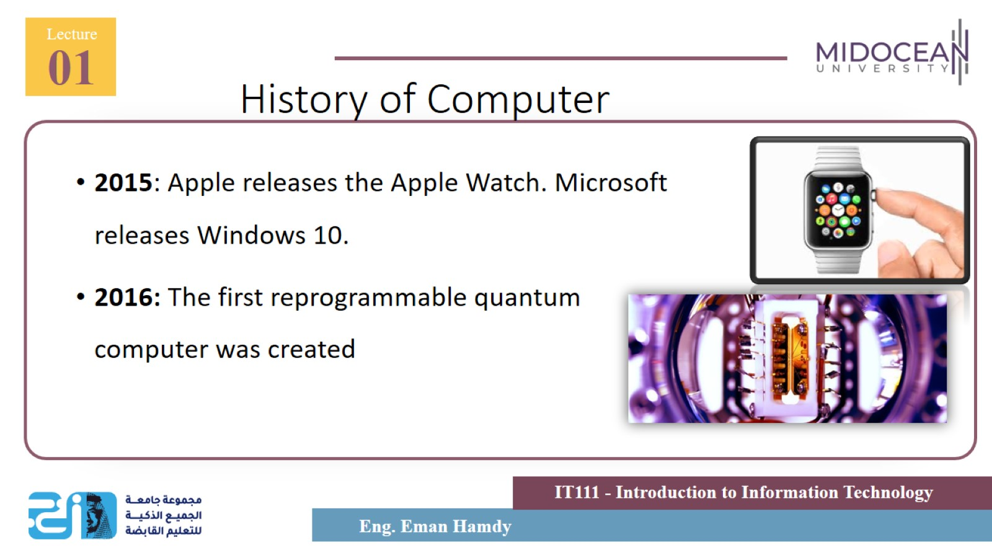
History of Computer

Slide 17
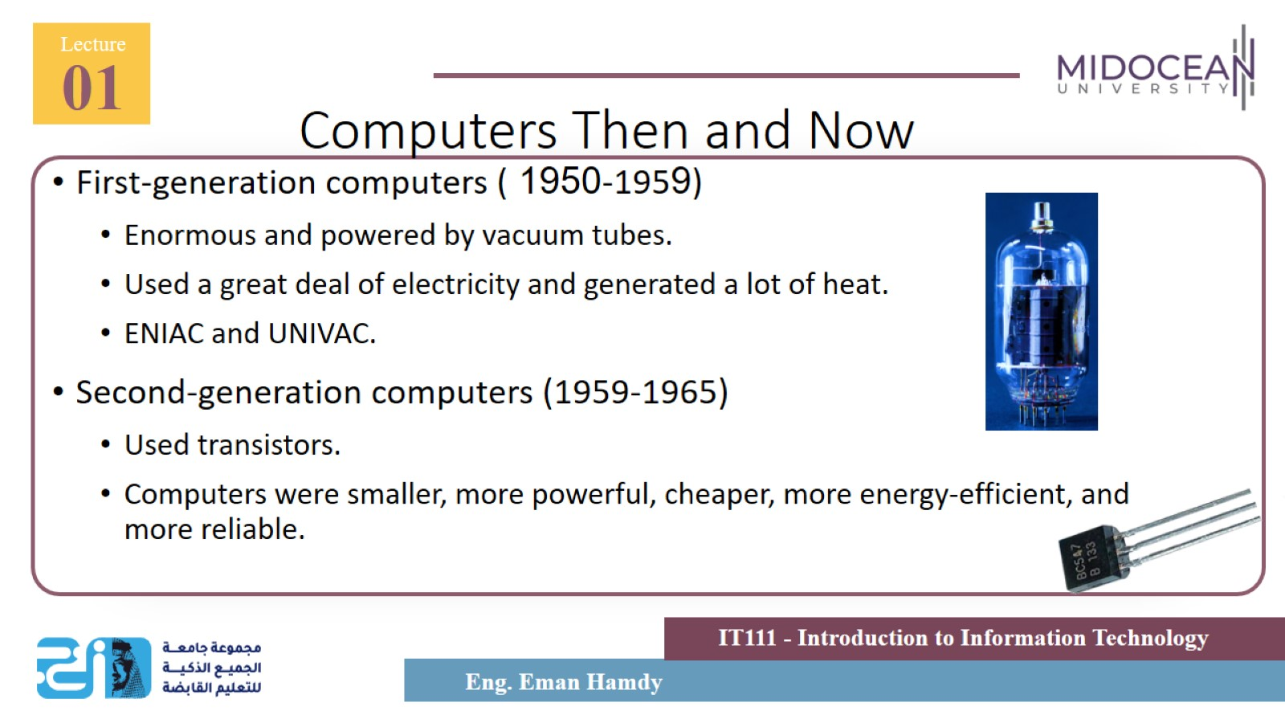
Computers Then and Now

Slide 18
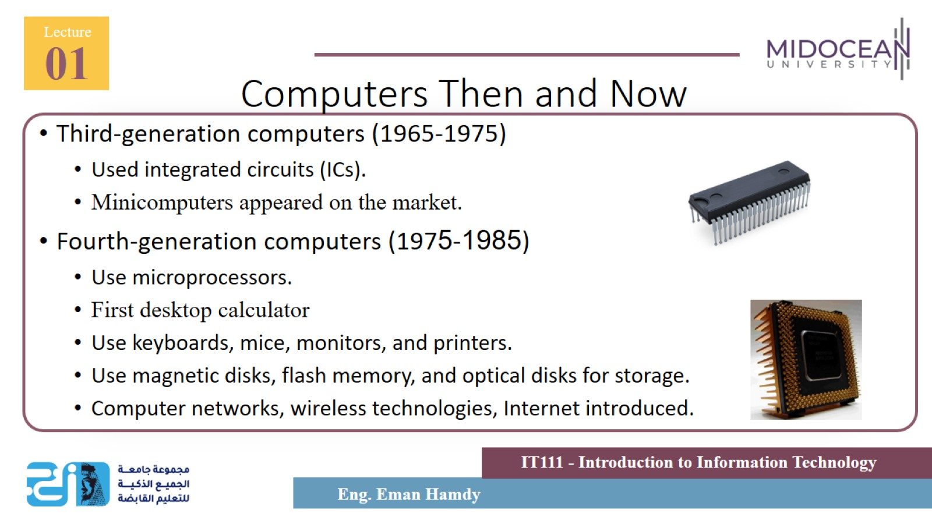
Computers Then and Now

Slide 19
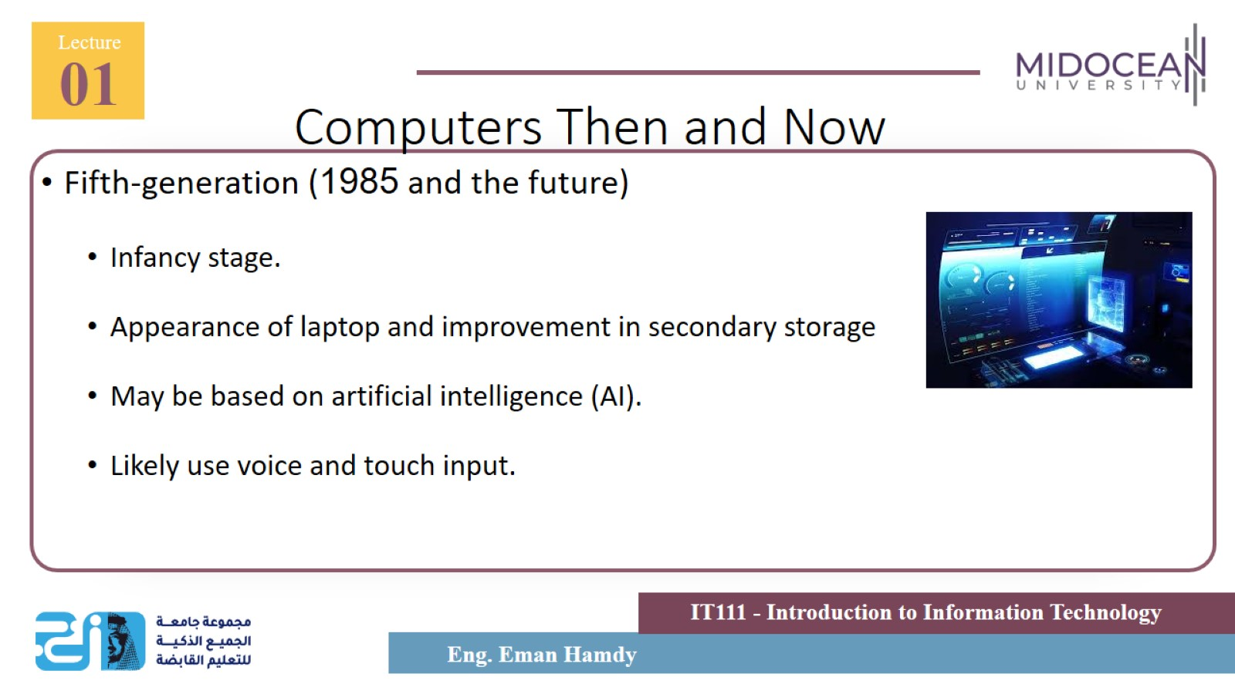
Computers Then and Now

Slide 20
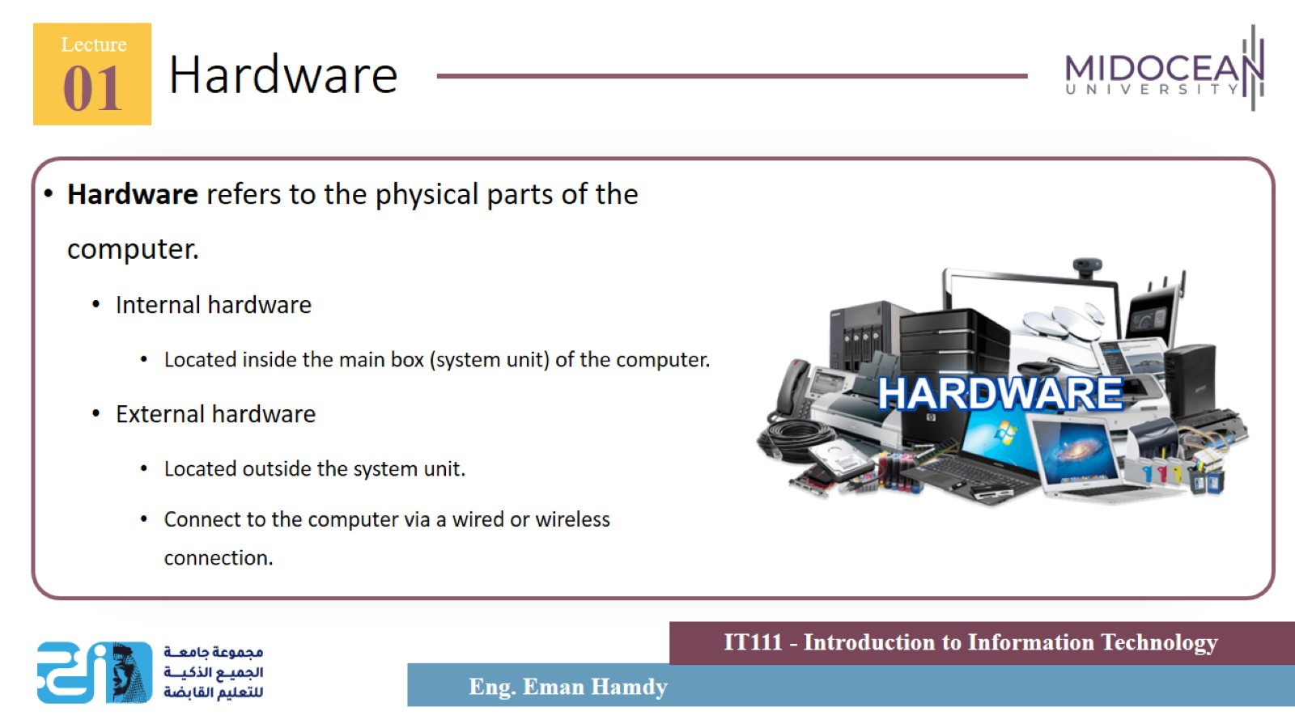
Hardware

Slide 21
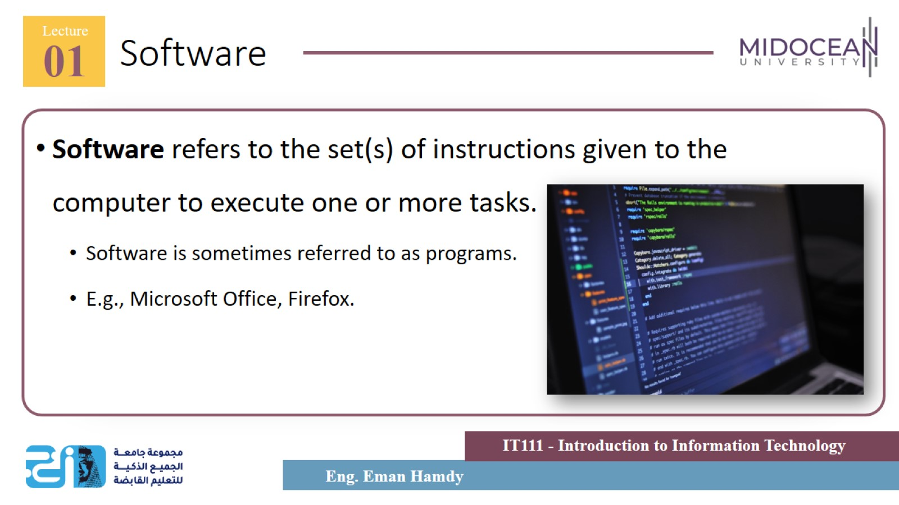
Software

Slide 22
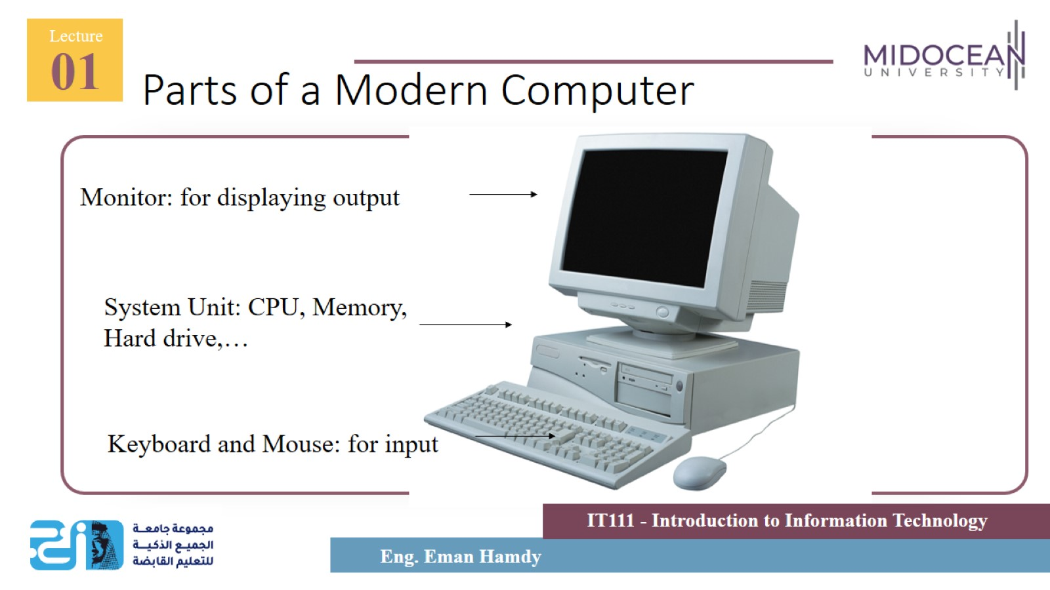
Parts of a Modern Computer

Slide 23
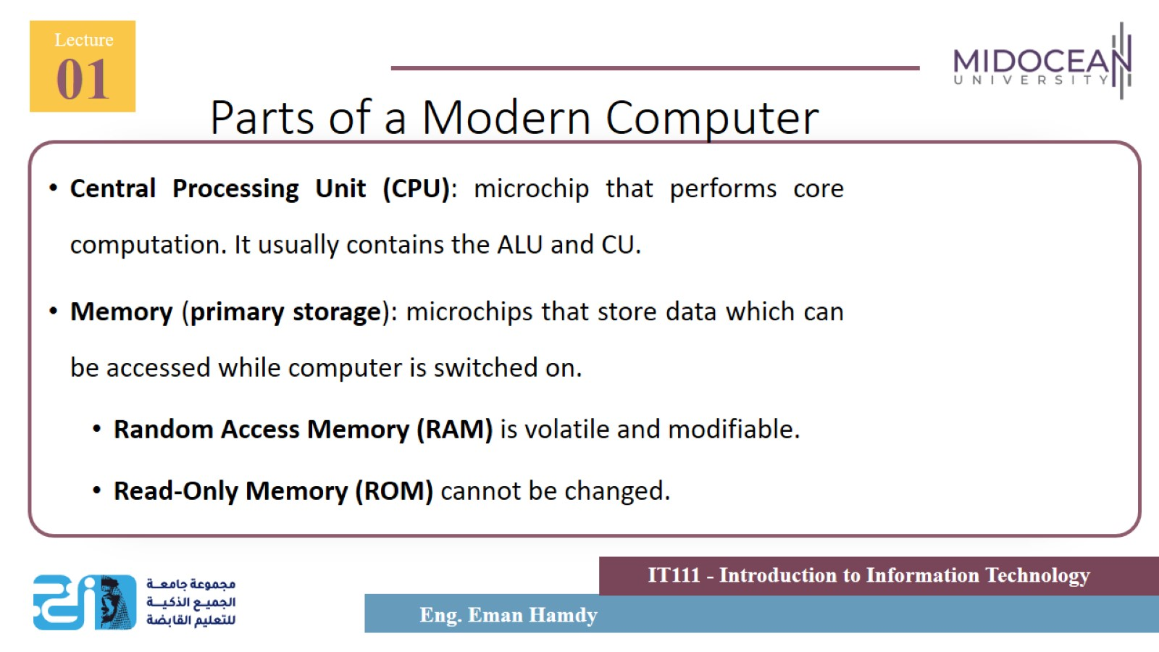
Parts of a Modern Computer

Slide 24
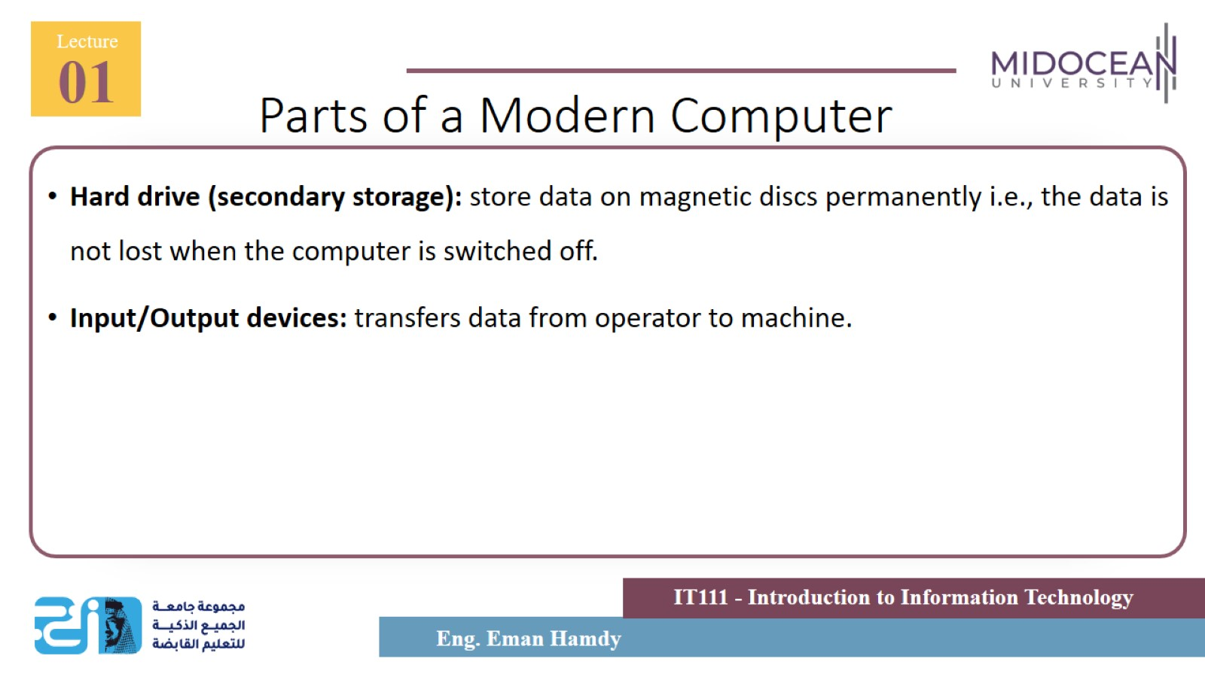
Parts of a Modern Computer

Slide 25
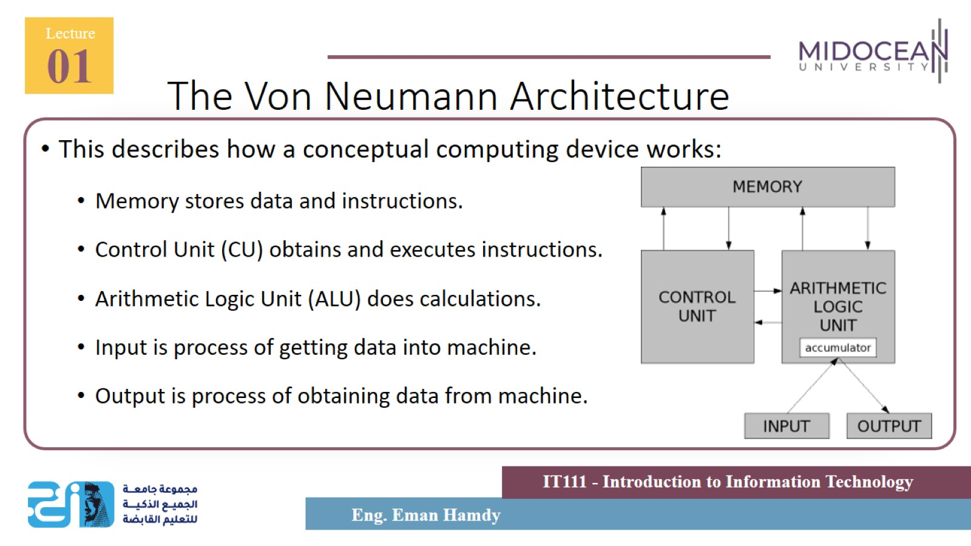
The Von Neumann Architecture

Slide 26
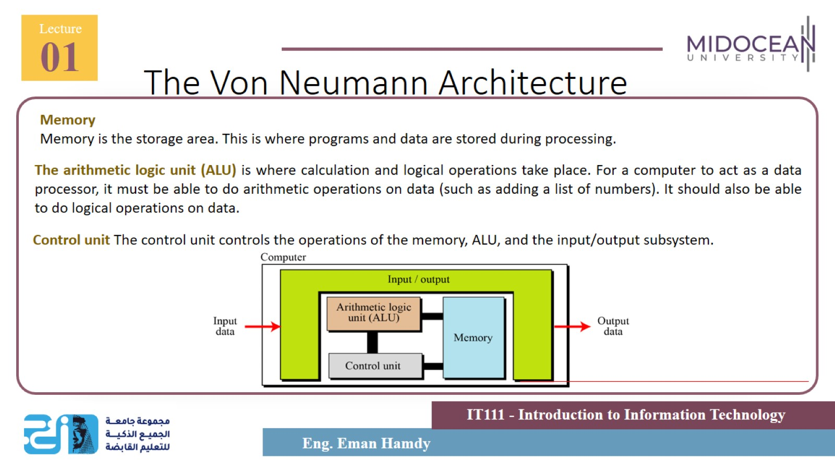
The Von Neumann Architecture

Slide 27
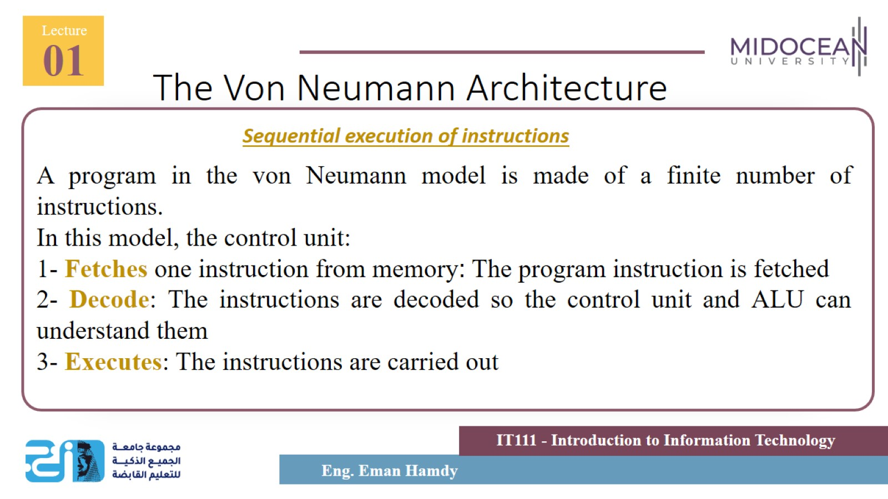
The Von Neumann Architecture

Slide 28
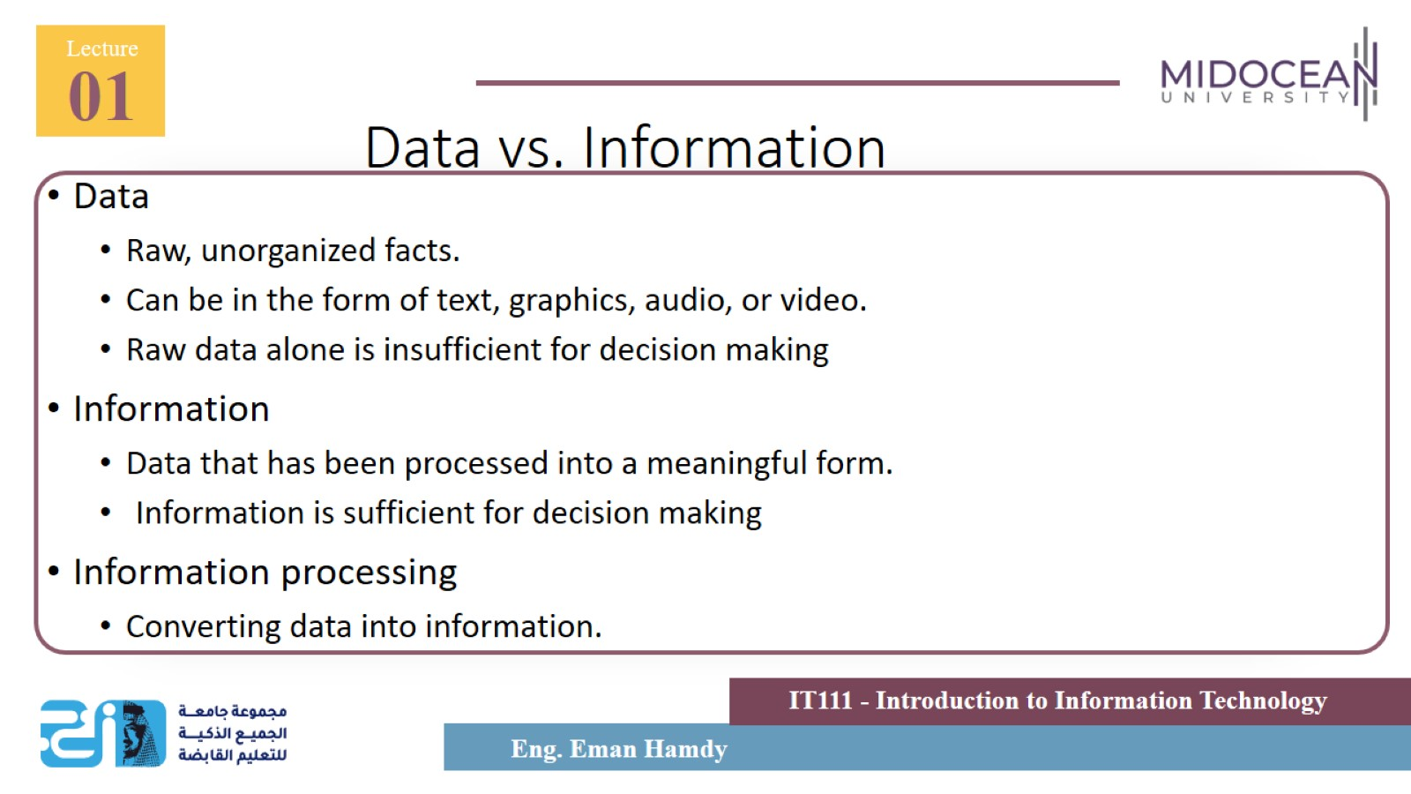
Data vs. Information

Slide 29
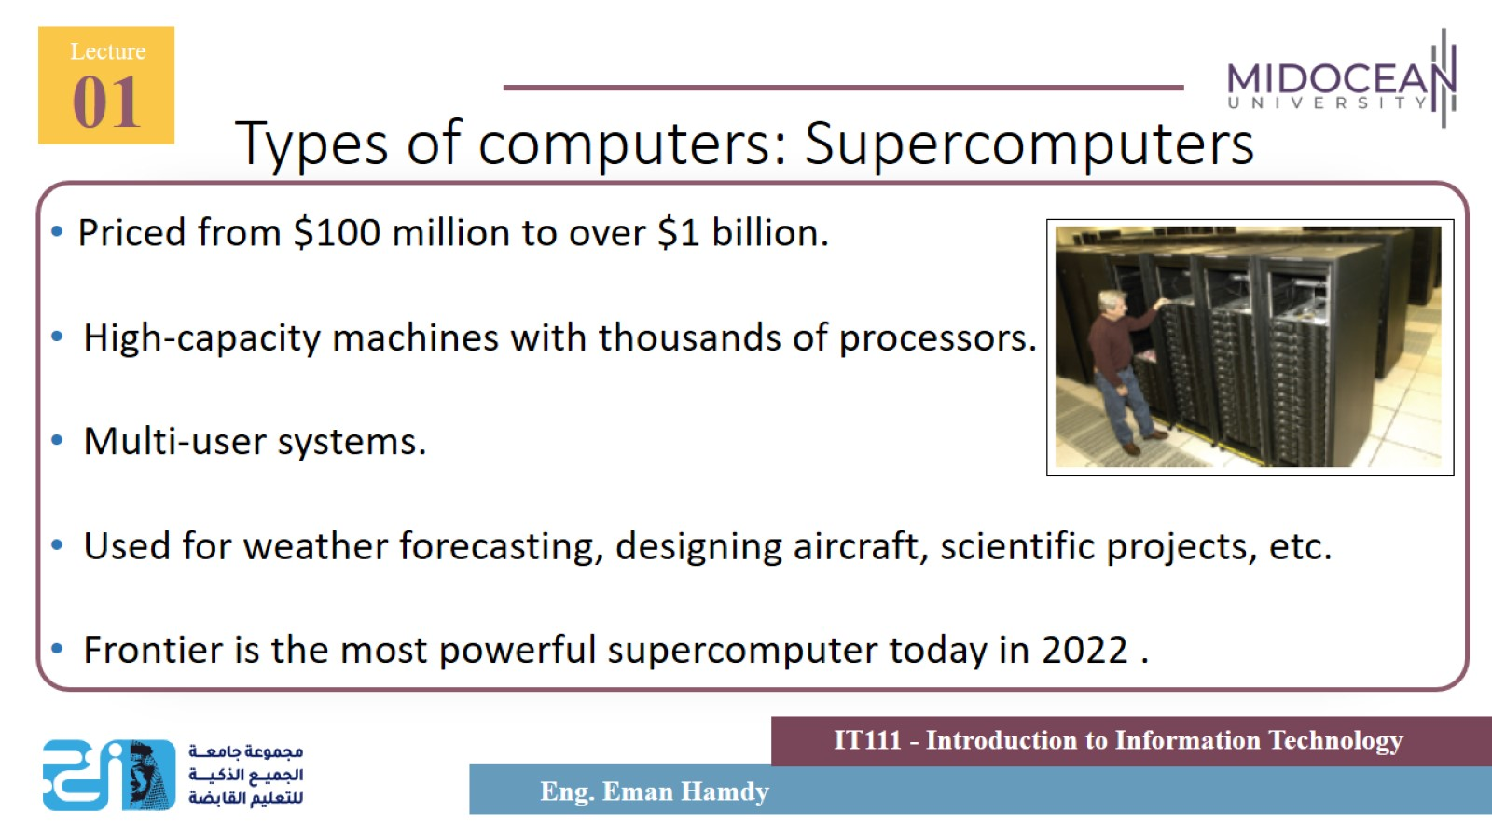
Types of computers: Supercomputers

Slide 30
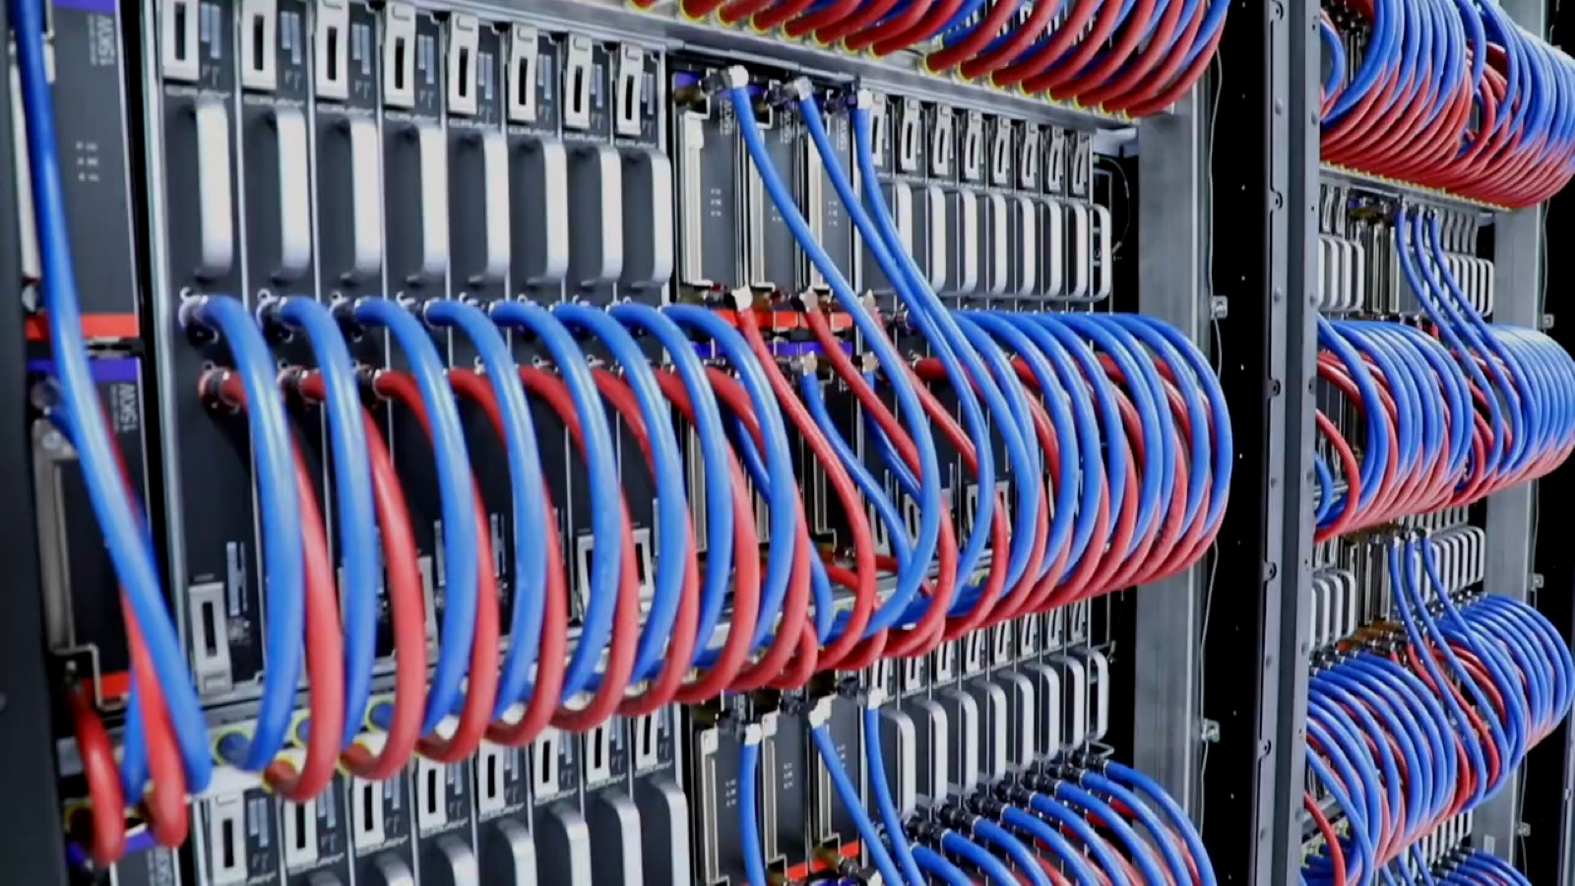

Slide 31
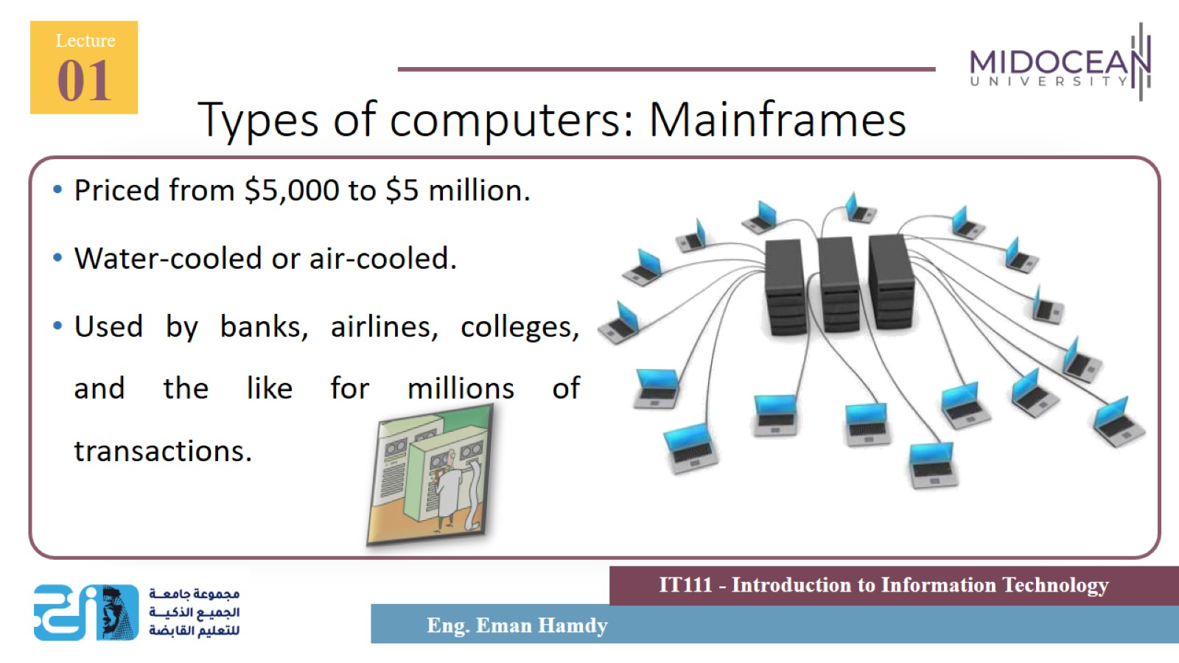
Types of computers: Mainframes

Slide 32
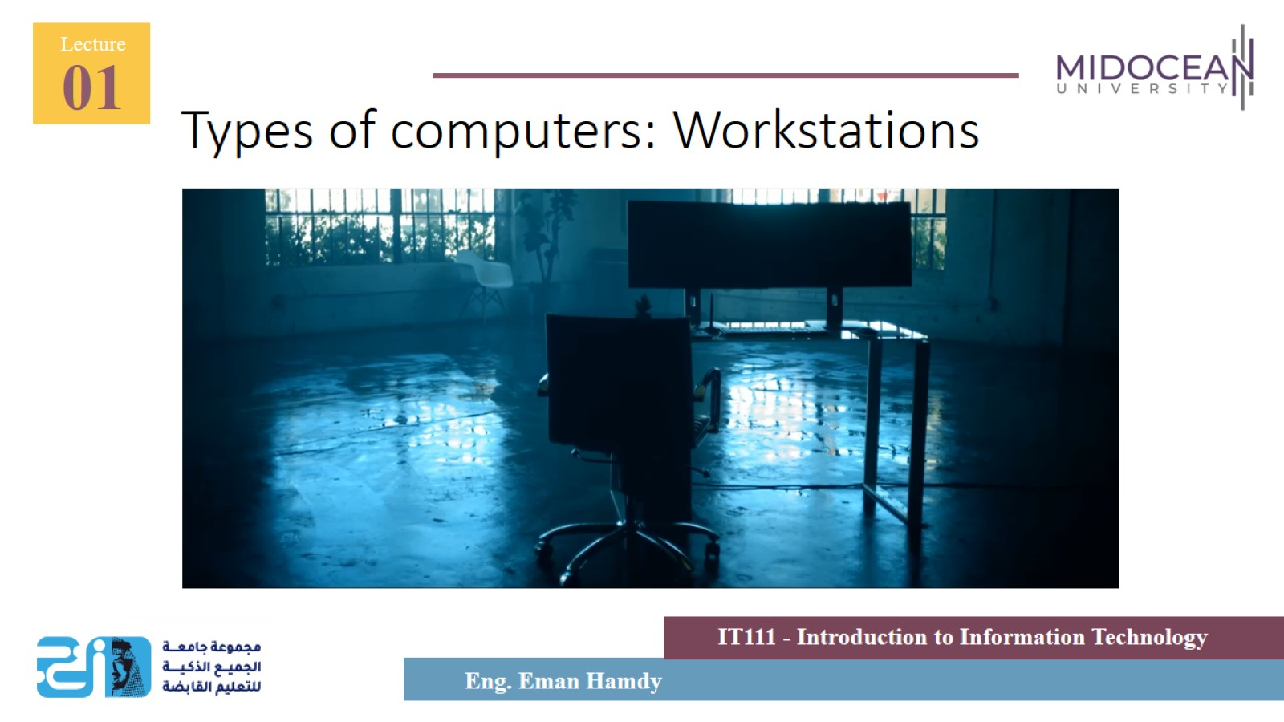
Types of computers: Workstations

Slide 33
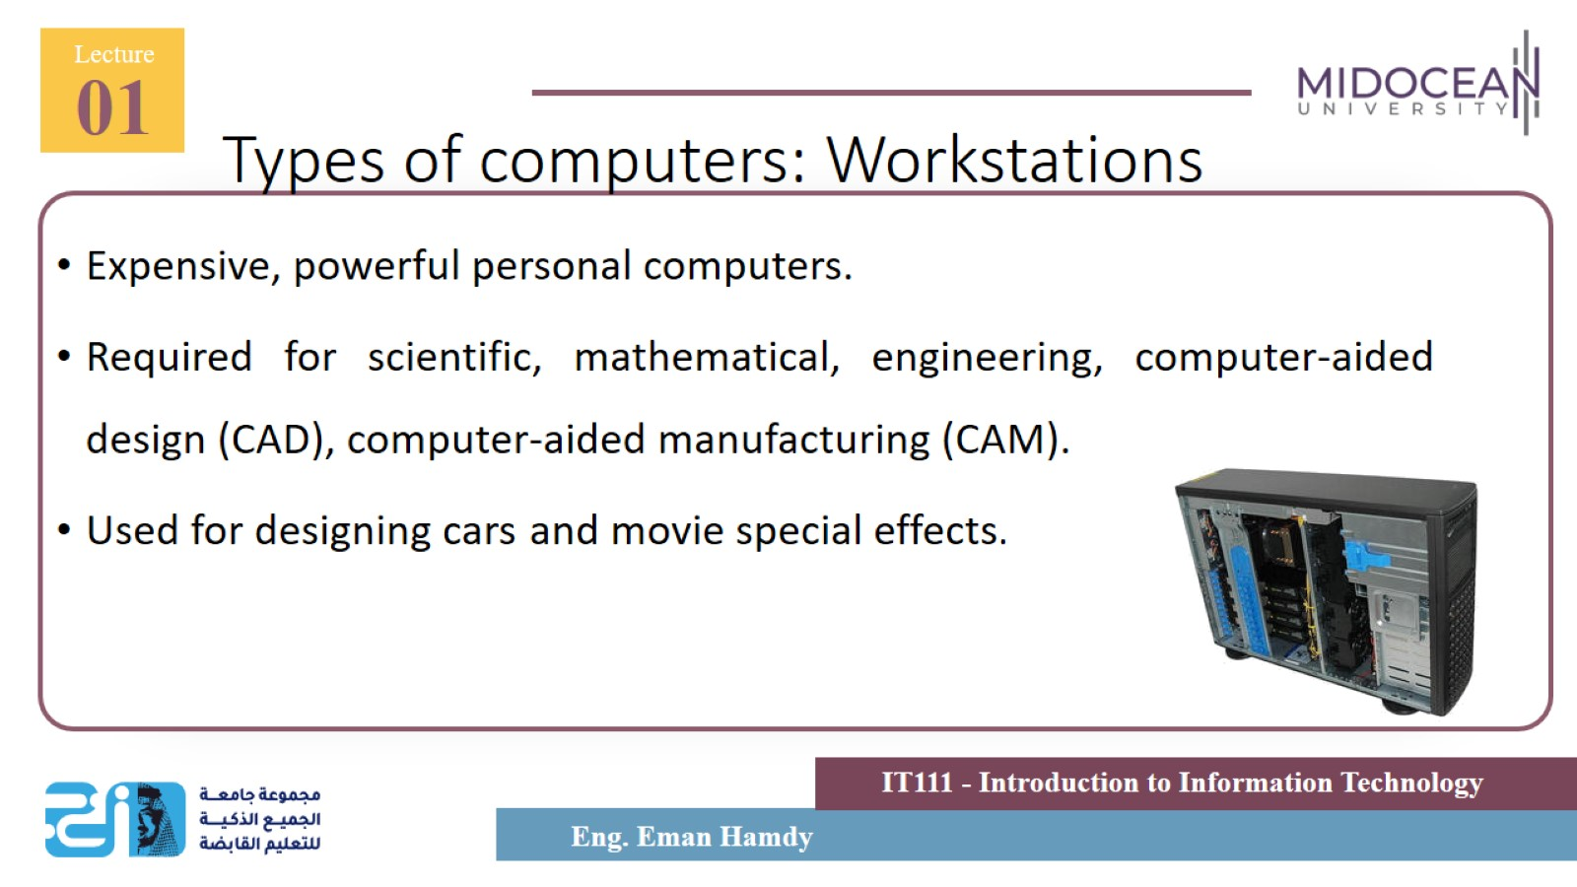
Types of computers: Workstations

Slide 34
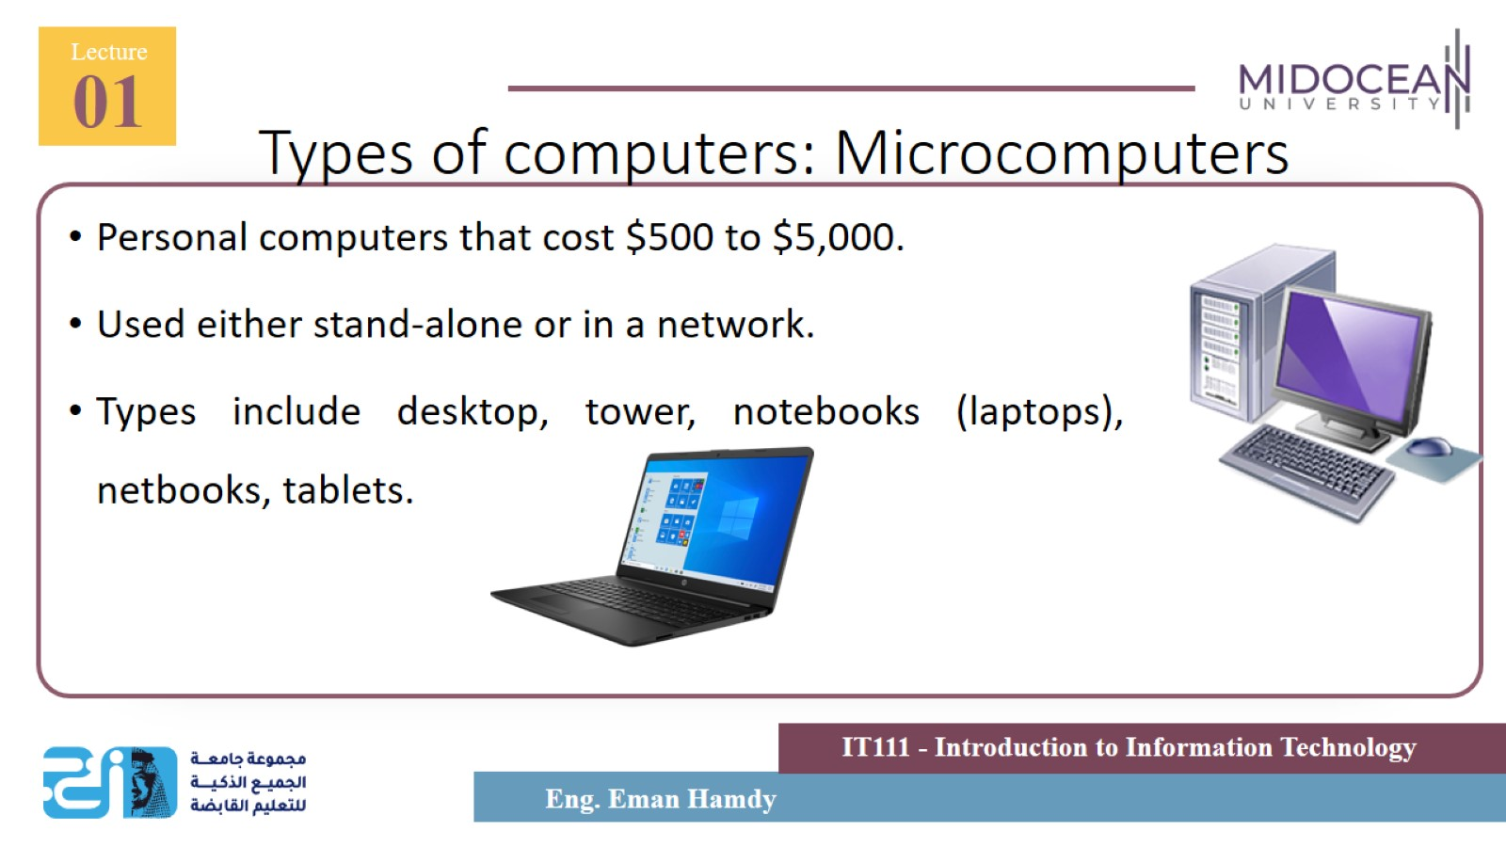
Types of computers: Microcomputers

Slide 35
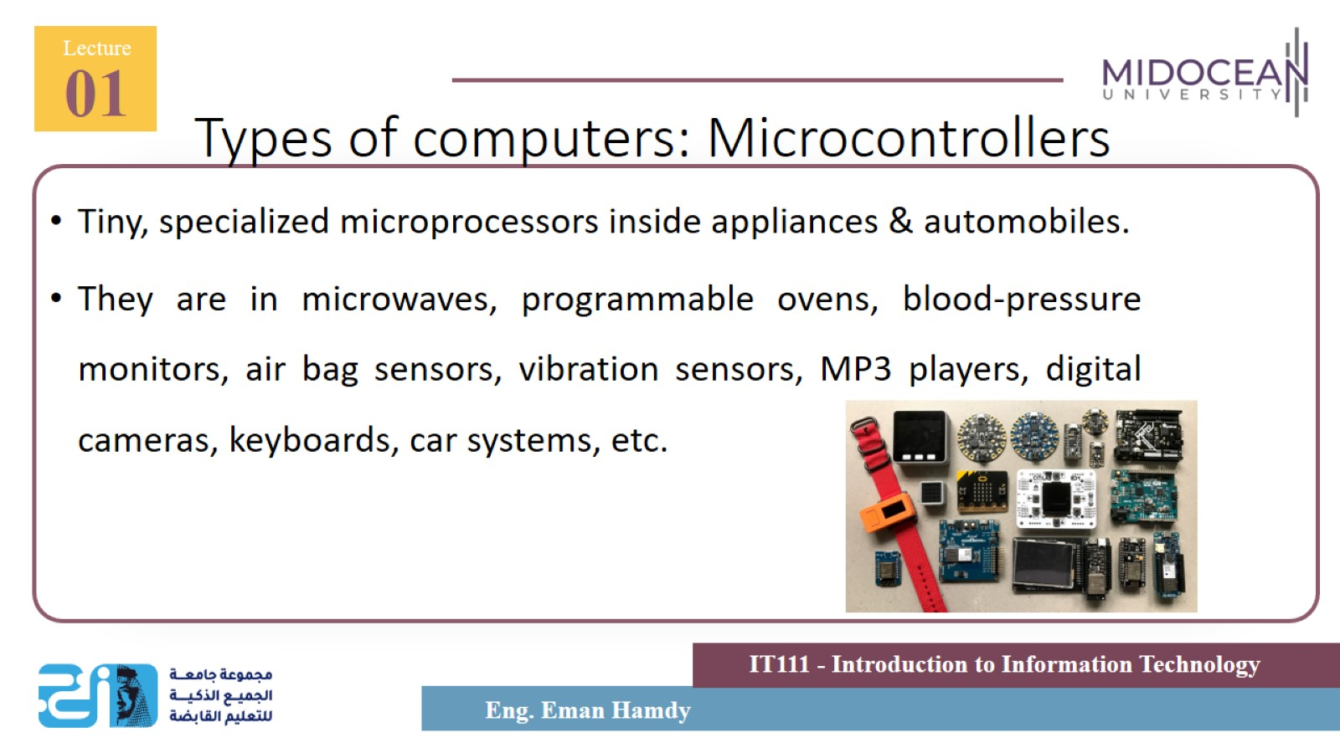
Types of computers: Microcontrollers

Slide 36
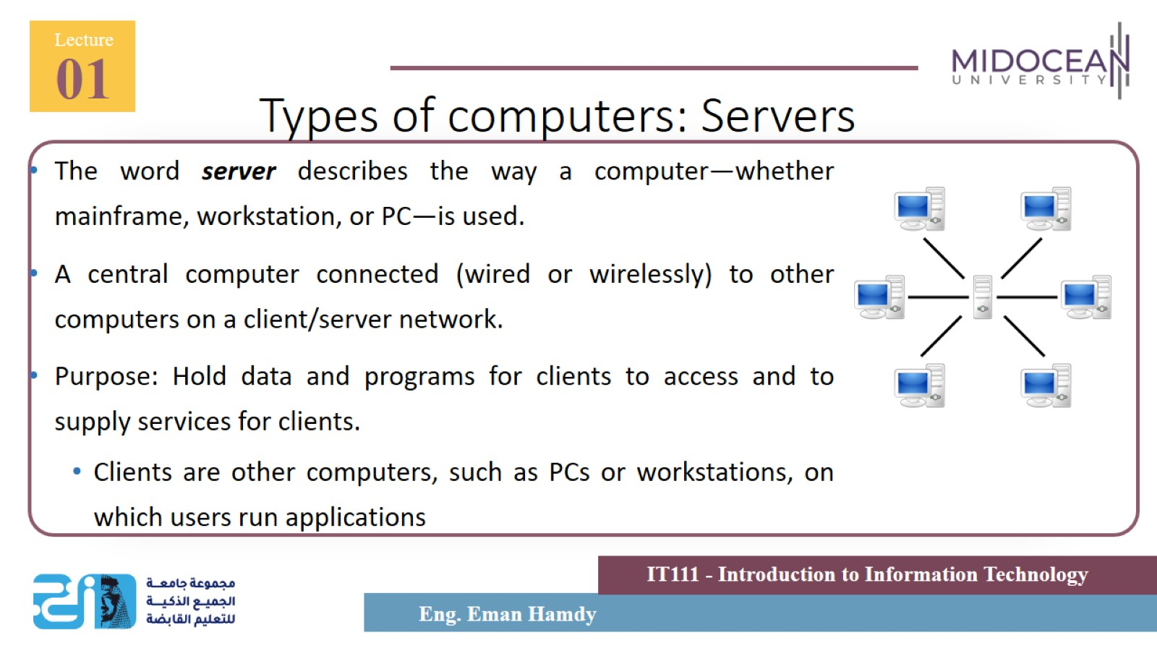
Types of computers: Servers

Slide 37
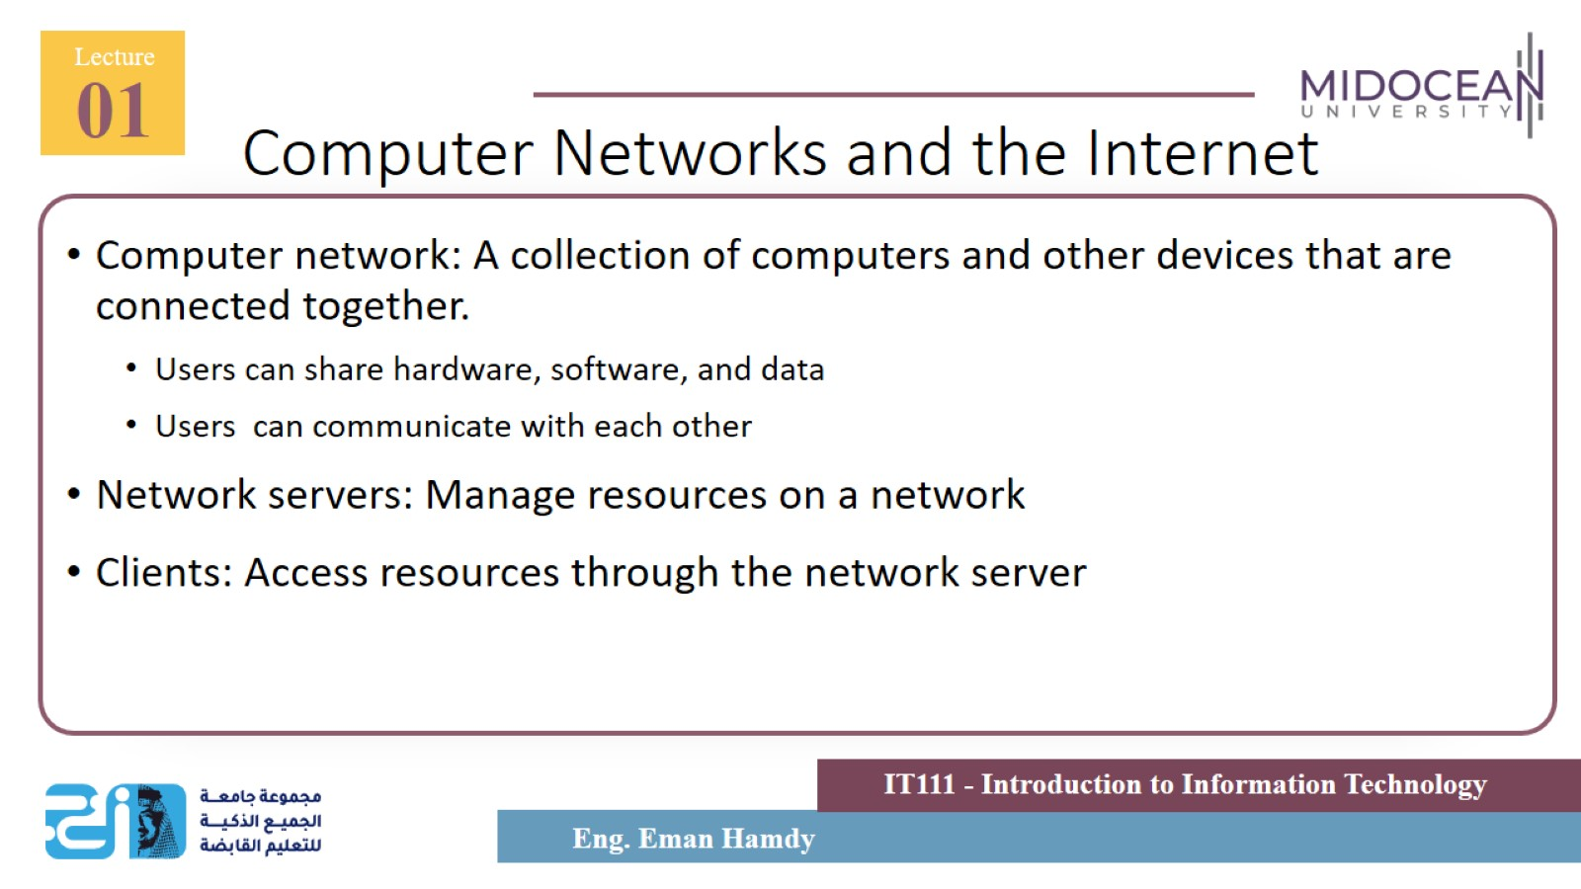
Computer Networks and the Internet

Slide 38
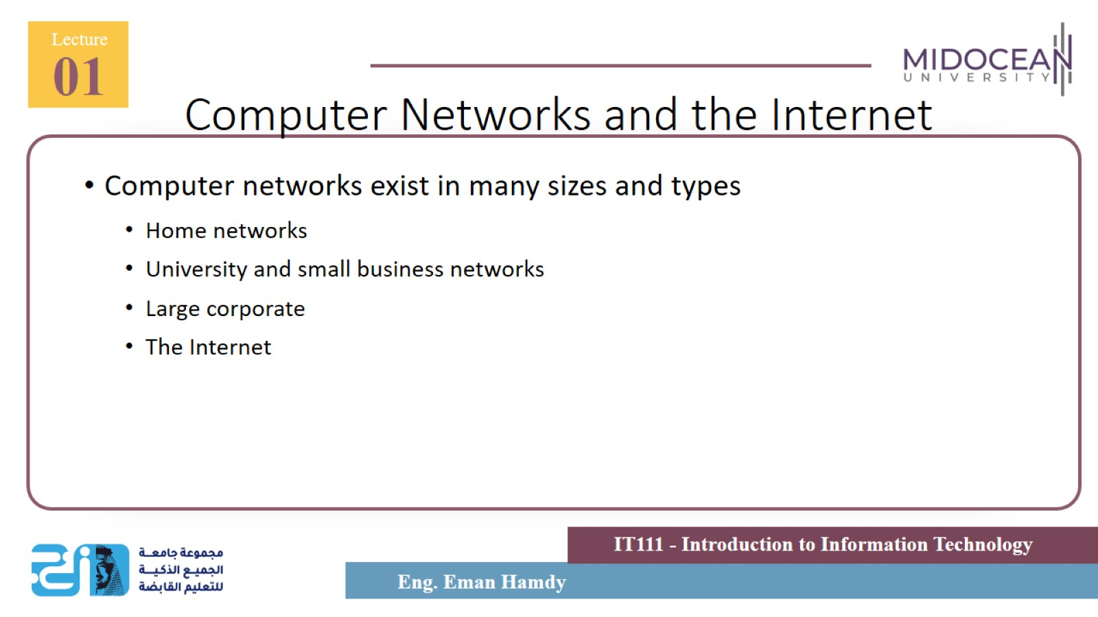
Computer Networks and the Internet

Slide 39
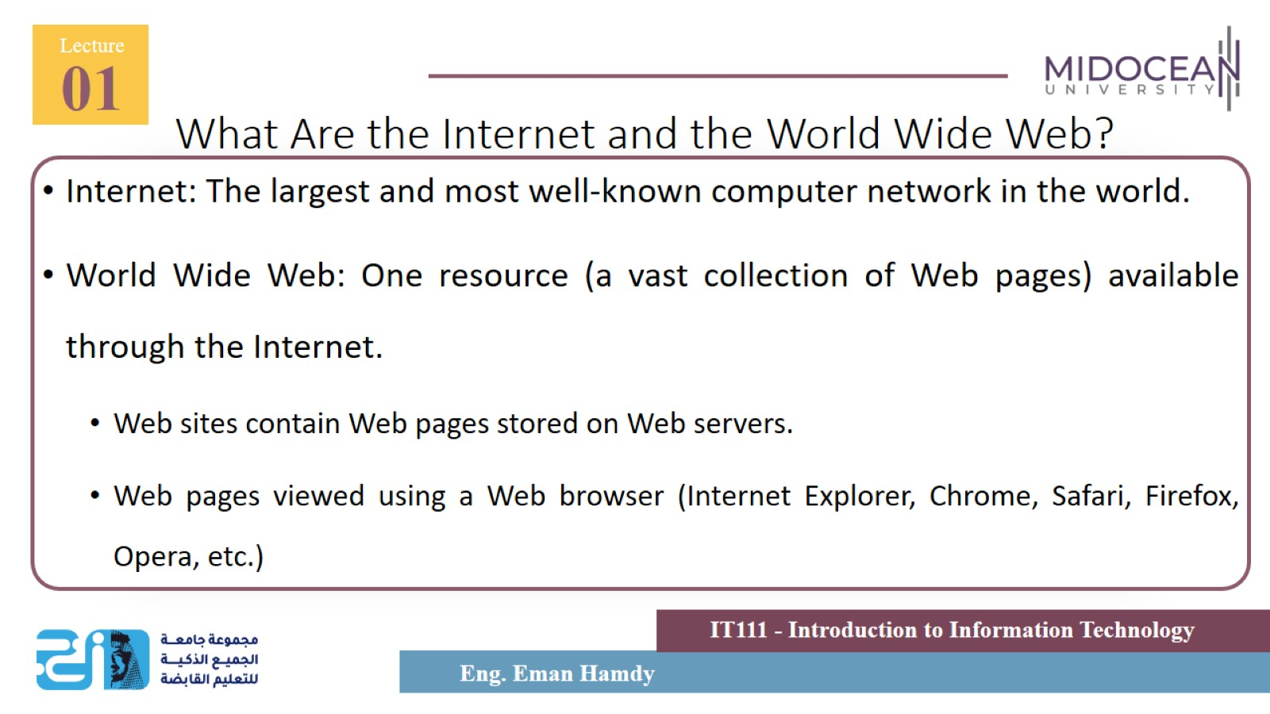
What Are the Internet and the World Wide Web?

Slide 40
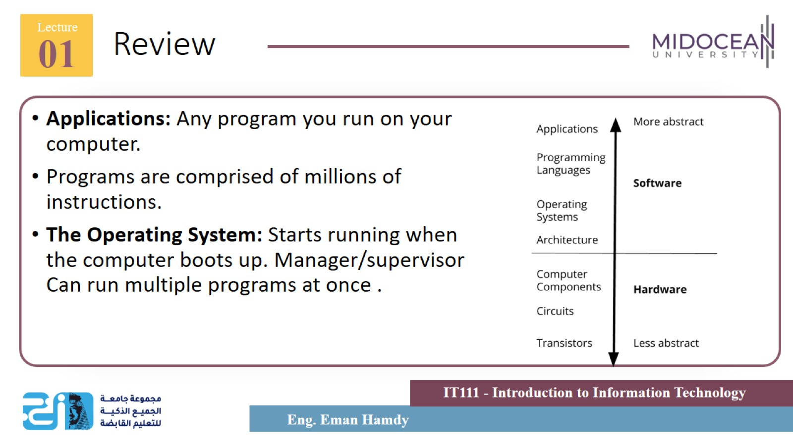
Review

Slide 41
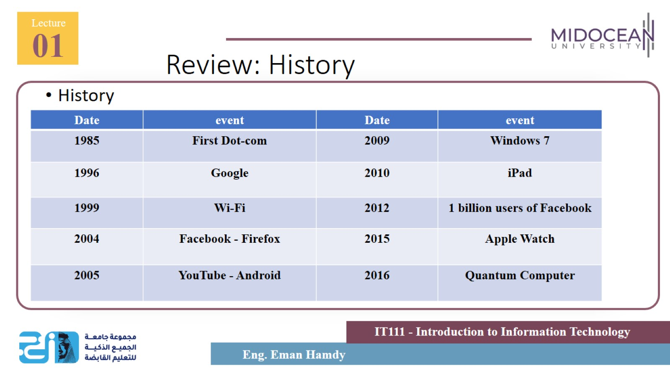
Review: History

Slide 42
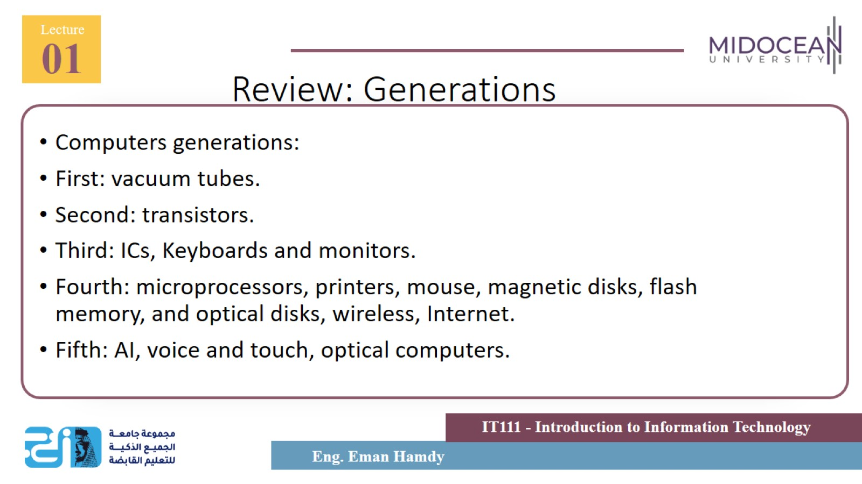
Review: Generations

Slide 43
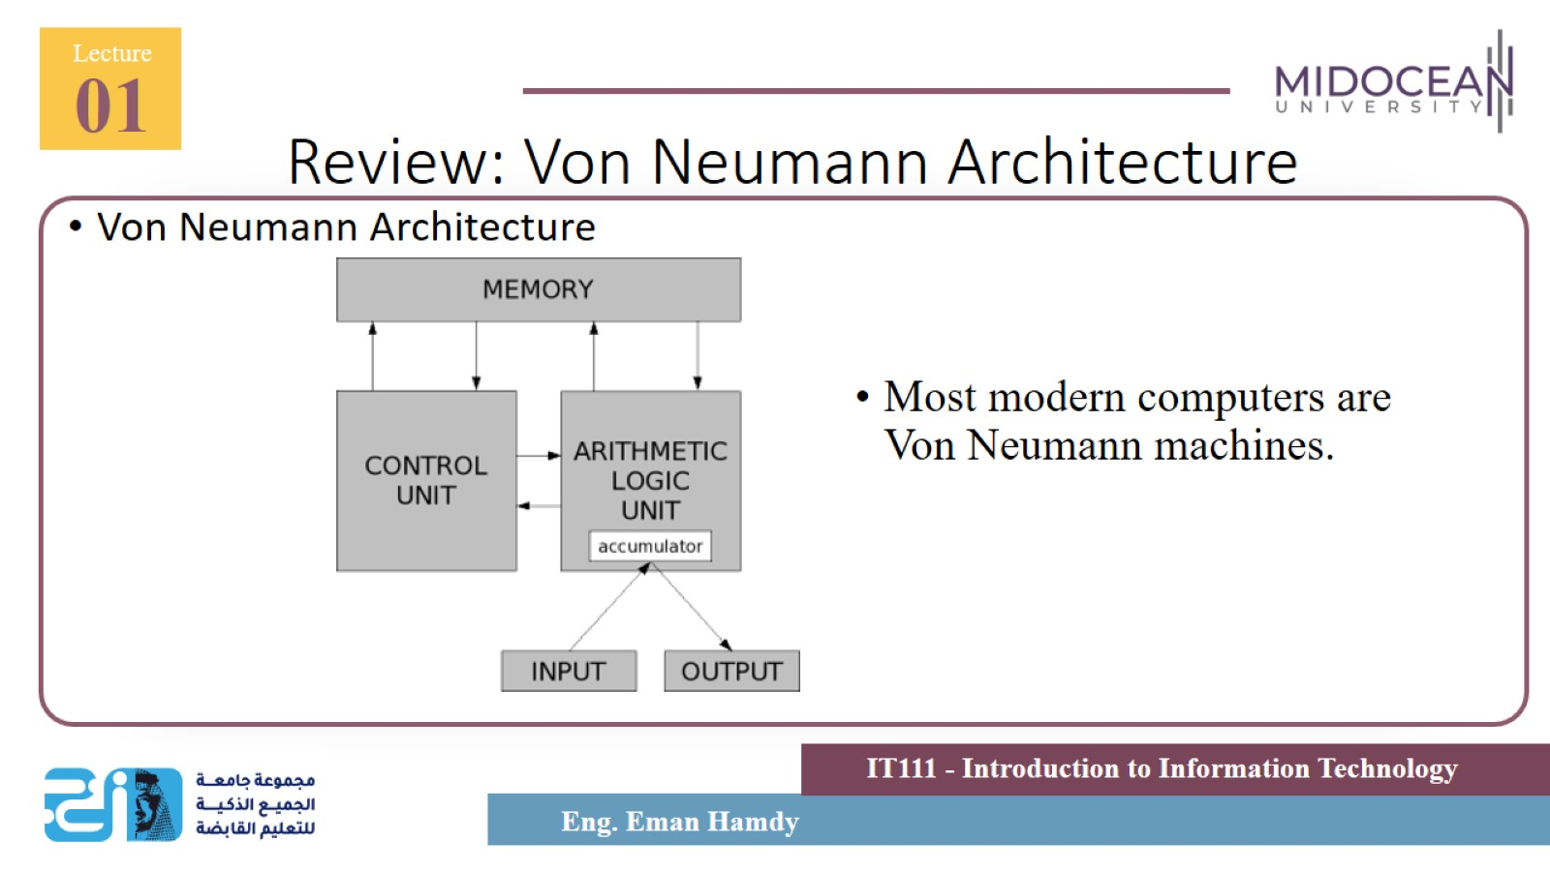
Review: Von Neumann Architecture

Slide 44
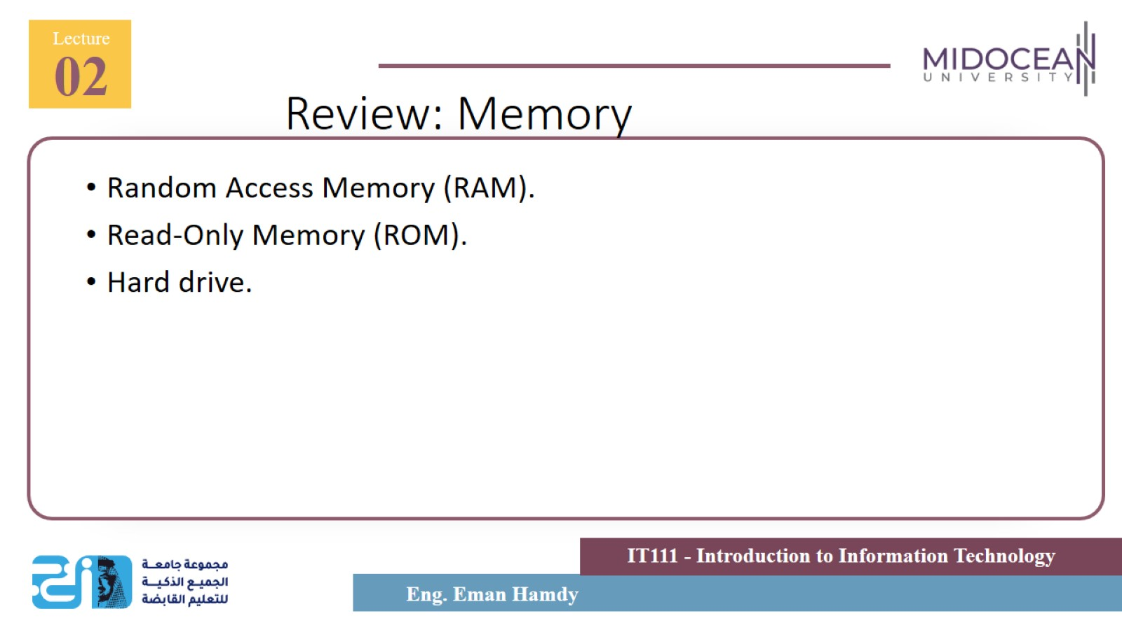
Review: Memory

Slide 45
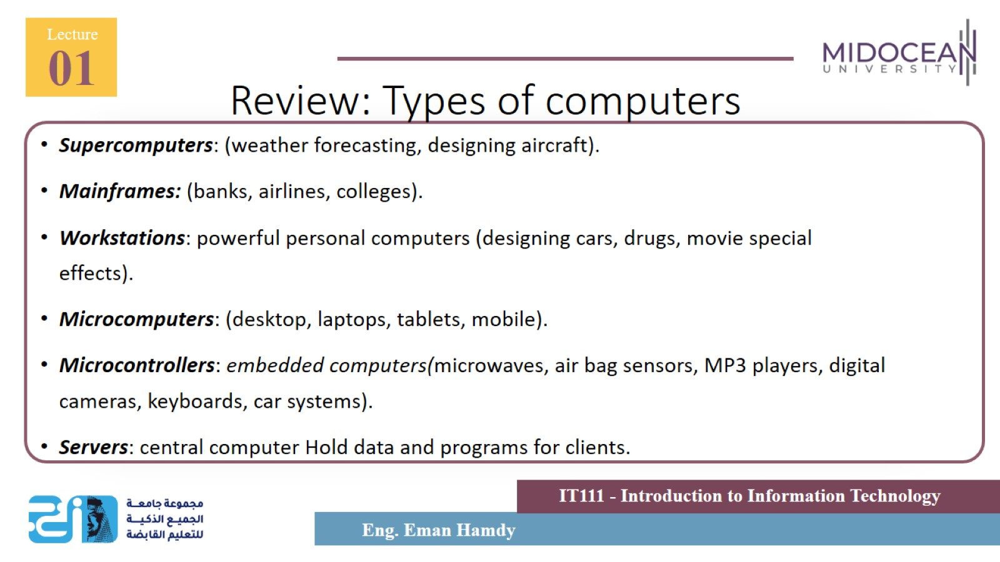
Review: Types of computers

Slide 46
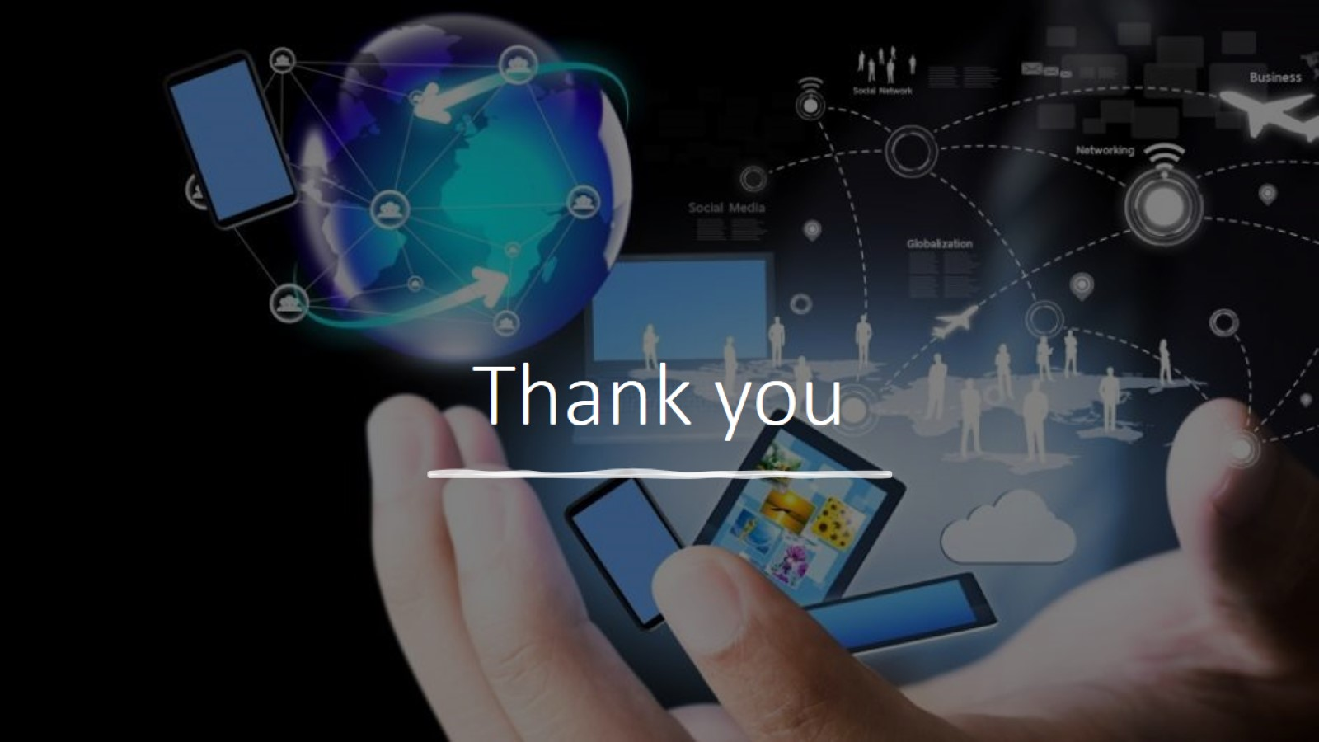
Thank you

