Slide 1



Software Engineering
Prepared by Dr. Yasser Abdelhamid
IT 382
Software Engineering
Lecture 9

Slide 2

Lecture Outline
Architectural Design
Software Architecture
Application Architecture
www.midocean.ae

Slide 3
Software architecture
Architectural design is identifying
    The sub-systems
    Sub-system control
    Sub-system communication
Specification
Architecture
Design

Slide 4
Architectural Design
An early stage of the system design process.
Represents the link between specification and design processes.
Often carried out in parallel with some specification activities.
Specification
Architecture
Design

Slide 5
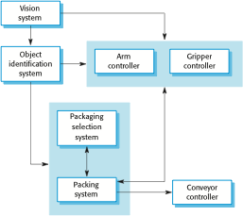
The architecture of a packing robot control system

Slide 6
Architectural Abstraction
Architecture in the small is concerned with the architecture of individual programs.
At this level, we are concerned with the way that an individual program is decomposed into components (modules) .

Slide 7
Architectural Abstraction
Architecture in the large is concerned with:
  The architecture of complex enterprise systems that include other systems, programs, and program components.
  These complex enterprise systems
    Are distributed over different computers,
    May be owned and managed by different companies

Slide 8
Advantages of explicit architecture
Stakeholder communication
  Architecture may be used as a focus of discussion by system stakeholders.
System analysis
  More system understanding and easier management
Large-scale reuse
  The architecture may be reusable across a range of systems

Slide 9
Architectural representations
Simple, informal block diagrams showing:
  Entities and relationships are the most frequently used method for documenting software architectures.
But these have been criticized because
  They lack semantics, do not show the types of relationships between entities nor the visible properties of entities in the architecture.

Slide 10
Box and line diagrams …. trade off
- Negative:
  Very abstract - they do not show the nature of component relationships nor the externally visible properties of the sub-systems.
+ Positive
  Useful for communication with stakeholders and for project planning.

Slide 11
Use of architectural models
As a way of facilitating discussion about the system design
  A high-level architectural view of a system is useful for communication with system stakeholders and project planning because it is not cluttered with detail.
  Stakeholders can relate to it and understand an abstract view of the system. They can then discuss the system as a whole without being confused by detail.
As a way of documenting an architecture that has been designed
  The aim here is to produce a complete system model that shows the different components in a system, their interfaces and their connections.

Slide 12
Architectural Design Decisions
Architectural design is a creative process
Examples of architectural design decisions
  Is there a generic application architecture that can be used?
  How will the system be distributed?
  What architectural styles are appropriate?
  How will the system be decomposed into modules?
  What control strategy should be used?
  How will the architectural design be evaluated?
  How should the architecture be documented?

Slide 13
Architecture Reuse
Systems in the same domain often have similar architectures that reflect domain concepts.
Application product lines are built around a core architecture with variants that satisfy particular customer requirements.
The architecture of a system may be designed around one or more architectural patterns or ‘styles’.

Slide 14
Architecture and system characteristics
(non-functional requirements)
Performance
  minimize communications.
    Use large rather than fine-grain components.
Security
  Use a layered architecture with critical assets in the inner layers.
Safety
  Localize safety-critical features in a small number of sub-systems.
Availability
  Include redundant components and mechanisms for fault tolerance.
Maintainability
  Use fine-grain, replaceable components.

Slide 15
Architectural views
We have 2 what's:
  What views or perspectives are useful when designing and documenting a system’s architecture?
  What notations should be used for describing architectural models?

Slide 16
Architectural views
Each architectural model only shows one view or perspective of the system.
  It might show:
    How a system is decomposed into modules,
    How the run-time processes interact
    How the different ways in which system components are distributed across a network.
For both design and documentation, you usually need to present multiple views of the software architecture.

Slide 17
4 + 1 view model of software architecture
A logical view, which shows the key abstractions in the system as objects or object classes.
A process view, which shows how, at run-time, the system is composed of interacting processes.
A development view, which shows how the software is decomposed for development.
A physical view, which shows the system hardware and how software components are distributed across the processors in the system.
Related using use cases or scenarios (+1)

Slide 18
Architectural patterns
Patterns are a means of representing, sharing and reusing knowledge.
An architectural pattern is a stylized description of good design practice, which has been tried and tested in different environments.
Patterns should include information about when they are and when they are not useful.
Patterns may be represented using tabular and graphical descriptions.

Slide 19
The Model-View-Controller (MVC) pattern
Name | MVC (Model-View-Controller)
Description | Separates presentation and interaction from the system data. The system is structured into three logical components that interact with each other. The Model component manages the system data and associated operations on that data. The View component defines and manages how the data is presented to the user. The Controller component manages user interaction (e.g., key presses, mouse clicks, etc.) and passes these interactions to the View and the Model.
Example | A web-based application system organized using the MVC pattern.
When used | Used when there are multiple ways to view and interact with data. Used when the future requirements for interaction and presentation of data are unknown.
Advantages | Allows the data to change independently of its representation and vice versa. Supports presentation of the same data in different ways with changes made in one representation shown in all of them.
Disadvantages | Can involve additional code and code complexity when the data model and interactions are simple.

Slide 20
The Model-View-Controller (MVC) pattern
Name | MVC (Model-View-Controller)
Description | Separates presentation and interaction from the system data. The system is structured into three logical components that interact with each other. The Model component manages the system data and associated operations on that data. The View component defines and manages how the data is presented to the user. The Controller component manages user interaction (e.g., key presses, mouse clicks, etc.) and passes these interactions to the View and the Model.
Example | A web-based application system organized using the MVC pattern.
When used | Used when there are multiple ways to view and interact with data. Used when the future requirements for interaction and presentation of data are unknown.
Advantages | Allows the data to change independently of its representation and vice versa. Supports presentation of the same data in different ways with changes made in one representation shown in all of them.
Disadvantages | Can involve additional code and code complexity when the data model and interactions are simple.

Slide 21
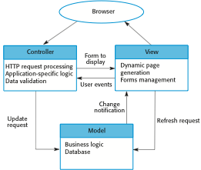
Web application architecture using the MVC pattern

Slide 22
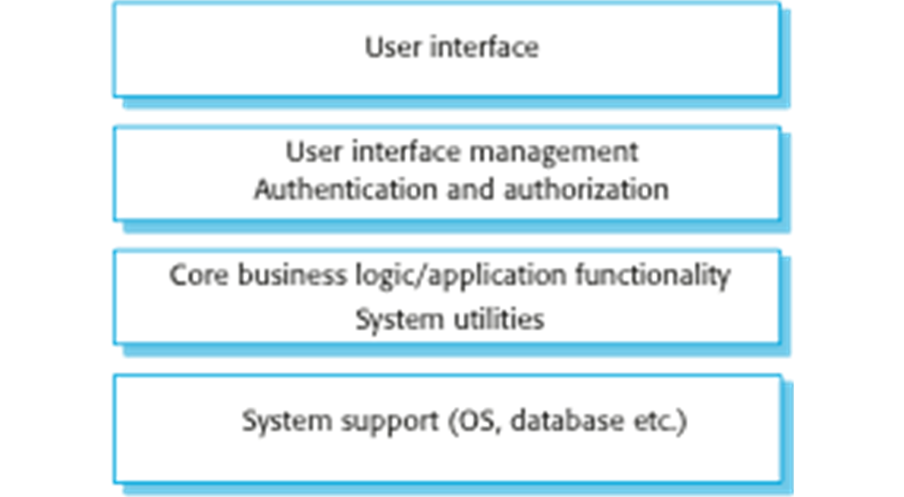
Layered Architecture
Organises the system into a set of layers each of which provide a set of services.
Supports the incremental development of sub-systems in different layers.
When a layer interface changes, only the adjacent layer is affected.

Slide 23
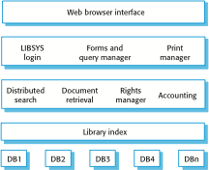
The architecture of the LIBSYS system

Slide 24
The Layered architecture pattern
Lo. Name | Layered architecture
Description | Organizes the system into layers with related functionality associated with each layer. A layer provides services to the layer above it so the lowest-level layers represent core services that are likely to be used throughout the system.
Example | A layered model of a system for sharing copyright documents held in different libraries.
When used | Used when building new facilities on top of existing systems; When the development is spread across several teams with each team responsibility for a layer of functionality; When there is a requirement for multi-level security.
Advantages | Allows replacement of entire layers as long as the interface is maintained. Redundant facilities (e.g., authentication) can be provided in each layer to increase the dependability of the system.
Disadvantages | In practice, providing a clean separation between layers is often difficult. A high-level layer may have to interact directly with lower-level layers rather than through the layer immediately below it. Performance can be a problem because of multiple levels of interpretation of a service request as it is processed at each layer.

Slide 25
The Layered architecture pattern
Lo. Name | Layered architecture
Description | Organizes the system into layers with related functionality associated with each layer. A layer provides services to the layer above it so the lowest-level layers represent core services that are likely to be used throughout the system.
Example | A layered model of a system for sharing copyright documents held in different libraries.
When used | Used when building new facilities on top of existing systems; When the development is spread across several teams with each team responsibility for a layer of functionality; When there is a requirement for multi-level security.
Advantages | Allows replacement of entire layers as long as the interface is maintained. Redundant facilities (e.g., authentication) can be provided in each layer to increase the dependability of the system.
Disadvantages | In practice, providing a clean separation between layers is often difficult. A high-level layer may have to interact directly with lower-level layers rather than through the layer immediately below it. Performance can be a problem because of multiple levels of interpretation of a service request as it is processed at each layer.

Slide 26
Repository Architecture
Sub-systems must exchange data. This may be done in two ways:
  Shared data is held in a central database or repository and may be accessed by all sub-systems;
  Each sub-system maintains its own database and passes data explicitly to other sub-systems.
When large amounts of data are to be shared, the repository model of sharing is most commonly used. This is an efficient data sharing mechanism.

Slide 27
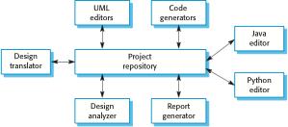
A repository architecture for an IDE

Slide 28
The Repository pattern
Name | Repository
Description | All data in a system is managed in a central repository that is accessible to all system components. Components do not interact directly, only through the repository.
Example | An integrated development environment (IDE) where the components use a repository of system design information. Each software tool generates information which is then available for use by other tools.
When used | when you have a system in which large volumes of information are generated that has to be stored for a long time. You may also use it in data-driven systems where the inclusion of data in the repository triggers an action or tool.
Advantages | Components can be independent—they do not need to know of the existence of other components. Changes made by one component can be propagated to all components. All data can be managed consistently (e.g., backups done at the same time) as it is all in one place.
Disadvantages | The repository is a single point of failure so problems in the repository affect the whole system. May be inefficiencies in organizing all communication through the repository. Distributing the repository across several computers may be difficult.

Slide 29
Client-Server Architecture
Distributed system model which shows how data and processing is distributed across a range of components.
Set of stand-alone servers which provide specific services such as printing, data management, etc.
Set of clients which call on these services.
Network which allows clients to access servers.

Slide 30
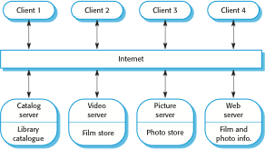
A client–server architecture for a film library

Slide 31
The Client–Server Pattern
Name | Client-server
Description | In a client–server architecture, the functionality of the system is organized into services, with each service delivered from a separate server. Clients are users of these services and access servers to make use of them.
Example | A film and video/DVD library organized as a client–server system.
When used | Used when data in a shared database has to be accessed from a range of locations. Because servers can be replicated, may also be used when the load on a system is variable.
Advantages | servers can be distributed across a network. General functionality (e.g., a printing service) can be available to all clients and does not need to be implemented by all services.
Disadvantages | Each service is a single point of failure so susceptible to denial of service attacks or server failure. Performance may be unpredictable because it depends on the network as well as the system. May be management problems if servers are owned by different organizations.

Slide 32
Pipe and Filter Architecture
Functional transformations process their inputs to produce outputs.
Variants of this approach are very common. When transformations are sequential, this is a batch sequential model which is extensively used in data processing systems.
Not really suitable for interactive systems.

Slide 33
The pipe and filter pattern
Name | Pipe and filter
Description | The processing of the data in a system is organized so that each processing component (filter) is discrete and carries out one type of data transformation. The data flows (as in a pipe) from one component to another for processing.
Example | processing invoices example .
When used | Commonly used in data processing applications (both batch- and transaction-based) where inputs are processed in separate stages to generate related outputs.
Advantages | Easy to understand and supports transformation reuse. Workflow style matches the structure of many business processes. Evolution by adding transformations is straightforward. Can be implemented as either a sequential or concurrent system.
Disadvantages | The format for data transfer has to be agreed upon between communicating transformations. Each transformation must parse its input and un-parse its output to the agreed form. This increases system overhead and may mean that it is impossible to reuse functional transformations that use incompatible data structures.

Slide 34
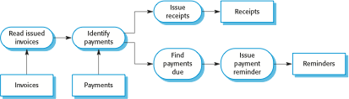
An example of the pipe and filter architecture

Slide 35
Application Architectures

Slide 36
Application Architectures
Application systems are designed to meet an organizational need.
As businesses have much in common ➔
  Their application systems also tend to have a common architecture.
A generic application architecture
  is an architecture that may be configured and adapted to create a system that meets specific requirements.

Slide 37
When to use Application Architectures ?
As a starting point for architectural design.
As a design checklist.
As a way of organizing the teamwork
As a means of assessing components for reuse.

Slide 38
Examples of Application Types
Transaction processing applications
Data-centered applications that process user requests and update information in a system database.
Language processing systems
Applications where the users’ intentions are specified in a formal language that is processed and interpreted by the system.
Data processing applications
Data driven applications that process data in batches without explicit user intervention during the processing.
Event processing systems
Applications where system actions depend on interpreting events from the system’s environment.

Slide 39
Application type examples:
Transaction processing systems
Information systems
E-commerce systems;
Reservation systems.
Language processing systems
Compilers;
Command interpreters.

Slide 40
Summary
Architectural Design
Software Architecture
Application Architecture
www.midocean.ae

Slide 41



Thank You

