Slide 1

PMG 622
Agile Project Management
ZOOM MEETING: 09 (01-08-22)
Everyone’s Smart
University
دكتور مهندس استشاري ادارة المشروعات
Eng. Dr. Akram Mustafa Suliman Ali,
PhD. AU, BEng. & MSc. AAST, CEng CMarEng MIMarEST, PE, PMP®,
ASQ CSSBB, ISO Lead Auditor, NDT Level II,

Slide 2
Planning and Time Boxing
Planning Is Useful. Blindly Following the Plans Is Stupid
Effectiveness = Planning
Efficiency = Time Boxing (Sprints)
Failing to plan is planning to fail
Notes:
Individuals and Interactions Over Processes and Tools. ...
Working Software Over Comprehensive Documentation. ...
Customer Collaboration Over Contract Negotiation. ...
Responding to Change Over Following a Plan
P --- P
P --- C
C --- C
C --- P
SMARTER
Specific
Measureable
Attainable
Relevant
Time bound
Evaluate
Review

Slide 3
Scrum’ THREE BEST PRACTICES
Best Practice #1: User Stories
Best Practice #2: Planning Poker
Best Practice #3: Use of the Scrum Board
Notes:
Half-Done IS Not Done
Do It Right the First Time
Fixing a bug later took 24 times the effort if it is fixed on the same day it is created.
The story should include:
Customer
Object
Motivation → How is it going to satisfy the customer?
INVEST
Definition of done.
INVEST = READY STORY → Independent; Negotiable; Valuable; Estimable; Small; Testable (write the test before you do the story)
I want a car as ………………… (a) Urban Commuter, (b) South Dakota Farmer that I can use on daily basis

Slide 4
Best Practice #1: User Stories
Plain-english requirements, written on common 3X5 index cards
Form: As [a type of user] I want to [perform a specific action] such that [result]
Example: “As a web user, I want to make a reservation, such that I may secure my lodging”
Stories that are big are called EPICS
Acceptance criteria goes on card back
Notes:
Half-Done IS Not Done
Do It Right the First Time
Fixing a bug later took 24 times the effort if it is fixed on the same day it is created.
The story should include:
Customer
Object
Motivation → How is it going to satisfy the customer?
INVEST
Definition of done.
INVEST = READY STORY → Independent; Negotiable; Valuable; Estimable; Small; Testable (write the test before you do the story)
I want a car as ………………… (a) Urban Commuter, (b) South Dakota Farmer that I can use on daily basis

Slide 5
Tips to Keep in Mind
Half-Done IS Not Done
Do It Right the First Time
Fixing a bug later took 24 times the effort if it is fixed on the same day it is created.

Slide 6
User Stories
I.N.V.E.S.T.
  Independent
  Negotiable
  Valuable
  Estimable
  Small
  Testable

Slide 7
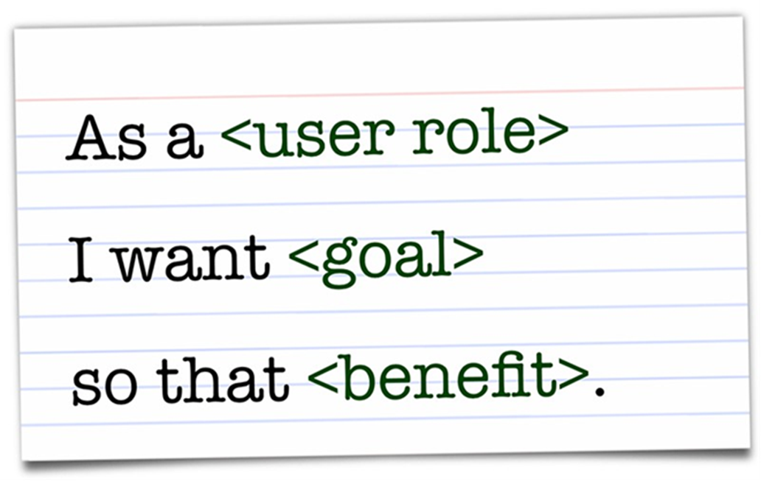
Story Contents
The story should include:
Customer
Object
Motivation → How is it going to satisfy the customer?
INVEST
Definition of done.

Slide 8
Story Statement Example
I want a car as ………………… (a) Urban Commuter, (b) South Dakota Farmer that I can use on daily basis

Slide 9
Disciplined Agile

Slide 10
Reference Book

Slide 11
A3.14 DISCIPLINED AGILE (DA) [framework]

Slide 12
Disciplined Agile (DA).
A process decision framework that enables simplified process decisions around incremental and iterative solution delivery.

Slide 13
PMI Reference
https://www.pmi.org/disciplined-agile/introduction-to-disciplined-agile

Slide 14
Introduction to Disciplined Agile® (DA™ = DAD ) [toolkit]
True business agility comes from freedom, not frameworks.
Disciplined Agile (DA) is an agnostic, hybrid tool kit that harnesses hundreds of Agile, Lean, and traditional strategies to guide you to the best way of working (WoW) for your team or organization.
DA is context sensitive; rather than prescribing a collection of "best practices," it teaches you how to choose and later evolve a fit-for-purpose WoW that is best for you given the situation you face.

Slide 15
A Quick Primer on Disciplined Agile Delivery (DA = DAD) [toolkit]
Disciplined Agile (DA = DAD) is very much a tool kit, not a framework.
An agile framework will present you with a collection of what it considers to be “best practices,” but the reality is that all practices are contextual in nature, working well in some situations and poorly in others.
DA is a process-decision tool kit that enables you to easily choose your own WoW that is fit-for-purpose for you.
Where frameworks prescribe what to do, regardless of whether it’s appropriate for you, the DA tool kit instead provides you with freedom of choice.

Slide 16
DA addresses four views:
Mindset. DA builds on the foundations of agile and lean to address enterprise realities.
People. DA describes the roles, responsibilities, and team structures you should have in place.
Flow. DA describes the dynamic aspects of processes via lifecycle and workflow diagrams.
Practices. DA outlines the techniques that move your team forward, using straightforward goal diagrams that provide a high-level picklist of practices.

Slide 17
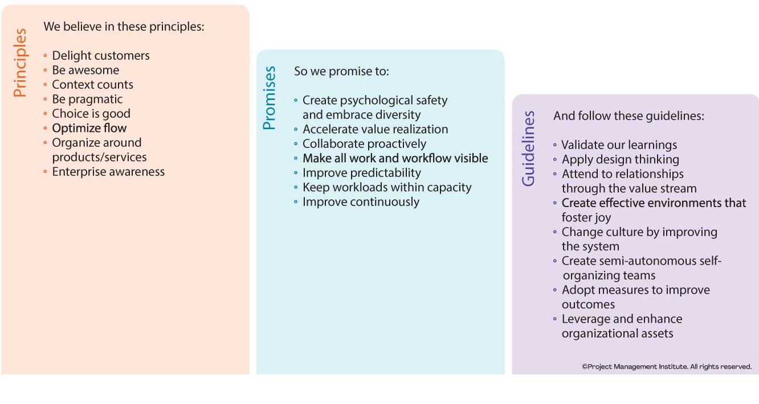
The Disciplined Agile Mindset

Slide 18
Primary Roles on Disciplined Agile Delivery (DAD) Teams
Team Lead
  Agile process expert, keeps team focused on achievement of goals, removes impediments (i.e. call Agile PM, Scrum Master)
Product Owner
  Owns the product vision, scope and priorities of the solution
Architecture Owner
  Owns the architecture decisions and technical priorities, mitigates key technical risks
Team Member
  Cross-functional team members that deliver the solution
Stakeholder
  Includes the customer but also other stakeholders such as the sponsor, operations engineers, support staff, architecture, database groups, finance, and more

Slide 19
Assignment 02 Q1
Select ALL the correct answers
قم باختيار جميع الاجوبة الصحيحة
Disciplined Agile Delivery (DAD) supports the following lifecycles.
Choose all that apply
يدعم التسليم السريع المنضبط (DAD) دورات الحياة التالية. اختر كل ما يمكن تطبيقه
Water Fall Delivery
Lean Delivery
Agile Delivery
Hybrid Delivery

Slide 20
Assignment 02 Q2
Select ALL the correct answers
قم باختيار جميع الاجوبة الصحيحة
Which roles appear on Disciplined Agile Delivery (DAD) teams?
Choose all that apply
Product Owner
Architecture Owner
Agile Project Manager
Stakeholder

Slide 21
Assignment 02 - Q 4
As a new Project Manager, you are requested to draft a minimum capital budget plan. You are also tasked to manage the project to use Disciplined Agile Delivery. Which of the following items you will cancel in order to reduce your project's capital cost?
بصفتك مدير مشروع جديد ، يُطلب منك صياغة خطة ميزانية الحد الأدنى لرأس المال. أنت مكلف أيضًا بإدارة المشروع لاستخدام التسليم السريع المنضبط. أي من العناصر التالية سوف تلغيها لتقليل التكلفة الرأسمالية لمشروعك؟
  Middle managers tier as they do not actually perform any work
  State of the art communication tools to use the same technology of the client
  Re-modelling the team space to be more open by removing barriers and walls
  Cancel the Agile Architect position as the product owner is technically competent

Slide 22
Assignment 02 - Q 03
The Disciplined Agile Delivery framework provides tailoring flexibility through prescriptive best practices that work well in all situations.
يوفر إطار عمل التسليم السريع المنضبط مرونة في التصميم من خلال أفضل الممارسات التوجيهية التي تعمل بشكل جيد في جميع المواقف.
True
False
Assignment 02 - Q 05
The downside to Disciplined Agile Delivery is its lack of frameworks thus limiting the business freedom to achieve true agility.
الجانب السلبي للتسليم السريع المنضبط هو افتقارها إلى أطر عمل مما يحد من حرية العمل لتحقيق خفة الحركة الحقيقية.
True
False

