Slide 1

The Cultures of New Media (DGM 715)
Prepared by
Dr. Mohamed Owies
Lecture No.1
The Cultures of New Media
(DGM 715)

Slide 2
The Cultures of New Media
Prepared by
Dr. Mohamed Owies
Lecture No.1
First Lecture
The Cultures of New Media

Slide 3
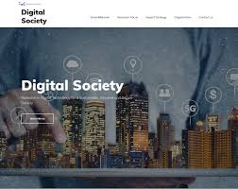
First Lecture
The content of Lecture 1
The first lecture sheds light on a number of important topics, including the following:
Digital Society
Media Everywhere
Zeroes and Ones and coding of content
Time and Space factors in the media environment
Digital tools and platforms
The Internet
Media as Environments, Environments as Media
User-Generated Content
Social Media Sites

Slide 4
First Lecture
Digital Society
Process of evolution derived from the information society through the intensive use of technologies and digital media where the internet positions itself as the information tool on levels of creation publishing, distribution, sharing, and participation.
A digital society in which everything runs on digital technology where paperless and electronic means are the norm.

Slide 5
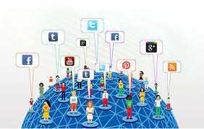
First Lecture
Media Everywhere
Different tools and platforms that we use to get or spread information, and communicate, enable and limit what we can do in their own specific ways. The medium used will alter our ways of seeing, speaking, and acting. Think about the difference between learning about current events from the website of a big media corporation and from friends on Facebook or Twitter.
Today, we live in a digital society in the sense that we are in an era where our lives, our relationships, our culture, and our sociality are digitised, digitalised, and affected throughout by digital processes.

Slide 6
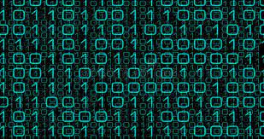
First Lecture
Zeroes and Ones
From the outset, the digital has to do with mathematics. Being digital, then, means simply using numbers — digits — rather than analogous objects to convey information.
In computing, input values are converted to binary numbers, 0 and 1, instead of using all numbers ranging from zero to nine.
The binary system was invented by philosopher and mathematician Gottfried Leibniz in the 1600s. He used this system for coding, computing, and controlling information when experimenting with ideas for machines.
This is how the computers that we have today, in anything from smartphones and laptops to refrigerators and drones, work too
Technologically speaking, this binary system forms the basis for everything we do that is digital.

Slide 7
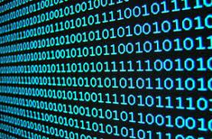

First Lecture
Zeroes and Ones
Applications, such as text, sound, graphics, and images became digitally encodable. Today, computers can store and transmit data, which changes how we deal with anything from our family photos and recipes to government documents or business plans.
We have also learnt that computers can manage communication networks, and this has transformed how we form friendships, and how we connect and stay in touch with people, sometimes across large geographical distances.
Furthermore, computers can process text, images, and sound, which has changed the way in which writers write, musicians play, and painters paint. Spaceships and airplanes are flown by computers, and digital devices are increasingly entangled in our everyday lives, in the form of laptops, tablets, smartphones, and things like robot vacuum cleaners.

Slide 8
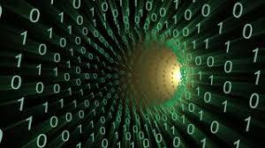
First Lecture
Zeroes and Ones
Digitalisation of ourselves and sociality continually moves ever closer with wearable devices. Still, at the heart of every computer lie circuits that contribute to all of these social and cultural transformations, through the breaking down of operations into mathematical equations.
When we speak of today’s society as being digital, we don’t very often mean to say that it just draws upon binary numerical operations. What we do tend to mean is that it has been transformed in a number of quite drastic ways, following the development of the early ‘computing’ machines into smart device.

Slide 9
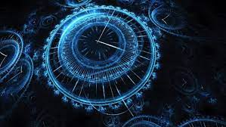
First Lecture
Time and Space
Another often emphasised feature of digital society is that it compresses time and space and makes them less important. For example, when we send texts, chats, or emails to each other, there is no need for us to be in the same place to be able to communicate. The exchange need not be instantaneous either, as we can respond to digital messages whenever it suits us.
it is not that important really whether one should label our present-day society ‘post-industrial’, ‘post-Fordist’, ‘post-modern’, or as an ‘information society’, ‘network society’ or a ‘control society’.

Slide 10
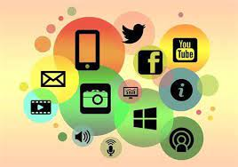
First Lecture
Digital tools and platforms
There are many ways of collectively naming the interactive activities and environments that people engage in online. You will see that I write of the environments as sometimes ‘internet and social media’, sometimes ‘digital media’ or ‘digitally networked media’, and sometimes as ‘digital tools and platforms’.

Slide 11
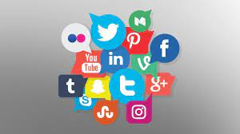
First Lecture
Digital tools and platforms
The things such as computers, smartphones and tablets, and to services such as email, texting, Skype, YouTube, Facebook, Twitter, Instagram, Snapchat, blogs, forums, and so on. With these digital tools and platforms, people do things among and between each other.

Slide 12
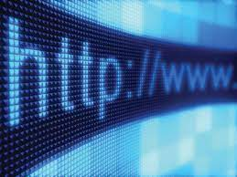
First Lecture
The Internet
Before moving on to a more specific discussion of what digital media might mean, we must focus first on one of the key inventions of digital society — namely, the internet.
This global network of computers, which enables and structures an unmeasurable amount of social activity around the world, feels today as if it was always there. But in fact, it only became widely available in the mid-1990s, through the invention of a protocol for something called the World Wide Web.

Slide 13
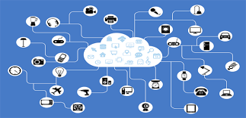
First Lecture
The Internet
The strategy was to establish a computer network that did not rely on centralised command, and thus was not vulnerable to attacks targeting central hubs (Galloway 2004). Baran’s network was based on the technology of packet-switching, through which messages are distributed in small fragments to be reassembled at the receiving end.
The system was finally realised at the end of the 1960s through funding from the Advanced Research Projects Agency (ARPA), President Eisenhower’s response to the Soviet Sputnik launch. The agency’s ARPANET, the first computer network based on packet-switching, was used by the military and by academics to transfer and exchange information.

Slide 14
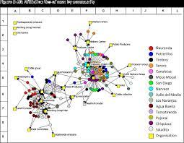
First Lecture
The Internet
Castells (2002: 24–25) describes how the Network Working Group, which was doing most ARPANET design in the late 1960s, consisted mainly of graduate students who had studied in the same secondary school in Southern California, later to become students of Leonard Kleinrock at California University.

Slide 15
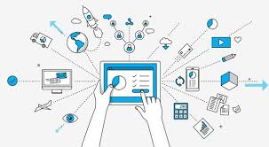
First Lecture
The Internet
The young ARPANET developers, and the student culture of which they were part – as well as the wider context of late 1960s counterculture – had a great impact on how the global internet came to emerge. Castells (2002) writes that the birth of the internet happened at the rather unlikely intersection of science, military interests, and libertarian culture. It is a common misinterpretation that the internet was created solely as a military command-and-control mechanism, when it was in fact co-opted already from the start by academics (and others).

Slide 16

First Lecture
The Internet
E-mail, which was initially called network mail, was introduced in 1972, and the term internet itself appeared in 1974 as an abbreviation for ‘internetworking’. Control of the network was transferred from the Department of Defense to the National Science Foundation by the end of the 1980s, and then to commercial telecommunications interests in 1995.

Slide 17
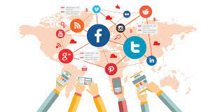
First Lecture
The Internet
Since then tools using the internet infrastructure — such as the web, social media, and mobile apps — have become a crucial part of how people today obtain information, communicate, and interact. This digital and cultural ecosystem provides us with a language for relating to each other and the world around us. In that sense, the internet is a medium.

Slide 18
First Lecture
Media as Environments, Environments as Media
From the perspective of media ecology, the internet — as an intrinsic part of digital society — is a medium because it is an environment. And conversely, it is an environment because it is a medium.

Slide 19
First Lecture
Media as Environments, Environments as Media
Media ecologists such as McLuhan (1964) and media theorist Neil Postman (1970) have maintained that media must be defined as something more wide-ranging than the traditional informational devices, such as radio, television, newspaper, movies, sound records, computers, and so on.

Slide 20

First Lecture
Media as Environments, Environments as Media
Instead, they argued, a medium is any symbolic structure, or social environment, that in some way, and under certain circumstances, defines human interaction and the production of culture.

Slide 21
First Lecture
Media as Environments, Environments as Media
From this perspective, a newspaper is a medium because it provides us with a certain way of relating to the world — through print text, still images, and certain journalistic genres and conventions. It also establishes limits, as a conventional old school newspaper does not allow for things like moving images, sounds, and online reader comments.

Slide 22
First Lecture
Media as Environments, Environments as Media
In a similar way, from a media ecology perspective, coffee houses and classrooms are also media, for the same reasons: they offer certain ways of relating to the world, while at the same time establishing boundaries for what can be said, done, expressed, learnt, or achieved. Sociologically speaking, this means that media, like the internet, are social structures.
From the perspective of media ecology, media — such as the internet and platforms — are such environments: symbolic structures within which we are situated and through which we engage.

Slide 23
First Lecture
Media as Environments, Environments as Media
This embeddedness happens on two levels.
First, there is the sensorial level, where things like a Facebook page, a Twitter profile, or an Instagram feed each employ our senses in different ways, much like reading is visual, radio is auditory, and video games are visual and auditory, as well as tactile. In a way, the reality we sense is constructed or reconstructed through the medium at hand.

Slide 24
First Lecture
Media as Environments, Environments as Media
Famously, McLuhan (1964: 35) defined media as ‘extensions’ of our senses that decide how people experience and become aware of the world around them. This also relates to what McLuhan meant when he, even more famously, declared that ‘the medium is the message’. Switching from one medium to another reconfigures our senses and alters the ways in which we understand and reconstruct the world around us.

Slide 25

First Lecture
Media as Environments, Environments as Media
Second, there is the symbolic level, at which every medium is constituted by a certain systematic set of rules and codes in the form of vocabulary, grammar, and other conventions. such as: posting an Instagram photo require knowledge of conventions such as using hashtags and applying filters.
Media ecologists talk of some major changes throughout history and how these introduced crucial social transformations. The shift from a culture of talking to a culture of writing meant that the elders’ role as experts and unique sources of knowledge diminished.

Slide 26
First Lecture
Media as Environments, Environments as Media
The introduction of the printing press meant a further democratisation of information, and the arrival of electronic media contributed even more to balancing the temporal, spatial, and symbolic constraints for who could speak, where and when, and to whom.

Slide 27
First Lecture
Media as Environments, Environments as Media
Today, we live in a world with a growing number of co-existing media, which means that we relate not to one, but to a combination of several environments. It is not sensible to conceive the internet as part writing, part still image, part moving image, part sound, part computer, part telephone, part television, and so on. Rather, it must be approached as a whole, and then as a whole that might be more than the sum of its parts.

Slide 28
First Lecture
Media as Environments, Environments as Media
While the content of radio, television, or the internet might be a football game or a political debate, the message — in McLuhan’s terms — of each of these media is not that. The message is instead equal to the social changes that a medium generates.

Slide 29
First Lecture
Media as Environments, Environments as Media
He wrote (McLuhan 1964: 20) that ‘the “message” of any medium or technology is the change of scale or pace or pattern that it introduces into human affairs’. He also argued that the content of a medium is always another medium: the content of television might be the medium of a theatrical play, the medium of football, and so on.

Slide 30
First Lecture
Media as Environments, Environments as Media
He wanted to make the point that by just studying the content, we risk becoming entangled in this spiral of media within media within media.
It was therefore better, he thought, to instead focus on understanding media in terms of the ways in which they transform the social.

Slide 31

First Lecture
User- Generated Content
In media studies during the last few decades, however, there has been increased talk about users being active. They have been shown to be just as competent as the creators of content. Their expertise is sometimes of a different kind, and comes into expression in how they make use of media content in smart and unexpected ways.

Slide 32
First Lecture
User- Generated Content
But more and more often they also create entirely new things by and for themselves. Because of this, words like producer or participant have become more popular than ‘user’ in some contexts.
User-generated content (UGC) is increasingly common in the online economy, often appearing in forms of blogs, wikis, podcasts, pictures, videos, and social networks.

Slide 33
First Lecture
User- Generated Content
In the case of news media, the use of websites to integrate user content has intensified. For example, the Wall Street Journal (WSJ ), in its online version, offers readers the opportunity to add content under the section titled “Journal Community.
In addition, using this platform, news readers can make comments or ask questions about stories published by WSJ journalists.

Slide 34
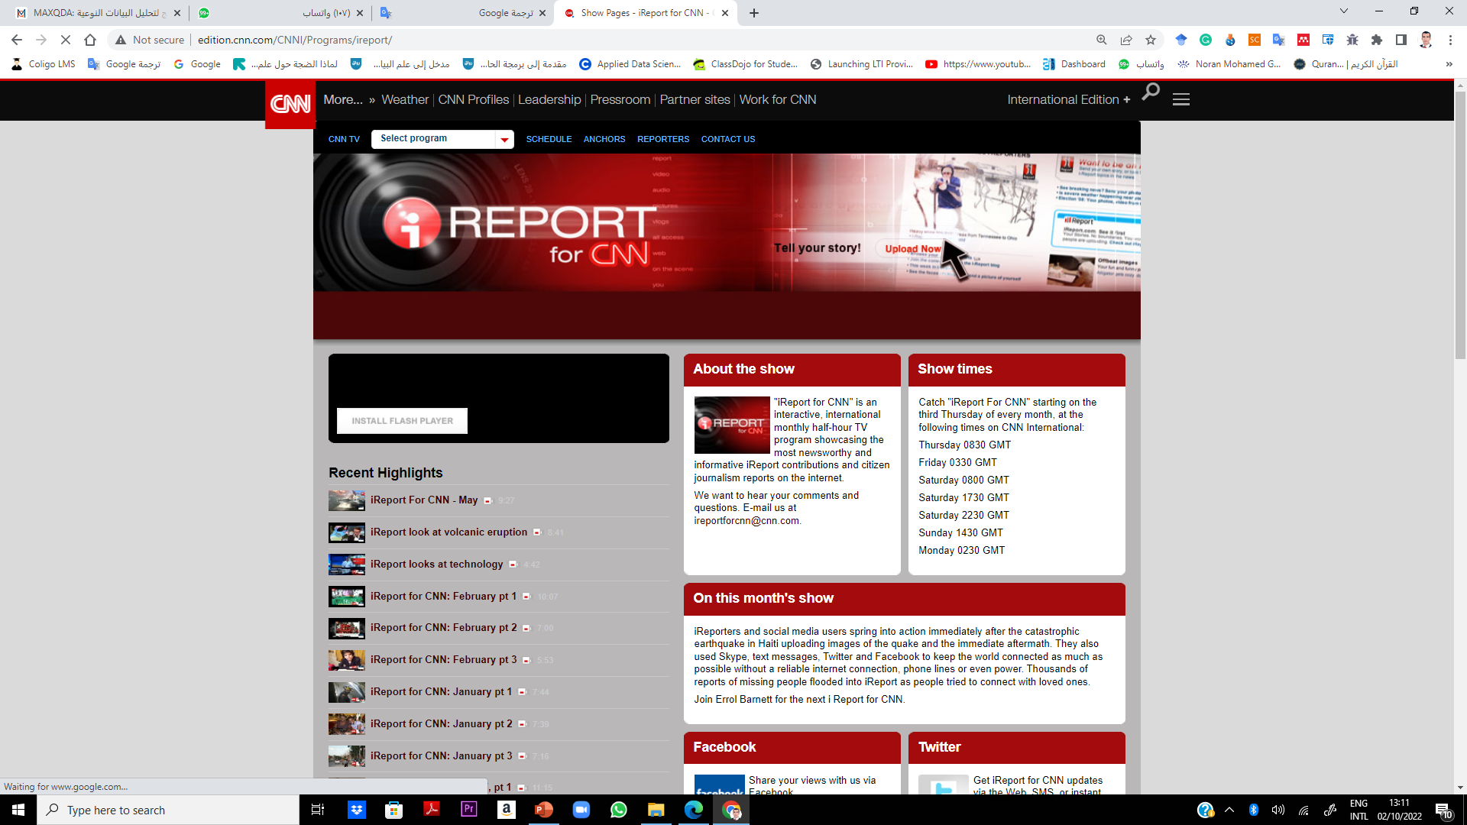

First Lecture
User- Generated Content
Similarly, CNN on its website has been broadcasting news videos called I-Reports that are submitted by its audience. For these news companies, the impact of UGC on profitability is unknown, as it can be a substitute for professionally prepared content.
I am the witness (أنا الشاهد ) am the witness" is a weekly program that adopts the style of citizen journalism.

Slide 35
First Lecture
User- Generated Content
The program presents stories and testimonies narrated by citizens from all over the world, especially from the Arab world, in audio and video, in which they deal with their daily lives or issues related to their societies and countries.
If you have personal experience, photos or videos that you want to submit for the program, please use the form at the bottom of the page or write to us at the following email address

Slide 36


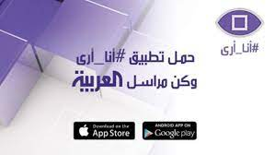
First Lecture
User- Generated Content
observers Program برنامج مراقبون
It deals with the events through direct testimonies of people who witnessed the event, and uses photos, videos and recordings sent by amateur observers and verified by France 24 journalists.
Al-Arabiya has officially launched the “I see” news service, a special application through which activists and the public in general can send photos, videos and texts, which are shown - according to their importance - on Al-Arabiya and Al-Hadath channels.
The application includes 9 sections, through which the user can participate by publishing what he sees around him, wherever he is in the world, and these sections are: Politics, Sports, Society, Style, Food, Movies, Technology, Comedy, Music.

Slide 37
First Lecture
Social Media
Digital Tools and Platforms for Being Social
web 1
the starting to use the web in the 1990s will recall the experience of quite static forms of content, and of a relative lack of two-way communication. A few years into the 2000s however, there was increasing talk of a transition from an early form of web — web 1.0 — to something that was called web 2.0.
The latter -web 2- is a concept with several dimensions.
First, it was a buzzword used in business lingo and where people uploaded videos to YouTube, ‘liked’ stuff on Facebook, and blogged about their favourite brands .

Slide 38
First Lecture
Social Media
Second, it referred to certain technological solutions and innovations — blogging platforms, RSS feeds, wikis, social network sites — that encouraged participation, networking, and creativity among peers.
Third — and most importantly from a sociological perspective — it is related to a certain frame of mind and action which is about different forms of making and connecting (Gauntlett 2011).

Slide 39
First Lecture
Social Media
The web 2.0 was developed in order to realise the interactive and collaborative potentials of the internet in better ways than web 1.0. With innovations like blogs, social-networking sites, wikis, tagging, and sharing, 2.0 emphasises social interaction, creativity, and the production of knowledge among peers. It also enables the co-creation and constant editing by multiple users of multimodal content, that is, content which mixes several modalities (written text, photographic images, videos, sounds, etc.).
When we speak of online platforms for such types of interaction, networking, and creativity today — Twitter, Facebook, Wikipedia, YouTube, Instagram, etc. — we tend to call them social media. But this does not mean that people didn’t socialise, create, and share things through media before.

Slide 40
First Lecture
Social Media
There are also often functions for reacting to, or interacting with, content by liking it, disliking it, sharing it, commenting on it, responding to it, and sometimes editing or remixing it.
For Gauntlett, YouTube is a prime example of a digital creative platform because of three things:
It is a framework for participation. The wide range of types of video that are uploaded by people.

Slide 41
First Lecture
Social Media
The platform is content-agnostic, which means that it neither knows nor cares about all of the uploads, experimentations, and innovations that its users might be doing. YouTube as such does not care whether a big news corporation registers an account to post its professionally produced features, or if an ‘ordinary person’ goes on the site to share gaming walkthrough videos.
The platform has community features by which users can communicate and connect to promote their own videos, to share knowledge and skills, to entertain or support each other.

Slide 42
Second Lecture
Thank You

