Slide 1


Project Business
Analysis
Prepared by Eng. Ahmed Hussein, MBA, PfMP©, PMP©, CMP APMG
PMG 461
Bachelor of Project Management
Lecture 8

Slide 2



Documenting Requirements
Lecture 8
PMG 461
Project Business Analysis
Prepared by
Eng. Ahmed Hussein, MBA, PfMP©, PMP©, CMP APMG
www.midocean.ae

Slide 3
In Previous Lectures
Business Analysts elicit requirements from stakeholders using various qualitative and quantitative techniques.
Plan for business analysis plan and work plan before starting the analysis
Business Analyst Models requirement using a mix of the various modelling techniques
Requirements are engineered through elicitation, analysis, documentation, validation, and requirements management.
Contribute to identifying and engaging stakeholders.
www.midocean.ae

Slide 4

Lecture
What we will cover
08
Business Requirements Document
Content of Requirements Document
Writing, Categorizing and Prioritizing Requirements
Peer Review and Version Control for Requirements Document
www.midocean.ae

Slide 5

Lecture
Requirements Document Overview
08
www.midocean.ae

Slide 6
Requirements Documentation is done throughout the
Requirements Engineering Process.
Requirement Elicitation
Requirements Analysis
Requirements validation
Requirements Documentation
Requirements Management
www.midocean.ae

Slide 7
Requirements Documentation
Requirements documentation encompasses the detailed articulation of how individual requirements align with the overarching business objectives of the project.
These requirements initially commence at a high-level, evolving into more detailed specifications as greater insight into project requirements is acquired.
www.midocean.ae

Slide 8
Purpose of Requirements Document
Defines solution for business opportunity or problem in sufficient details
Basis for validating stakeholder needs
Input to Project Scope Definition
Main input to technical teams (design, development, and quality)
Basis for traceability, audit and verification
www.midocean.ae

Slide 9
Key Attributes
Unambiguous
  Requirements should be clearly defined, ensuring measurability and testability, thereby mitigating ambiguity in interpretation.
Traceability
  Each requirement should be traceable throughout the project lifecycle, enabling seamless tracking of its implementation and verification.
Completeness
  Include all necessary requirements, leaving no critical aspects unaddressed, ensuring comprehensive coverage of project needs.
Consistency and Stakeholder Acceptance
  Exhibit internal coherence while also aligning with the expectations and preferences of key stakeholders. Consensus and buy-in from stakeholders are imperative for project success
www.midocean.ae

Slide 10
How is Requirements Document used?
Requirements Document
Define Scope
Scope Statement
Create WBS
WBS
Conduct Procurement
Contracts
Process
Output
www.midocean.ae

Slide 11
Lecture
Contents of Requirements Document
08
www.midocean.ae

Slide 12
Variation in Documentation Formats
Requirements documentation formats span from simple listings, organized by stakeholder and priority, to elaborate structures including:
  Executive summaries for high-level overviews.
  Detailed descriptions offering in-depth insights into each requirement.
  Supplementary attachments providing additional context or supporting documentation.
Requirements documentation should include “To Be” Solution, and may include “As Is” situation.
This diversity caters to varied project needs and accommodates stakeholders' preferences.
Such versatility enhances communication and aids in comprehensive understanding of project requirements across all involved parties.
www.midocean.ae

Slide 13
Sample Requirements Document in Agile Projects (Product Backlog)
A prioritized list of all the work that needs to be done to complete the project.
Id | Backlog Item | Assigned to Sprint | Status | Size (In Story Points)
1 | Design |  | Open
2 | Coding |  | Open
3 | Add |  | Open
4 | Subtract |  | Open
5 | Multiply |  | Open
6 | Divide |  | Open
7 | Sin |  | Open
8 | Cos |  | Open
9 | Tan |  | Open
10 | Sec |  | Open
Id | Backlog Item | Assigned to Sprint | Status | Size (In Story Points)
11 | Csc |  | Open
12 | Cot |  | Open
13 | Polynomial |  | Open
14 | Rational |  | Open
15 | Exponential |  | Open
16 | Logarithmic |  | Open
17 | Radical |  | Open
18 | Mean |  | Open
19 | Median |  | Open
20 | Mode |  | Open
Id | Backlog Item | Assigned to Sprint | Status | Size (In Story Points)
21 | Std. Deviation |  | Open
22 | Variance |  | Open
23 | Count |  | Open
24
25
26
27
28
29
40
 |  |  | Total
www.midocean.ae

Slide 14
Components of Requirements
Document
Introduction and Background
A description of the business situation and drivers for the project.
Solution
"To Be" process models to set the vision for new processes
"As Is" processes (if needed)
Function Models
Diagrams showing functionality
Examples:
Context Diagrams
Data Models
Provide higher level of details
Examples:
Requirements Catalogue
documenting each individual requirement
Examples:
Requirements Catalogue
clarify project objectives and scope of the work
ensure stakeholders are aware of the business context of the requirements
Use Case Diagrams
Entity Relationship Diagrams
important for tracing and verification
Glossary:
Provides clear definitions so that requirements can be easily read, understood, and agreed.
Clarifies terminology used.
www.midocean.ae

Slide 15
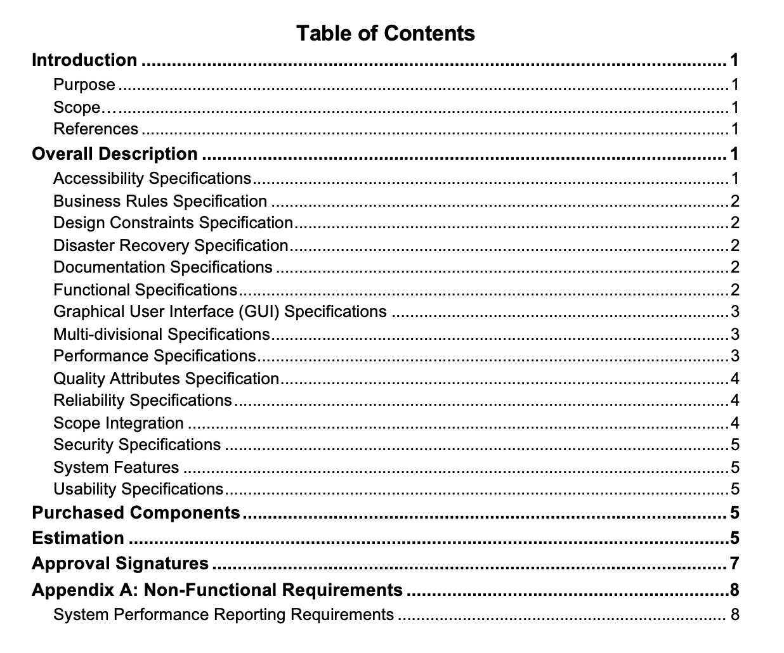
Sample Requirements Document
Table of Content

Slide 16
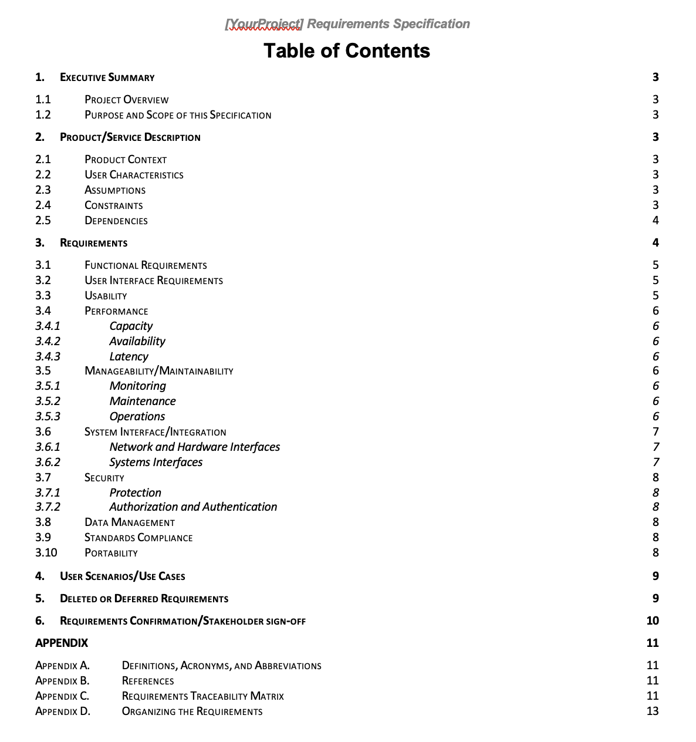
Sample Requirements Document
Table of Content

Slide 17
Business Requirement Document (BRD) vs. Business Requirements Specifications (BRS)
Aspect | Business Requirements Document (BRD) | Business Requirements Specifications (BRS)
Definition | Outlines high-level business objectives, goals, and needs. | Translates high-level business needs into specific requirements.
Scope | Provides a broad overview of the business problem or opportunity. | Delves deeper into the specific functional requirements.
Audience | Stakeholders, executives, project sponsors. | Technical team (developers, designers, testers).
Content | Business objectives, current state analysis, desired future state, stakeholders, constraints, risks, assumptions. | Detailed functional requirements, user stories, use cases, acceptance criteria, data requirements.
Level of Detail | Focuses on 'what' rather than 'how'. | Provides granular view of 'how' the system should behave.
www.midocean.ae

Slide 18
Lecture
Writing, Categorizing and Prioritizing Requirements
08
www.midocean.ae

Slide 19

SMART Requirements
Review and ensure ALL Defined requirements are SMART.
Example: Business Requirement for Operations: Reduce Order Processing time in operations from 2 hours to 30 min. by Dec. 2024
www.midocean.ae

Slide 20
Writing Requirements
Information should be transcribed into high-quality, well-formatted requirements to maximize their value to stakeholders and the project team.
Well-written requirements contribute to clarity, conciseness, and reduced conflict and confusion regarding project deliverables.
The structure and guidelines for documenting requirements depend on the selected project lifecycle.
Requirements are typically documented in text format for developing business requirements documentation or solution requirements documents.
For projects following Agile lifecycle, requirements are often written in the format of user stories.
Regardless of the format, requirements can extend beyond text to include visual representations.
www.midocean.ae

Slide 21
Requirements Format
When the user clicks check button (condition), the system (subject) will (imperative) display (active verb) the inventory balance (object) allowing the user to buy the item (outcome).
Condition
Subject
Imperative
Active Verb
Object
Business rule (optional)
Output (optional)
www.midocean.ae

Slide 22
Requirements Format Example
When the structure is finished (condition), the workers (subject) will (imperative) move (active verb) the bricks beside the building (object) allowing Building of walls (outcome).
www.midocean.ae

Slide 23
Unambiguous Requirements
Clear and measurable
Avoids misunderstandings
Ambiguous | Unambiguous
the system will check the address field to be only alphanumeric and containing valid postal code. | 1.2.1 The system shall validate that: 1.2.1.1. Address field is alphanumeric 1.2.1.2 Postal code is entered 1.2.1.3 Postal code is valid
If store code entered does not match store codes on file, the system will display error message | 1.4.1 when store code entered, system will validate against store codes on file, and : - if store code matches, will move to next step, - If store code does not match, display “invalid store code”
www.midocean.ae

Slide 24
Consistent Requirements
No contradiction or redundancy.
Consistent language throughout the document
Inconsistent | Consistent
12.1.1 the Application will 17.2.3 the system should 19.1.4 the IT application will | 12.1.1 the IT Application System should 17.2.3 the IT Application System should 19.1.4 the IT Application System application should
www.midocean.ae

Slide 25
Complete and Measurable Requirements
More Information to make it more complete.
Being Specific and quantify information
Incomplete | Complete
The session should be terminated after some idle time. | The session should be terminated after 3 min. of idle time
The new production line capacity will be sufficient for 3 years. | The new production line capacity will be 500,000 tons which is sufficient for 3 years.
www.midocean.ae

Slide 26
Requirements Categorization
Business Requirements
Stakeholder Requirements
Solution Requirements
Transition Requirements
Product Requirements
Functional Requirements
Non-Functional Requirements
www.midocean.ae

Slide 27
Business Requirements
Examples:
All Documentation in Arabic (Language)
Need for Back up Site and installation (Business Continuity)
Design must be approved by risk department (Policies)
Business Goals, objectives
Constraints: budget, timescale, resources
Policies
Legal
Branding
Cultural
Language
Business Continuity
www.midocean.ae

Slide 28
Stakeholder Requirements
Examples:
Report requested by a certain department
Testing scenarios requested by a manager
Certain days to work on the project for a department
Needs of a stakeholder or a group of stakeholders
Sometimes to align with certain practice or standard followed by the stakeholder.
www.midocean.ae

Slide 29
Solution-Functional Requirements
Examples:
Features
Procedures and Processes
Fields and screens
Interfaces
Describe features and behaviors of the solution product.
www.midocean.ae

Slide 30
Solution-Non-Functional Requirements
Examples
Availability
Performance
Security Requirements
Access
Backup and Recovery
Maintenance
Describe environmental conditions or qualities required by the solution product.
www.midocean.ae

Slide 31
Transition Requirements
Examples:
Training of IT personnel
Data Conversion
Dates and times to transition
Describe temporary capabilities to move from current state to future state.
www.midocean.ae

Slide 32
Requirements Prioritization Schema
(MoSCoW)
Defines how requirements will be prioritized.
Defined in Business Analysis Plan
Establishes prioritization rules
Done in workshops through:
  Voting
  Delphi Technique
Must Have (Mo)
Should HAVE (S)
Could Have (C)
Won’t Have (W)
www.midocean.ae

Slide 33
Peer Review and Version Control for Requirements Document
Lecture
08
www.midocean.ae

Slide 34
Peer-Review
A structured evaluation process, where peers within the project team assess completeness, clarity, consistency, and correctness.
The aim is to identify errors, ambiguities, and discrepancies.
Ensures alignment with project objectives and stakeholder needs.
Leverages diverse perspectives and expertise within the team.
Facilitates constructive feedback and refinement before finalization.
Requirements Document
Peer Review
Present to Stakeholders for Validation and Approval
www.midocean.ae

Slide 35
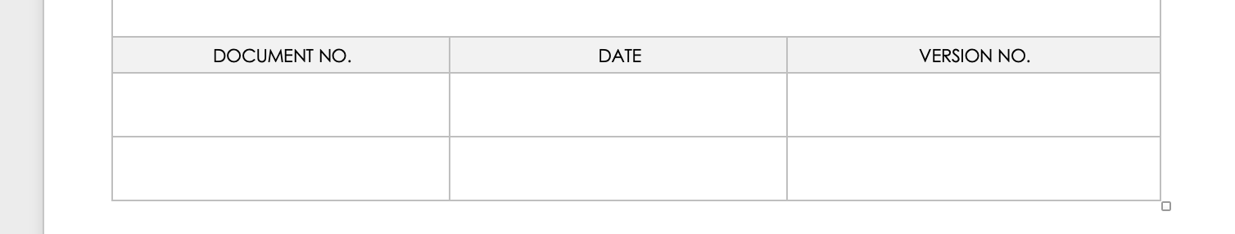
Version Control
Version control ensures systematic management of changes in requirements documentation.
Vital for maintaining document integrity, consistency, and tracking revisions.
www.midocean.ae

Slide 36
Importance of Version Control
Facilitates collaboration
Ensures traceability
Mitigates risks
Helps prevent errors, conflicts, and loss of critical information.
Tracks changes, allowing easy identification of who made specific edits and when.
Enables multiple team members to work on the document simultaneously.
www.midocean.ae

Slide 37
Best Practices for Version Control
Utilize dedicated version control software/tools.
1
Establish clear naming conventions for document versions.
2
Implement a review and approval process for changes.
3
Regularly back up documents to prevent data loss.
4
www.midocean.ae

Slide 38
Lecture
Key Points
08
Requirements should be unambiguous, clear, consistent, and complete
Requirements document as used to define Scope, WBS, and in contracts
Various formats for Requirements Document depending on project lifecycle and needs
Guidelines for writing, categorizing, and prioritizing requirements
Utilize Peer-review to refine document and implement version control.
www.midocean.ae

Slide 39

For Discussion Panel:
Watch the video “Business Requirements Document BRD Tutorial & Template Walkthrough”
Download and Review “Business Requirements Document Template”
Reading, Chapter 10 “Documenting and Managing Requirements”
from textbook “Business Analysis” by James Cadle, Malcolm Eva, Keith Hindle, Debra Paul, 2nd edition
Lecture
08
For Discussion Panel and Next Lecture
www.midocean.ae

Slide 40


Thank You

