Slide 1


Planning and Time Management
Chapter 3 lectuer-1
Everyone’s Smart
University
MGM111
Principle of Management

Slide 2
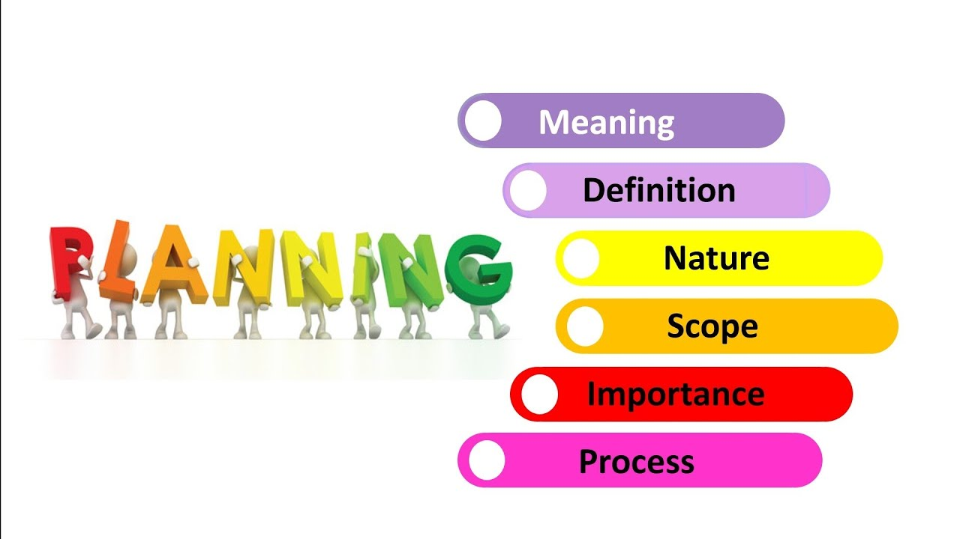

planning

Slide 3
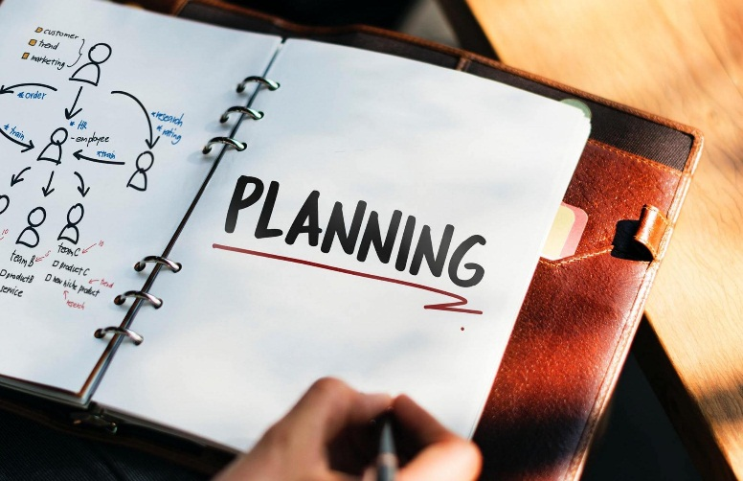
Learning Outcomes
managers plan.
types of plans do managers use.
useful planning tools and techniques.
control process.

Slide 4
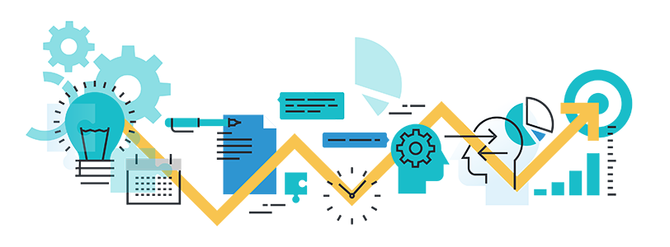

Before You Plan
Mission Statement
what we do; purpose of organization
Vision Statement
how we want it to be; future state of organization
Values
what do we stand for; culture framework
Primary Objectives
how to get there; translated into goals and action plans

Slide 5


Why Should We Plan?
To set the organization up for positive outcomes such as:
Better leadership—more cohesive team
A clear picture of trends which may impact the organization now and in the future
A clearly defined mission, vision, and strategy
Identification of short- and long-term “attention” areas
Specific plans to improve performance
Consistent, sustained success, as opposed to marginal success
To directly address issues/threats such as:
Decreased membership
Unhappy members (retention)
Competitive threats
Financial instability
Succession planning

Slide 6
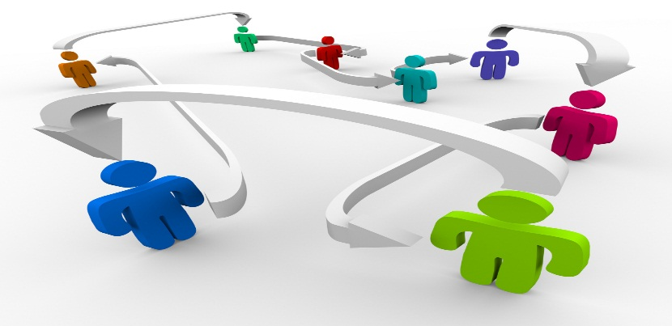
Why Plan?
Want to plan change, not become a victim of change
  planning is an effort to anticipate future change
Gives the organization a sense of direction
Involve staff in decision making
Helps coordinate the different functions and departments
Facilitate control and demonstrate accountability

Slide 7


Factors in Planning
Time frame
Collecting and analyzing data
Levels of planning in the organizational structure
Flexibility
Accountability

Slide 8

Types of Plans
Overall strategic plan
Annual budget/operations plan
Collection development plan
Information technology plan
Development (fund raising) plan
Staff development (training) plan
Marketing plan
Building / facilities plan
Instructional plan
Evaluation or outcomes assessment plan

Slide 9
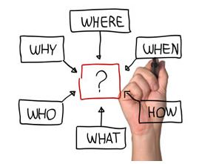
managers plan
Planning
  The process of setting objectives and determining how to best accomplish them.
Objectives
  Identify the specific results or desired outcomes that one intends to achieve.
Plan
  A statement of action steps to be taken in order to accomplish the objectives.

Slide 10
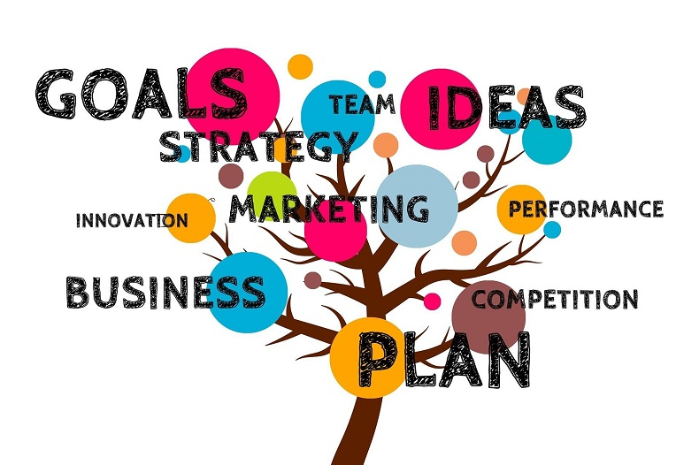

managers plan
Steps in the planning process:
  Define your objectives.
  Determine where you stand vis-à-vis objectives.
  Develop premises regarding future conditions.
  Analyze and choose among action alternatives.
  Implement the plan and evaluate results.

Slide 11
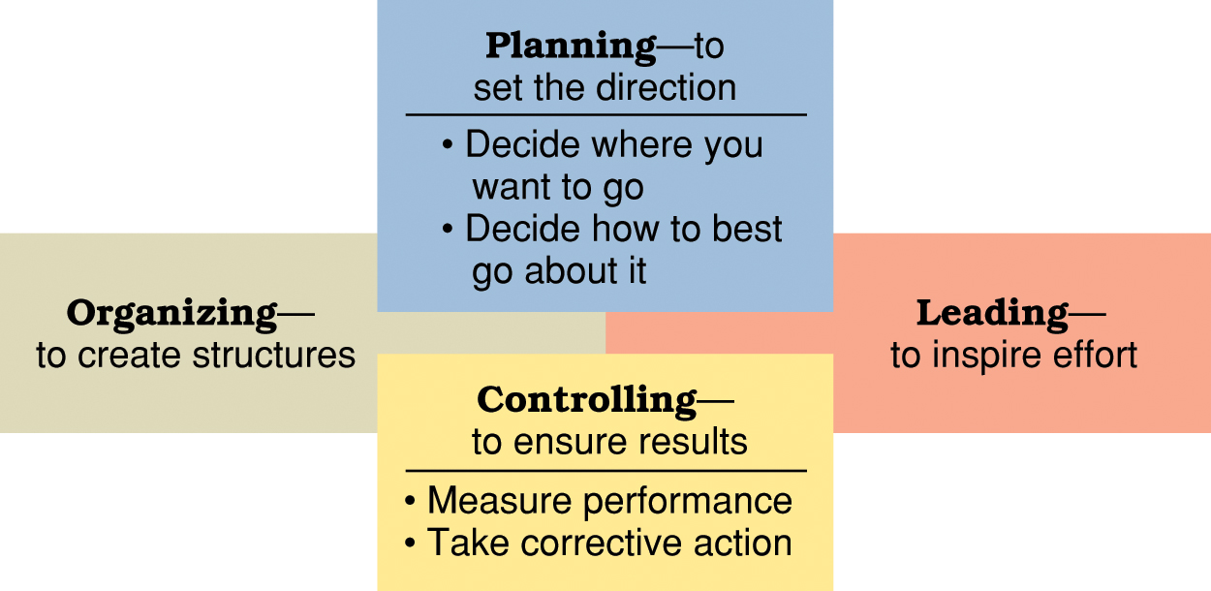
The roles of planning and controlling in the management process.

Slide 12
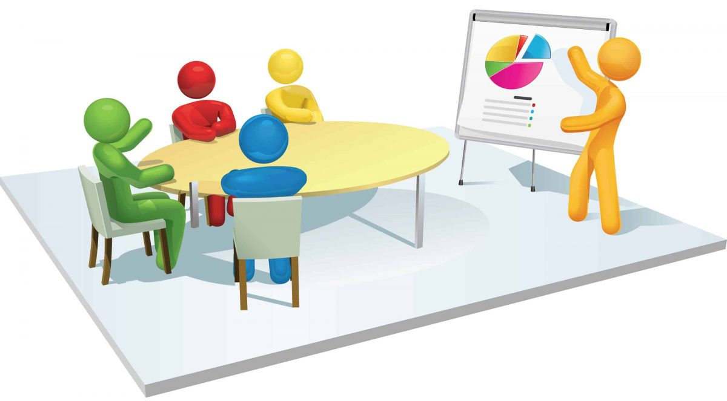
managers plan
Benefits of planning:
  Improves focus and flexibility.
  Improves action orientation.
  Improves coordination.
  Improves time management.
  Improves control.

Slide 13
What types of plans do managers use?
Short-range and long-range plans:
  Short-range plans = 1 year or less
  Intermediate-range plans = 1 to 2 years
  Long-range plans = 3 or more years
People vary in their capability to deal effectively with different time horizons.
Higher management levels focus on longer time horizons.

Slide 14
Long-range plans
= 3 or more years
Intermediate-range plans = 1 to 2 years
Short-range plans = 1 year or less

Slide 15

What types of plans do managers use?
Strategic and operational plans
  Strategic plans — set broad, comprehensive, and longer-term action directions for the entire organization.
  Operational plans — define what needs to be done in specific areas to implement strategic plans.
    Production plans
    Financial plans
    Facilities plans
    Marketing plans
    Human resource plans

Slide 16
What types of plans do managers use?
Policies and procedures
  Standing plans
    Policies and procedures that are designed for repeated use.
  Policy
    Broad guidelines for making decisions and taking action in specific circumstances.
  Rules or procedures
    Plans that describe exactly what actions are to be taken in specific situations.

Slide 17
What types of plans do managers use?
Budgets and project schedules
  Single-use plans
    Only used once to meet the needs and objectives of a well-defined situation in a timely manner.
  Budgets
    Single-use plans that commit resources to activities, projects, or programs.
    Fixed, flexible, and zero-based budgets.
  Projects
    One-time activities that have clear beginning and end points.
    Project management and project schedules.

Slide 18
useful planning tools and techniques?
1- Forecasting
2- Contingency planning
3- Scenario planning
4- Benchmarking
5- Use of staff planners

Slide 19
useful planning tools and techniques?
Forecasting
  Making assumptions about what will happen in the future.
  Qualitative forecasting uses expert opinions.
  Quantitative forecasting uses mathematical and statistical analysis.
  All forecasts rely on human judgment.
  Planning involves deciding on how to deal with the implications of a forecast.

Slide 20

useful planning tools and techniques?
Contingency planning
  Identifying alternative courses of action that can be implemented to meet the needs of changing circumstances.
  Contingency plans anticipate changing conditions.
  Contingency plans contain trigger points.

Slide 21

useful planning tools and techniques?
Scenario planning
  A long-term version of contingency planning.
  Identifying alternative future scenarios.
  Plans made for each future scenario.
  Increases organization’s flexibility and preparation for future shocks.

Slide 22

useful planning tools and techniques?
Benchmarking
  Use of external comparisons to better evaluate current performance and identify possible actions for the future.
  Adopting best practices of other organizations that achieve superior performance.

Slide 23
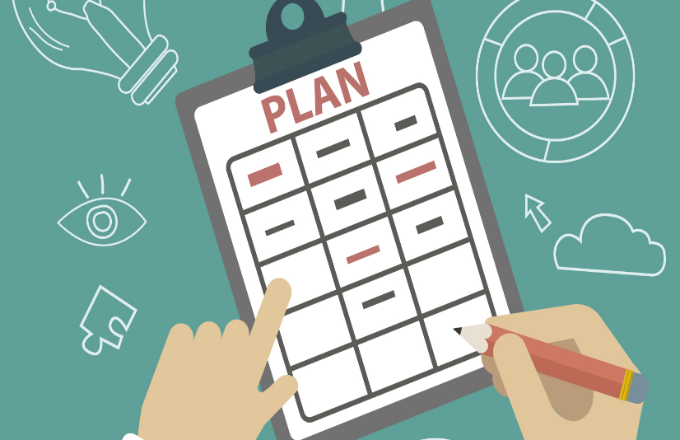
useful planning tools and techniques?
Use of staff planners
  Coordinating the planning function for the total organization or one of its major components.
  Possible communication gaps between staff planners and line management.

Slide 24
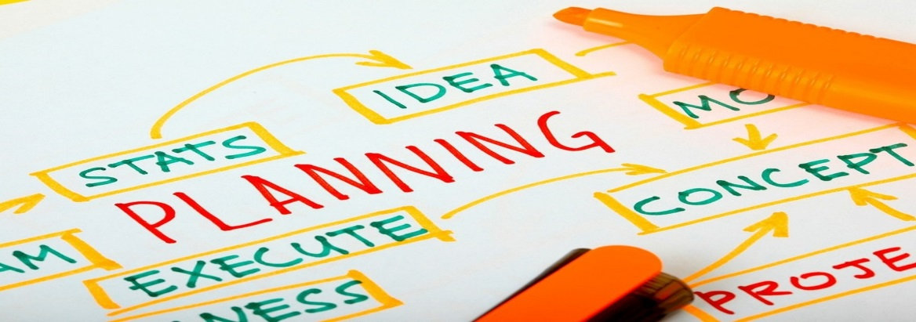
STRATEGIC PLANNING
“If you don’t know where you’re going, any road will get you there?”
“If you don’t know where you’re going, how will you know when you get there?”
Strategic planning solves these problems.

Slide 25
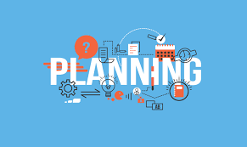
control process
Controlling
  The process of measuring performance and taking action to ensure desired results.
  Has a positive and necessary role in the management process.
  Ensures that the right things happen, in the right way, at the right time.
  Organizational learning and after-action review.

Slide 26
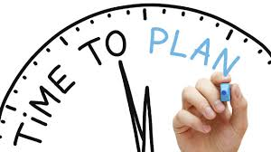
control process
Steps in the control process:
  Step 1 — establish objectives and standards.
  Step 2 — measure actual performance.
  Step 3 — compare results with objectives and standards.
  Step 4 — take corrective action as needed.

Slide 27
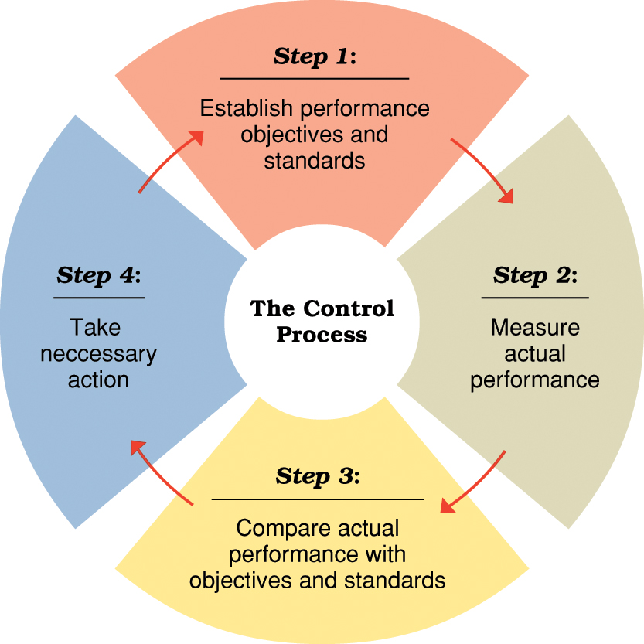

Four steps in the control process

Slide 28
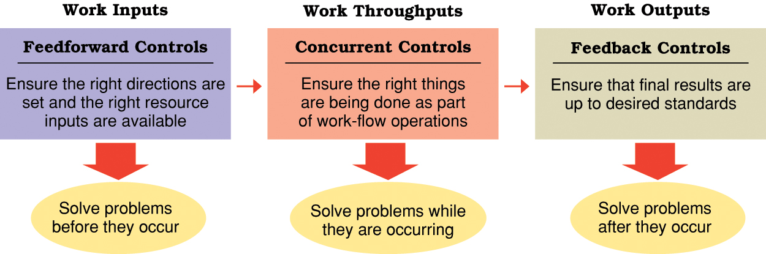

The role of feed forward, concurrent, and feedback controls in organizations

Slide 29
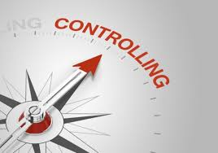
Effective Controls
The Best Controls in Organizations are
Strategic and results oriented
Understandable
Encourage self-control
Timely and exception oriented
Positive in nature
Fair and objective
Flexible

Slide 30
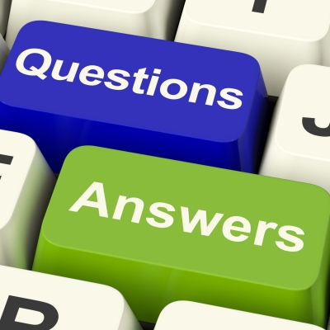

Slide 31
THANKS

