Slide 1



Network
Programming
in Python
Prepared by Dr. Hamada I. AbdulWakel
Lecture 10

Slide 2



File Transfer Protocol
In Python
Lecture 10
Prepared by
Dr. Hamada I. AbdulWakel
www.midocean.ae

Slide 3
Lecture
RECAP: LECTURE 9
10
Sending Emails.
Securing Emails.
Retrieving Emails.
www.midocean.ae

Slide 4
Lecture
LECTURE MAIN POINTS
10
The File Transfer Protocol.
FTP Python Module.
Creating an FTP Client.
www.midocean.ae

Slide 5
Lecture
10
FILE TRANSFER PROTOCOL
FTP is a standard internet protocol provided by TCP/IP used for transmitting/downloading files between client and server.
FTP provides the sharing of files.
FTP overcomes the problem of transferring and translating file types between different operating systems.
www.midocean.ae

Slide 6
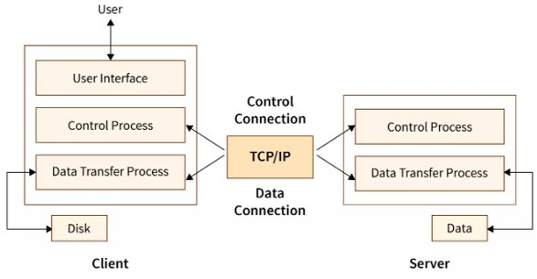
Lecture
10
FTP PARTS
www.midocean.ae

Slide 7
Lecture
10
FTP PARTS
Cont'd
FTP client has three components:
  The user interface.
  The control process.
  The data transfer process.
The server has two components:
  The server control process.
  The server data transfer process.
www.midocean.ae

Slide 8
Lecture
10
FTP COMMUNICATION CONNECTIONS
FTP actually uses two TCP connections during operation.
The control connection:
  Carries commands and the resulting acknowledgments or error codes.
  Uses very simple rules for communication.
  Remains opened during the entire interactive FTP session.
www.midocean.ae

Slide 9
Lecture
10
FTP COMMUNICATION CONNECTIONS
Cont'd
The data transfer connection:
  Used for transmitting file data or other blocks of information, such as directory listings.
  Uses very complex rules as data types may vary.
  Opens when a command comes for transferring the files and closes when the file is transferred.
www.midocean.ae

Slide 10
FTP CONTROL CONNECTION COMMANDS
Lecture
10
OPEN: used to open new connection with the server.
USER: sends the user identification to the server.
PASS: sends the user password to the server.
CWD: allows the user to work with a different directory without altering his login information.
www.midocean.ae

Slide 11
FTP CONTROL CONNECTION COMMANDS
Lecture
10
Cont'd
MKD: causes the directory specified in the path-name to be created as a directory.
PUT: used to put a file in the server.
CLOSE: used to close connection with the server.
www.midocean.ae

Slide 12
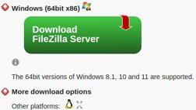
Lecture
10
LOCAL FTP SERVER
FileZilla is a free and open-source, cross-platform FTP application.
Run the executable and complete the installation.
While installation, set the server administration password and remember the server administration port.
www.midocean.ae

Slide 13
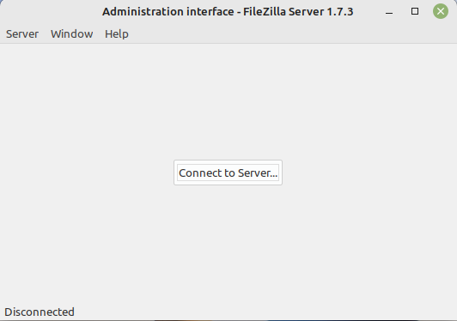
Lecture
10
LOCAL FTP SERVER
Cont'd
www.midocean.ae

Slide 14
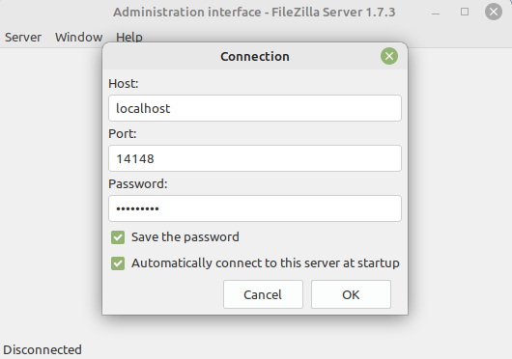
Lecture
10
LOCAL FTP SERVER
Cont'd
www.midocean.ae

Slide 15
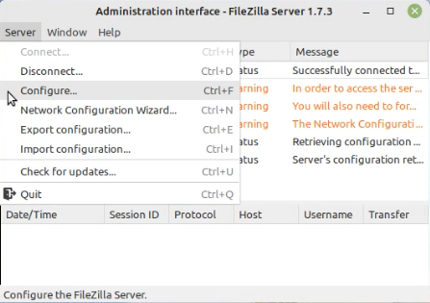
Lecture
10
LOCAL FTP SERVER
Cont'd
www.midocean.ae

Slide 16
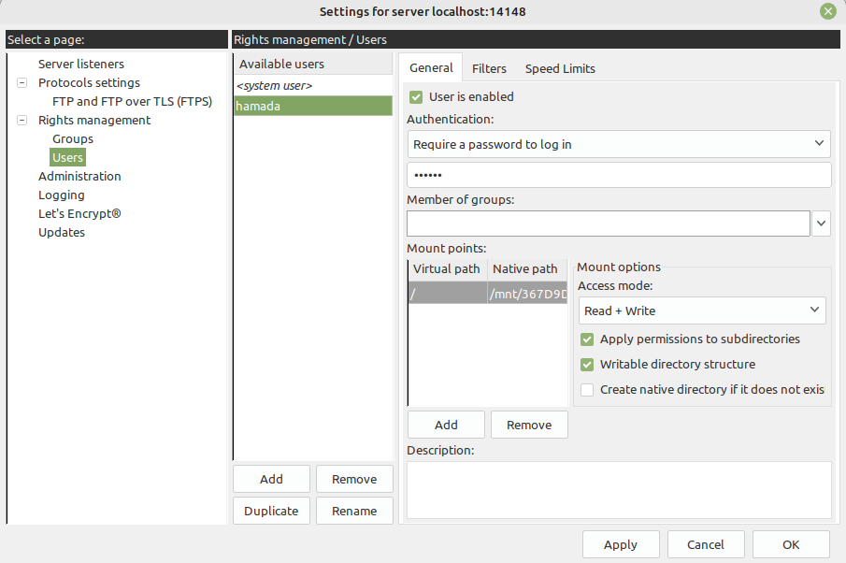
Lecture
10
LOCAL FTP SERVER
Cont'd
www.midocean.ae

Slide 17
Lecture
10
FTP MODULE
Python provides FTP module in its standard library called ftplib that implements the client side of the FTP protocol.
Features:
  Connecting to an FTP server.
  Navigating its structure.
  Downloading files from the FTP server.
  Uploading files to an FTP server.
www.midocean.ae

Slide 18
Lecture
10
FTP MODULE METHOD
FTP(): create an FTP client instance.
FTP_TLS(): create an FTP client instance under a secure connection.
connect(): connect to an FTP server.
login(): login to an FTP server.
prot_p(): used with a secure FTP connection.
www.midocean.ae

Slide 19
Lecture
10
FTP MODULE METHOD
Cont'd
pwd(): get current working directory in FTP server.
cwd(): change the working directory.
nlst(): return a list of file and folder names in a working directory.
storbinary(): used to upload a file to an FTP server.
retrbinary(): used to download a file from an FTP server.
www.midocean.ae

Slide 20
Lecture
10
FTP MODULE METHOD
Cont'd
rename(): rename a file or folder in an FTP server.
delete(): delete a file or folder from an FTP server.
rmd(): delete a folder from an FTP server.
mkd(): create a folder in an FTP server.
size(): return the size of a file in an FTP server.
quit(): close an FTP server connection.
www.midocean.ae

Slide 21
Lecture
10
FTP CLIENT
Connection steps:
  Set up connection parameters.
  Create an FTP client instance.
  Connect to FTP server.
  Login to FTP server.
  Perform required operation on FTP server.
  Close connection.
www.midocean.ae

Slide 22
Lecture
10
FTP CLIENT
Cont'd
Code:
import ftplib
ftphost = "localhost"
ftpport = 21
ftpusername = "yourUserName"
ftppassword = "youPassword"
ftp = ftplib.FTP()
ftp.connect(ftphost, ftpport)
ftp.login(ftpusername, ftppassword)
ftp.quit(); print("FTP handling performed successfully")
www.midocean.ae

Slide 23
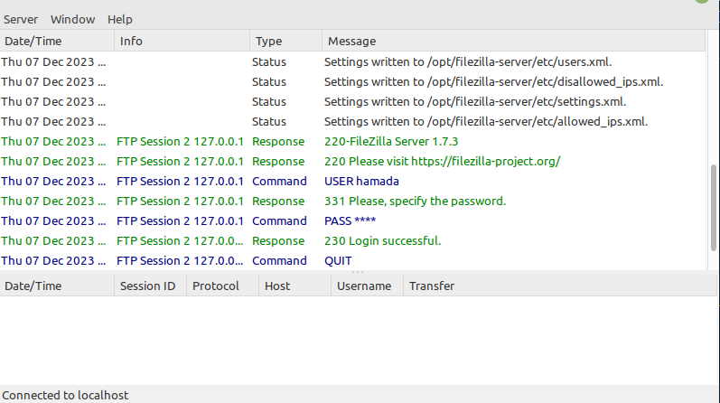
Lecture
10
FTP CLIENT
Cont'd
www.midocean.ae

Slide 24
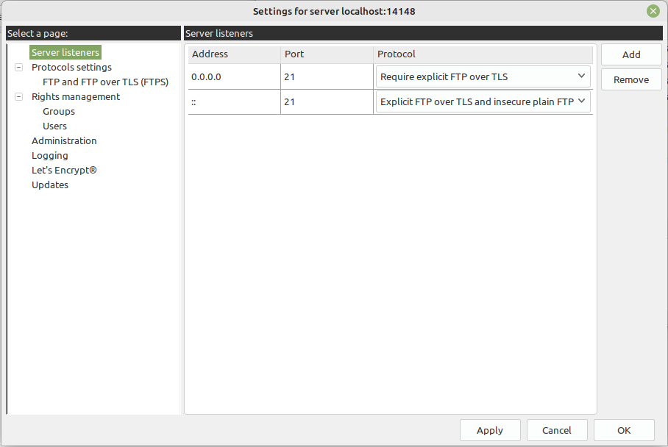
Lecture
10
SECURED FTP CLIENT
www.midocean.ae

Slide 25
Lecture
10
SECURED FTP CLIENT
Cont'd
Code:
import ftplib
ftphost = "localhost"
ftpport = 21
ftpusername = "yourUserName"
ftppassword = "youPassword"
ftp = ftplib.FTP_TLS()
ftp.connect(ftphost, ftpport)
ftp.login(ftpusername, ftppassword)
ftp.prot_p(); ftp.quit(); print("FTP handling performed successfully")
www.midocean.ae

Slide 26
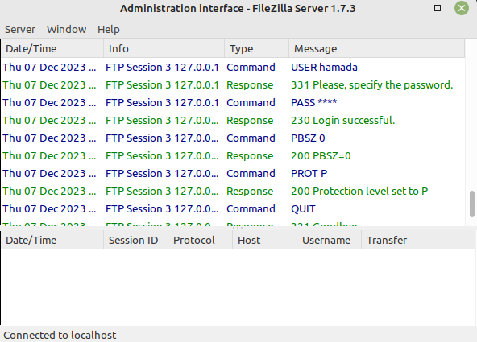
Lecture
10
FTP CLIENT
Cont'd
www.midocean.ae

Slide 27
Lecture
10
WORKING ON FTP SERVER
Code:
import ftplib
ftphost = "localhost"; ftpport = 21
ftpusername = "yourUserName"
ftppassword = "youPassword"
ftp = ftplib.FTP()
ftp.connect(ftphost, ftpport)
ftp.login(ftpusername, ftppassword)
ftp.cwd('/your/configured/path') #ftplib.error_perm
www.midocean.ae

Slide 28
Lecture
10
WORKING ON FTP SERVER
Code:
print( ftp.pwd() )
fileNames = ftp.nlst()
for file in fileNames:
print(file)
ftp.quit()
www.midocean.ae

Slide 29
Lecture
10
WORKING ON FTP SERVER
Cont'd
Code:
with open("message.txt", 'rb') as file:
rescode = ftp.storbinary("STOR message.txt", file, blocksize= 1024*1024)
if rescode.startswith("226"):
print("File uploaded seccussefuly")
else:
print("File not uploaded!")
ftp.quit()
www.midocean.ae

Slide 30
Lecture
10
WORKING ON FTP SERVER
Cont'd
Code:
with open("message.txt", 'wb') as file:
rescode = ftp.retrbinary("RETR message.txt", file.write)
if rescode.startswith("226"):
print("File downloaded seccussefuly")
else:
print("File not uploaded!")
ftp.quit()
www.midocean.ae

Slide 31
Lecture
10
WORKING ON FTP SERVER
Cont'd
Code:
ftp.rename("oldFileName.extension", "newFileName.extension")
ftp.delete("fileName.extension")
ftp.mkd("folderName")
ftp.rmd("folderName")
print(ftp.size("fileName.extension"))
print(ftp.dir())
ftp.quit()
www.midocean.ae

Slide 32
Lecture
10
QUESTIONS FOR ONLINE DISCUSSION
Write a program to create your own FTP client to upload and download files to a specific location in your machine.
www.midocean.ae

Slide 33


Thank You

