Slide 1



The Negotiation and Influencing Skills
How to overcome communication’s barriers and Risk Management tactics for effective negotiation
Lec.4
ENT623
College of Entrepreneurship and Innovation
Prepared by
Dr. Bothaina Mahmoud Fouad

Slide 2

Understand Barriers of communication in negotiation
Understand the dynamics of Risk Management in the Negotiation situation
Case studies
Our Learning Outcomes

Slide 3
Barriers of communication in negotiation
Language barriers: When parties speak different languages or dialects, it can be difficult to communicate effectively and accurately. This can lead to misunderstandings and misinterpretations of what is being said.
Cultural barriers: Cultural differences can affect communication in negotiation, as different cultures may have different communication styles, norms, and expectations. For example, some cultures may value direct communication, while others may use indirect communication.
Emotional barriers: Strong emotions such as anger, frustration, and anxiety can make it difficult to communicate effectively in negotiation. Parties may become defensive, dismissive, or unresponsive, which can lead to breakdowns in communication.

Slide 4
Barriers of communication in negotiation
4.Information barriers: Parties may have different levels of information or access to information, which can create an imbalance of power and lead to misunderstandings or mistrust.
5.Perception barriers: Parties may have different perceptions of the situation, the other party, or the negotiation process. These different perceptions can lead to misunderstandings and misinterpretations of what is being said.
6.Technology barriers: In today's digital age, parties may communicate through technology such as email and video conferencing, which can create barriers to effective communication. Technical difficulties and miscommunications can occur, which can hinder the negotiation process.

Slide 5
Ex: Barriers of communication in negotiation
Before taking my new job, I had 10 years of successful experience negotiating with suppliers all over the United States.
The company I just joined sources materials and components from almost everywhere but the United States.
What advice can you give me on negotiating with foreign suppliers?

Slide 6
Ex: Barriers of communication in negotiation
When negotiating with foreign suppliers, you’ll confront a variety of obstacles, such as:
unfamiliar laws,
ideologies, and governments, that are usually absent from negotiations with U.S. suppliers.
the cultural differences between the two sides ( in case of International negotiations).

Slide 7
Ex: Barriers of communication in negotiation
Culture consists of the socially transmitted behavior patterns, attitudes, norms, and values of a given community, whether a nation, an ethnic group, or even an organization.
Understanding a foreign counterpart’s culture is a lot like peeling an onion, as you interpret behavior to reveal attitudes, which reflect norms, which are founded on values.

Slide 8
To overcome these barriers
parties can improve their communication and achieve more successful negotiation outcomes through taking a lot of steps, such as:
actively listening,
asking clarifying questions, and
using clear and concise language.
Parties can also work to understand and respect cultural differences,
manage their emotions, and share information openly and transparently. By addressing these barriers,

Slide 9
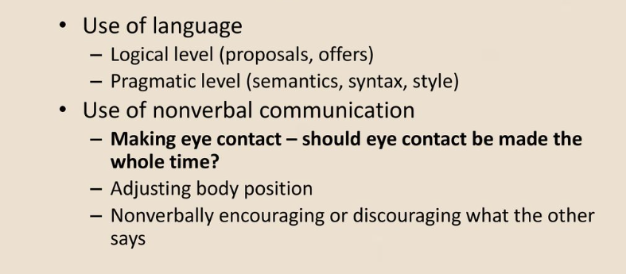
How people communicate in negotiation

Slide 10
Role of Non-Verbal Communication in Negotiation and Conflict Resolution
There are many non-verbal means of communication that may spoil or succeed negotiation processes, so we can focus on this 5 Tricks to enhance the success of negotiations:
Mirror the other person ” mirroring technique “: Look at the body language of the other person and try to adopt their same tone and behavior. to gain a situation of trust.
Nodding and keep eye contact: is essential to reduce tension and build relationships, even if you are in the middle of a disagreement or harsh criticism. “The eyes are the windows to the soul” when you avoid eye contact, you are showing unease and lack of confidence, which translates into a burden for any negotiator.
Pay attention to your hands: Your hands should show confidence and calmness.
Relax your body: Even in intense negotiations, it is important to keep a relaxed body position to help you relieve tension. Add to that a soft and non-aggressive tone of voice to build trust and favor effectiveness in negotiations.
Don’t forget to smile: It is highly likely that we will try to build long-term relationships in a negotiation. emphasis is placed on these types of relationships, to be built on friendly and sincere foundations. Smiling and showing a natural and transparent attitude is essential for the agreement to succeed.
https://www.game-learn.com/en/resources/blog/5-non-verbal-communication-tricks-be-successful-in-negotiations/#:~:text=Nodding%20and%20keeping%20eye%20contact,is%20the%20most%20damaging%20one.

Slide 11
Digital Communication in Negotiation
For the past few years, almost all negotiations have been occurring virtually. But even before Covid-19, digital negotiations use online platforms and tools to carry out meetings and reach agreements. This enables professionals to communicate and negotiate remotely instead of relying on traditional face-to-face meetings.
an increasing number of dealmakers were connecting through digital tools. Video technologies, low-cost teleconferencing, and email have all become efficient ways for teams to prepare together and to negotiate with counterparts.
https://accentonbusiness.net/top-six-communication-skills-negotiation/

Slide 12
Advantages of Digital Communication in Negotiation
time constraints and Remove global barriers Digital negotiations break down geographical barriers, allowing companies to negotiate with clients and partners around the globe without the need to travel to them | Speed and Efficiency: - Instant Communication: Messages can be sent and received instantly, facilitating quick decision-making and responses. - Automation: Tools like emails, chatbots, and automated responses streamline communication processes.
removes pressure from the negotiator. and allowed him to freely explore ideas, adjust strategy, and provide a more considered approach to their next input to the negotiation. | Cost-Effectiveness: - Reduced Costs: Digital communication often lowers costs associated with printing, mailing, and long-distance phone calls. - Remote Collaboration: Tools like video conferencing reduce travel expenses and enable remote work.
https://accentonbusiness.net/top-six-communication-skills-negotiation/

Slide 13
Advantages of Digital Communication in Negotiation
Flexible scheduling and Record of negotiations | Data Tracking and Analysis: - Metrics and Analytics: Organizations can track communication effectiveness and engagement through analytics tools, allowing for informed decision-making. - Feedback Mechanisms: Digital tools facilitate quick feedback, improving processes and employee engagement.
Sometimes, negotiating through email or text can also encourage a more sophisticated level of thinking and lead to more objective and rational solutions. | Enhanced Collaboration: - Real-Time Collaboration: Tools like Google Docs and project management software allow multiple users to work together in real time. - Shared Resources: Digital platforms enable easy sharing of documents and resources, promoting teamwork.
https://accentonbusiness.net/top-six-communication-skills-negotiation/

Slide 14
Disadvantages of Digital Communication in Negotiation
Overload and Distraction: - Information Overload: The sheer volume of digital communication can overwhelm employees, leading to stress and decreased productivity. - Distractions: Notifications and constant connectivity can lead to interruptions, hindering focus. | Limitations with seeing a negotiator’s emotions: There are non-verbal clues that come along with the physical mode of negotiation, such as facial gestures, hand movement, sitting positions, among many others. Virtual communication hardly gives access to all those features.
Miscommunication: - Lack of Nonverbal Cues: Digital communication often lacks tone, body language, and facial expressions, leading to misunderstandings. - Ambiguity: Short messages or informal language can be misinterpreted, affecting clarity. | Technical challenges and issues: there could still be technical challenges such as poor audio recording or limited bandwidth. Reliability: Technical failures, such as internet outages or software malfunctions, can disrupt communication. - Learning Curve: Employees may require training to effectively use digital communication tools, which can be time-consuming.
Security Risks: - Data Breaches: Digital communication is vulnerable to hacking, phishing, and other cyber threats, putting sensitive information at risk. - Compliance Issues: Organizations must navigate regulations regarding data protection, which can be complex and costly. | Misinterpretation of text: the other person at the end of the negotiation table might easily read another meaning.
https://accentonbusiness.net/top-six-communication-skills-negotiation/

Slide 15
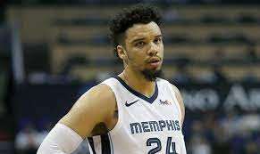
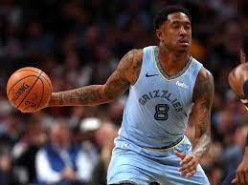
02
Case Study
Dillon and Marshon Brooks

Slide 16
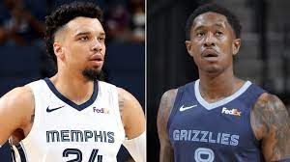
Chapter
02
Memphis has two players with the last name Brooks – Dillon Brooks, a twenty-two-year-old small forward with a lot of skill and potential; and MarShon Brooks, a twenty-nine-year-old shooting guard who was out of the NBA playing in China last season.
Somehow, Washington and Phoenix thought that Dillon Brooks was part of the trade deal; Memphis, however, was offering MarShon Brooks. Seemingly, no one confirmed which Brooks it was until the deal was about to be finalized

Slide 17
Chapter
02
When the teams discovered that they were talking about two very different Brooks, the trade talks broke down and temporarily ended. The impact rippled throughout the league (and on Twitter).
Some players were already informed about the trade, and many of the details were being talked about widely in the press. The breakdown of the trade happened in such a public and embarrassing way over the course of just thirty minutes that it seemed almost unbelievable.
Ariza ultimately was traded to Washington, but the resulting public embarrassment and locker room tension could have been avoided with improved preparation, reflection, and communication.

Slide 18
1
As negotiation trainers and consultants, we see the following as three important lessons to take away from this case study
Preparation
each team should have been aware that there were multiple Brooks playing for Memphis had they prepared more effectively. It can be easy to jump right into a negotiation without spending time preparing, especially in a fast-paced, high-stakes industry like professional sports. As we’ve stated before, however, preparation is an essential part of the negotiation process. The time and effort spent on this step will pay off in dividends during the negotiation itself.

Slide 19
2
As negotiation trainers and consultants, we see the following as three important lessons to take away from this case study
Question your assumptions
It’s interesting that each team assumed that the Brooks in play was the one who benefited them the most. Phoenix would have preferred the young up-and-comer Dillon, while Memphis would have preferred dealing a deep reserve player like MarShon. It’s easy to laugh at a situation like this and think that we would never make such a mistake. However, we all rely on assumptions. When we act upon assumptions without questioning them first, we create situations ripe for misunderstanding. If you find yourself talking to someone and feel like you are talking past one another, ask yourself: is there a conclusion or assumption I’m making that might be different from the other side?

Slide 20
3
As negotiation trainers and consultants, we see the following as three important lessons to take away from this case study
Confirm your understanding – early and often
Luckily, each team ultimately recognized their error and were able to make a trade work. Miscommunication happens – you cannot prepare for everything, and you cannot expect to be perfect. However, we can increase the likelihood that we catch miscommunications earlier in the negotiation process by confirming our understanding of what our counterpart is saying. Utilizing active listening techniques, we summarize what our negotiation counterpart is saying. If we have misunderstood them – or if we are talking about two different things, as in the case of the Ariza trade – we can clarify it up front and keep it from possibly derailing the negotiation in the future

Slide 21
This messy trade negotiation delivers one final lesson:
when you make a mistake during a negotiation, you can use it as a chance to improve moving forward. Reviewing your negotiations is as important as preparing for them because it allows you to learn and grow, and you can utilize those lessons in your next negotiation to continue improving your skills and negotiated outcomes

Slide 22
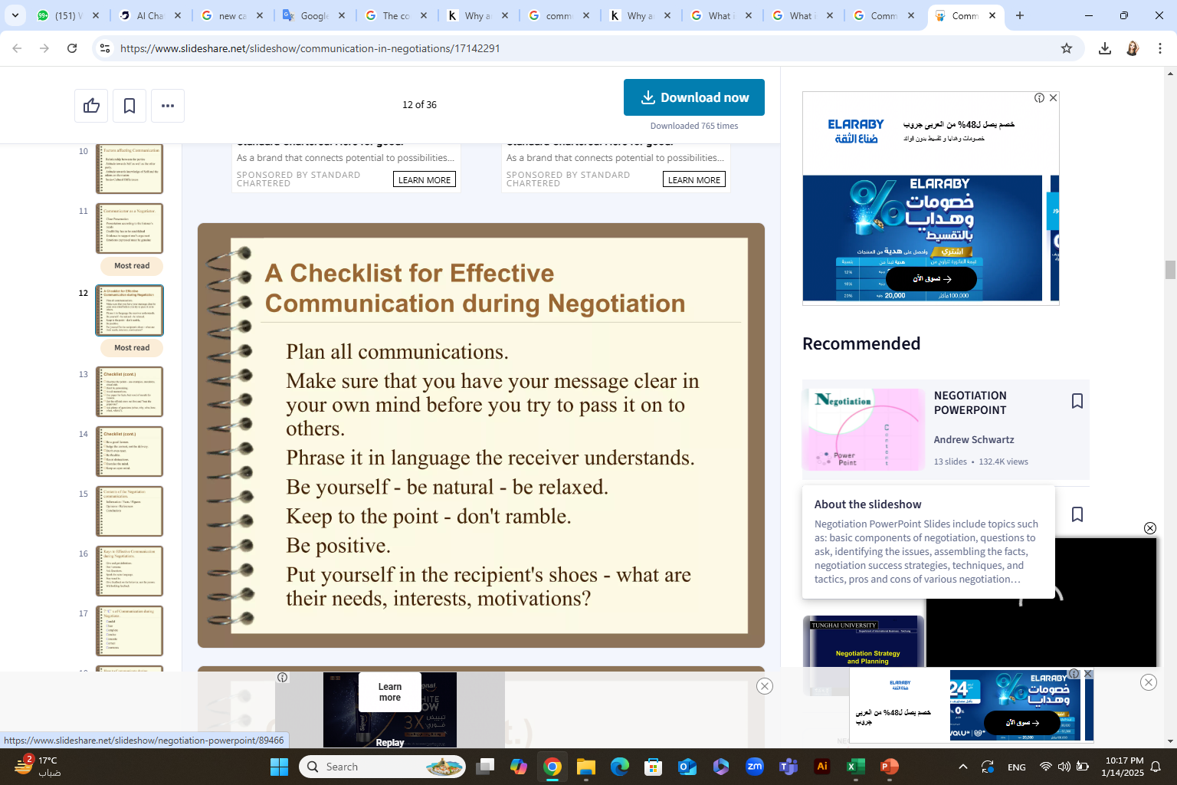

Slide 23
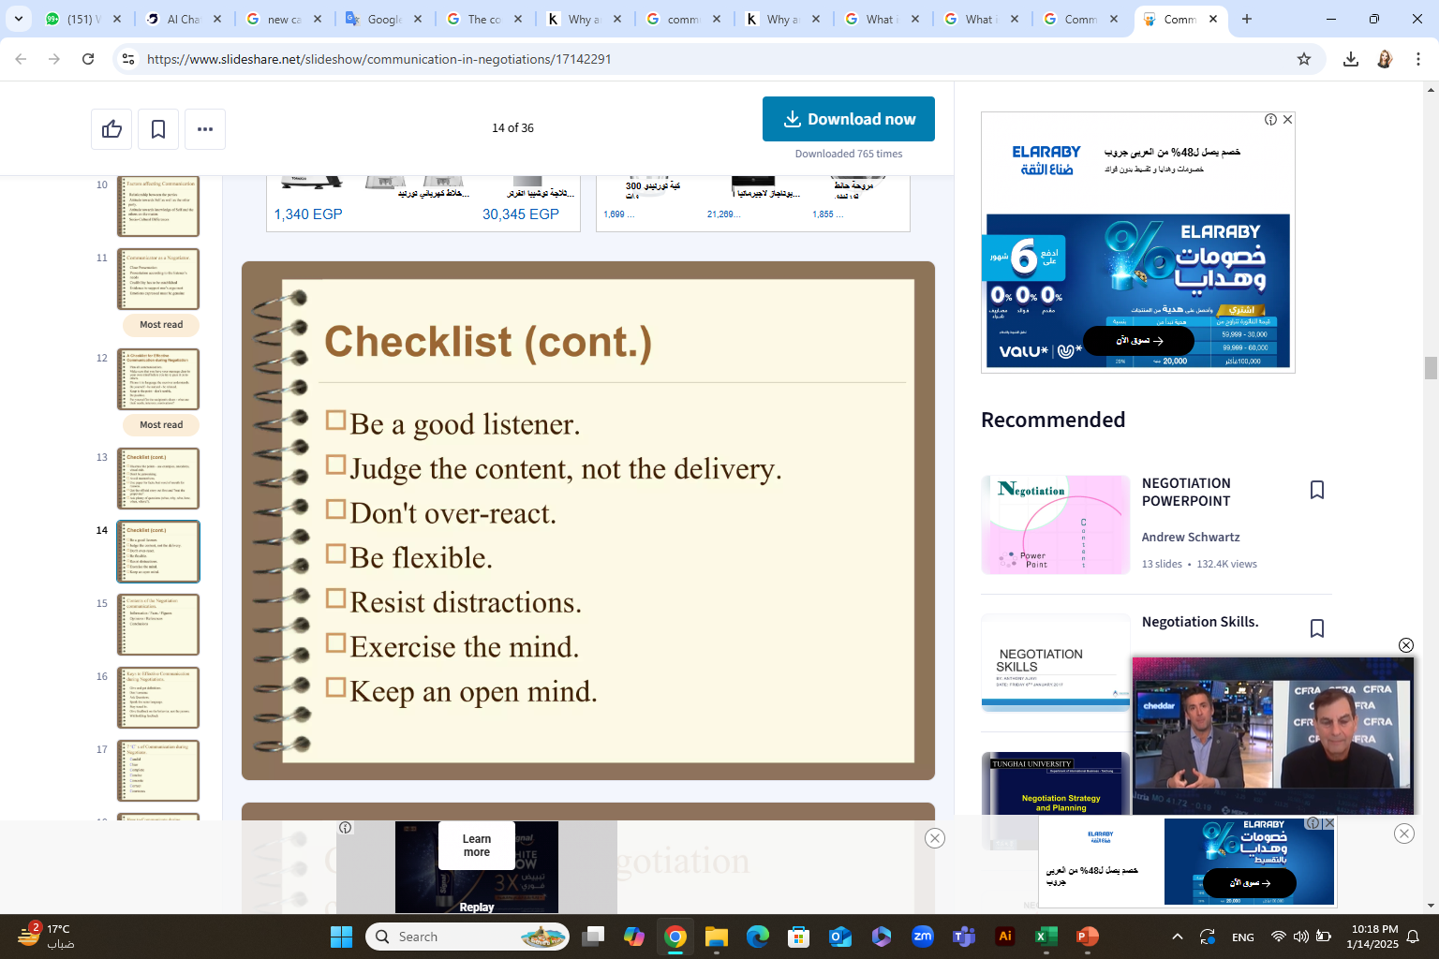

Slide 24
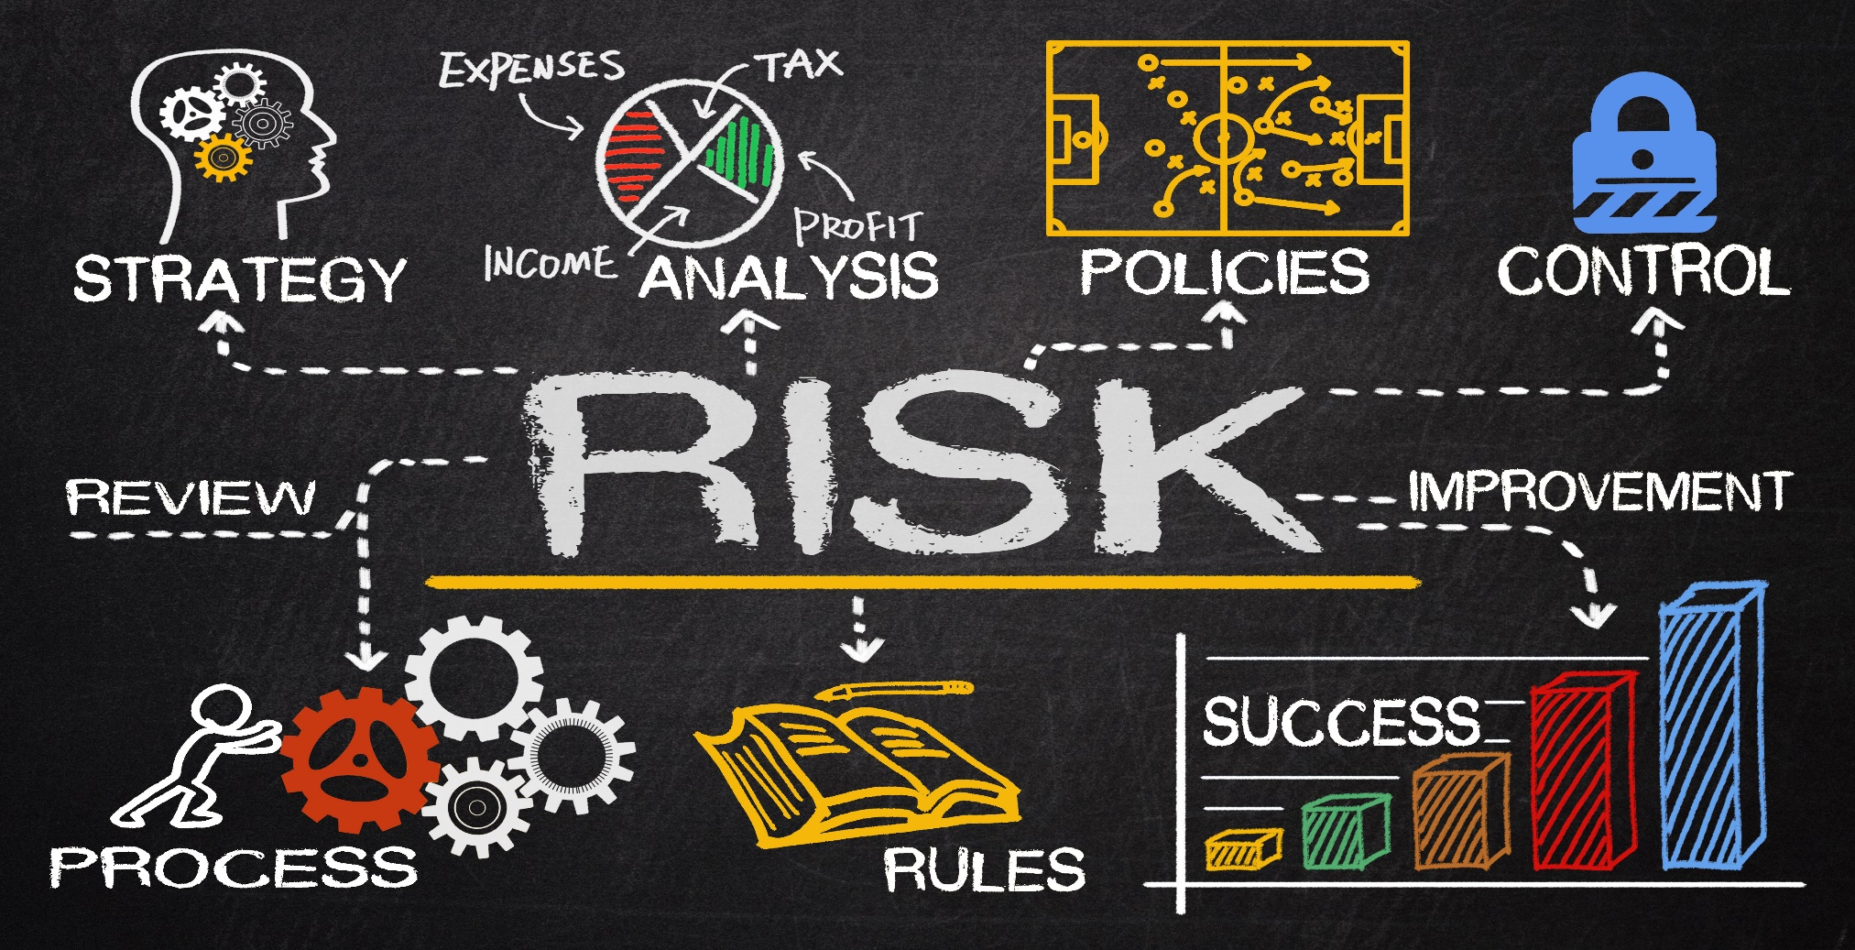
Conclusion
The Risk Management

Slide 25
Risk Management
Conclusion
What is a Risk Management Framework?
The Role of Risk Management in Effective Negotiation
Key Strategies for Mitigating Uncertainty in Negotiation
What are the best ways for risk management professionals to improve your negotiation skills?

Slide 26
Conclusion
1. What is a Risk Management Framework?

Slide 27
Conclusion
A Risk Management Framework is a structured process used to manage uncertainties that may impact the objectives of a project or organization.
It includes five practical steps:
Risk Identification: Define and categories risks, such as operational, financial, compliance, and reputational risks.
Risk Assessment: Use tools like risk matrices to priorities risks based on likelihood and impact.
Risk Mitigation: Implement strategies to minimize risks, such as dual sourcing, performance bonds, or contingency planning.
Risk Monitoring: Continuously track risks using key risk indicators (KRIs), regular reviews, and supplier scorecards.
Communication and Reporting: Maintain transparency through dashboards, heat maps, and regular risk reports.

Slide 28
Conclusion
2. The Role of Risk Management in Effective Negotiation

Slide 29
Conclusion
Risk management is crucial for effective negotiation because it enables negotiators to anticipate potential problems, develop mitigation strategies, and navigate uncertainties to achieve desired outcomes. By proactively identifying and assessing risks, negotiators can better prepare for negotiations, improve their decision-making, and increase the likelihood of successful agreements.

Slide 30
The Role of Risk Management in Effective Negotiation
Conclusion
Enhanced Preparation and Strategy:
Risk Identification and Assessment: A key aspect of risk management is identifying potential risks that could arise during negotiations, such as financial uncertainties, legal liabilities, or potential disagreements.
Impact and Probability Assessment: Once risks are identified, they need to be assessed based on their potential impact and the likelihood of their occurrence. This helps prioritize which risks require immediate attention and mitigation strategies.
Developing Contingency Plans: Risk management allows negotiators to develop contingency plans for various scenarios, ensuring they are prepared to respond effectively to unexpected challenges during the negotiation process

Slide 31
The Role of Risk Management in Effective Negotiation
Conclusion
2. Improved Decision-Making:
Informed Choices: By understanding the potential risks and their consequences, negotiators can make more informed decisions about acceptable levels of risk, trade-offs, and acceptable outcomes.
Prioritizing Key Issues: Risk management helps negotiators focus on the most critical issues and potential pitfalls, ensuring that time and resources are allocated effectively.
Confidence and Negotiation Power: A well-developed risk management strategy can boost a negotiator's confidence and bargaining power, as they are better prepared to navigate challenges and defend their position

Slide 32
The Role of Risk Management in Effective Negotiation
Conclusion
3. Minimizing Potential Disputes:
Clear Risk Allocation: Effective risk management includes clearly defining and allocating risks between parties involved in the negotiation. This can minimize ambiguity and potential for future disputes.
Reduced Likelihood of Project Derailment: By addressing potential risks early on, risk management can help prevent project derailment and contract disputes, ensuring that negotiations lead to successful and sustainable agreements.
Building Trust and Relationships: Open communication about risks and mitigation strategies can build trust and foster a more collaborative environment between negotiating parties

Slide 33
The Role of Risk Management in Effective Negotiation
Conclusion
4. Supporting Negotiation Outcomes:
Achieving Desired Outcomes: Risk management helps negotiators achieve their objectives by anticipating potential problems and developing strategies to address them.
Protecting Value: Effective risk management ensures that negotiations balance risk mitigation with cost efficiency, value creation, and innovation.
Enhancing Resilience: By incorporating risk management practices, organizations can improve their overall resilience and ability to withstand disruptions

Slide 34
Conclusion
3. Key Strategies for Mitigating Uncertainty in Negotiation
Tactical Approaches to Managing Uncertainty in Negotiations

Slide 35
Conclusion
Identify and Assess Risks: Begin by thoroughly analyzing the negotiation context, identifying potential risks and uncertainties. This includes understanding both the specific issues at hand and the broader environment in which the negotiation takes place.
Develop Contingency Plans: Once risks are identified, create alternative plans (Plan B, Plan C, etc.) to address potential problems. This preparedness allows negotiators to adapt to unexpected situations and avoid being caught off guard.
Shift or Transfer Risk: Where possible, negotiate clauses that transfer risk to the other party. This could involve insurance policies, performance bonds, or other mechanisms that protect your interests if things don't go as planned.

Slide 36
Conclusion
Build in Flexibility: In uncertain environments, it's crucial to maintain flexibility in your negotiation strategy. Avoid rigid positions and be open to creative solutions that address the needs of all parties involved.
Communicate Effectively: Open and honest communication is essential for managing risk. Clearly articulate your concerns, expectations, and potential solutions to the other party, fostering trust and collaboration.
Scenario Planning: Explore different possible future scenarios and their potential impact on the negotiation. This helps in anticipating challenges and developing appropriate responses.

Slide 37
Conclusion
Quantify Risk: When possible, assess the potential impact of risks in terms of time, cost, or other relevant metrics. This allows for a more informed decision-making process.
Seek Professional Advice: If the negotiation involves complex issues or significant risks, consider seeking guidance from risk management experts or legal professionals

Slide 38
Conclusion
4. What are the best ways for risk management professionals to improve your negotiation skills?
Negotiation Skill-Building for Risk Management Professionals: Best Practices and Tools

Slide 39
Conclusion
Understand your BATNA
Before you enter any negotiation, you should know your best alternative to a negotiated agreement (BATNA). This is the most favorable outcome you can expect if the negotiation fails or reaches an impasse. Your BATNA helps you set your minimum acceptable offer and avoid accepting unfavorable terms.

Slide 40
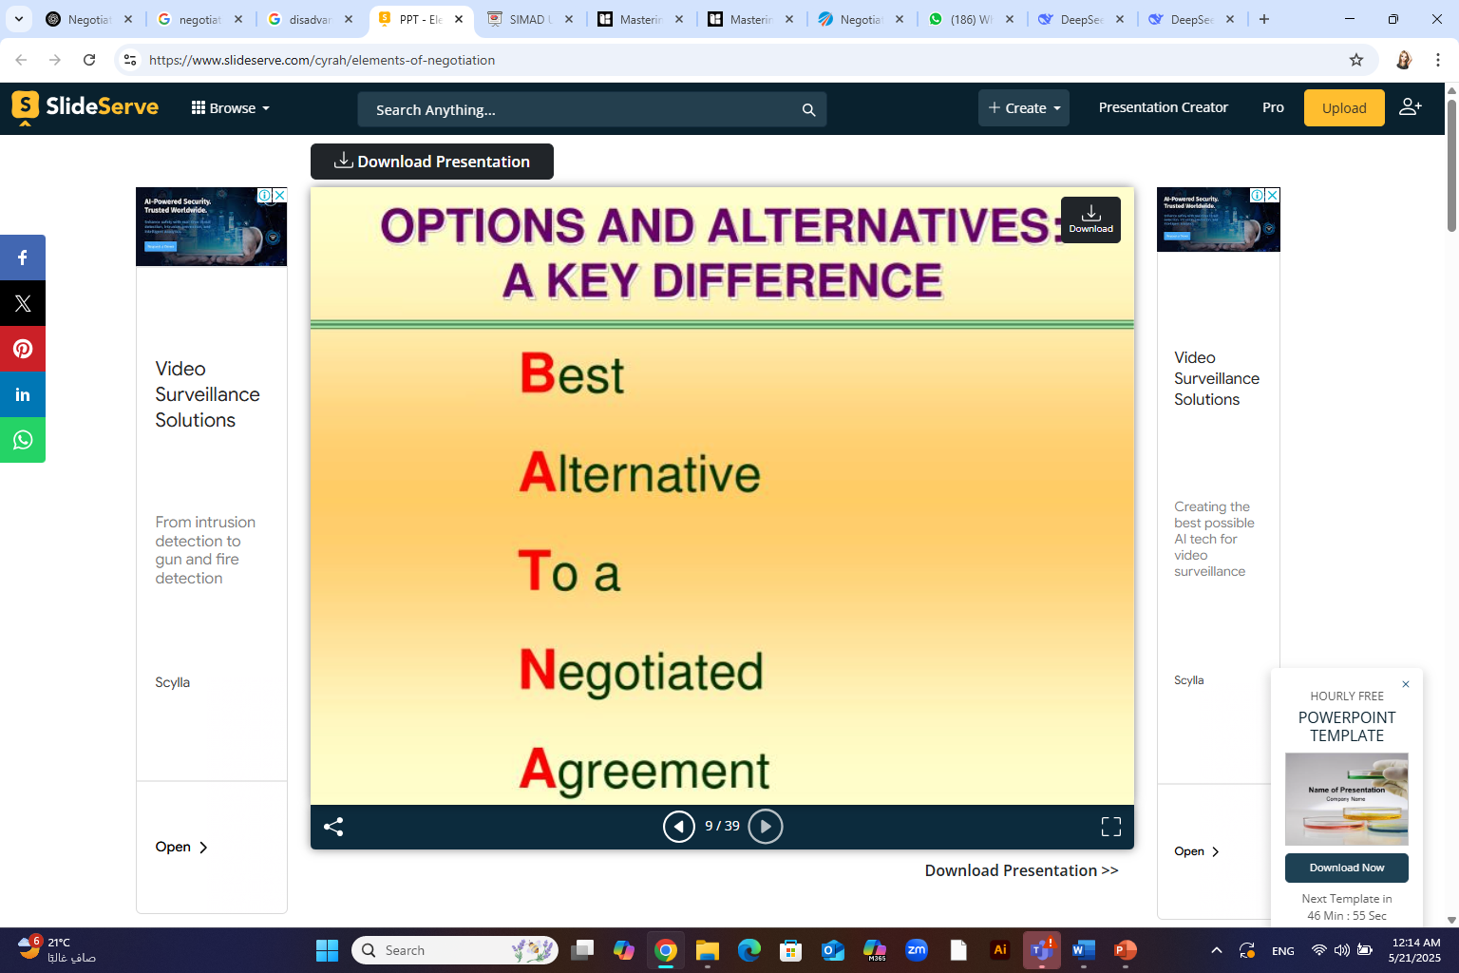
What is the meaning of ( BATNA ) in negotiation
BATNA stands for Best Alternative To a Negotiated Agreement. It's a term used in negotiation, referring to the best course of action you would take if you cannot reach an agreement with the other party. Essentially, it's your "Plan B" or fallback option.

Slide 41
Conclusion
To determine your BATNA, you should research the market, analyze your strengths and weaknesses, and evaluate your options. You should also try to estimate the BATNA of the other party and use it as a benchmark for your proposals.

Slide 42
What is the meaning of ( ZOPA ) in negotiation
Conclusion
ZOPA stands for Zone of Possible Agreement. It's the sweet spot in negotiations where both parties' interests align, creating the potential for a mutually acceptable deal. In other words, it's the overlap between the buyer's and seller's acceptable terms

Slide 43
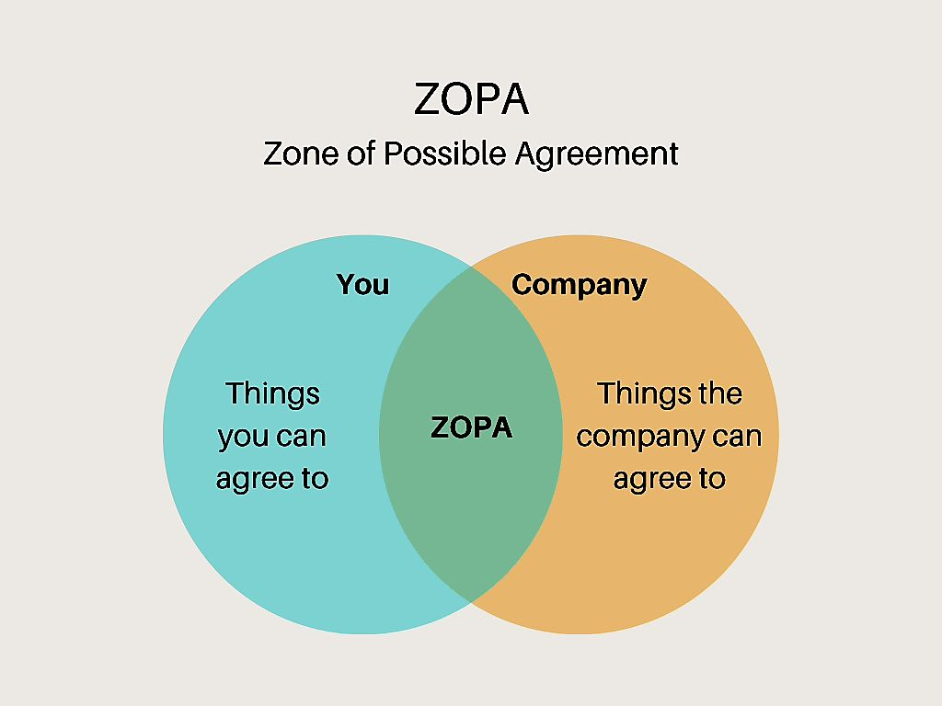
Conclusion

Slide 44
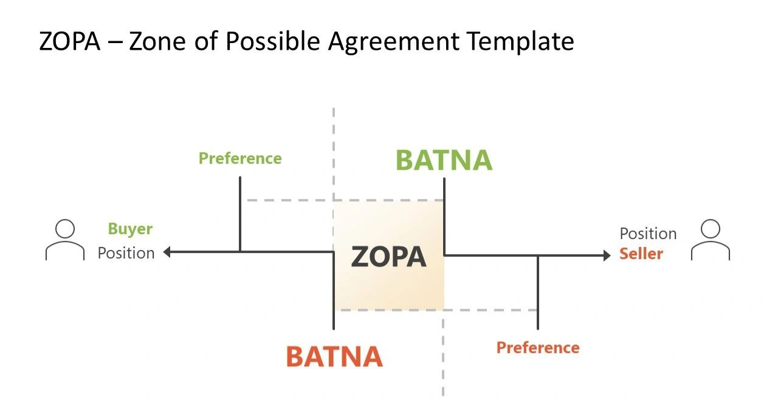
Conclusion

Slide 45
The Relationship Between ZOPA and BATNA
BATNA Defines the Boundaries of ZOPA
  Your BATNA determines your reservation price—the minimum you are willing to accept (or maximum you're willing to offer).
  The overlap between your reservation price and the other party’s defines the ZOPA.
  If BATNAs are strong, the ZOPA might be narrower or even non-existent.
If No ZOPA Exists, BATNA Becomes Critical
  If the two parties’ reservation prices don’t overlap, there is no ZOPA, and a deal isn’t possible unless someone changes their position.
  In this case, you must walk away and pursue your BATNA.
Understanding the Other Party’s BATNA Can Expand the ZOPA
  Skilled negotiators try to assess or influence the other party’s BATNA to shift the ZOPA in their favor.
  If you believe the other party’s BATNA is weak, you might make a more aggressive offer.
BATNA Strength = Negotiation Power
  A strong BATNA gives you leverage, which can improve your position within the ZOPA.
  Conversely, a weak BATNA means you’ll likely need to accept terms closer to the other party’s reservation point.
Conclusion

Slide 46
Conclusion
Build rapport and trust
Negotiation is not only about numbers and facts, but also about emotions and relationships. To negotiate successfully, you need to build rapport and trust with the other party. This can help you overcome barriers, find common ground, and create value.
To build rapport and trust, you should use active listening, show empathy, ask open-ended questions, and acknowledge the other party's interests and concerns. You should also avoid making assumptions, judgments, or personal attacks, and focus on the issues rather than the personalities.

Slide 47
Conclusion
Use collaborative problem-solving
Negotiation is not a zero-sum game, where one party wins and the other loses. Rather, it is a collaborative problem-solving process, where both parties can achieve mutually beneficial outcomes.
To use collaborative problem-solving, you should adopt a win-win mindset, identify the underlying needs and interests of both parties, generate multiple options, and evaluate them objectively and transparently. You should also seek feedback, clarify expectations, and document the agreement.

Slide 48
Conclusion
Manage emotions and conflicts
Negotiation can be stressful and emotional, especially when there are high stakes, complex issues, or conflicting interests.
To manage emotions and conflicts, you should be aware of your own triggers, biases, and reactions, and regulate them accordingly. You should also recognize and respect the emotions of the other party, and avoid escalating or ignoring them. You should also use constructive communication, such as reframing, paraphrasing, summarizing, and validating, to defuse tension and restore harmony

Slide 49
Conclusion
Learn from feedback and experience
Negotiation is a continuous learning process, where you can improve your skills and performance by seeking feedback and reflecting on your experience.
To learn from feedback and experience, you should solicit feedback from the other party, your peers, your mentors, or your coaches, and use it to identify your strengths and areas for improvement. You should also review your negotiation process and outcomes, and analyze what worked well and what did not. You should also celebrate your successes and learn from your failures.

Slide 50
Conclusion
Practice and improve
The best way to improve your negotiation skills is to practice and improve. You can practice your negotiation skills by participating in simulations, role-plays, case studies, or real-life scenarios, and applying the techniques and strategies you have learned.
You can also improve your negotiation skills by reading books, articles, blogs, or podcasts, attending workshops, courses, or webinars, or joining professional networks or communities of practice. You should also seek opportunities to negotiate in different contexts, cultures, and industries, and challenge yourself to expand your comfort zone.

Slide 51



Thank You

