Slide 1



Build a Small Network
Lecture 10
CCNA – Introduction to Networks V7.0 (ITN)
Prepared by
Dr. Abdelrhman Ahmed

Slide 2
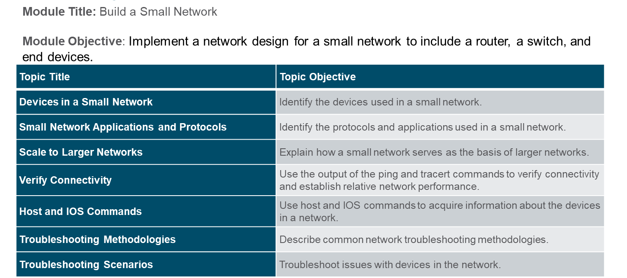
Chapter
Module Objectives
10

Slide 3
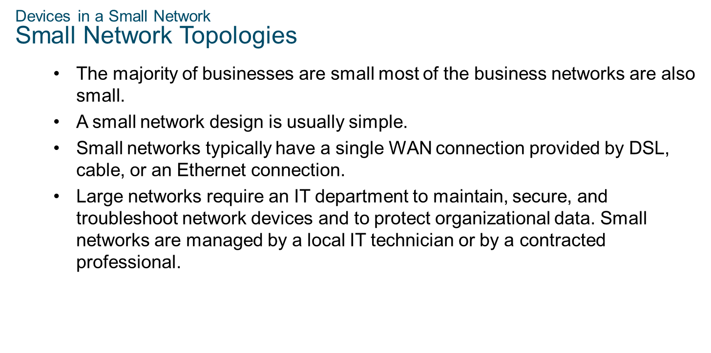
Chapter
Devices in a Small Network
10

Slide 4
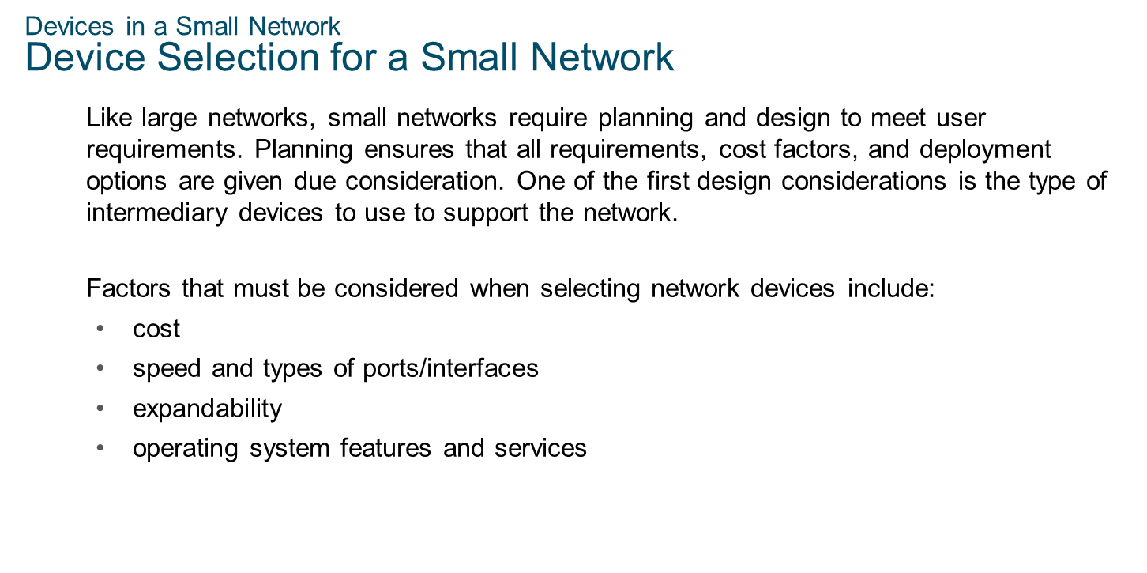
Chapter
Devices in a Small Network
10

Slide 5
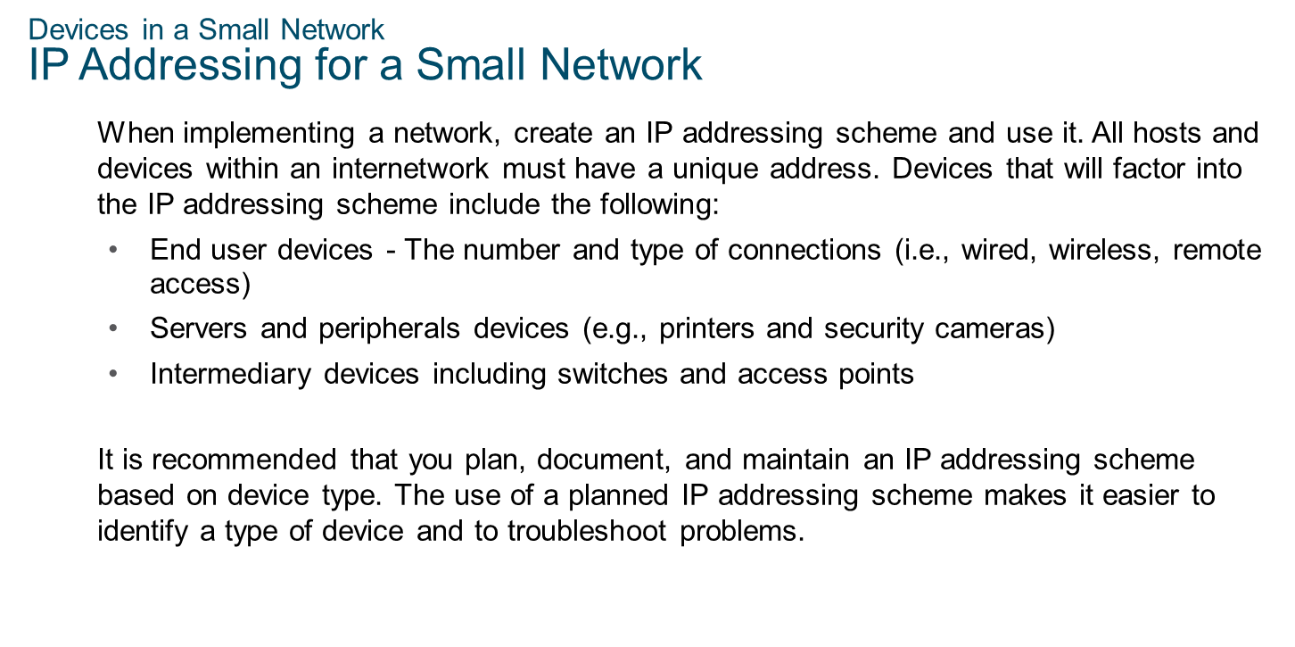
Chapter
Devices in a Small Network
10

Slide 6
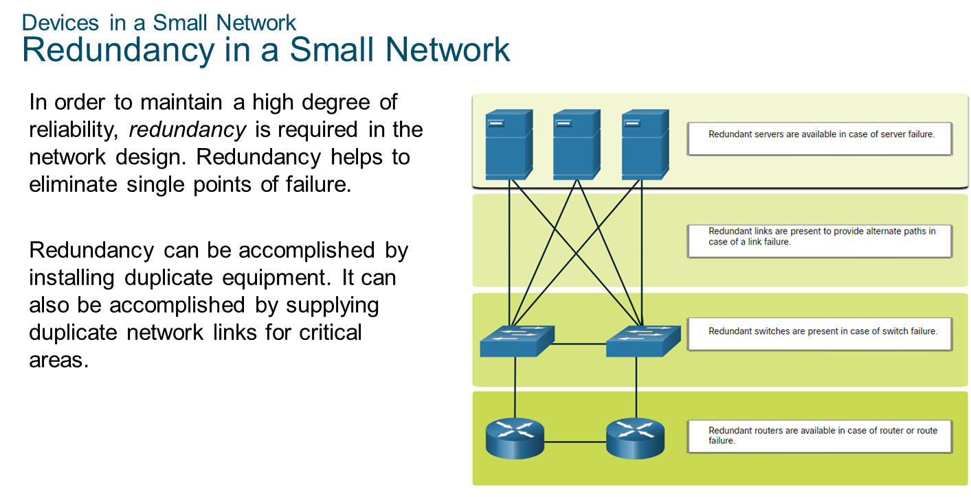
Chapter
Devices in a Small Network
10

Slide 7
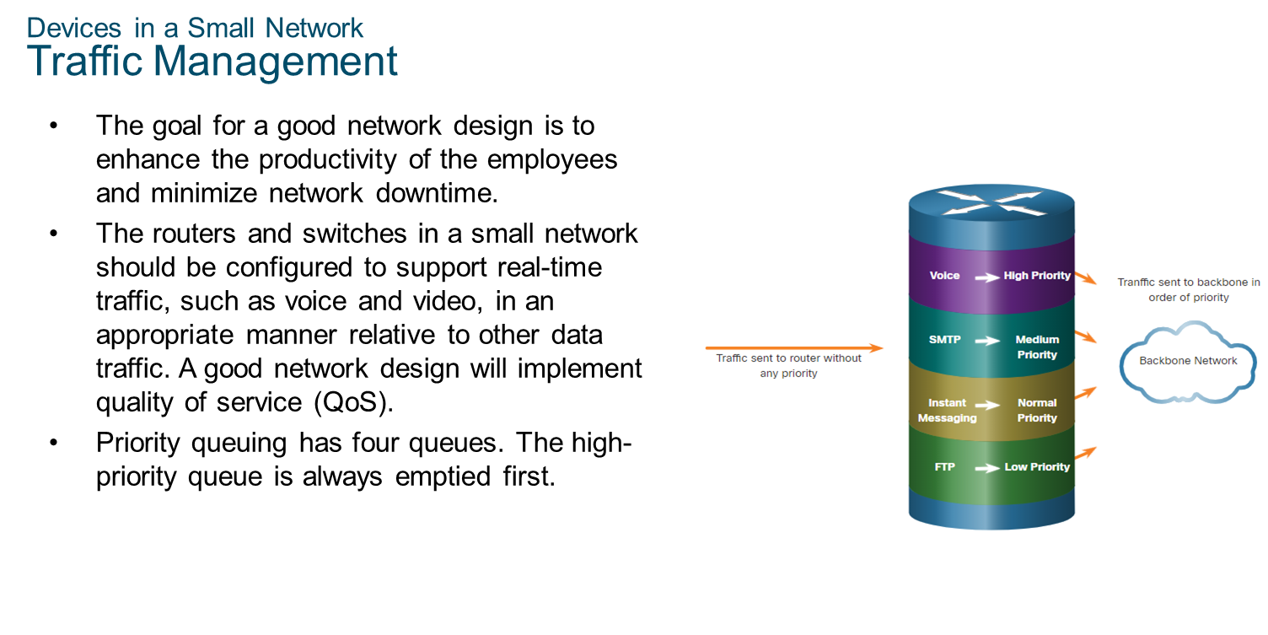
Chapter
Devices in a Small Network
10

Slide 8
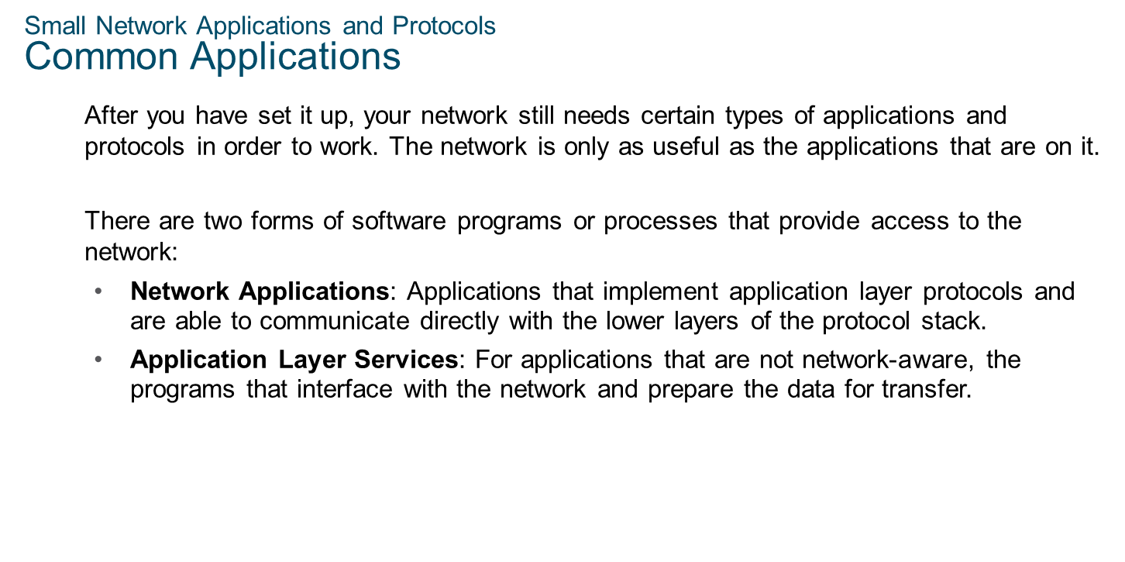
Chapter
Small Network Applications and Protocols
10

Slide 9
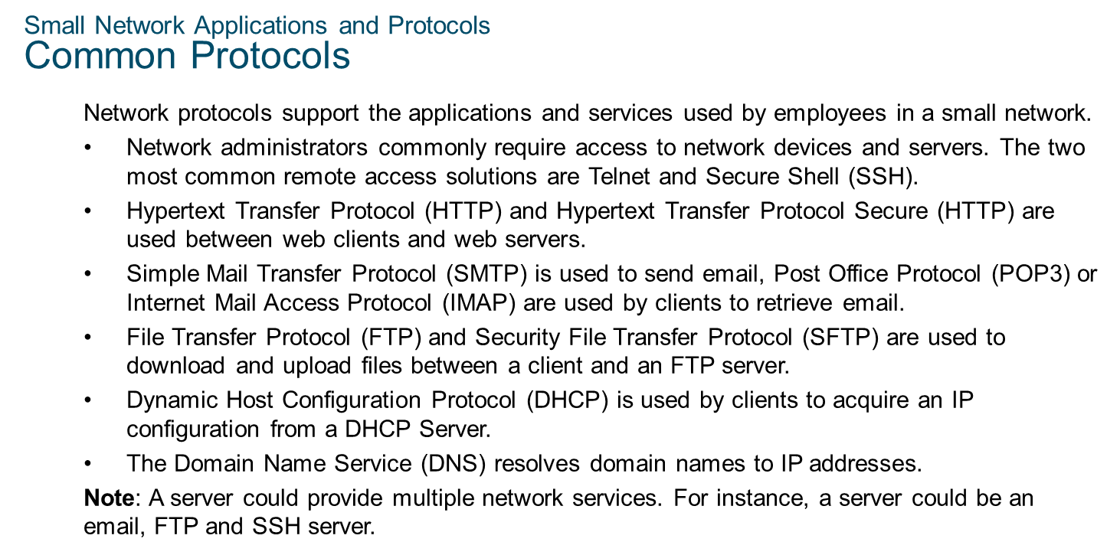
Chapter
Small Network Applications and Protocols
10

Slide 10
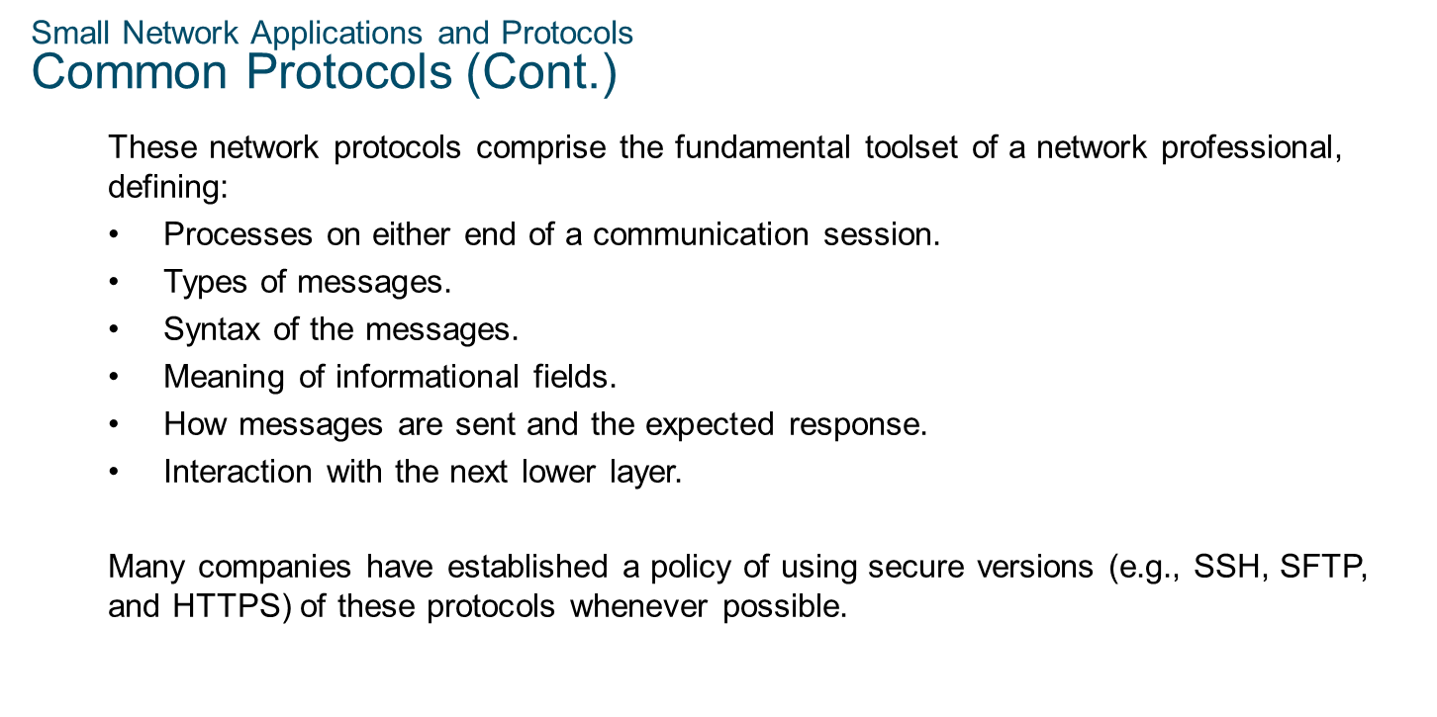
Chapter
Small Network Applications and Protocols
10

Slide 11
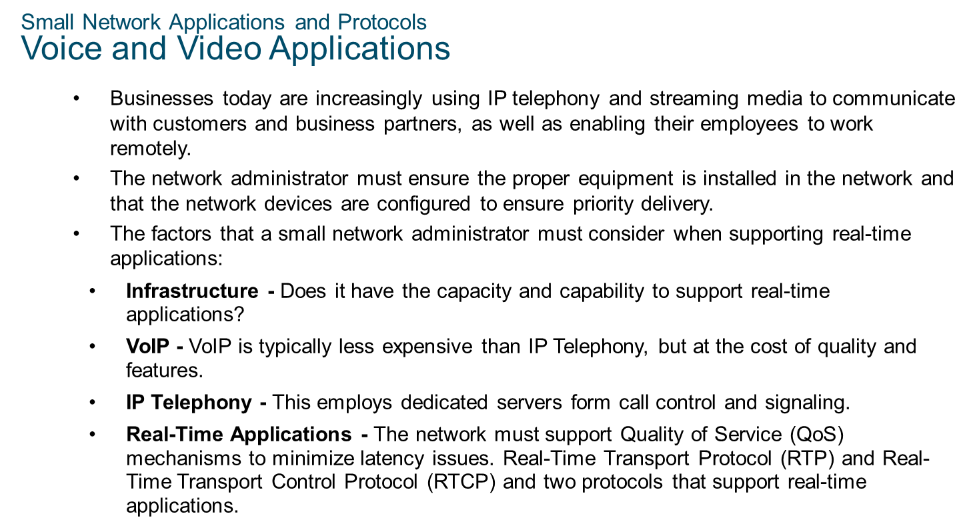
Chapter
Small Network Applications and Protocols
10

Slide 12
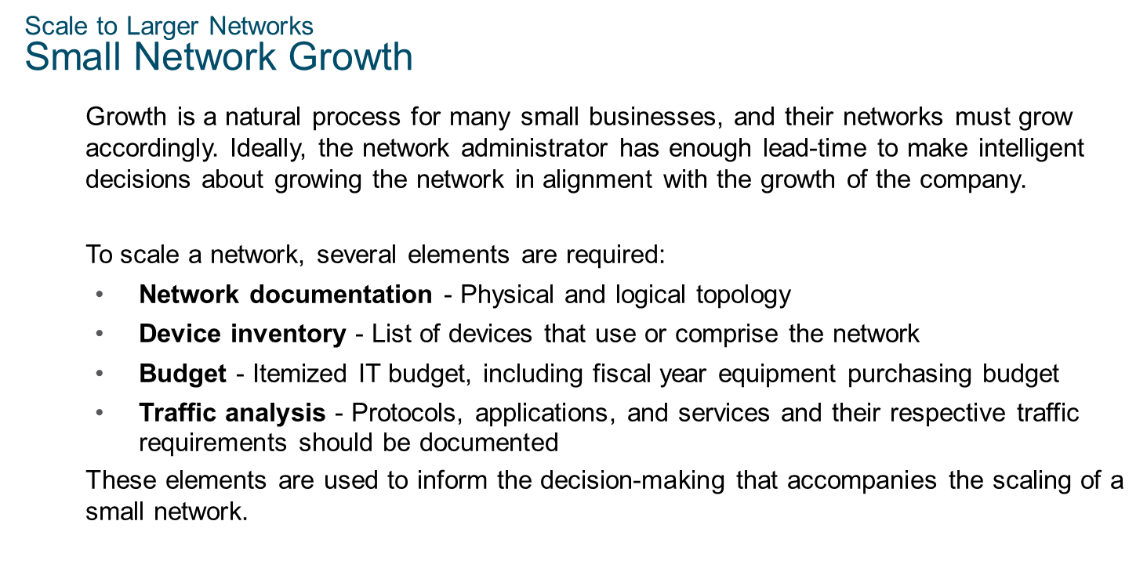
Chapter
Scale to Large Networks
10

Slide 13
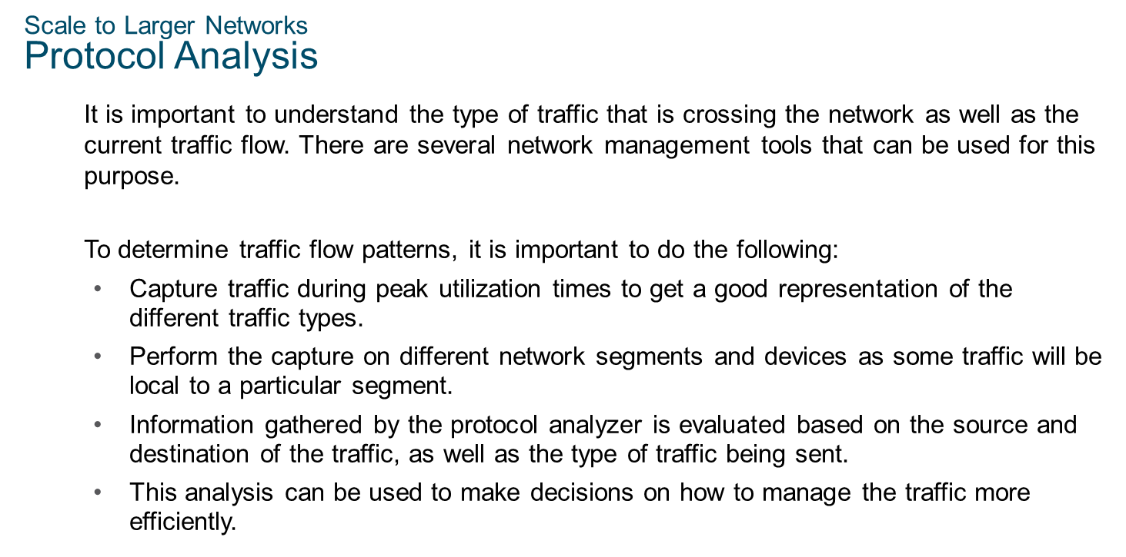
Chapter
Scale to Large Networks
10

Slide 14
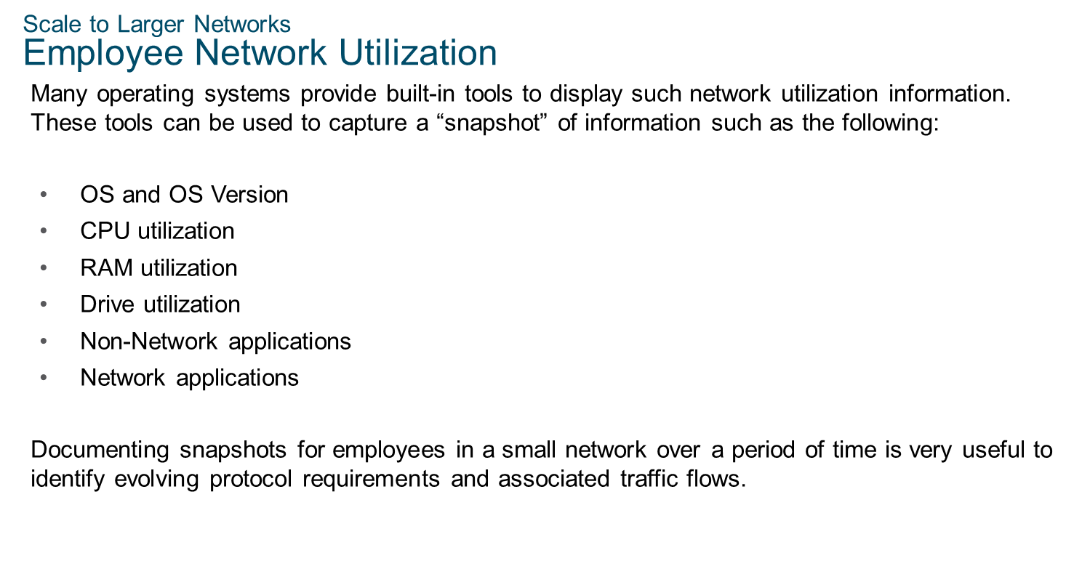
Chapter
Scale to Large Networks
10

Slide 15
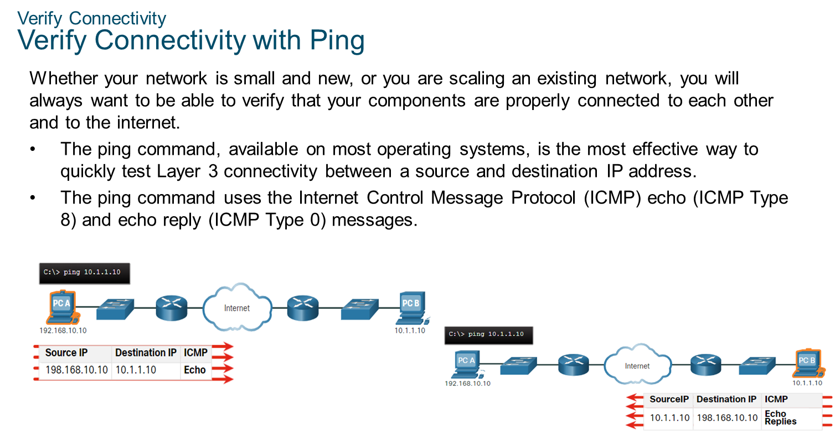
Chapter
10
Verify Connectivity

Slide 16
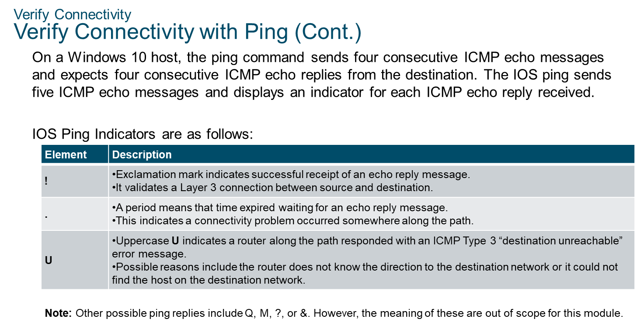
Chapter
10
Verify Connectivity

Slide 17
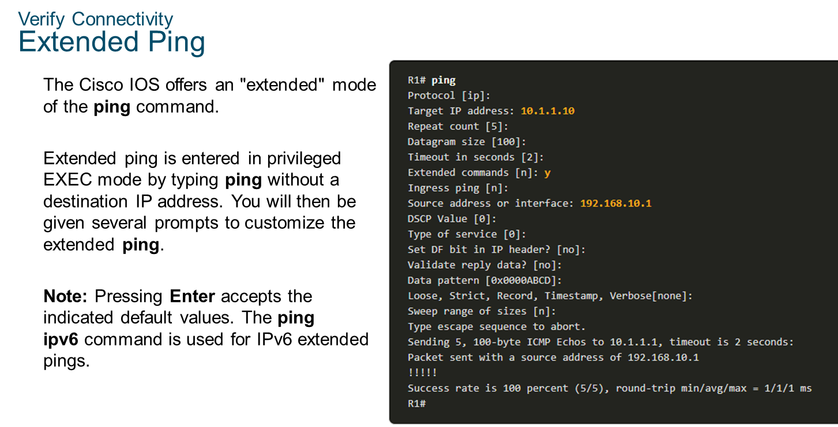
Chapter
10
Verify Connectivity

Slide 18
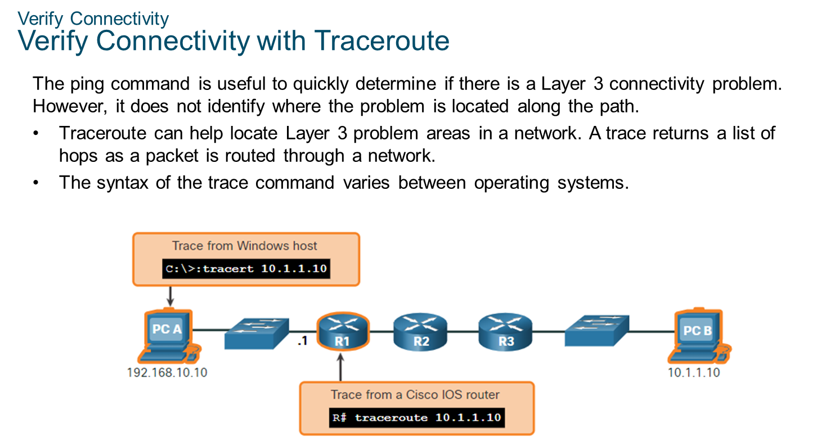
Chapter
10
Verify Connectivity

Slide 19
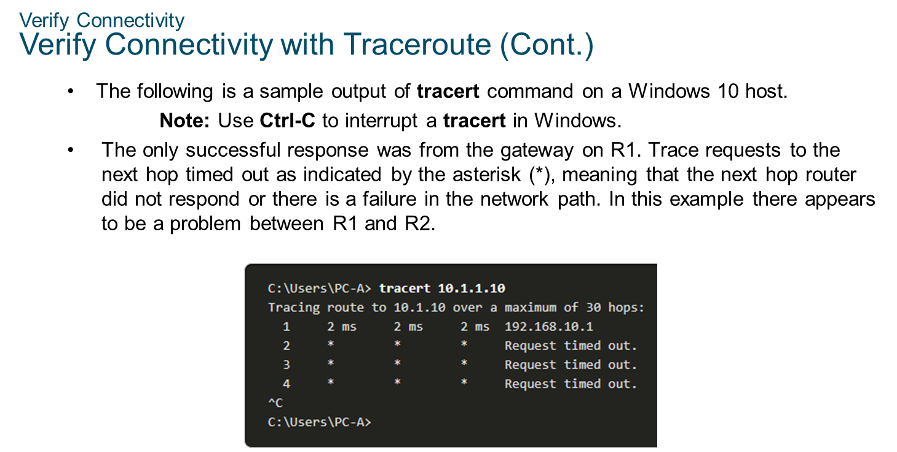
Chapter
10
Verify Connectivity

Slide 20
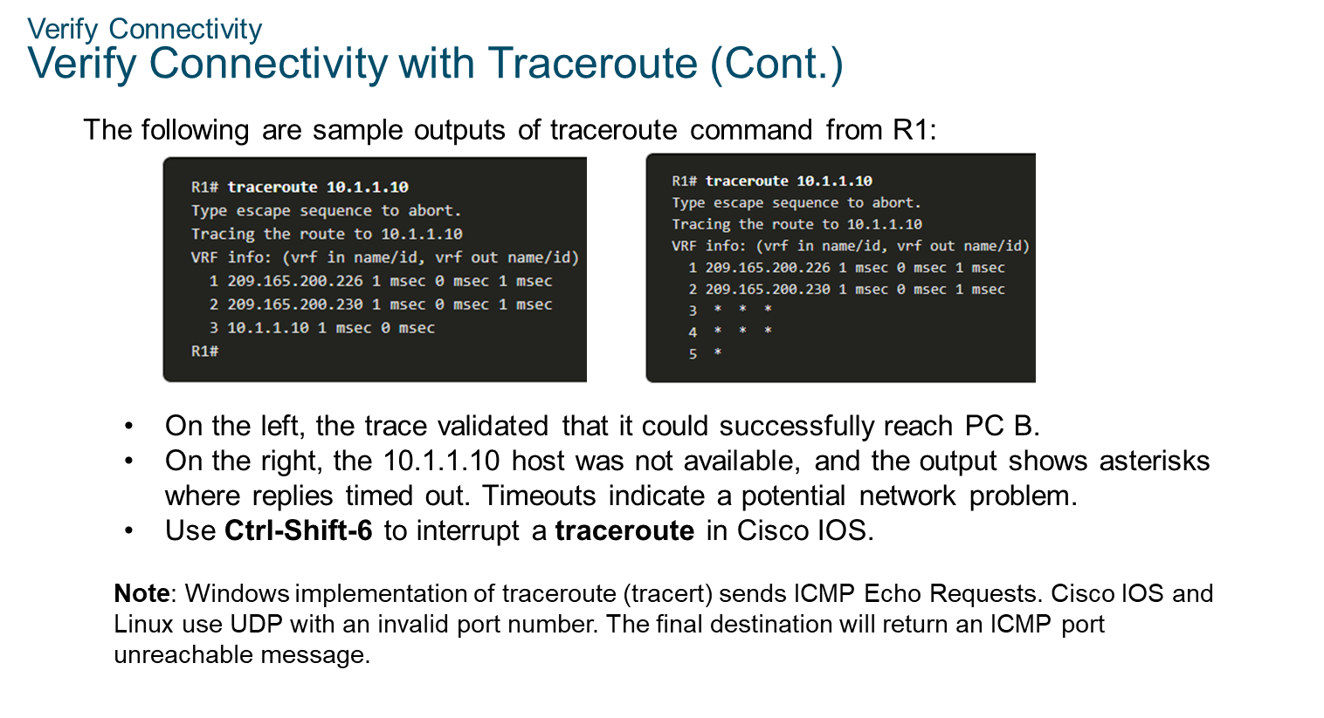
Chapter
10
Verify Connectivity

Slide 21
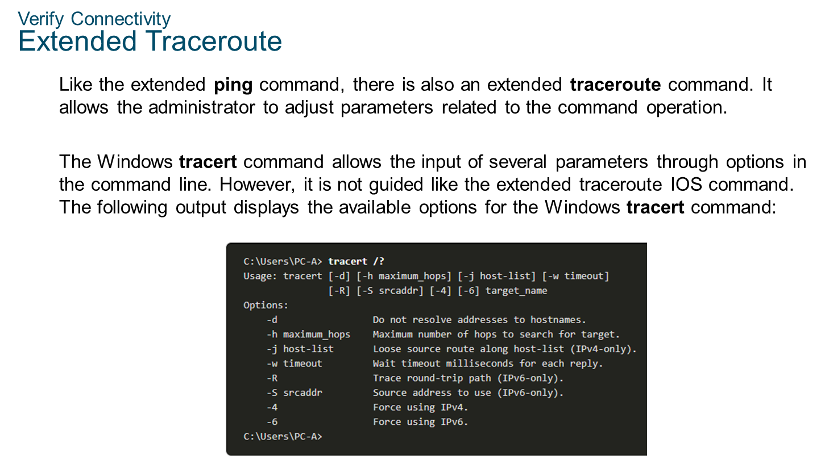
Chapter
10
Verify Connectivity

Slide 22
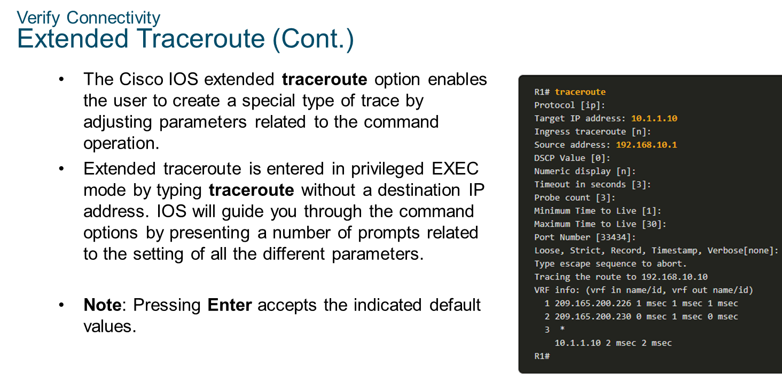
Chapter
10
Verify Connectivity

Slide 23
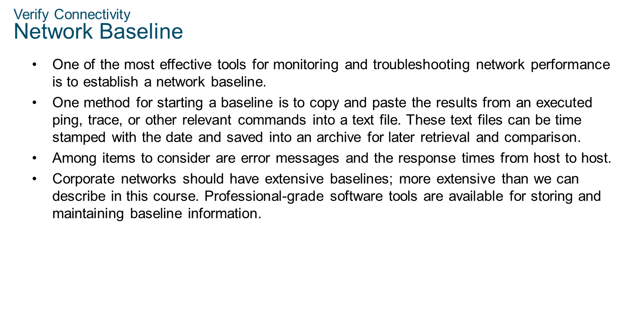
Chapter
10
Verify Connectivity

Slide 24
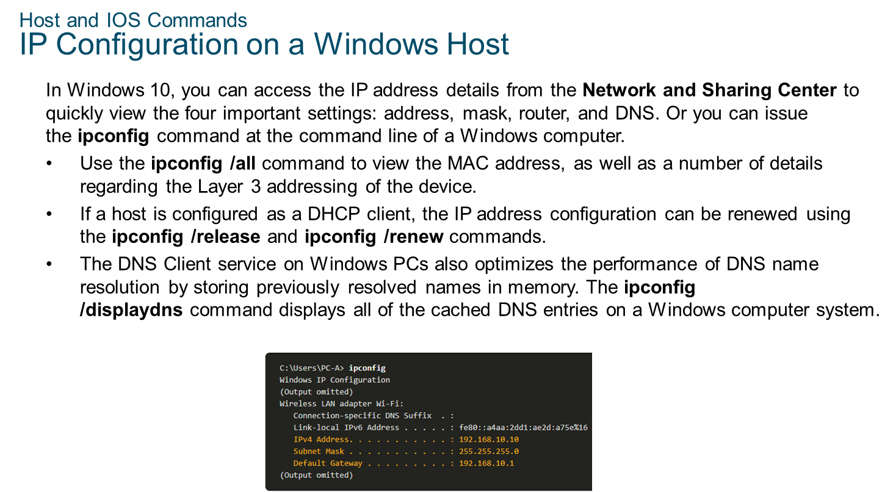
Chapter
10
Host and IOS Commands

Slide 25
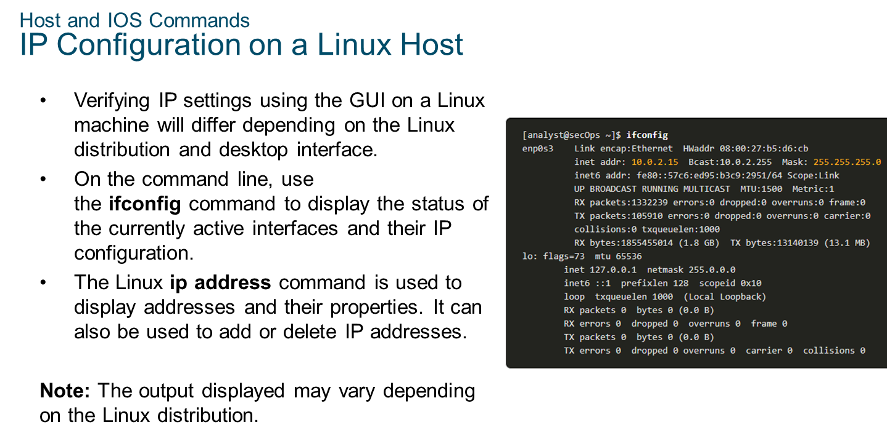
Chapter
10
Host and IOS Commands

Slide 26
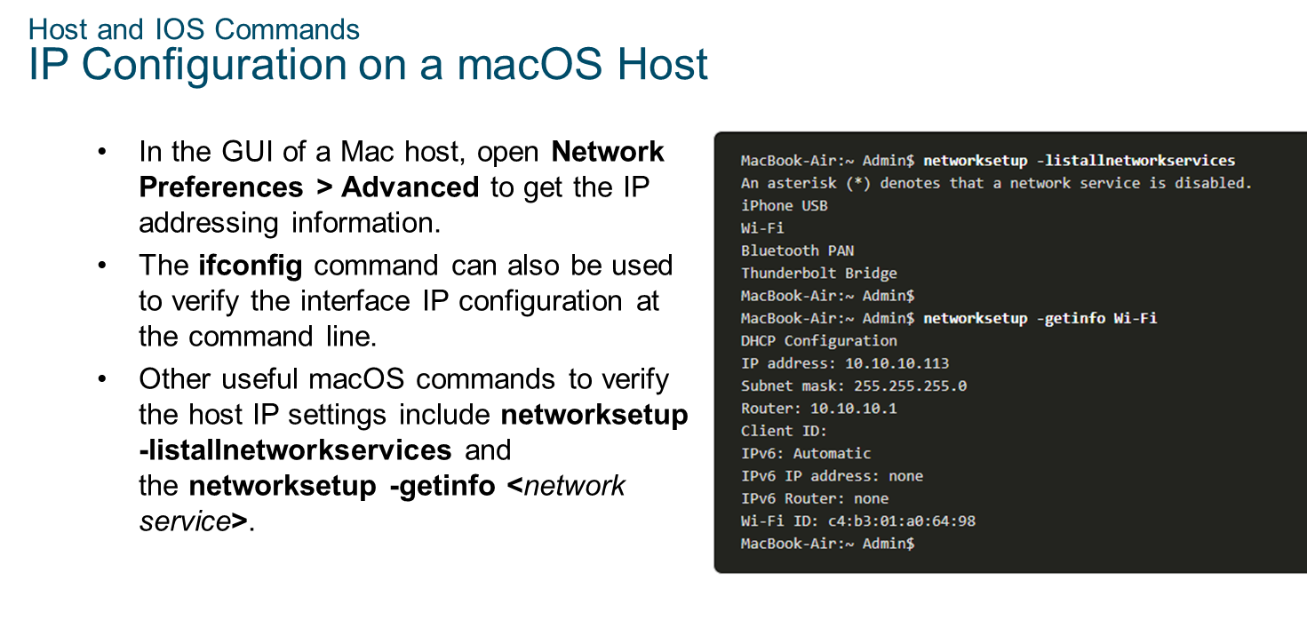
Chapter
10
Host and IOS Commands

Slide 27
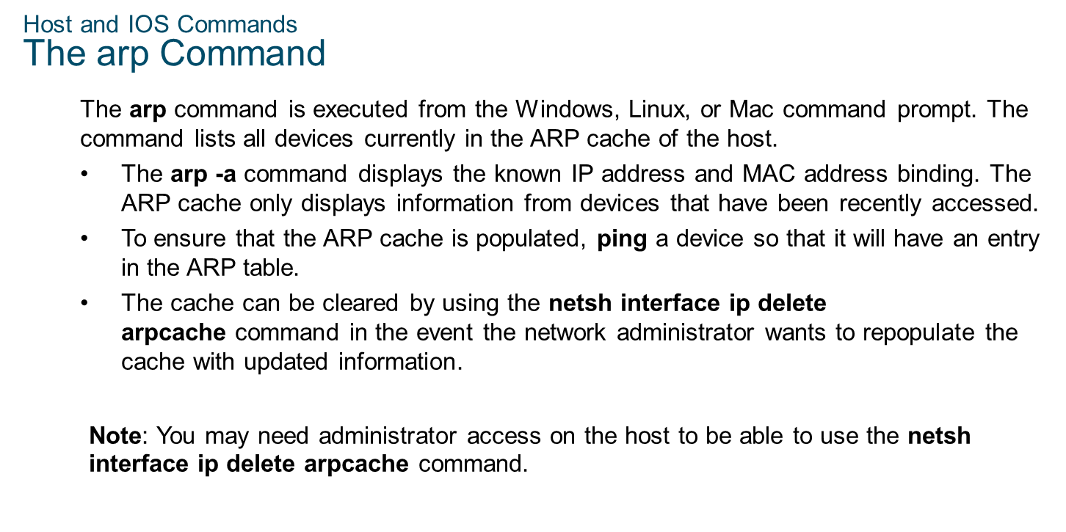
Chapter
10
Host and IOS Commands

Slide 28
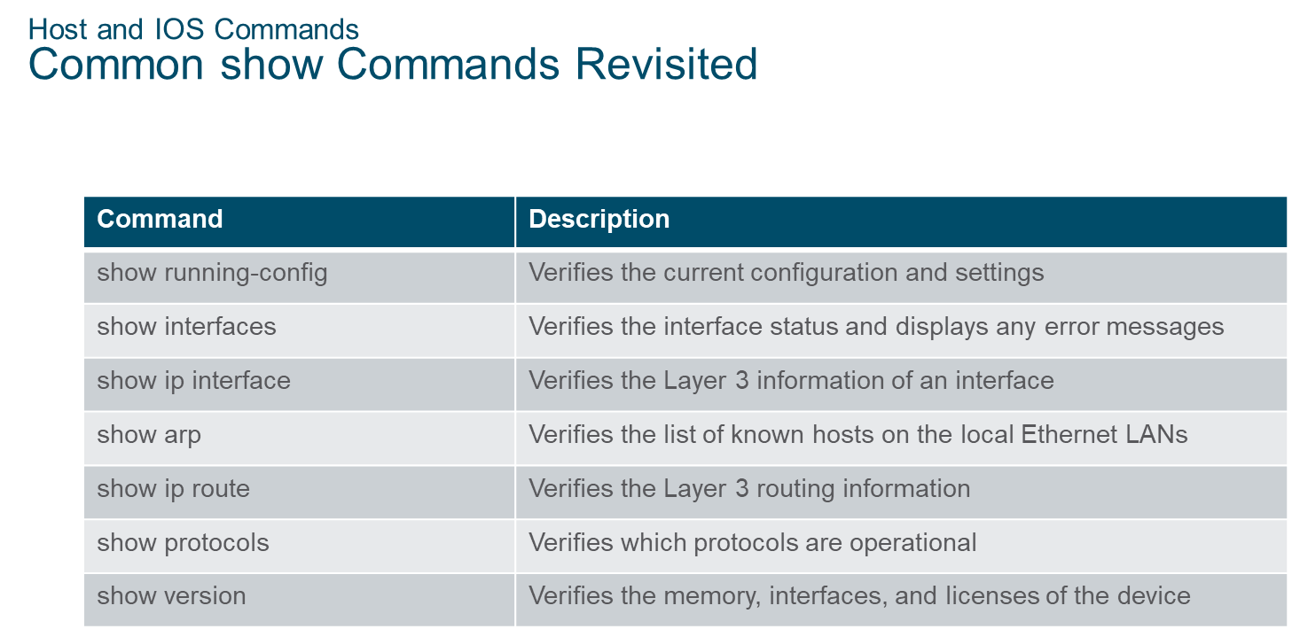
Chapter
10
Host and IOS Commands

Slide 29
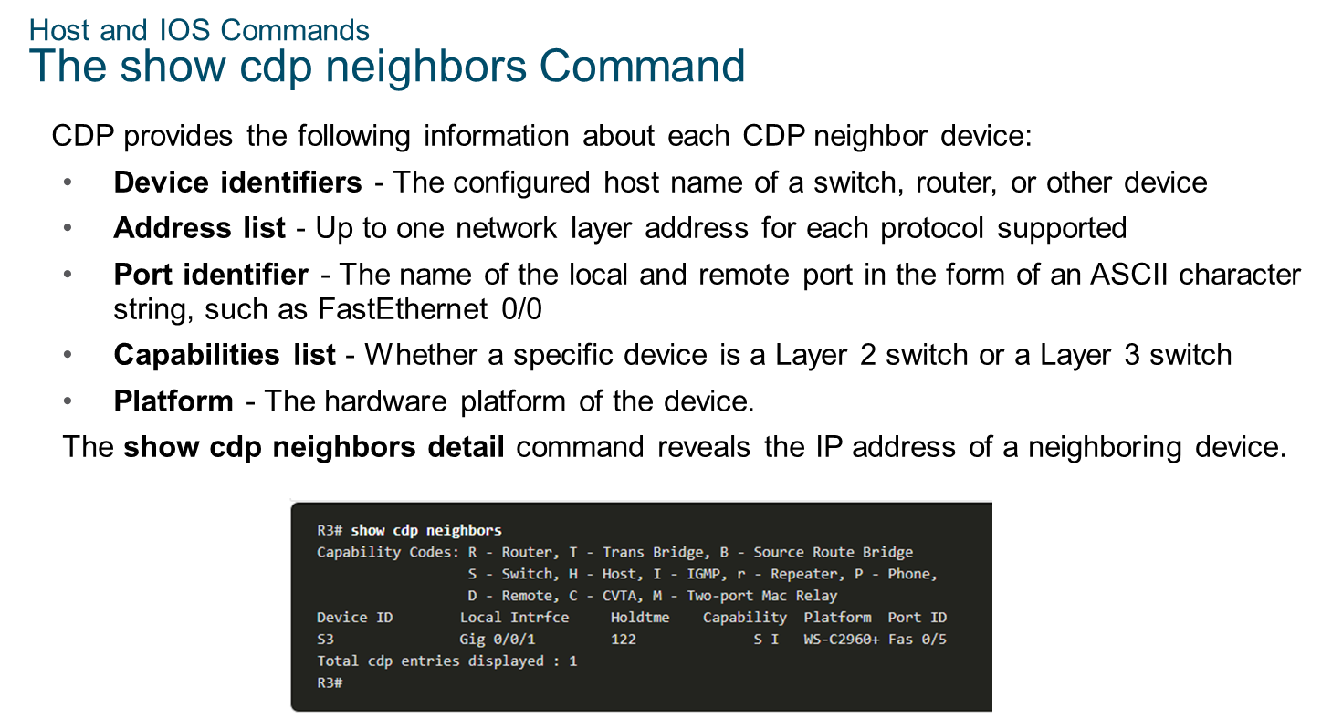
Chapter
10
Host and IOS Commands

Slide 30
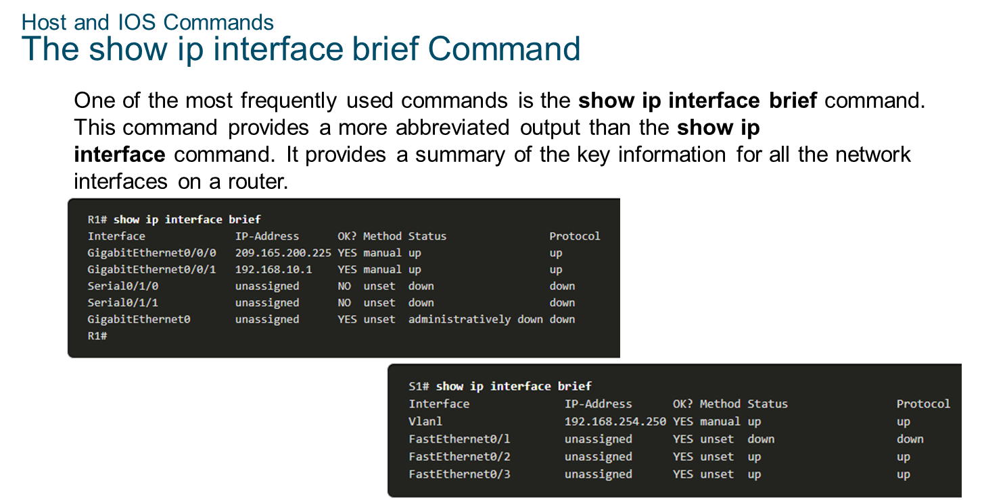
Chapter
10
Host and IOS Commands

Slide 31
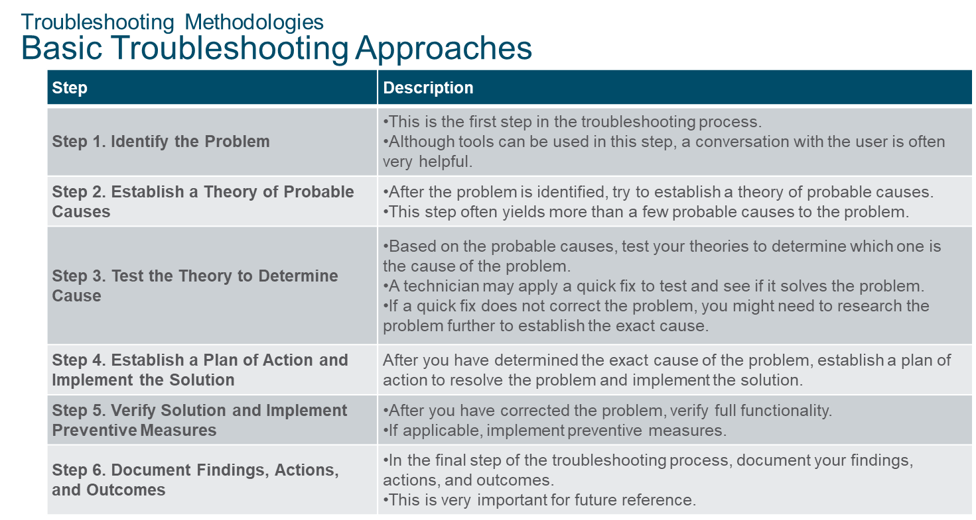
Chapter
10
Troubleshooting Methodologies

Slide 32
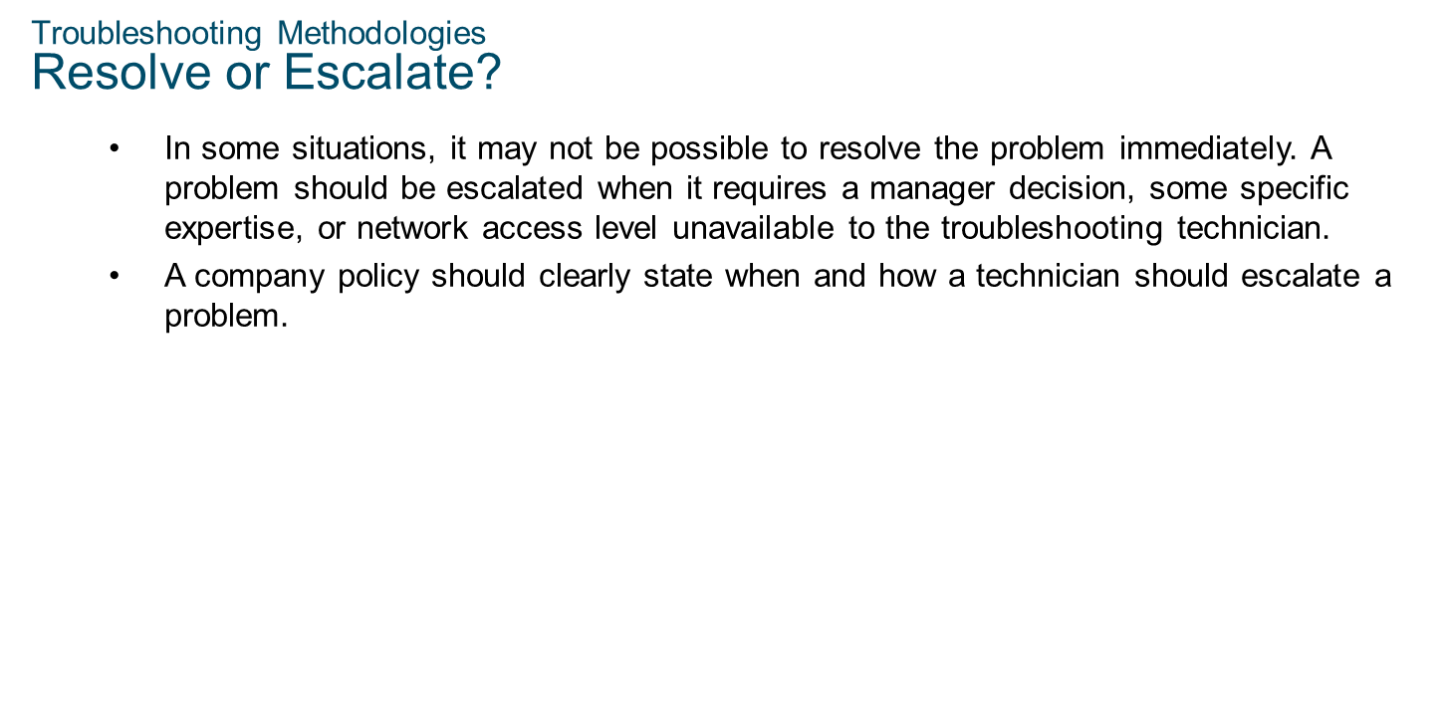
Chapter
10
Troubleshooting Methodologies

Slide 33
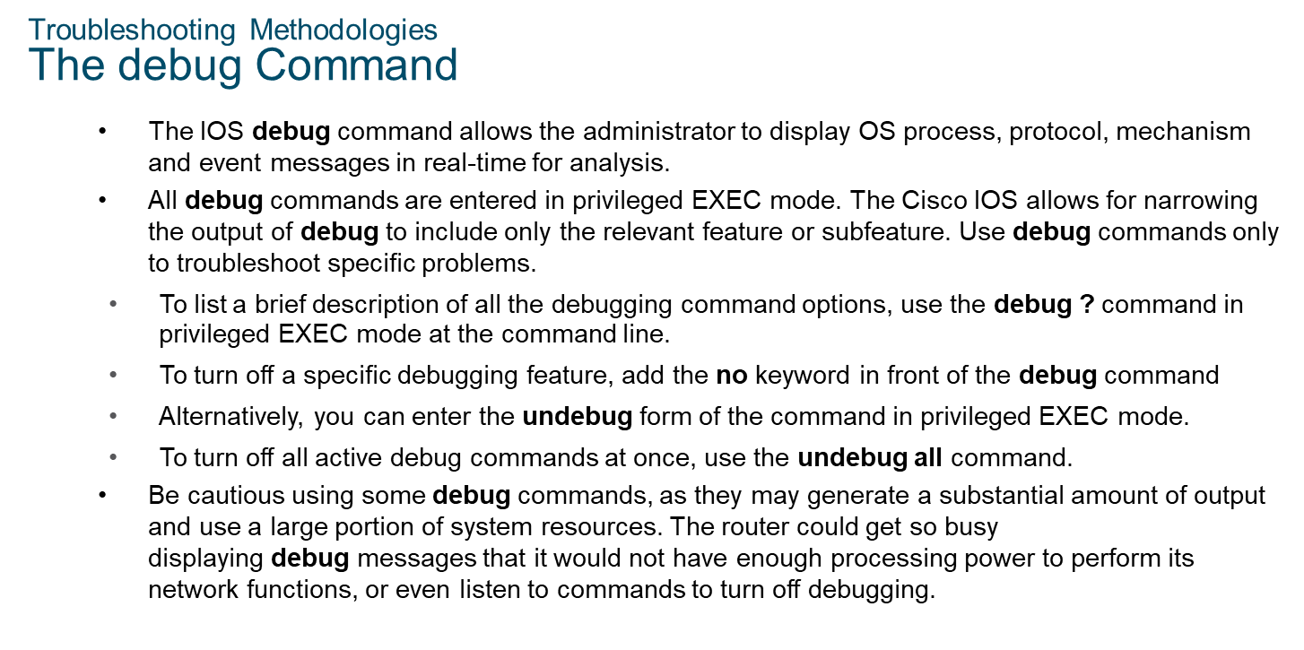
Chapter
10
Troubleshooting Methodologies

Slide 34
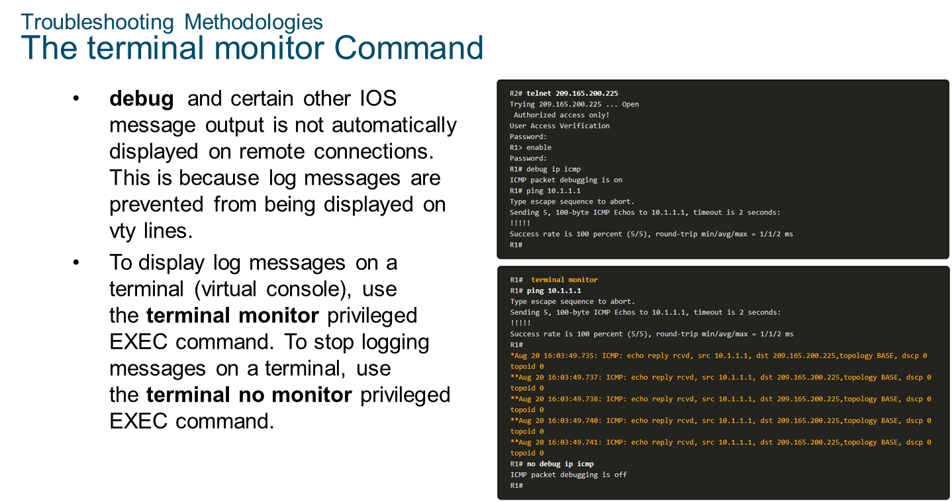
Chapter
10
Troubleshooting Methodologies

Slide 35
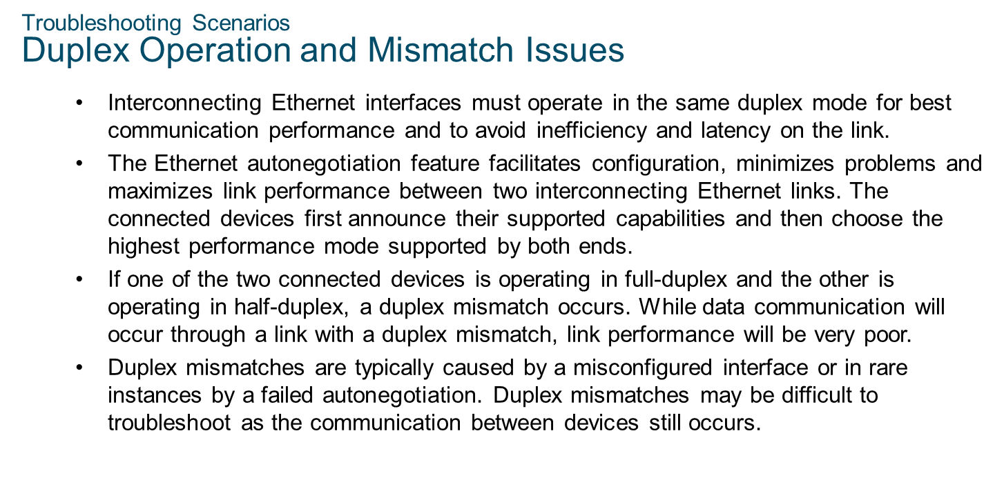
Chapter
10
Troubleshooting Scenarios

Slide 36
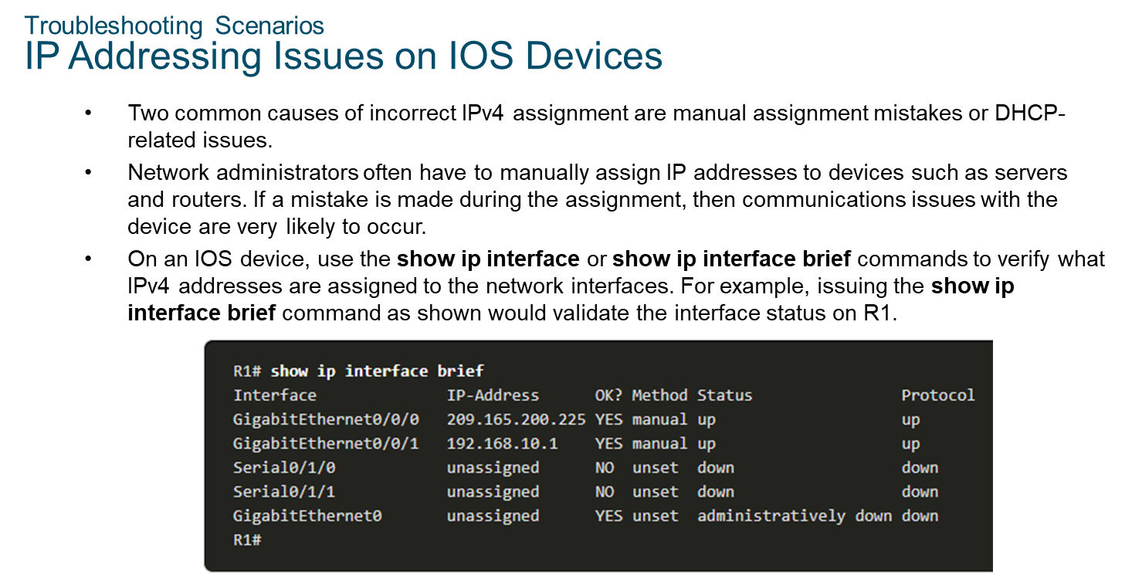
Chapter
10
Troubleshooting Scenarios

Slide 37
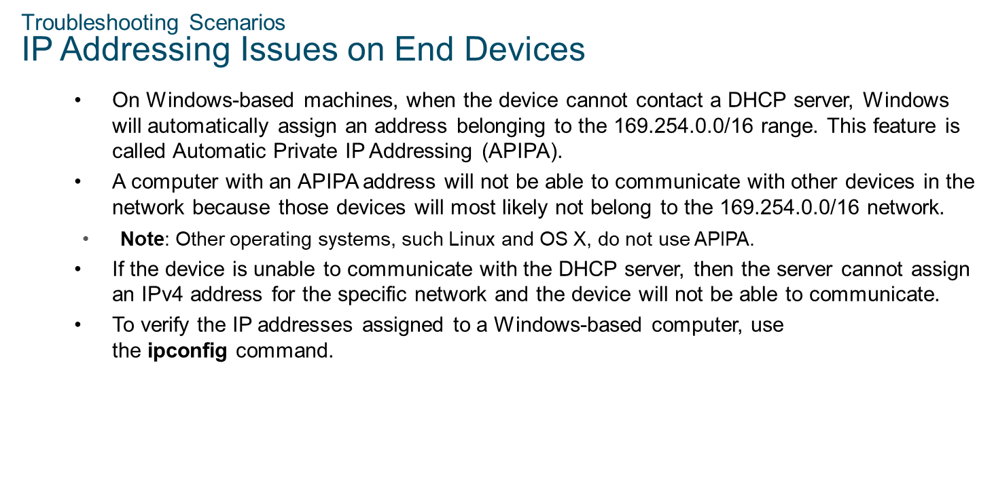
Chapter
10
Troubleshooting Scenarios

Slide 38
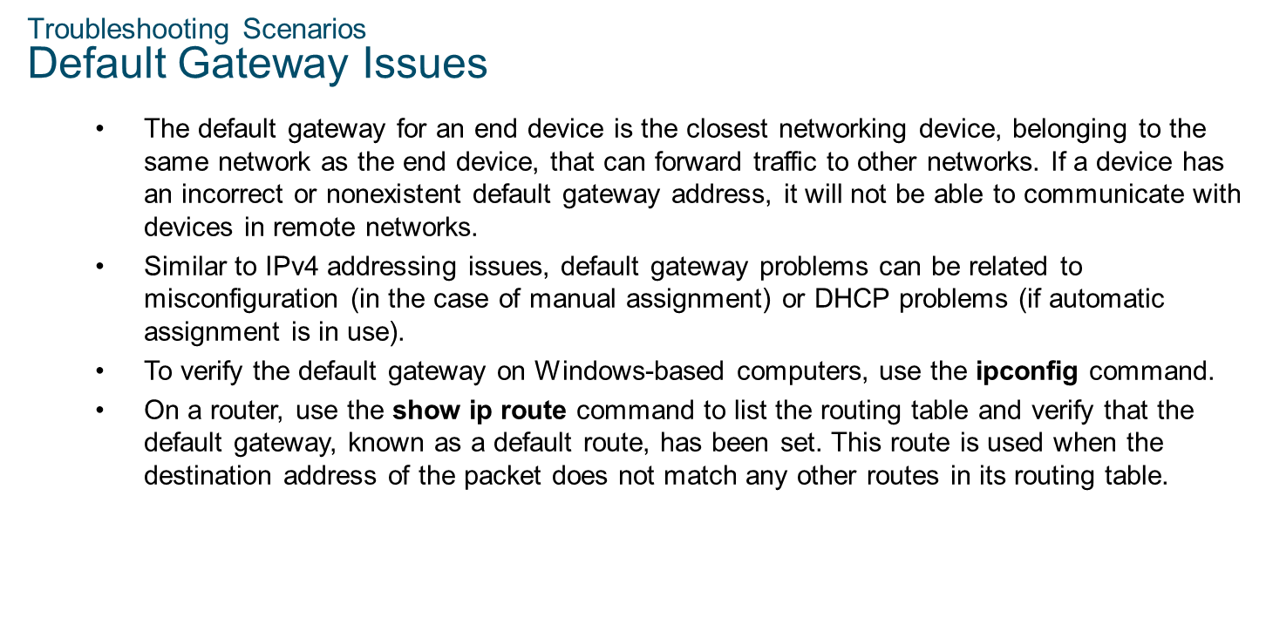
Chapter
10
Troubleshooting Scenarios

Slide 39
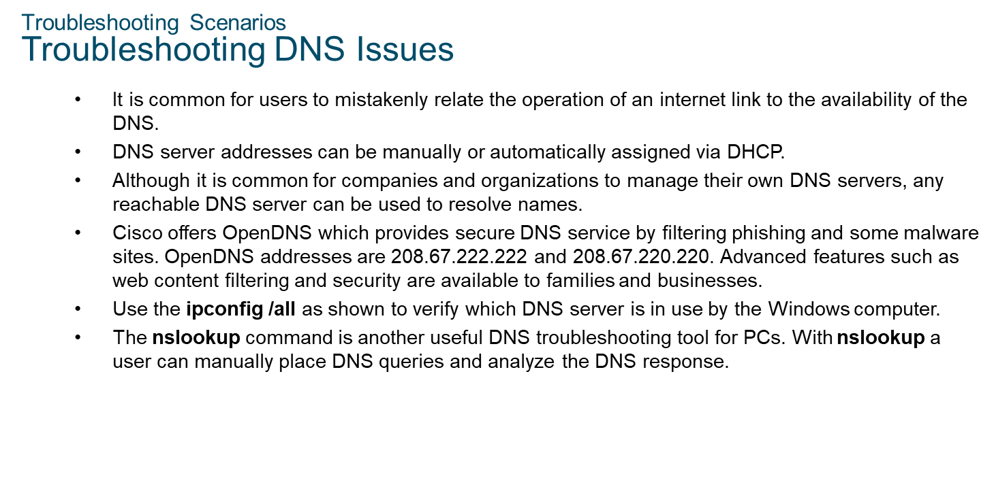
Chapter
10
Troubleshooting Scenarios

Slide 40



Thank You

