Slide 1






Entrepreneurship & Innovation
Prepared by Dr. Amany Ramadan
Lecture 1
ENT 511
Entrepreneurship & Innovation

Slide 2

Entrepreneurship
Lecture 1: Introduction
Notes:
2

Slide 3

Course Aims
Provide knowledge and understanding of entrepreneurship and entrepreneurial process
Present various models of entrepreneurship and enterprise activity, including intrapreneurship, social enterprise and corporate entrepreneurship
Provide understanding of the contribution of the small business sector and entrepreneurial ventures
Provide models of entrepreneurship in technology and growth sectors
Develop an appreciation of ethical issues (roles and responsibilities) associated with business enterprise
Notes:
3

Slide 4
Course Aims
Equip students with an experience of transferring knowledge into practice by simulating the business planning process
Develop core skills, applicable to entrepreneurship, such as team working, communication, initiative, creativity, analysis, problem identification and solving
Develop business skills applicable to entrepreneurship, eg, marketing, financial planning, presenting
Equip students for future ventures by providing hands-on experience of simulated entrepreneurship
Notes:
4

Slide 5
What is an entrepreneur?
Notes:
5
Refer to chapter 1 of Burns book.

Slide 6
Entrepreneurs
Entrepreneur is derived from the French word entreprendre, meaning “to undertake”.
Entrepreneurs use innovation to exploit or create change and opportunity for the purpose of making profit. They do this by shifting economic resources from an area of lower to an area of higher productivity, accepting a high degree of risk and uncertainty in doing so.
Notes:
6

Slide 7



What is an Entrepreneur?
One who creates a new business in the face of risk and uncertainty for the purpose of achieving profit and growth by identifying opportunities and assembling the necessary resources to capitalize on them.
Ch. 1: The Foundations of Entrepreneurship

Slide 8

The World of the Entrepreneur
Global Entrepreneurship Monitor (GEM) study reports:
  Men are twice as likely to start a business as women.
  Most entrepreneurs turn to family members and friends for capital.
  Entrepreneurs are most likely to launch businesses when they are
  between the ages of 25 and 44.
Ch. 1: The Foundations of Entrepreneurship

Slide 9
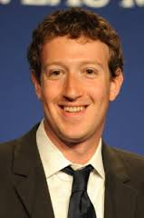


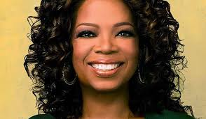
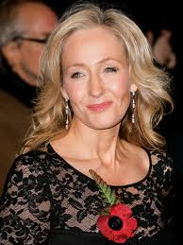

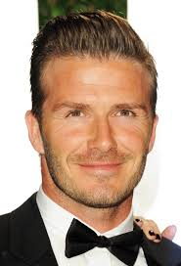

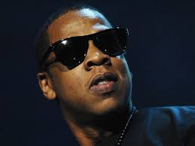
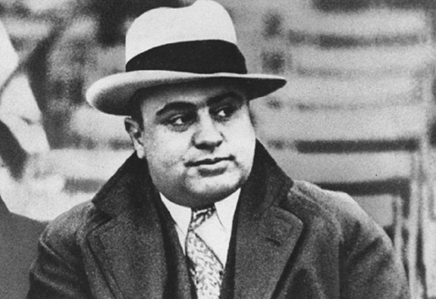
Who one is the odd one out?
Notes:
9

Slide 10
Characteristics of Entrepreneurs
Desire for responsibility
Risk Taker (solid business plan- calculated)
Confidence in their ability to succeed
Desire for immediate feedback
High level of energy(hard work-long hours-proactive)
Future orientation
Skilled at organizing(management skills)
Value achievement over money
Commitment & flexibility (changes in demand & business)

Slide 11
Economic Theories of Entrepreneurship
Capitalist – Adam Smith, 1776, David Ricardo, 1871
Technological Knowledge – Jeremy Bentham, 1838
Risk Taker –Richard Cantillion, 1755
Risk Taker & Innovator – Von Thunen, 1850
Economic Change – Carl Menger, 1871
Capitalist – Amasa Walker, 1866, Francis A. Walker, 1887
Novel Resource Combination – Alfred Marshall, 1920
Risk Taker & Uncertainty Avoidance – Frank Knight, 1921
Innovator – Joseph Schumpeter, 1952
Alertness – Isreal Kirzner, 1973
Notes:
11
An idea of the different schools of though surrounding entrepreneurship.

Slide 12
Evolving Entrepreneurs
Date | Author | Concept
1755 | Cantillon | Introduced the concept of entrepreneurs from entreprendre (‘ability to take charge')
1803, 1817 | Say | Emphasised the ability of the entrepreneur to 'marshal’ resources in order to respond to unfulfilled opportunities
1871 | Menger | Noted the ability of entrepreneurs to distinguish between 'economic goods' - those with a market or exchange value - and all others
1893 | Ely and Hess | Attributed to entrepreneurs the ability to take integrated action in the enterprise as a whole, combining roles in capital, labour, enterprise and entrepreneur
1911, 1928 | Schumpeter | Envisioned that entrepreneurs proactively 'created' opportunity using 'innovative combinations' which often included 'creative destruction' of passive or lethargic economic markets
1921 | Knight | Suggested that entrepreneurs were concerned with 'efficiency' in economic factors by continually reducing waste, increasing savings and thereby creating value, implicitly understanding the opportunity-risk-award relationship
1948, 1952, 1967 | Hayek | Continued the Austrian tradition of analytical entrepreneurs giving them capabilities of discovery and action, recognising the existence of information asymmetry which they could exploit
19373, 1979, 1997, 1999 | Kirzner | Attributed to entrepreneurs a sense of 'alertness' to identify opportunities and exploit them accordingly
1974 | Drucker | Attributed to entrepreneurs the capacity to 'foresee' market trends and make a timely response
1975, 1984, 1985 | Shapero | Attributed to 'judgement' ability to entrepreneurs to identify 'credible opportunities' depending on two critical antecedents - perceptions of 'desirability' and feasibility' from both personal and social viewpoints
Notes:
12

Slide 13
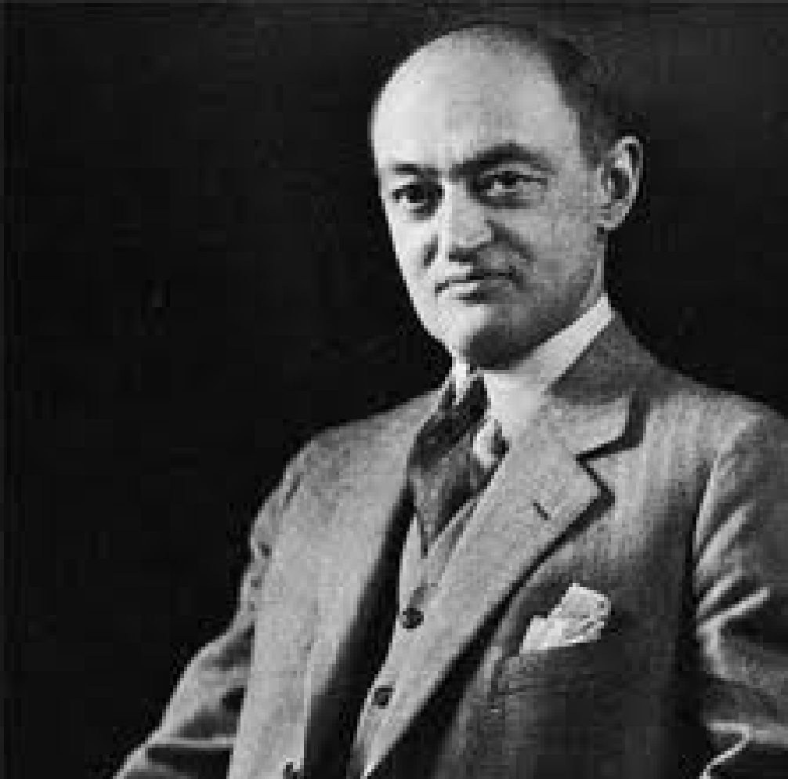
Schumpeter
Schumpeter’s entrepreneur is an innovator.
The entrepreneur brings change through the introduction of new technological processes or products.
The person who destroys the existing economic order by introducing new products and services, by creating new forms of organisation, or by exploiting new raw materials.
Creative destruction.
Notes:
13

Slide 14
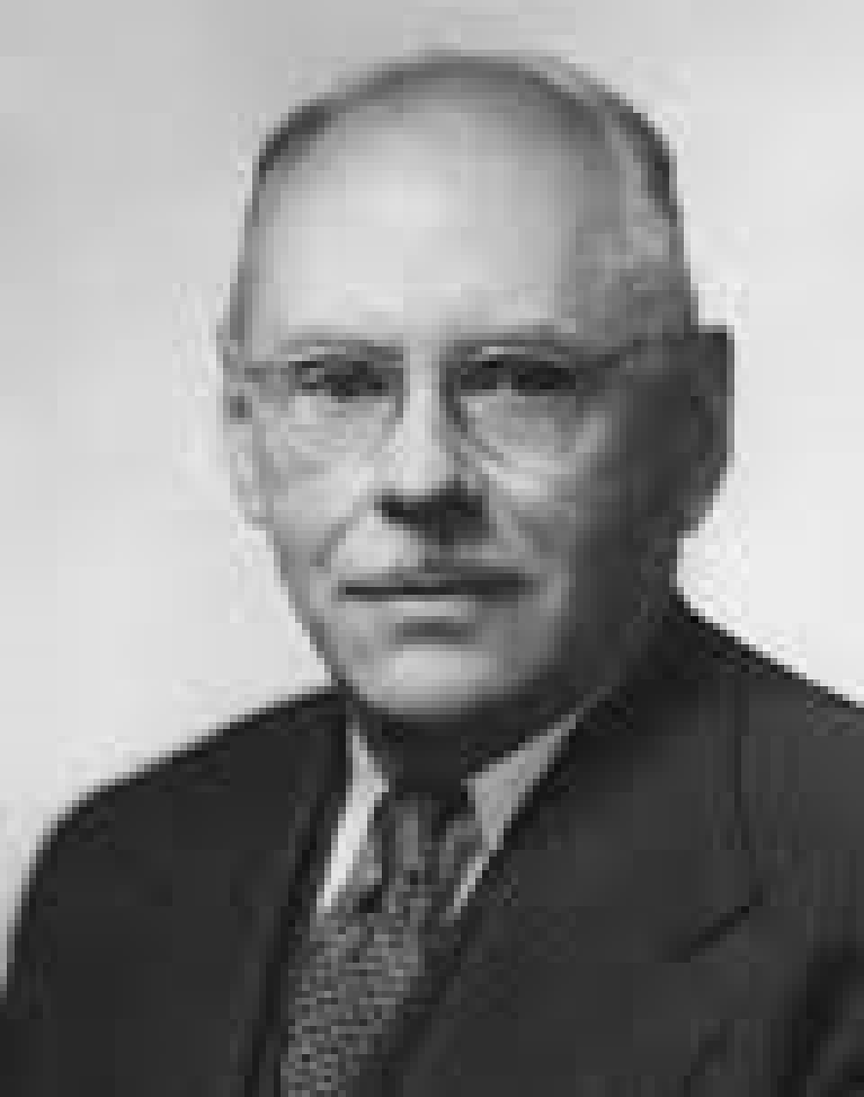
Knight
•Calculated risk-taker
The opportunity for profit arises out of uncertainty and risk
The entrepreneur is an individual who is prepared to undertake risk and the reward - profit
Responsibility for one's own actions
Notes:
14

Slide 15
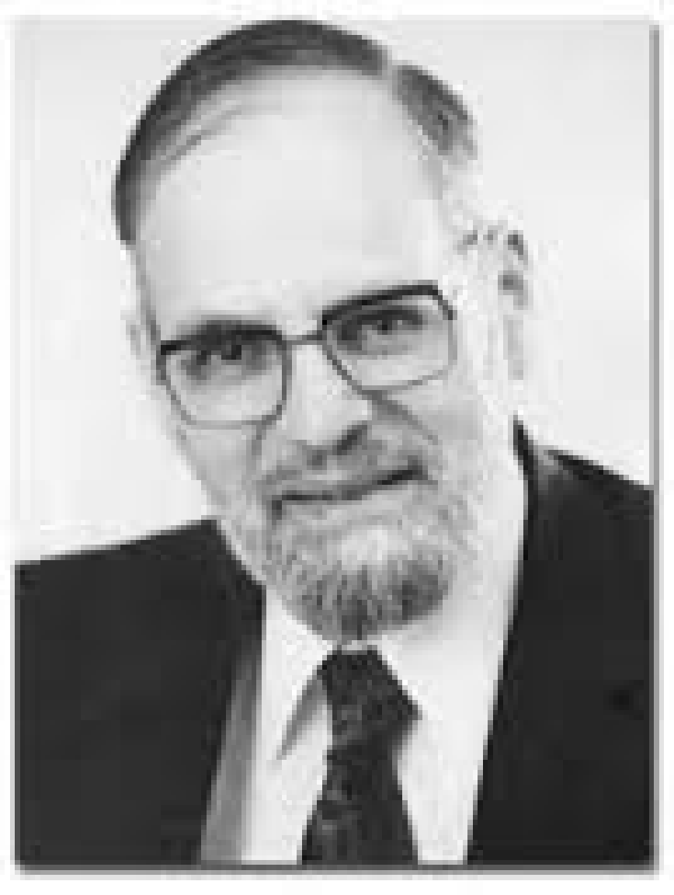
Kirzner
Entrepreneur is alert to profitable opportunities for exchange
Entrepreneur is the middle-man who facilitates exchange
Entrepreneur has additional knowledge to exploit to take advantage of profitable opportunities
Notes:
15

Slide 16
Opportunity Entrepreneurs Vs. Necessity Entrepreneurs
Opportunity Entrepreneurs, those who start businesses because they spot an opportunity in the marketplace
Necessity Entrepreneurs, those who start businesses because they cannot find work any other way.

Slide 17
Serial Entrepreneurs
Serial Entrepreneurs, those who repeatedly start businesses and grow them to a sustainable size before striking out again.
The majority of serial entrepreneurs are Leapfroggers, people who start a company, manage its growth until they get bored, and then sell it to start another.

Slide 18
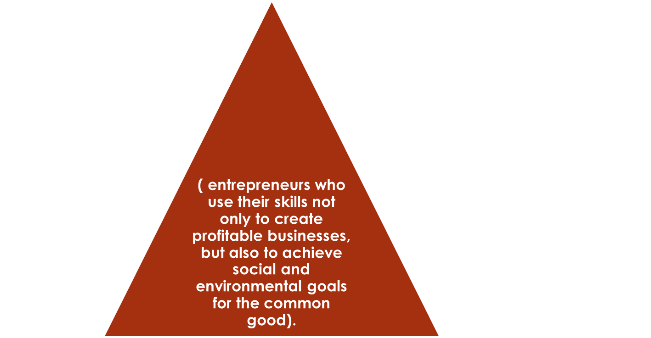

Social entrepreneurs

Slide 19
Understanding Entrepreneurship
Author | Definition
Drucker (1985) | Entrepreneurship is an act of innovation that involves endowing existing resources with new wealth-producing capacity.
Stevenson et al. (1989) | Entrepreneurship is the pursuit of an opportunity without concern for current resources or capabilities.
Low and Macmillan (1988) | Entrepreneurship is the creation of new enterprises.
Timmons (1997) | Entrepreneurship is a way of thinking, reasoning and acting that is opportunity obsessed, holistic in approach, and leadership balanced.
Venkataraman (1997) | Entrepreneurship research seeks to understand how opportunities to bring into existence future goods and services are discovered, created and exploited, by and whom, and with what consequences.
Notes:
19

Slide 20
…Entrepreneurship
“An activity that involves discovery, evaluation and exploitation of opportunities to introduce new goods and services, and organize new markets, processes and raw materials through coordinating efforts of the entrepreneur that previously did not exist” (Shane, 2003: 4)
And he adds…
He adds that entrepreneurship “involves the nexus of entrepreneurial opportunities and enterprising individuals … where a situation in which a person can create a new means-ends framework for recombining resources that the entrepreneur will yield a profit” (Shane, 2003: 18).
Notes:
20

Slide 21

Benefits of Entrepreneurship
The opportunity to:
Create your own destiny
Make a difference
Reach your full potential
Reap impressive profits
Contribute to society and to
be recognized for your efforts
Do what you enjoy and to have fun at it

Slide 22

Drawbacks of Entrepreneurship
Uncertainty of income
Risk of losing your entire investment
Long hours and hard work
Lower quality of life until the business gets established
High levels of stress
Complete responsibility

Slide 23
Deadly Mistakes of Entrepreneurship
Management mistakes
Lack of experience
Poor financial control
Weak marketing efforts
Failure to develop a strategic plan
Poor location
Incorrect pricing

Slide 24
Avoiding the Pitfalls of Small Business Failure
Know your business in depth
Develop a solid business plan
Manage financial resources
Learn to manage people effectively
Set your business apart from the competition
Maintain a positive attitude

Slide 25


Feeding the Entrepreneurial Fire
Entrepreneurs as heroes
Entrepreneurial education
Demographic and economic factors
Technology advancements
Independent lifestyles
E-commerce and the Internet
International opportunities

Slide 26
Three Types of Entrepreneurship
Productive entrepreneurship is innovation leading to wealth creation and economic development which advances not only the individual but wider society. Pursue a business opportunity within prevailing institutions.
Unproductive entrepreneurship is some form of bureaucracy that typically benefits an individual but not necessarily society. Create contracts to overcome institutional shortcomings e.g. lobbying; help others avoid taxes.
Destructive entrepreneurship also benefits the individual more than society.
Baumol, W.J. (1990) Entrepreneurship: Productive, Unproductive and Destructive. Journal of Political Economy, 98(5), 893-921.
Notes:
26

Slide 27


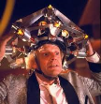







The Myths of Entrepreneurship
Myth 1: Entrepreneurs are doers, not thinkers
Myth 2: Entrepreneurs are born, not made
Myth 3: Entrepreneurs are always inventors
Myth 4: Entrepreneurs are academic and social misfits
Myth 5: Entrepreneurs must fit the profile
Myth 6: All entrepreneurs need is money
Myth 7: All entrepreneurs need is luck
Myth 8: Entrepreneurship is unstructured and chaotic
Myth 9: Most entrepreneurial initiatives fail
Myth 10: Entrepreneurs are extreme risk takers
Notes:
27

Slide 28
Why is Entrepreneurship so Important?
Important contributions to industrial markets:
Entrepreneurs play an important role in the change of technology;
Entrepreneurs create an additional sense of competition whilst also, providing a mechanism for regeneration;
Entrepreneurs contribute to international competition via niche markets and;
Entrepreneurs influence in creating jobs.
Notes:
28

Slide 29
What explains this recent growth in entrepreneurship??
Structural shift from manufacturing (large firm dominated) to services (small firm dominated)
Growth in personal, flexible, tailor-made services
Restructuring by large firms – focus on core activities, sub-contract non-core activities
Technological change
  Scientific discoveries exploited by small firms
  Production and IT technologies have reduced the role of economies of scale
Low cost and access to communications technology (‘the great equaliser’): access to information, distribution (‘the long tail’)
Notes:
29

Slide 30
What explains this recent growth in entrepreneurship??
Importance of human capital rather than financial capital as the basis for competitiveness
Consumer choice – reaction against mass produced products and services: individualism, demand for authenticity, natural products (e.g. real ale beer) – growth in market niches
Deregulation of markets: e.g. in airlines, telecoms, media
Personal choice – ‘rebellion’, reaction against working in large impersonal organisations, want to control own destiny
Availability of finance – venture capital
Availability of support, advice and education

Slide 31
Reading
Bygrave, W.D. (1989) The entrepreneurship paradigm (1): a philosophical look at its research methodologies, Entrepreneurship Theory and Practice, 14(1), 1-26.
Notes:
31

Slide 32
Core Reading Text
Recommended reading list and journals are compulsory
Arshed, N. and Danson, M. (2016). Enterprise: Concepts and Issues. Goodfellows, UK.
Burns, P. (2011) Entrepreneurship and Small Business (3rd ed). UK, Palgrave Macmillan.
Notes:
32

Slide 33





International Organizations
المؤسسات الداعمة

Slide 34






Government
المؤسسات الداعمة

Slide 35
What is the Startup Businesses
A startup is a newly emerged business venture that aims to develop a viable business model to meet a marketplace need or problem.

Slide 36
Business Incubators
Nurture young firms and help them to survive and grow during the startup period.
Ch. 1: The Foundations of Entrepreneurship

Slide 37
El Menus
For food lovers out there, Elmenus made everybody’s life easier. Elmenus is a food discovery platform with over 3000 Restaurant menus and 300.000 dishes to help you decide what to eat. It delivers your choice at your doorstep. Elmenus was founded in 2011 by Amir Allam.

Slide 38
Wuzzuf
One of Arab’s top recruitment site performs as a hub for many job seekers to find an employment opportunity. Wuzzuf continues to develop innovative online recruitment solutions for top enterprises and organizations.
Since May 2012, more than 100,000 job seekers have been hired directly through the site.

Slide 39
Female Entrepreneurs
Today, many women and young girls break free of the status quo and prove themselves as successful entrepreneurs.
The number of women that are starting up their own businesses is increasing day after another.
With their great determination they have given us a reason to keep moving forward, especially those who built their empire from scratch and managed to rise with it to international fame.

Slide 40

Female Entrepreneurs That Will Inspire You To Follow Your Dreams
Azza Fahmy – Founder of Azza Fahmy
Arab’s pioneer in culture jewelry, is the true definition of “every necklace has a story”. Every piece of jewelry she crafts has a rich heritage behind it.
The brand is well established internationally and had a massive amount of popularity, especially among celebrities and public figures such as Raya Abi Rached, Nicole Scherzinger and Rihanna.
The hard work and amount of effort exerted to build her empire is the most astonishing, “So I tied my hair back, put on my overalls and spent my days in a workshop full of men learning the tricks of the jewelry making trade,” she said.

Slide 41
Conclusion
Entrepreneurs:
Are an important part of the free enterprise system
Are a diverse and talented group of people
Are able to enhance the profitability of their businesses through acquiring additional knowledge and experience

