Slide 1



Information Security
Standards & Specifications
Lecture 1
HCIA-Security
Prepared by
Dr. Abdelrhman Ahmed

Slide 2
Chapter
Forward
01
• In the process of information security system construction, enterprises comply with international standards and specifications to develop their own information security specifications and improve operations.
• This document describes and analyzes several international information security standards to help better understand information security.

Slide 3
Chapter
01
Objectives
• Upon completion of this course, you will be able to describe:
□ Common information security standards.
□ Significance of information security standards.
□ Main points of common information security standards.

Slide 4
Chapter
01
Contents
1. Information Security Standards and Specifications
2. ISO 27001 ISMS
3. Graded Protection of Information Security
4. Other Standards

Slide 5
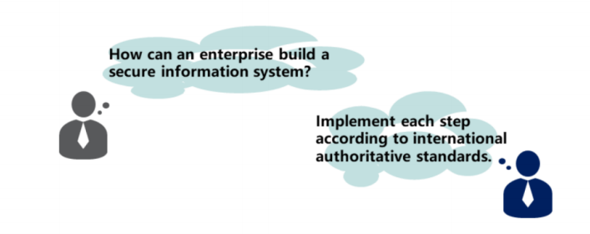
Chapter
Significance of Information Security Standards
01
Standards are normative documents that are jointly formulated, approved by recognized authorities, and used throughout the industry to achieve the best security.

Slide 6
Chapter
Information Security Standards Organizations
01
• International organizations related to information security standardization:
□ International Organization for Standardization (ISO)
□ International Electronical Commission (IEC)
• Chinese security standards organizations:
□ China Information Security Standardization Technical Committee
□ Cyber and Information Security Technical Committee (TC8) of China Communications Standards Association (CCSA)
• Other standards organizations:
□ International Telecommunication Union (ITU)
□ Internet Engineering Task Force (IETF)

Slide 7
Chapter
Information Security Standards Organizations
01
• International information security standardization began in the middle of the 1970s, rapidly developed in the 1980s and drew global attention in the 1990s. At present, there are nearly 300 international and regional organizations establishing standards or technical rules.
• ISO is a global non-governmental organization and plays a crucial role in international standardization. It has published international standards and related documents for most fields (including monopolized industries such as military, oil, and shipping).

Slide 8
Chapter
Information Security Standards Organizations
01
• IEC was the first international organization established for the preparation and publication of international standards for all electrical, electronic and related technologies.
• ITU is the United Nations specialized agency for information and communication technologies. It allocates global radio spectrum and satellite orbits, develops global telecommunication standards, works to improve telecommunication infrastructure in the developing world, and promotes global telecommunication development.
• IETF is a large open international community of network designers, operators, vendors, and researchers concerned with the evolution of the Internet architecture and the smooth operation of the Internet.

Slide 9
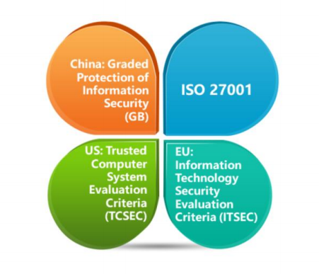
Chapter
01
Common Information Security Standards & Specifications

Slide 10
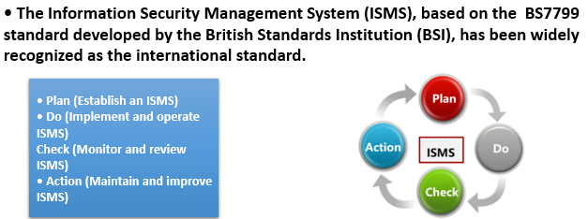
Chapter
01
ISO 27001 ISMS

Slide 11
Chapter
ISO 27001 ISMS
01
Plan : ISMS planning and preparation
Establish security policy, objectives, processes and procedures relevant to managing risks and improving information security to deliver results in accordance with an organizations over all policies and objectives.
Do : ISMS document development Implement and operate the ISMS policy, controls, processes and procedures.

Slide 12
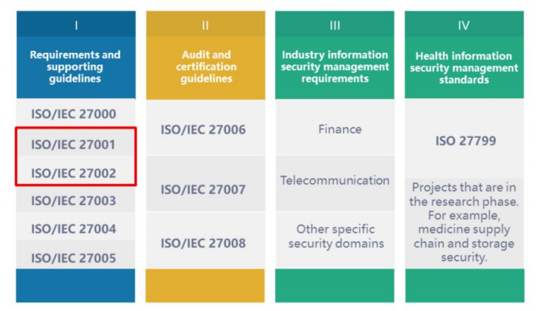
Chapter
ISO 27001 ISMS Family of Standards
01

Slide 13
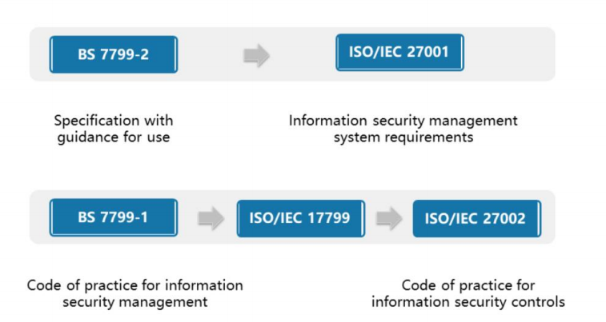
Chapter
ISO 27001 Evolution
01
• ISO/IEC 27001 and ISO/IEC 27002, released in 2013, are the currently used standards.

Slide 14
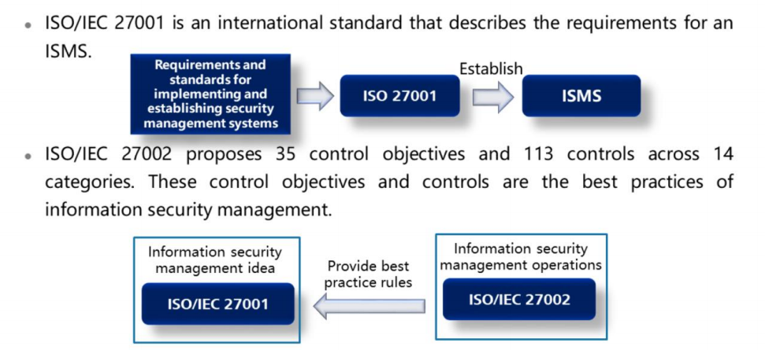
Chapter
01
ISMS and ISO/IEC 27000

Slide 15
Chapter
01
ISMS and ISO/IEC 27000
• Any company can implement an ISMS, but how? What requirements must be met? ISO 27000 provides detailed requirements which organizations can use to establish ISMSs.
• ISO 27001 is to manage information security risks based on risk assessments and to comprehensively, systematically, and continuously improve information security management using the Plan, Do, Check, Action (PDCA) cycle. It can be used to establish and implement ISMSs and ensure information security of organizations.
• ISO 27001, an overall information security management framework based on the PDCA cycle, focuses on the establishment of a continuous-cyclic long-term management mechanism. Only certification to ISO/IEC 27001 is possible. Other ISO/IEC standards are the specific clauses and operation guides for the certification. For example, ISO 27002 defines a specific information security management process under the guidance of ISO 27001.

Slide 16
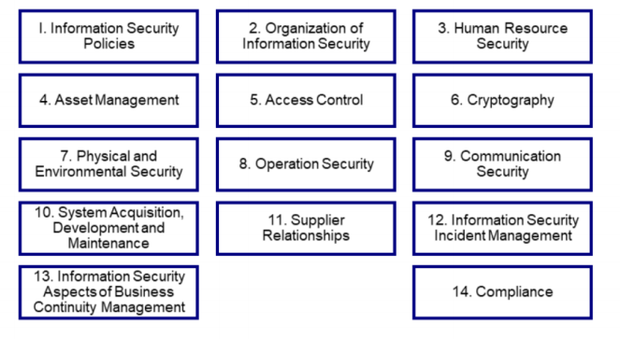
Chapter
Elements of Building an ISMS
01
• 14 control areas in ISO 27002:

Slide 17
Chapter
Elements of Building an ISMS
01
• The key check points in the ISO 27001 certification process are as follows:
• Document review:
□ Risk assessment reports
□ Security principles
□ Statement of Applicability (SoA)
□ Other ISMS documents
• Formal review:
□ Check records, including account and permission assignment, training, business continuity drill, access control, and media usage records.
□ Check the information asset identification and processing, and risk assessment and handling forms.
□ Perform terminal security check, including the screen saver, screen lock, and antivirus software installation and upgrade status.
□ Carry out the physical environment survey, including the field observation and inquiry of equipment rooms and office environments.

Slide 18
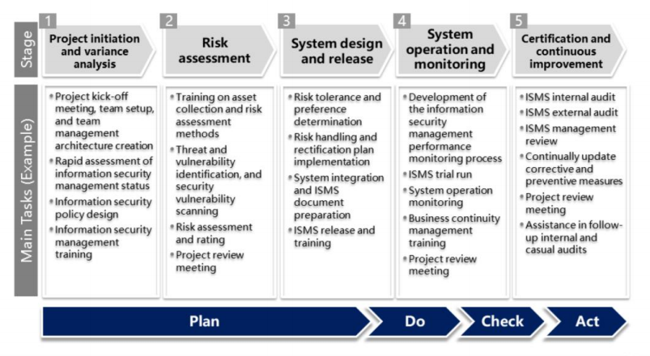
Chapter
ISO 27000 Project Implementation Methodology and Steps
01

Slide 19



Thank You

