Slide 1

Control and Iteration Statements
Prepared by Dr. Hamada I. AbdulWakel
Lecture 3
CYB550
Programming Foundations In Python

Slide 2

Lecture 2
(cont'd)
ASSIGNMENT STATEMENT IN PYTHON
Variables receive their initial values and can be reset to new values with an assignment statement.
  Variable defining/initializing
  Variable references.
  <var_name> = <expr>
Notes:
Analysis and design may produce a prototype of a system for coding, and then back up to earlier phases to fill in more details after some testing

Slide 3
Lecture 2
(cont'd)
EXPRESSIONS IN PYTHON
Expressions provide an easy way to perform operations on data values to produce other data values.
An arithmetic expression consists of operands and operators.
  Operators:
    -, *, /, +
Notes:
Analysis and design may produce a prototype of a system for coding, and then back up to earlier phases to fill in more details after some testing

Slide 4
Lecture 2
(cont'd)
EXPRESSIONS IN PYTHON
Cont'd
Rule of priority, that is some operator has highest priority than others.
  ()
  **
  Unary operator
  *, /, //, %
  +, -
Rule of associativity, evaluate expression of similar priority from left to right.
  Ex: 2+5-1
Notes:
Analysis and design may produce a prototype of a system for coding, and then back up to earlier phases to fill in more details after some testing

Slide 5
Lecture 2
(cont'd)
GETTING INPUTS IN PYTHON
Almost all programs interact with the user through giving data to the program to process it and display other data.
  Use the input() function.
    input()
    input("Enter your name: ")
    name = input("Enter your name: ")
    Age = int(input("Enter your Age: "))
Notes:
Analysis and design may produce a prototype of a system for coding, and then back up to earlier phases to fill in more details after some testing

Slide 6
Lecture 2
(cont'd)
SIMPLE CALCULATOR IN PYTHON
Num1 = input("Enter the first number: ")
Num2 = input("Enter the second number: ")
Result = Num1 + Num2
print(Result)
Notes:
Analysis and design may produce a prototype of a system for coding, and then back up to earlier phases to fill in more details after some testing

Slide 7
Lecture 2
(cont'd)
INPUTS EXPRESSIONS IN PYTHON
Write a program that reads a three-digit number, separates this number into its individual digits and print them. Ex: 234 -> 2 3 4
  Code for help:
  Number = 234
  Digit1 = Number // 100
  New_number = Number % 100
  print("First digit = ", Digit1)
  print("New number after removing the first digit = ", New_number)
Notes:
Analysis and design may produce a prototype of a system for coding, and then back up to earlier phases to fill in more details after some testing

Slide 8
Lecture 2
(cont'd)
INPUTS EXPRESSIONS IN PYTHON
Cont'd
Write a program which inputs a temperature reading expressed in Fahrenheit and outputs its equivalent in Celsius, using the formula:
ºC = 5/9 ( ºF - 32)
  Code for help:
  Temp_fah = float(input("Enter a temperature in Fahrenheit: "))
  Temp_cel = 5/9 * (Temp_fah - 32)
  print("The equivalent Celsius temperature = ", Temp_cel)
Notes:
Analysis and design may produce a prototype of a system for coding, and then back up to earlier phases to fill in more details after some testing

Slide 9
Lecture 3
MODULE OBJECTIVES
Control the program flow.
Relational operators and comparison expressions.
Selection statements.
Iteration statements.

Slide 10
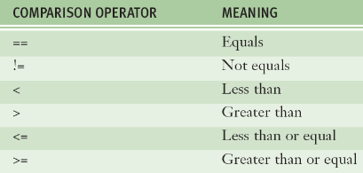
Lecture 3
BOOLEAN TYPE & EXPRESSIONS
Boolean data type consists of two values: true and false

Slide 11
Lecture 3
BOOLEAN TYPE & EXPRESSIONS
Cont'd
Code to know boolean types:
print (15 > 3) print (15 < 3) print(15 == 15)
x1 = 5 y1 = 5
x2 = 'Hello' y2 = 'Hello'
x3 = [1, 2, 3] y3 = [1, 2, 3]
print(x1 is not y1)
print(x2 is y2)
print(x3 is y3)
Notes:
Analysis and design may produce a prototype of a system for coding, and then back up to earlier phases to fill in more details after some testing

Slide 12
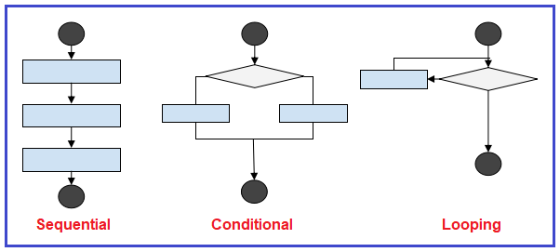
Lecture 3
PROGRAM FLOW

Slide 13
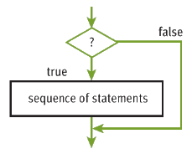
Lecture 3
SELECTION STATEMENTS
Basic-selection statement (if statement).
  Syntax
  if <condition>:
  <statement(s)>

Slide 14
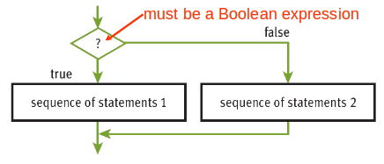
Lecture 3
SELECTION STATEMENTS
Cont'd
Two-way selection statement (if else statement).
  Syntax
  if <condition>:
  <true statement(s)>
  else:
  <false statement(s)>

Slide 15
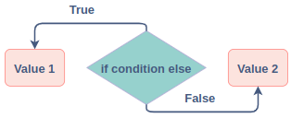
Lecture 3
SELECTION STATEMENTS
Cont'd
Ternary operator (if else statement).
  Syntax
  <variable> = <true statement> if <condition> else <false statement>

Slide 16
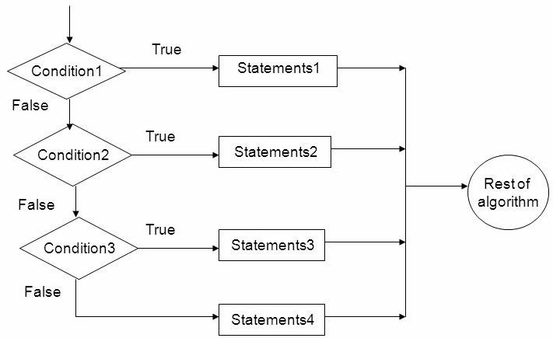
Lecture 3
SELECTION STATEMENTS
Cont'd
Multi-way selection statement (if elif statement).
  Syntax
  if <condition1>:
  <true cond1_statement(s)>
  elif <condition2>:
  <true cond2_statement(s)>
  else:
  <otherwise statement(s)>

Slide 17
Lecture 3
COMPOUND BOOLEAN EXPRESSIONS
Cont'd
Write a program which inputs a person's height (in cm) and weight (in kg) and outputs one of the messages: underweight, normal, or overweight, using the criteria:
    Underweight: weight < height/2.5
    Normal: height/2.5 <= weight <= height/2.3
    Overweight: height/2.3 < weight

Slide 18
Lecture 3
COMPOUND BOOLEAN EXPRESSIONS
Cont'd
Write a program to calculate the roots for the following equation:
ax² + bx + c = 0
  Help:
    Use sqrt function in cmath module/package.
    If d > 0 then there are two real roots.
    If d == 0 then there are two equal real roots.
    If d < 0 then there is no roots.

Slide 19
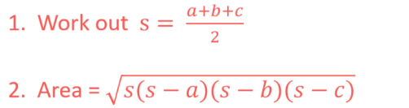
Lecture 3
COMPOUND BOOLEAN EXPRESSIONS
Cont'd
Write a program that accepts the sides (a, b, c) of a triangle and calculates and display its area.
  Help:

Slide 20
Lecture 3
COMPOUND BOOLEAN EXPRESSIONS
Cont'd
Write a program that accepts the sides (a, b, c) of a triangle and calculates and display its area.
  Code for help:
a = float(input('Enter first side: '))
b = float(input('Enter second side: '))
c = float(input('Enter third side: '))
s = (a + b + c) / 2
area = (s*(s-a)*(s-b)*(s-c)) ** 0.5
print("The area of the triangle = ", area)

Slide 21
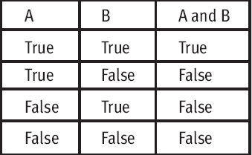
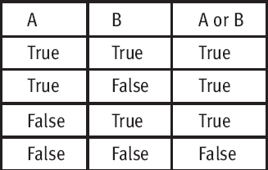
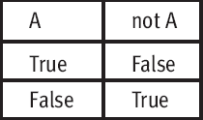
Lecture 3
COMPOUND BOOLEAN EXPRESSIONS
Logical operators

Slide 22
Lecture 3
COMPOUND BOOLEAN EXPRESSIONS
Cont'd
Write a program that check of a given number is divided by 3 and 4.
  Code for help:
  Num = int(input())
  if Num % 3 == 0 and Num % 4:
  print("The number is divided by both 3 and 4")
  elif Num % 3 == 0 or Num % 4:
  print("The number is divided by either 3 or 4")
else:
print("The number is not divided by any of 3 or 4")

Slide 23
Lecture 3
COMPOUND BOOLEAN EXPRESSIONS
Cont'd
Write a program that check if a single digit integer is a positive or negative.
  Code for help:
  x = int(input("Enter a single digit number: "))
  if x < 0 and x < 10:
  print("This number is a single digit positive number")
  elif x < 0 and x > -10:
  print("This number is a single digit negative number")
  else:
  print("Invalid integer")

Slide 24
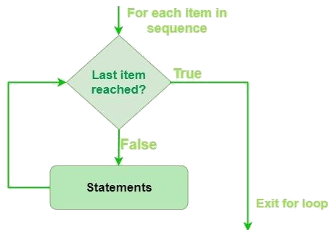
Lecture 3
CONDITIONAL ITERATION
For loop.
  Syntax
  for <variable> in <sequence> :
  <statement 1> ….....

Slide 25
Lecture 3
CONDITIONAL ITERATION
Cont'd
Write a program that reads the number of students in a class then reads their marks and finds and displays the average.
  Code for help:
  stdCount = int(input("Enter number of students in a class"))
  sum = 0.0
  for i in range(stdCount):
  mark = float(input("Enter mark: "))
  sum += mark
  print("The marks average = ", sum / stdCount)

Slide 26
Lecture 3
CONDITIONAL ITERATION
Cont'd
Write a program that calculates the total of the following series of numbers:
1/30 + 2/29 + 3/28 + ….....+ 30/1
  Code for help:
  min = 1; max = 6; sum = 0.0
  for i in range(min, max):
  sum += min / (max-1); min += 1; max -= 1
  print(sum)

Slide 27
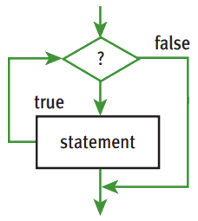
Lecture 3
CONDITIONAL ITERATION
While (entry-control) loop.
  Syntax
  while <condition>:
  <statement 1> …....

Slide 28
Lecture 3
CONDITIONAL ITERATION
Cont'd
Write a program that calculates the average of a set of temperature. Data is terminated by the value 999.
  Code for help:
  sum = 0.0; count = 0
  temp = float(input("enter a temperature "))
  while temp != 999:
  count += 1; sum += temp
  temp = float(input("enter another temp"))
  print("temperature average = ", sum/count)

Slide 29
Lecture 3
CONDITIONAL ITERATION
Cont'd
Write a program that print each character of a given string from the end.
  Code for help:
  s = "Hello"
  l= len(s)
  while l > 0:
  print(s[l-1])
  l -= 1

Slide 30
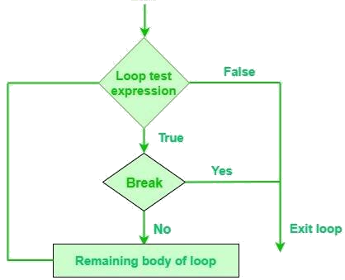
Lecture 3
CONDITIONAL ITERATION
Break statement.
  Syntax
  while <condition>:
  <statement 1> …....
  if <condition>:
  break

Slide 31
Lecture 3
CONDITIONAL ITERATION
Cont'd
Write a program to print numbers from 1 to 10. The program may stop in 5.
  Code for help:
  count= 0
  while count < 10:
  if count == 5
  break
  print(count)
  count += 1

Slide 32
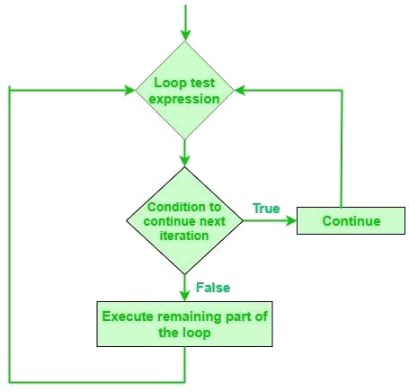
Lecture 3
CONDITIONAL ITERATION
Continue statement.
  Syntax
  while <condition>:
  <statement 1> …....
  if <condition>:
  continue

Slide 33
Lecture 3
CONDITIONAL ITERATION
Cont'd
Write a program to print numbers from 1 to 10 except 5.
  Code for help:
  count= 0
  while count < 10:
  if count == 5
  continue
  print(count)
  count += 1

Slide 34
Lecture 3
CONDITIONAL ITERATION
Cont'd
Write a program that calculates the occupancy rate for a hotel. The program should start by asking the user how many floors the hotel has. A loop should then iterate once for each floor. In each iteration, the loop should ask the user for the number of rooms on the floor and how many of them are occupied. After all the iterations, the program should display how many rooms the hotel has, how many of them are occupied, how many of them are unoccupied. The percentage may be calculated by dividing the number of rooms occupied by the number of rooms.

Slide 35
THANK YOU

