Slide 1


Project Governance
Prepared by Dr. Fayez Jrad
PMG 424
Lecture 0 Orientation

Slide 2



Project Governance
Lecture 0 Orientation
PMG 424
Prepared by
Dr. Fayez Jrad
www.midocean.ae

Slide 3
Lecture
Session Outline
Orientation
Academic Agenda
Course Objectives
Learning Outcomes
Course Outline
Topics
Conclusion
www.midocean.ae

Slide 4
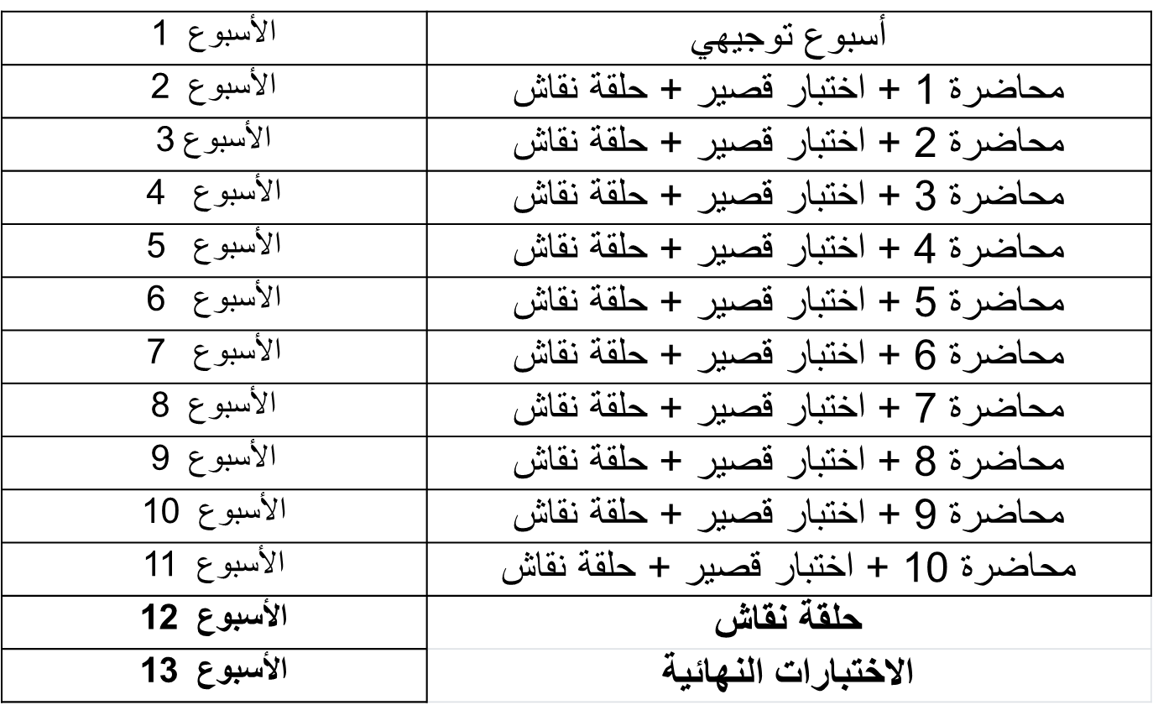
Academic Agenda
www.midocean.ae

Slide 5
Quizzes & Exams
أسئلة الاختبار الفصلي / True-False / MCQ / أسئلة صوتية
تعد الإجابة على الاختبار بمثابة الحضور للطلاب
درجة الاختبار القصير 8 درجات/8 أسئلة (اجمالي 80 درجة)
فترة عقد الاختبار القصير /24 دقيقة/
www.midocean.ae

Slide 6
Quizzes & Exams
الاختبار النهائي سيكون من خلال المودل
أسئلة الاختبار النهائي / True-False / MCQ / أسئلة صوتية
درجة الاختبار النهائي 20 درجة/20 سؤال
فترة عقد الاختبار النهائي /60 دقيقة/
www.midocean.ae

Slide 7
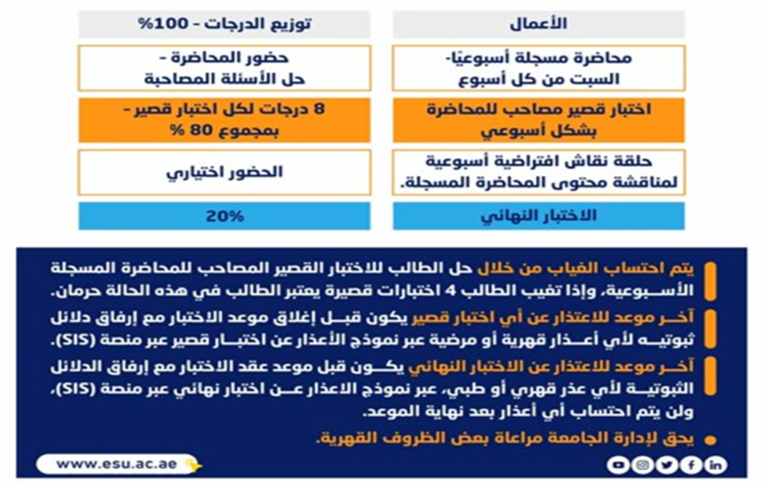
Obligations and Grading
www.midocean.ae

Slide 8
Lecture
Online Lecture
Orientation
Answer your questions/inquiries
Solve different issues/problems
Discuss your opinions with the instructor/classmates
Trigger activities related to previous session topics
www.midocean.ae

Slide 9
Lecture
Course Objectives
Orientation
Introducing the principles of project governance.
Using governance to establish a good project structure, harmonizes processes and resources, and provides a smooth path to achieve project goals.
Applying governance to remove costly inefficiencies that negatively impact smooth running and reduces the risk of conflict.
Providing an opportunity to discuss enterprise projects and other megaprojects.
www.midocean.ae

Slide 10
Lecture
Learning Outcomes
Orientation
Categorize the core issues of project governance within the context of projects and programs.
Evaluate and critique the strengths and challenges of various governance structures.
Given a large enterprise project, recommend methods and procedures that ensure the project is governed according to best practices.
Evaluate how changes to project scope may impact the project’s schedule, cost, and quality, and create a scope document that will produce the desired project outcomes.
www.midocean.ae

Slide 11
Lecture
Orientation
Course Outline
Lecture 1: Definition of Governance.
Lecture 2: Governance Structures and Management Scope.
Lecture 3: Creating Project-focused Governance Structures.
Lecture 4: Transparent and Accountable Organizations.
Lecture 5: Project Ownership vs. Asset Ownership.
Lecture 6: Towards an Integrated Governance Model.
Lecture 7: Effective Project Governance.
Lecture 8: Governance of Portfolios.
Lecture 9: Governance of Programs
Lecture 10:Governance of Projects
www.midocean.ae

Slide 12
Lecture 1: Definition of Governance
What Is a Project?
General Project Characteristics.
The Evolution of Governance.
Organizational Governance.
Project Governance.
What is Governance?
Why Governance?
Governance Theories.
www.midocean.ae

Slide 13
Lecture 1: Definition of Governance
Shareholder Theory
  Principles of Shareholder Theory
  Disadvantages of Shareholder Theory
  Implications of Shareholder Theory on PM
Stakeholder Theory
Transaction Costs Economics (TCE)
Agency Theory
www.midocean.ae

Slide 14
Lecture 02
Governance Structures and Management Scope
Governance Scope.
Governance and Project Management.
Governance and Portfolios.
Governance and Projects.
Paradigms for Project Management Governance.
Behavioral-oriented Organizations.
Outcome-oriented Organizations.
www.midocean.ae

Slide 15
Lecture 02
Governance Structures and Management Scope
The Conformist Paradigm.
The Flexible Economist Paradigm.
The Versatile Artist Paradigm.
The Agile Pragmatist Paradigm.
The Choice of Governance Paradigm.
www.midocean.ae

Slide 16
Lecture 3:
Creating Project-focused Governance Structures
Projects and Strategy.
The Delivery Circle.
The Control Circle.
Projects as Temporary Organizations.
Why We Need Project Governance.
Objectives of Project Governance.
Governance Institutions.
Board of Directors and Projects.
Board of Directors and Project Management.
Decisions of the Board of Directors.
www.midocean.ae

Slide 17
Lecture 3:
Creating Project-focused Governance Structures
Individual Project Governance.
Portfolio Governance.
Governance Decisions at the Portfolio Level.
Sponsors.
Steering Groups.
Strategic Project Management Offices.
Tactical Project Management Offices.
Project Management Governance Institutions.
www.midocean.ae

Slide 18
Lecture 4:
Transparent and Accountable Organizations
Why Organizational Governance.
Quality of Project Management.
Project Management Quality Forces.
A Framework For Organizational Migration.
Governance Framework for Project Management.
Elements of the Framework.
Stronger PMO Roles.
The Variation of the PMO Approach.
How PMI Maturity Model Works.
www.midocean.ae

Slide 19
Lecture 5:
Project Ownership vs. Asset Ownership
What is an Asset?
Asset Ownership.
Asset Owners.
Asset Owner Responsibilities.
Project Ownership.
Project Owner Synonyms.
Project Owner Job Description.
Project Owner Incentives.
Project Ownership Role.
Project Owner Duties.
www.midocean.ae

Slide 20
Lecture 5:
Project Ownership vs. Asset Ownership
Project Owner Responsibilities.
Project Owner vs. Project Manager.
Project Owner vs. Project Sponsor.
Project Owner vs. Product Owner.
Project Owner vs. Product Manager.
Project Owner vs. Project Leader.
Asset Ownership vs. Project Ownership.
www.midocean.ae

Slide 21
Lecture 6:
Towards an Integrated Governance Model
Linking Governance of Projects, Programs, and Portfolios.
No One-Size-Governance-Fits-All.
The Governance Model.
Governance Paradigm.
Importance of Governance Paradigm.
Governance Institutions.
The Macro View of Governance.
Example of Project Governance Hierarchy.
www.midocean.ae

Slide 22
Lecture 6:
Towards an Integrated Governance Model
Linking Institutional Theory (Legitimacy).
Pragmatic Legitimacy.
Legitimacy and Institutions.
Implications of Legitimacy.
The Total Project Governance Model.
The Role of Governance Paradigms.
www.midocean.ae

Slide 23
Lecture 7:
Effective Project Governance
Causes of Project Governance Problems.
Project Governance Objectives.
Confusion Regarding Project Governance Objectives.
Problems of Overemphasized Project Reporting
Risk Aversion.
Problems with Consensus Approach Regarding Risk Aversion.
www.midocean.ae

Slide 24
Lecture 7:
Effective Project Governance
Project Stakeholders
Stakeholder Issues
Deciding on Main Stakeholders
Effective Project Governance
Summary of Effective Governance Solutions
www.midocean.ae

Slide 25
Lecture 8:
Governance of Portfolios.
The Logic of Portfolios.
What is a Project Portfolio.
Effectiveness and Project Portfolios.
Decisions on Portfolios.
Possible Governance Structures.
Multi-project Organizations.
Portfolios of Projects.
Programs of Projects.
Hybrid Organizations.
www.midocean.ae

Slide 26
Lecture 8:
Governance of Portfolios.
Performance of Governance Structures.
Portfolio Management.
Portfolio Management Objectives.
Portfolio Optimization Strategies.
Value Maximization Strategy.
Balancing Strategy.
Roles and Authorities of Portfolio Managers.
Measuring Portfolio Performance.
www.midocean.ae

Slide 27
Lecture 9:
Governance of Programs
What is a Project Program?
Efficiency and Project Programs.
Importance of Programs.
Decisions on Programs.
Main Areas Concerning Programs.
The Reality of Programs.
Forms of Programs .
www.midocean.ae

Slide 28
Lecture 9:
Governance of Programs
Temporary Programs.
Semi-permanent Programs.
Execution of Program Governance.
The Aim of Program Governance.
Goal Setting.
Effective Goal Setting.
www.midocean.ae

Slide 29
Lecture 9:
Governance of Programs
Themes of Program Management
Achievement of Program Objectives
Organization Structures
Roles and Authorities
Controlling Program Progress
Program Progress Reviews
www.midocean.ae

Slide 30
Lecture 10:
Governance of Projects
The Aim of Project Governance.
Approaches of Project Governance.
Perspectives of Project Governance.
Implications of Shareholder Theory on PM.
The Steering Group.
Level of Project Governance.
Level of Project Support.
Steering Group Governance Roles and Tasks.
www.midocean.ae

Slide 31
Lecture 10:
Governance of Projects
Establishing the Governance Infrastructure.
Steering Group Meetings.
Governance of Project Contracts.
Types of Project Management Methodologies.
Predictive Methodologies.
Convergent Methodologies.
Emergent Methodologies.
www.midocean.ae

Slide 32
Conclusion
Definition of governance | Defining governance and why we need it.
Types of Governance Structures | Exploring existing governance theories, paradigms, and structures
Creating Project-focused Governance Structures | Understanding governance in the context and scope of project management
Transparent and Accountable Organizations | Discussing how to create transparent and accountable organizations and the main roles needed
Project Ownership vs Asset Ownership | Differentiating between project ownership and asset ownership
Understanding Project Governance Structures | Understanding governance structures within different scales of projects, programs, and portfolios
Governance, Decisions, Risks, and Resources | Clarifying the interlink between governance and decision-making, risk management, and resource allocation
Verification and Validation | Presenting a model for governance of projects, programs and portfolios, and envisaging the future of project governance
Enterprise PM | Describing how projects on a companywide scale
www.midocean.ae

Slide 33

Reference
www.midocean.ae

Slide 34



Thank You

