Slide 1


Introduction to Economics
Lecture 5
MGM112
Elasticity
Prepared by
Lec. Dina ElWakkad
www.midocean.ae

Slide 2

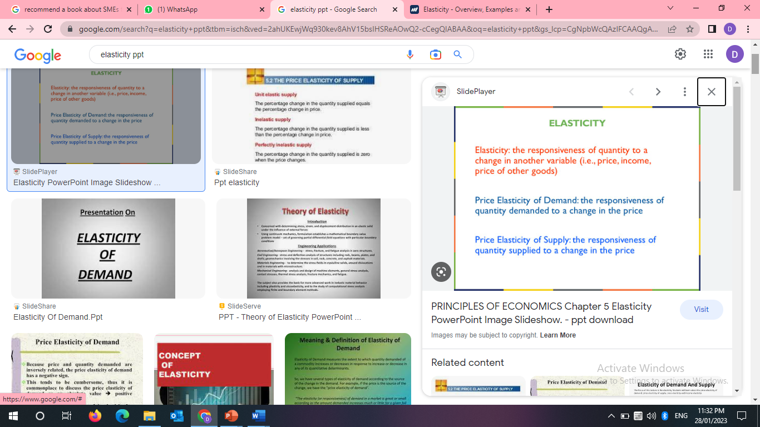
Chapter
Elasticity
05
www.midocean.ae

Slide 3
Chapter
Types of Elasticity
05
Elasticity
Elasticity OF Demand
Elasticity OF Supply
www.midocean.ae

Slide 4
Chapter
Types of Elasticity
05
1) Elasticity OF Demand
www.midocean.ae

Slide 5
Types of Elasticity
Chapter
05
Elasticity of Demand
Price elasticity
Cross elasticity
Normal goods
Inferior goods
Income elasticity
- Elastic
-Inelastic
-Unit elastic
- Perfectly elastic
-perfectly inelastic
a substitute
a complement.
www.midocean.ae

Slide 6
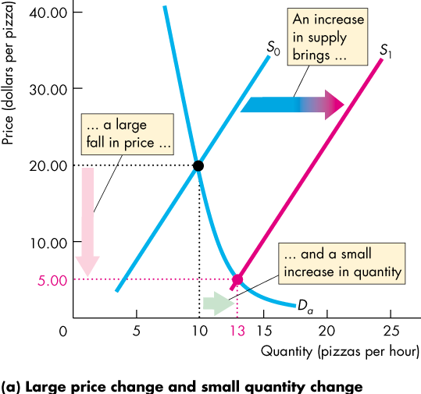
2) Price Elasticity of Demand
Chapter
05
  In the Figure, an increase in supply brings
  A large fall in price
  A small increase in the quantity demanded
www.midocean.ae

Slide 7
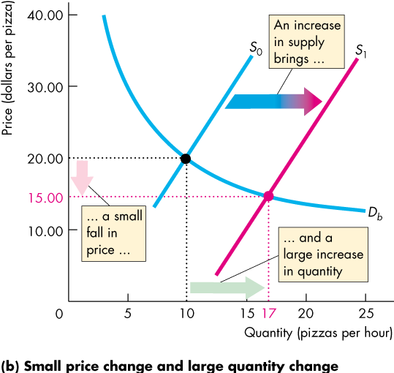
2) Price Elasticity of Demand
Chapter
05
  In The Figure, an increase in supply brings
  A small fall in price
  A large increase in the quantity demanded
www.midocean.ae

Slide 8
2) Price Elasticity of Demand
Chapter
05
  The contrast between the two outcomes highlights the need for:
  A measure of the responsiveness of the quantity demanded to a price change.
  The price elasticity of demand is a measure of the responsiveness of the quantity demanded of a good to a change in its price when all other influences on buying plans remain the same.
www.midocean.ae

Slide 9
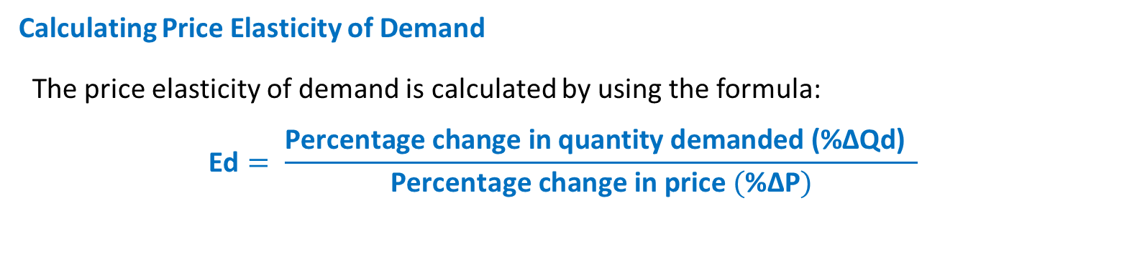
2) Price Elasticity of Demand
Chapter
05
Calculating Price Elasticity of Demand
  The price elasticity of demand is calculated by using the formula:
  $$\text{Ed}= \frac{\text{Percentage} \text{change} \text{in} \text{quantity} \text{demanded}\text{ (}\text{\%}\text{∆}\text{Qd}\text{)} }{\text{Percentage} \text{change} \text{in} \text{price} (\text{\%}\text{∆}\text{P})}$$
www.midocean.ae

Slide 10
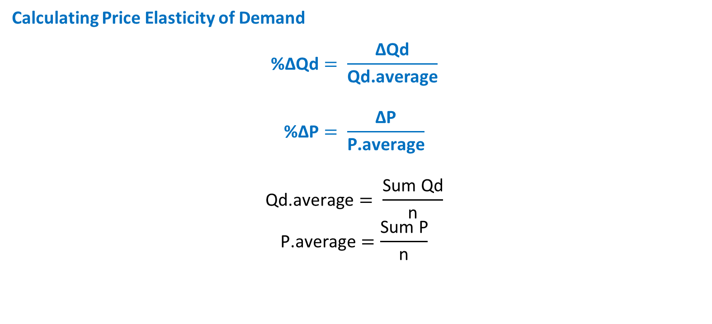
2) Price Elasticity of Demand
Chapter
05
Calculating Price Elasticity of Demand
  $$\text{\%}\text{∆}\text{Qd}= \frac{\text{∆}\text{Qd}}{\text{Qd}\text{.}\text{average}}$$
  $$\text{\%}\text{∆}\text{P}= \frac{\text{∆}\text{P}}{\text{P}\text{.}\text{average}}$$
  $$\text{Qd}\text{.}\text{average}= \frac{\text{Sum} \text{Qd}}{\text{n}}$$
  $$\text{P}\text{.}\text{average}=\frac{\text{Sum} \text{P}}{\text{n}}$$
www.midocean.ae

Slide 11
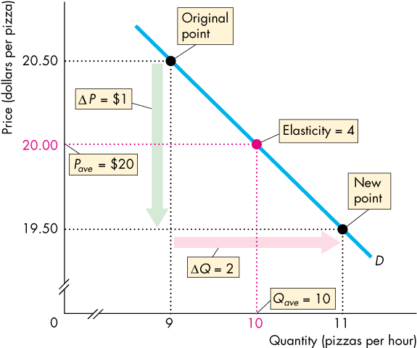
2) Price Elasticity of Demand
Chapter
05
Numerical Example:
  Using the following data Using the mid -point formula to get elasticities
Price | Qd
20.5 | 9
19.5 | 11
www.midocean.ae

Slide 12
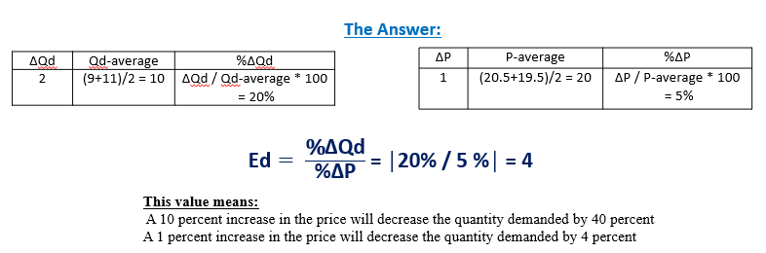
2) Price Elasticity of Demand
Chapter
05
Numerical Example:
www.midocean.ae

Slide 13
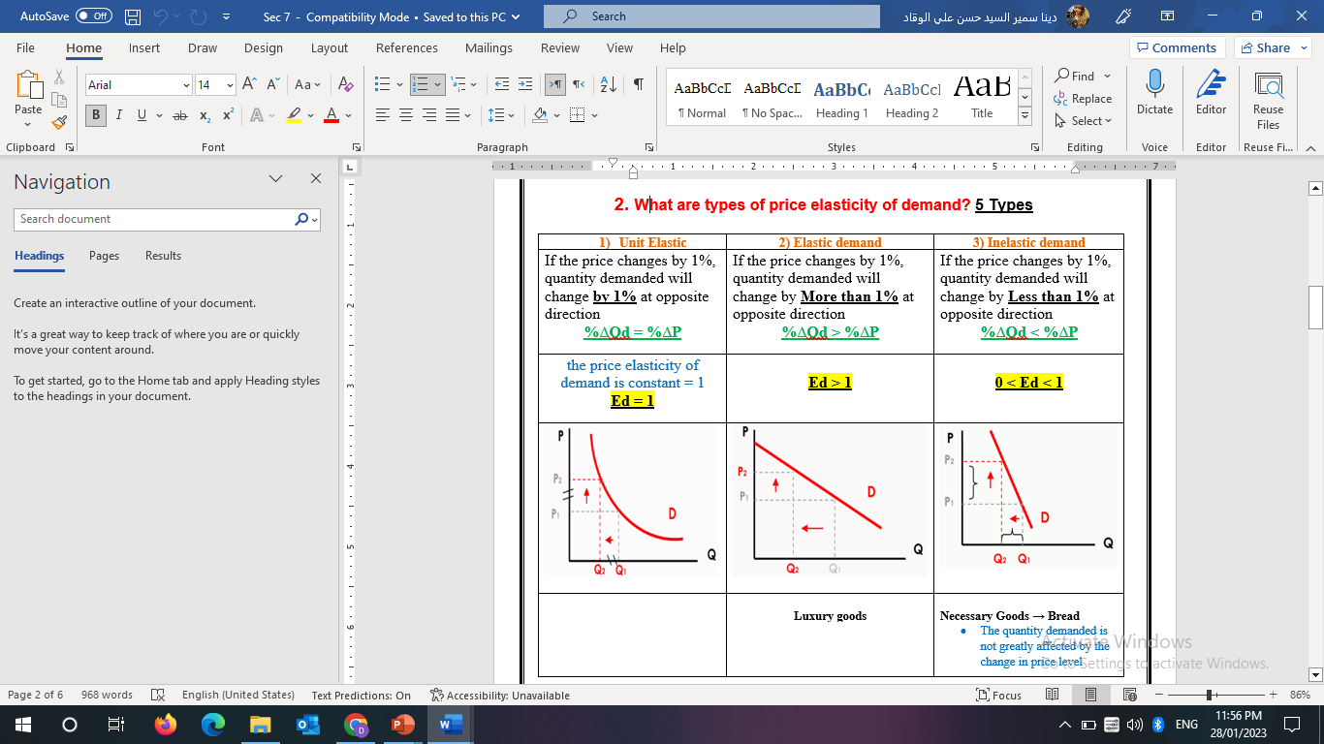
a) Types of Price Elasticity of Demand
Chapter
05
5 Types
Demand is price inelastic if a relatively large price increase leads to a relatively small decrease in the quantity demanded.
www.midocean.ae

Slide 14
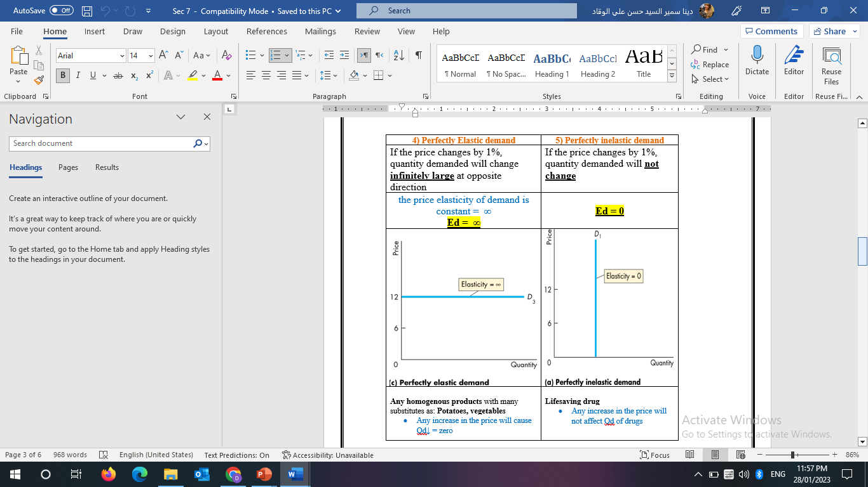
a) Types of Price Elasticity of Demand
Chapter
05
5 Types
www.midocean.ae

Slide 15
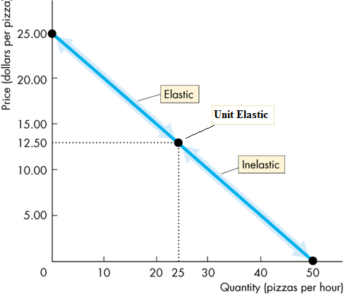
a) Types of Price Elasticity of Demand
Chapter
05
  Price elasticity varies along a linear demand curve
At prices above the mid-point of the demand curve, demand is elastic.
At the mid-point of the demand curve, demand is Unit elastic.
At prices below the mid-point of the demand curve, demand is inelastic
www.midocean.ae

Slide 16
Chapter
a) Factors That Influence the Price Elasticity of Demand
05
1) The closeness of substitutes (+VE)
The closer / many the substitutes for a good or service → the more elastic are the demand for the good or service → Luxuries, such as exotic vacations
The Fewer the substitutes for a good or service → Inelastic demand for the good or service → Luxuries, such as exotic vacations → Necessities, such as food or housing
2) Proportion of Income Spent on the Good (+VE)
The greater the proportion of income consumers spend on a good, the larger is the elasticity of demand for that good.
3) Time Elapsed Since Price Change (+VE)
The more time consumers have to adjust to a price change, or the longer that a good can be stored without losing its value, the more elastic is the demand for that good
www.midocean.ae

Slide 17
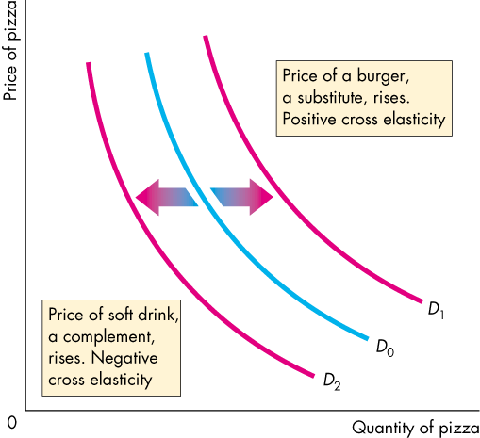
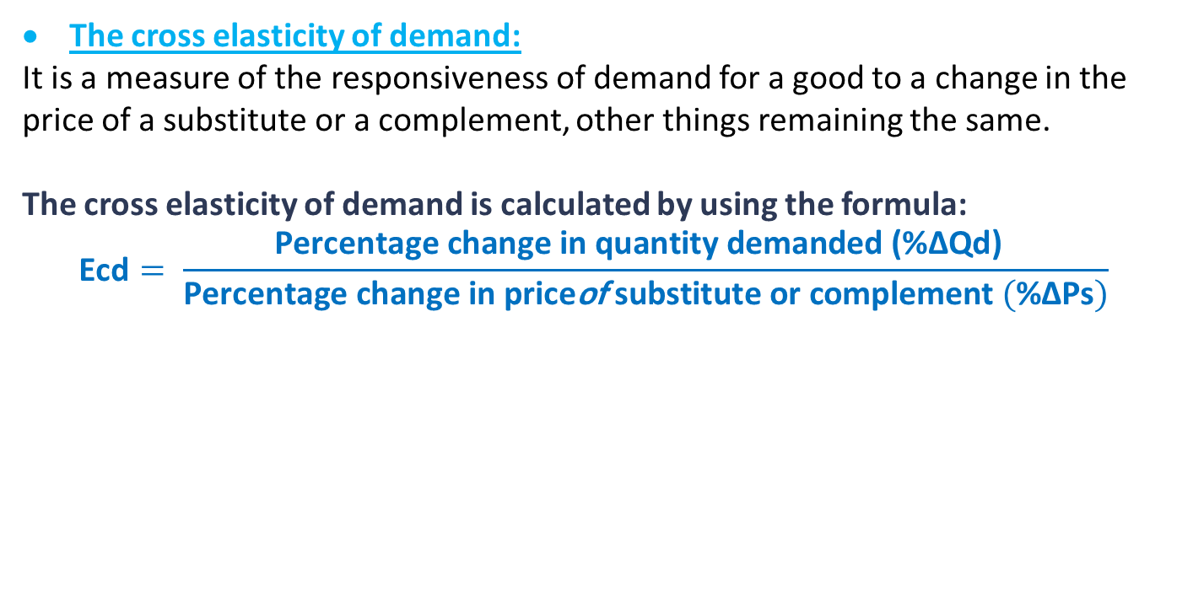
b) The Cross Elasticity of Demand
Chapter
05
The cross elasticity of demand:
It is a measure of the responsiveness of demand for a good to a change in the price of a substitute or a complement, other things remaining the same.
The cross elasticity of demand is calculated by using the formula:
  $$\text{Ecd}= \frac{\text{Percentage} \text{change} \text{in} \text{quantity} \text{demanded}\text{ (}\text{\%}\text{∆}\text{Qd}\text{)} }{\text{Percentage} \text{change} \text{in} \text{price}\text{of} \text{substitute} \text{or} \text{complement} (\text{\%}\text{∆}\text{Ps})}$$
a substitute good | a complement good
Price of a substitute good ↑ Ecd > 0 (positive) | Price of a complement ↑ Ecd < 0 (negative)
www.midocean.ae

Slide 18
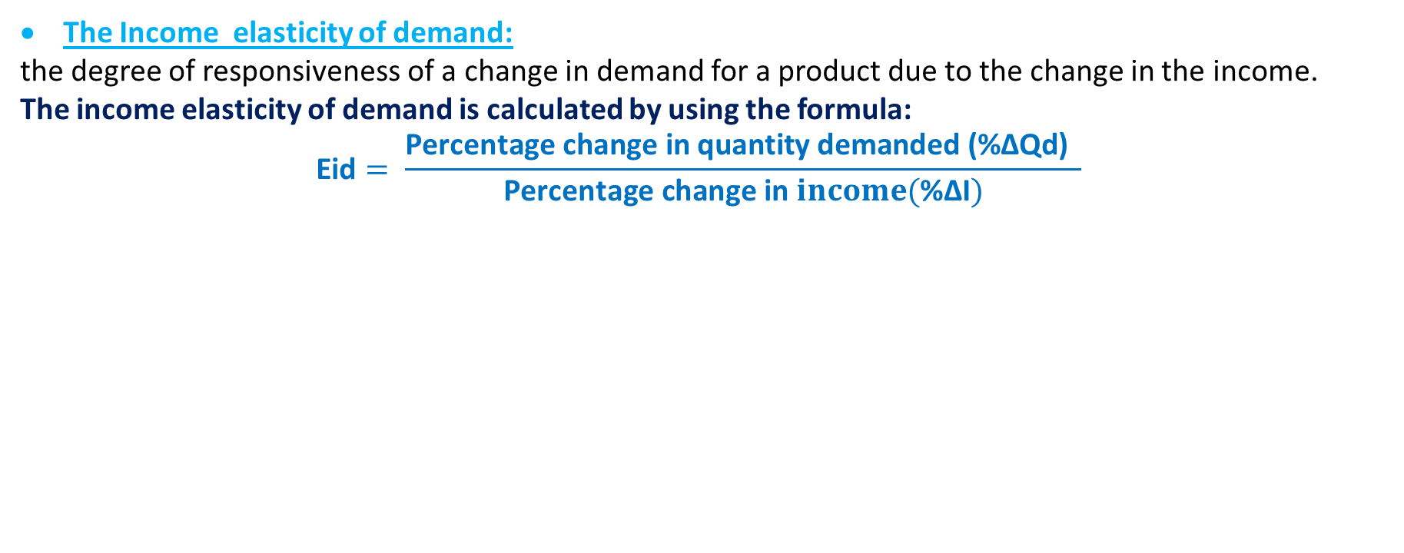
Chapter
c) The Income Elasticity of Demand
05
The Income elasticity of demand:
the degree of responsiveness of a change in demand for a product due to the change in the income.
The income elasticity of demand is calculated by using the formula:
  $$\text{Eid}= \frac{\text{Percentage} \text{change} \text{in} \text{quantity} \text{demanded}\text{ (}\text{\%}\text{∆}\text{Qd}\text{)} }{\text{Percentage} \text{change} \text{in} income(\text{\%}\text{∆}\text{I})}$$
a normal good | An inferior good
Eid > 1 → demand is income elastic and the good is a normal good. 0 <Eid < 1 → demand is income inelastic and the good is a normal good. + Eid | Eid < 0 (negative) → the good is an inferior good. -Eid
www.midocean.ae

Slide 19
Chapter
Types of Elasticity of Demand
05
Elasticity of Demand
Price elasticity
Cross elasticity
Normal goods
Inferior goods
Income elasticity
- Elastic
-Inelastic
-Unit elastic
- Perfectly elastic
-perfectly inelastic
a substitute
a complement.
www.midocean.ae

Slide 20

Think
Suppose the price of burgers increases from $2 to $3 each. The degree to which quantity demanded responds to this price increase depends on the
A) price elasticity of demand.
B) the price elasticity of supply.
C) income elasticity of demand.
D) cross elasticity of demand.
The price elasticity of demand is equal to the ________ in the ________ divided by the ________ in the ________.
A) percentage change; price; percentage change; quantity demanded
B) change; price; change; quantity demanded
C) percentage change; quantity demanded; percentage change; price
D) change; quantity demanded; change; price
www.midocean.ae

Slide 21
Think
If a 6 percent decrease in the price leads to a 5 percent increase in the quantity demanded, the price elasticity of demand is
A) 0.30.
B) 0.60.
C) 0.83. ( 0.05 / 0.06 )
D) 1.20.
Taco Bell's economists determine that the price elasticity of demand for their tacos is 2.0. So, if Taco Bell raises the price of its tacos by 6.0 percent, the quantity demanded will decrease by ________ percent.
A) 2.0
B) 3.0
C) 6.0
D) 12.0 ( 2 * 6% )
www.midocean.ae

Slide 22
Think
The price elasticity of demand for DVDs is 2. If the price of a DVD increased by 2 percent, the quantity demanded will ________.
A) decrease by 2 percent
B) not change
C) decrease by 4 percent
D) decrease by 1 percent
If the price elasticity of demand for a good is 0.8, then a
A) 1 percent rise in the price leads to a 0.8 percent decrease in the quantity demanded.
B) one dollar rise in the price leads to a 0.8 percent decrease in the quantity demanded.
C) 1 percent rise in the price leads to an 80 percent decrease in the quantity demanded.
D) 1 percent rise in the price leads to an 8 percent decrease in the quantity demanded.
www.midocean.ae

Slide 23
Think
Demand is perfectly inelastic when
A) shifts in the supply curve results in no change in price.
B) the good in question has perfect substitutes.
C) shifts of the supply curve results in no change in quantity demanded.
D) shifts of the supply curve results in no change in the total revenue from sales.
A good with a vertical demand curve has a demand with
A) unit elasticity.
B) infinite elasticity.
C) zero elasticity.
D) varying elasticity.
www.midocean.ae

Slide 24
Think
If the demand for a good is perfectly elastic, the price elasticity of demand is ______ and the demand curve is ________.
A) infinite; vertical
B) zero; vertical
C) zero; horizontal
D) infinite; horizontal
D) 5.00; decrease; 5.00
Price elasticity of demand is not influenced by:
a. the number of substitutes available.
b. the proportion of the consumer’s budget spent on the good.
c. the length of the time period under consideration.
d. the units of measurement used for price or for quantity demanded.
www.midocean.ae

Slide 25
Chapter
Types of Elasticity
05
2) Elasticity OF Supply
www.midocean.ae

Slide 26
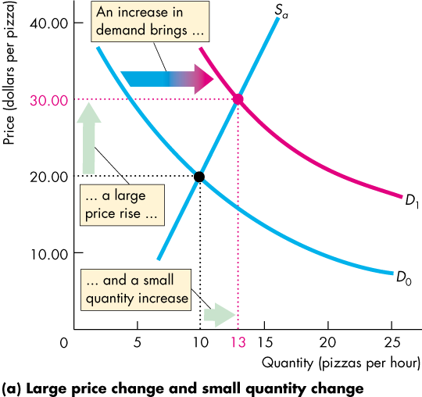
2) Price Elasticity of Supply
  When demand increases, is the change in the quantity supplied small or large?
  In the Figure, an increase in demand brings
  A large rise in price
  A small increase in the quantity supplied
www.midocean.ae

Slide 27
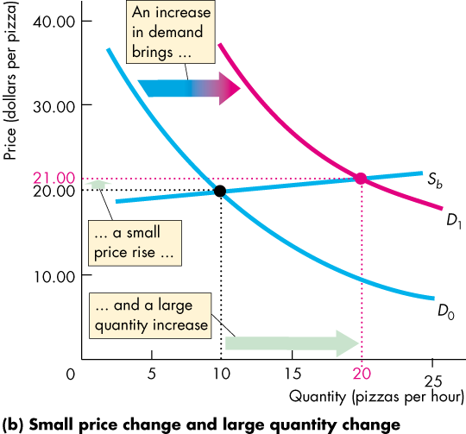
2) Price Elasticity of Supply
  In the Figure, an increase in demand brings
  A small rise in price
  A large increase in the quantity supplied
www.midocean.ae

Slide 28
2) Price Elasticity of Supply
  The contrast between the two outcomes highlights the need for:
  A measure of the responsiveness of the quantity supplied to a price change.
  The price elasticity of supply is a measure of the responsiveness of the quantity supplied to a change in the price of a good when all other influences on selling plans remain the same.
www.midocean.ae

Slide 29
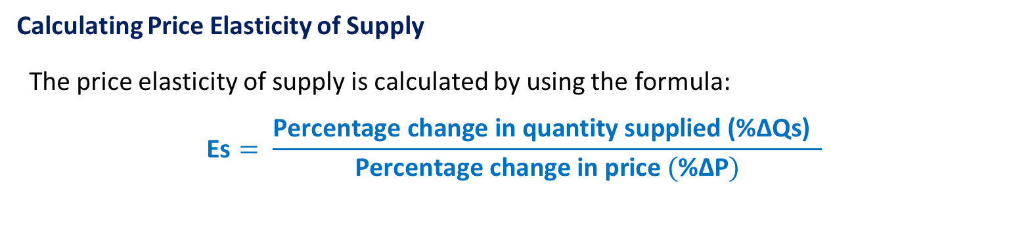
2) Price Elasticity of Supply
Calculating Price Elasticity of Supply
  The price elasticity of supply is calculated by using the formula:
  $$\text{Es}= \frac{\text{Percentage} \text{change} \text{in} \text{quantity} \text{suppli}\text{ed}\text{ (}\text{\%}\text{∆}\text{Qs}\text{)} }{\text{Percentage} \text{change} \text{in} \text{price} (\text{\%}\text{∆}\text{P})}$$
www.midocean.ae

Slide 30

2) Price Elasticity of Supply
Calculating Price Elasticity of Supply
  $$\text{\%}\text{∆}\text{Qs}= \frac{\text{∆}\text{Q}s}{\text{Q}\text{s}\text{.}\text{average}}$$
  $$\text{\%}\text{∆}\text{P}= \frac{\text{∆}\text{P}}{\text{P}\text{.}\text{average}}$$
  $$\text{Q}\text{s}\text{.}\text{average}= \frac{\text{Sum} \text{Q}\text{s}}{\text{n}}$$
  $$\text{P}\text{.}\text{average}=\frac{\text{Sum} \text{P}}{\text{n}}$$
www.midocean.ae

Slide 31
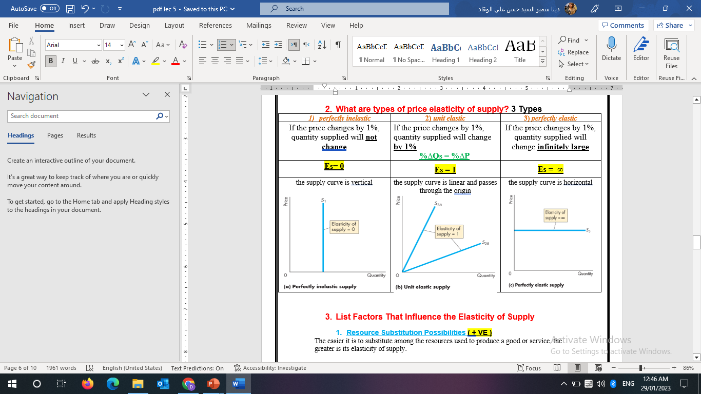
2) Types of Price Elasticity of Supply
3 Types
www.midocean.ae

Slide 32
2) Factors That Influence the Price Elasticity of Supply
Resource Substitution Possibilities ( + VE )
The easier it is to substitute among the resources used to produce a good or service, the greater is its elasticity of supply.
2) Time Frame for Supply Decision ( + VE )
The more time that passes after a price change, the greater is the elasticity of supply.
Momentary supply is perfectly inelastic:
  The quantity supplied immediately following a price change is constant.
Short-run supply is somewhat elastic.
Long-run supply is the most elastic.
www.midocean.ae

Slide 33
Think
The price elasticity of supply tends to be:
a. Smaller in the long run than in the short run.
b. Smaller in the short run than in the long run.
c. larger in the short run than in the long run.
d. Unrelated to the length of time.
If the price increased by 5%, given that elasticity is 5, quantity supplied will:
a. increase by 25%. (5*0.05) *100 = 25%
b. decrease by 1%.
c. decrease by 25%.
d. None of the above.
www.midocean.ae

Slide 34
Think
If the price elasticity of supply is unit elastic how does quantity supplied change in response to a 25% increase in price?
a. Quantity supplied increase by 50%.
b. Quantity supplied decrease by 50%.
c. Quantity supplied decrease by 25%.
d. Quantity supplied increase by 25%.
If the price of a movie ticket increases by 4 percent and the quantity of movies supplied rises by 2 percent, the price elasticity of supply is
a. 2.0.
b. 4.0.
c. 0.5. (0.02/0.04 = 0.5)
d. Some amount that cannot be determined without more information.
www.midocean.ae

Slide 35
Think
If a 3% increase in price leads to an 10% decrease in quantity demanded, demand is
a. Perfectly elastic
b. Elastic
c. Unit elastic
d. Inelastic
8. A perfectly elastic supply curve is
a. Vertical straight line
b. Horizontal straight line
c. Downward-sloping straight line
d. An upward-sloping straight
www.midocean.ae

Slide 36
Think
Which of the following effects a product’s price elasticity of demand?
a. Availability of substitution
b. the time factor
c necessity of the product is to consumers
d. all of the above
Other things being equal, the price elasticity of demand for a product will be more elastic
a. if spending on the item is a very large proportion of the household’s budget
b. if spending on the item is a very small proportion of the household’s budget
c. when the price of the product is very low
d. for a product with no close substitutes
www.midocean.ae

Slide 37
Summary outlines
Elasticity of Demand
  Price Elasticity of Demand (Definition- Calculate – Types - Factors)
  Cross Elasticity of Demand (Definition- Calculate – Types )
  Income Elasticity of Demand (Definition- Calculate – Types )
  Elasticity of Supply (Definition- Calculate – Types - Factors)
www.midocean.ae

Slide 38
Important Notes
Definition of Elasticity:
Elasticity measures the responsiveness of a variable to a change in another variable.
Definition of Elasticity of demand:
The price elasticity of demand measures the responsiveness of the quantity demanded to change in price.
The price elasticity of demand is defined as the magnitude of the percentage change in quantity demanded divided by the percentage change in price.
The price elasticity of demand is estimated at 1.4. This value means a one percent increase in the price will decrease the quantity demanded by 1.4 percent
www.midocean.ae

Slide 39
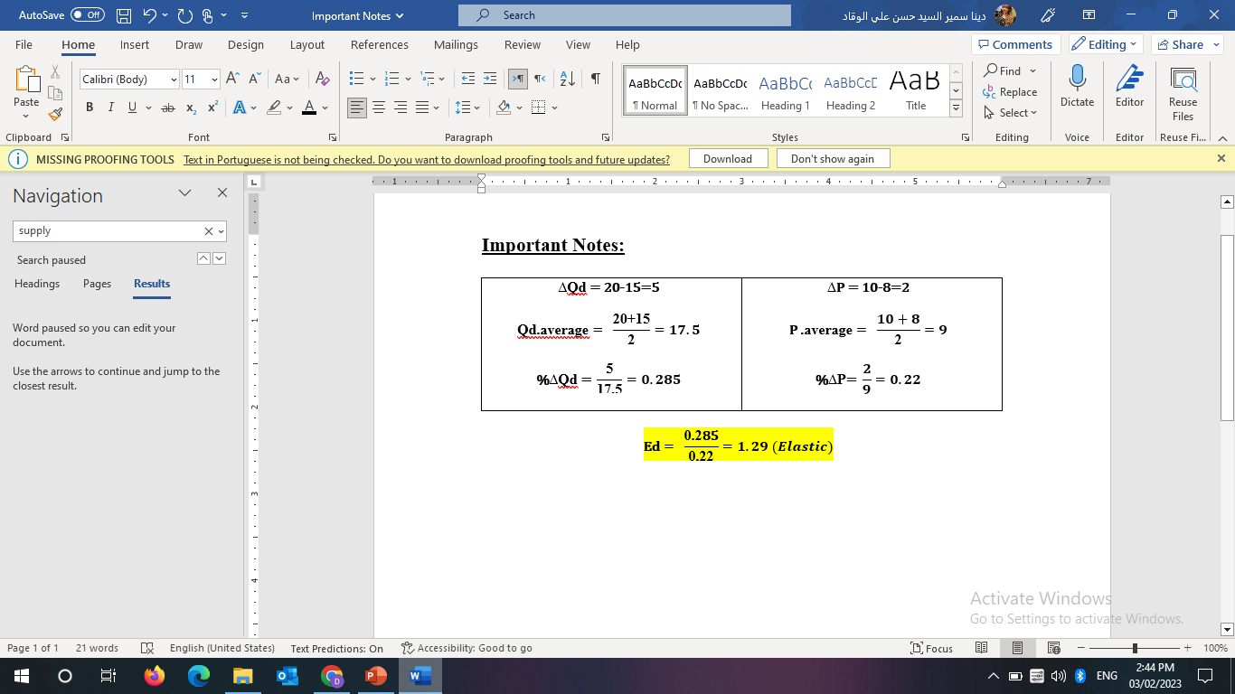
Important Notes
Measure of Elasticity of demand:
The price elasticity of demand is estimated at 0.03. This value means a 10 percent increase in the price of oil will decrease the quantity of oil demanded by 0.3 percent.
A 20 percent increase in the quantity demanded results from a 10 percent decline in its price. The price elasticity is 2.
A 5 percent increase in the quantity demanded results from a 10 percent decline in its price. The price elasticity of demand is 0.5.
If the price decreases by 3 percent and as a result the quantity demanded increases by 12 percent, the price elasticity of demand equals 4.
Using average price and average quantity, calculate the price elasticity of demand if a price rise from $8 to $10 and decreases the quantity demanded from 20 units to 15 units. Calculate The price elasticity of demand.
www.midocean.ae

Slide 40
Important Notes
Types of Price Elasticity of demand:
Dan sells newspapers. Dan says that a 5 percent increase in the price of a newspaper will decrease the quantity of newspapers demanded by 9 percent. According to Dan, the demand for newspapers is elastic.
If the quantity demanded changes by a relatively small amount for a given change in price, then demand is inelastic.
If the price elasticity is between 0 and 1, demand is inelastic.
Demand is inelastic if the price elasticity of demand is less than 1
If a 20 percent increase in the price results in a 10 percent decrease in the quantity demanded, then the demand for used cars is inelastic.
Demand is price inelastic if a relatively large price increase leads to a relatively small decrease in the quantity demanded.
www.midocean.ae

Slide 41
Important Notes
Types of Price Elasticity of demand:
If a consumer is relatively insensitive to changes in the price of a good, then the consumer's demand for the good is inelastic.
If the price of a good increases from $3 to $4, and the quantity demand remains unchanged, then the demand is perfectly inelastic.
If the demand for a good is elastic, when the price increases, the quantity demanded will decrease by a greater percentage than the price increased
If the demand for a good is elastic, the price elasticity of demand is greater than 1.
When the percentage change in quantity demanded equals than the percentage change in price, the demand for the good is unit elastic.
When the price elasticity of demand for a good 0, the demand curve is vertical.
www.midocean.ae

Slide 42
Important Notes
Types of Price Elasticity of supply:
If the supply curve is vertical, then supply is relatively perfectly inelastic.
The elasticity of supply for paintings by Picasso is perfectly inelastic.
The elasticity of supply equals infinity if the supply curve is horizontal.
www.midocean.ae

Slide 43


Thank You

