Slide 1


Final Project-2
Lecture 5
PMG497
L5- Statistical Analysis- P1

Slide 2

Session Outline
Chapter 1: The Where, why, and How of Data Collection
Chapter 2 : Graphs, Charts, and Tables – Describing Your Data
Chapter 3 : Describing Data Using Numerical Measures
Chapter 9: Introduction to Hypothesis Testing
Chapter 14: Introduction to Linear Regression and Correlation Analysis
Chapter 15: Multiple Regression Analysis and Model Building
Business Statistics: A Decision-Making Approach, 7e © 2008 Prentice-Hall, Inc.

Slide 3


Chapter 1-
The Where, why, and How of Data Collection
1

Slide 4
Chapter Goals
After completing this chapter, you should be able to:
Describe key data collection methods
Know key definitions:
  ♦Population vs. Sample ♦Primary vs. Secondary data types
  ♦Qualitative vs. Qualitative data ♦Time Series vs. Cross-Sectional data
Explain the difference between descriptive and
inferential statistics
Describe different sampling methods

Slide 5
Tools of Business Statistics
Descriptive statistics
  Collecting, presenting, and describing data
Inferential statistics
  Drawing conclusions and/or making decisions concerning a population based only on sample data
Business Statistics: A Decision-Making Approach, 7e © 2008 Prentice-Hall, Inc.

Slide 6

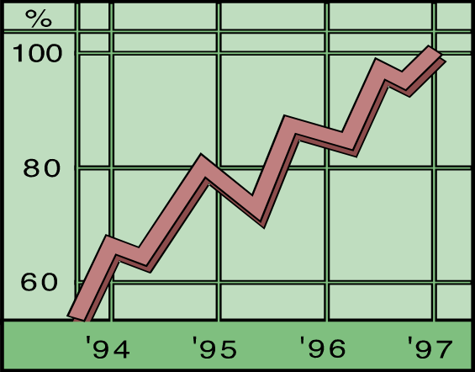
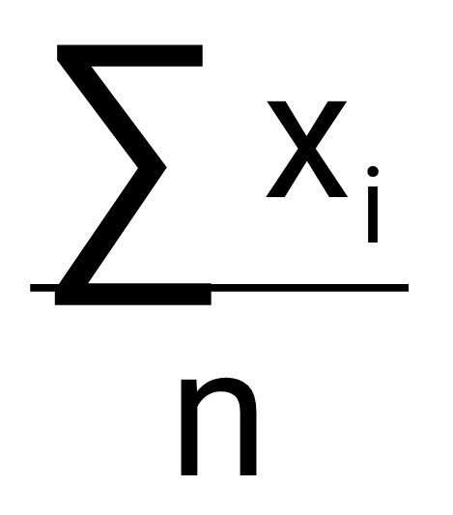
Descriptive Statistics
Collect data
  e.g., Survey, Observation,
  Experiments
Present data
  e.g., Charts and graphs
Characterize data
  e.g., Sample mean =

Slide 7
Inferential Statistics
Making statements about a population by examining sample results
Sample statistics Population parameters
(known) Inference (unknown, but can
be estimated from
sample evidence)

Slide 8
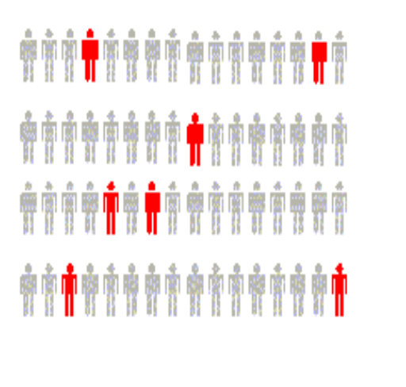
Inferential Statistics
Drawing conclusions and/or making decisions concerning a population based on sample results.
Estimation
  e.g., Estimate the population mean weight using the sample mean weight
Hypothesis Testing
  e.g., Use sample evidence to test the claim that the population mean weight is 120 pounds
Business Statistics: A Decision-Making Approach, 7e © 2008 Prentice-Hall, Inc.

Slide 9




Tools for Collecting Data
Data Collection Methods
Experiments
Written questionnaires
Telephone surveys
Direct observation and personal interview
Business Statistics: A Decision-Making Approach, 7e © 2008 Prentice-Hall, Inc.

Slide 10
Survey Design Steps
Define the issue
  what are the purpose and objectives of the survey?
Define the population of interest
Develop survey questions
  make questions clear and unambiguous
  use universally-accepted definitions
  limit the number of questions
Business Statistics: A Decision-Making Approach, 7e © 2008 Prentice-Hall, Inc.

Slide 11
Survey Design Steps
(continued)
Pre-test the survey
  pilot test with a small group of participants
  assess clarity and length
Determine the sample size and sampling method
Select sample and administer the survey
Business Statistics: A Decision-Making Approach, 7e © 2008 Prentice-Hall, Inc.

Slide 12
Types of Questions
Closed-end Questions
  Select from a short list of defined choices
    Example: Major: __business __liberal arts
    __science __other
Open-end Questions
  Respondents are free to respond with any value, words, or statement
    Example: What did you like best about this course?
Demographic Questions
  Questions about the respondents’ personal characteristics
  Example: Gender: __Female __ Male
Business Statistics: A Decision-Making Approach, 7e © 2008 Prentice-Hall, Inc.

Slide 13
Populations and Samples
A Population is the set of all items or individuals of interest
  Examples: All likely voters in the next election
All parts produced today
All sales receipts for November
A Sample is a subset of the population
  Examples: 1000 voters selected at random for interview
        A few parts selected for destructive testing
        Every 100th receipt selected for audit
Business Statistics: A Decision-Making Approach, 7e © 2008 Prentice-Hall, Inc.

Slide 14
Key Definitions
A population is the entire collection of things under consideration
  A parameter is a summary measure computed to describe a characteristic of the population
A sample is a portion of the population selected for analysis
  A statistic is a summary measure computed to describe a characteristic of the sample
Business Statistics: A Decision-Making Approach, 7e © 2008 Prentice-Hall, Inc.

Slide 15
Population vs. Sample
Population
Sample
a b c d
ef gh i jk l m n
o p q rs t u v w
x y z
b c
g i n
o r u
y
Business Statistics: A Decision-Making Approach, 7e © 2008 Prentice-Hall, Inc.

Slide 16
Why Sample?
Less time consuming than a census
Less costly to administer than a census
It is possible to obtain statistical results of a sufficiently high precision based on samples.
Business Statistics: A Decision-Making Approach, 7e © 2008 Prentice-Hall, Inc.

Slide 17
Sampling Techniques
Sampling Techniques
Nonstatistical Sampling
Statistical Sampling
Convenience
Simple
Random
Systematic
Judgment
Cluster
Stratified
Business Statistics: A Decision-Making Approach, 7e © 2008 Prentice-Hall, Inc.

Slide 18
Statistical Sampling
Items of the sample are chosen based on known or calculable probabilities
Statistical Sampling
(Probability Sampling)
Simple Random
Stratified
Systematic
Cluster
Business Statistics: A Decision-Making Approach, 7e © 2008 Prentice-Hall, Inc.

Slide 19
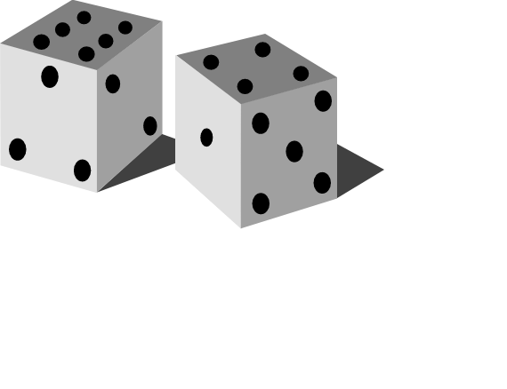
Simple Random Sampling
Every possible sample of a given size has an equal chance of being selected
Selection may be with replacement or without replacement
The sample can be obtained using a table of random numbers or computer random number generator
Business Statistics: A Decision-Making Approach, 7e © 2008 Prentice-Hall, Inc.

Slide 20
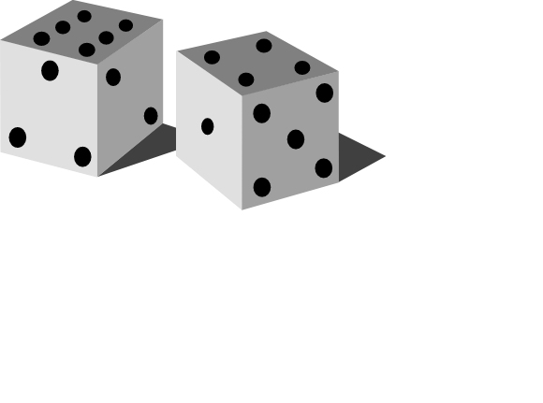
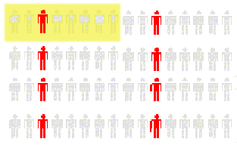
Systematic Random Sampling
Decide on sample size: n
Divide frame of N individuals into groups of k individuals: k=N/n
Randomly select one individual from the 1st group
Select every k^{th} individual thereafter
N = 64
n = 8
k = 8
First Group
Business Statistics: A Decision-Making Approach, 7e © 2008 Prentice-Hall, Inc.

Slide 21
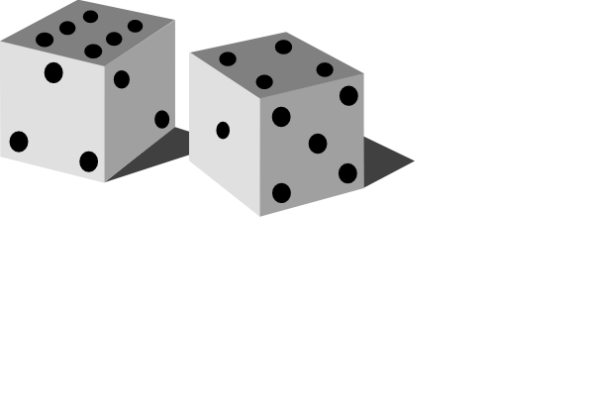
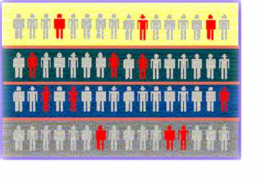

Stratified Random Sampling
Divide population into subgroups (called strata) according to some common characteristic
Select a simple random sample from each subgroup
Combine samples from subgroups into one
Population
Divided
into 4
strata
Sample
Business Statistics: A Decision-Making Approach, 7e © 2008 Prentice-Hall, Inc.

Slide 22
Data Types
Data
Qualitative
(Categorical)
Quantitative
(Numerical)
Examples:
Marital Status
Political Party
Eye Color
(Defined categories)
Discrete
Continuous
Examples:
Number of Children
Defects per hour
(Counted items)
Examples:
Weight
Voltage
(Measured characteristics)

Slide 23
Data Types
Time Series Data
  Ordered data values observed over time
Cross Section Data
  Data values observed at a fixed point in time
Business Statistics: A Decision-Making Approach, 7e © 2008 Prentice-Hall, Inc.

Slide 24
Data Types
 | Sales (in $1000’s)
 | 2003 | 2004 | 2005 | 2006
Atlanta | 435 | 460 | 475 | 490
Boston | 320 | 345 | 375 | 395
Cleveland | 405 | 390 | 410 | 395
Denver | 260 | 270 | 285 | 280
Time Series Data
Cross Section Data
Business Statistics: A Decision-Making Approach, 7e © 2008 Prentice-Hall, Inc.

Slide 25
Data Measurement Levels
Highest Level
Complete Analysis
Measurements
Ratio/Interval Data
Rankings
Ordered Categories
Higher Level
Mid-level Analysis
Ordinal Data
Categorical Codes ID Numbers Category Names
Lowest Level
Basic Analysis
Nominal Data

Slide 26
Chapter 2
Graphs, Charts, and Tables – Describing Your Data
2

Slide 27
Chapter Goals
After completing this chapter, you should be able to:
Construct a frequency distribution
Construct and interpret a histogram
Business Statistics: A Decision-Making Approach, 7e © 2008 Prentice-Hall, Inc.

Slide 28
Frequency Distributions
What is a Frequency Distribution?
A frequency distribution is a list or a table …
containing the values of a variable (or a set of ranges within which the data fall) ...
and the corresponding frequencies with which each value occurs (or frequencies with which data fall within each range)
Business Statistics: A Decision-Making Approach, 7e © 2008 Prentice-Hall, Inc.

Slide 29
Why Use
Frequency Distributions?
A frequency distribution is a way to summarize data
The distribution condenses the raw data into a more useful form...
and allows for a quick visual interpretation of the data
Business Statistics: A Decision-Making Approach, 7e © 2008 Prentice-Hall, Inc.

Slide 30

Frequency Distribution: Discrete Data
Discrete data: possible values are countable
Example: An advertiser asks 200 customers how many days per week they read the daily newspaper.
Number of days read | Frequency
0 | 44
1 | 24
2 | 18
3 | 16
4 | 20
5 | 22
6 | 26
7 | 30
Total | 200
Business Statistics: A Decision-Making Approach, 7e © 2008 Prentice-Hall, Inc.

Slide 31
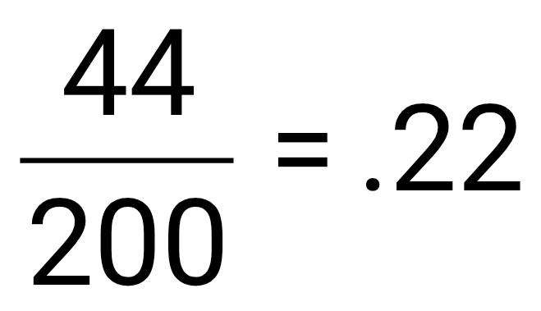
Relative Frequency
Relative Frequency: What proportion is in each category?
Number of days read | Frequency | Relative Frequency
0 | 44 | .22
1 | 24 | .12
2 | 18 | .09
3 | 16 | .08
4 | 20 | .10
5 | 22 | .11
6 | 26 | .13
7 | 30 | .15
Total | 200 | 1.00
22% of the people in the sample report that they read the newspaper 0 days per week
Business Statistics: A Decision-Making Approach, 7e © 2008 Prentice-Hall, Inc.

Slide 32
Frequency Distribution: Continuous Data
Continuous Data: may take on any value in some interval
Example: A manufacturer of insulation randomly selects 20 winter days and records the daily high temperature
24, 35, 17, 21, 24, 37, 26, 46, 58, 30,
32, 13, 12, 38, 41, 43, 44, 27, 53, 27
(Temperature is a continuous variable because it could
be measured to any degree of precision desired)
Business Statistics: A Decision-Making Approach, 7e © 2008 Prentice-Hall, Inc.

Slide 33
Grouping Data by Classes
  Sort raw data from low to high:
12, 13, 17, 21, 24, 24, 26, 27, 27, 30, 32, 35, 37, 38, 41, 43, 44, 46, 53, 58
Find range: 58 - 12 = 46
Select number of classes: 5 (usually between 5 and 20)
Compute class width: 10 (46/5 then round off)
Determine class boundaries:10, 20, 30, 40, 50
(Sometimes class midpoints are reported: 15, 25, 35, 45, 55)
Count the number of values in each class
Business Statistics: A Decision-Making Approach, 7e © 2008 Prentice-Hall, Inc.

Slide 34
Frequency Distribution Example
Data from low to high:
12, 13, 17, 21, 24, 24, 26, 27, 27, 30, 32, 35, 37, 38, 41, 43, 44, 46, 53, 58
Frequency Distribution
Class Frequency
Relative
Frequency
10 but under 20 3 .15
20 but under 30 6 .30
30 but under 40 5 .25
40 but under 50 4 .20
50 but under 60 2 .10
Total 20 1.00
Business Statistics: A Decision-Making Approach, 7e © 2008 Prentice-Hall, Inc.

Slide 35
Frequency Histograms
The classes or intervals are shown on the horizontal axis
frequency is measured on the vertical axis
Bars of the appropriate heights can be used to represent the number of observations within each class
Such a graph is called a histogram
Business Statistics: A Decision-Making Approach, 7e © 2008 Prentice-Hall, Inc.

Slide 36
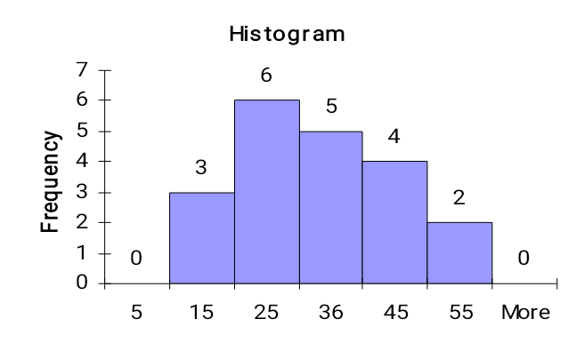
Histogram Example
Data in ordered array:
12, 13, 17, 21, 24, 24, 26, 27, 27, 30, 32, 35, 37, 38, 41, 43, 44, 46, 53, 58
No gaps between bars, since continuous data
0 10 20 30 40 50 60
Class Endpoints
Class Midpoints
Business Statistics: A Decision-Making Approach, 7e © 2008 Prentice-Hall, Inc.

Slide 37
Chapter 3
Describing Data Using
Numerical Measures
3

Slide 38
Chapter Goals
After completing this chapter, you should be able to:
Compute and interpret the mean, median, and mode for a set of data
Compute the range, variance, and standard deviation and know what these values mean
Business Statistics: A Decision-Making Approach, 7e © 2008 Prentice-Hall, Inc.

Slide 39
Chapter Topics
Measures of Center and Location
  Mean, median, mode
Measures of Variation
  Range, variance and standard deviation
Business Statistics: A Decision-Making Approach, 7e © 2008 Prentice-Hall, Inc.

Slide 40
Summary Measures
Describing Data Numerically
Center and Location
Variation
Mean
Range
Median
Variance
Mode
Standard Deviation
Business Statistics: A Decision-Making Approach, 7e © 2008 Prentice-Hall, Inc.

Slide 41
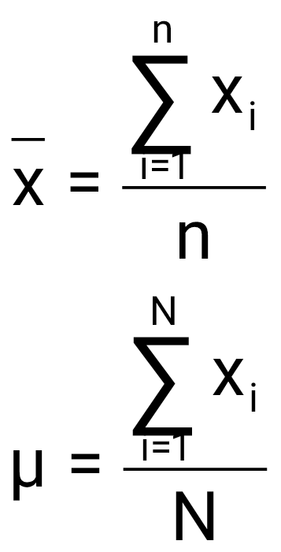
Measures of Center and Location
Overview
Center and Location
Mean
Median
Mode
Business Statistics: A Decision-Making Approach, 7e © 2008 Prentice-Hall, Inc.

Slide 42
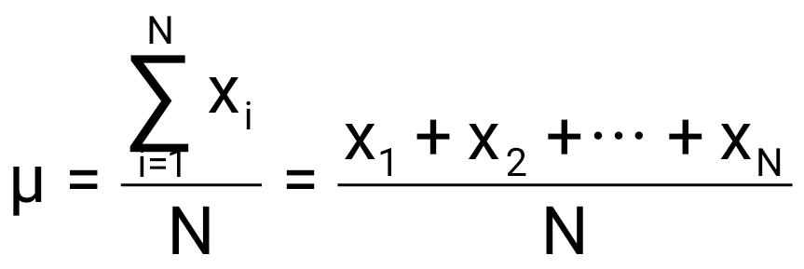
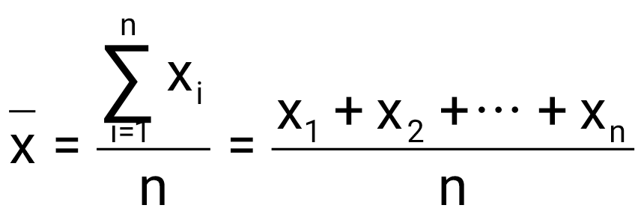
Mean (Arithmetic Average)
The Mean is the arithmetic average of data values
  Population mean
  Sample mean
N = Population Size
n = Sample Size
Business Statistics: A Decision-Making Approach, 7e © 2008 Prentice-Hall, Inc.

Slide 43
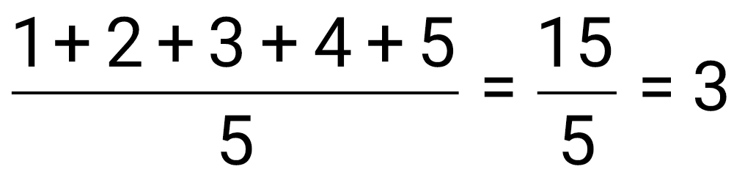
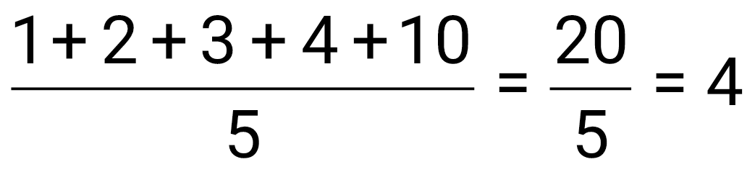
Mean (Arithmetic Average)
(continued)
The most common measure of central tendency
Mean = sum of values divided by the number of values
Affected by extreme values (outliers)
0 1 2 3 4 5 6 7 8 9 10
0 1 2 3 4 5 6 7 8 9 10
Mean = 3
Mean = 4
Business Statistics: A Decision-Making Approach, 7e © 2008 Prentice-Hall, Inc.

Slide 44
Median
In an ordered array, the median is the “middle” number, i.e., the number that splits the distribution in half
The median is not affected by extreme values
0 1 2 3 4 5 6 7 8 9 10
0 1 2 3 4 5 6 7 8 9 10
Median = 3
Median = 3
Business Statistics: A Decision-Making Approach, 7e © 2008 Prentice-Hall, Inc.

Slide 45
Median
(continued)
To find the median, sort the n data values from low to high (sorted data is called a data array)
Find the value in the i = (1/2)n position
The i^{th} position is called the Median Index Point
  If i is not an integer, round up to next highest integer
Business Statistics: A Decision-Making Approach, 7e © 2008 Prentice-Hall, Inc.

Slide 46
Median Example
(continued)
Data array:
4, 4, 5, 5, 9, 11, 12, 14, 16, 19, 22, 23, 24
Note that n = 13
Find the i = (1/2)n position:
i = (1/2)(13) = 6.5
Since 6.5 is not an integer, round up to 7
The median is the value in the 7th position:
M_{d} = 12

Slide 47
Shape of a Distribution
Describes how data is distributed
Symmetric or skewed
Left-Skewed
Symmetric
Right-Skewed
Mean < Median
Mean = Median
Median < Mean
(Longer tail extends to left)
(Longer tail extends to right)
Business Statistics: A Decision-Making Approach, 7e © 2008 Prentice-Hall, Inc.

Slide 48
Mode
A measure of location
The value that occurs most often
Not affected by extreme values
Used for either numerical or categorical data
There may be no mode
There may be several modes
0 1 2 3 4 5 6 7 8 9 10 11 12 13 14
0 1 2 3 4 5 6
Mode = 5
No Mode
Business Statistics: A Decision-Making Approach, 7e © 2008 Prentice-Hall, Inc.

Slide 49
Review Example
Five houses on a hill by the beach
House Prices:
$2,000,000
500,000
300,000
100,000
100,000

Slide 50
Summary Statistics
House Prices:
$2,000,000
500,000
300,000
100,000
100,000
Sum 3,000,000
Mean: ($3,000,000/5)
= $600,000
Median: middle value of ranked data
= $300,000
Mode: most frequent value
= $100,000

Slide 51
Which measure of location is the “best”?
Mean is generally used, unless extreme values (outliers) exist
Then Median is often used, since the median is not sensitive to extreme values.
  Example: Median home prices may be reported for a region – less sensitive to outliers

Slide 52
Distribution Shape and Box and Whisker Plot
Left-Skewed
Symmetric
Right-Skewed
Q1
Q2
Q3
Q1
Q2
Q3
Q1
Q2
Q3
Business Statistics: A Decision-Making Approach, 7e © 2008 Prentice-Hall, Inc.

Slide 53
Measures of Variation
Variation
Range
Variance
Standard Deviation
Population
Variance
Population
Standard
Deviation
Sample
Variance
Sample
Standard
Deviation
Business Statistics: A Decision-Making Approach, 7e © 2008 Prentice-Hall, Inc.

Slide 54
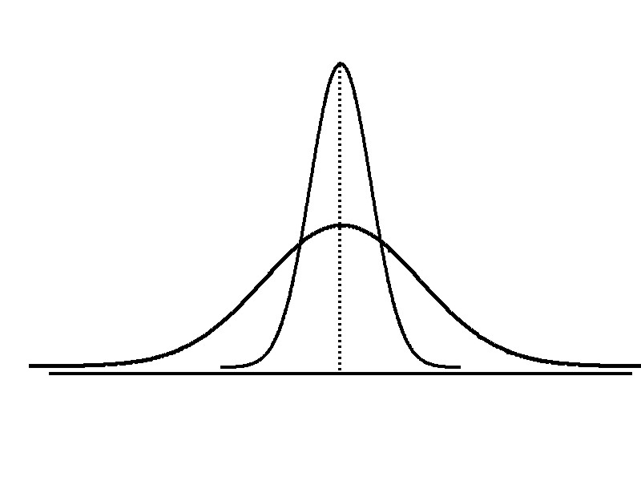
Variation
Measures of variation give information on the spread or variability of the data values.
Same center,
different variation

Slide 55
Range
Simplest measure of variation
Difference between the largest and the smallest observations:
Range = x_{maximum} – x_{minimum}
Example:
0 1 2 3 4 5 6 7 8 9 10 11 12 13 14
Range = 14 - 1 = 13
Business Statistics: A Decision-Making Approach, 7e © 2008 Prentice-Hall, Inc.

Slide 56
Disadvantages of the Range
Ignores the way in which data are distributed
Sensitive to outliers
7 8 9 10 11 12
7 8 9 10 11 12
Range = 12 - 7 = 5
Range = 12 - 7 = 5
1,1,1,1,1,1,1,1,1,1,1,2,2,2,2,2,2,2,2,3,3,3,3,4,5
Range = 5 - 1 = 4
1,1,1,1,1,1,1,1,1,1,1,2,2,2,2,2,2,2,2,3,3,3,3,4,120
Range = 120 - 1 = 119
Business Statistics: A Decision-Making Approach, 7e © 2008 Prentice-Hall, Inc.

Slide 57
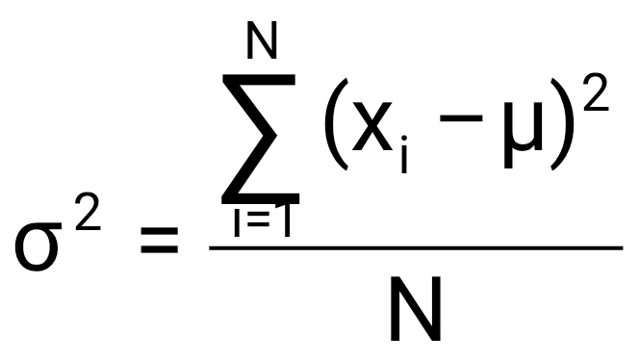
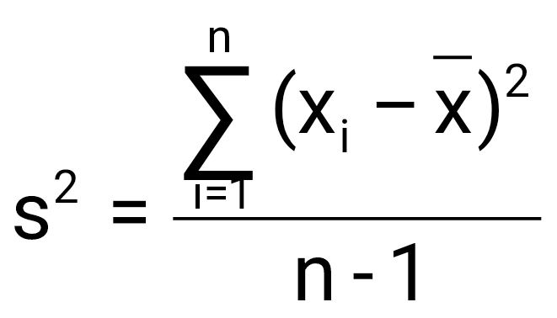
Variance
Average of squared deviations of values from the mean
  Population variance:
  Sample variance:
Business Statistics: A Decision-Making Approach, 7e © 2008 Prentice-Hall, Inc.

Slide 58
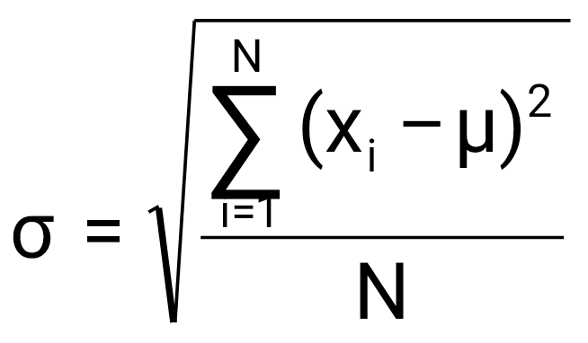
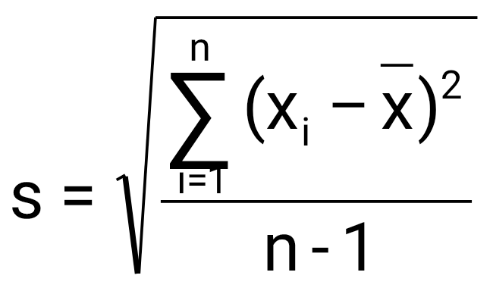
Standard Deviation
Most commonly used measure of variation
Shows variation about the mean
Has the same units as the original data
  Population standard deviation:
  Sample standard deviation:
Business Statistics: A Decision-Making Approach, 7e © 2008 Prentice-Hall, Inc.

Slide 59
Calculation Example: Sample Standard Deviation
Sample
Data (X_{i}) : 10 12 14 15 17 18 18 24
n = 8 Mean = x = 16

Slide 60
Chapter 9
Introduction to
Hypothesis Testing
4

Slide 61
Chapter Goals
After completing this chapter, you should be able to:
Formulate null and alternative hypotheses for applications involving a single population mean or proportion
Formulate a decision rule for testing a hypothesis
Know how to use the test statistic, critical value, and p-value approaches to test the null hypothesis
Know what Type I and Type II errors are
Compute the probability of a Type II error
Business Statistics: A Decision-Making Approach, 7e © 2008 Prentice-Hall, Inc.

Slide 62

What is a Hypothesis?
A hypothesis is a claim
(assumption) about a
population parameter:
Business Statistics: A Decision-Making Approach, 7e © 2008 Prentice-Hall, Inc.

Slide 63

The Null Hypothesis, H₀
(continued)
Begin with the assumption that the null hypothesis is true
  Similar to the notion of innocent until
  proven guilty
Refers to the status quo
May or may not be rejected
Business Statistics: A Decision-Making Approach, 7e © 2008 Prentice-Hall, Inc.

Slide 64
The Alternative Hypothesis, H_{A}
Is the opposite of the null hypothesis
  e.g.: Challenges the status quo
May or may not be accepted
Is generally the hypothesis that is believed (or needs to be supported) by the researcher – a research hypothesis
Business Statistics: A Decision-Making Approach, 7e © 2008 Prentice-Hall, Inc.

Slide 65
Errors in Making Decisions
Type I Error
  Reject a true null hypothesis
  Considered a serious type of error
  The probability of Type I Error is α
    Called level of significance of the test
    Set by researcher in advance
Business Statistics: A Decision-Making Approach, 7e © 2008 Prentice-Hall, Inc.

Slide 66
Errors in Making Decisions
(continued)
Type II Error
  Fail to reject a false null hypothesis
  The probability of Type II Error is β
  β is a calculated value, the formula is discussed later in the chapter
Business Statistics: A Decision-Making Approach, 7e © 2008 Prentice-Hall, Inc.

Slide 67
Outcomes and Probabilities
Possible Hypothesis Test Outcomes
State of Nature
Decision
H₀ True
H₀ False
Do Not
No error
(1 - )
Type II Error
( β )
Reject
Key:
Outcome
(Probability)
α
H
0
Reject
Type I Error
( )
No Error
( 1 - β )
H
α
0

Slide 68
Type I & II Error Relationship
Type I and Type II errors cannot happen at
the same time
  Type I error can only occur if H₀ is true
  Type II error can only occur if H₀ is false
Business Statistics: A Decision-Making Approach, 7e © 2008 Prentice-Hall, Inc.

Slide 69
Level of Significance, α
Defines unlikely values of sample statistic if null hypothesis is true
  Defines rejection region of the sampling distribution
Is designated by α , (level of significance)
  Typical values are .01, .05, or .10
Is selected by the researcher at the beginning
Provides the critical value(s) of the test
Business Statistics: A Decision-Making Approach, 7e © 2008 Prentice-Hall, Inc.

Slide 70
Process of Hypothesis Testing
1. Specify population parameter of interest
2. Formulate the null and alternative hypotheses
3. Specify the desired significance level, α
4. Define the rejection region
5. Take a random sample and determine whether or not the sample result is in the rejection region
6. Reach a decision and draw a conclusion
Business Statistics: A Decision-Making Approach, 7e © 2008 Prentice-Hall, Inc.

Slide 71
P-Value Approach to Testing
Determine the p-value from a table or computer
Compare the p-value with α
  If p-value < α , reject H₀
  If p-value ≥ α , do not reject H₀
Business Statistics: A Decision-Making Approach, 7e © 2008 Prentice-Hall, Inc.

Slide 72



Thank You

