Slide 1

Assistant professor of Business Administration
Department of Management
(MGM 630)
Strategic and Operational Management
Dr. Adam Yagoub
جامعة الجميع الذكية

Slide 2
Lecture 1
Basic Model of Strategic Management
What Strategy Is: Gaining and Sustaining Competitive Advantage.
Stakeholders and Competitive Advantage.
The AFI Strategy Framework.

Slide 3
Lecture 2
Strategic Leadership: Managing the Strategy Process
Vision, Mission, and Values
Strategic Leadership.
The Strategic Management Process.

Slide 4
Lecture 3
External Analysis: Industry Structure, Competitive Forces, and Strategic Groups
The PESTEL Framework .
Industry Structure and Firm Strategy: The Five Forces Model.
Changes over Time: Industry Dynamics.
Performance Differences within the Same Industry: Strategic Groups.

Slide 5
Lecture 4
Internal Analysis: Resources, Capabilities, and Core Competencies
Core Competencies.
The Resource-Based View.
The Dynamic Capabilities Perspective.
The Value Chain Analysis.
Implications for the Strategist.

Slide 6
Lecture 5
Competitive Advantage, Firm Performance, and Business Models
Competitive Advantage and Firm Performance.
Business Models: Putting Strategy into Action.

Slide 7
Lecture 6
Business Strategy: Differentiation, Cost Leadership, and Blue Oceans
Business-Level Strategy: How to Compete for Advantage
Differentiation Strategy: Understanding Value Drivers
Cost-Leadership Strategy: Understanding Cost Drivers
Business-Level Strategy and the Five Forces: Benefits and Risks
Blue Ocean Strategy: Combining Differentiation and Cost Leadership

Slide 8
Lecture 7
Corporate Strategy: Vertical Integration and Diversification
What Is Corporate Strategy?
The Boundaries of the Firm:
Vertical Integration along the Industry Value Chain:
Corporate Diversification: Expanding Beyond a Single Market,

Slide 9
Lecture 8
Organizational Design: Structure, Culture, and Control
Organizational Design and Competitive Advantage.
Strategy and Structure.
Organizational Culture: Values, Norms, and Artifacts.
Strategic Control-and-Reward Systems.

Slide 10
Lecture 9
Corporate Governance and Business Ethics
1. The Shared Value Creation Framework.
2. Corporate Governance.
3. Strategy and Business Ethics.

Slide 11
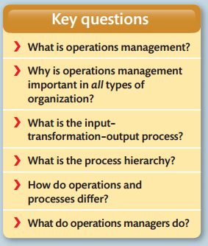
Lecture 10
Operations management

Slide 12
Course Learning Outcomes
- Understand the business process and analyze the operations
- Acquire knowledge of production planning and resource management
- Understand the concept of Corporate Vision - Mission and Objectives

Slide 13
Course Learning Outcomes
- Understand the concept of SWOT and Portfolio Analysis
- Understand the different stages in strategy formulation process
- Understand the concept of Strategic Business Unit and Business Process re-engineering.

Slide 14
1. Strategic management, third edition, 2017
By Frank t. Rothaermel
Georgia Institute of Technology
2. Operations management, Eighth edition
By Nigel Slack Alistair Brandon-Jones
Robert Johnston
References

Slide 15
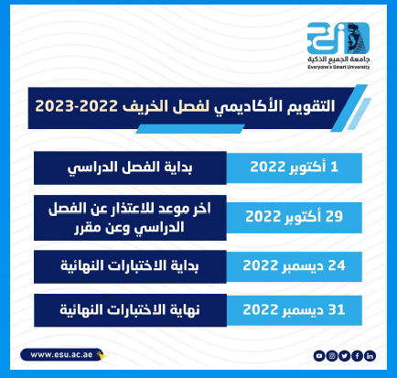

Slide 16
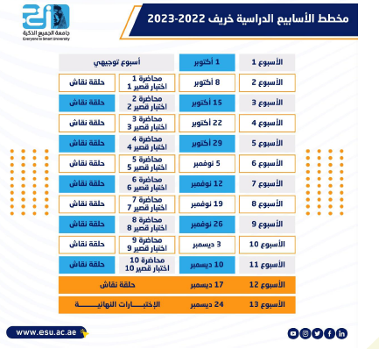

Slide 17
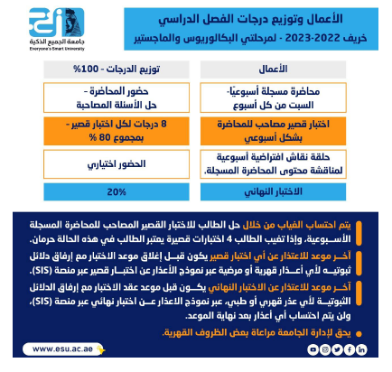

Slide 18
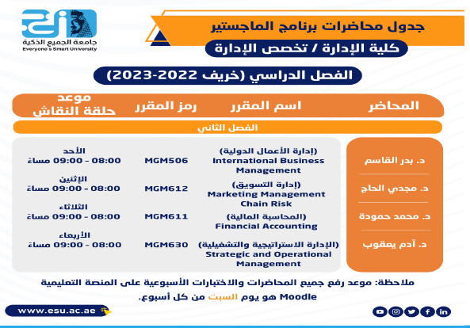

Slide 19


Slide 20


