Slide 1



Communication skills
Prepared by Dr. Merna Emad
Lecture 4
www.midocean.ae

Slide 2

Section two
Listening styles
Improving Your Listening
Lecture
KEYS for Listening Excellence
Section one
Hearing and Listening
Listening barriers

Slide 3
SECTION ONE

Slide 4
HEARING AND LISTENING

Slide 5
Hearing and Listening
Did you know?
The average person remembers between 25% and 50% of what he or she hears. That means that when you talk to your boss, your colleagues or customers, your friends and family, they are likely to retain less than half of the conversation.

Slide 6
Hearing and Listening
Hearing
is your physical ability to detect sounds. It is the physiological process or function of receiving sounds.
For example, we are accustomed to the sounds of airplanes, lawn mowers, furnace blowers, the rattling of pots and pans, and so on. We hear those incidental sounds and, unless we have a reason to do otherwise, we train ourselves to ignore them.

Slide 7
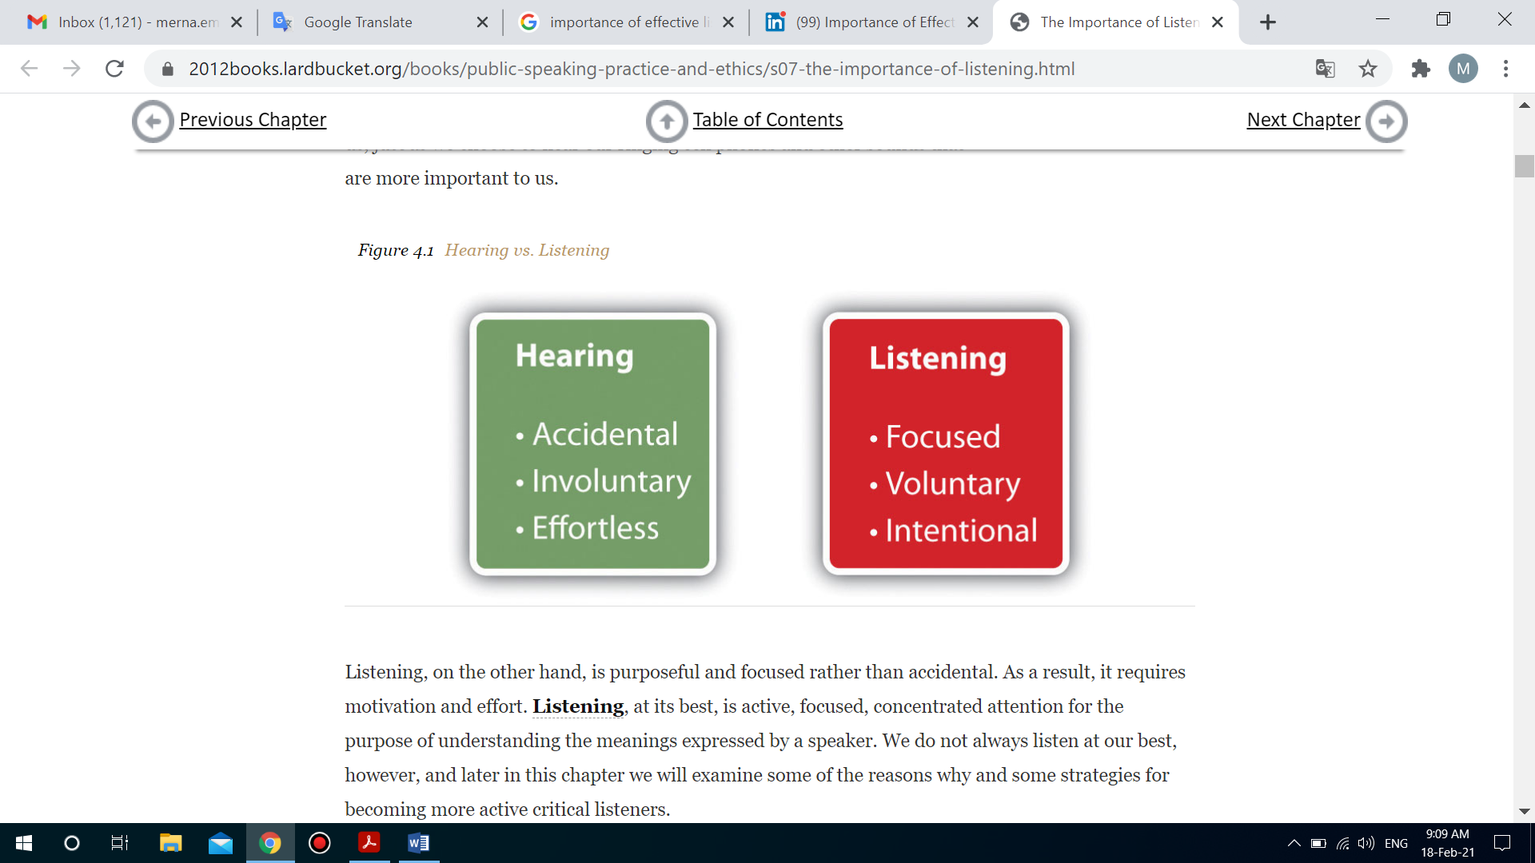
Hearing and Listening
Listening
requires you to concentrate on the verbal and nonverbal messages being sent and to determine the meaning of those messages. Listening, at its best, is active, focused, concentrated attention for the purpose of understanding the meanings expressed by a speaker.

Slide 8
Hearing and Listening
Importance of Effective Listening
Effective listening is central to fostering interpersonal relationships with coworkers, leaders, and clients.
Effective listening can affect one’s relationship satisfaction and can be a determining factor in whether someone is an effective communicator.
Effective listening can enhance your image as People Will Perceive You as Intelligent and Perceptive.
Good Listening Can Help Your Public Speaking. As a result, you have the ability to analyze what you think works and doesn’t work in others’ speeches, which can help you transform your speeches in the process.

Slide 9
Hearing and Listening
Importance of Effective Listening
Listening, in addition to other communication abilities, is a likely predictor of who gets promoted or receives other relevant rewards, such as status and power.
Better listeners hold higher-level positions and are promoted more often than those with less-developed listening abilities.

Slide 10
Hearing and Listening
Characteristics of Good Listener
Admits that listening is difficult.
Pays effort to carefully listen.
Reviews and mentally summarizes the talking points.
Pays attention to nonverbal communication (facial expressions, gestures, tone of voice) to see if it adds meaning to the spoken words.
Weighs the evidence used by the talker to support the points he or she makes.
Never forget to practice.

Slide 11
BARRIERS TO LISTENING

Slide 12
Barriers to Listening
Failing to Limit Distractions
Noise is part of every communication interaction.
External noise
Internal noise

Slide 13
Barriers to Listening
Failing to Limit Distractions
External noise
External noise includes external distractions.
For example, Audible talking during a meeting, ruffling of papers, or a cell phone going off in the next cubicle.
How to avoid?
Whenever possible, you should take steps to control the external noise that might interfere with your ability to listen to others, as well as their ability to listen to you.

Slide 14
Barriers to Listening
Failing to Limit Distractions
External noise
How to avoid?
When you are talking to someone on the phone, turn away from your computer if you are distracted by messages in your inbox.
If you are running a meeting, begin by asking everyone to turn off their cell phones.
If the work environment is such that it is difficult for people to break away from distractions, hold a retreat away from your worksite to maximize the team’s ability to listen effectively.

Slide 15
Barriers to Listening
Failing to Limit Distractions
Internal noise
Internal noise encompasses any internal condition or state that interferes with the communicator’s ability to focus on the message.
For example,
We think of our personal problems during the business meeting so we don’t pay attention to all the business details.
We think of our lunch meal while listening to a friend’s problem so we miss up lots of details.
We think of answers during discussions to argue well not to communicate well.

Slide 16
Barriers to Listening
Failing to Limit Distractions
External noise
How to avoid?
Controlling internal noise in others can be difficult, however it is not impossible.
You must reflect on what is causing your internal noise.
Address those factors.
If you have an urgent matter to deal with, don’t try to hold a conversation with someone. You simply won’t be able to listen.
Tell the other party you will need to reschedule your conversation for a time when you can give your undivided attention.

Slide 17
Barriers to Listening
Failing to Focus on the Message
WHY?
Because of the theme of our area.
Noise
In the ever-changing world of social media and emerging technology, we are locked into a mode of continuous partial attention.
We are always scanning our smartphones for the next bit of news or the latest update. Multitasking is the norm, despite some evidence that it prevents us from doing anything to the best of our abilities.

Slide 18
Barriers to Listening
Failing to Focus on the Message
WHY?
Because of speakers’ mistakes
If a speaker uses jargon (technical words used by specialized groups) with which you are not familiar.
If there is no common understanding, language can separate, insulate, and intimidate.
Message overload can have the same impact as jargon. Message overload occurs when a speaker includes too many details in a message, making it difficult for the listener to comprehend.

Slide 19
Barriers to Listening
Failing to Focus on the Message
WHY?
Because of presenters’ mistakes
Presenters make the mistake of not introducing the direction of the presentation and not summarizing their talk.
Presenters sometimes make the mistake of including too many graphs and charts during their talks.
PowerPoint slides are made up with so many details and non-relatable information.

Slide 20
Barriers to Listening
Failing to Focus on the Message
How to avoid?
If the environment is not suitable for you, try to postpone the meeting or highlight that you are not concentrating.
Leave your smartphone during any kind of conversation.
Read the non-verbal communication well as much attention you pay as you listen to the verbal communication.
Try to concentrate on the main points during a mess presentations and sum up the content by yourself.
Ask questions.

Slide 21
Barriers to Listening
Failing to Focus on the Message
Our bias
Bias is any assumption we make or attitude we have about a person, an issue, or a topic before we have heard all the facts.
Why it happens?
If you equate a speaker with subject matter or experiences that have made you feel frustrated or angry in the past, chances are good that you will be biased about that person before he or she gives the speech.
For example,
If you feel strongly about a particular topic because of your values, you may refuse to listen to any other perspective, no matter whom it comes from

Slide 22
Barriers to Listening
Our bias
How to avoid?
Effective listening requires you to put your biases aside and regard the other as having a valid point of view worthy of your time and careful attention.
Admit that it is not a right thing.
Listen to the message the other person trying to say until the end.
Think of the message while breathing deeply.
Evaluate it.

Slide 23
Barriers to Listening
Failing to be an active listener
An active listener focuses on asking questions and will often listen to the message and then paraphrase it for the sender.
We cannot be active listeners unless we know the deference between various types of listening.
In your professional career, you will engage in three types of listening:
Informational listening
Empathetic listening
Critical listening

Slide 24
Barriers to Listening
Failing to be an active listener
Informational listening
Informational listening occurs when you focus on the content of the message to acquire knowledge. Part of learning a new position involves listening to information during new-employee orientation and one-on-one training.
Critical listening
Critical listening asks you to evaluate the information being sent.
Empathetic listening
Empathetic listening is listening to understand the speaker’s point of view without judgment.

Slide 25
Barriers to Listening
Failing to be an active listener
How to avoid?
Consciously decide if you are going to be an active listener or a passive listener.
Listens thoughtfully to the meaning of the speaker’s words;
Considers the content of the message, both stated and implied;
Thinks about the feelings associated with the message, attending to the speaker’s verbal and nonverbal cues;
Makes every effort to reflect that message accurately.
Asking questions, you can develop a better understanding of the speaker’s message and provide support to the speaker.

Slide 26
SECTION TWO

Slide 27
LISTENING STYLES

Slide 28
Listening styles
People
The people-oriented listener is interested in the speaker. People-oriented listeners listen to the message in order to learn how the speaker thinks and how they feel about their message.
For example,
For instance, when people-oriented listeners listen to an interview with a famous rap artist, they are likely to be more curious about the artist as an individual than about music, even though the people-oriented listener might also appreciate the artist’s work. If you are a people-oriented listener, you might have certain questions you hope will be answered, such as:
Does the artist feel successful?
What is it like to be famous?
What kind of educational background does he or she have?

Slide 29
Listening styles
People
The people-oriented listener is interested in the speaker. People-oriented listeners listen to the message in order to learn how the speaker thinks and how they feel about their message.
Key type
The people-oriented listener is likely to be more attentive to the speaker than to the message. If you tend to be such a listener, understand that the message is about what is important to the speaker.

Slide 30
Listening styles
Action
Action-oriented listeners are primarily interested in finding out what the speaker wants.
when you are in a meeting and the manager reviews the yearly evaluation. You tend to concentrate on the final results and what should be done next year. You are not interesting on how we get there or what are the feelings of my manager and Co-workers.
For example,
Key type
Action-oriented listening is sometimes called task-oriented listening. In it, the listener seeks a clear message about what needs to be done, and might have less patience for listening to the reasons behind the task.

Slide 31
Listening styles
Content
Content-oriented listeners are interested in the message itself, whether it makes sense, what it means, and whether it’s accurate.
When you give a speech, many members of your classroom audience will be content-oriented listeners who will be interested in learning from you. You therefore have an obligation to represent the truth in the fullest way you can. You can emphasize an idea, but if you exaggerate, you could lose credibility in the minds of your content-oriented audience.
For example,
Key type
content-oriented listeners want to listen to well-developed information with solid explanations.

Slide 32
Listening styles
Time
People using a time-oriented listening style prefer a message that gets to the point quickly. Time-oriented listeners can become impatient with slow delivery or lengthy explanations.
In your professional future, some of your audience members will have real time constraints, not merely perceived ones. Imagine that you’ve been asked to deliver a speech on a new project to the board of directors of a local corporation. If your speech is long and filled with overly detailed information, time-oriented listeners will simply start to tune you out as you’re speaking and they will not be listening to your message.
For example,
Key type
This type of listeners may be receptive for only a brief amount of time; therefore, they tend to be impatient. Time-oriented listeners convey their impatience through eye rolling, shifting about in their seats, checking their cell phones, and other inappropriate behaviors. They want the pure message in the shortest time.

Slide 33
IMPROVING YOUR LISENTING

Slide 34
Improving your Listening
The HURIER model provides a framework for skill-based listening by defining listening as six interrelated components:
Hearing
Understanding
Remembering
Interpreting
Evaluating
Responding

Slide 35
Improving your Listening
Hearing
Hearing refers to concentrating on and attending to the message.
Steps
Making sure you can properly hear the other person.
Be sure that you limit any distractions that would prevent you from doing so.
Understanding is the process of attaching meaning to the verbal communication, or comprehending the literal meaning of the message.

Slide 36
Improving your Listening
Understanding
Understanding is the process of attaching meaning to the verbal communication, or comprehending the literal meaning of the message.
Steps
Hear the message
Understand the speaker’s use of language and the basic context of the information considering all the other factors.

Slide 37
Improving your Listening
Remembering
Remembering includes recalling the message so that it can be acted on.
Steps
Be present
Be mindful
Create an outline of the main points.

Slide 38
Improving your Listening
Interpreting
Interpreting is the step where we make sense of the verbal and nonverbal codes to assign meaning to the information received or the sensitivity to nonverbal and contextual aspects of the message.
Steps
Be Observant
Aside your bias.

Slide 39
Improving your Listening
Evaluating
Evaluating is the logical assessment of the value of the message.
Learning to evaluate a message without bias, distractions, apprehension, or gender/cultural differences takes time and patience.
Steps
Be Observant
Consider the message with its details.
Listen to the end.
Logically evaluate.

Slide 40
Improving your Listening
Responding
Responding is the last step and involves giving some form of response to the message, either verbally or nonverbally.
Steps
Paraphrasing
Summarizing
Reflecting
Asking questions
Using nonverbal cues such as head nods, emotional expressions.

Slide 41
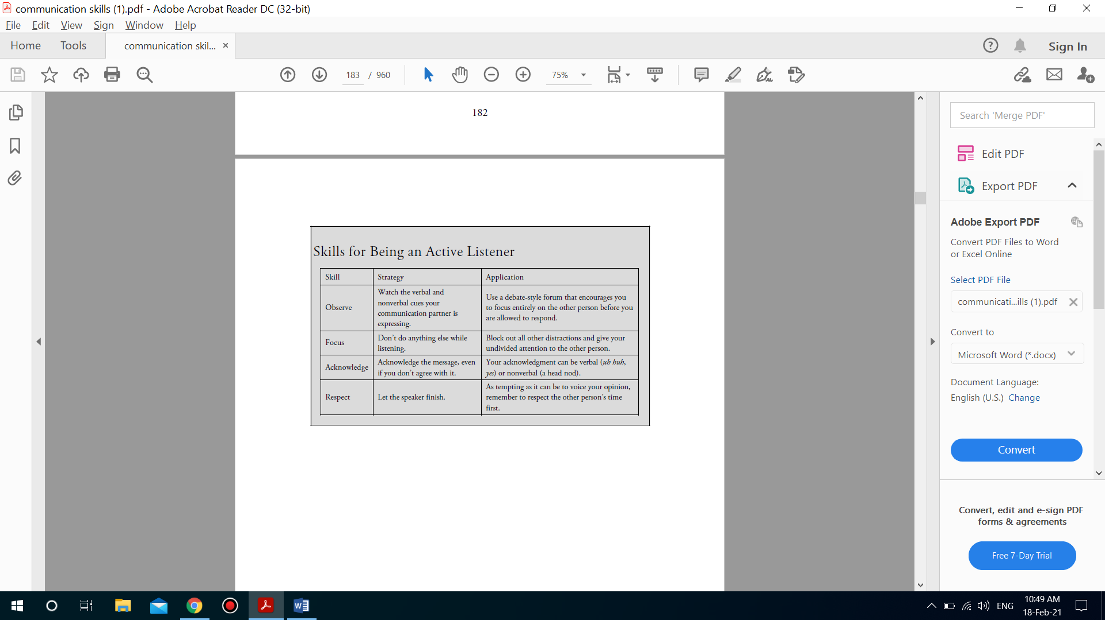
Improving your Listening

Slide 42
KEYS for Excellence in the Workplace

Slide 43
KEYS for Excellence in the Workplace
K
Know yourself
Understand the components of being an active listener and critically apply them to your professional interactions. Realize your strengths and weaknesses as a listener and adapt accordingly.
E
Evaluate the professional context
Learn whether your professional environment uses formal or informal communication. In addition, pay attention to jargon used at your work. Use active listening to create understanding of words or phrases you are not familiar with.

Slide 44
KEYS for Excellence in the Workplace
Y
Your communication interaction
Take what you have learned from the first two steps and try communicating with fellow business professionals. Are you using the workplace jargon correctly and effectively? Be critical about the responses you receive from your peers.
S
Step back and reflect
Ask yourself if you and your communication partner(s) came away from the interaction with mutual understanding. Think about what was effective and what was not. Repeat the process to gain greater and more effective strategies for being a good listener and a good communicator.

Slide 45




Thank You

