Slide 1

Introduction to Cryptography
Prepared by Dr. Mohammad Alkhatib
Associate Professor
Major: Information Security
Lecture #4: AES Algorithm

Slide 2

Module 2
Cryptography Algorithms
AES Algorithm
Introduction to AES
High-level description
Confusion & Diffusion for secure block cipher
Feistel Network
DES Encryption Process
Internal Structure of DES Algorithm

Slide 3
Module 2
Classification of the field of Cryptology
Cryptology
Cryptography
Cryptanalysis
Symmetric Ciphers
Asymmetric Ciphers
Protocols
Block Ciphers
Stream Ciphers
DES
AES

Slide 4
Module 2
Classification of the field of Cryptology
AES (Rijndael) uses (encrypts/decrypts) a block length of 128 bits, and support key length of 128, 192, or 256 bits
Therefore, three key lengths must be supported by Rijndael as this was a NIST design requirement
128 bits
AES
128 bits
X
Y
Key 128, 192, 256 bits

Slide 5
Module 2
Overview of the AES Algorithm
The number of internal rounds of the AES cipher depends on the key length.
Number of Rounds (nr) | Key Length of AES
10 | 128 bits
12 | 192 bits
14 | 256 bits
For almost all Commercial applications
AES does not have a Feistel structure. It is worth mentioning that the Feistel networks do not encrypt an entire block per iteration, while AES encrypts all 128 bits in one iteration.
AES contains small number of encryption rounds, compared to DES

Slide 6
Module 2
Overview of the AES Algorithm
Motivations:
AES is currently the most important symmetric key algorithm in the world. Researchers estimate that more than 50% of data encrypted in the last decade use AES algorithm.
There are enormous amount of applications that use AES algorithm, such as wifi connection, vlan, …. etc..
NSA allows to encrypt classified data (up to Top Secret) using AES algorithm with key length = 192 bits or 256 bits.

Slide 7
Module 2
Overview of the AES Algorithm
AES consists of so-called layers. Each layer manipulates all 128 bits of the data path (also called the state of the algorithm).
In AES, there are three different types of layers, as follows:
Key Addition layer
Byte Substitution layer (S-Box)
Diffusion layer
Each round, except the first, consists of all three layers
The last round nr does not make use of the MixColumn transformation,

Slide 8
Module 2
Overview of the AES Algorithm (Encryption Layers)
Key Addition layer: A 128-bit round key (also called subkey), which has been derived from the main key in the key schedule, is XORed to the state (data path to be encrypted (128 bits)).
Byte Substitution layer (S-Box): Each element of the state is nonlinearly transformed using lookup tables with special mathematical properties, which provides confusion to the data.

Slide 9
Module 2
Overview of the AES Algorithm (Encryption Layers)
3. Diffusion layer: It provides diffusion over all state bits, and consists of two sublayers, as follows:
The ShiftRows layer permutes the data on a byte level.
The MixColumn layer is a matrix operation which combines (mixes) blocks of four bytes.

Slide 10
Module 2
Overview of the AES Algorithm
Since it is a symmetric key algorithm, it has one main key shared between sender and recipient.
The key schedule computes round keys, or subkeys, (k0,k1, . . . ,knr ) from the original AES key.
It should be mentioned at this stage that all operations within the AES layers use Galois field computations
Galois field is a new mathematical concept, which is widely used in cryptographic operations for both symmetric and public-key algorithms

Slide 11
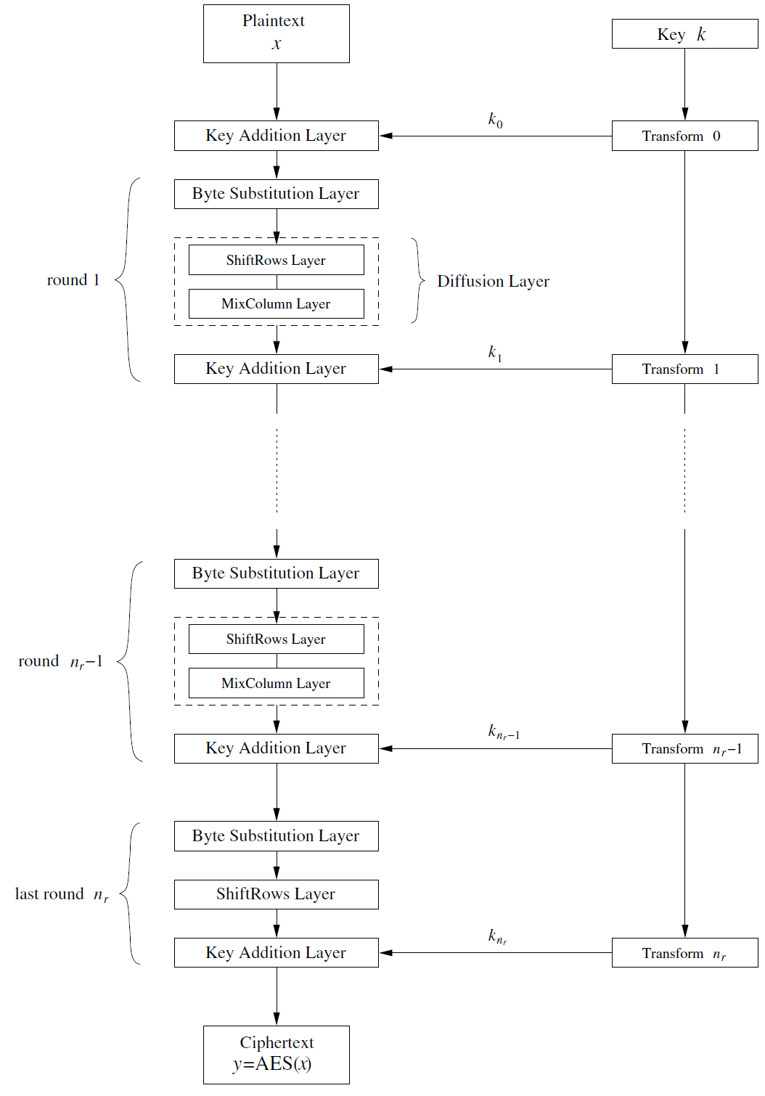
Module 2
Overview of the AES Algorithm

Slide 12
Module 2
Overview of the AES Algorithm
Question: What does happen inside the layers??

Slide 13
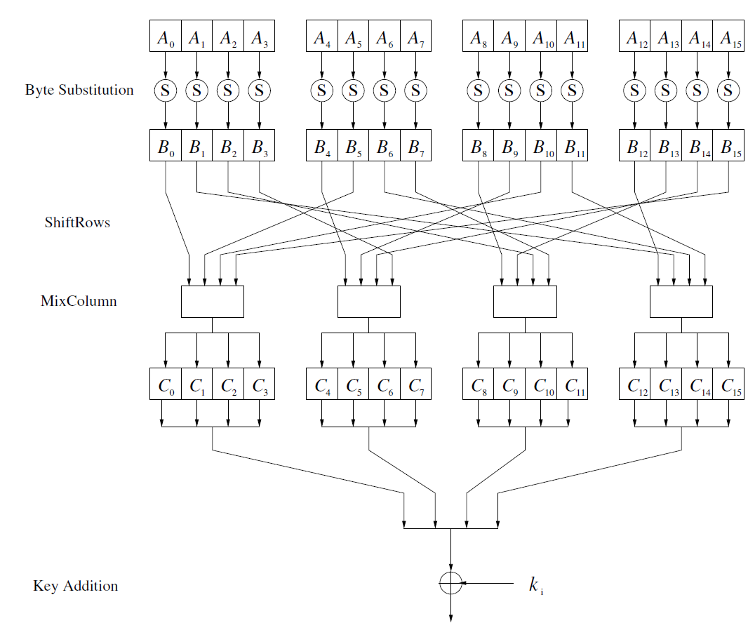
Module 2
Internal Structure of AES Algorithm
Internal structure of a single AES round

Slide 14
Module 2
Internal Structure of AES Algorithm
Note that AES is not a feistel network algorithm
Each encryption round of AES can be described as follows:
The 16-byte input A0, . . . ,A15 is fed byte-wise into the S-Box
The 16-byte output B0, . . . ,B15 is permuted byte-wise in the ShiftRows layer
Then, the output is mixed by the MixColumn transformation c(x).
Finally, the 128-bit subkey ki is XORed with the intermediate result
Note: Unlike DES, the AES is a byte-oriented cipher
Note that at the beginning of AES and the very end, a sub-key is added (key whitening)

Slide 15
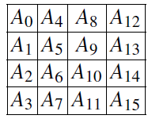
Module 2
Internal Structure of AES Algorithm
In order to understand how the data moves through AES, we first imagine that the
state A (i.e., the 128-bit data path) consisting of 16 bytes A0,A1, . . . ,A15 is arranged in a four-by-four byte matrix:

Slide 16
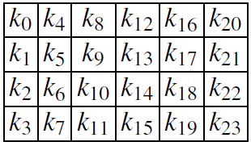
Module 2
Internal Structure of AES Algorithm
AES operates on elements, columns or rows of the current state matrix. Similarly, the key bytes are arranged into a matrix with four rows and four (128-bit key), six (192-bit key) or eight (256-bit key) columns. Here is, as an example, the state matrix of a 192-bit key:

Slide 17
Module 2
Internal Structure of AES Algorithm
The Byte Substitution layer is first layer in each round of AES encryption process.
The Byte Substitution layer can be viewed as a row of 16 parallel S-Boxes, each with 8 input and output bits.
All 16 S-Boxes are identical in AES, where, in DES, eight different S-Boxes are used
Each state byte Ai is replaced (substituted), by another byte Bi, such that:
S(Ai) = Bi.
The S-Box is the only nonlinear element of AES.
The S-Box substitution is a bijective mapping, which means that each of the 2⁸ = 256 possible input elements is one-to-one mapped to one output element.
To perform decryption process, we need to reverse the S-Box uniquely. This is allowed by the bijective mapping property.

Slide 18
Module 2
Byte Substitution Layer
The Byte Substitution layer is first layer in each round of AES encryption process.
The Byte Substitution layer can be viewed as a row of 16 parallel S-Boxes, each with 8 input and output bits.
All 16 S-Boxes are identical in AES, where, in DES, eight different S-Boxes are used
Each state byte Ai is replaced (substituted), by another byte Bi, such that:
S(Ai) = Bi.
The S-Box is the only nonlinear element of AES.
The S-Box substitution is a bijective mapping, which means that each of the 2⁸ = 256 possible input elements is one-to-one mapped to one output element.
To perform decryption process, we need to reverse the S-Box uniquely. This is allowed by the bijective mapping property.

Slide 19
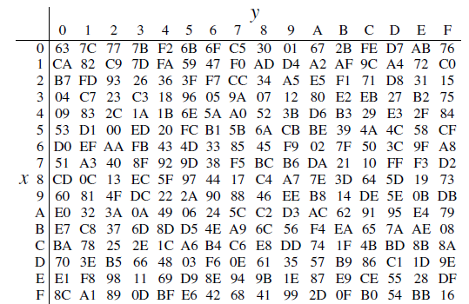
Module 2
Byte Substitution Layer
The Substitution values, in hexadecimal notation, for input byte (xy) in the AES S-Box are shown in the following figure.

Slide 20
Module 2
Byte Substitution Layer
Example: Assume that the input byte to the S-Box is Ai = (C2)hex, then the substituted value is:
S((C2)hex) = (25)hex.
On a bit, this substitution can be described as:
S(11000010) = (00100101).
Even though the S-Box is bijective, it does not have any fixed points. Therefore, there
aren’t any input values Ai such that S(Ai) = Ai. Even the zero-input is not a fixed
point ➔ S(00000000) = (01100011).

Slide 21

Module 2
Byte Substitution Layer
Example: Assume the input to the Byte Substitution layer is
(C2,C2, . . . ,C2) in hexadecimal notation.
The output state is then (25, 25, ….., 25)
Note: The DES S-boxes are random tables that fulfill certain properties.
The AES S-Boxes have a strong algebraic structure.
An AES S-Box can be represented by two steps of mathematical transformation, such that:

Slide 22
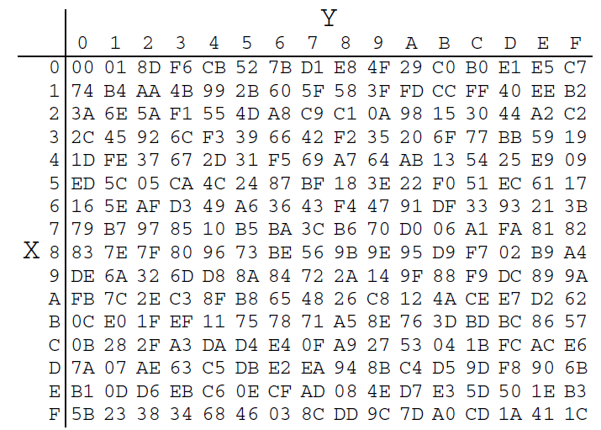
Module 2
Byte Substitution Layer
Galois field inversion:
For each input element Ai, the inverse is computed: Bi = A⁻¹i , where both Ai and Bi
are considered elements in the field GF(2⁸) with the fixed irreducible polynomial
P(x) = x⁸ +x⁴ +x³ +x+1.
A lookup table with all inverses is shown in the following table. Note that the inverse of the zero element does not exist. The AES assumes that the zero element Ai = 0 is mapped to itself.

Slide 23
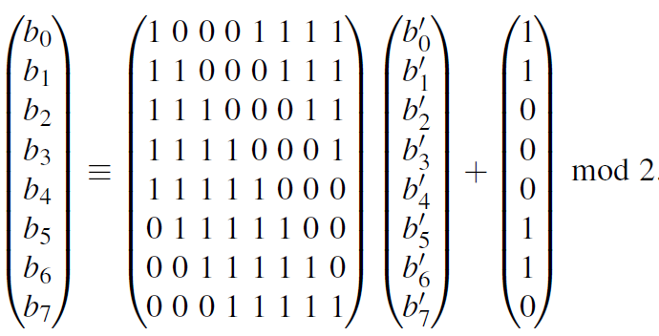
Module 2
Byte Substitution Layer
Affine Mapping:
Each byte B/i is multiplied by a constant bitmatrix followed by the addition of a constant 8-bit vector. The operation can be described as follows:
Note that B = (b7, . . . ,b0) is the bitwise vector representation of Bi(x) = A⁻¹i (x).
This step is referred to as affine mapping.

Slide 24
Module 2
Byte Substitution Layer
Example: Assume that the S-Box input Ai = (11000010)2 = (C2)hex.
From S-Box inputs table we can see that the inverse is:
A⁻¹i = Bi = (2F)hex = (00101111)2.
We now apply the Bi bit vector as input to the affine transformation.
Note that the least significant bit (lsb) b0 of Bi is at the rightmost position.
Bi = (00100101) = (25)hex
Thus, S((C2)hex) = (25)hex, which is exactly the result that is also given in the S-Box
table

Slide 25
Module 2
Byte Substitution Layer
The advantage of using inversion in GF(2⁸) as the core function of the Byte
Substitution layer is that it provides a high degree of nonlinearity, which in turn provides optimum protection against some of the strongest known analytical attacks.
Furthermore, the affine step “destroys” the algebraic structure of the Galois field, which in turn is needed to prevent attacks that would exploit the finite field inversion

Slide 26
Module 2
Diffusion Layer
In AES, the Diffusion layer consists of two sublayers, as follows:
The ShiftRows transformation
The MixColumn transformation.
The diffusion is the spreading of the influence of individual bits over the entire state. Unlike the nonlinear S-Box, the diffusion layer performs a linear operation on state matrices A,B.
X1: 0 0 0 0 0 0 0 0
y1: 1 0 0 0 0 1 0 1
AES
X2: 1 0 0 0 0 0 0 0
y2: 0 0 0 0 0 1 0 1
y2: 1 1 1 1 0 0 1 0 

Slide 27
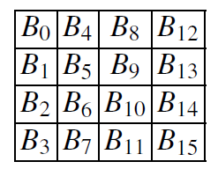
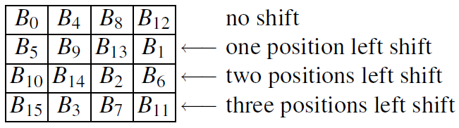
Module 2
Diffusion Layer (ShiftRows Sublayer)
The ShiftRows transformation cyclically shifts the second row of the state matrix by three bytes to the right, the third row by two bytes to the right and the fourth row by one byte to the right.
The first row is not changed by the ShiftRows transformation.
The purpose of the ShiftRows transformation is to increase the diffusion
properties of AES.
Example: Assume that the input of the ShiftRows sublayer is given as a state matrix
B = (B0,B1, . . . ,B15):
Output State

Slide 28
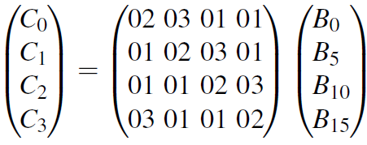
Module 2
Diffusion Layer (MixColumn Sublayer)
The MixColumn step is a linear transformation which mixes each column of the state matrix.
The MixColumn operation is the major diffusion element in AES because every input byte influences four output bytes.
Let us denote the 16-byte input state by B and the 16-byte output state by C, such that: MixColumn(B) =C, where B is the state after the ShiftRows operation.
Each 4-byte column is considered as a vector and multiplied by a fixed 4×4 matrix.
The matrix contains constant entries. Multiplication and addition of the coefficients is done in GF(2⁸). The following example shows how the first four output bytes are computed:
The second column of output bytes (C4,C5,C6,C7) is computed by multiplying the four input bytes (B4,B9,B14,B3) by the same constant matrix, and so….

Slide 29
Module 2
Diffusion Layer (MixColumn Sublayer)
Each state byte Ci and Bi is an 8-bit value representing an element from GF(2⁸). All arithmetic involving the coefficients is done in this Galois field.
For the constants in the matrix a hexadecimal notation is used. For example: “01” refers to the GF(2⁸) polynomial with the coefficients (00000001), which means it is the element 1 of the Galois field, where “02” refers to the polynomial with the bit vector (00000010), which means the polynomial x, and “03” refers to the polynomial with the bit vector (00000011), which means the Galois field element x+1.
The additions in the vector–matrix multiplication are GF(2⁸) additions, that is simple bitwise XORs of the respective bytes

Slide 30
Module 2
Diffusion Layer (MixColumn Sublayer)
For the multiplication of the constants, we have to realize multiplications with the constants 01, 02 and 03.
Multiplication by 01 is multiplication by the identity and does not involve any explicit operation. Multiplication by 02 can be implemented as a multiplication by x, and a modular reduction with P(x) = x⁸ +x⁴ +x³ +x+1. Similarly, multiplication by 03, which represents the polynomial (x+1), and should be followed by a modular reduction with P(x).

Slide 31
Module 2
Diffusion Layer (MixColumn Sublayer)
Example: Assume that the input state to the MixColumn layer is B = (25,25, . . . ,25).
In this special case, only two multiplications in GF(2⁸) have to be done. These are
02 · 25 and 03 · 25, which can be computed in polynomial notation:
02 · 25 = x · (x⁵+x²+1)
= x⁶ + x³ + x,
03 · 25 = (x+1) · (x⁵ + x² + 1)
= (x⁶ + x³ + x) + (x⁵ + x² +1)
= x⁶ + x⁵ + x³ + x² + x + 1
Since both intermediate values have a degree smaller than 8, no modular reduction
with P(x) is necessary.

Slide 32
Module 2
Diffusion Layer (MixColumn Sublayer)
The output bytes of C result from the following addition in GF(2⁸):
01 · 25 = x⁵+ x²+ 1
01 · 25 = x⁵+ x²+ 1
02 · 25 = x⁶+ x³+ x
03 · 25 = x⁶+ x⁵+ x³+ x²+ x+ 1
__________________________
Ci = x⁵+ x²+ 1,
where i = 0, . . . , 15. This leads to the output state C = (25,25, . . . ,25)

Slide 33
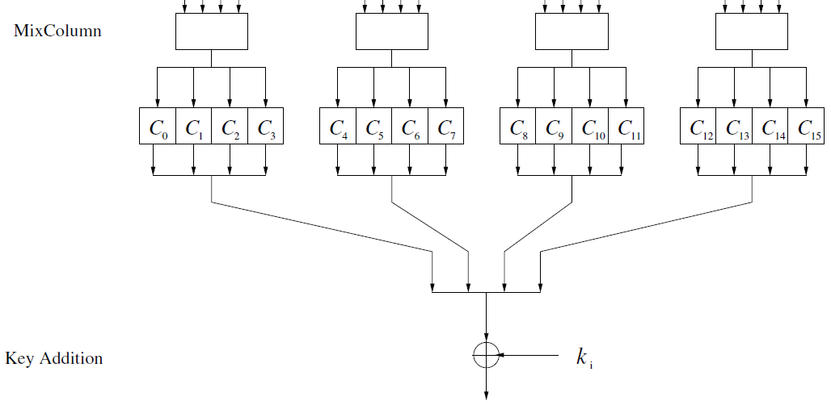
Module 2
Key Addition Layer
The two inputs to the Key Addition layer are the current 16-byte state matrix and a subkey which also consists of 16 bytes (128 bits).
The two inputs are combined through a bitwise XOR operation, which is equal to addition in the Galois field GF(2)
Inputs to the key addition (XOR) layer

Slide 34
Module 2
Key Addition Layer (Key Schedule)
The key schedule takes the original input key (of length 128, 192 or 256 bit) and derives the subkeys used in AES.
Note that an XOR addition of a subkey is used both at the input and output of AES. This process is sometimes referred to as key whitening.
Therefore, the number of subkeys is equal to the number of rounds plus one.
Thus, for the key length of 128 bits, the number of rounds is nr = 10, and there are 11 subkeys, each of 128 bits. The AES with a 192-bit key requires 13 subkeys of length 128 bits, and AES with a 256-bit key has 15 subkeys.
The AES subkeys are computed recursively, i.e., in order to derive subkey ki, subkey ki−1 must be known
The AES key schedule is word-oriented, where 1 word = 32 bits. Subkeys are stored in a key expansion array W that consists of words.

Slide 35
Module 2
Key Addition Layer (Key Schedule)
The 11 subkeys are stored in a key expansion array with the elementsW[0], . . . ,W[43].
The elements K0, . . . ,K15 denote the bytes of the original AES key.
Note that the first subkey k0 is the original AES key, i.e., the key is copied into the first four elements of the key array W. The other array elements are computed as follows.
The leftmost word of a subkey W[4i], where i = 1, . . . , 10, is computed as:
W[4i] =W[4(i−1)]+g(W[4i−1]).
Here g() is a nonlinear function with a four-byte input and output. The remaining three words of a subkey are computed recursively as:
W[4i+ j] =W[4i+ j−1]+W[4(i−1)+ j], where i = 1, . . . ,10 and j = 1,2, 3.
The computation of the subkeys are depicted in the following figure (next slide)

Slide 36
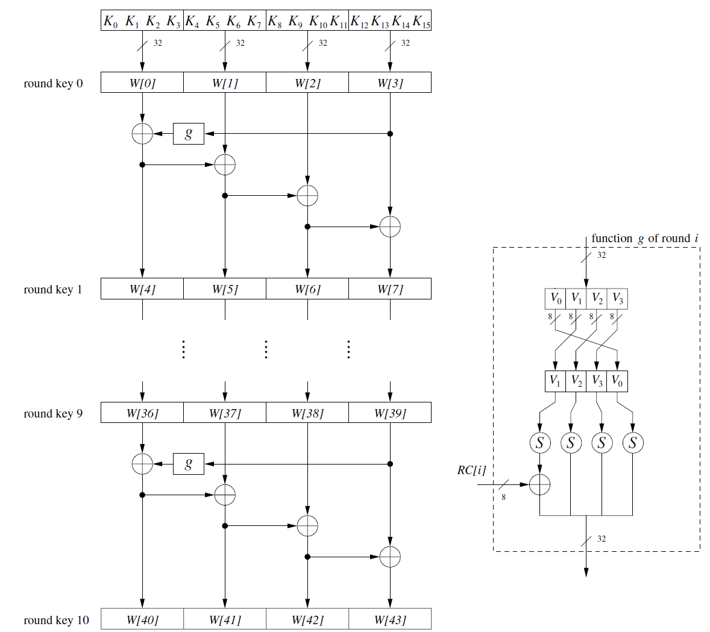
Module 2
Key Addition Layer (Key Schedule)

Slide 37
Module 2
Key Addition Layer (Key Schedule)
The function g() rotates its four input bytes, performs a byte-wise S-Box substitution, and adds a round coefficient RC to it.
The round coefficient is an element of the Galois field GF(2⁸), i.e, an 8-bit value. It is only added to the leftmost byte in the function g().
The round coefficients vary from round to round according to the following rule:
RC[1] = x⁰ = (00000001)₂,
RC[2] = x¹ = (00000010)₂,
RC[3] = x² = (00000100)2,
...
RC[10] = x⁹ = (00110110)₂.
The function g() has two purposes. First, it adds nonlinearity to the key schedule.
Second, it removes symmetry in AES. Both properties are necessary to thwart
certain block cipher attacks.

Slide 38
Module 2
Key Addition Layer (Key Schedule)
Each round coefficient (RC) is multiplied by 2. Both of them are elements in the field 2⁸
Example: how can we calculate RC # 9
RC#9 = 2*RC#8 ➔
(0000 0010) * (10000000) ➔
x * x⁷ ⁼ x⁸
Now, use the irreducible polynomial: P(x) = x⁸ +x⁴ +x³ +x+1
The result: x⁴ +x³ +x+1 ➔ 0001 1011 ➔ 1B
Round coefficient j | Round j
01 | 1
02 | 2
04 | 3
08 | 4
10 | 5
20 | 6
40 | 7
80 | 8
1B | 9
36 | 10

Slide 39
Module 2
Key Addition Layer (Key Schedule)
Each round coefficient (RC) is multiplied by 2. Both of them are elements in the field 2⁸
Example: how can we calculate RC # 10
RC#10 = 2*RC#9 (1B) ➔
(0000 0010) * (00011011) ➔
x * x⁸ ⁼ x⁹
Note that x⁸ was computed as: : x⁴ +x³ +x+1
The result: x⁵ +x⁴ + x² +x ➔ 0011 0110 ➔ 36
Round coefficient j | Round j
01 | 1
02 | 2
04 | 3
08 | 4
10 | 5
20 | 6
40 | 7
80 | 8
1B | 9
36 | 10

Slide 40
Module 2
Key Addition Layer (Key Schedule)
Example, suppose that the round key for round 8 is
EA D2 73 21 B5 8D BA D2 31 2B F5 60 7F 8D 29 2F
Then, the first 4 bytes (first column) of the round key for round 9 are calculated as
follows:
i = 36 | Round i
7F8D292F | Word [35]
8D292F7F | After RotWord
5DA515D2 | After SubWord
1B000000 | Rcon (9)
46A515D2 | After XOR with Rcon
EAD27321 | w[i- 4]
AC7766F3 | w[i] = g XOR w[i- 4]

Slide 41
Module 2
Key Addition Layer (Key Schedule)
There are two different approaches when implementing any of the previous key schedules:
Precomputation: All subkeys are expanded first into the arrayW. The encryption
(decryption) of a plaintext (ciphertext) is executed afterwards. This approach is often
taken in PC and server implementations of AES, where large pieces of data are encrypted under one key. Please note that this approach requires (nr +1) · 16 bytes
of memory, e.g., 11 · 16 = 176 bytes if the key size is 128 bits. This is the reason why such an implementation on a device with limited memory resources, such as a
smart card, is sometimes not desireable.

Slide 42
Module 2
Key Addition Layer (Key Schedule)
On-the-fly A new subkey is derived for every new round during the encryption
(decryption) of a plaintext (ciphertext). Please note that when decrypting ciphertexts,
the last subkey is XORed first with the ciphertext. Therefore, it is required to
recursively derive all subkeys first and then start with the decryption of a ciphertext
and the on-the-fly generation of subkeys. As a result of this overhead, the decryption
of a ciphertext is always slightly slower than the encryption of a plaintext when the
on-the-fly generation of subkeys is used.

Slide 43
Module 2
Decryption
Because AES is not based on a Feistel network, all layers must actually be inverted,
i.e., the Byte Substitution layer becomes the Inv Byte Substitution layer, the ShiftRows layer becomes the Inv ShiftRows layer, and the MixColumn layer
becomes Inv MixColumn layer. However, as we will see, it turns out that the inverse
layer operations are fairly similar to the layer operations used for encryption.
In addition, the order of the subkeys is reversed, i.e., we need a reversed key schedule. A block diagram of the decryption function is shown in the figure in next slide.

Slide 44
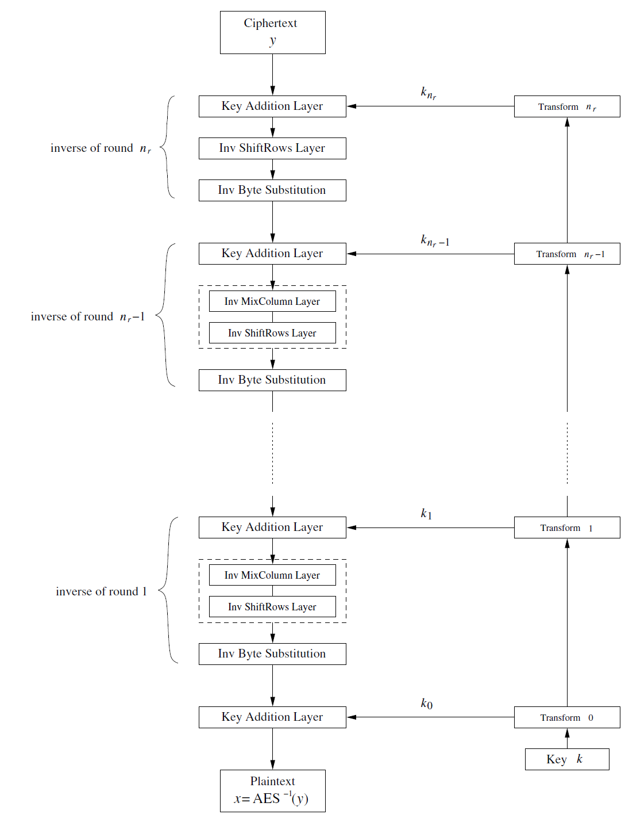
Module 2
Decryption (Overview)

Slide 45
Module 2
Decryption (Overview)
Since the last encryption round does not perform the MixColum operation, the first decryption round also does not contain the corresponding inverse layer.
All other decryption rounds, however, contain all AES layers. Since XOR operation is its own inverse, the key addition layer in the decryption mode is the same as in the encryption mode: it consists of a row of plain XOR gates

Slide 46
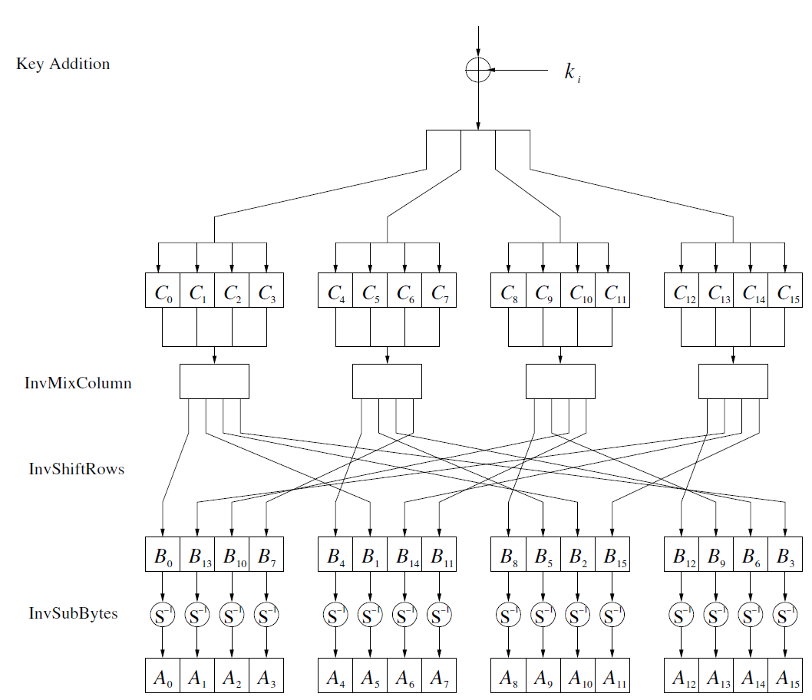
Module 2
Decryption (Overview)

Slide 47
Module 2
Decryption (Overview)
After the addition of the subkey, the inverse MixColumn step is applied to the state (again, the exception is the first decryption round).
In order to reverse the MixColumn operation, the inverse of its matrix must be used. The input is a 4-byte column of the State C which is multiplied by the inverse 4×4 matrix.
The matrix contains constant entries. Multiplication and addition of the coefficients is done in GF(2⁸).
The second column of output bytes (B4,B5,B6,B7) is computed by multiplying the four input bytes (C4,C5,C6,C7) by the same constant matrix, and so on.
Each value Bi andCi is an element from GF(2⁸). Also, the constants are elements from GF(2⁸).
The notation for the constants is hexadecimal and is the same as was used for the
MixColumn layer, for example: 0B = (0B)hex = (00001011)2 = x3+x+1.
Additions in the vector–matrix multiplication are bitwise XORs

Slide 48
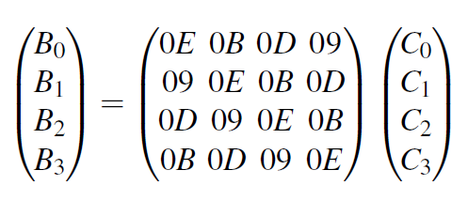
Module 2
Decryption (Overview)
Example for MixColumn Multiplication

Slide 49
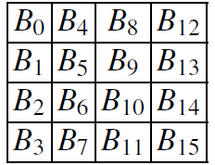
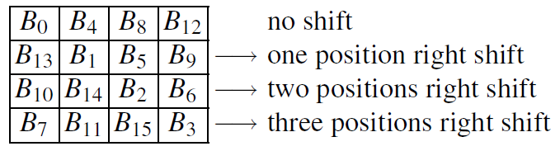
Module 2
Decryption (Inverse ShiftRows )
In order to reverse the ShiftRows operation of the encryption algorithm, we must shift the rows of the state matrix in the opposite direction. The first row is not changed by the inverse ShiftRows transformation. If the input of the ShiftRows sublayer is given as a state matrix B = (B0,B1, . . . ,B15):
The inverse ShiftRows sublayer yields the output:

Slide 50
Module 2
Decryption (Inverse ShiftRows )
K12 | K8 | K4 | K0
K9 | K5 | K1 | K13
K6 | K2 | K14 | K10
K3 | K15 | K11 | K7
No shift
One position right shift
Two positions right shift
Three positions right shift
The inverse ShiftRows sublayer yields the output:

Slide 51
Module 2
Decryption (Inverse Byte Substitution)
The inverse S-Box is used when decrypting a ciphertext. Since the AES S-Box is
a bijective, i.e., a one-to-one mapping, it is possible to construct an inverse S-Box
such that:
Ai = S⁻¹(Bi) = S⁻¹(S(Ai)),
where Ai and Bi are elements of the state matrix. The entries of the inverse S-Box
are given in the table in next slide.

Slide 52
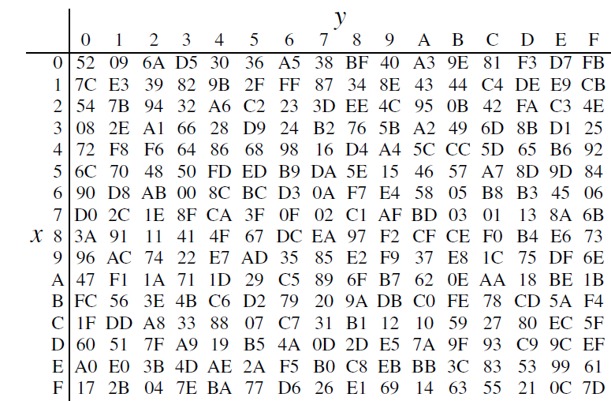
Module 2
Decryption (Inverse Byte Substitution)

Slide 53
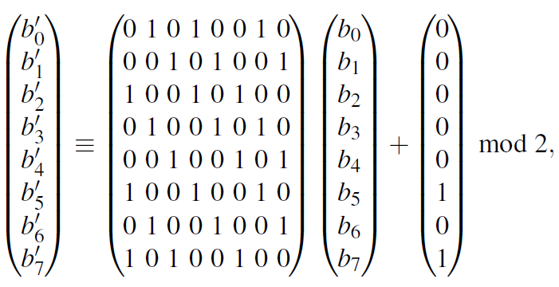
Module 2
Decryption (Inverse Byte Substitution)
In order to reverse the Sbox substitution, we first have to compute the inverse of the affine transformation. For this, each input byte Bi is considered an element of GF(2⁸). The inverse affine transformation on each byte Bi is defined by:
where (b7, . . . ,b0) is the bitwise vector representation of Bi(x), and (b′7, . . . ,b′0) the
result after the inverse affine transformation.

Slide 54
Module 2
Decryption (Inverse Byte Substitution)
In the second step of the inverse S-Box operation, the Galois field inverse has to
be reversed. For this, note that Ai = (A−1i )⁻¹. This means that the inverse operation
is reversed by computing the inverse again.
In our notation we thus have to compute Ai = (B′i)⁻¹ ∈ GF(2⁸) with the fixed reduction polynomial P(x) = x8+x4+x3+x+1.
Again, the zero element
is mapped to itself. The vector Ai =(a7, . . . ,a0) (representing the field element a7x7+···+a1x+a0) is the result of the substitution: Ai = S⁻¹(Bi).

Slide 55
Module 2
Decryption (Inverse Byte Substitution)
Since decryption round one needs the last subkey, the second decryption round
needs the second-to-last subkey and so on, we need the subkey in reversed order.
In practice this is mainly achieved by computing the entire key schedule first and storing all 11, 13 or 15 subkeys, depending on the number or rounds AES is using (which in turn depends on the three key lengths supported by AES).
This precomputation adds usually a small latency to the decryption operation
relative to encryption.
Note: The main source for the majority of contents in these slides is:
C. Paar and J. Pelzl. Understanding Cryptography. A textbook for Student and Practitioners. Springer 2010

