Slide 1


English Course- Advanced Level
Prepared by
Ahmed Soliman

Slide 2



Lecture 6
www.midocean.ae

Slide 3
Lecture Outline:
Listening: Summer Camp
Reading: How do animals sleep?
Writing: Cover Letter
Speaking: Describe an exciting book that you enjoy reading
www.midocean.ae

Slide 4
Listening
(Summer Camp)
www.midocean.ae

Slide 5
Vocabulary and Sample Sentences
starving (adjective): very hungry from lack of food
– The boys were starving after getting lost in the woods for hours.
tidy up (phrasal): clean up or organize
– I need to tidy up my room before I can invite guests over.
inspect (verb): to check or look at something carefully
– The camp leader decided to inspect each group’s cabin carefully to make sure they were not leaving food inside.
swat (verb): to hit something like an insect
– I spent the whole afternoon swatting flies instead of concentrating on my reading.
archery (noun): the sport of shooting arrows with a bow
– Carol took up archery when she was in elementary school.
settle for (phrasal verb): accept something even though it is not what you want
– We didn’t have any more steak for dinner, so I had to settle for rice and beans.
aimlessly (adverb): without clear direction
– The young man got lost after dark, but he sat down and waited for help instead of walking aimlessly without any idea where he was.
beat (adjective): very tired
– The men were beat after hiking 10 hours in the snow.
www.midocean.ae

Slide 6
Listen to the recording and answer the questions.
https://www.esl-lab.com/difficult/summer-camp/
1- Brad has to _____ before he eats breakfast.
feed the rooster and the other animals
go to the stream to get water
clean his sleeping quarters
2- What happened to Brad when he went fishing?
A tree branch fell on him.
He lost one of his shoes.
He lost his fishing pole.
www.midocean.ae

Slide 7
3- Brad ate _____ for dinner.
steak
hot dogs
beans
4- Brad was _____ when he got lost in the forest.
running away from a bear
looking for the cabin
searching for wood
www.midocean.ae

Slide 8
5- How did Brad like summer camp?
He didn't have fun.
It was okay.
He had a great time.
www.midocean.ae

Slide 9
Listening Script
Dear Mom and Dad,
This is my fifth day at summer camp. Life in the great outdoors isn’t exactly what I expected, but I’m not starving . . . yet . . . so don’t worry about me.
I guess I should tell you about what I do every day. First, everyone has to get up at 5:30 A.M. They have this silly old rooster named Harry who loves to wake us up. Next, we have to make our beds and tidy up the cabin before our camp counselor, Jeff, comes to inspect the place.
Then, we have breakfast around 6:30 A.M. After that, we have some free time, so I’ve been going down to the nearby stream to fish for a couple of hours. But yesterday, the only thing I caught was an old shoe and a tree branch. Great catch, Huh? Then when I was trying to swat a mosquito buzzing around my head, I slipped and fell in the stream and lost my fishing pole. That ended my fishing career.
Well, in the afternoon, there are different activities we can choose from like archery, horseback riding, and hiking. I thought archery would be the sport for me until I shot an arrow through Jeff’s pant leg. As you can imagine, I haven’t been invited back since.
www.midocean.ae

Slide 10
In the evening, everyone is assigned a different chore to get dinner ready. Yesterday, I was in charge of cooking the hot dogs, but I accidentally dropped them in the fire, so we had to settle for beans instead. The other kids are always razzing me about it.
At night, we sit around a campfire in front of the cabin, sing songs, and tell ghost stories. That’s usually fun, but one night while trying to find more sticks for the fire, I got all turned around and got lost. After about an hour of wandering aimlessly in the forest, I finally found my way back, but no one seemed to have realized what had happened, thinking that I just had gone to bed. A bear or wolf could have eaten me and no one would have known it. I was so beat I just crashed . . . out like a light.
Well, today is another day and tomorrow I come home . . . and not a bit too soon. I’ve learned that camping is just not for me.
Love,
Brad
www.midocean.ae

Slide 11
Reading
(How do animals sleep?)
www.midocean.ae

Slide 12
Read the following passage and choose the best answer
Most humans sleep on a bed or a mat. Animals, however, have many different ways of sleeping. Some animals sleep in groups for warmth. Lions, monkeys and penguins are a few animals that sleep in groups.
Elephants sleep in groups for protection. Larger, older elephants make a circle around younger elephants. The young elephants get inside the circle and lie down and sleep. The larger elephants sleep standing up.
Some animals sleep in trees. Birds lock their feet onto branches to keep them from falling out of the trees. Other animals, like squirrels and baboons, sleep in nests that they build in trees. They curl up to keep warm. Bats hang upside down from tree branches to sleep.
www.midocean.ae

Slide 13
Most animals look for warm, dry places to sleep, but ducks often sleep in water. Most animals lie down to sleep. However, some large animals, like horses, sleep standing up. Flamingos sleep standing on just one of their two legs.
Nocturnal nocturnal Most animals sleep at night, but some animals are animals like bats sleep during day. They wake up when the sun goes down. Animals sleep in different places and different ways. But every animal must sleep.
www.midocean.ae

Slide 14
Examples of animals that sleep in groups to get warm are………….
a. lions, penguins and monkeys
b. elephants, lions and squirrels
c. penguins, lions and elephants
d. elephants, flamingos and monkeys
2. Examples of animals that sleep standing are………………
a. Bats and lions
b. Flamingos and monkeys
c. squirrels and baboons
d. Horses and large elephants
www.midocean.ae

Slide 15
3. Paragraph 3 is mainly talking about the animals that sleep ---------
a during day
b. for warmth
c. for protection
d. in trees
4. The word “nocturnal” probably means…………….
a. active at night
b. active at day
c. bats
d. dry
www.midocean.ae

Slide 16
5. The best title for the passage is……………..
a. Why animals sleep
b. How and where animals sleep
c. What animals eat
d. Nocturnal animals
www.midocean.ae

Slide 17
Writing
(Cover Letter)
www.midocean.ae

Slide 18
What is a Cover Letter? (and Why It’s Important)
A cover letter is a one-page document that you submit as part of your job application (alongside your CV or Resume).
Its purpose is to introduce you and briefly summarize your professional background. On average, your cover letter should be from 250 to 400 words long.
A good cover letter can spark the HR manager’s interest and get them to read your resume.
A bad cover letter, on the other hand, might mean that your application is going directly to the paper shredder. So, to make sure this doesn’t happen, it’s essential to know how to write a convincing cover letter.
www.midocean.ae

Slide 19
Cover letter format
Header with date and contact information
Salutation or greeting
Opening paragraph
Middle paragraph(s)
Closing paragraph
Letter ending and signature
www.midocean.ae

Slide 20
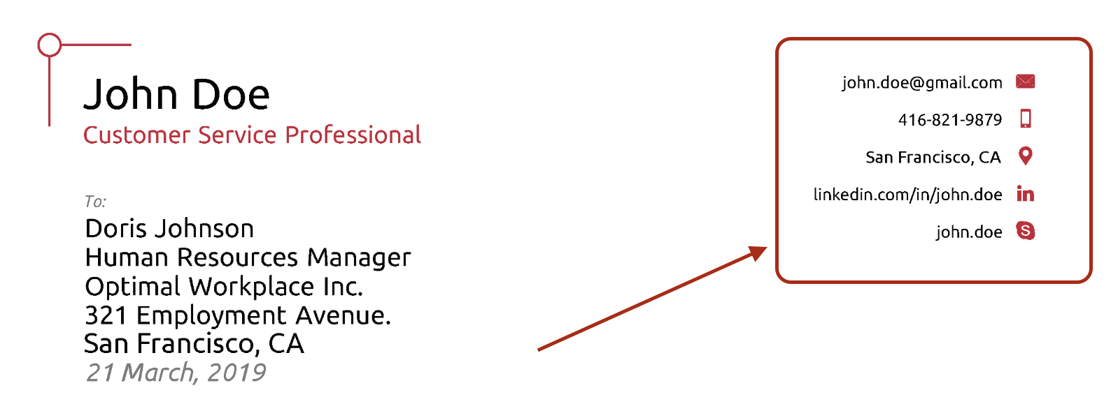
How to Write the Perfect Cover Letter (And Get Hired!)
1- Start the Cover Letter with a Header
www.midocean.ae

Slide 21
2. Include a greeting
Example greetings:
Dear Hiring Manager,
Dear Tyler Wallace,
www.midocean.ae

Slide 22
3- Write an Attention-Grabbing Introduction
So, it’s essential to catch their attention from the very first paragraph.
www.midocean.ae

Slide 23
4- Explain why you’re the perfect person for the job
This is where you show off your professional skills and convince the HR manager that you’re a better fit for the job than all the other applicants.
But first things first - before you even write anything, you need to learn what the most important requirements for the role are. So, open up the job ad and identify which of the responsibilities are the most critical.
www.midocean.ae

Slide 24
5- Explain why you’re a good fit for the company
Once you’ve written the last paragraph, you might be thinking - I’m a shoo-in for the job! What else do I need to write? I’ll just wrap up the cover letter and hit that sweet SEND button.
Well, no. You’re not quite there yet.
The HR manager doesn’t only look at whether you’ll be good at the job or not. They’re looking for someone that’s also a good fit for the company culture.
After all, employees that don’t fit in are bound to quit, sooner or later. This ends up costing the company a ton of money, up to 50% of the employee’s annual salary.
Meaning, you also need to convince the HR manager that you’re really passionate about working with them.
www.midocean.ae

Slide 25
6- Wrap up with a call to action
Finally, it’s time to finish up your cover letter and write the conclusion.
In the final paragraph, you want to:
Wrap up any points you couldn't in the previous paragraphs. Do you have anything left to say? Any other information that could help the hiring manager make their decision? Mention it here.
Thank the hiring manager for their time. It never hurts to be courteous, as long as you don’t come off as too needy.
Finish the cover letter with a call to action. The very last sentence in your cover letter should be a call to action. You should ask the hiring manager to take some sort of action.
www.midocean.ae

Slide 26
Good Example:
So to wrap it all up, thanks for looking into my application. I hope I can help Company X make the most out of their Facebook marketing initiatives. I'd love to further discuss how my previous success at XYZ Inc. can help you achieve your Facebook marketing goals.
www.midocean.ae

Slide 27
7- Use the right formal closing
Once you’re done with the final paragraph, all you have to do is write down a formal “goodbye” and you’re good to go.
Feel free to use one of the most popular conclusions to a cover letter:
Best Regards,
Kind Regards,
Sincerely,
Thank you,
www.midocean.ae

Slide 28
8- End with your signature at the bottom.
www.midocean.ae

Slide 29
Speaking
(Describe an exciting book that you enjoy reading)
www.midocean.ae

Slide 30
Describe an exciting book that you enjoy reading
You should say:
When you read it?
What kind of book is it?
What is it about?
And explain why you think it is exciting
www.midocean.ae

Slide 31




Thank You

