Slide 1


Measures of central tendency,
dispersion, and frequency table
Prepared by Dr. Hesham Mousli
MHA 613
Statistics in Healthcare
Lecture 3

Slide 2


Numerical Descriptive Statistics
(Numerical data)
(Measures of central tendency)
Chapter
03
It is very difficult to have any ‘feeling’ for a set of numerical measurements unless we can summarize the data in a meaningful way.
We can also condense the information by providing measures that describe the important characteristics of the data.
The arithmetic mean (average) is a general term for a measure of location; it describes a typical measurement for data centeredness.

Slide 3
Chapter
The arithmetic mean
03
The arithmetic mean, often simply called the mean, of a set of values is calculated by adding up all the values and dividing this sum by the number of values in the set.
It is useful to be able to summarize this verbal description by an algebraic formula.

Slide 4
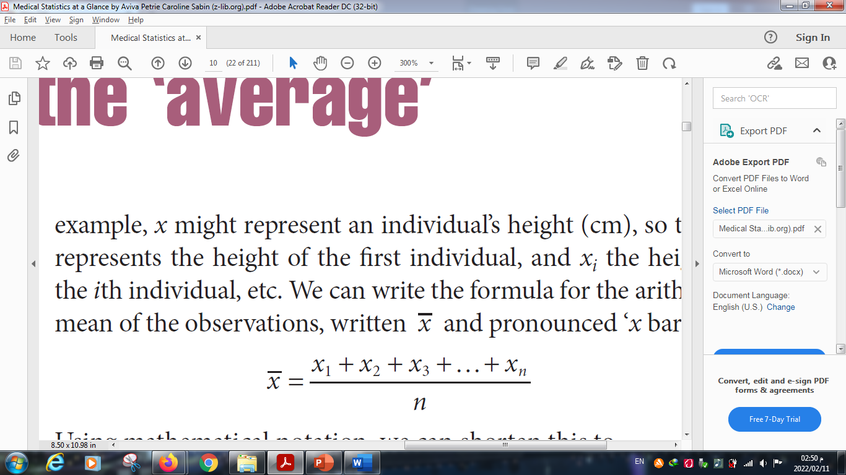
Chapter
The arithmetic mean
03
Using mathematical notation, we write our set of n observations of a variable, x, as x₁, x₂, x₃, …, x_{n}.
For example, x might represent an individual’s height (cm), so that x₁ represents the height of the first individual, and X_{i} represents the height of the i^{th} individual, etc.
We can write the formula for the arithmetic mean of the observations, which is written x̅ and pronounced ‘x bar’, as:

Slide 5
Chapter
The median
03
If we arrange our data in order of magnitude, starting with the smallest value and ending with the largest value, then the median is the middle value of this ordered set.
The median divides the ordered values into two halves, with an equal number of values both above and below it.

Slide 6
Chapter
The median
03
It is easy to calculate the median if the number of observations, n, is odd.
It is the (n + 1)/2th observation in the ordered set after ordering the data set in either an ascending or descending way.
So, for example, if n = 11, then the median is the (11 + 1)/2 = 12/2 = 6th observation in the ordered set.

Slide 7
Chapter
The median
03
If n is even then, we usually calculate it as the arithmetic mean of the two middle observations in the ordered set (i.e. the n/2th and the (n/2 + 1) ^{th}).
So, for example, if n = 20, the median is the arithmetic mean of the 20/2 = 10th and the (20/2) + 1) = (10 + 1) = 11th observations in the ordered set.

Slide 8
Chapter
The median
03
If n is even then, we usually calculate it as the arithmetic mean of the two middle observations in the ordered set (i.e. the n/2th and the (n/2 + 1) ^{th}).
So, for example, if n = 20, the median is the arithmetic mean of the 20/2 = 10th and the (20/2) + 1) = (10 + 1) = 11th observations in the ordered set.

Slide 9
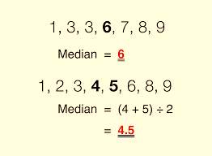
Chapter
The median
03

Slide 10
Chapter
The mode
03
The mode is the value that occurs most frequently in a data set.
Some data sets do not have a mode because each value only occurs once.
When two or more values occur with the same highest frequency, they are referred to as modes (Bimodal or Multimodal).
We rarely use the mode as a summary measure.

Slide 11
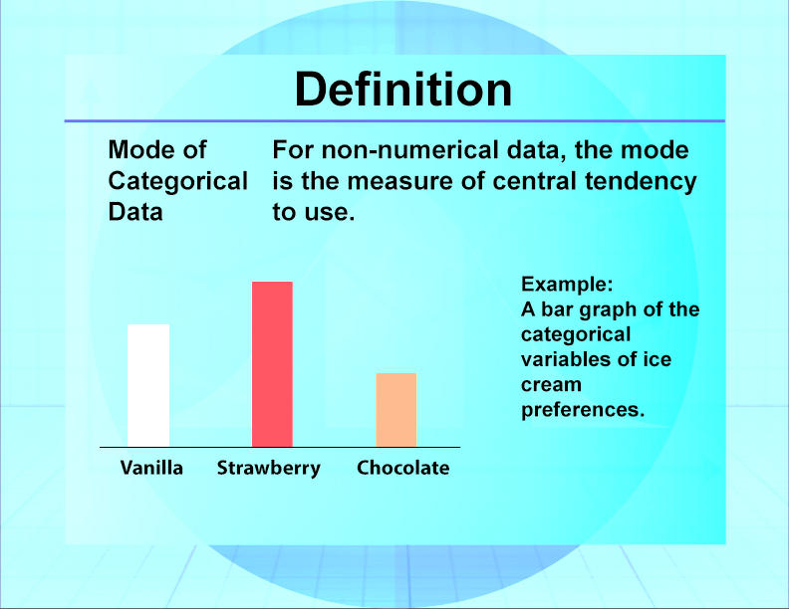
Chapter
The mode
03

Slide 12
Chapter
Pros. & Cons.
03
Type of measure | Advantages | Disadvantages
Mean | Use all the data values Algebraically defined so, mathematically manageable | Distorted by outliers
Median | Not distorted by outliers | Ignores most of the data
Mode | Easily determined for the categorical data | Ignores most of the data

Slide 13
Numerical Descriptive Statistics
(Numerical data)
(Measures of dispersion)
Chapter
03
We can provide two summary measures of a continuous variable: one indicating the 'average' and the other describing the 'spread' of observations.
Then we have condensed the data in a meaningful way. (summarized data).
Main measures of spread (dispersion) are: (Range, Interquartile Range (IQR), Variance, Standard deviation).

Slide 14
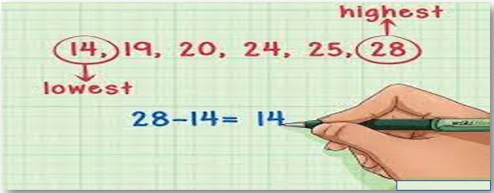
Chapter
The Range
03

Slide 15
Chapter
The Interquartile Range (IQR)
03
To calculate the IQR, the data set is divided into quartiles, or four rank-ordered even parts.
These quartiles are denoted by Q1 (also called the lower quartile) , Q2 (the median), and Q3 (also called the upper quartile).
The lower quartile corresponds with the 25th percentile and the upper quartile corresponds with the 75th percentile, so IQR = Q3 − Q1.

Slide 16
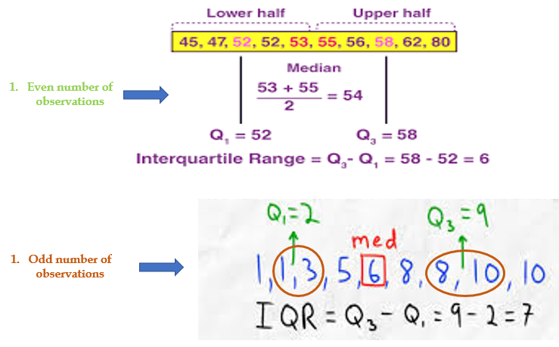

Slide 17
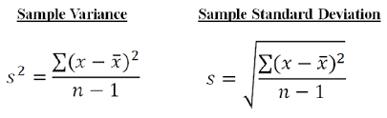
Chapter
The Variance & Standard Deviation
03

Slide 18
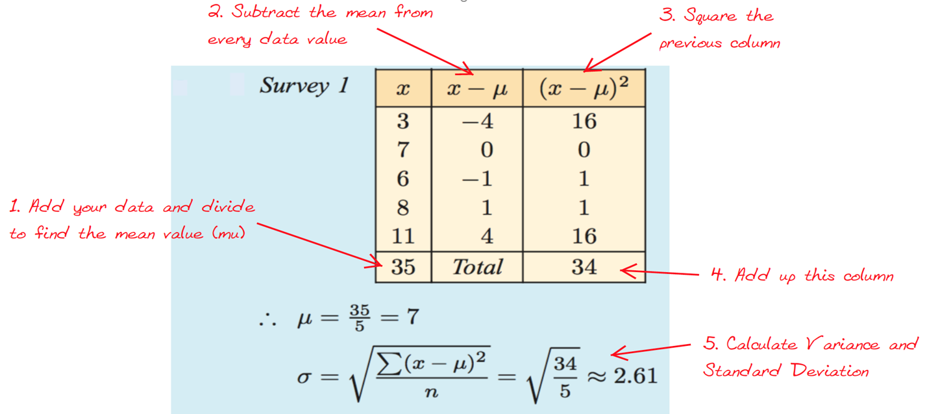
Chapter
Calculating Variance & Standard Deviation
03

Slide 19
Chapter
Pros. & Cons.
03
Type of measure | Advantages | Disadvantages
Range | Easy determined | Uses only two observations Distorted by outliers
Variance | Uses every observation | Sensitive to outliers
Standard Deviation | Uses every observation Easily interpreted | Sensitive to outliers

Slide 20
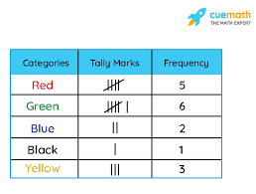
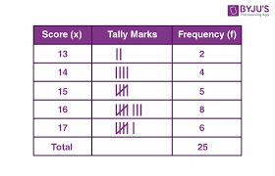
Numerical Descriptive Statistics (Categorical data)
(Frequencies)
Chapter
03

Slide 21
Chapter
Case Scenario (1)
03
Medication Error Reduction Program:
  A healthcare system wants to evaluate the effectiveness of a program to reduce medication errors in its pharmacy department over six months.

Slide 22
Chapter
Case Scenario (1)
03
Month | Total Prescriptions | Medication Errors | Error Rate (%)
Jan. | 10,000 | 30 | 0.30%
Feb. | 11,500 | 25 | 0.22%
Mar. | 12,000 | 28 | 0.23%
Apr. | 11,000 | 18 | 0.16%
May | 12,500 | 15 | 0.12%
June | 13,000 | 10 | 0.08%

Slide 23
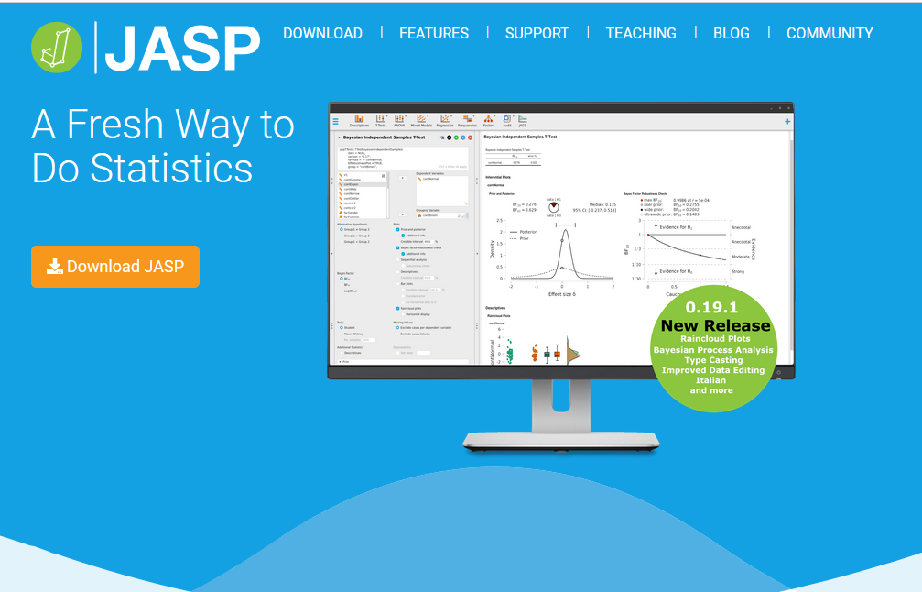
Chapter
TITLE OF SLIDE
03

Slide 24
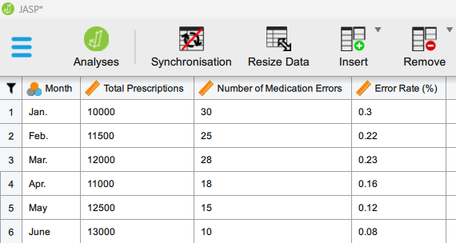

Slide 25
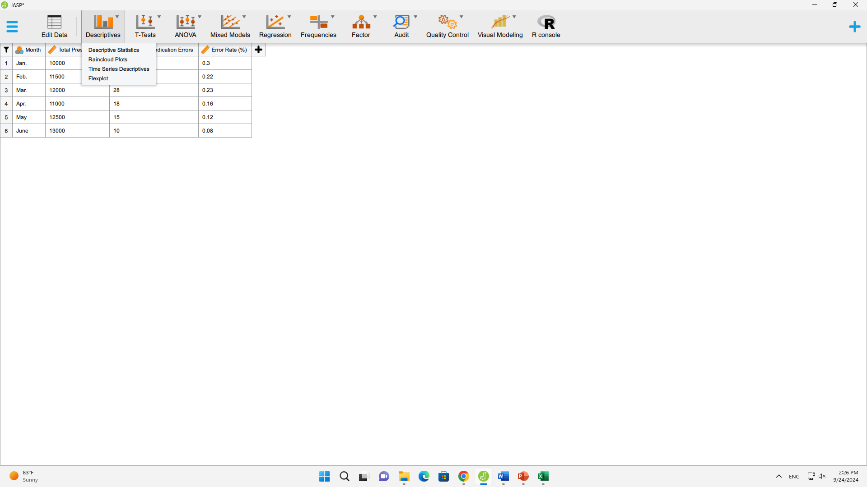

Slide 26
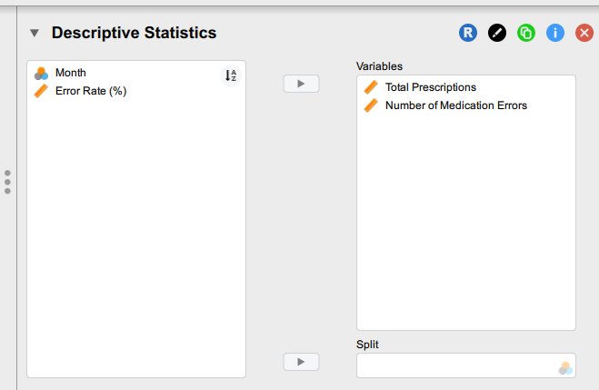

Slide 27
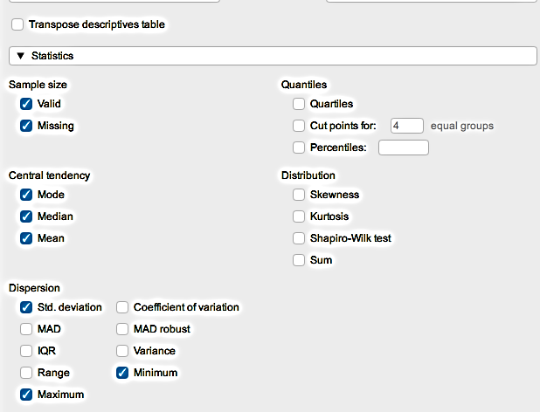

Slide 28
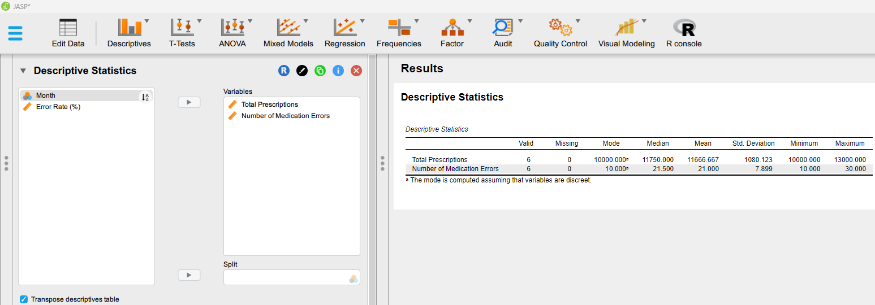

Slide 29
Descriptive Statistics Applied:
  Mean and Median Error Rate: To track progress over time.
  Error Rate Trend: Monthly percentage reduction in errors.
  Proportion of errors to prescriptions: Relative to the workload.
Request Additional frequency distribution for 126 medication error incidents categorized by error types:

Slide 31
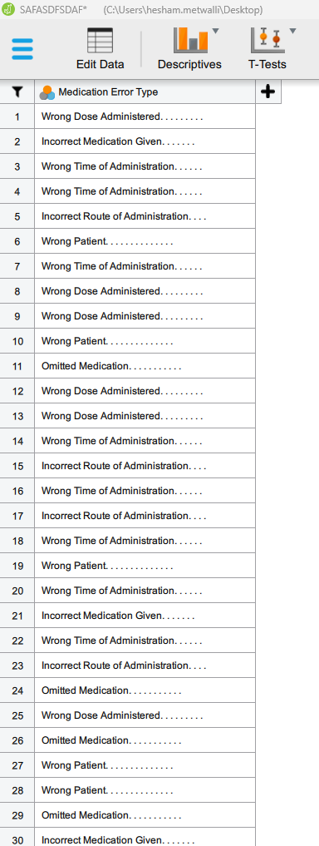

Slide 32
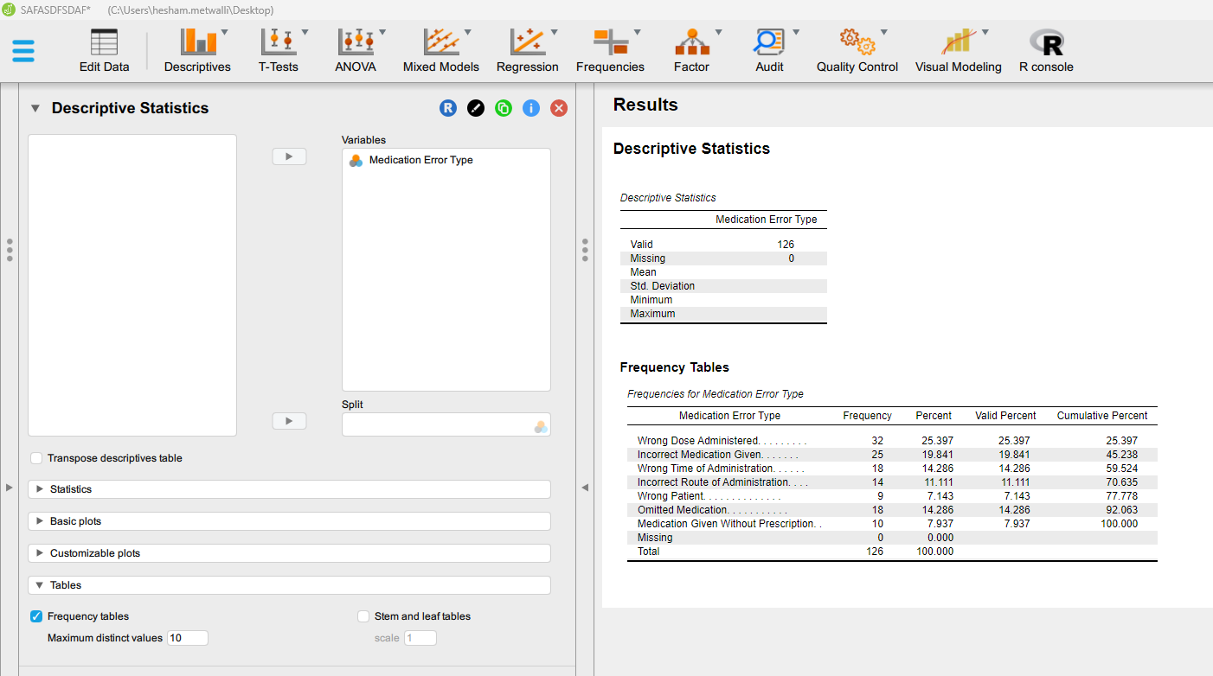

Slide 34
  Decision Making:
  The descriptive statistics show a significant reduction in the medication error rate from 0.30% to 0.08%. The management concludes that the error reduction program is effective. They decide to:
  Scale the program to other departments like surgery and inpatient wards.
  Provide additional training and improve communication between pharmacists and prescribers, since the results are promising but could still be improved.

Slide 35
Chapter
Case Scenario (2)
03
Staffing Optimization in an Outpatient Clinic:
  An outpatient clinic is experiencing long patient waiting times, which impacts patient satisfaction. The clinic's management aims to optimize staffing levels by analyzing patient flow and waiting time data.

Slide 36
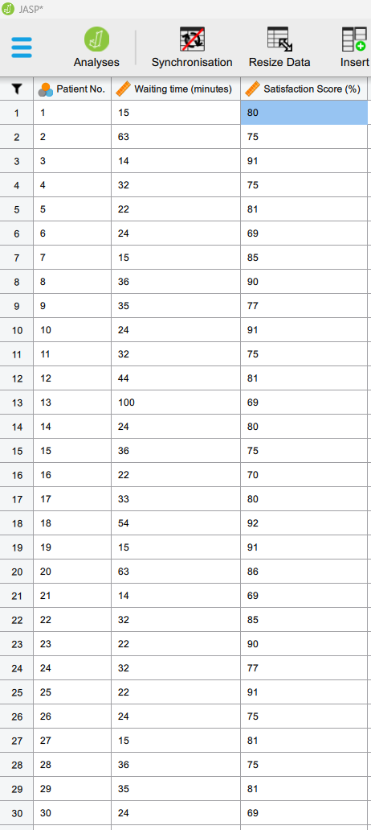

Slide 37
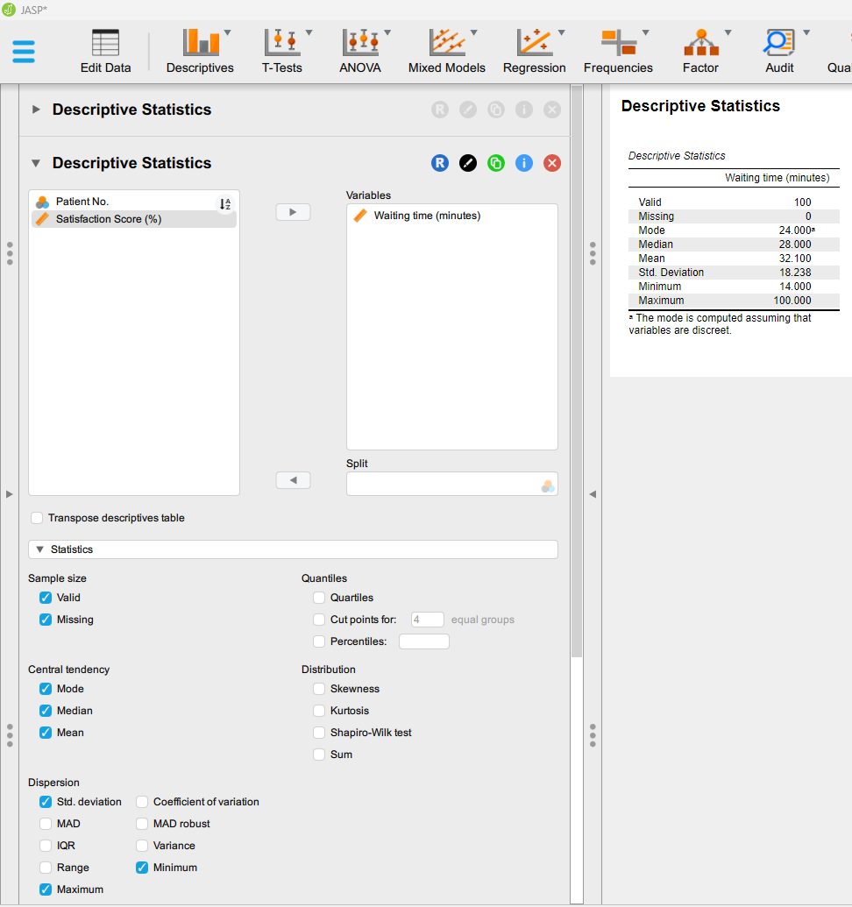

Slide 38
Descriptive Statistics Applied:
  Mean Waiting Time: Identifies the busiest hours with the longest waits.
  Mean & Median Patient Satisfaction Scores: Used to gauge patient perception based on wait times.
Request Additional frequency distribution for patients’ reported complaints:

Slide 39
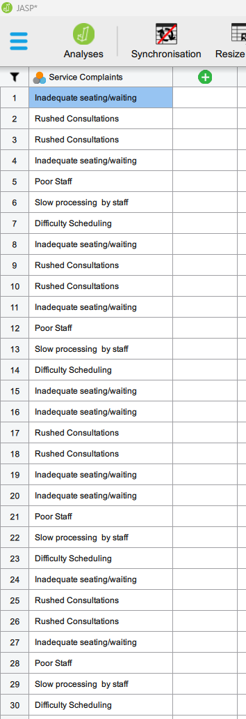

Slide 40
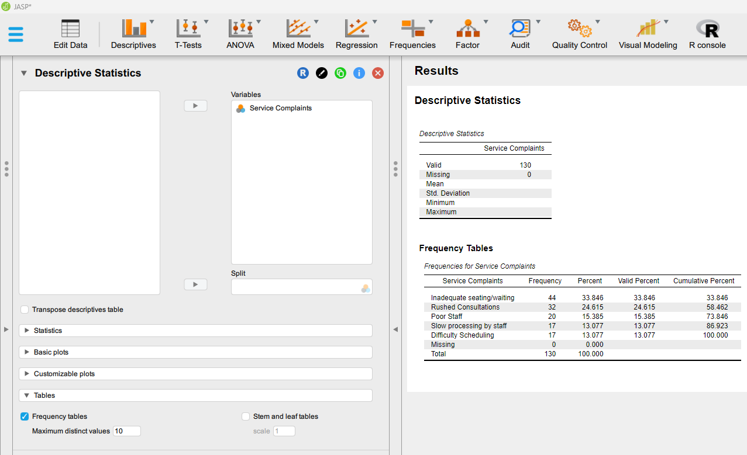

Slide 41
  Decision Making:
  The clinic notices a peak in patient arrivals between 9 AM and 11 AM, with waiting times significantly increasing during those hours. The analysis suggests a clear relationship between low staff numbers and longer wait times. Management decides to:
  Increase staffing during peak hours to reduce waiting times.
  Introduce an appointment scheduling system to smooth outpatient arrivals and prevent overcrowding.

Slide 42
Chapter
TO WRAP UP
03
Key statistical tools for measuring central tendency are the mean, median, mode.
Key statistical tools for measuring dispersion are the range, interquartile range (IQR), variance, and standard deviation.
Key statistical tools for analyzing frequencies are the frequency distribution and frequency table.
In healthcare decision-making, these statistical tools are crucial for data analysis, trend identification, and informed decisions to improve patient care and efficiency.

Slide 43



Thank You

