Slide 1


Prepared by Dr. Weam Nasan Agha
REA619
Property and Facilities Management
Lecture 3

Slide 2



Real Estate Management
Lecture 3
REA619
Property and Facilities Management
Prepared by
Dr. Weam Nasan Agha

Slide 3

Recap-Lecture2
Lease Life Cycle
(1) Pre-Lease Phase
(2) Lease Execution
(3) Lease Administration/ Occupancy
(4) Lease Expiration / Termination
(5) Post-Lease (Recovery & Re-letting)

Slide 4
Recap-Lecture2
Lease Life Cycle
1.1 Marketing the Property
(2) Lease Execution Phase
Listings vs. Advertising
2.1 Signing the Lease Agreement
(1)Pre-Lease Phase
Exclusive authorization to Lease
vs. Open Listing
2.2 Tenant pays the Security Deposit
1.3 Negotiation of Lease Terms
Real Estate Agent vs. Leasing Agent vs. Property Manager
Leasing Agent (Broker)’s Role
1.2 Tenant Screening
2.3 Delivery of Possession
LOI vs. Offer to Lease
Definition, objectives,
Summary of
Responsibilities
Core Components & additional of an Offer to Lease
Core Dimensions of Tenant
Good Faith Deposit vs. Security Deposit
Counteroffers
Special Considerations

Slide 5
Contents * Lease Administration Phase*
Landlord and Tenant Obligations
Financial Management of Leases
The Concept of Financial Management of Leases
Core Processes in the Financial Management of Leases
(1) Market Analysis and Rent Determination
(2) Revenue Management and Rent Collection

Slide 6

Lease Administration/ Occupancy Phase
Lease Administration is one of the most important pillars of Modern Real Estate Management.
Lease Administration aims to organize the contractual relationship between landlords and tenants while maximizing returns and protecting rights.

Slide 7
Lease Administration/ Occupancy Phase
Lease Administration includes:
Continuous Monitoring to Compliance (Landlord and Tenant Obligations, Property maintenance responsibilities, Access rights and restrictions)
Financial Management (timely rent collection, meticulous handling of security deposits, and transparent disclosure of operating costs)
Tenant Relationship Management, which prioritizes proactive communication, responsive issue resolution, and strategic retention efforts to foster long-term occupancy stability.

Slide 8
Landlord and Tenant Obligations
Mutual obligations are the foundation of contractual fairness.
Type of Obligations | Landlord Obligations | Tenant Obligations
Rent | Collects rent on schedule | Pays rent timely
Insurance | Insures building against risks and disasters | Insures internal property and contents.
Legal | Adheres to laws and regulations | Follows lease terms
Maintenance | Repairs major damages, maintains common areas | Maintenance of internal facilities and private units
Maintenance and insurance are essential for asset sustainability.
Legal compliance reduces disputes and enhances trust.

Slide 9
Landlord and Tenant Obligations
Once a landlord of residential or commercial premises undertakes to make repairs on the premises to correct a dangerous condition, the landlord is required to complete the repairs in a timely and proper manner.
Nondelegable Duty
A duty which cannot be transferred or assumed by another person. In the case of a landlord, a nondelegable duty cannot be assumed by a property manager or contractor.suitable tenants.

Slide 10
Landlord and Tenant Obligations
Now consider a commercial landlord who hires a contractor to repair the roof on leased property. A tenant is injured as a result of the contractor’s negligence while performing the repair.
The tenant claims the landlord is liable for their injuries since the landlord was responsible for the maintenance which created a dangerous condition.
The landlord claims they are not liable since it was the roofing contractor’s negligence while on the job which caused the tenant’s injury, not the landlord.
Is the landlord liable for injuries to a tenant caused by a contractor hired by the landlord to perform repairs?
Yes! A landlord’s duty to exercise care (not to be negligent) in the repair and
maintenance of a leased premises is a nondelegable duty. A nondelegable
duty is an obligation which cannot be transferred or assumed by another
person, such as a property manager or contractor

Slide 11
Financial Management of Leases
The Concept of Financial Management of Leases
Financial management of leases is a core pillar of modern property management, linking operational activities of real estate assets with the financial performance of investors, owners, and tenants.
Financial management of leases is defined as “a comprehensive process that entails planning, implementing, and monitoring all financial aspects of leased properties, including revenue and expense management, performance evaluation, budgeting, and cash flow analysis”.

Slide 12
Financial Management of Leases
The Concept of Financial Management of Leases
Financial management of leases is not merely an Accounting Function; rather, it is an Integrated System designed to maximize financial returns, mitigate financial risks, and ensure the operational sustainability of real estate assets.

Slide 13
Financial Management of Leases
(1)
Market Analysis and Rent Determination
(2) Revenue Management and Rent Collection
(3)
Operating Expense Management – CAM
(5) Accounting and Financial Reporting
(6)
Risk and Legal Management
(4)
Budgeting and Financial Forecasting
Core Processes in the Financial Management of Leases
Market Analysis
Property Assessment
Lease Type Selection
Rent Adjustment Provisions
Revenue Management
Rent Collection
Payment Methods
Delinquency Management Strategies

Slide 14
Financial Management of Leases
Core Processes in the Financial Management of Leases
(1) Market Analysis and Rent Determination
Market analysis constitutes the initial step in financial management, as it provides the basis for determining the fair rental value of a property.
A Comparative Market Analysis (CMA) is typically employed to assess current market rents and establish competitive pricing.
Market Analysis
Property Assessment
Property Assessment involves evaluating a property based on its location, size, intended use, and the prevailing supply and demand conditions in the real estate market.

Slide 15
Financial Management of Leases
Core Processes in the Financial Management of Leases
(1) Market Analysis and Rent Determination
Lease Type Selection is a crucial step in property financial management, as it directly influences market analysis and the determination of fair rental values.
There are four primary types of leases, each with distinct implications for the allocation of operating expenses between the landlord and tenant, which in turn influences the property’s overall rental value.
Lease Type Selection
Full-Service Gross Lease
Gross Lease
Net Lease
Triple Net Lease – NNN

Slide 16
Financial Management of Leases
(1) Market Analysis and Rent Determination
Full-Service Gross Lease vs. Gross Lease vs. Net Lease vs. Triple Net Lease
Lease Type | Description | Tenant Responsibilities | Landlord Responsibilities | Example
Full-Service Gross Lease | A comprehensive lease where the landlord bears all maintenance costs, including the tenant’s basic utilities (electricity, water, janitorial services), unless modified. | Payment of monthly rent only No operational or service expenses. | - Coverage of all expenses:• Property taxes • Insurance• Structural and common area maintenance• Tenant utilities (electricity, water, janitorial). | Residential apartment or administrative office: Monthly rent includes all services without additional fees. Tenant pays only the rent.
Gross Lease | A total lease where the tenant pays a fixed rent in addition to their basic utility costs (electricity, janitorial services), with no other expenses unless modified. | Payment of base monthly rent Payment of electricity and janitorial services No responsibility for maintenance or ownership costs (unless modified). | - Coverage of all expenses except tenant’s basic utilities:• Property taxes.• Insurance.• Structural and common area maintenance. | Commercial office: Tenant pays rent + personal electricity bills + janitorial fees, while landlord covers taxes, insurance, and structural maintenance.
Selecting the appropriate lease structure ensures that rental prices reflect prevailing market conditions and that financial responsibilities are distributed appropriately among the concerned parties

Slide 17
Financial Management of Leases
(1) Market Analysis and Rent Determination
Full-Service Gross Lease vs. Gross Lease vs. Net Lease vs. Triple Net Lease
Lease Type | Description | Tenant Responsibilities | Landlord Responsibilities | Example
Net Lease | A net lease where the tenant bears a portion of ownership costs (typically one or two), in addition to base rent and utilities. | Payment of base monthly rent. Bearing a portion of expenses:• Such as property taxes or insurance (as specified in the lease).• Basic utilities (electricity, janitorial). | Coverage of expenses not borne by the tenant. Management of major maintenance. | Mixed-use building: Tenant pays rent + property taxes, while landlord covers insurance and structural maintenance.
Triple Net Lease (NNN) | A triple net lease where the tenant bears all ownership costs (taxes, insurance, maintenance) in addition to base rent and utilities. | Payment of base monthly rent. Payment of all ownership costs:• Property taxes.• Insurance.• Property maintenance (including repairs)• Basic utilities (electricity, janitorial). | Limited responsibilities (typically major structural repairs or emergencies). -No operational or service expenses. | Standalone retail store or factory: Tenant pays rent + taxes + insurance + full maintenance + electricity + janitorial. Landlord covers only structural renovations.
Selecting the appropriate lease structure ensures that rental prices reflect prevailing market conditions and that financial responsibilities are distributed appropriately among the concerned parties

Slide 18
Financial Management of Leases
Core Processes in the Financial Management of Leases
Lease Type Selection
(1) Market Analysis and Rent Determination
Full-Service Gross Lease
Gross Lease
Net Lease
Triple Net Lease – NNN
Selecting the appropriate lease structure ensures that rental prices reflect prevailing market conditions and that financial responsibilities are distributed appropriately among the concerned parties.
Selecting the appropriate lease structure ensures that rental prices reflect prevailing market conditions and that financial responsibilities are distributed appropriately among the concerned parties

Slide 19
Financial Management of Leases
Core Processes in the Financial Management of Leases
(1) Market Analysis and Rent Determination
Rent constitutes the cornerstone of real estate investment. Given market fluctuations (inflation, demand, costs), it has become essential to incorporate Rent Adjustment Provisions within lease agreements.
These Provisions ensure the property’s value and sustainable operating income while distributing financial risks between the landlord and tenant.
Rent Adjustment Provisions

Slide 20
Financial Management of Leases
Core Processes in the Financial Management of Leases
Rent Adjustment Provisions
(1) Market Analysis and Rent Determination
Rent Escalation Provision: A provision in a lease agreement that regulates rent increases over time in response to factors such as inflation, property value appreciation, or tenant sales.
Consumer Price Index (CPI) : a statistical measure that tracks the average change over time in the prices paid by consumers for a fixed basket of goods and services. CPI reflects the purchasing power of money and how it changes over time in relation to the cost of living.
Property Value: Determined by Net Operating Income (NOI) and Capitalization Rate.
Net Operating Income (NOI):Total rental income after deducting all operating expenses (taxes, maintenance, insurance).
Capitalization Rate: a financial ratio used in real estate investment valuation. It represents the expected annual return on a property relative to its market value or purchase price.

Slide 21
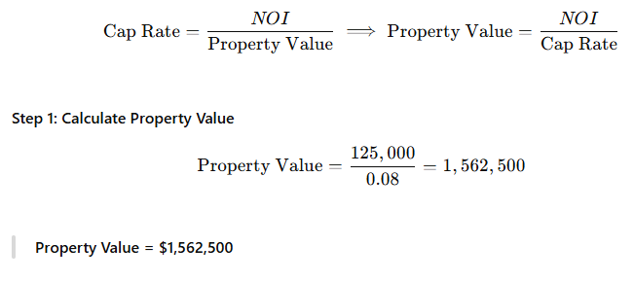
Financial Management of Leases
Core Processes in the Financial Management of Leases
Rent Adjustment Provisions
(1) Market Analysis and Rent Determination
Academic Example: Calculating NOI, Cap Rate, and Property Value
Net Operating Income (NOI) Calculation
Property Data:
Annual rental income = $150,000
Additional income (services, parking, etc.) = $10,000
Operating expenses = $35,000
Step 1: Calculate Gross Income
Gross Income=150,000+10,000=160,000
Step 2: Calculate NOI
NOI=Gross Income−Operating Expenses=160,000−35,000=125,000
NOI = $125,000
Market capitalization rate =8%

Slide 22
Financial Management of Leases
Types of Rent Adjustment Provisions
Graduated Rent Provision
Inflation-Adjusted Rent Provision
Appreciation-Adjusted Rent Provision
Percentage Lease Rent Provision
Core Processes in the Financial Management of Leases
(1) Market Analysis and Rent Determination
A rent provision which increases the initial monthly rent in pre-set increments over the term of the lease
A rent provision which calls for periodic
rent increases based on
changes in inflation
index figures during
the period
A rent provision which adjusts rent every several years to reflect an increase in the rental value of a property exceeding the rate of inflation brought about by local demographics
A rent provision which combines a fixed base rent with an additional rent calculated as a percentage of the tenant’s sales exceeding a specified breakpoint.

Slide 23
Financial Management of Leases
(1) Market Analysis and Rent Determination
Comparison Table of Types of Rent Adjustment Provisions
Provision Type | Objective | Mechanism of Operation | Advantages | Example
Graduated Rent Clause | Protects the landlord’s income from inflation in short-term leases. | Annual or semi-annual rent increases, either as a fixed amount or a percentage of the base or previous rent. | Flexibility in negotiation; incentivizes long-term tenancy. | Commercial Office: First year rent at $5,000/month, increasing by 3% / $150 each year for 5 years
Inflation-Adjusted Rent Clause | Maintains the purchasing power of rental income against consumer price inflation. | Annual rent increases based on an inflation index (e.g., Consumer Price Index - CPI or Cost of Funds Index). | Transparency, reliability; safeguards against currency devaluation. | Residential Apartment: Annual increase = (Current CPI / Previous CPI) × Current Rent. If monthly rent is $1,000 and the CPI increases by 3% for the year, the new monthly rent becomes $1,030.

Slide 24
Financial Management of Leases
(1) Market Analysis and Rent Determination
Comparison Table of Types of Rent Adjustment Provisions
Provision Type | Objective | Mechanism of Operation | Advantages | Example
Appreciation-Adjusted Rent Clause | Capitalizes on property value appreciation due to local factors (demographics, development). | Rent adjustments every 3-5 years based on rental market analysis of comparable properties in the area. | Yields returns exceeding inflation; reflects true location value. | Retail Store: After 3 years, rent is adjusted to reflect the average rental rates of comparable properties in the area, adjusted for inflation. If property value rises from $500,000 to $550,000 in 3 years; rent may be increased by 10%

Slide 25
Financial Management of Leases
(1) Market Analysis and Rent Determination
Comparison Table of Types of Rent Adjustment Provisions
Provision Type | Objective | Mechanism of Operation | Advantages | Example
Percentage Lease Rent Clause | Share in tenant’s commercial success, particularly for high-traffic retail or hospitality properties | Payment of a base monthly rent plus a percentage of tenant’s gross sales exceeding a negotiated threshold (breakpoint). | Aligns landlord interests with tenant success; reflects location value. | Store: Base rent of $10000/month + 5% of sales exceeding $ 150000 annually. (Total Gross Sales – Annual Base Rent) × Agreed Percentage
Base Rent = $10,000 per month ($120,000 per year)Agreed
Percentage = 5% of sales exceeding the Break Point=$150,000).
If the Store annual sales = $200,000 Then: Excess Sales = $200,000 – $150,000 = $50,000 Percentage Rent = $50,000 × 5% = $2500
Therefore, the tenant pays a total of:$120,000 (base rent) + $2500 (percentage rent) = $122,500 per year
Example:

Slide 26
Financial Management of Leases
Core Processes in the Financial Management of Leases
(1) Market Analysis and Rent Determination
Rent Adjustment Provisions
Rent adjustment Provisions are vital instruments for protecting landlord investments, transforming market dynamics into profitable opportunities. The appropriate clause selection depends on:
Lease Term
Property Type
Economic Conditions:
High-traffic commercial → Percentage Lease
High inflation → Inflation
+ Appreciation Clauses.
Short-term leases → Graduated Rent.
Through these mechanisms, landlords ensure sustainable operating income, enhance long-term property value, and equitably distribute financial risks with tenants
Selecting the appropriate lease structure ensures that rental prices reflect prevailing market conditions and that financial responsibilities are distributed appropriately among the concerned parties

Slide 27
Financial Management of Leases
Core Processes in the Financial Management of Leases
(2) Revenue Management and Rent Collection
Revenue Management is a data-driven strategic system that seeks to optimize pricing and occupancy decisions in order to achieve the highest possible Net Operating Income (NOI) from real estate assets.
Unit Revenue Optimization
Price–Occupancy Balance
Objectives of Revenue Management
Cash Flow Stability
Actual vs. Projected Revenue

Slide 28
Financial Management of Leases
Core Processes in the Financial Management of Leases
(2) Revenue Management and Rent Collection
Rent Collection refers to the operational process that ensures the conversion of contractually expected revenues into actual cash inflows.
Ensure consistent cash flow to cover operating expenses and financial obligations
Reduce delinquency rates and shorten collection times.
Objectives of Rent Collection Policies
Provide accurate financial data for accounting and reporting purposes
Protect ownership rights, ensure compliance with legal frameworks, and maintain professional tenant relations.

Slide 29
Financial Management of Leases
Core Processes in the Financial Management of Leases
(2) Revenue Management and Rent Collection
Revenue Management | Rent Collection
Revenue Management determines how much to charge, when, and to whom the unit should be leased | Rent Collection ensures that the determined amount is actually paid and received on time.
Revenue Management generates expected revenue | Rent Collection secures actual revenue
Revenue Management is the science and art of pricing and forecasting to maximize property income | Rent Collection is the art and discipline of execution and control, ensuring that forecasted revenues become actual cash flows

Slide 30
Financial Management of Leases
Core Processes in the Financial Management of Leases
(2) Revenue Management and Rent Collection
Poor collection = Failure to achieve revenue management goals
Even if units are perfectly priced, weak rent collection leads to reduced cash flow and higher bad debts.
Good revenue management policies facilitate collection
This can be achieved by selecting creditworthy tenants, using realistic grace periods, and setting clear payment terms.
Collection data are key inputs for revenue management
They reveal tenants’ financial behavior, identify trends in payment delays or future risks, and help adjust pricing policies accordingly.
Their relationship is complementary and cyclical:
Revenue management plans and predicts; rent collection executes and validates.

Slide 31
Financial Management of Leases
Essential Components of the Rent Collection Process
Lease Payment Clauses
Rent Roll and Ledger Records
Payment Channels
Delinquency Follow‐up Procedures
Partial Payments and Payment Plans
Documentation and Record Keeping
Revenue Management and Rent Collection

Slide 32
Financial Management of Leases
Revenue Management and Rent Collection
Essential Components of the Rent Collection Process
Lease Payment Clauses
The lease must clearly define the due date, acceptable payment methods, late‐fee policies, and any grace periods
Detailed schedules for each tenant showing rent due, paid, overdue, and security deposits. These ledgers form the accounting backbone for reconciliation.
Rent Roll and Ledger Records
Payment Channels
Checks, bank transfers/ACH, credit cards, online payment portals, and lockbox systems. Each must be assessed for security, cost, settlement speed, and traceability

Slide 33
Financial Management of Leases
Revenue Management and Rent Collection
Essential Components of the Rent Collection Process
A progressive enforcement policy beginning with a friendly reminder, then a formal written notice (e.g., Three-Day Notice to Pay or Quit), and finally legal action if necessary
Delinquency Follow‐up Procedures
Partial Payments and Payment Plans
Clear, written policies for accepting partial rent payments or establishing payment arrangements, outlining their effect on fees and legal standing
Documentation and Record Keeping
Maintain receipts, correspondence, late‐payment notices, and legal proof of service

Slide 34
Payment Methods
Paper Check
Bank Transfer / ACH
Credit Card
Online Payment Portals
Lockbox System
Financial Management of Leases
Revenue Management and Rent Collection

Slide 35
Financial Management of Leases
Revenue Management and Rent Collection
Payment Methods
Payment Method | Advantages | Disadvantages / Risks | Recommended Use
Paper Check | Low processing cost; familiar to tenants | Slow clearing time; risk of bounced checks | Traditional residential tenancies; combined with other
Bank Transfer / ACH | Fast and reliable settlement; suited for businesses | Bank fees; requires verification | Commercial or institutional leases
Credit Card | Immediate payment; convenient for tenants | High processing fees; chargeback risk | Optional for urgent or online payments
Online Payment Portals | Automated, real‐time reporting; minimizes manual errors | Subscription or integration costs | Multi‐unit or portfolio management
Lockbox System | Separates cash handling from on‐site management; faster bank processing | Service fees; limited digital integration | High‐volume or multi‐property operations

Slide 36
Delinquency Management Strategies
1 – Friendly Reminder
2 – Initial Written Notice
3 – Legal Notice (e.g., Three-Day Notice)
4 – Temporary Payment Agreement
5 – Legal Action / Eviction
Financial Management of Leases
Revenue Management and Rent Collection

Slide 37
Financial Management of Leases
Revenue Management and Rent Collection
Delinquency Management Strategies
Procedural Stage | Typical Action | Objective | Legal / Operational Notes
1 – Friendly Reminder | Phone call or email within a few days of delinquency | Recover payment promptly without escalation | Strengthens tenant relationship
2 – Initial Written Notice | Registered letter or notice specifying overdue amount | Establish formal accountability and consequences | Retain proof of service
3 – Legal Notice (e.g., Three-Day Notice) | Formal demand to pay or vacate | Activate legal pathway if unpaid | Requirements vary by jurisdiction
4 – Temporary Payment Agreement | Written arrangement for partial or scheduled payments | Avoid eviction and preserve revenue | Must document all terms and penalties
5 – Legal Action / Eviction | Filing for eviction or monetary judgment | Recover possession and enforce rights | Must comply with local housing and notice laws.

Slide 38
Financial Management of Leases
Revenue Management and Rent Collection
Workflow Example — Tenant Delinquency Case
Scenario: A tenant fails to pay rent on the due date.
Day1-3
Record delinquency in the rent roll; send a friendly reminder (email/SMS).
Day4-7
Make a personal phone call; offer a possible payment plan if justified.
Day8-10
Send a formal written notice detailing the overdue balance and penalties (retain a copy).
Day11-21
If no response, issue a Three-Day Notice to Pay or Quit (or equivalent) and prepare a legal file.
Afterward
Initiate legal proceedings if payment is still not received, documenting all communications and offers of settlement

Slide 39
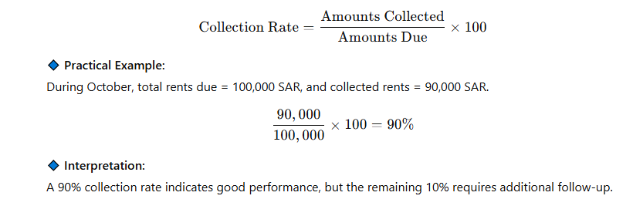
Financial Management of Leases
Revenue Management and Rent Collection
Performance Indicators (KPIs) for Rent Collection Effectiveness
Collection Rate
Measures how successfully an organization collects the amounts due within a specific period of time.
Total collected ÷ Total billed during a defined period

Slide 40
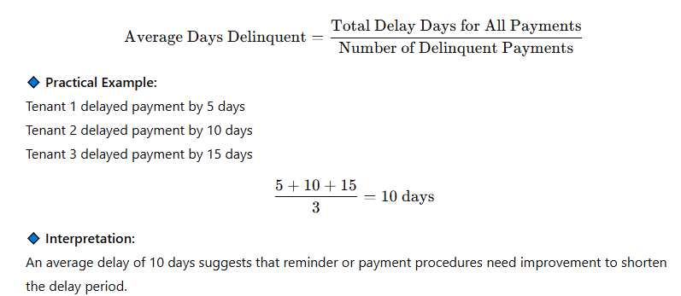
Financial Management of Leases
Revenue Management and Rent Collection
Performance Indicators (KPIs) for Rent Collection Effectiveness
Average Days Delinquent
Measures the average number of days tenants delay rent payments after the due date.

Slide 41
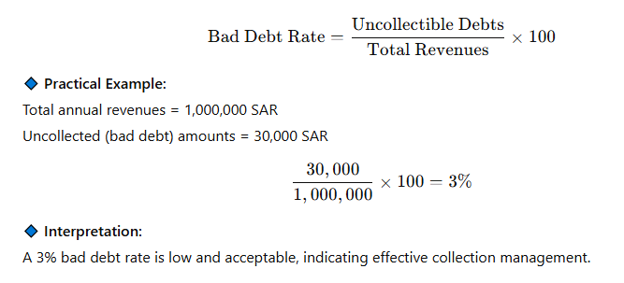
Financial Management of Leases
Revenue Management and Rent Collection
Performance Indicators (KPIs) for Rent Collection Effectiveness
Bad Debt Ratio
Measures the percentage of amounts that are permanently uncollectible compared to total revenues.

Slide 42
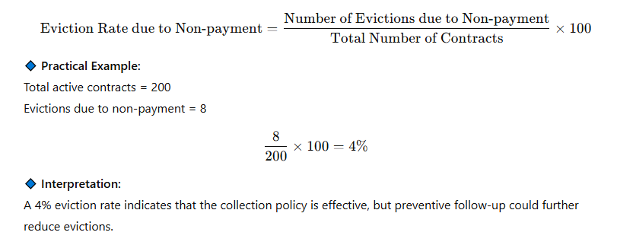
Financial Management of Leases
Revenue Management and Rent Collection
Performance Indicators (KPIs) for Rent Collection Effectiveness
Eviction Rate due to Non-Payment
Indicator of lease quality and tenant screening effectiveness.
Measures the percentage of tenants evicted due to non-payment of rent out of the total number of tenants.

Slide 43
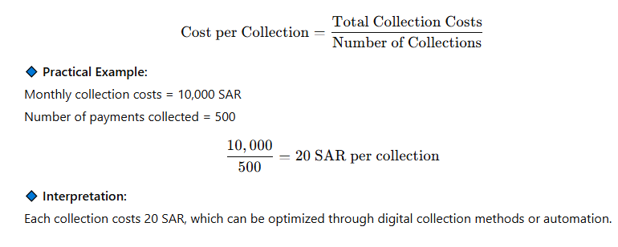
Financial Management of Leases
Revenue Management and Rent Collection
Performance Indicators (KPIs) for Rent Collection Effectiveness
Cost per Collection Transaction
Measures the administrative and system costs incurred to collect each rent payment.
Total administrative and processing costs ÷ Number of payments.

Slide 44
Financial Management of Leases
Revenue Management and Rent Collection
Performance Indicators (KPIs) for Rent Collection Effectiveness
Indicator | Measures | Objective
Collection Rate | Effectiveness of revenue collection | Increase to near 100%
Average Days Delinquent | Speed of payment | Reduce to the minimum possible
Bad Debt Rate | Revenue losses | Keep it low (<5%)
Eviction Rate due to Non-payment | Quality of collection policy | Minimize as much as possible
Cost per Collection | Operational efficiency | Reduce through digital transformation

Slide 45
Lecture Summary: Quick Review
Lease Life Cycle * Lease Administration *
Landlord and Tenant Obligations
Financial Management of Leases
1) Market Analysis and Rent Determination
2) Revenue Management and Rent Collection
Market Analysis
The Concept
Lease Type Selection
Core Processes
Essential Components of the Rent Collection Process
Property Assessment
Payment Methods
Rent Adjustment Provisions
Delinquency Management Strategies
Performance Indicators (KPIs) for Rent Collection Effectiveness

Slide 46



Thank You

