Slide 1


Project Time Management
مقرر: إداره وقت المشروع
Prepared by Dr. Amira Elfekky
PMG 212
Lecture 1

Slide 2

Agenda
Understanding Project Management
Meaning of “ Project “
Meaning of “ Project time management“
Benefits of project time management
Project Management Life Cycle
Successful project management
Benefits of project management
Obstacles of project management
Project Management
Project Manager's Role
Functional Manager’s Role
www.midocean.ae

Slide 3

Chapter
8 steps to effective project time management
1
  1. Plan your project
  2. Define your deliverables
  3. Organize project tasks
  4. Create a timeline
  5. Assign jobs
  6. Use project planning tools
  7. Communicate regularly
  8. Minimize distractions
www.midocean.ae

Slide 4
Agenda
Understanding Project Management
Meaning of “ Project “
Meaning of “ Project time management“
Benefits of project time management
Project Management Life Cycle
Successful project management
Benefits of project management
Obstacles of project management
Project Management
Project Manager's Role
Functional Manager’s Role
www.midocean.ae

Slide 5


Chapter
1
Understanding Project Management
In order to understand project management, one must begin with the definition of a project.
A project can be any series of activities and tasks.
www.midocean.ae

Slide 6
Agenda
Understanding Project Management
Meaning of “ Project “
Meaning of “ Project time management“
Benefits of project time management
Project Management Life Cycle
Successful project management
Benefits of project management
Obstacles of project management
Project Management
Project Manager's Role
Functional Manager’s Role
www.midocean.ae

Slide 7
Chapter
Meaning of “ Project “
1
A project: is a temporary endeavor undertaken to create a unique product, service, or result.
Project characteristic:
  Projects are temporary.
  Has definite beginning and end, the end is reached when the project’s objective have been achieved.
  Projects are unique.
  Every project creates a unique product, service, or results.
  Progressively elaborated.
  Progressively: proceeding in steps.
  Elaborated: worked with care and detail.
www.midocean.ae

Slide 8
Chapter
Meaning of “ Project “
1
The temporary nature of projects indicates that a project has a definite beginning and end.
Temporary does not necessarily mean a project has a short duration.
The end of the project is reached when one or more of the following is true:
  The project’s objectives have been achieved;
  The objectives will not or cannot be met;
www.midocean.ae

Slide 9
Chapter
Project Ending
1
  Funding is exhausted or no longer available for allocation to the project;
  The need for the project no longer exists (e.g., the customer no longer wants the project completed, a change
  in strategy or priority ends the project, the organizational management provides direction to end the project);
  The human or physical resources are no longer available; or
  The project is terminated for legal cause or convenience.
www.midocean.ae

Slide 10
Agenda
Understanding Project Management
Meaning of “ Project “
Meaning of “ Project time management“
Benefits of project time management
Project Management Life Cycle
Successful project management
Benefits of project management
Obstacles of project management
Project Management
Project Manager's Role
Functional Manager’s Role
www.midocean.ae

Slide 11
Chapter
Meaning of “ Project time management“
1
  Project time management is the process of planning, scheduling and overseeing activities required to complete a project. Organizations use it to define milestones, meet deadlines, stay within budget and work toward project goals. It’s typically handled by a designated project manager, but also involves team managers responsible for helping employees with their own time management skills.
www.midocean.ae

Slide 12
Agenda
Understanding Project Management
Meaning of “ Project “
Meaning of “ Project time management“
Benefits of project time management
Project Management Life Cycle
Successful project management
Benefits of project management
Obstacles of project management
Project Management
Project Manager's Role
Functional Manager’s Role
www.midocean.ae

Slide 13
Chapter
Benefits of project time management
1
Effective task management doesn’t just lead to more productive employees. With the right strategies in place, you’ll also experience:
Shorter deadlines: Proper time management makes it easier to complete tasks on time, ensuring customer satisfaction and helping you maintain a competitive edge in your market.
Better use of resources: Managing project timelines also helps improve employee efficiency as you redistribute unbalanced workloads. By keeping your finger on the pulse of all activities, you’ll see if someone’s carrying more than their fair share of the burden
www.midocean.ae

Slide 14
Chapter
1
Benefits of project time management
Effective task management doesn’t just lead to more productive employees. With the right strategies in place, you’ll also experience:
Controlled budgets: Time management helps control project costs by ensuring timely completion of activities and preventing delays that would otherwise lead to additional expenses.
Improved communication: By adhering to project schedules, project managers have the details they need to update stakeholders and set clear expectations.
www.midocean.ae

Slide 15
Agenda
Understanding Project Management
Meaning of “ Project “
Meaning of “ Project time management“
Benefits of project time management
Project Management Life Cycle
Successful project management
Benefits of project management
Obstacles of project management
Project Management
Project Manager's Role
Functional Manager’s Role
www.midocean.ae

Slide 16
Project Management Life Cycle
Project Management Process Groups
Chapter
1
Initiation
Planning
Execution
Controlling
Closeout

Slide 17
1st PM Process Group
Project initiation
Chapter
1
● Selection of the best project given resource limits
● Recognizing the benefits of the project
● Preparation of the documents to sanction the project
● Assigning of the project manager
www.midocean.ae

Slide 18
2nd PM Process Group
Project planning
Chapter
1
● Definition of the work requirements
● Definition of the quality and quantity of work
● Definition of the resources needed
● Scheduling the activities
● Evaluation of the various risks
www.midocean.ae

Slide 19
3rd PM Process Group
Project execution
Chapter
1
● Negotiating for the project team members
● Directing and managing the work
● Working with the team members to help them improve
www.midocean.ae

Slide 20
4th PM Process Group
Project monitoring and control
Chapter
1
● Tracking progress
● Comparing actual outcome to predicted outcome
● Analyzing variances and impacts
● Making adjustments
www.midocean.ae

Slide 21
5th PM Process Group
Project closure
Chapter
1
● Verifying that all of the work has been accomplished
● Contractual closure of the contract
● Financial closure of the charge numbers
● Administrative closure of the paper work
www.midocean.ae

Slide 22
Agenda
Understanding Project Management
Meaning of “ Project “
Meaning of “ Project time management“
Benefits of project time management
Project Management Life Cycle
Successful project management
Benefits of project management
Obstacles of project management
Project Management
Project Manager's Role
Functional Manager’s Role
www.midocean.ae

Slide 23
Chapter
Successful project management
1
Successful project management can then be defined as having achieved the project objectives:
● Within time
● Within cost
● At the desired performance/technology level
● While utilizing the assigned resources effectively and efficiently
● Accepted by the customer
www.midocean.ae

Slide 24
Agenda
Understanding Project Management
Meaning of “ Project “
Meaning of “ Project time management“
Benefits of project time management
Project Management Life Cycle
Successful project management
Benefits of project management
Obstacles of project management
Project Management
Project Manager's Role
Functional Manager’s Role
www.midocean.ae

Slide 25
Chapter
Benefits of project management
1
● Identification of functional responsibilities to ensure that all activities are accounted for, regardless of personnel turnover
● Minimizing the need for continuous reporting
● Identification of time limits for scheduling
www.midocean.ae

Slide 26
Chapter
Benefits of project management
1
● Identification of a methodology for trade-off analysis
● Measurement of accomplishment against plans
● Early identification of problems so that corrective action may follow
● Improved estimating capability for future planning
● Knowing when objectives cannot be met or will be exceeded
www.midocean.ae

Slide 27
Agenda
Understanding Project Management
Meaning of “ Project “
Meaning of “ Project time management“
Benefits of project time management
Project Management Life Cycle
Successful project management
Benefits of project management
Obstacles of project management
Project Management
Project Manager's Role
Functional Manager’s Role
www.midocean.ae

Slide 28
Chapter
Obstacles of project management
1
● Project complexity
● Customer’s special requirements and scope changes
● Organizational restructuring
● Project risks
● Changes in technology
● Forward planning and pricing
www.midocean.ae

Slide 29
Agenda
Understanding Project Management
Meaning of “ Project “
Meaning of “ Project time management“
Benefits of project time management
Project Management Life Cycle
Successful project management
Benefits of project management
Obstacles of project management
Project Management
Project Manager's Role
Functional Manager’s Role
www.midocean.ae

Slide 30
Chapter
Project Management
1
Project management can mean different things to different people.
Quite often, people misunderstand the concept because they have ongoing projects within their company and feel that they are using project management to control these activities.
www.midocean.ae

Slide 31
Chapter
Project Management
1
In such a case, the following might be considered an appropriate definition:
Project management is the art of creating the illusion that any outcome is the result of a series of predetermined, deliberate acts when, in fact, it was dumb luck.
www.midocean.ae

Slide 32
Chapter
Project Management
1
Project management is designed to make better use of existing resources by getting work to flow horizontally as well as vertically within the company.
www.midocean.ae

Slide 33
Chapter
Project Management
1
Project management is the planning, organizing, directing, and controlling of company resources for a relatively short-term objective that has been established to complete specific goals and objectives.
www.midocean.ae

Slide 34
Chapter
Project Management
1
Classical management is usually considered to have five functions or principles:
● Planning
● Organizing
● Staffing
● Controlling
● Directing
www.midocean.ae

Slide 35
Chapter
Project Management
1
Today, the definition of project success has been modified to include completion:
● Within the allocated time period
● Within the budgeted cost
● At the proper performance or specification level
● With acceptance by the customer/user
www.midocean.ae

Slide 36
Chapter
Project Management
1
Today, the definition of project success has been modified to include completion:
● With minimum or mutually agreed upon scope changes
● Without disturbing the main work flow of the organization
● Without changing the corporate culture
www.midocean.ae

Slide 37
Agenda
Understanding Project Management
Meaning of “ Project “
Meaning of “ Project time management“
Benefits of project time management
Project Management Life Cycle
Successful project management
Benefits of project management
Obstacles of project management
Project Management
Project Manager's Role
Functional Manager’s Role
www.midocean.ae

Slide 38
Chapter
PROJECT MANAGER’S ROLE
1
The project manager is responsible for coordinating and integrating activities across multiple, functional lines.
The integration activities performed by the project manager include:
● Integrating the activities necessary to develop a project plan
www.midocean.ae

Slide 39
Chapter
PROJECT MANAGER’S ROLE
1
The integration activities performed by the project manager include:
● Integrating the activities necessary to execute the plan
● Integrating the activities necessary to make changes to the plan
www.midocean.ae

Slide 40
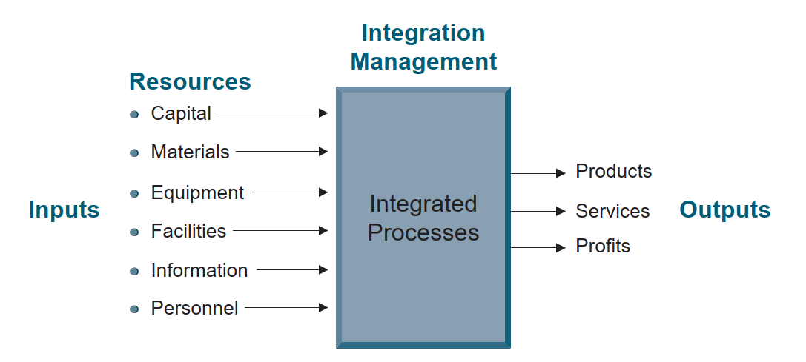
Chapter
Integration management.
1
www.midocean.ae

Slide 41
Agenda
Understanding Project Management
Meaning of “ Project “
Meaning of “ Project time management“
Benefits of project time management
Project Management Life Cycle
Successful project management
Benefits of project management
Obstacles of project management
Project Management
Project Manager's Role
Functional Manager’s Role
www.midocean.ae

Slide 42
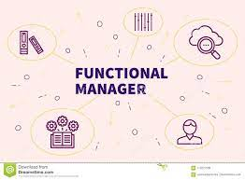
Chapter
FUNCTIONAL MANAGER’S ROLE
1
● The functional manager has the responsibility to define how the task will be done and where the task will be done (i.e., the technical criteria).
www.midocean.ae

Slide 43
Chapter
FUNCTIONAL MANAGER’S ROLE
1
● The functional manager has the responsibility to provide sufficient resources to accomplish the objective within the project’s constraints (i.e., who will get the job done).
www.midocean.ae

Slide 44


Chapter
FUNCTIONAL MANAGER’S ROLE
1
● The functional manager has the responsibility for the deliverable.
www.midocean.ae

Slide 45

www.midocean.ae

Slide 46


Thank You

