Slide 1


Slide 2
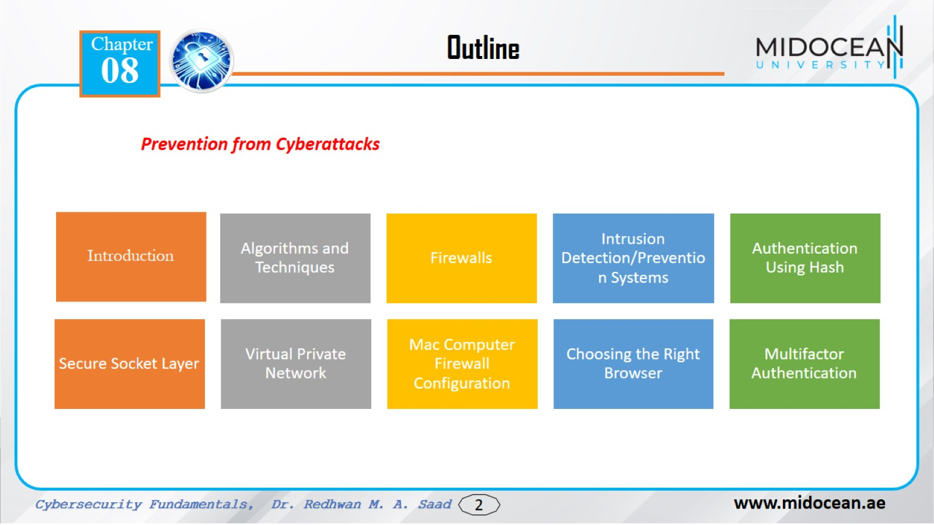

Slide 3


Slide 4


Slide 5
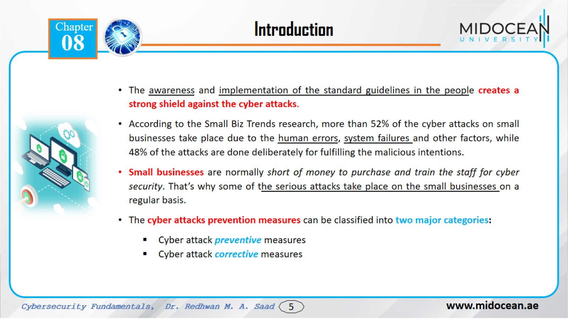

Slide 6
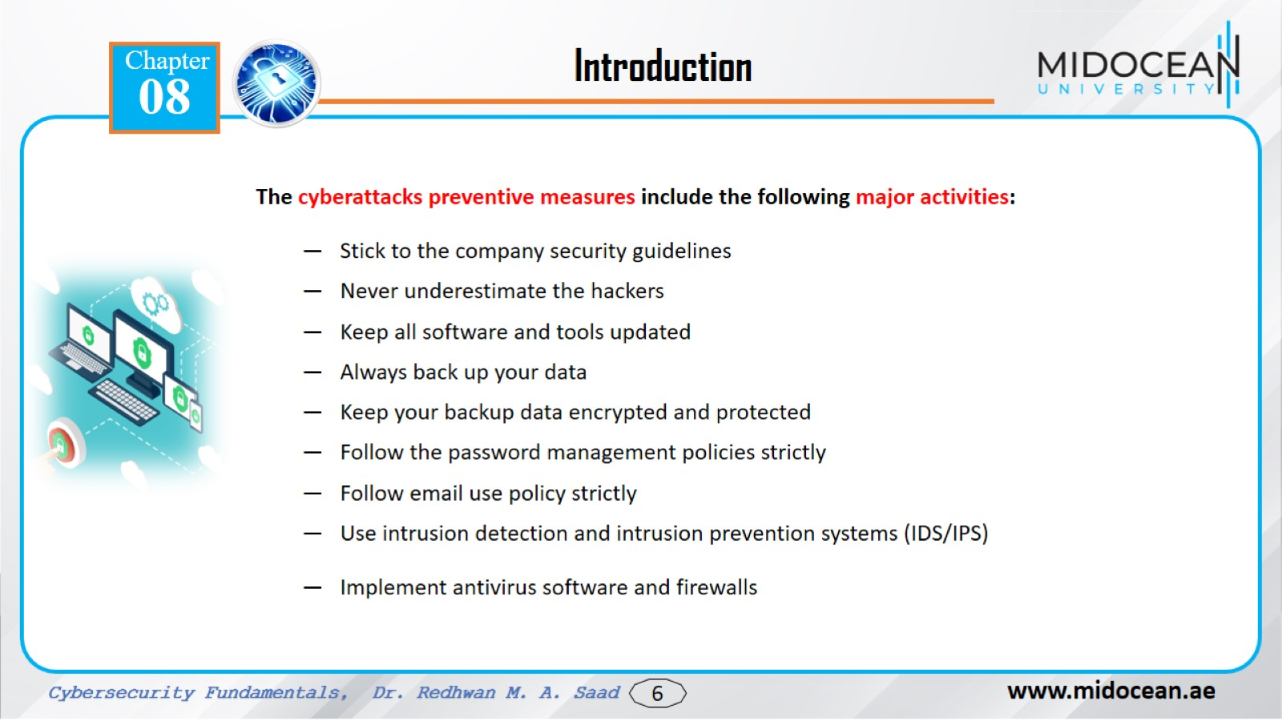

Slide 7
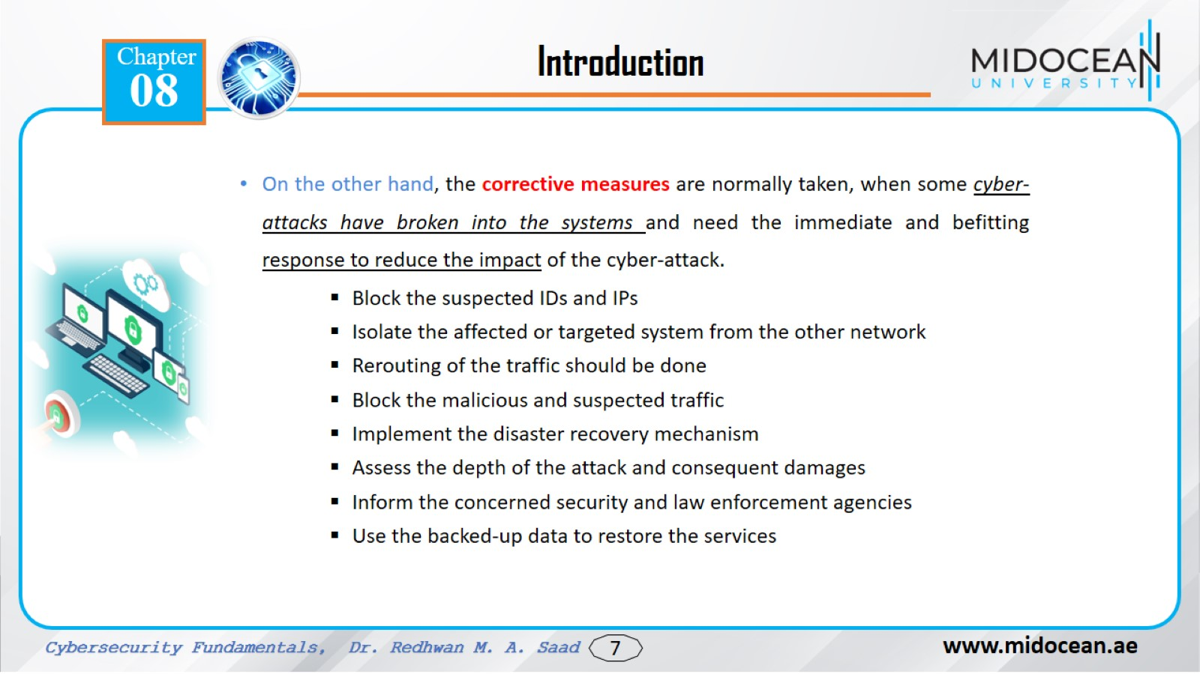

Slide 8
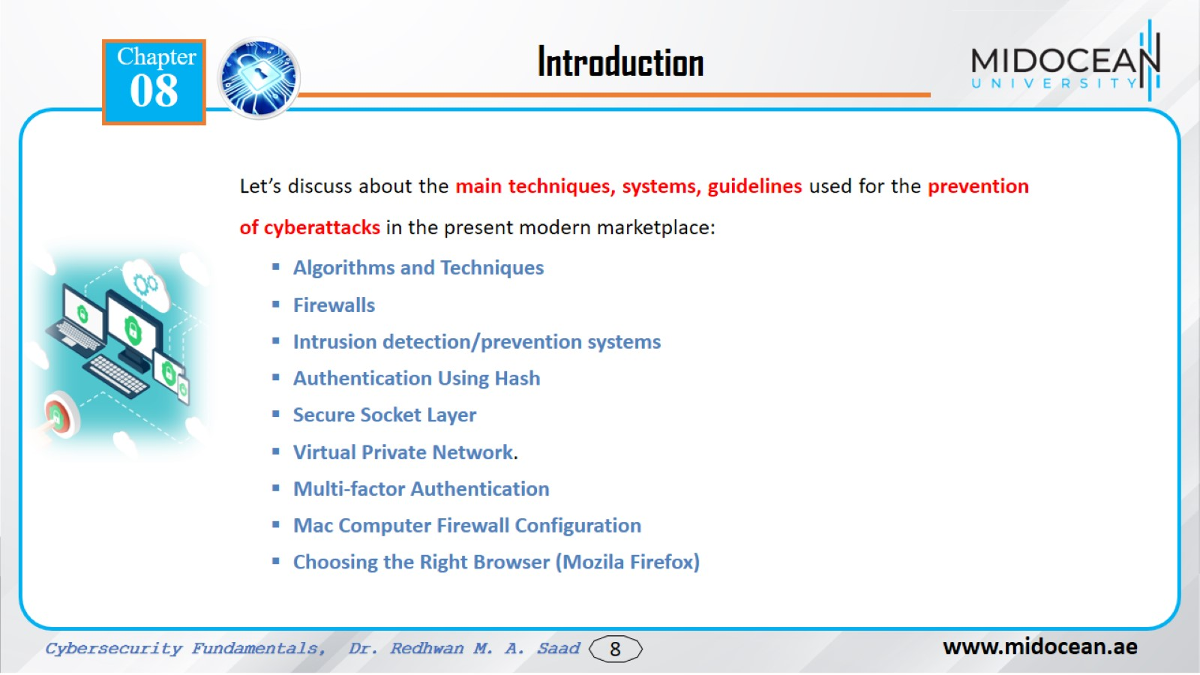

Slide 9
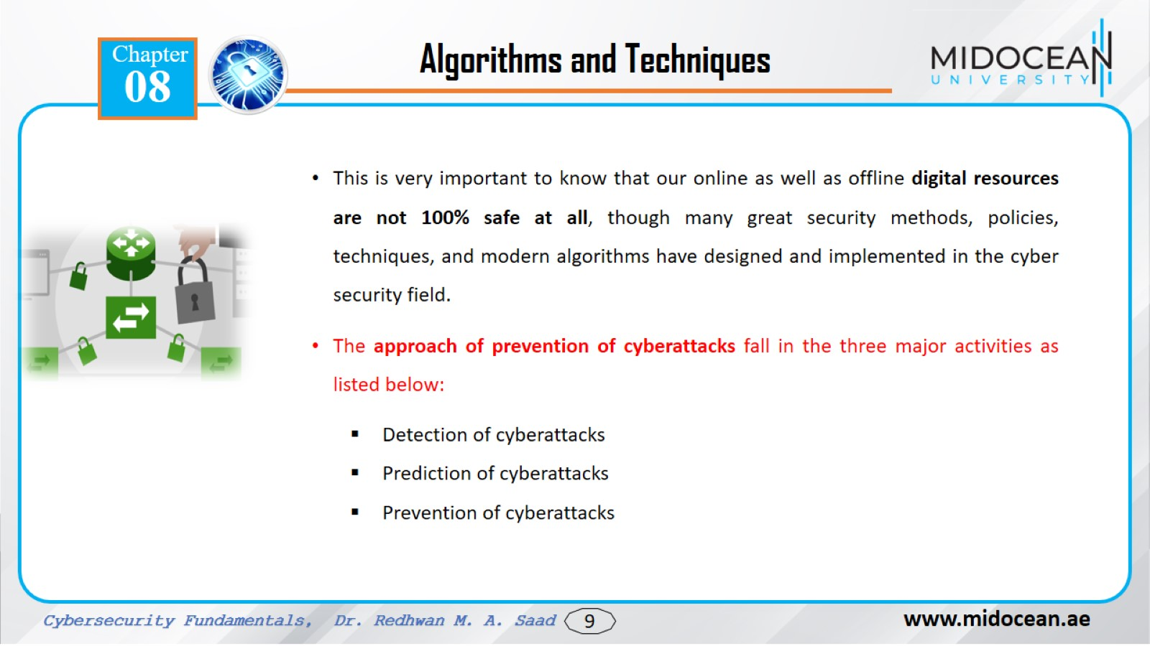

Slide 10
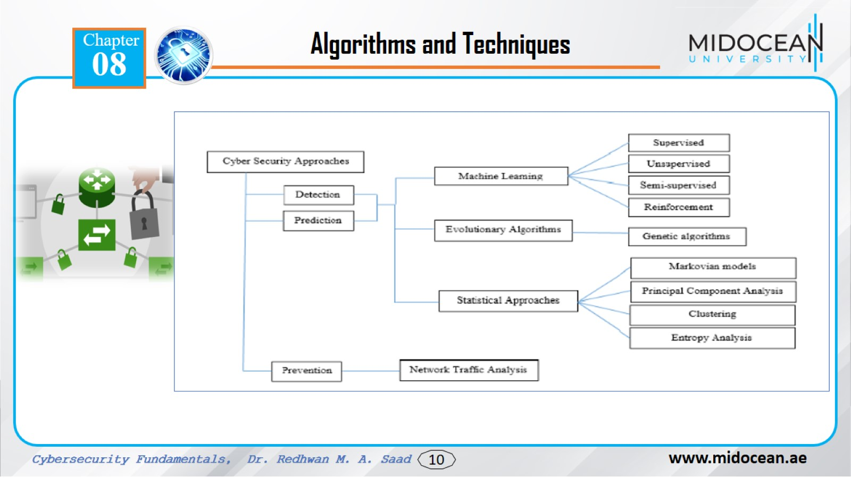

Slide 11
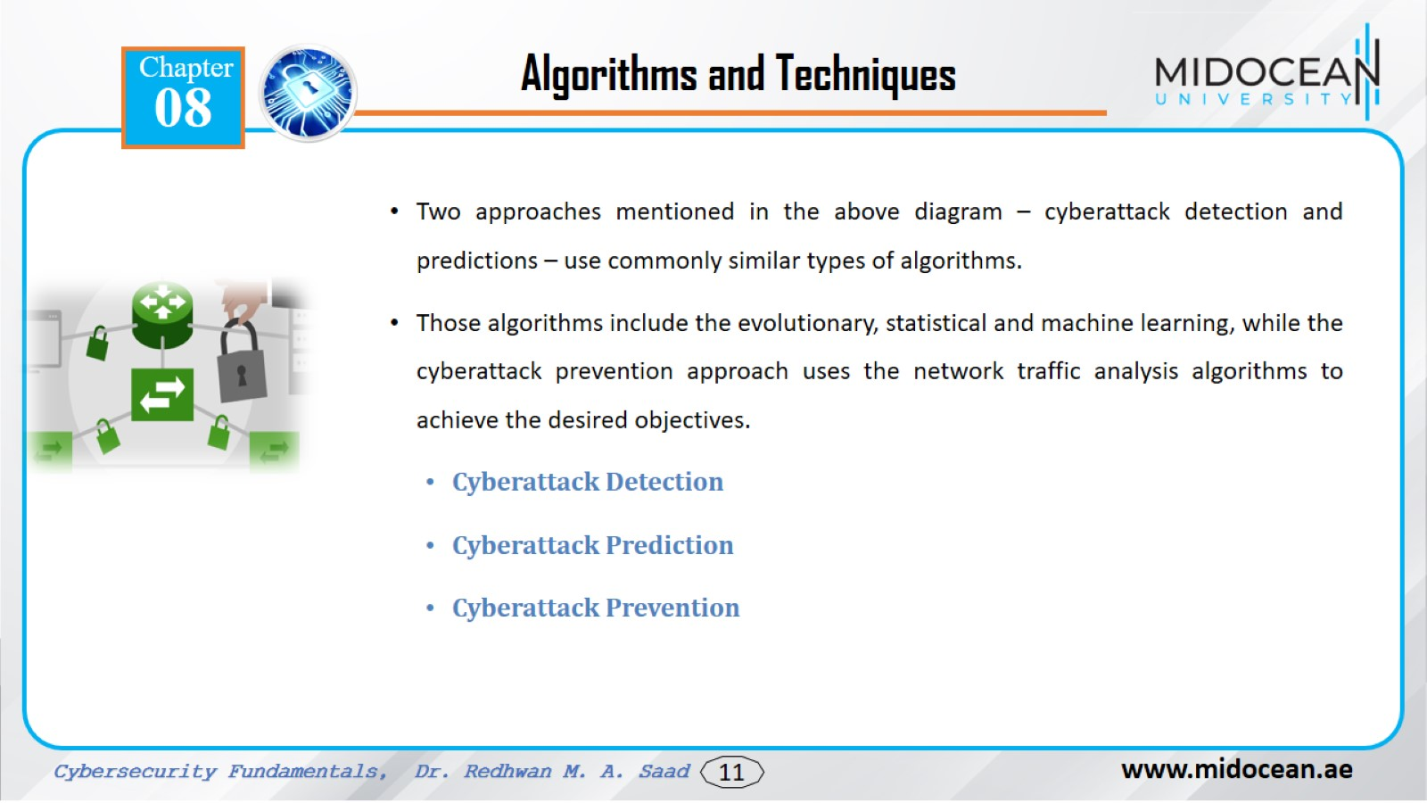

Slide 12
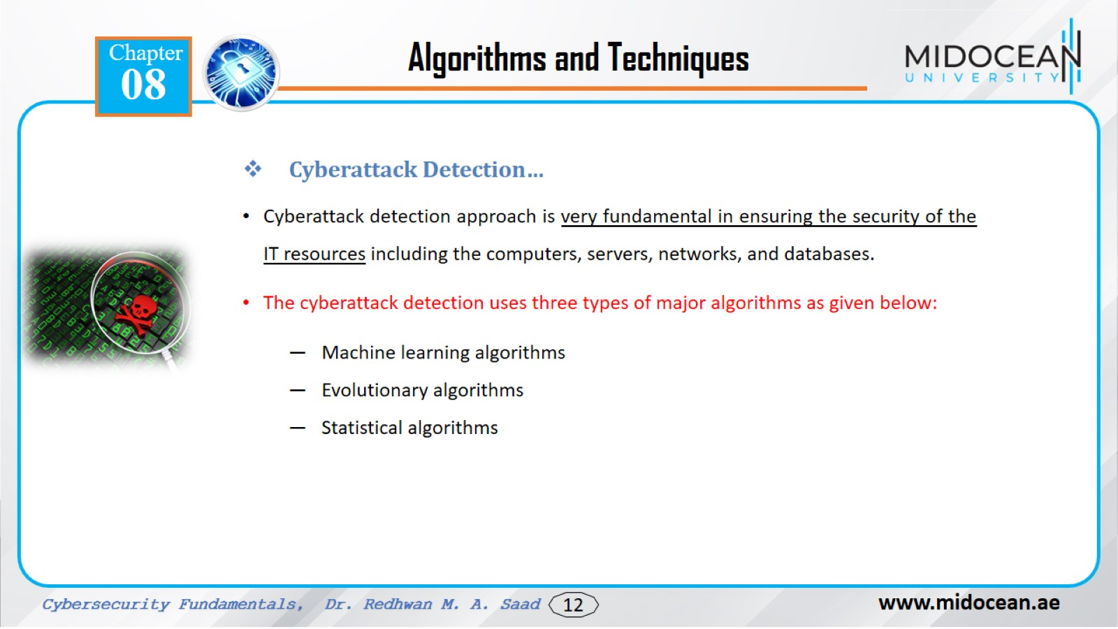

Slide 13
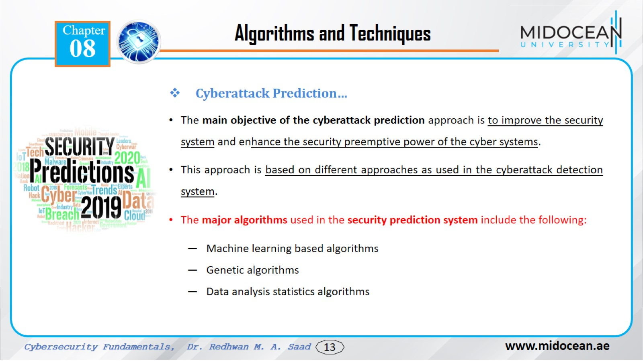

Slide 14
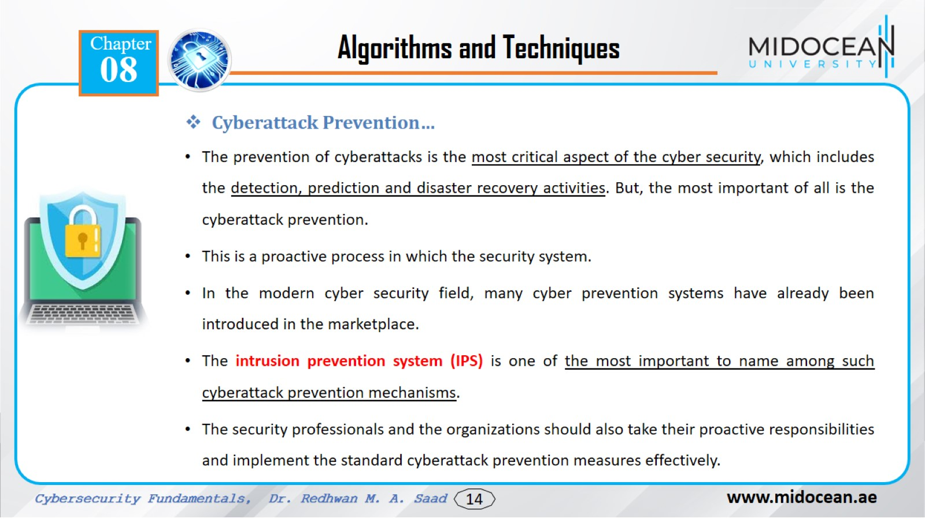

Slide 15
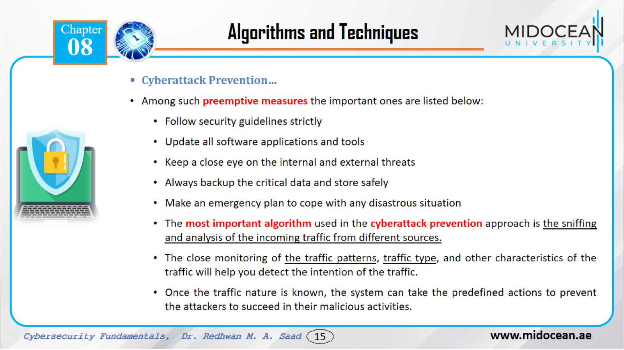

Slide 16
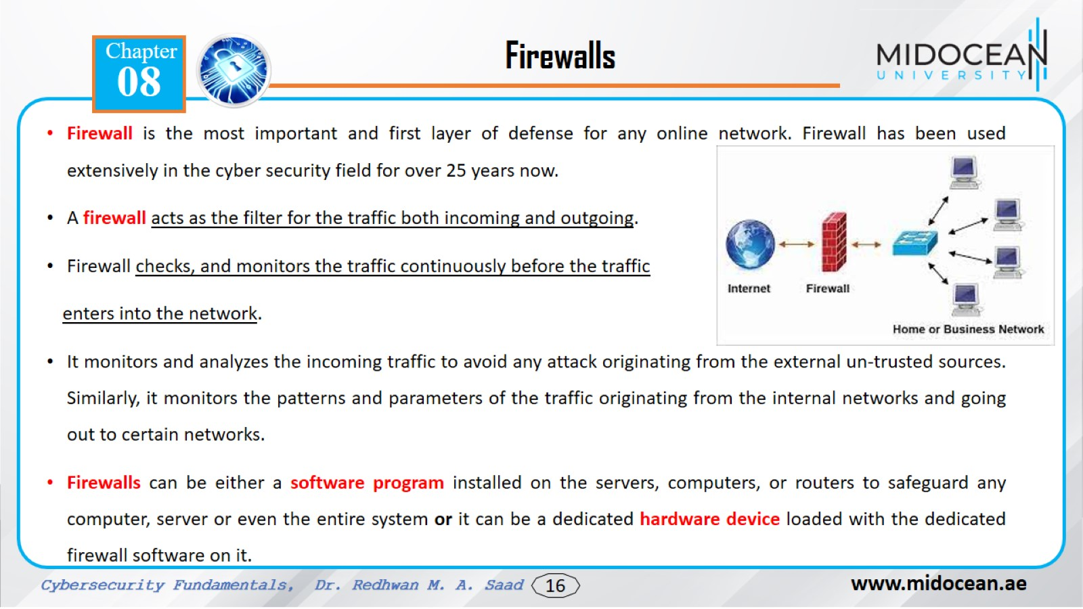

Slide 17
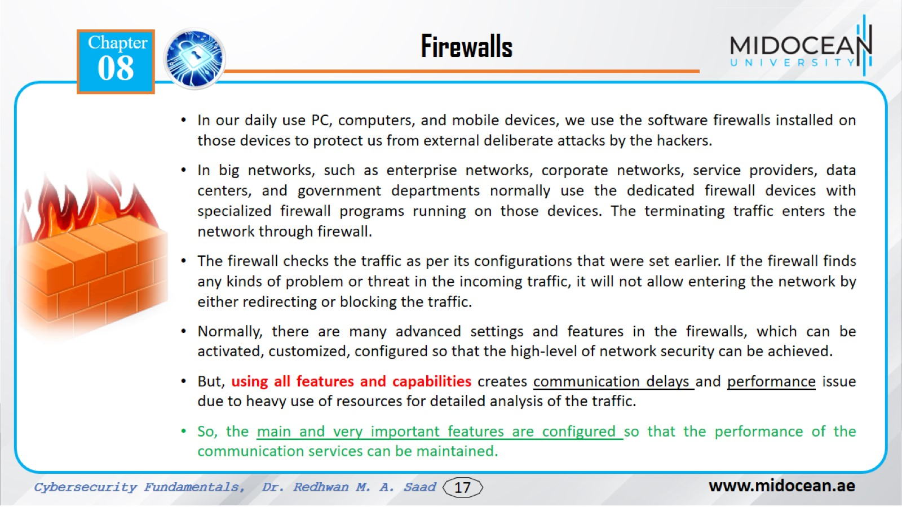

Slide 18
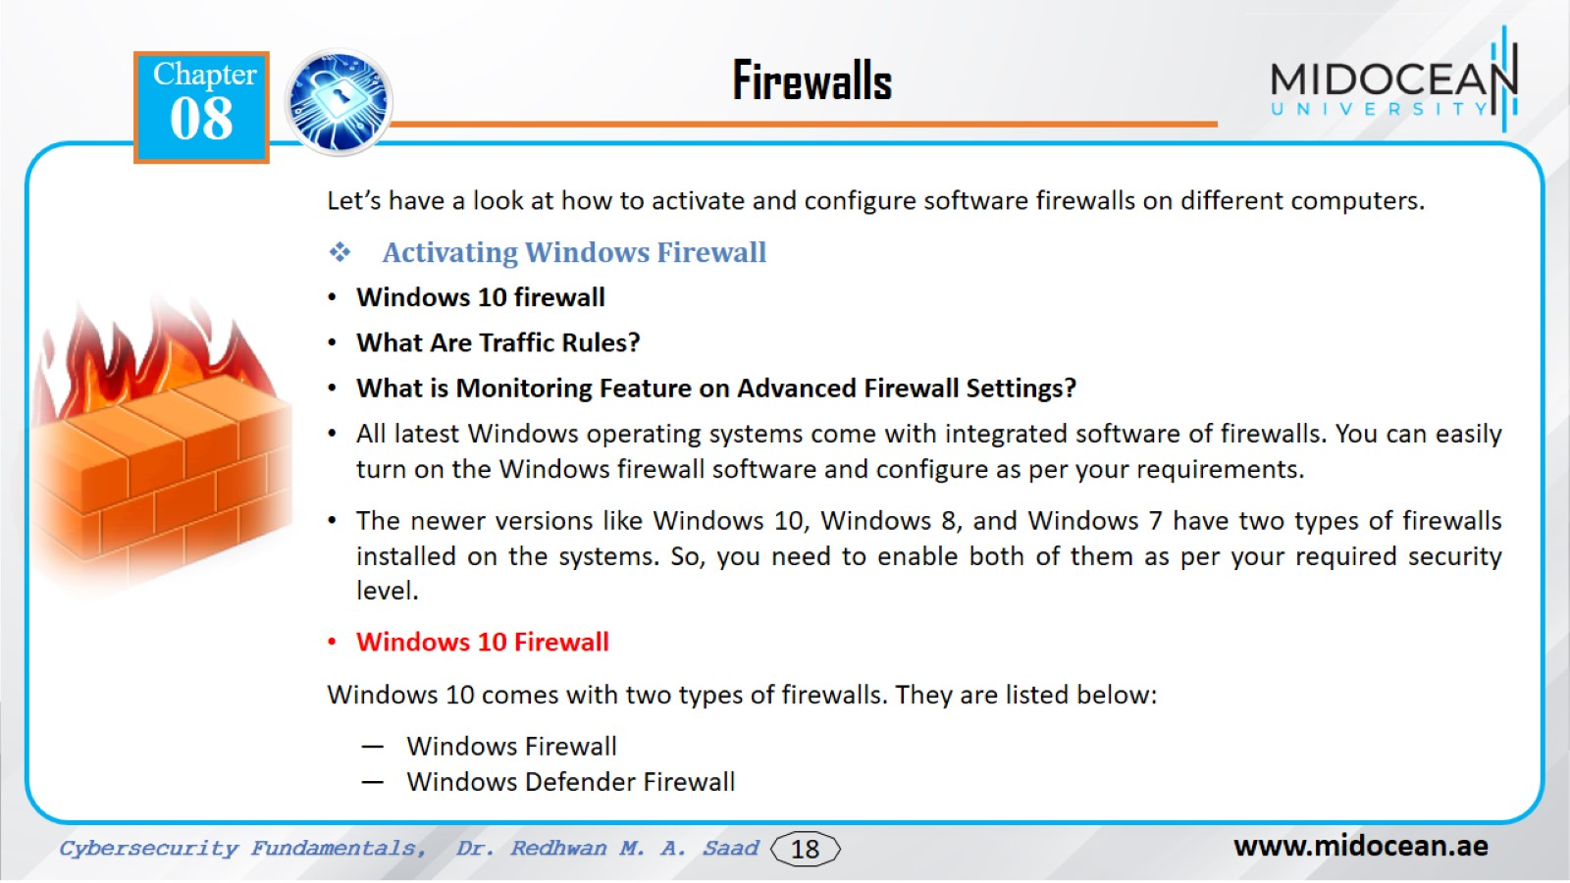

Slide 19
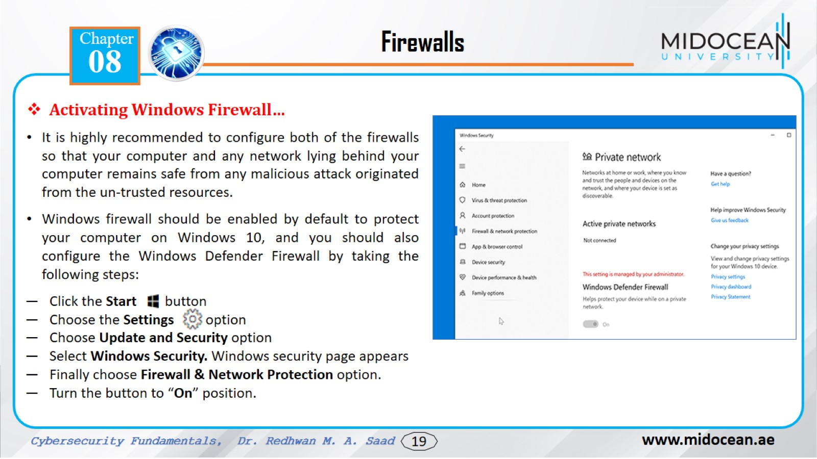

Slide 20
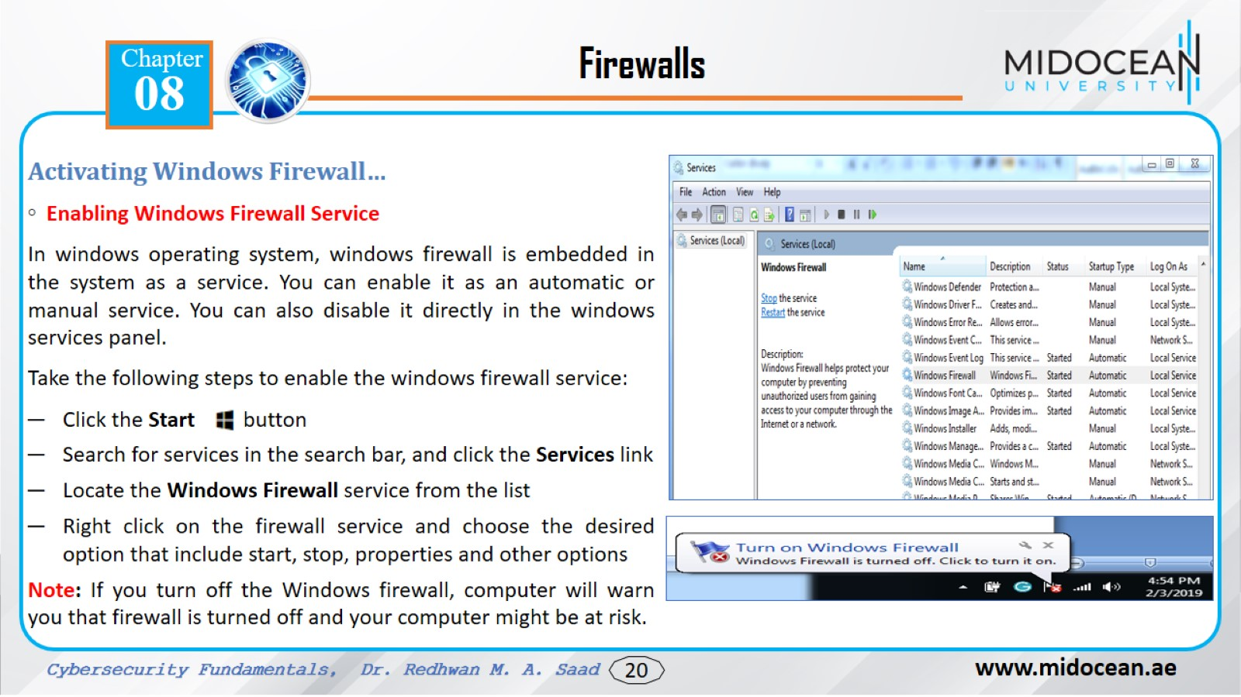

Slide 21
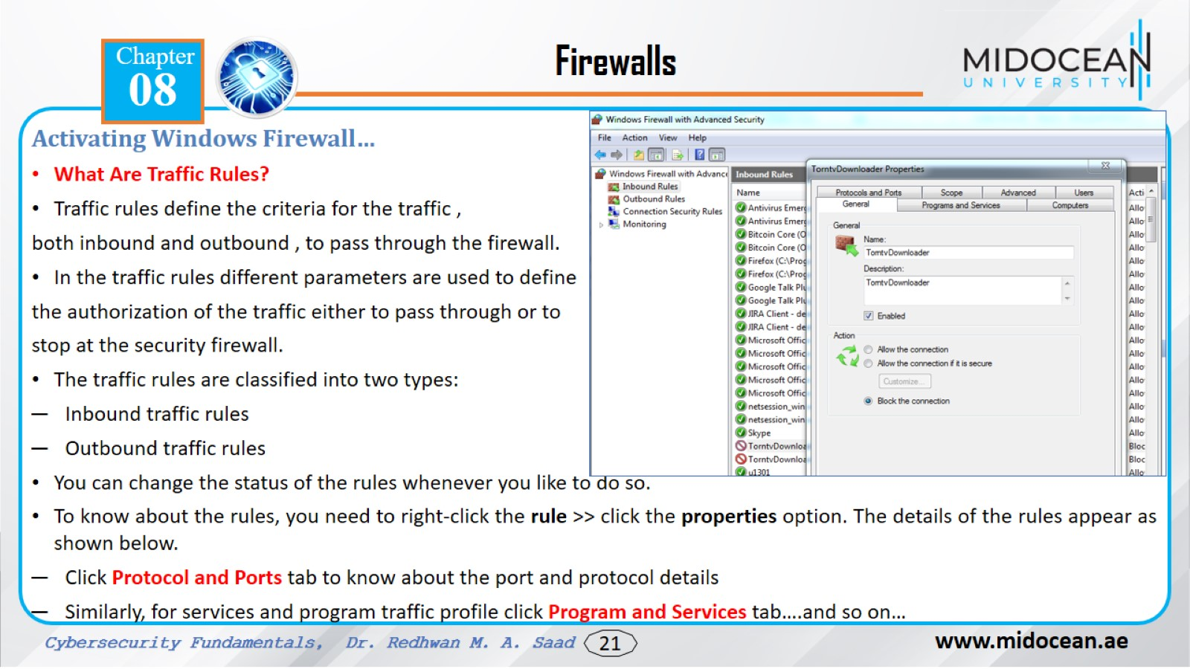

Slide 22
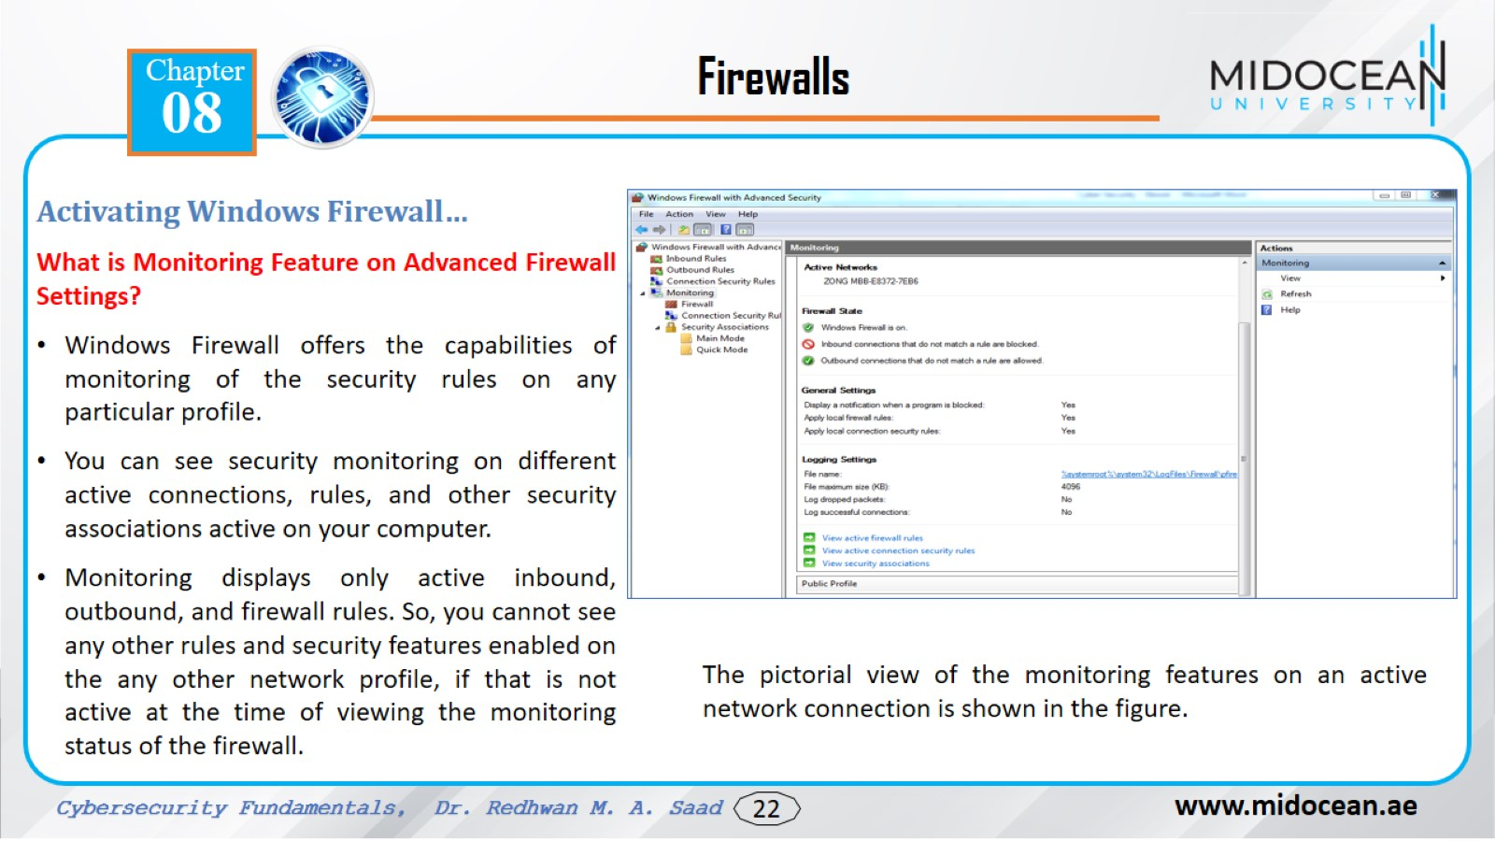

Slide 23
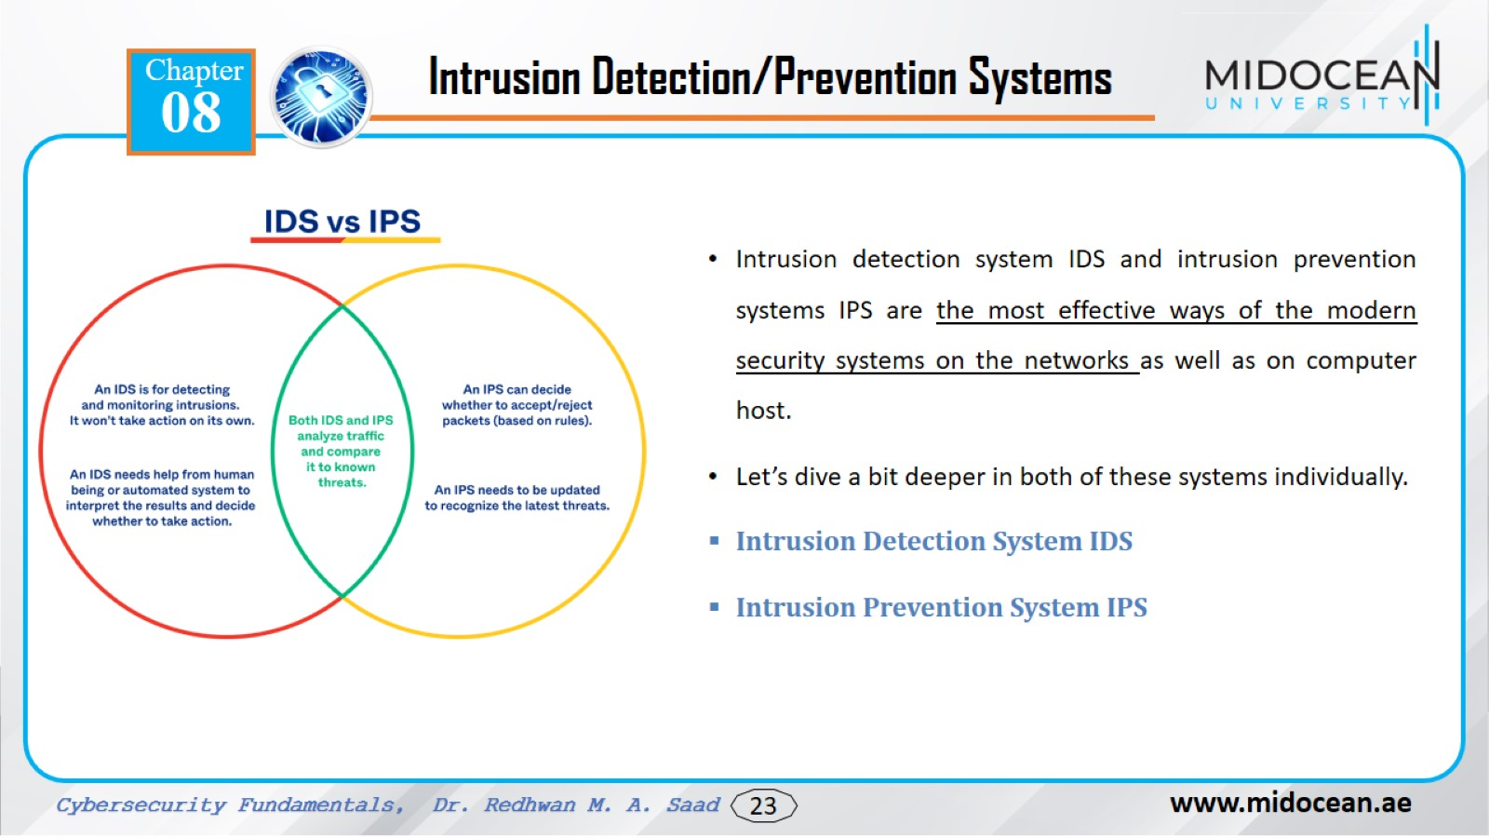

Slide 24
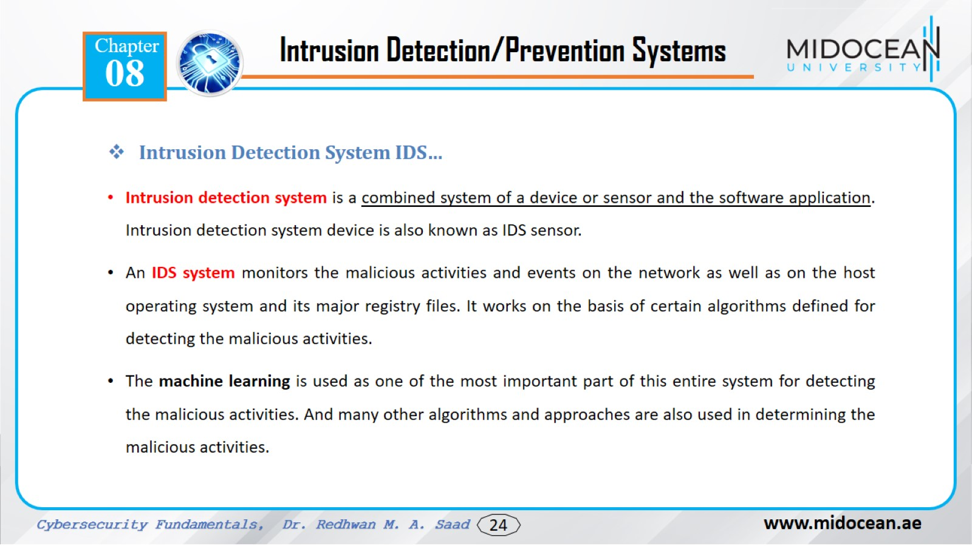

Slide 25
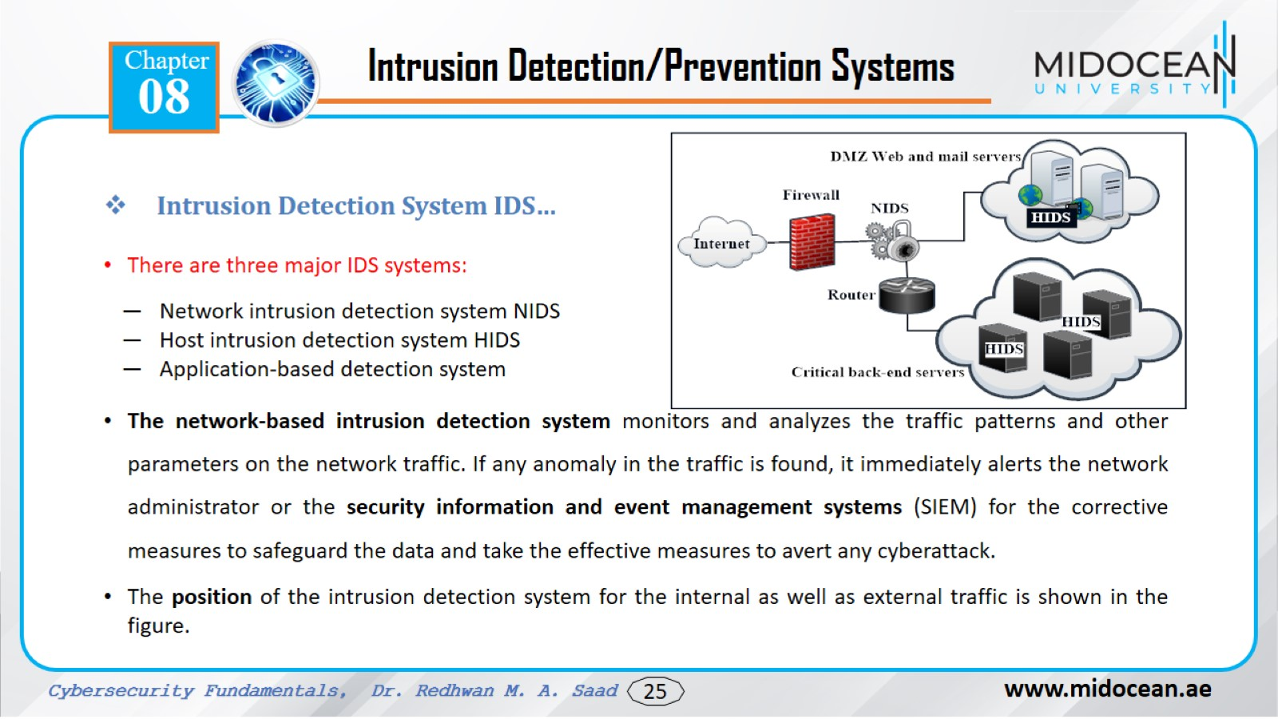

Slide 26
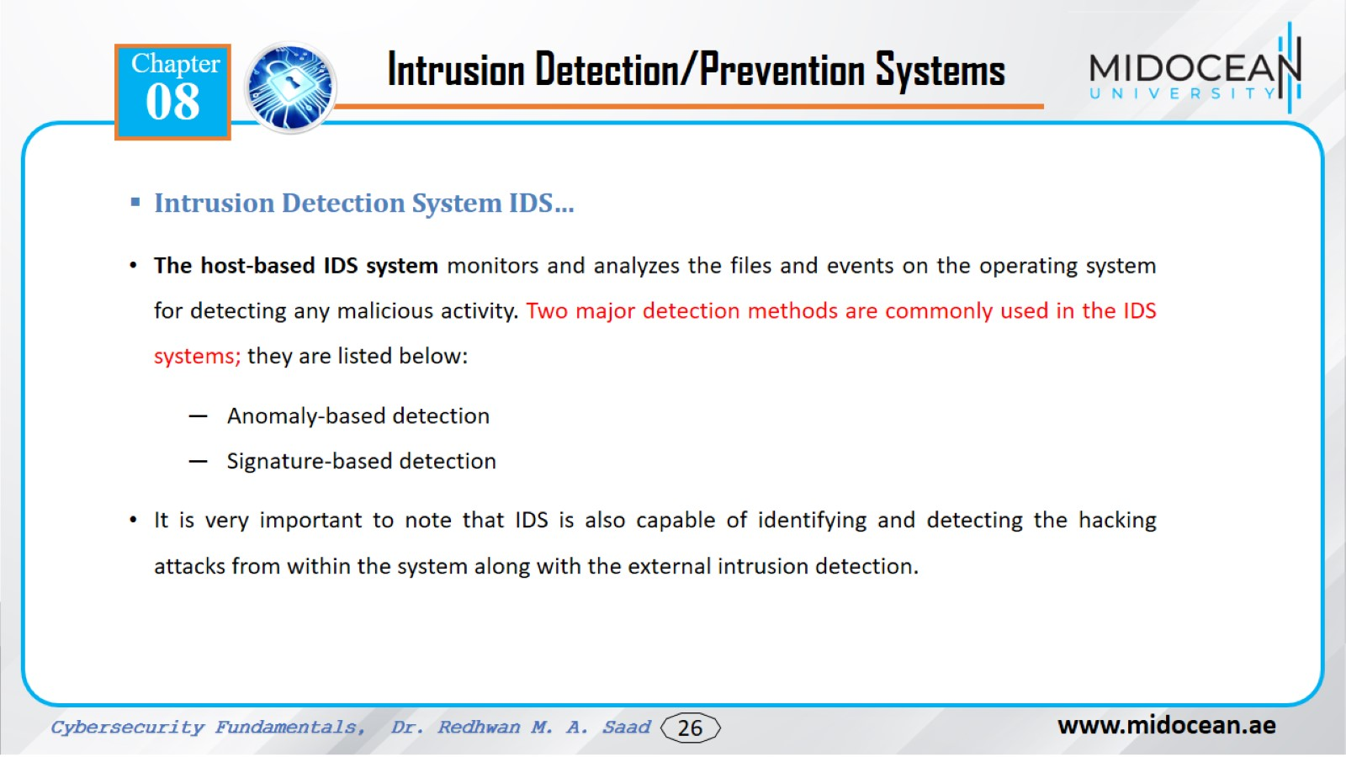

Slide 27
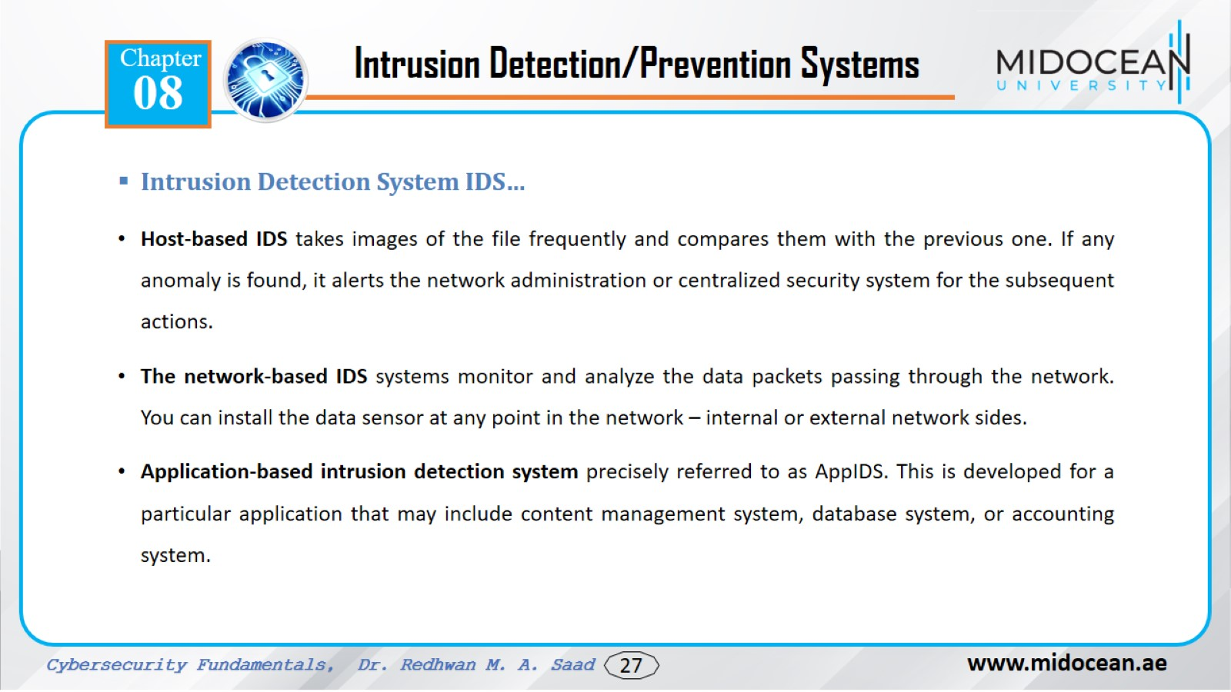

Slide 28
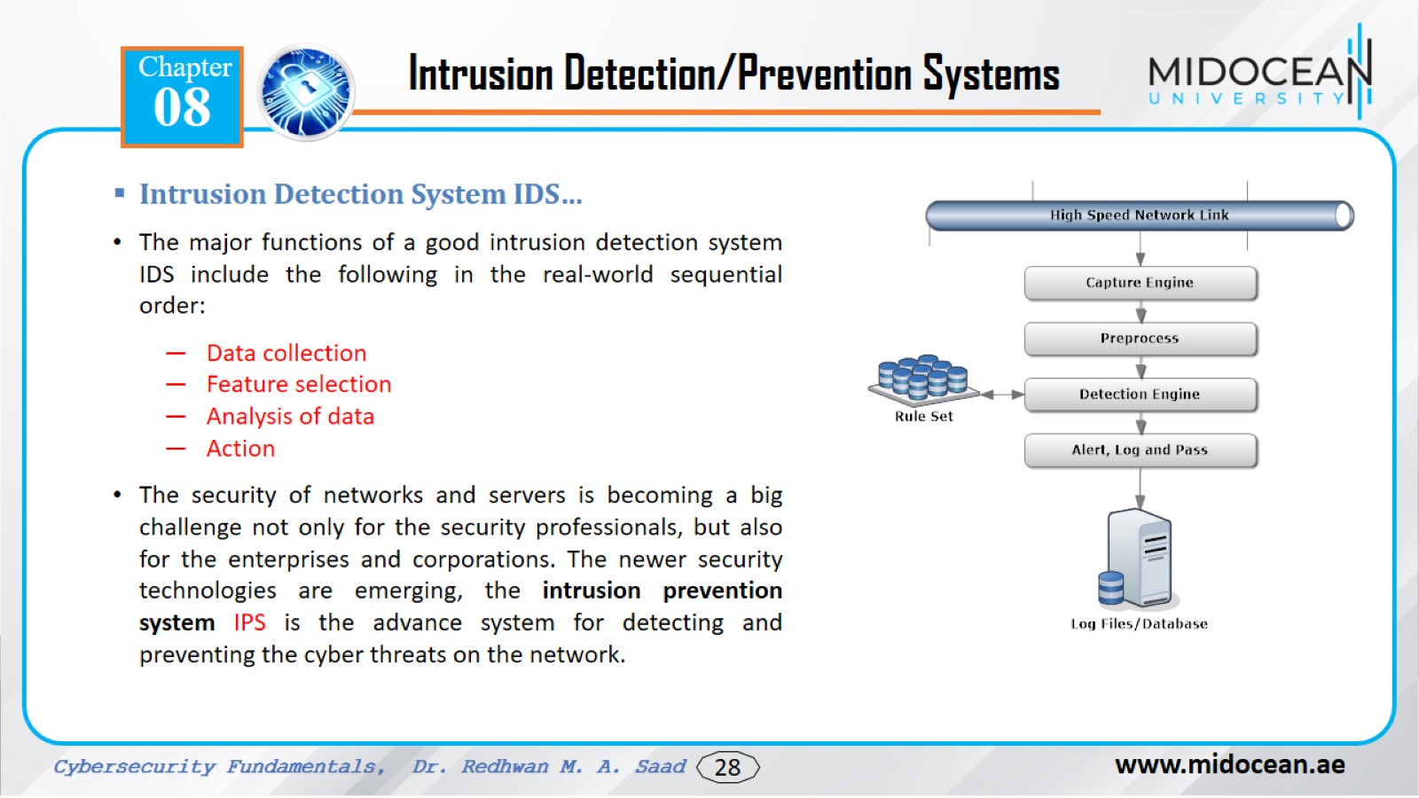

Slide 29
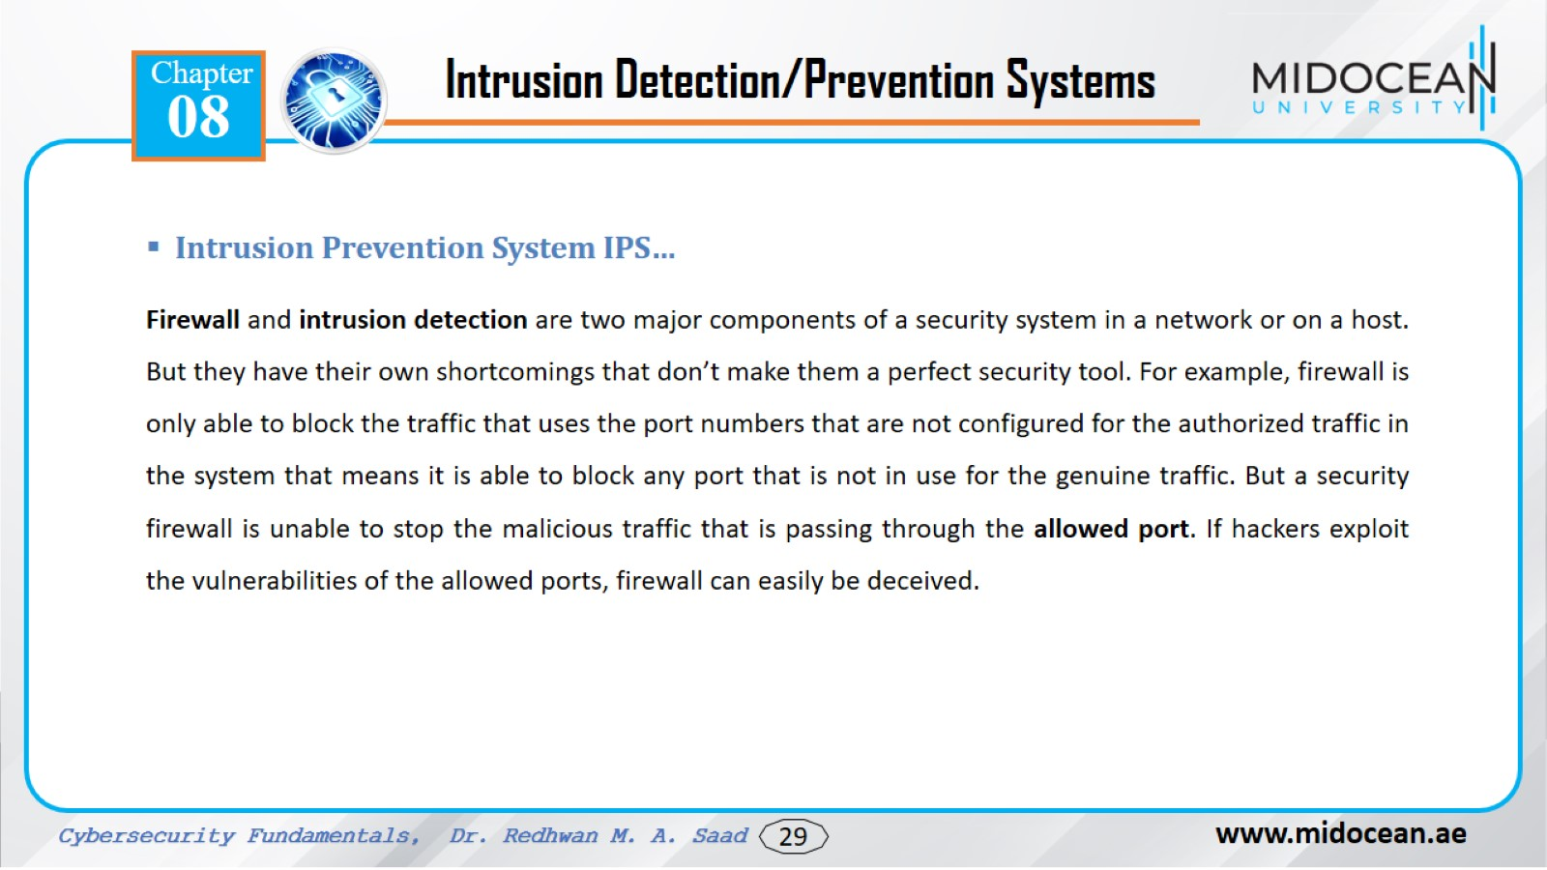

Slide 30
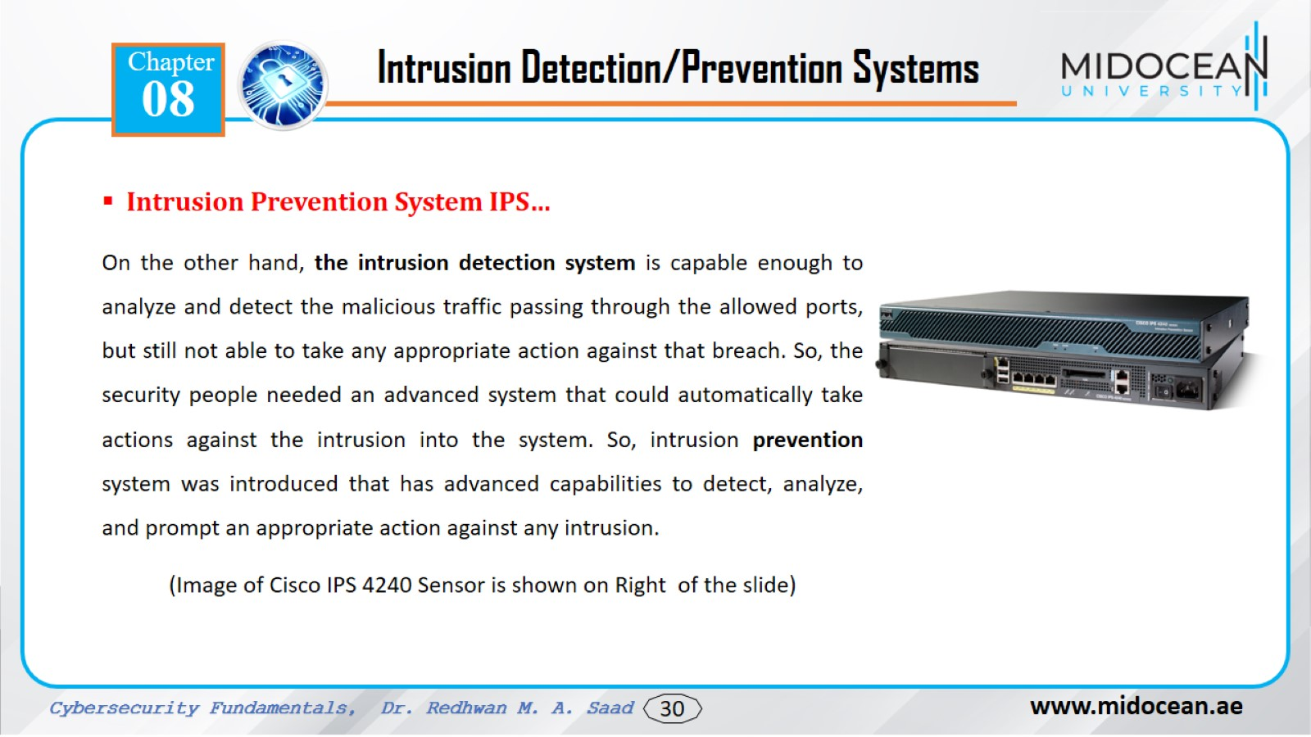

Slide 31
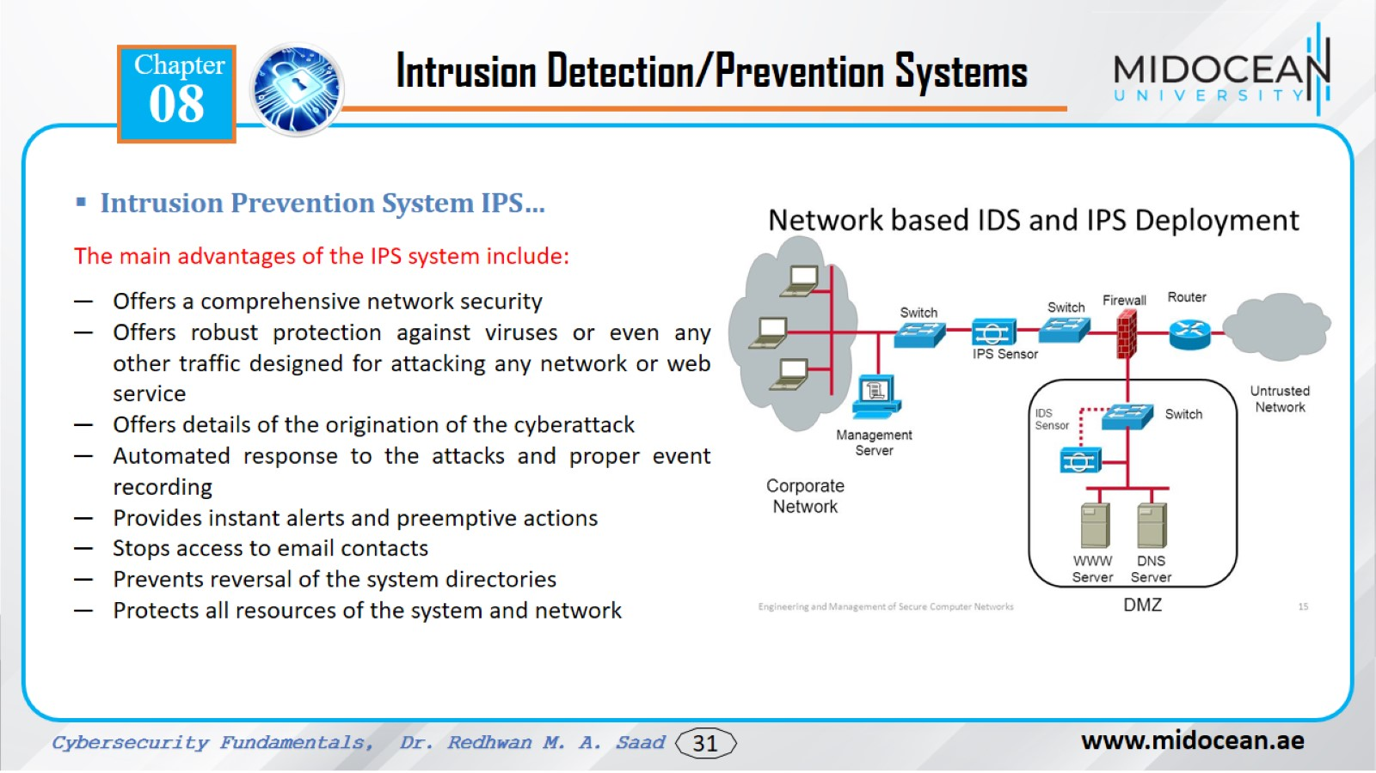

Slide 32
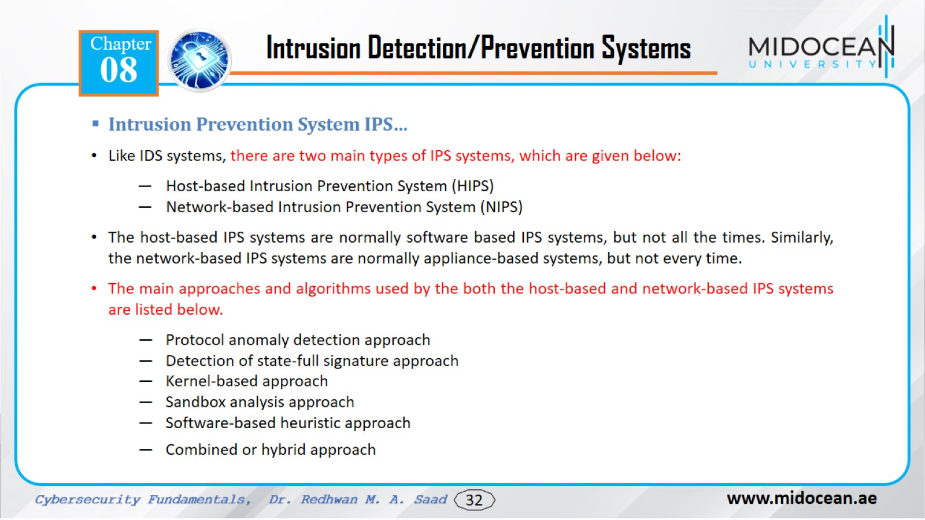

Slide 33
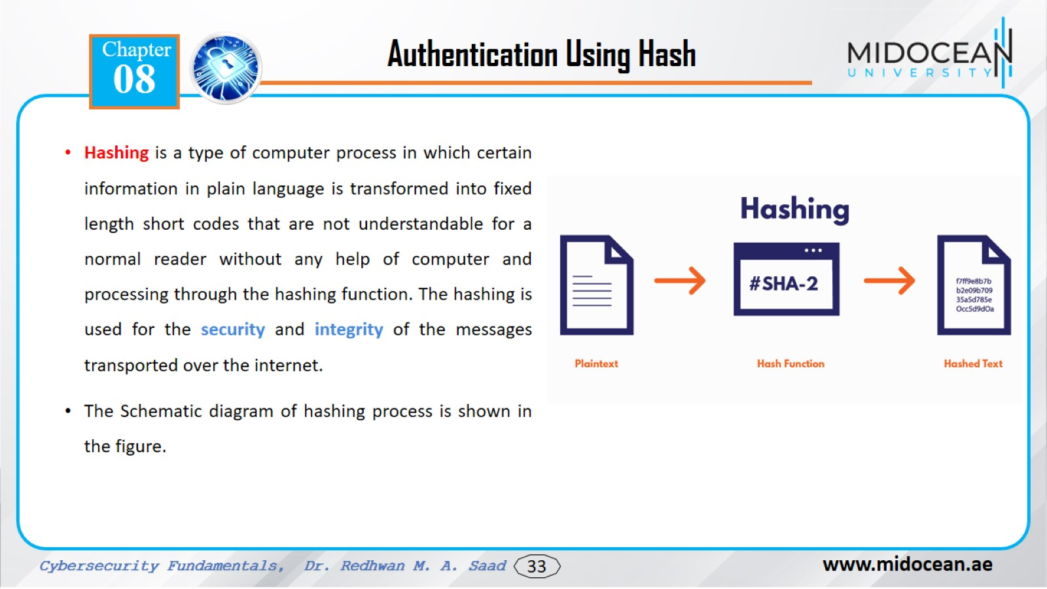

Slide 34
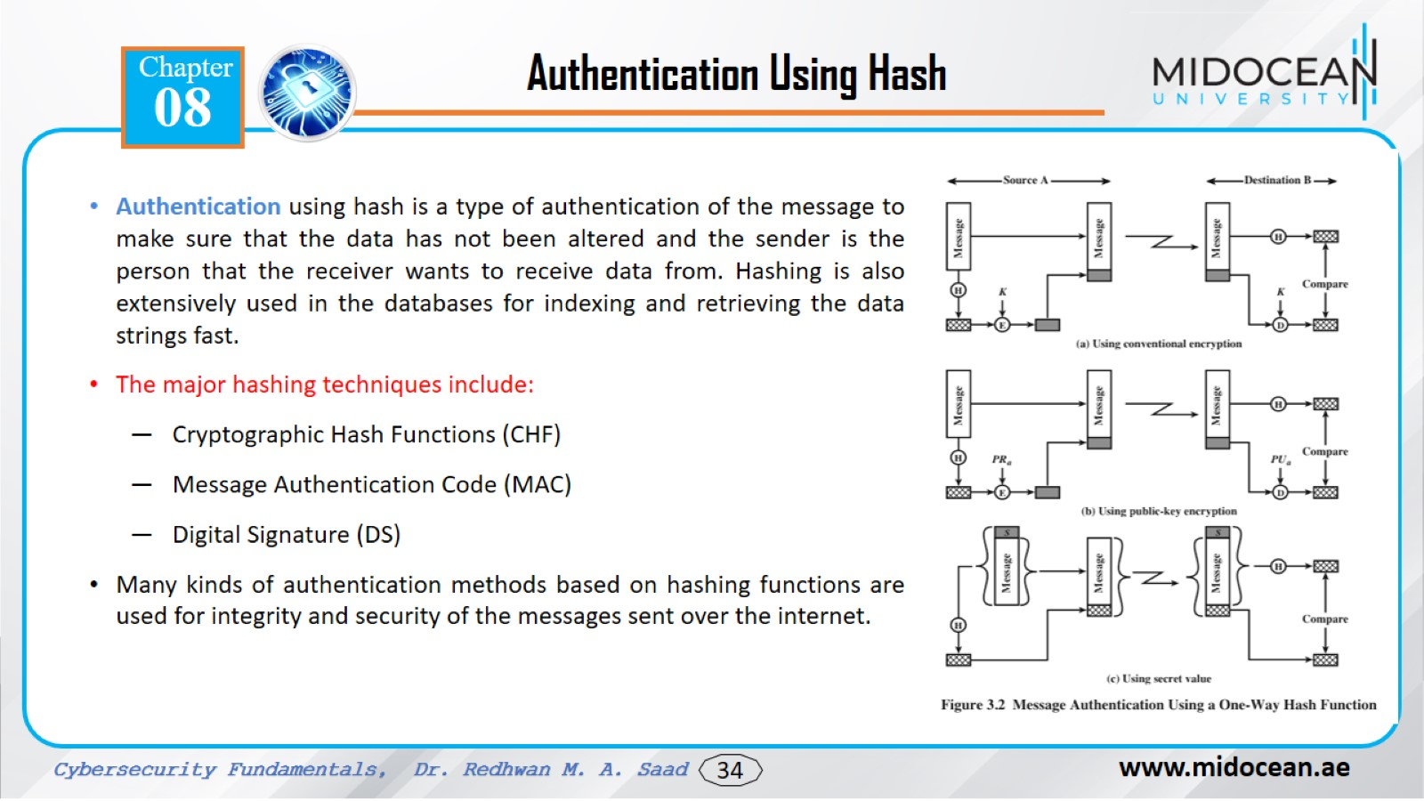

Slide 35
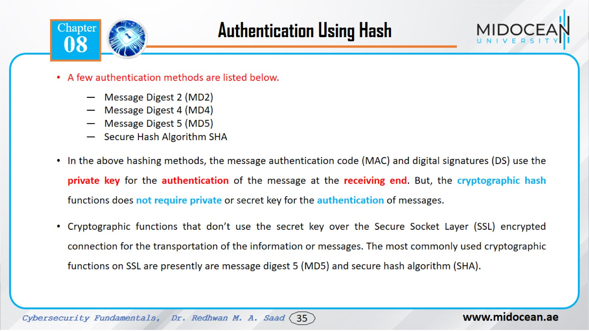

Slide 36
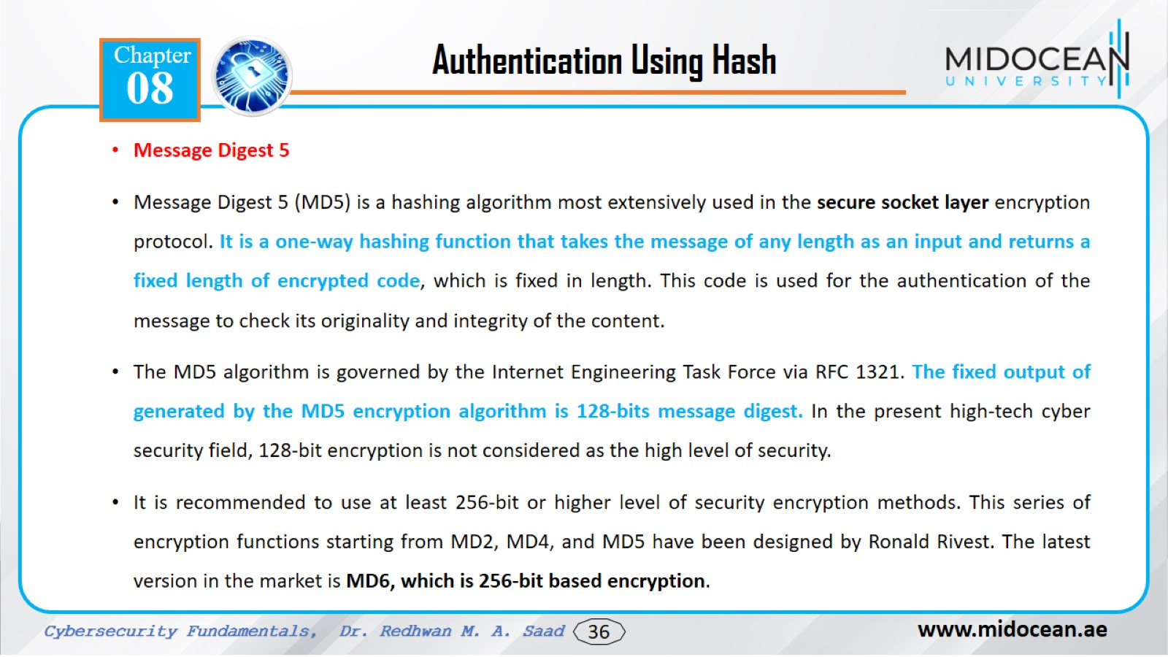

Slide 37
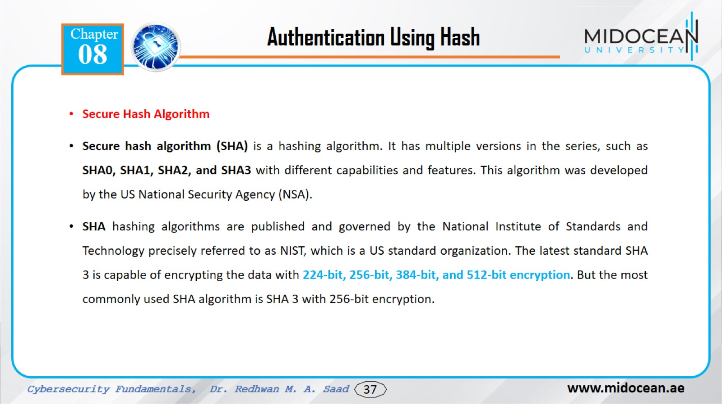

Slide 38
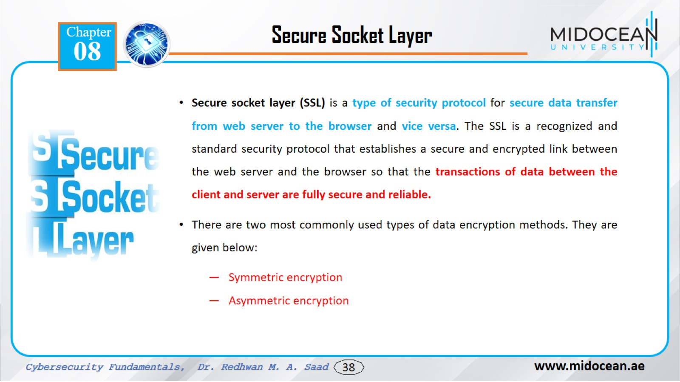

Slide 39
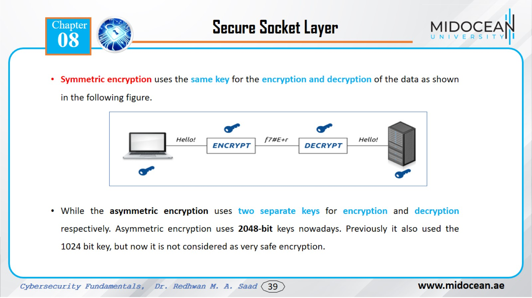

Slide 40
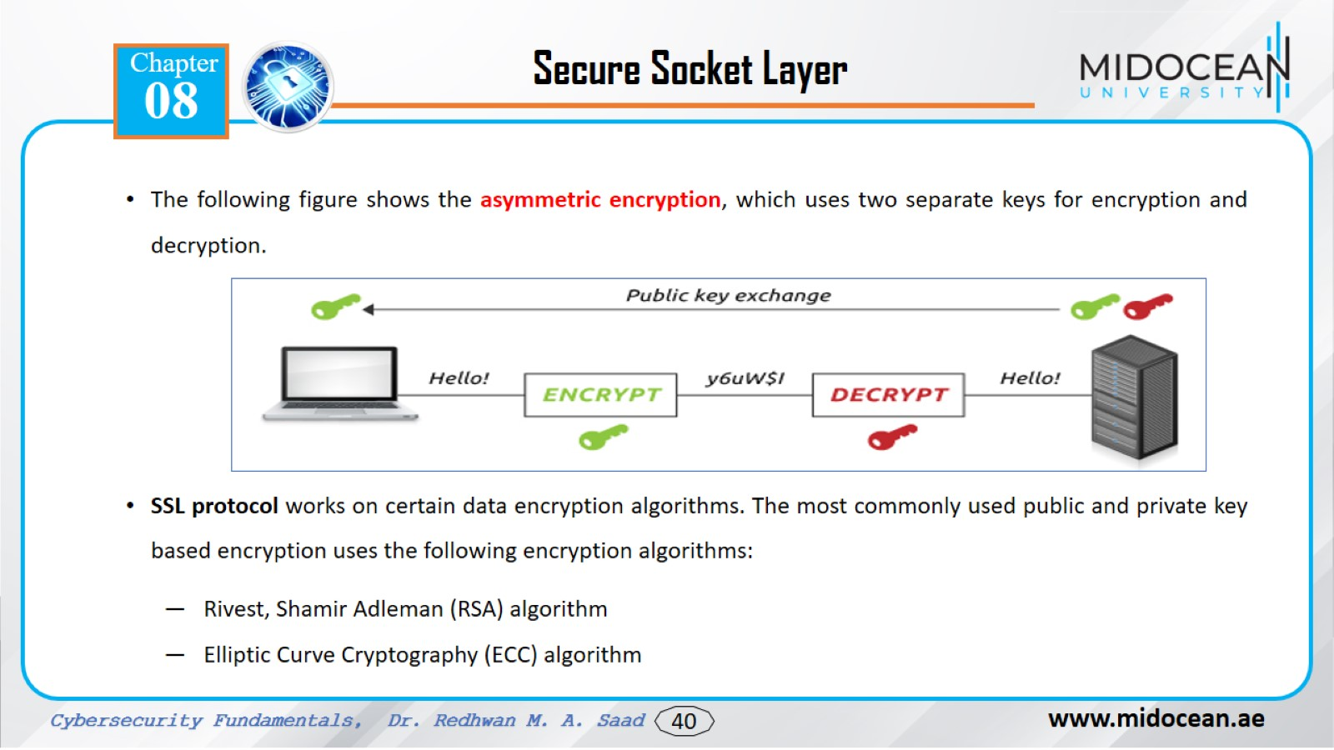

Slide 41
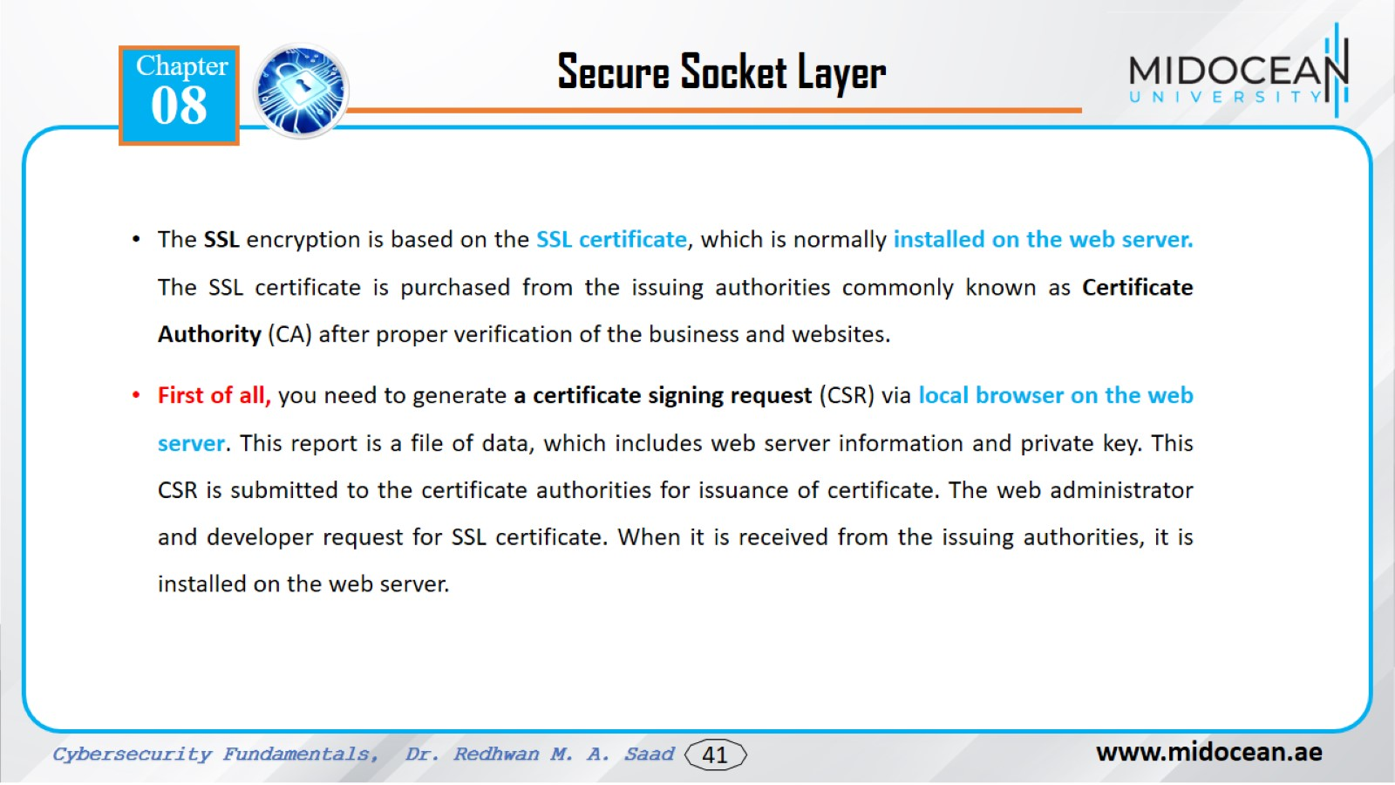

Slide 42
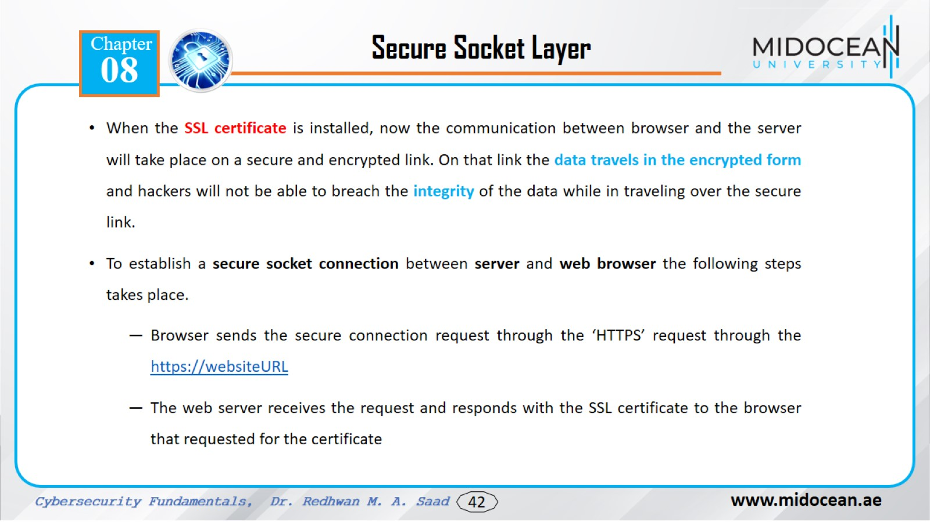

Slide 43
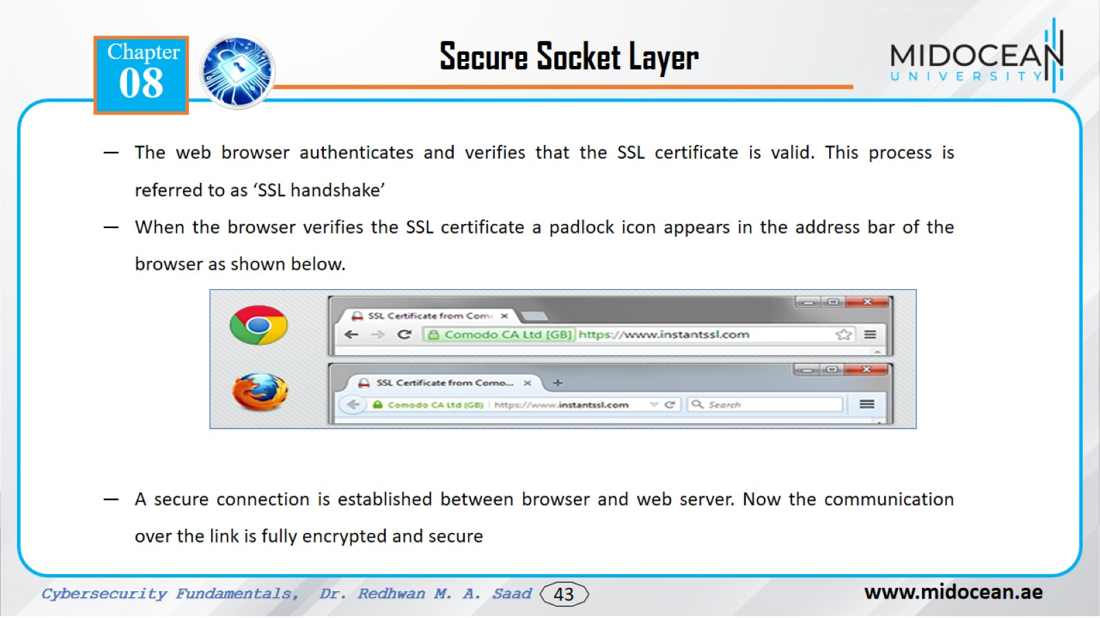

Slide 44
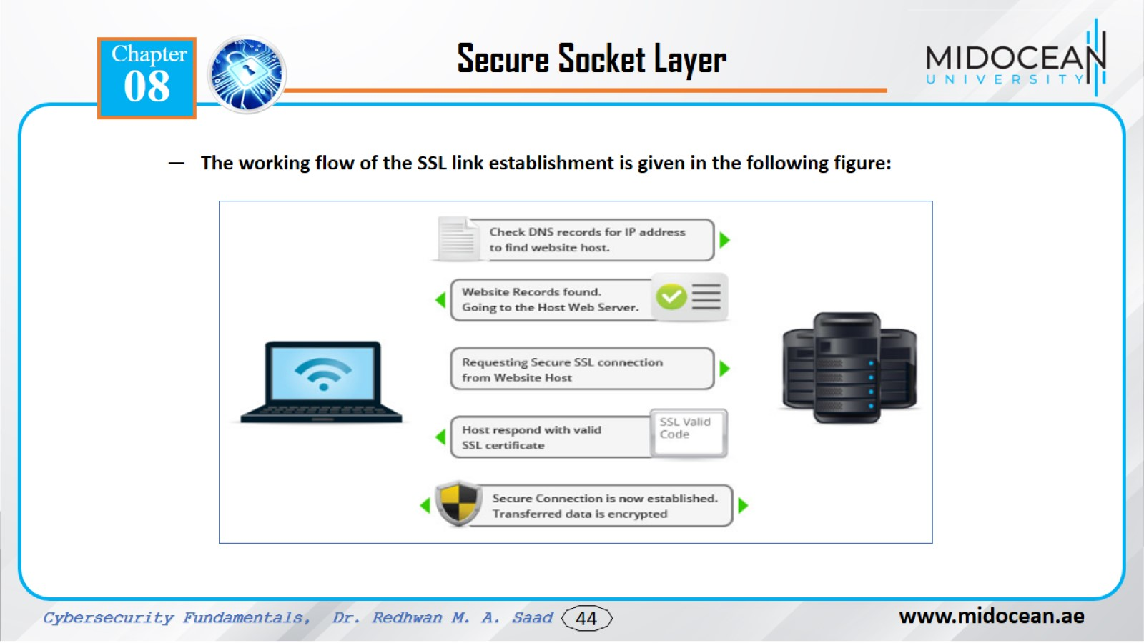

Slide 45
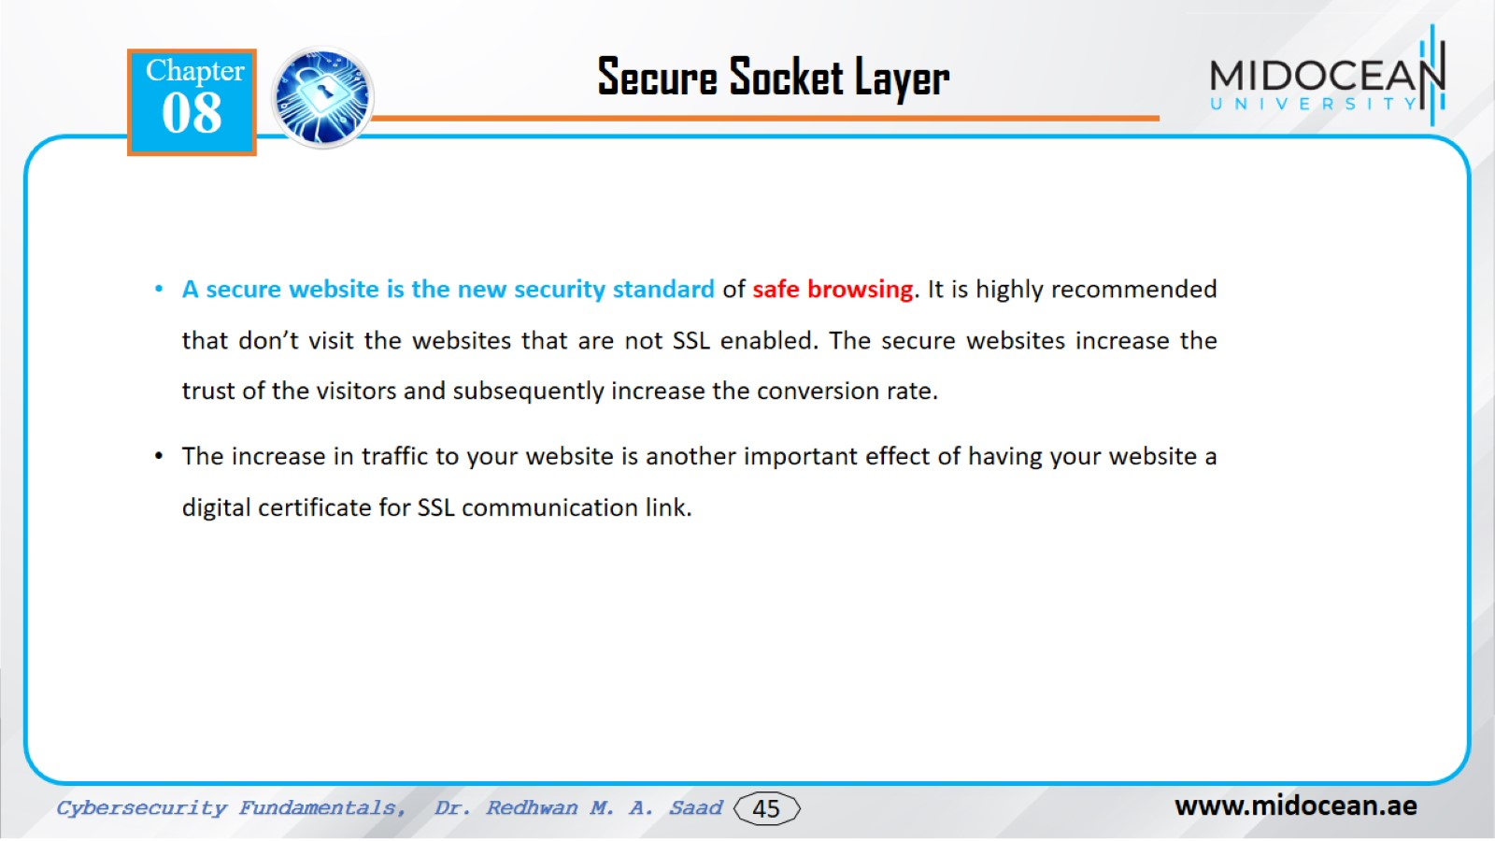

Slide 46
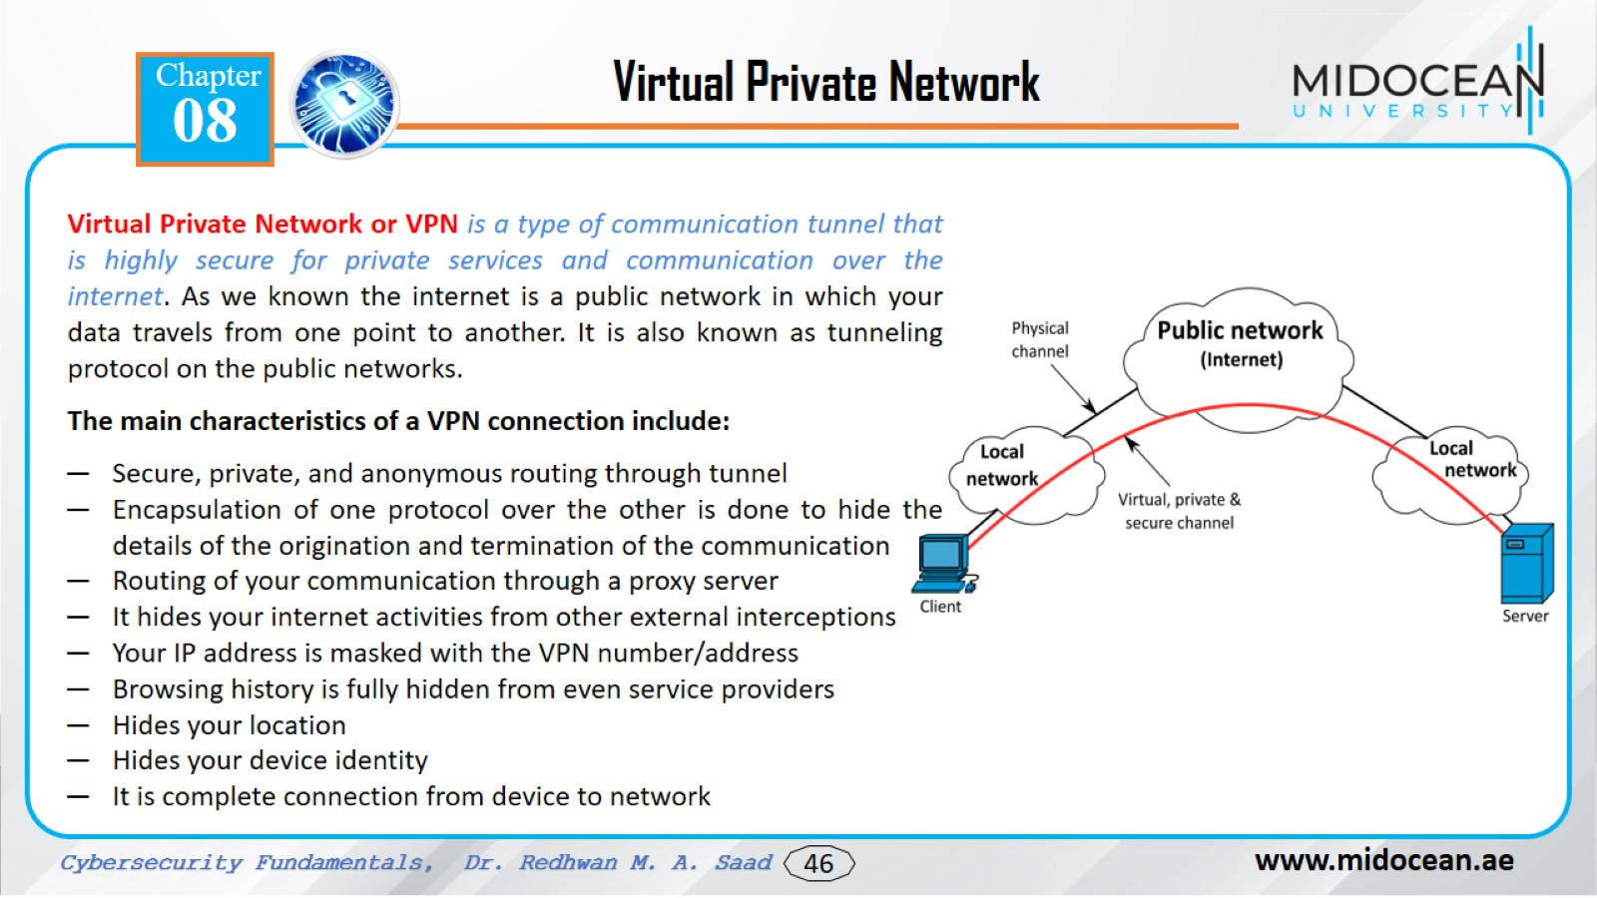

Slide 47
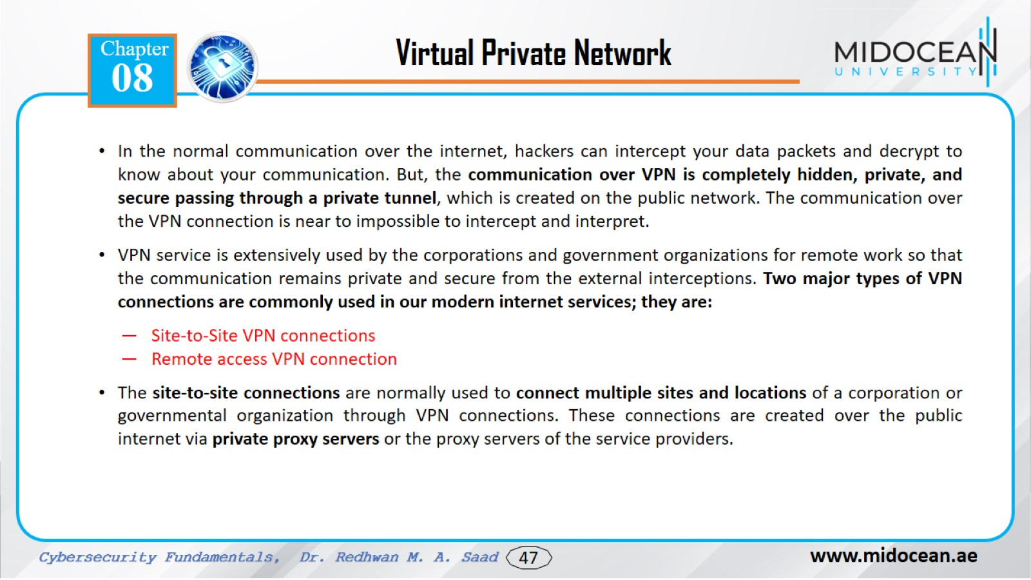

Slide 48
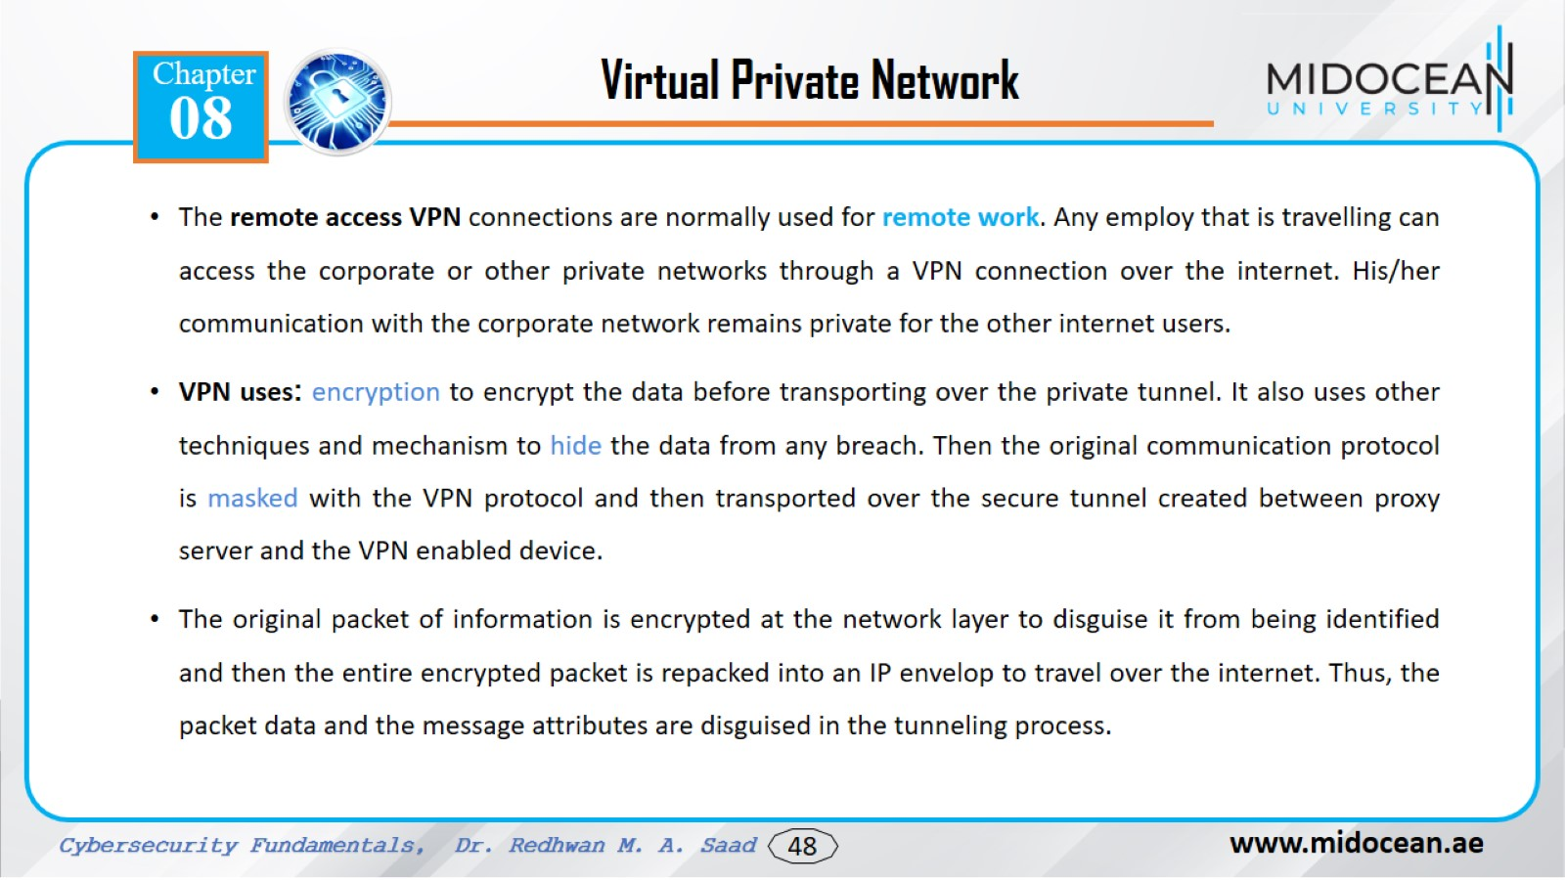

Slide 49
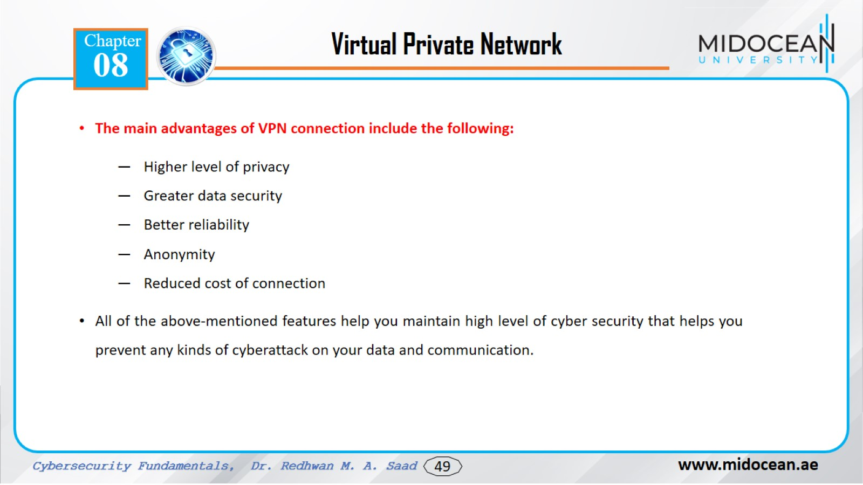

Slide 50
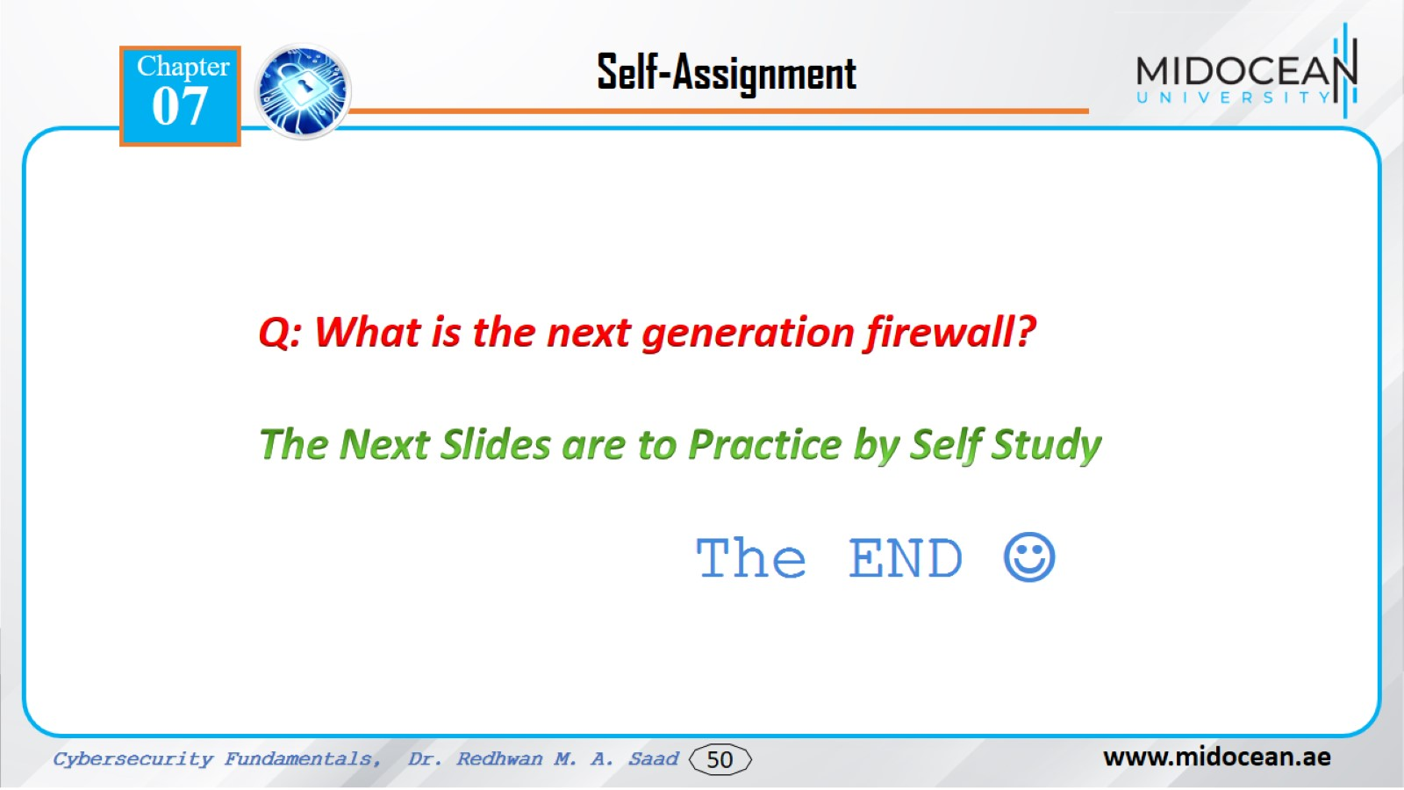

Slide 51


Slide 52
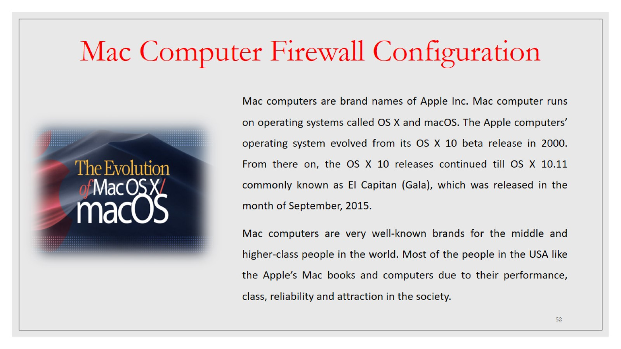
Mac Computer Firewall Configuration

Slide 53
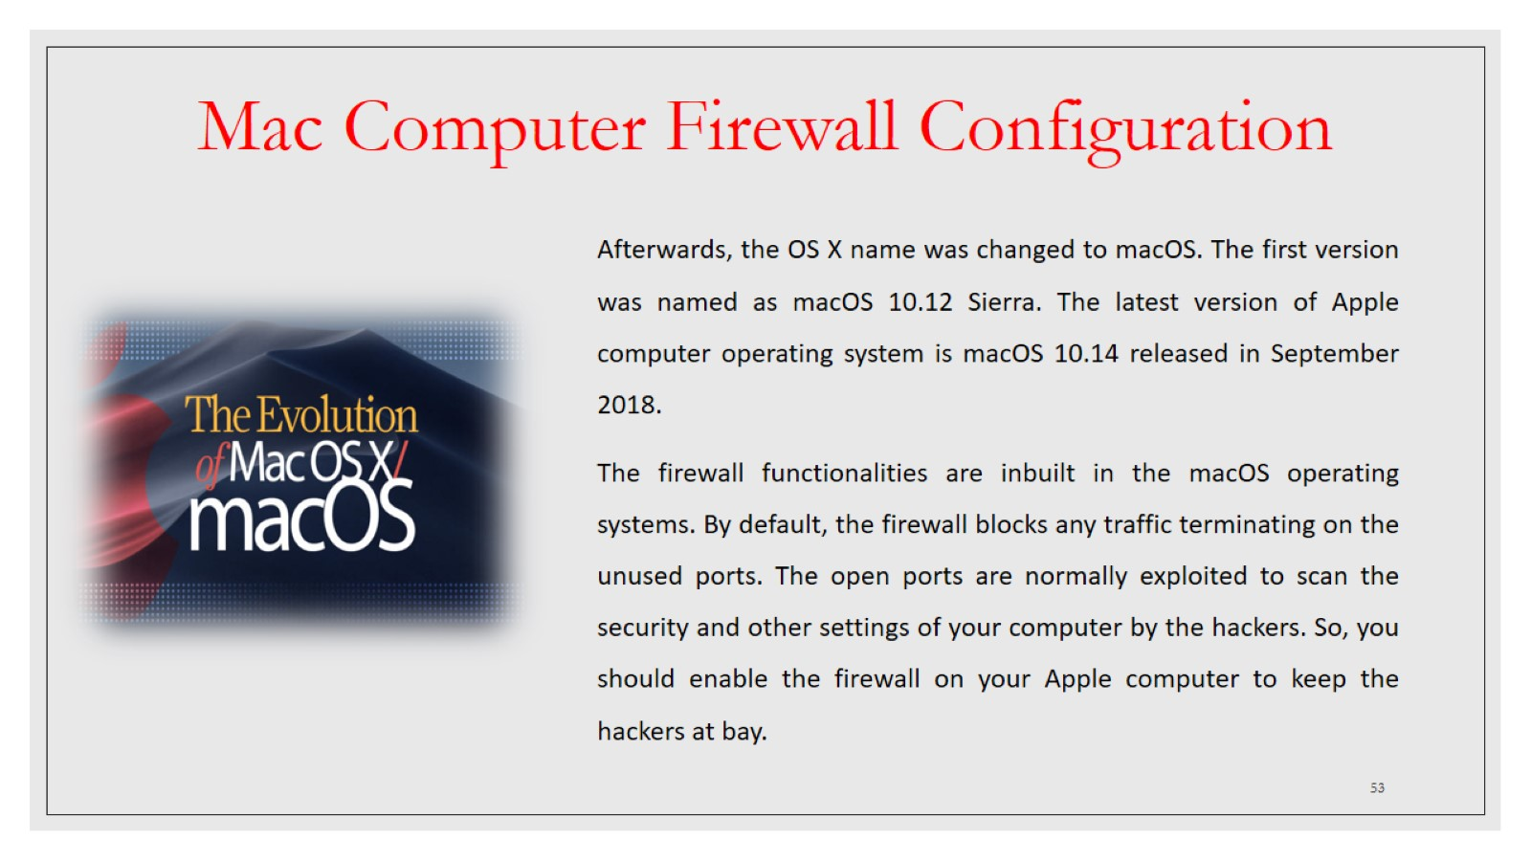
Mac Computer Firewall Configuration

Slide 54
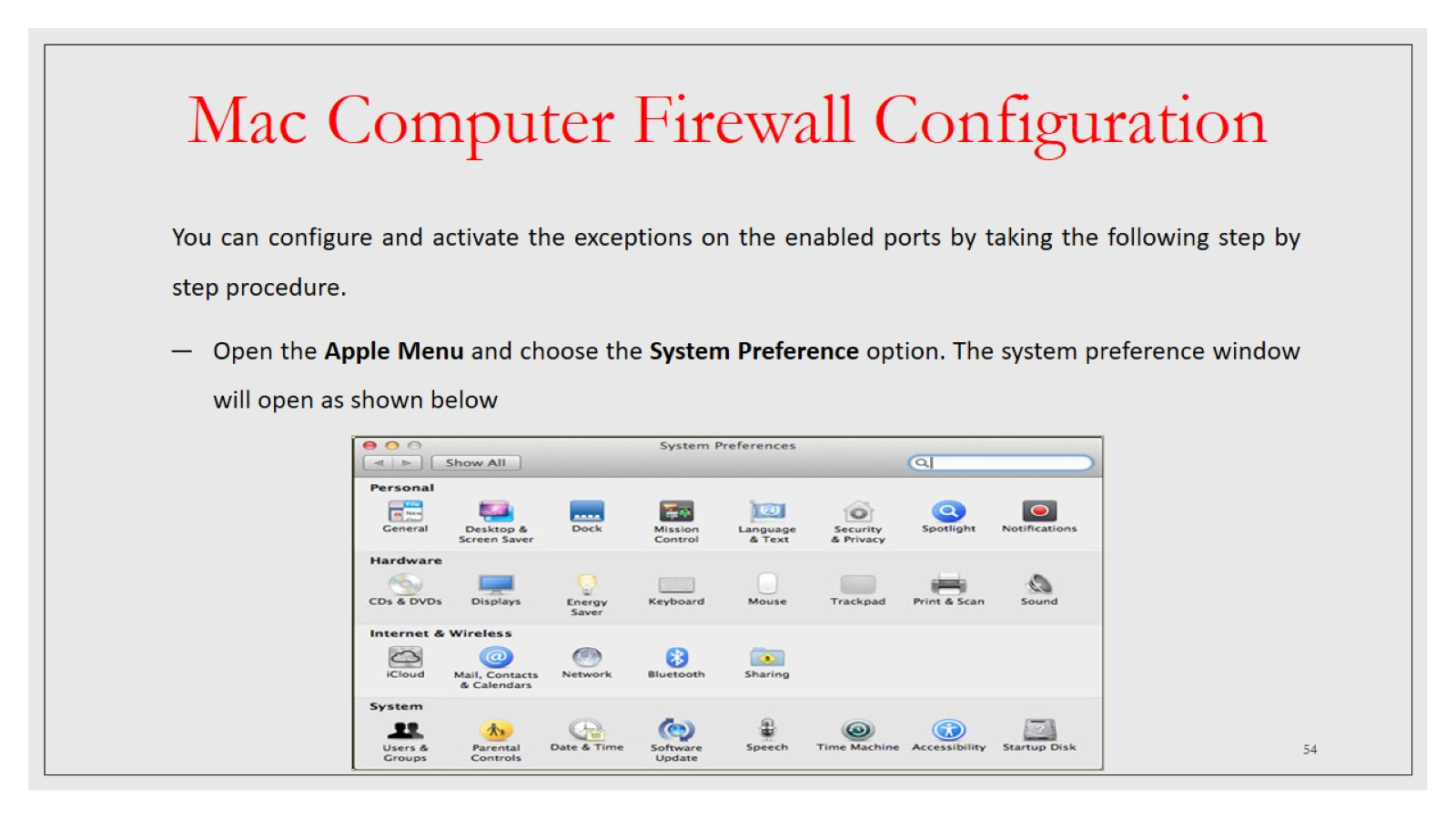
Mac Computer Firewall Configuration

Slide 55

Mac Computer Firewall Configuration

Slide 56

Mac Computer Firewall Configuration

Slide 57

Mac Computer Firewall Configuration

Slide 58

Mac Computer Firewall Configuration

Slide 59

Mac Computer Firewall Configuration

Slide 60

Choosing the Right Browser

Slide 61

Choosing the Right Browser

Slide 62

Choosing the Right Browser

Slide 63

Choosing the Right Browser

Slide 64

Choosing the Right Browser

Slide 65

Choosing the Right Browser

Slide 66

Choosing the Right Browser

Slide 67

Choosing the Right Browser

Slide 68

Choosing the Right Browser

Slide 69

Multi-factor Authentication

Slide 70

Multi-factor Authentication

Slide 71

Multi-factor Authentication

Slide 72

Multi-factor Authentication

Slide 73

Multi-factor Authentication

Slide 74

Multi-factor Authentication

Slide 75

Multi-factor Authentication

Slide 76

Multi-factor Authentication

Slide 77

Multi-factor Authentication

Slide 78

Multi-factor Authentication

Slide 79

Multi-factor Authentication

Slide 80

Multi-factor Authentication

Slide 81

Multi-factor Authentication

Slide 82

Multi-factor Authentication

Slide 83

Multi-factor Authentication

Slide 84

Multi-factor Authentication

Slide 85

Multi-factor Authentication

Slide 86

Multi-factor Authentication

Slide 87

Multi-factor Authentication

Slide 88

Multi-factor Authentication

Slide 89

Multi-factor Authentication

Slide 90

Multi-factor Authentication

Slide 91

Multi-factor Authentication

Slide 92

Multi-factor Authentication

Slide 93

Multi-factor Authentication

Slide 94

Multi-factor Authentication

Slide 95

Multi-factor Authentication

Slide 96


