Slide 1



Digital Content Direction
Prepared by Dr. Sherihan Mohamed
DGM 733
Lecture 3

Slide 2




Lecture 3
Lecture 2 Conclusion:
Remember the last Lecture we talk about:
* Digital Journalism: the line between ‘Producer’ and ‘Consumer’
* What is ‘Journalism’? Who Are ‘Journalists’?
* Digital Journalism: Key Features
* New Journalistic Identities
* Journalists on Social Media

Slide 3
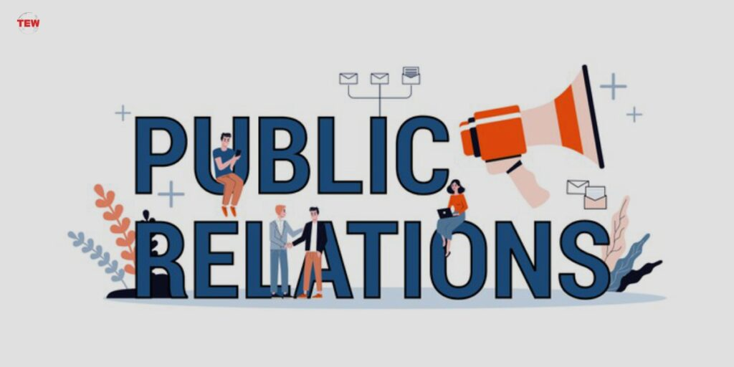
Digital Content: production media
Lecture 3

Slide 4

Lecture 3
Lecture Outlines:
* Public Relations: What Is PR?
* Copywriting, Editing and Other Essentials.
* Risk and Crisis Management.
* Convergence and SMIs.
* Who Are SMIs?
* Conclusion
* References

Slide 5

Lecture 3
Digital Content Direction
Public Relations: What Is PR?

Slide 6


“Public Relations” according to Public Relations Institute of Australia (PRIA) is: ‘Public relations is the deliberate, planned and sustained effort to establish mutual understanding between an organisation and its publics’.

Slide 7

It is, traditionally a two-way process whereby the communicator also listens and responds to those they are communicating with in order to create understanding and an ongoing relationship that benefits both parties.

Slide 8
PR has links to journalism in that it uses the same tools, formats and publications to reach its audiences.
Some journalists end up working in PR, so similar are the activities, roles and outputs in both professions.
Those who do cross over are sometime said, by their former colleagues, to have ‘gone to the Dark Side’.

Slide 9
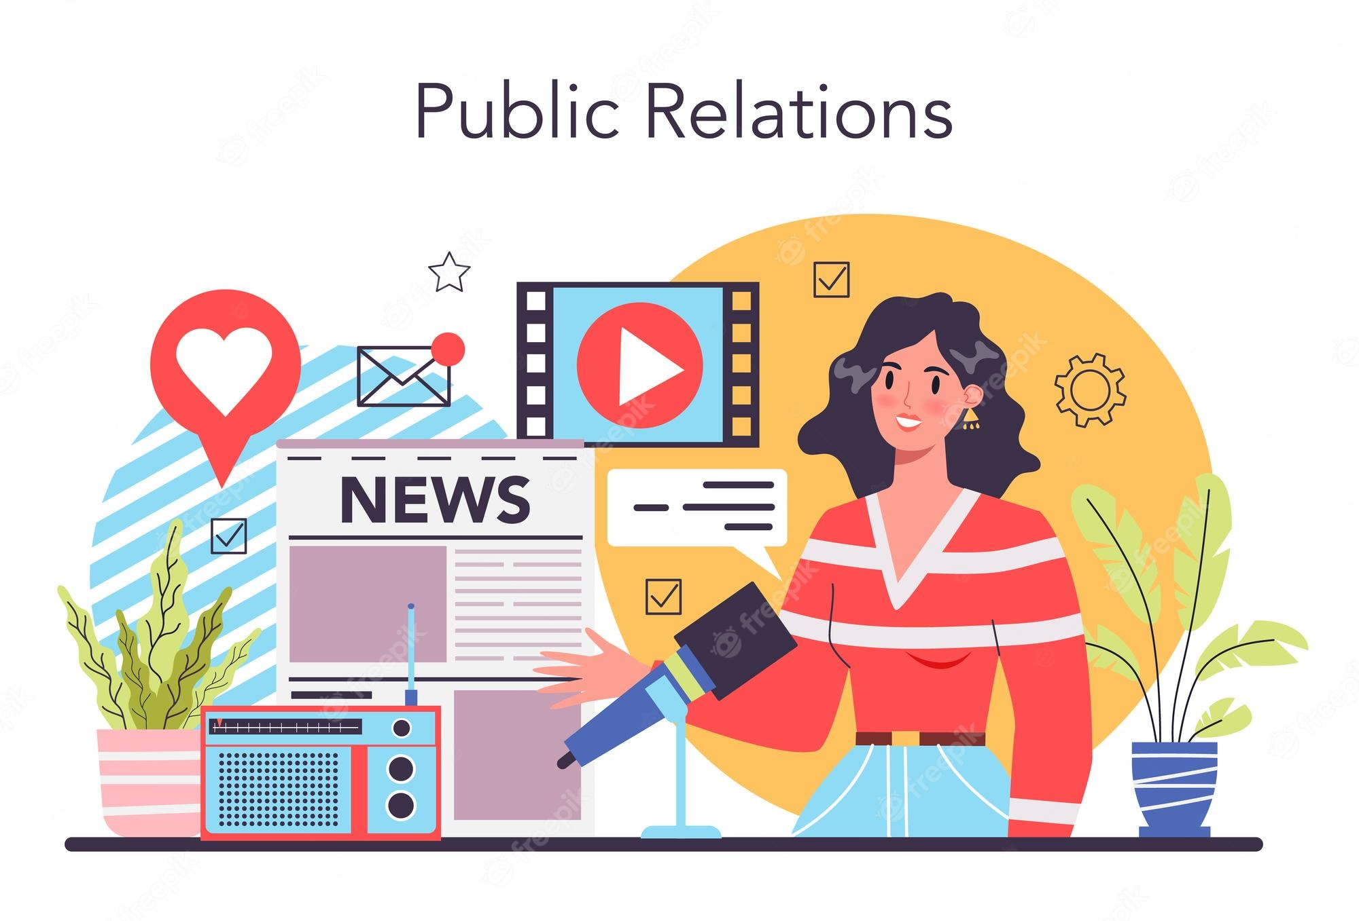
This speaks to the tension that exists between journalism, which often sees itself as striving for objectivity in its reporting, and PR, which is inherently about persuasion and the telling of a story from a particular point of view.

Slide 10
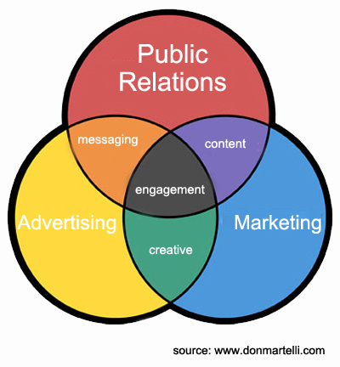
PR also has links to advertising and marketing, in that all three are concerned with persuasion.
The difference is, that with PR, persuasion traditionally relates to a message, set of values, a reputation or a solution, rather than a product.

Slide 11

PR also has links to the arts as it strives to evoke feelings and responses in an audience via the artefacts it creates. There is a performative element to PR too; the relationship it strives to establish and manage between organisations and publics can sometimes be likened to that of performer and audience. The PR organisation has to win over the public, much as a performer has to win over an audience.

Slide 12
Lecture 3
Digital Content Direction
Copywriting, Editing and Other Essentials.

Slide 13
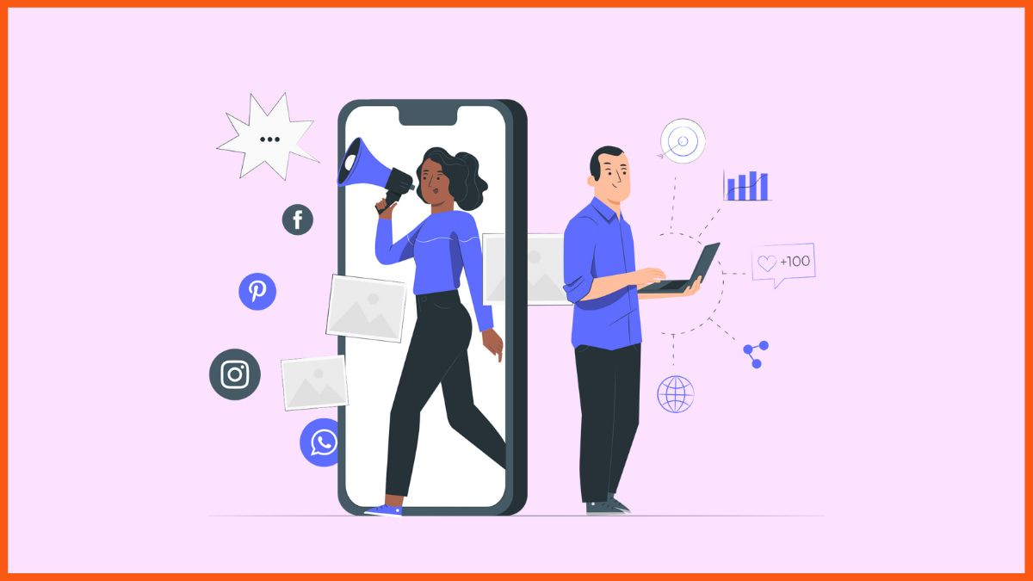
A good PR practitioner is something of a chameleon. They are able to write in whatever form(s) a particular media genre demands.

Slide 14

Traditionally, these genres were persuasive op ed pieces, profiles and features and, to a large degree, press releases written in inverted pyramid style, the same format as news stories. Whatever the form, the hope was the text would be so fit for purpose, it would be used by the target media outlet(s), hopefully, with as little editing as possible, meaning the client’s message would be communicated clearly and without adulteration to its intended public.

Slide 15

PR writers today, however, might have to write the op ed, plus a snappy 280- character teaser for Twitter, and a punchier, edited version of that tweet, with an image or video, for Instagram and Facebook. They might eschew the op ed altogether and craft the message as an Instagram or Facebook story, or a YouTube or TikTok video.

Slide 16

The potential combination of formats and channels necessary to reach a target audience continues to increase in complexity, as the social media landscape evolves.

Slide 17

So, although the basic skill set hasn’t changed, PR today makes use of multi-modal media to craft messages that work in whichever format the chosen media channel requires. It is crucial practitioners can not only write, but also create or curate imagery and video confidently for these disparate platforms.

Slide 18

TikTok videos, Instagram stories, tweets, Facebook posts and other social media forms have structures equally as rigid, in some ways, as those of legacy media artefacts, such as news articles.
Being able to craft messages in whatever format a particular social media channel demands is essential.

Slide 19

The use of such structures removes the potential distraction that a message with an unfamiliar shape might provide.
For instance, a Facebook post of 63, 206 characters (the maximum size allowed) might contain incredibly useful information, but so unusual is its shape and size that this becomes the main consideration, not the message itself.

Slide 20
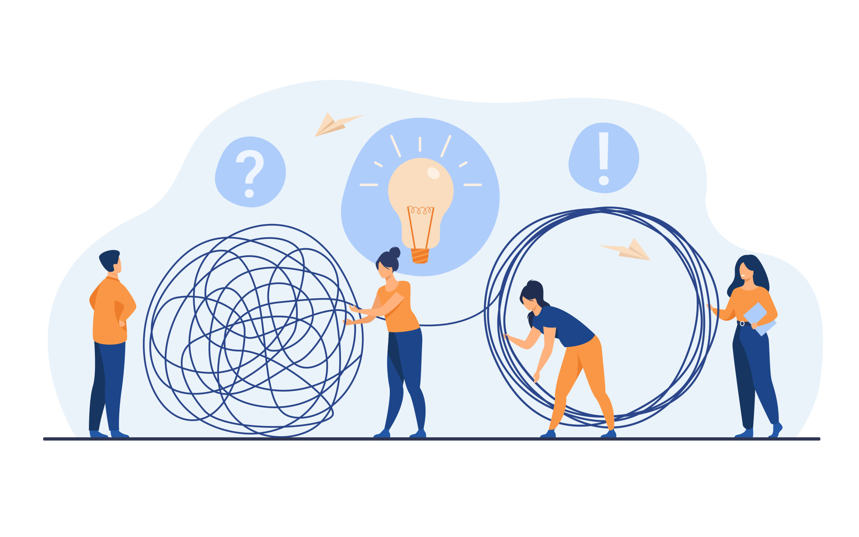
Middleness means that these formats and ways of writing are not fixed. What works today might be obsolete tomorrow. The move from 140 to 280 characters by Twitter is a prime example of this, as is the emergence of TikTok with its brief video format, and the rise of stories on Facebook and Instagram.

Slide 21
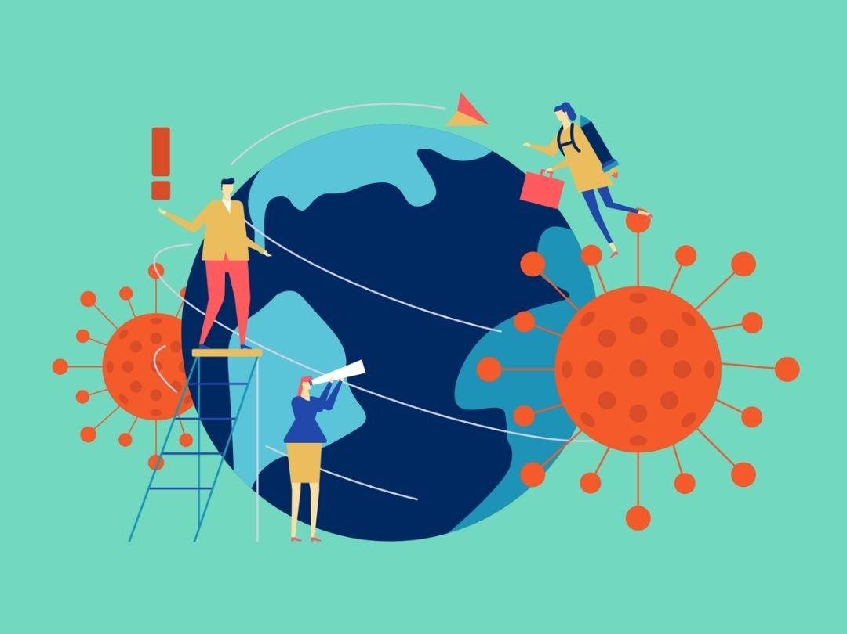
PR professionals need to be among the first to master new forms of communication. They must also be willing to change and to drop formats and platforms that no longer meet their client’s needs and/or have become outdated.

Slide 22
Lecture 3
Digital Content Direction
Risk and Crisis Management.

Slide 23

Risk and crisis management are two of the most crucial roles that PR organisations undertake.
The first point to consider in relation to this topic is that in the complex social media realm, everyone ‘will face a crisis’.

Slide 24
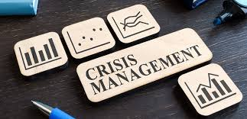
News breaks 24/7, and so the timeliness of responses to perceived or potential crises, when they inevitably emerge, is crucial. Hesitation, in terms of response time, could be seen as confusion, or that an organisation is struggling to come up with an ‘excuse’. Rushing into a response too soon could be seen as responding without really knowing all the facts.

Slide 25
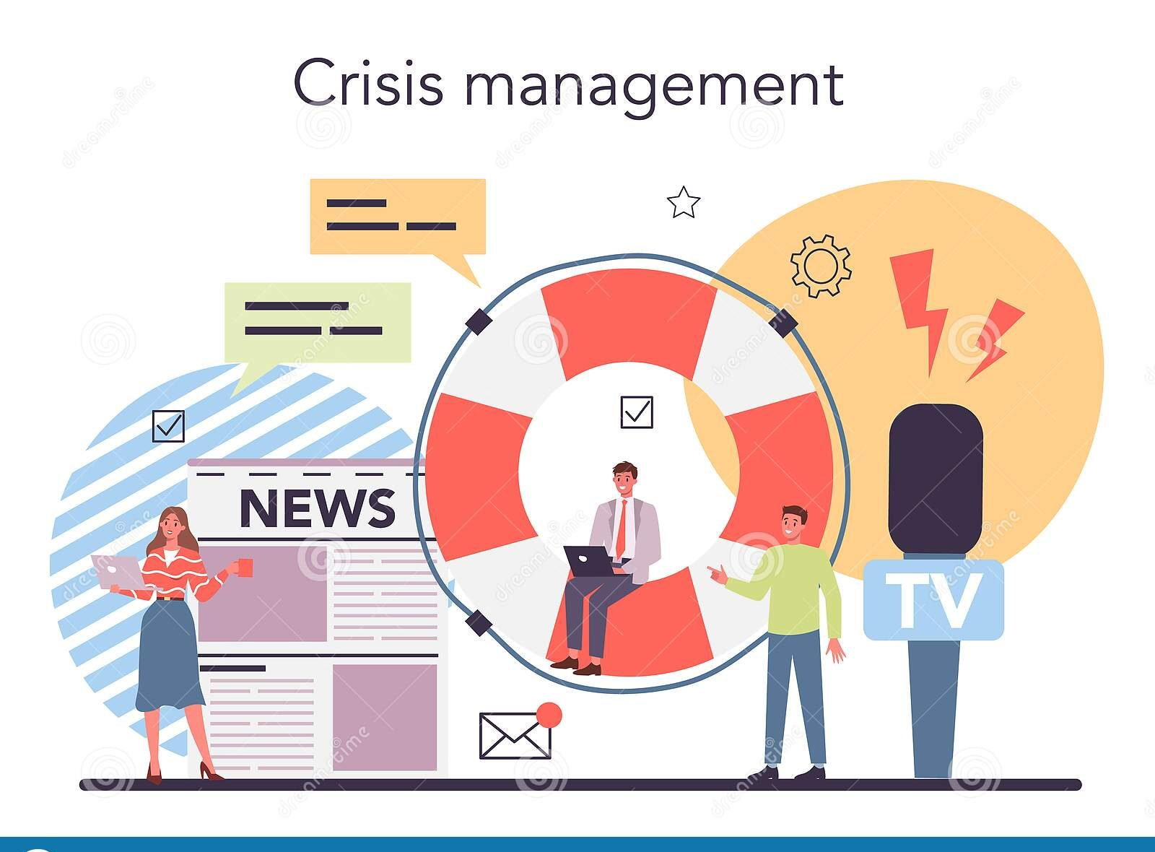
Should responses be confined to social media, or should legacy media, less effective perhaps but still carrying greater gravitas, be the main channel?
A failure to respond appropriately can turn a molehill into a reputation-savaging mountain in no time on social media. Yet, most medium and small PR organisations do not have (cannot afford) a dedicated crisis management team/person.

Slide 26
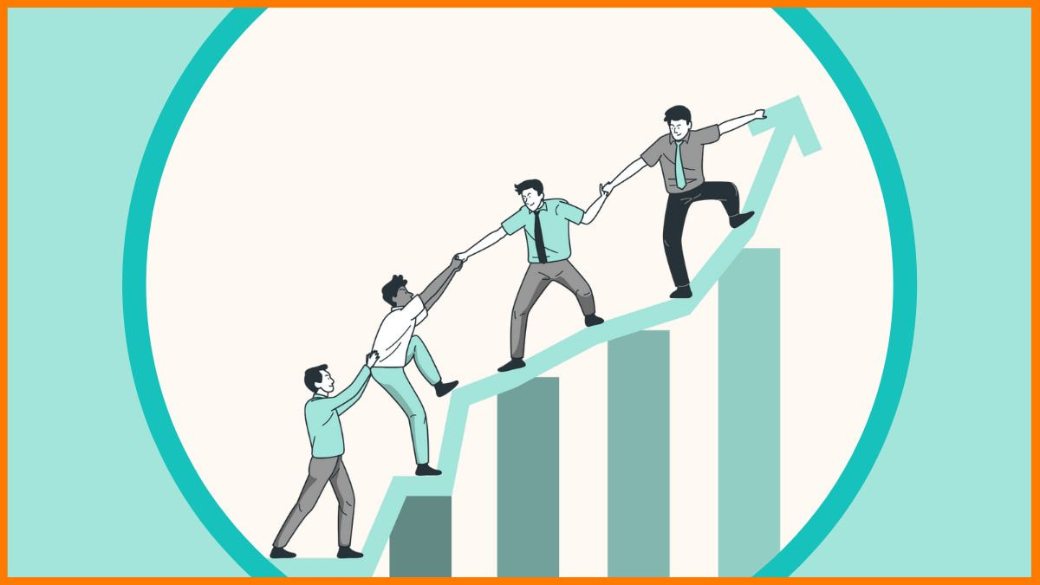
Garrick offers a three-point model for risk management that works to underpin all PR work, making the consideration of crisis an essential part of any campaign/post and therefore everybody’s business:
1. What can go wrong?
2. How likely is that to happen?
3. What are the consequences if it does happen?

Slide 27
Lecture 3
Digital Content Direction
Convergence and SMIs

Slide 28

As PR, advertising and marketing increasingly bypass traditional media in favour of direct communication with audiences via social media, the artefacts they produce begin to look the same.

Slide 29
Given that all three use the same tools and work in the same media spaces, this makes sense.
However, if PR begins to look and function like advertising and marketing, if that two-way relationship between organisation and public, based on mutual understanding is replaced by one way, organisation-centric communication, then PR risks becoming propaganda.

Slide 30
At the same time that PR begins to look more like advertising and marketing, so do they begin to function more like PR. By using media tools and channels that are essentially dialogic and rhizomic, they (advertising and marketing) are drawn into the world of the two-way relationship where campaigns are built more on an ongoing exchange between publics and organisations rather than on a one-way transmission of material and message to a passive audience.

Slide 31
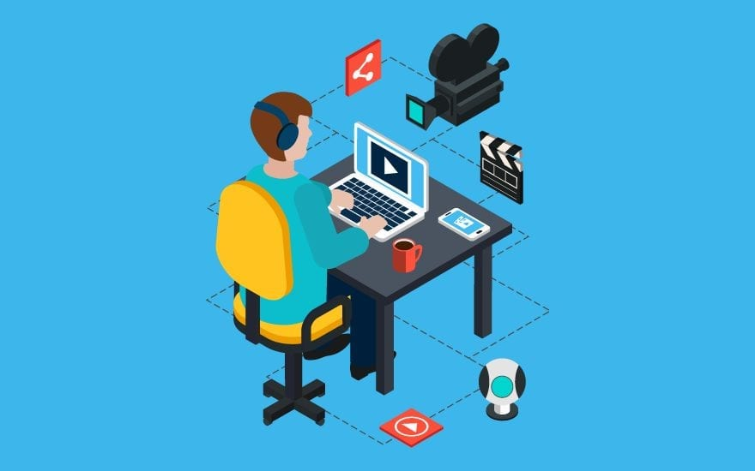
One area where this convergence is especially visible is in the SMI arena. Here, social media figures with perceived influence are co-opted by PR, marketing and advertising agencies to promote products and ideas via their social media feeds.

Slide 32

Working with a SMI requires ongoing relationship management between all parties involved: client, SMI and social media followers, which is characteristic of PR. Conversely, SMIs usually demand compensation either financial, or in kind, which turns the relationship into a paid advertising/marketing-type endorsement.

Slide 33
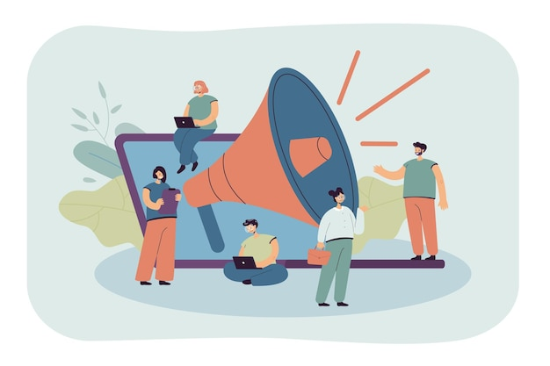
In the UK and USA, it has been law for a number of years that any compensation is acknowledged in the actual posts made by SMIs so that audiences are aware of when comment is being paid for.

Slide 34

In Australia, the Australian Association of National Advertisers (AANA) updated its code of ethics in February 2021 to require similar disclosure (AANA, 2021).
However, the PRIA Code of Ethics merely requires that practitioners must be ready and able to disclose such information if and when required (Public Relations Institute of Australia, 2019).

Slide 35

This muddies the waters somewhat, given the convergent nature of the PR/advertising relationship. How this convergence will resolve is a question for the future, given the state of middleness in which we find ourselves is likely to persist for some time. Nevertheless, PR practitioners need to be aware of the process, the effects it has on their profession and its role in the communications field.

Slide 36
Lecture 3
Digital Content Direction
Who Are SMIs?

Slide 37
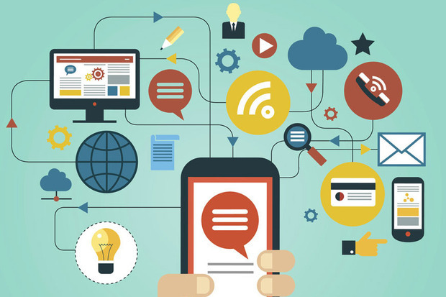
Increasingly, as audiences seek information about brands and organisations via social media, as the use of ad blockers increases and as trust in traditional media and means of communication is eroded by ideas of fake news and bias, the only way to claim space in social media, whether for PR or marketing purposes, is via the use of SMIs.

Slide 38

SMIs are people who have established credibility with large social media audiences because of their knowledge and expertise on particular topics, and thereby exert a significant influence on their followers’ and peer consumers’ decisions.

Slide 39

These figures are perceived, by their audiences, to be more authentic in their opinions of a product or idea than a celebrity paid to sell the same might be, even though SMIs are usually compensated in some way for the use or inclusion of a product in their feeds.

Slide 40

The dialogic nature of social media gives followers the illusion of intimacy; that they are somehow in contact, or could be if they wanted to be, with the person they follow.

Slide 41
This perceived authenticity comes from the idea that SMIs social media feeds give followers genuine insight into the lives of people they admire and respect and, hopefully, for PR purposes, want to mimic. These insights are necessarily curated, edited and sometimes even scripted, and thus are, at times, removed from notions of authenticity, but nevertheless they have the appearance of being so. Being seen as authentic and authoritative is key to building an audience.

Slide 42
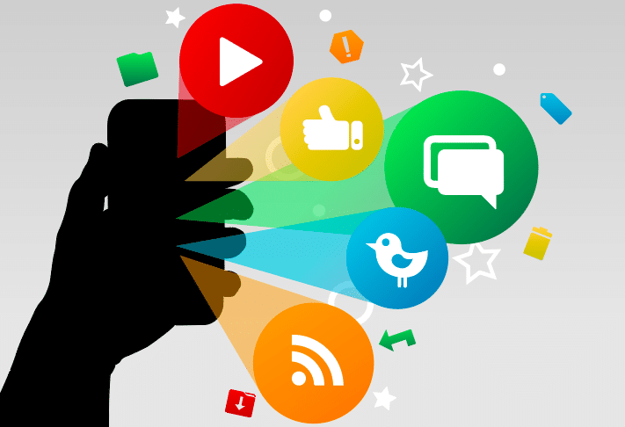
As with all aspects of PR, it plays to think carefully about how and why a brand might use a SMI.
A SMI may be working for several brands at once, so it is important to be aware there are no conflicts of interest which might damage a brand’s reputation and/or reduce the effectiveness of an influencer.

Slide 43
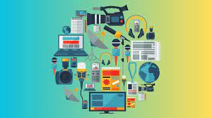
Control of an influencer’s messaging is also an issue. Unless a contract stipulates that an SMI will use word for word and image for image a brand’s copy, absolute control is lost once the SMI is given a brief.

Slide 44
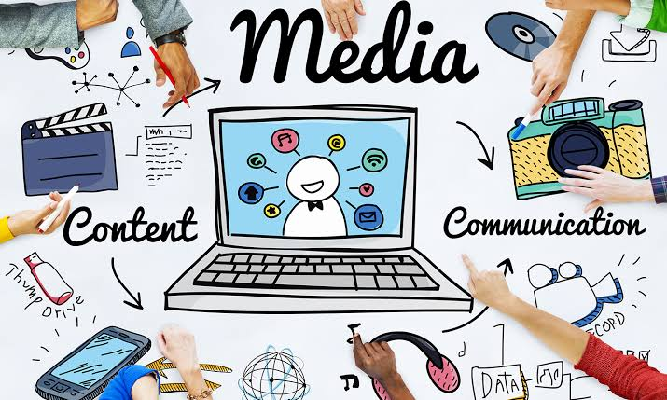
SMIs are ‘rightly protective of their relationship with their audience and they’ll also have firm views about what works and more importantly what doesn’t’. Thus, they may be reluctant to post copy that threatens that relationship.

Slide 45
Lecture 3
Lecture Outlines:
* Public Relations: What Is PR?
* Copywriting, Editing and Other Essentials.
* Risk and Crisis Management.
* Convergence and SMIs.
* Who Are SMIs?

Slide 46


Lecture 3
Lecture References:
* Jenkins, H., Ford, S., & Green, J. (2013), Spreadable media: Creating value and meaning in a networked culture, New York University Press.
* Jay Daniel Thompson & John Weldon (2022), Content Production for Digital Media: An Introduction, Springer Nature Singapore.

Slide 47


Thank You

Slide 48

Digital Content
Direction
Lecture 3
DGM 733
Prepared by:
Dr. Sherihan Mohamed

