Slide 1




Project Risk Management
Orientation Lecture
PMG510
Prepared by
Prepared by Dr. Usama Al-Fendi
www.midocean.ae

Slide 2
Orientation Lecture
About the Instructor
Education
Ph. D. in Business Economics/Financial Economics (Assessment: Excellent); University of Jordan, April 2014.
MBA, Concentration in Finance, (Assessment: Very Good) University of Jordan, 2008.
B.Sc. in Economics and administrative sciences, major in accounting and minor in banking and finance, (Assessment: Excellent); Yarmouk University, 2005.
www.midocean.ae

Slide 3
Orientation Lecture
About the Instructor
Experience
Assistant Professor of Risk Management in Faculty of Business and Finance, at American University of Madaba. Sep. 15th 2015 until present.
Head of Insurance and Risk Management Department - Jordan Deposit Insurance Corporation (JODIC), working for JODIC for more than 10 years (November 2005 – March 2016).
www.midocean.ae

Slide 4
Orientation Lecture
About the Instructor
Consultations and Training
Developing business model for emerging banks which includes establishing risk management department, building the theoretical and practical frame works, setting policy and procedure's guidance, and train the employees on the implementation stage through shadow management Project..
Provided tenths of training courses in the field of risk management, Basel accord, internal control systems, internal auditing and governance.
www.midocean.ae

Slide 5
Orientation Lecture
Course Description
This course introduces the concepts of risk, risk identification, assessment and evaluation, the need for risk management, risk management practice, and Insurance as one tool of risk management.
Both business and personal risk are addressed with emphasis on risk management treatment tools associated with controlling such risks.
The course covers all types of risks; including natural environmental); climate change risks; business risks; and operational risks.
www.midocean.ae

Slide 6
Orientation Lecture
Course Objectives
Identify different definitions of risk management and the context of each definition.
Identify the risk management environment and the main parties that involve in risk management process.
Introduce the main types of risks that affect organizations.
Explore the four Stages of risk management, and the main techniques used to implement it.
www.midocean.ae

Slide 7
Orientation Lecture
Course Objectives
Explain theories and views related to risk.
Define the fundamental characteristics of risks; types, sources and classifications.
Identify the scope for enterprise risk management.
Describe the processes, techniques and methods associated with risk management.
Critically analyze the ISO-31000 model for risk management.
Explore the benefits of the risk management process.
www.midocean.ae

Slide 8
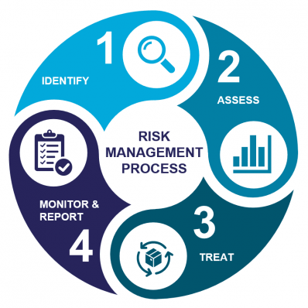
Orientation Lecture
Risk Management Process
www.midocean.ae

Slide 9
Orientation Lecture
Course Intended Learning outcomes ILO’s
Demonstrate an understanding of the multidimensional nature and views of risk.
Define the fundamental characteristics of risks; types, sources and classifications and burdens. Appreciate and describe the in-depth variations between different contextual settings, causes, and sources in which risks may arise.
www.midocean.ae

Slide 10
Orientation Lecture
Course Intended Learning outcomes ILO’s
Define Risk Management and describe the objectives, processes, techniques and methods associated with risk management. Understand the concepts and principles of Risk management. Comprehend the application of risk management techniques in treating organizational risks
www.midocean.ae

Slide 11
Orientation Lecture
Course Intended Learning outcomes ILO’s
Articulate and explain technical and conceptual issues in relation to solving real-life practical problems taken from a diverse set of risk management applications, and understand and build the ability to implement various forms of risk management tools, including risk register and heat maps.
www.midocean.ae

Slide 12
Orientation Lecture
Course Intended Learning outcomes ILO’s
Explain the basic concepts, elements and techniques associated with the risk management process in general, including, ISO 31000, COSO Enterprise risk management framework, personal risk management, financial risk management.
www.midocean.ae

Slide 13



Thank You

