Slide 1

Writing in an Organizations
Prepared by Dr. Adam Yagoub
Lecture 2
MGM202
The Writing Process and Collaboration at Work

Slide 2
Lecture 2
Key Learning Points
Course Outline
Lecture 1: Getting Started: Writing and Your Career.
Lecture 2: The Writing Process and Collaboration at Work.
Lecture 3: Writing Routine Business Correspondence.
Lecture 4: Writing Letters: Some Basics for Communicating with Audiences Worldwide.
Lecture 5: How to Get a Job: Searches, Dossiers, Portfolios, Résumés, Letters, and Interviews.
Lecture 6: Designing Successful Documents, Visuals, and Websites.
Lecture 7: Writing Instructions and Procedures.
Lecture 8: Writing Effective Short Reports.
Lecture 9: Writing Proposals.
Lecture 10: Writing Careful Long Reports.

Slide 3
Lecture 2
Lecture Outline
1- What Writing Is and Is Not.
2- Researching
3- Planning
4- Drafting
5- Revising
6- Editing
7- Collaboration Is Crucial to the Writing Process
8- Advantages of Collaborative Writing
9- Seven Guidelines for Successful Group Writing
10- Sources of Conflict in Group Dynamics and How to Solve Them
11 - Computer-Supported Collaboration

Slide 4
Lecture 2
The Writing Process and Collaboration at Work
1. What Writing Is and Is Not:
As you begin your study of writing for the world of work, it might be helpful to identify some notions about what writing is and what it is not.
- What Writing Is
■ Writing is a dynamic process; it is not static. It enables you to discover and evaluate your thoughts as you carefully draft and revise.
■ A piece of writing changes as your thoughts and information change and as your view of the material changes.

Slide 5
Lecture 2
The Writing Process and Collaboration at Work
■ Writing takes time. Some people think that revising and polishing are too time consuming. But poor writing actually takes more time and costs more money in the end. It can lead to misunderstandings, lost sales, product recalls, low morale, and even damage to your reputation and that of your company.
■ Writing means making a number of judgment calls. You have choices to make to meet an audience’s needs.
■ Writing grows sometimes in bits and pieces and sometimes in larger spurts. It needs many revisions; an early draft is never a final copy.

Slide 6
Lecture 2
The Writing Process and Collaboration at Work
- What Writing Is Not
■ Writing is not a mysterious process, known only to a few. Even if you have not done much writing before, you can learn to do it effectively.
■ Writing is not simply following a magical formula. Successful writing requires hard work and thoughtful effort, not simply following a formula, as if you were painting by numbers. Writing does not proceed in some predictable way where introductions are always written first and conclusions last.

Slide 7
Lecture 2
The Writing Process and Collaboration at Work
2- Researching:
Before you start to compose any e-mail, memo, letter, blog, proposal, or report, you’ll need to do some research. Research is crucial to obtain the right information for your audience. Information must be factually correct, timely, intellectually significant, and appropriate. The world of work is based on conveying information— the logical presentation and sensible interpretation of facts.

Slide 8
Lecture 2
The Writing Process and Collaboration at Work
Don’t ever think you are wasting time by not starting to write your report or letter immediately. Actually, you will waste time and risk doing a poor job if you do not find out as much as possible about your topic (and your audience’s interest in it). Do some necessary research.
First, find out as much as you can about your assignment and your readers, and what they expect from your written work. Next, determine the exact kind of research you must do to gather and interpret the information your audience needs.

Slide 9
Lecture 2
The Writing Process and Collaboration at Work
3- Planning:
At this stage in the writing process, your goal is to get something—anything— down on paper or on your computer screen. For most writers, getting started is the hardest part of the job. But you will feel more comfortable and confident once you begin to see your ideas written down before your eyes. It is always easier to clarify and criticize something you can see.

Slide 10
Lecture 2
The Writing Process and Collaboration at Work
4- Drafting:
If you have done your planning carefully, you will find it easier to start your first draft. When you draft, you convert the words and phrases from your outlines, brainstormed lists, or clustered groups into paragraphs. During drafting, as elsewhere in the writing process, you will see some overlap as you look back over your lists or outlines to shape your document.

Slide 11
Lecture 2
The Writing Process and Collaboration at Work
- Key Questions to Ask as You Draft
As you work on your drafts, ask yourself the following questions about your content and organization.
■ Am I giving my readers too much or too little information?
■ Does this point belong where I have it, or would it more logically follow or precede something else?
■ Is this point necessary and relevant?
■ Am I repeating or contradicting myself?
■ Have I ended appropriately for my audience?

Slide 12
Lecture 2
The Writing Process and Collaboration at Work
- Guidelines for Successful Drafting
Following are some suggestions to help your drafting go more smoothly and efficiently.
■ In an early draft, write the easiest part first. Some writers feel more comfortable drafting the body (or middle) of their work first.
■ As you work on a later draft, write straight through. Do not worry about spelling, punctuation, or the way a word or sentence sounds. Save those concerns for later stages.

Slide 13
Lecture 2
The Writing Process and Collaboration at Work
■ Allow enough time between drafts so that you can evaluate your work with fresh eyes and a clear mind.
■ Get frequent outside opinions. Show, e-mail, or fax a draft to a co-worker or a supervisor for comment. A new pair of eyes will see things you missed. As we’ll see, collaboration is essential in the workplace.
■ Start considering if visuals would enhance the quality of your work and, if so, decide on what types and where best to insert them.

Slide 14
Lecture 2
The Writing Process and Collaboration at Work
5- Revising:
Revision is an essential stage in the writing process. It requires more than giving your work another quick glance. Do not be tempted to skip the revision stage just because you have written the required number of words or sections or because you think you have put in too much time already. Revision is done after you produce a draft that you think conveys the appropriate message for your audience. The quality of your memo, letter, or report depends on the revisions you make now.

Slide 15
Lecture 2
The Writing Process and Collaboration at Work
- Allow Enough Time to Revise
Like planning or drafting, revision is not done well in one big push. It evolves over a period of time. Make sure you budget enough time to do it carefully.
■ Avoid drafting and revising in one sitting. If possible, wait at least a day before you start to revise. (In the busy work world, waiting a couple of hours may have to suffice.)
■ Ask a co-worker or friend familiar with your topic to comment on your work.
■ Plan to read your revised work more than once.

Slide 16
Lecture 2
The Writing Process and Collaboration at Work
- Revision Is Rethinking
When you revise, you resee, rethink, and reconsider your entire document. You ask questions about the major issues of content, organization, tone, and format . Revision involves going back and repeating earlier steps in the writing process.

Slide 17
Lecture 2
The Writing Process and Collaboration at Work
Revision means asking again the questions you have already asked and answered during the planning and drafting stages. During the process, you will discover gaps to fill, points to change, and errors to correct in your draft. Revision gives you a second (or third or fourth) chance to get things right for your audience. Take advantage of the document tracking options such as Track Changes and Edit that allow you to see your additions, cuts, and moves in a different color.

Slide 18
Lecture 2
The Writing Process and Collaboration at Work
7- Editing:
Editing is quality control for your reader. This last stage in the writing process might be compared to detailing an automobile—the preparation a dealer goes through to ready a new car for prospective buyers. Editing is done only after you are completely satisfied that you have made all the big decisions about content and organization—that you have said what you wanted to, where and how you intended, for your audience.

Slide 19
Lecture 2
The Writing Process and Collaboration at Work
When you edit, you will check your work for
■ sentences
■ word choices
■ punctuation and spelling
■ grammar and usage
■ clarity

Slide 20
Lecture 2
The Writing Process and Collaboration at Work
7- Collaboration Is Crucial to the Writing Process:
In the world of work, writing skills, such as researching, planning, drafting, revising, and editing—just discussed in this chapter—are vital for your success. But you will often communicate as part of a team (including managers and co-workers) to write a report, a proposal, or even a letter successfully. One survey estimates that 90 percent of all businesspeople spend some time writing as part of a collaborative team as depicted in Figure 2.8. Being a team player is one of the most prized skills you can possess in the world of work.

Slide 21
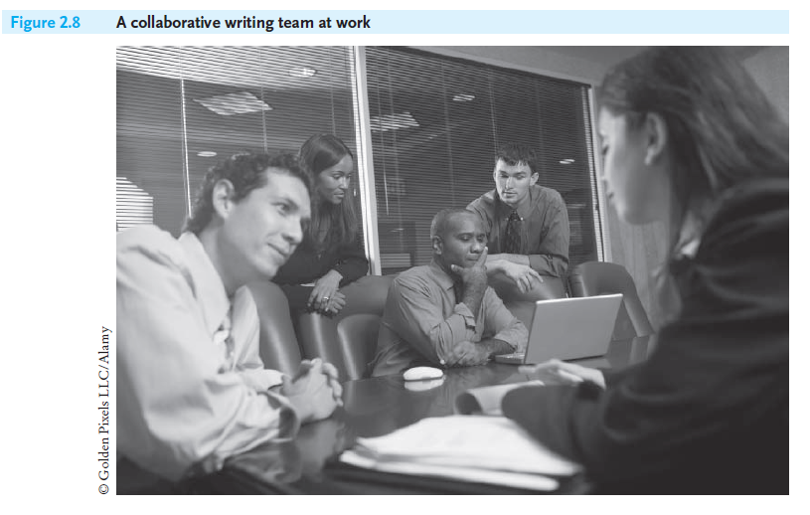
Lecture 2
The Writing Process and Collaboration at Work

Slide 22
Lecture 2
The Writing Process and Collaboration at Work
8- Advantages of Collaborative Writing:
Collaborative writing teams benefit both employers and employees. Collaboration gets writing done more easily and efficiently in the work place. Here are some of the advantages of writing as part of a team.
1. Builds on collective talents. Many heads are better than one. A writing team profits from the diverse backgrounds, skills, and research of its individual members. Collaboration joins individuals from diverse disciplines in the corporate world—IT staff, accountants, lawyers, media specialists, and security experts, among others.

Slide 23
Lecture 2
The Writing Process and Collaboration at Work
2. Allows for productive feedback and critique. Collaborative writing encourages all members of the team to get involved, offering both their agreement as well as their critical viewpoints to produce the highest-quality document possible.
3. Increases productivity and saves time. When a group has planned carefully, collaboration actually cuts down on the number of meetings and conferences, saving a company time and employees travel.

Slide 24
Lecture 2
The Writing Process and Collaboration at Work
4. Ensures overall writing effectiveness. The more people involved in developing a document, the greater the chances are for thoroughness and cohesion. Team effort helps to uncover inconsistencies, find omissions, and correct problems.
5. Accelerates decision-making time. A group investigating problems and offering pertinent solutions can considerably reduce the time it takes to prepare a document.

Slide 25
Lecture 2
The Writing Process and Collaboration at Work
6. Boosts employee morale and confidence while decreasing stress. Working as part of a team can relieve individuals of some job stress by not making them solely responsible for planning, drafting, and revising a document. Members can discuss ideas with each other and help one another in drafting, organizing, and editing a document. A team, therefore, provides a safety net by assuring individual members that they can always talk over problems and they will have help in meeting deadlines.

Slide 26
Lecture 2
The Writing Process and Collaboration at Work
7. Contributes to customer service and satisfaction. By pooling their knowledge of an audience’s needs, a collaborative writing team is much more likely— through discussions, interactions, even disagreements—to anticipate a customer’s, or an agency’s, requests and complaints.
8. Affords a greater opportunity to understand global perspectives. By working with a multinational work force, individuals can develop greater sensitivity to and appreciation of the needs and problems of an international audience.

Slide 27
Lecture 2
The Writing Process and Collaboration at Work
9- Seven Guidelines for Successful Group Writing:
To be successful, a collaborative writing team should observe the following seven guidelines helpful.
1. Understand and agree on the purpose, audience, scope, organization, and deadlines for the report. Everyone needs to be on the “same page” from start to finish.

Slide 28
Lecture 2
The Writing Process and Collaboration at Work
2. Establish group rules early on and stick to them. Decide when and where the group will meet, how and when members are to communicate with each other (face-to-face, telephone, e-mail, other online technologies).
3. Put the good of the group ahead of individual egos. Group harmony and productivity are essential if the report or proposal is to get done on time. Individuals need to be active participants and keen listeners. Getting one’s own way can slow down the overall success of the document. In the business world, sometimes a report bears only the boss’s name, not the name of the group that prepared it.

Slide 29
Lecture 2
The Writing Process and Collaboration at Work
4. Agree on the group’s organization. The group can appoint a leader who keeps the team on task by being a coordinator, cheerleader, a scheduler, an evaluator, and a peacemaker who can resolve conflicts quickly, and also a referee who knows when to call time-out.1 The leader must be skilled in interpersonal interactions.
5. Identify each member’s responsibilities precisely. There should be a fair distribution of labor so that each member can use his or her particular and proven skills.

Slide 30
Lecture 2
The Writing Process and Collaboration at Work
6. Provide clear and positive feedback at each meeting and for each part of the report the group prepares. Members need to come to meetings prepared, raise important questions, and make thoughtful recommendations.
7. Follow an agreed-on timetable, but leave room for flexibility. The group should estimate a realistic time frame necessary to complete the various stages of their work—when drafts and revisions are due or when editing must be concluded, for example. A project schedule based on that estimate should then be prepared.

Slide 31
Lecture 2
The Writing Process and Collaboration at Work
10- Sources of Conflict in Group Dynamics and How to Solve Them:
The success of collaborative writing depends on how well the team interacts. They have to meet and plan before they can even begin researching, set ground roles, decide on responsibilities, and work together on solving problems and come up with solutions. Discussion and criticism are essential to the process of creating any successful document—report, proposal, etc.
A conflict can even help the group generate and refine ideas, leading to a better organized and more carefully written document.

Slide 32
Lecture 2
The Writing Process and Collaboration at Work
But when conflict translates into ego tripping and personal attacks, nothing productive emerges. Everyone in the group must agree beforehand on three ironclad working policies of group dynamics:
(1) individuals must seek and adhere to group consensus.
(2) compromise may be advisable, even necessary, to meet a deadline.
(3) if the group decides to accept compromise, the group leader’s final decision on resolving conflicts must be accepted.

Slide 33
Lecture 2
The Writing Process and Collaboration at Work
- Common Problems, Practical Solutions
Following are some common problems in group dynamics, with suggestions on how to avoid or solve them.
1. Resisting constructive criticism. No one likes to be criticized, yet criticism can be vital to the group effort. Be open to suggestions.
Solution: When emotions become too heated, the group leader may wisely move the discussion to another section of the document or to another issue and allow some cooling-off time. Negotiation is an essential job skill.

Slide 34
Lecture 2
The Writing Process and Collaboration at Work
2. Giving only negative criticism. Do not saturate a meeting with nothing but negatives.
Solution: When you criticize an idea, diplomatically remind the individual of the team’s goals and point to ways in which revision (criticism) furthers them. Explain the problem, and offer a helpful, relevant revision. Never attack a group member. Mutual respect is everyone’s right and obligation. Be objective, constructive,
and cooperative.

Slide 35
Lecture 2
The Writing Process and Collaboration at Work
3. Dominating a meeting. The group process is about sharing and responding to ideas, not about taking over. When one group member dominates the discussion and becomes aggressive and territorial, the group process suffers.
Solution: The leader should let the group know that the participation of all members is valued, but then say “we need to hear from the rest of the group.”

Slide 36
Lecture 2
The Writing Process and Collaboration at Work
4. Refusing to participate. Withholding your opinions hurts the group efforts; identify what you believe are major problems and give the group a chance to consider them.
Solution: If you don’t feel sure of yourself or your points, talk to another member of the group, a listening partner, before a meeting to “test” your ideas or to write down your suggestions before a meeting to share them with the group.

Slide 37
Lecture 2
The Writing Process and Collaboration at Work
5. Interrupting with incessant questions. Some people interrupt a meeting so many times with questions that all group work stops. The individual may simply be unprepared or may be trying to exercise his or her control of the group.
Solution: When that happens, a group leader can remark, “We appreciate your interest, but would you try an experiment, please, and attempt to answer your own questions? "or if the person claims not to know, the leader might then say, “Why don’t you think about it for a while and then get back to us?”

Slide 38
Lecture 2
The Writing Process and Collaboration at Work
6. Inflating small details out of proportion. Some individuals waste valuable discussion and revision time by dwelling on relatively insignificant points.
Solution: If there is consensus about a matter, leave it alone and turn to more important issues. The leader should remind the group (without singling anyone out) about the bigger picture and caution them to stay on track.

Slide 39
Lecture 2
The Writing Process and Collaboration at Work
7. Being overly deferential to avoid conflict. This problem is the opposite of that described in #1. You will not help your group by being a “yes person” simply to appease a strong-willed member of the group.
Solution: Feel free to express your opinions politely; if tempers begin to flare, call in the group leader or seek the opinions of others on the team. The leader needs to promote and protect meetings as a safe place to express ideas.

Slide 40
Lecture 2
The Writing Process and Collaboration at Work
8. Not respecting cultural differences. You may have individuals from different countries or cultures on your team. Disregarding or misjudging the way they interact with the group can seriously threaten group success and harmony.
Solution: Some companies offer employees seminars on cultural sensitivity in the workplace. But a group leader must also ensure that diversity is honored and, if anyone does not, he/she may write that person up.

Slide 41
Lecture 2
The Writing Process and Collaboration at Work
9. Violating confidentiality. Leaking confidential information about a personal issue, product, procedure, or operation is a serious violation in the world of work.
Solution: Violating confidentiality is often grounds for dismissal. At a preliminary meeting, and periodically during the writing process, the leader should emphasize the whys, how's, and when's of confidentiality.

Slide 42
Lecture 2
The Writing Process and Collaboration at Work
10. Not finishing on time or submitting an incomplete document. Meeting established deadlines is the group’s most important obligation to one another and to their company.
Solution: The group leader can institute networking through e-mail to announce meetings, keep members updated, or provide for ongoing communication and questions.

Slide 43
Lecture 2
The Writing Process and Collaboration at Work
11 - Computer-Supported Collaboration:
To be successful writers, employees must be proficient in using multiple types of collaborative software systems, otherwise know as groupware. You will be expected to know—or at least be adaptable to learning—not only how to use e-mail for collaborative communications but also how to navigate document tracking systems (such as Microsoft Word’s Track Changes feature or Adobe Acrobat) as well as Web-based collaboration systems (wikis).

Slide 44
Lecture 2
The Writing Process and Collaboration at Work
Advantages of Computer-Supported Collaboration
Collaboration online offers significant advantages to both employers and workers. Here are some of those benefits:
1. Increased opportunities to “meet.” Today’s meeting-heavy and travel filled work environments often make collaborating in person difficult and costly. Various types of groupware provide a virtual shared work place where team members can ask questions, share information, make suggestions and revisions, and troubleshoot.

Slide 45
Lecture 2
The Writing Process and Collaboration at Work
2. Reduced stress in updating new group members. Groupware can efficiently and quickly bring new team members into the ongoing conversation, saving time and effort and reducing the stress of face-to-face meetings.
3. Expanded options to communicate worldwide. Groupware ensures the flexibility to contact group members anywhere—at a home office (telecommuters, freelancers), on the road, at another office, or in another country.

Slide 46
Lecture 2
The Writing Process and Collaboration at Work
4. Improved feedback and accountability. Because it is accessible and easy to use, groupware helps team members participate actively in the collaboration process.
5. Enhanced possibility of complete and clear information. Groupware allows everyone involved in the team to truly be “on the same page.” It provides a running record, thus saving all information and preventing misinterpretation.

Slide 47
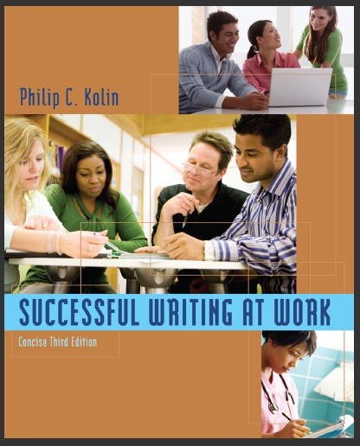
Lecture 2
The Writing Process and Collaboration at Work
References:
Successful Writing at Work, Concise Third Edition,
By: Philip C. Kolin
University of Southern Mississippi
Chapter 2

