Slide 1

Digital Media Infrastructures
Prepared by Dr. Shereen Kedwany
Lecture 2
DGM 711
Introduction to Digital Media

Slide 2
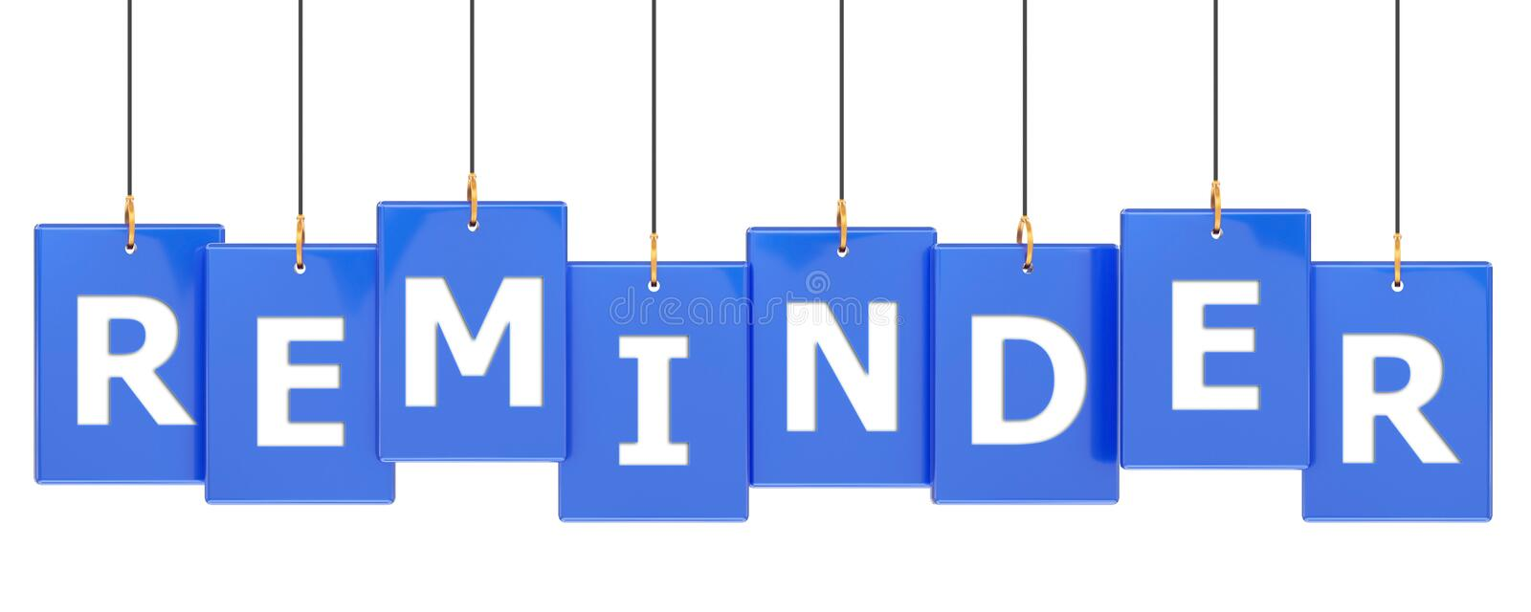

Chapter
02
Reminder
Mediatization is the increasing presence of media in all aspects of life .
Computer networks have become “the key infrastructure for all aspects of life in the digital environment.
“Digital Media” are “the means that they carry information represented by a numeric code and then transform it into human language”.
Digital media is sometime called multimedia.
Digital media can carry information very efficiently than old media.
The introduction of new media has not caused the disappearance of the old media.
A practice, content, or format can be re‐mediated by a new technology .

Slide 3


Chapter
02
Outline
I. The Digital Media Characteristics.
II. Infrastructures and Platforms.
III. The Web Generations .
IV. Conclusion.

Slide 4
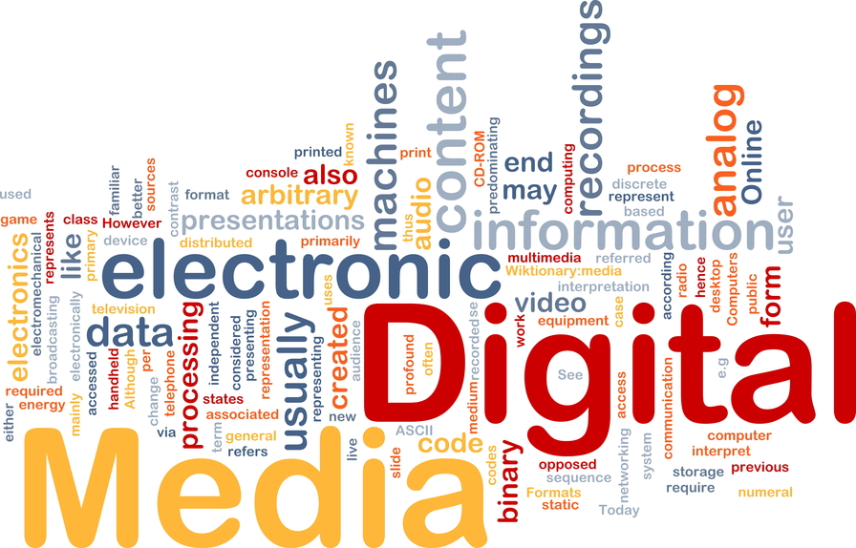
Chapter
02
I. The Digital Media Characteristics
Digital media have certain common characteristics that distinguish them from Analog old media.

Slide 5
Chapter
02
I. The Digital Media Characteristics
Digital Media
Convergent
Asymmetric
Ephemeral
Permanent
Hypertextual
Pervasive
Algorithmic
Distributed

Slide 6
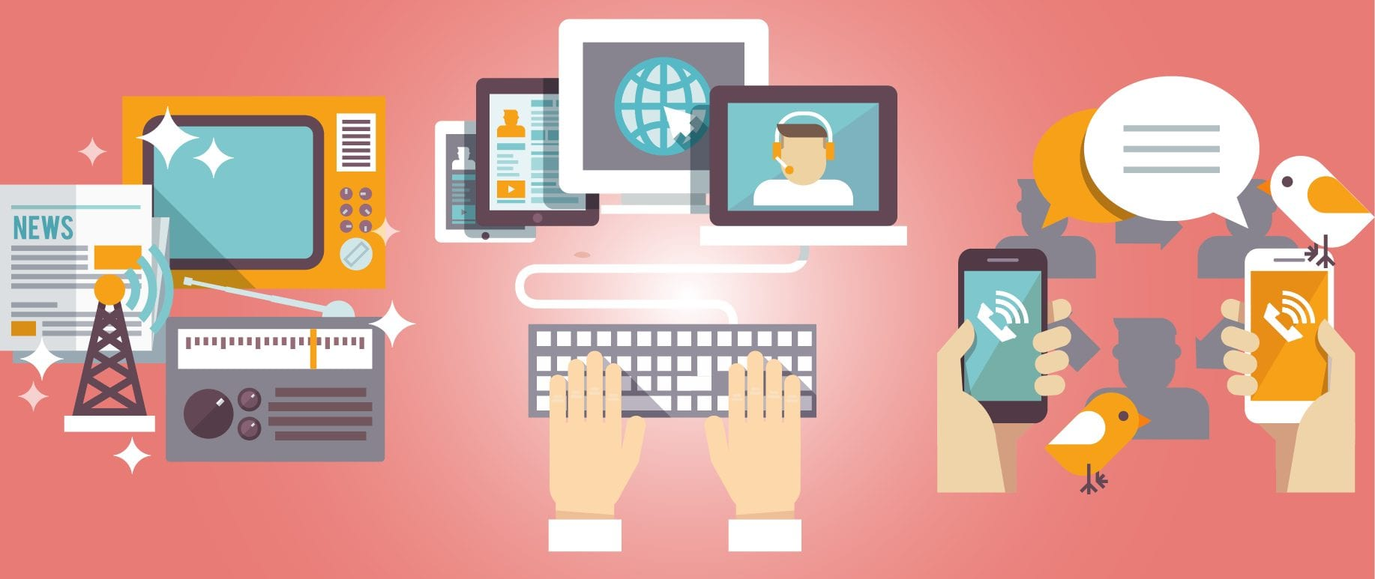
Chapter
02
1. Convergent
On digital media, different types of content (written, audio, visual, etc.) converge onto a single technical platform.
The personal computer, for example, is at the same time a television set, a typewriter, a radio, a telephone, and countless other machines.
Thanks to the digitization of information, computers are “universal machines” that can mimic other machines.

Slide 7
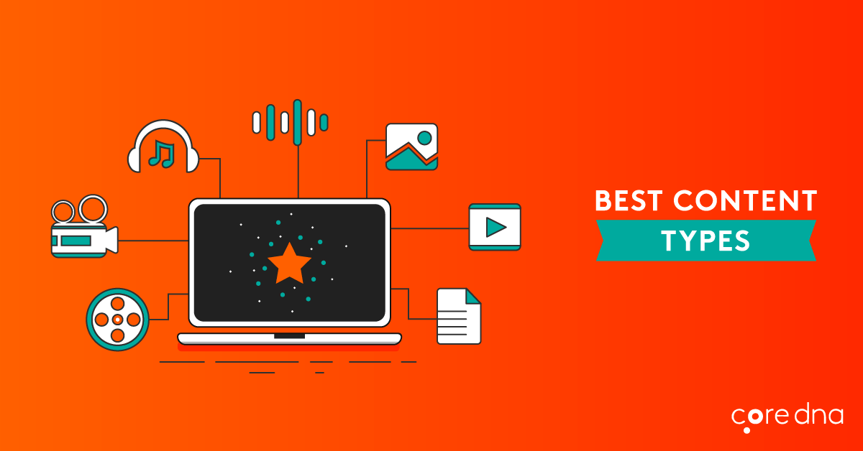
Chapter
02
1. Convergent
This means that the production and consumption of different kinds of media content (film, text, music, etc.) no longer presupposes different kinds of hardware (projectors, books, stereos) that use different codes and technological supports (celluloid, paper, vinyl), but can happen on a set of machines, such as computers or smartphones, where all these different kinds of content are represented by means of the same binary code.
This goes beyond the technical level and implies a cultural convergence between producers and consumers of media content.

Slide 8
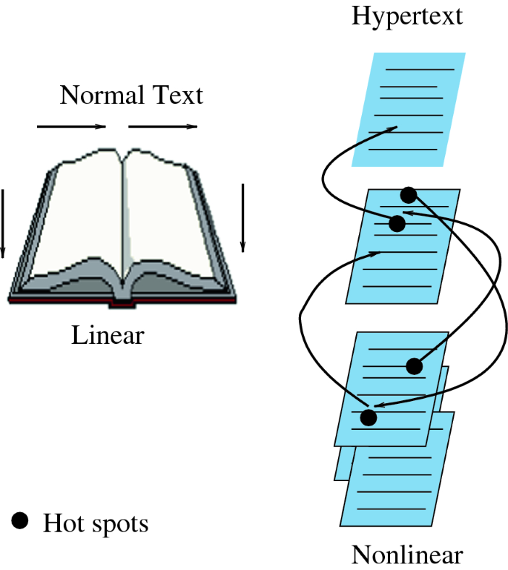
Chapter
02
2. Hypertextual
A hypertext is a text that embodies references to other texts or other forms of content.
On the World Wide Web, hypertexts are a fundamental feature that link one webpage to another.
This way, digital media allow users to enjoy content in a non‐linear fashion.
On a webpage you do not have to read contents in a linear way, as you would with a book.
Instead, you can customize your reading experience, jumping from one text to another, to a video, to a Wikipedia entry, and then back to another webpage or app .

Slide 9
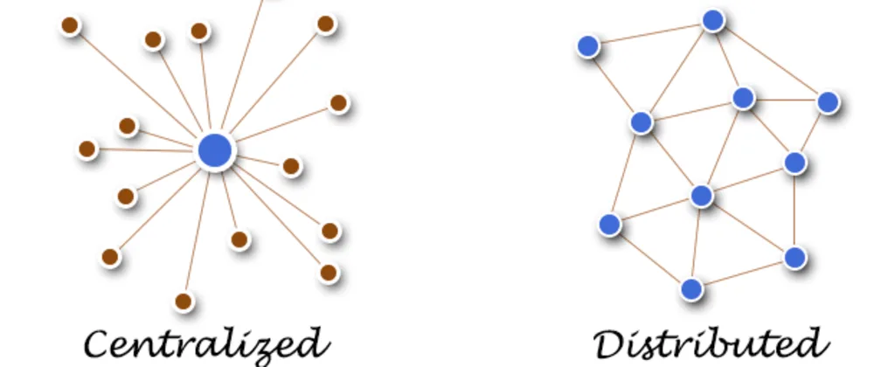
Chapter
02
3. Distributed
Traditional mass media are centralized and unidirectional: information is transmitted from a central facility, such as a newsroom, to a large audience of readers.
Digital media are instead characterized by a distributed model.
Indeed, the internet is composed by thousands of interconnected nodes rather than a few core hubs .

Slide 10
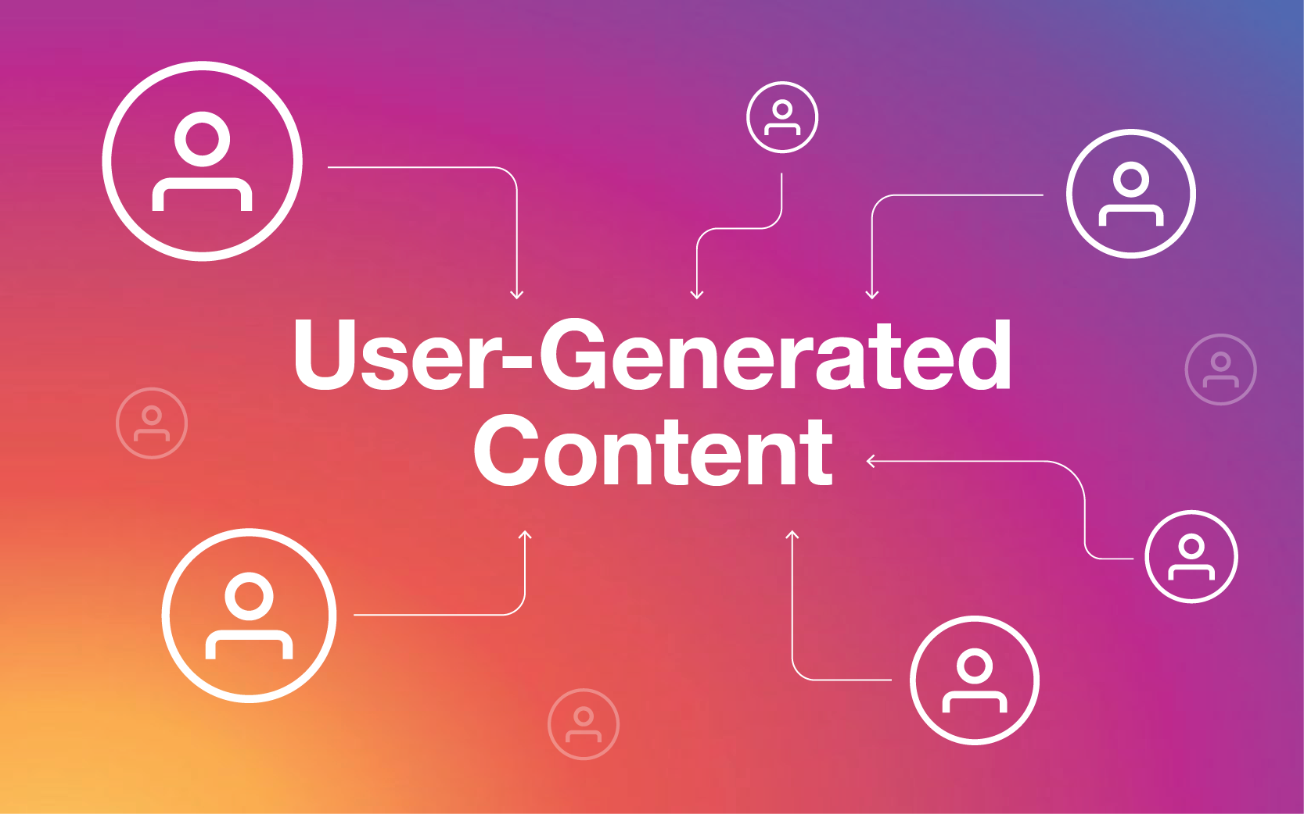
Chapter
02
3. Distributed
Furthermore, the spread of cheap computers, tablets, and smartphones, along with widespread internet connectivity and software that foster the production of User‐Generated Content (UGC), has allowed users to take a greater role in the creation of content.
The resources for information production and distribution are at least partially in the hands of individuals who communicate horizontally via media platforms .

Slide 11
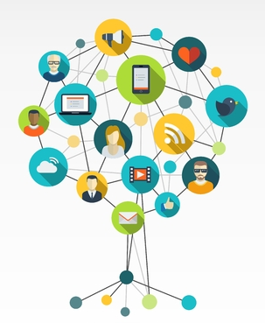
Chapter
02
4. Pervasive
Mobile technologies, such as mobile phones, smartphones, and tablets, give a pervasive or even ubiquitous scope to digital media.
In fact, they allow people to access and post information at any time and from any location, and companies to track and surveil user behavior at an unprecedented scale.

Slide 12
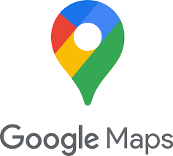
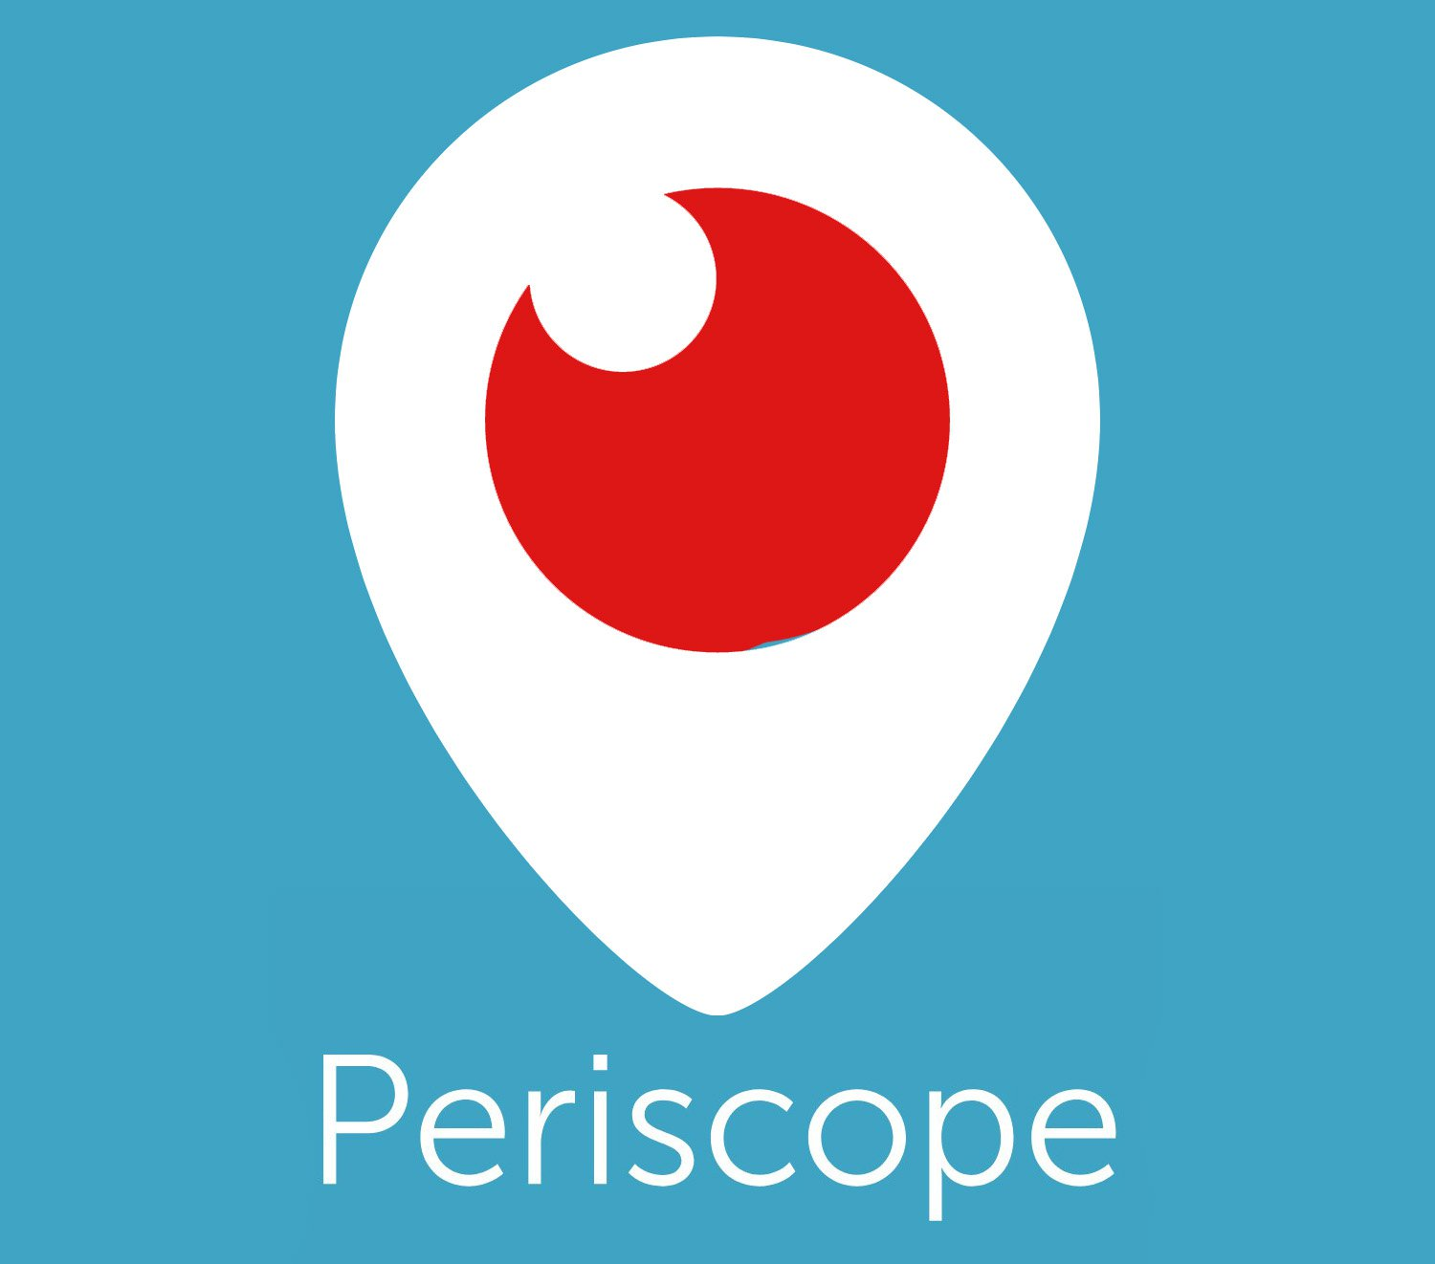
Chapter
02
4. Pervasive
This makes it possible to produce and exchange information specifically related to the place and time of use: to upload information on a shared map, for example Google Maps, or to communicate and interact with those who are attending an event in a particular location, for example textually via Twitter or with a video via Periscope.

Slide 13
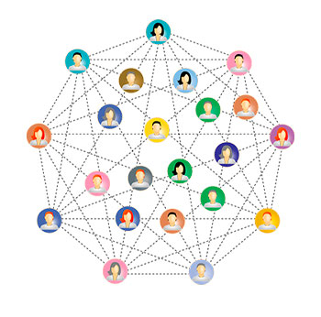
Chapter
02
4. Pervasive
Mobile technologies have the ability to modify and extend our social networks.
In this sense, they are not only a means for creating abstract communities, but also a tool to strengthen social ties connected to specific physical locations or territories.

Slide 14
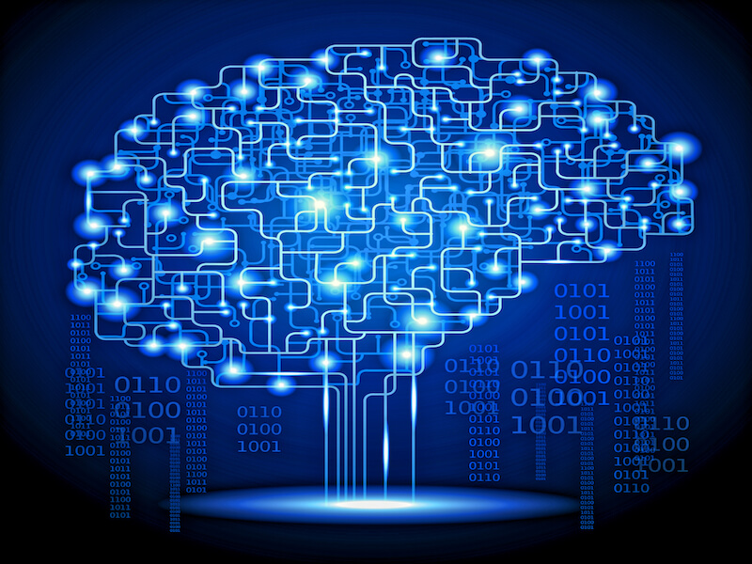
Chapter
02
5. Algorithmic
Most digital media services and technologies are underpinned by algorithms.
These are programs that follow procedural logics in order to generate specific outputs.
The role of algorithms is made possible by the fact that digital technologies “datafy” behaviors and interactions, or transform them into data that can be analyzed and then used to make choices.

Slide 15
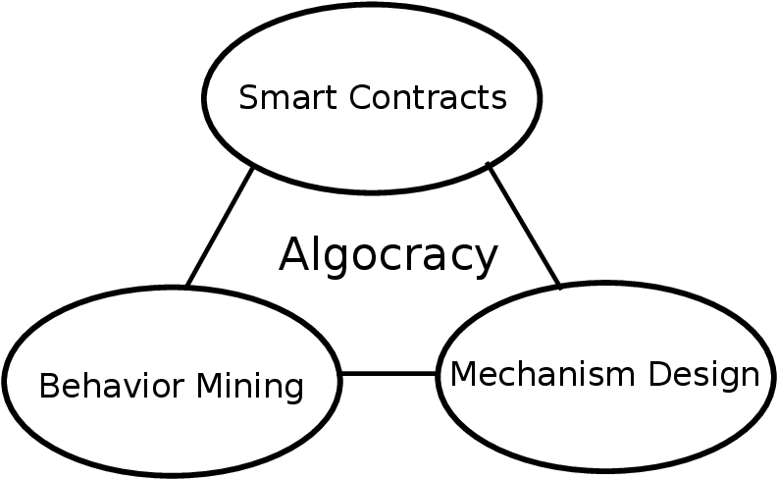
Chapter
02
5. Algorithmic
Algorithms bring with them a promise of objectivity, as they are supposed to be accurate and free from bias or external influence .
And yet the study of their logics and effects has found that, like any human technology, they are not neutral .
The term “Algocracy” describes situations in which power is exercised by algorithms that affect action by making some kinds of interaction or organization possible and blocking others .

Slide 16
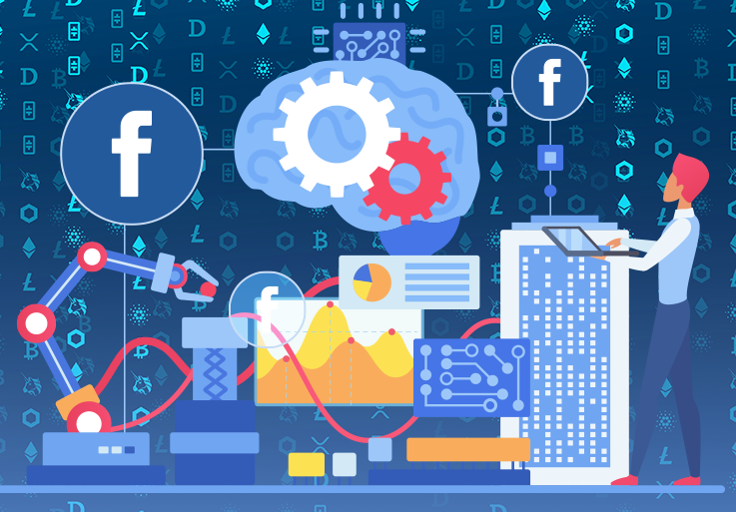
Chapter
02
5. Algorithmic
For example, Facebook’s algorithms analyze the activities of users and estimate which content is more likely to generate interactions if shown on their timeline.
Software, in sum, structures all activities mediated by digital technologies.
Many algorithms are based on machine learning technologies.
This means that while using a certain service, individuals contribute to training algorithms.

Slide 17
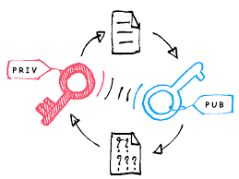
Chapter
02
6. Asymmetric
Digital media are highly commodified, as the biggest services are owned by a handful of gigantic corporations.
In this landscape, power is unevenly distributed, as individual users do not have access to the information these corporations collect about their interactions and behaviors, although such information shapes the way users interact with a certain platform or service .

Slide 18
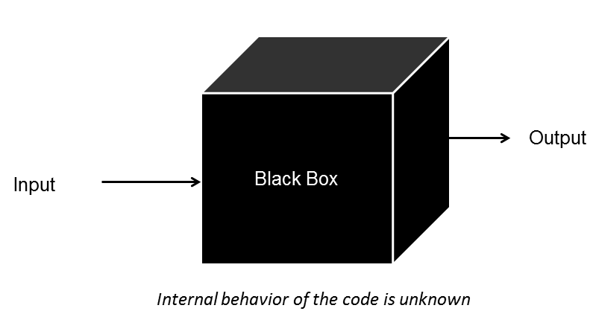
Chapter
02
6. Asymmetric
Users do not know the algorithms that underpin the functioning of Tinder, and need to guess how to influence the way the platform decides to which other users one’s profile will be suggested as a possible match.
Indeed, digital media tend to be perceived as black boxes that obscure the underlying operations that structure user experience.

Slide 19

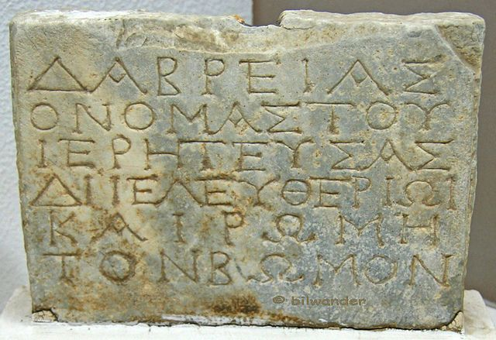
Chapter
02
7. Ephemeral or Permanent ?
Different media have different duration and persistence.
The paper book can be stored for centuries;.
Inscriptions on stone last for millennia.
In the case of the information produced and transmitted by digital media, its duration in time depends on several factors.

Slide 20
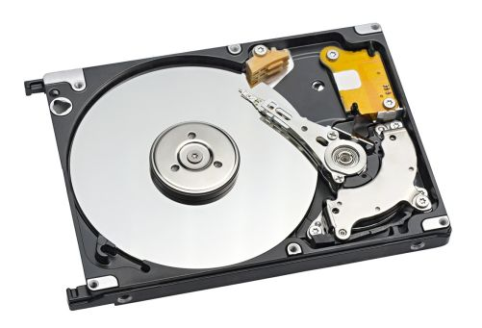
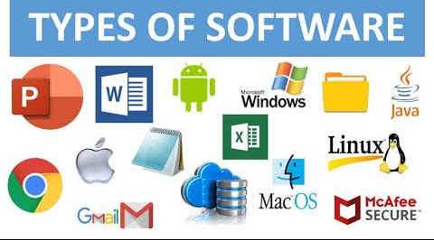
Chapter
02
7. Ephemeral or Permanent ?
The hard disks used to store data in digital form tend not to last more than one or two decades.
The softwares that transform human language into binary code are quickly replaced by new programs.

Slide 21

Chapter
02
7. Ephemeral or Permanent ?
At a stage of human history in which knowledge is archived and stored on digital media, these problems assume a central importance for institutions like libraries or archives, whose mandate includes the preservation of documents for future generations.

Slide 22
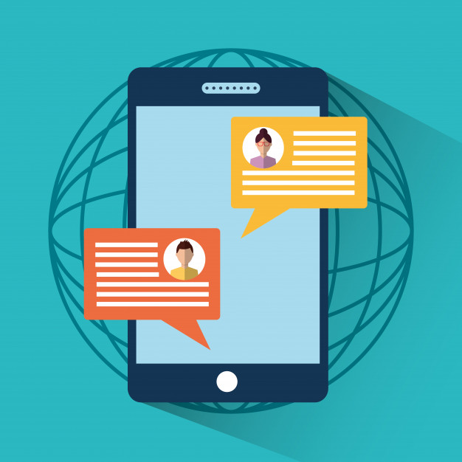
Chapter
02
7. Ephemeral or Permanent ?
At a different level, digital communications like messages, chats, or pictures are perceived as being highly ephemeral .
However, copies and traces of these communications can be duplicated and stored for years without the author’s knowledge, by the companies that manage digital communication services, by government agencies, or by other individuals.

Slide 23
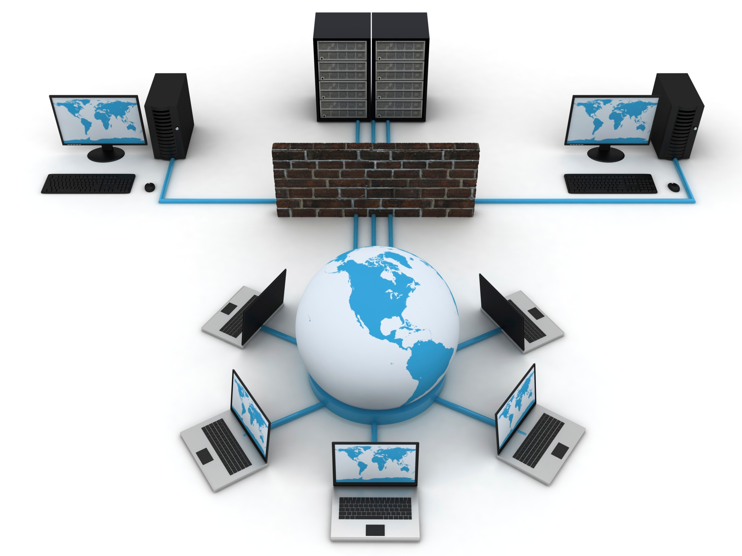
Chapter
02
II. Infrastructures and Platforms
The technical characteristics that underpin digital media reach global significance through the infrastructures that compose digital networks.
Understanding the architecture and design of the “plumbing” of digital media is crucial for the study of the actors and communities that populate them.

Slide 24
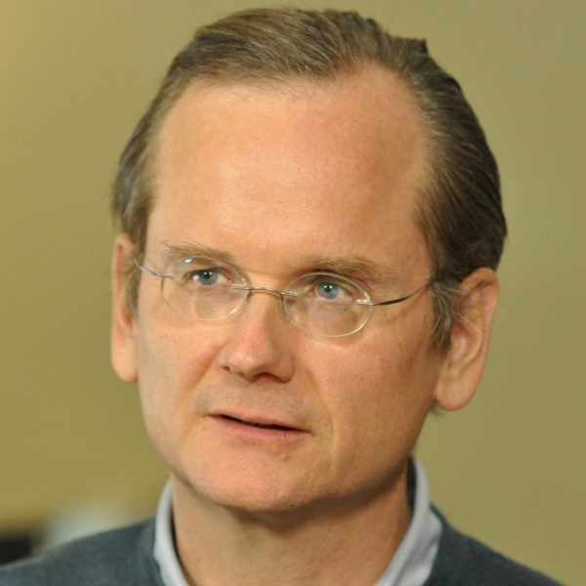
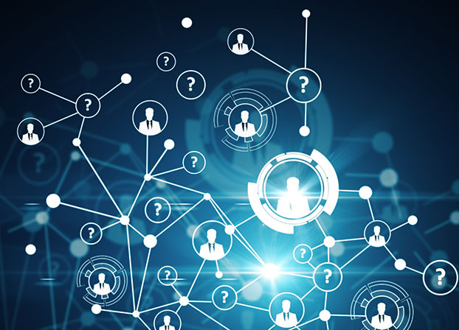
Chapter
02
II. Infrastructures and Platforms
According to the American law scholar Lawrence Lessig (2002), “code is law.”
With this formula, Lessig suggested that the architecture of the different layers of digital networks is not neutral, but rather has te power to shape the behaviors of their users.

Slide 25
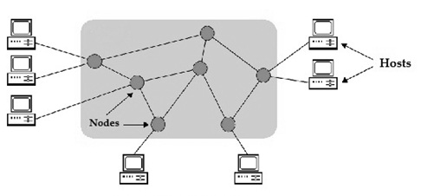
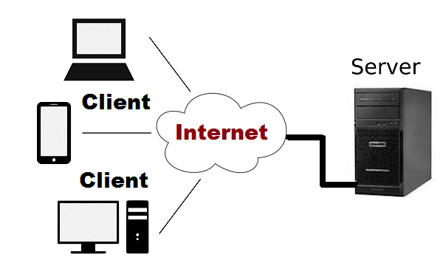
Chapter
02
II. Infrastructures and Platforms
Unlike broadcast media, such as a television station or a newspaper, the internet is a communication system that is not based on a single central hub. Instead, it is composed by a series of interconnected nodes.
Indeed, the internet is a distributed structure shaped as a network, which means that information is physically located on thousands of computers called servers, to which other computers connect to request the information they want, such as that making up a website.

Slide 26
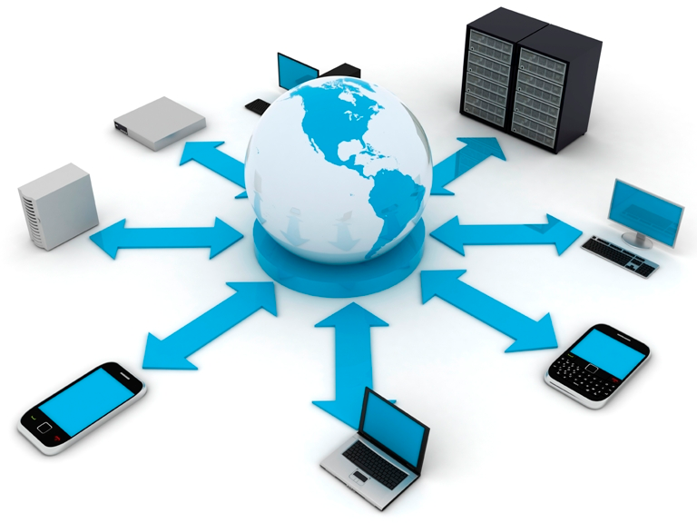
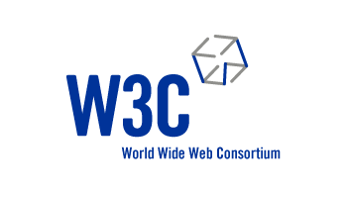
Chapter
02
II. Infrastructures and Platforms
Furthermore, the internet is an open system : anyone with access to a telephone or broadband line can access it, either with a personal computer or another device.
These infrastructural features are based upon a global governance system.
The World Wide Web Consortium (W3C) is an international organization that deals with web standards, with the task of keeping them open.

Slide 27
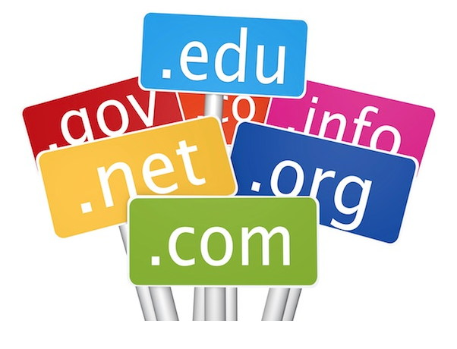

Chapter
02
II. Infrastructures and Platforms
Each website has an “address” where it can be reached, that is, an alphanumeric code that identifies the site and allows users to get to the server on which the information that constitutes it is stored.
These codes are called domains and are managed and awarded by an international organization, the Internet Corporation for Assigned Names and Numbers (Icann).
There are national domains, such as .it, .ca, or .se, or others that define the type of activity carried out by the site, such as .com for commercial activities or .org for associations and nonprofit organizations.

Slide 28
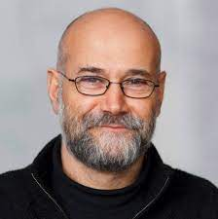
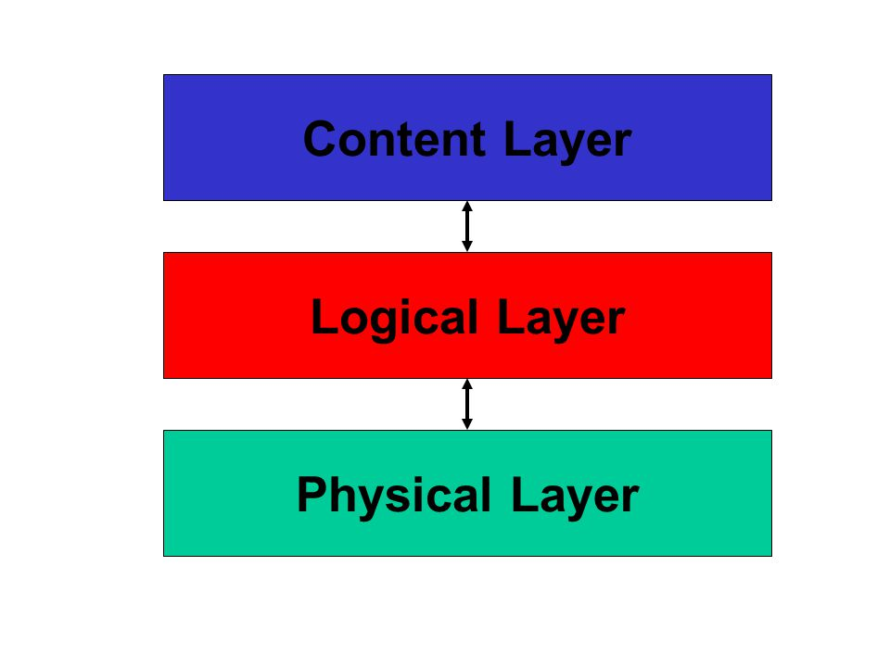
Chapter
02
II. Infrastructures and Platforms
To understand digital media, it is important to differentiate the levels that compose them.
As argued by Yochai Benkler, digital media and network technologies are composed of different “layers,” that are related to one another but have their own peculiarities, problems, and challenges (2006).

Slide 29
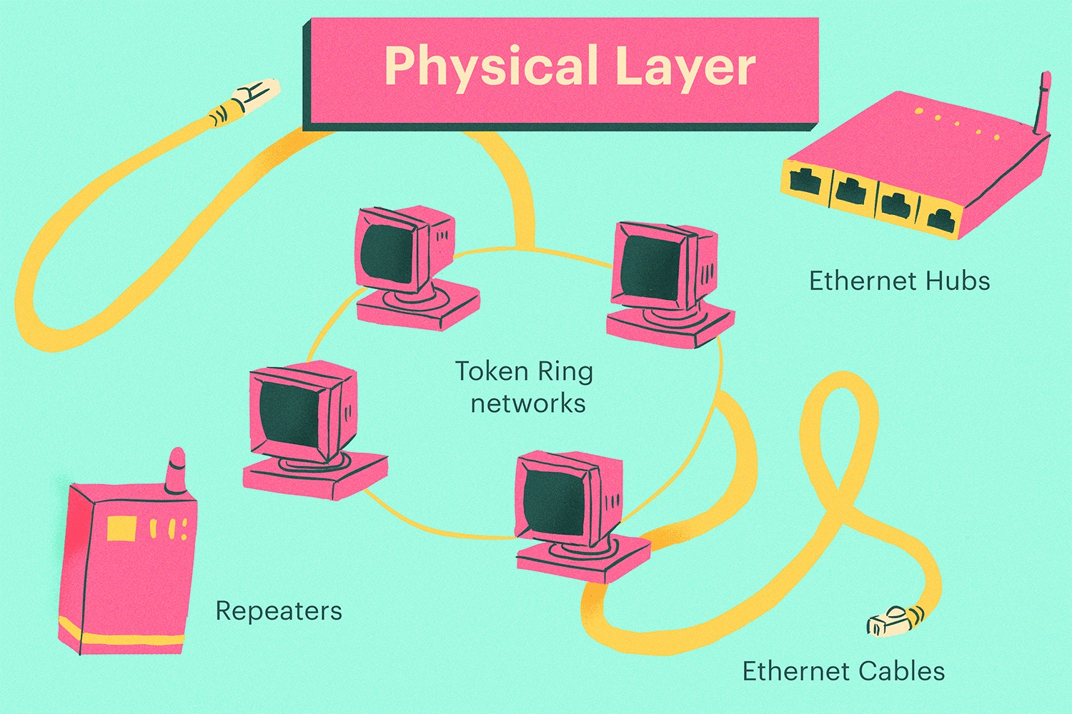
Chapter
02
II. Infrastructures and Platforms
The first is the physical layer:
It is composed of material components such as the frequencies that are used for radio broadcasts, and the cables, computers and servers, satellites, and telephone lines that make up the internet.

Slide 30
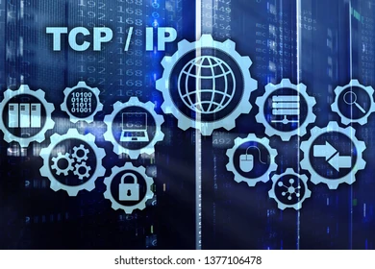
Chapter
02
II. Infrastructures and Platforms
The second is the logical layer :
composed of the software, standards, and protocols that underpin digital networks:
For example, the TCP/IP protocols that allow for the transfer of information on the internet, or the software that manages an online platform, social network, or database.

Slide 31
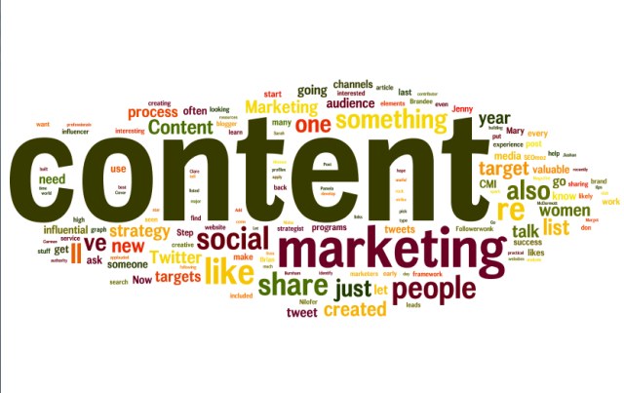
Chapter
02
II. Infrastructures and Platforms
The third is the content layer,
that is, the humanly intelligible information that is produced and exchanged within the network:
for example, the text of an article in an online newspaper, the content of an email, or a picture posted on a social media.

Slide 32
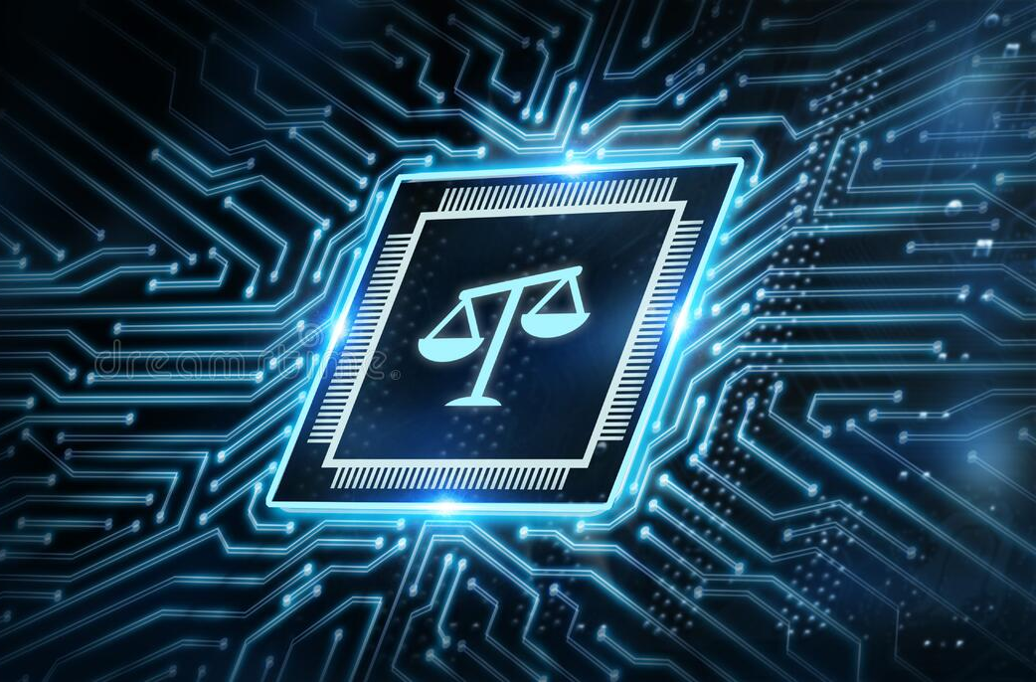
Chapter
02
II. Infrastructures and Platforms
Finally, there is also the legal layer,
the set of national and international laws and policies governing the functioning of digital networks and the behavior of their users.
This level is related to the other three.

Slide 33
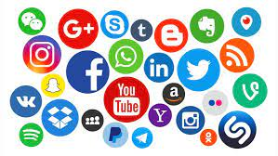

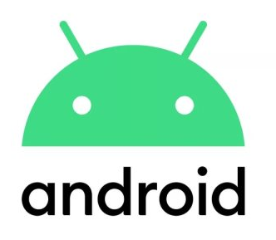
Chapter
02
II. Infrastructures and Platforms
Another important focus of studies of digital media is represented by one component of digital media infrastructures: platforms.
From a technical viewpoint, a digital platform is nothing else than a software environment in which a set of programs can be executed.
In this sense both a browser such as Firefox or an operating system such as Android can be seen as platforms, as they are environments for other applications – think of a Netflix movie watched on Firefox, or an app downloaded onto an Android phone.

Slide 34
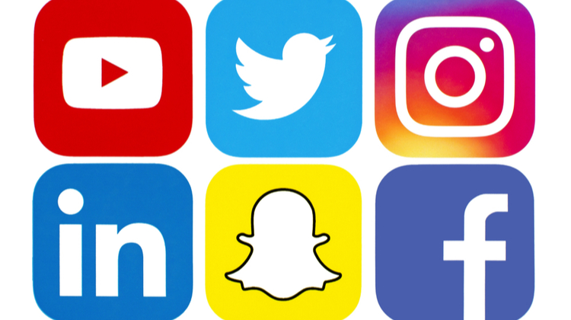
Chapter
02
II. Infrastructures and Platforms
Media scholars researching social media platforms have analyzed the way these services use algorithms to organize and mediate the interactions that are carried out through their interfaces.
For example, Instagram uses the same principles to mediate the circulation and exchange of images.

Slide 35
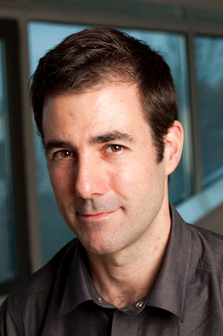
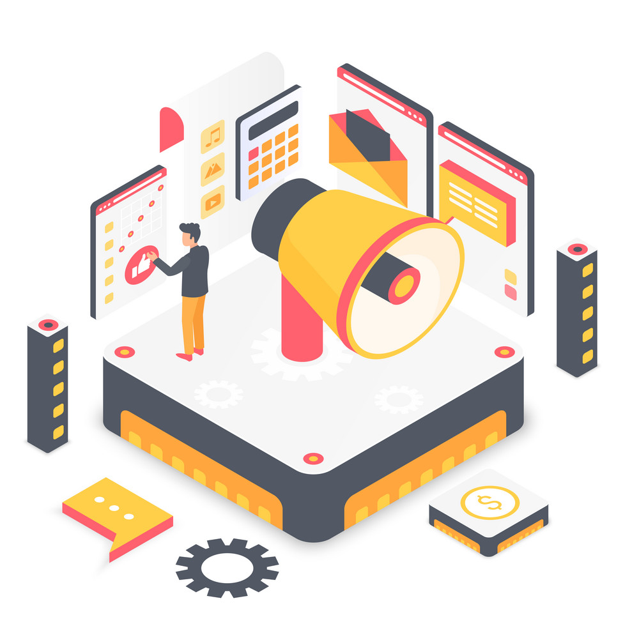
Chapter
02
II. Infrastructures and Platforms
In this sense, platforms are stages that allow users to perform specific activities (Gillespie 2010) while shaping how such activities can be carried out.

Slide 36
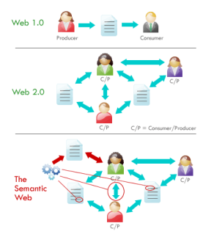
Chapter
02
III. The Web Generations :

Slide 37
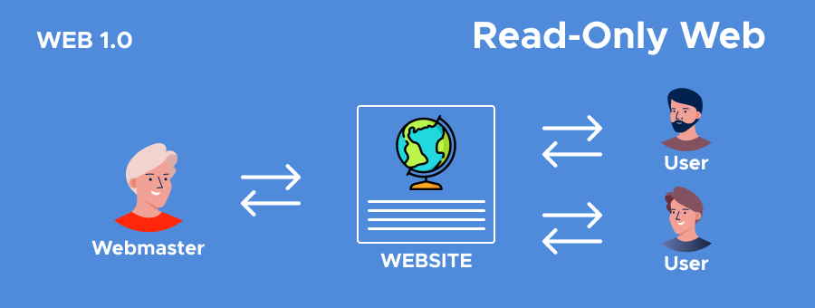
Chapter
02
III. The Web Generations :
Web 1.0 is the first generation of the web which could be considered the read-only web and also as a system of cognition.
Web 1.0 began as an information place for businesses to broadcast their information to people.
The early web provided a limited user interactions or content contributions and only allowed to search the information and read it.

Slide 38
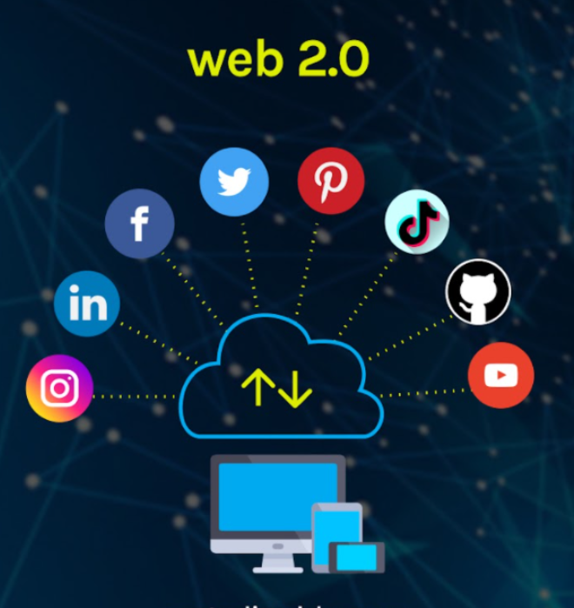
Chapter
02
III. The Web Generations :
Web 2.0 was defined as a read-write web .
The technologies of web 2.0 have more user-generated content and usability for end-users .
A Web 2.0 website allows users to interact and collaborate with each other through social media dialogue as creators of user-generated content in a virtual community.
It is also known as participatory web and social web.

Slide 39
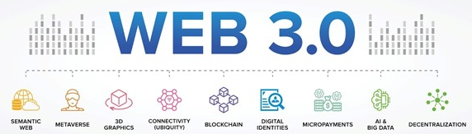
Chapter
02
III. The Web Generations :
Web 3.0 is more focused on the use of technologies like machine learning and AI (Artificial intelligence) to provide relevant content for each user instead of just the content other end users have provided.

Slide 40
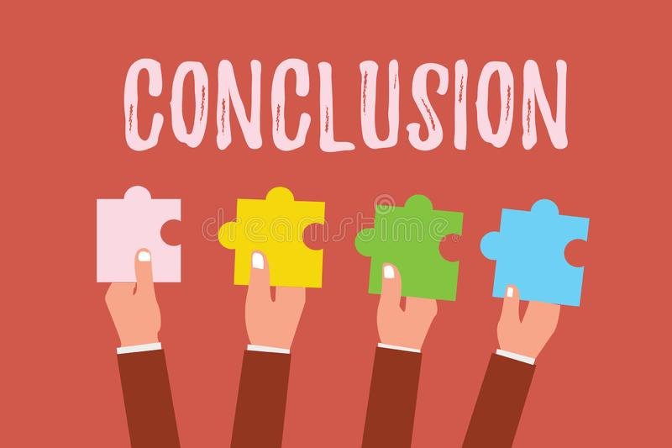
Chapter
02
Conclusion
Digital media have common characteristics that distinguish them from Analog old media (Convergent, Hypertextual, Distributed, Pervasive, Algorithmic, Asymmetric, Ephemeral & Permanent) .
The architecture of the digital networks is not neutral, but rather has the power to shape the behaviors of their users.
The internet is an open system , based upon a global governance system.
Digital media and network technologies are composed of different “layers,” (physical, logical, content & Legal).
There are three generations of the web (Web 1.0 - Web 2.0 - Web 3.0 ).

Slide 41
Thank you for listening
DGM 711
Introduction to Digital Media

