Slide 1


Risk Management
Prepared by Dr. Majid Saad
MGM510
Lec.9 : Fundamental Legal Principles

Slide 2
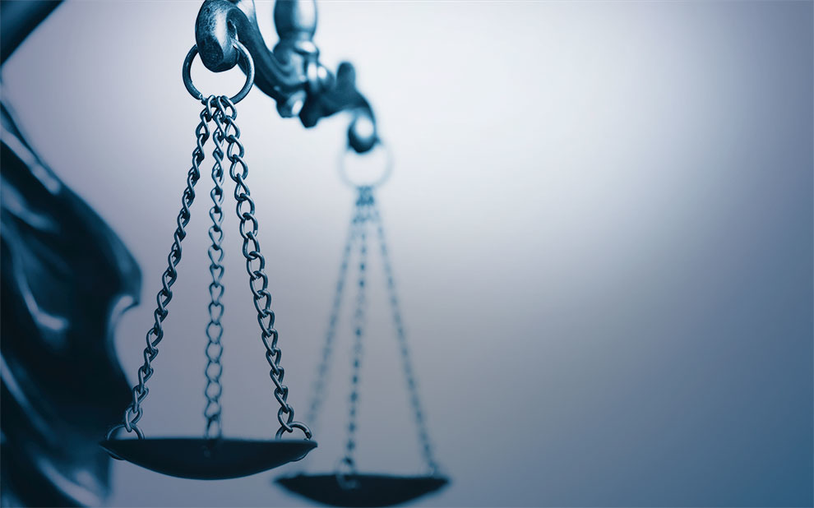
Lec.9 : Fundamental Legal Principles
“It is unfair to believe everything we hear about lawyers— some of it may not be true.”
Gerald F. Lieberman

Slide 3

Lecture objectives
After studying this chapter, you should be able to:
Explain the fundamental legal principles that are reflected in insurance contracts, including:
Principle of indemnity Principle of insurable interest
Principle of subrogation Principle of utmost good faith
Explain how the legal concepts of representations, concealment, and warranty support the principle of utmost good faith.
Describe the basic requirements for the formation of a valid insurance contract.
Show how the nature of insurance contracts differs from that of other contracts.
Explain the law of agency and how it affects the actions and duties of insurance agents.

Slide 4
Lecture topics
Insurance contracts are complex legal documents that reflect both general rules of law and insurance law.
In this lecture, we examine the fundamental legal principles on which insurance contracts are based, legal requirements for a valid insurance contract, and legal characteristics of insurance contracts that distinguish them from other types of contracts.
The lecture concludes with a discussion of the law of agency and its application to insurance agents.

Slide 5
Principle of Indemnity
The principle of indemnity is one of the most important principles in insurance. The principle of indemnity states that the insurer agrees to pay no more than the actual amount of the loss; stated differently, the insured should not profit from a loss.
A contract of indemnity does not mean that all covered losses are always paid in full.
The principle of indemnity has two fundamental purposes:
- The first purpose is to prevent the insured from profiting from a loss.
- The second purpose is to reduce moral hazard. If dishonest policyholders could profit from a loss, they
might deliberately cause losses with the intention of collecting the insurance.

Slide 6
Principle of Indemnity
Actual Cash Value
- The concept of actual cash value supports the principle of indemnity. In property insurance, the basic method for indemnifying the insured is based on the actual cash value of the damaged property at the time of loss.
The courts have used a number of methods to determine actual cash value, including the following:
Replacement cost less depreciation
Fair market value
Broad evidence rule

Slide 7
Replacement Cost Less Depreciation
Under this rule, actual cash value is defined as replacement cost less depreciation. This rule has been used traditionally to determine the actual cash value of property in property insurance. It takes into consideration both inflation and depreciation of property values over time. Replacement cost is the current cost of restoring the damaged property with new materials of like kind and quality. Depreciation is a deduction for physical wear and tear, age, and economic obsolescence.

Slide 8
Fair Market Value
Some courts have ruled that fair market value should be used to determine actual cash value of a loss. Fair market value is the price a willing buyer would pay a willing seller in a free market.
The fair market value of a building may be below its actual cash value based on replacement cost less depreciation. This difference is due to several factors, including a poor location, deteriorating neighborhood, or economic obsolescence of the building..

Slide 9
Broad Evidence Rule
The broad evidence rule means that the determination of actual cash value should include all relevant factors an expert would use to determine the value of the property. Relevant factors include replacement cost less depreciation, fair market value, present value of expected income from the property, comparison sales of similar property, opinions of appraisers, and numerous other factors.

Slide 10
Exceptions to the Principle of Indemnity
There are several important exceptions to the principle of indemnity. They include the following:
Valued policy
Valued policy laws
Replacement cost insurance
Life insurance

Slide 11
Exceptions to the Principle of Indemnity
Valued Policy
A valued policy is a policy that pays the face amount of insurance if a total loss occurs.
Valued Policy Laws
A valued policy law is a law that exists in some states that requires payment of the face amount of insurance to the insured if a total loss to real property occurs from a peril specified in the law.
Replacement Cost Insurance
Replacement cost insurance means there is no deduction for physical depreciation in determining the amount paid for a loss.
Life Insurance
A life insurance contract is not a contract of indemnity but is a valued policy that pays a stated amount to the beneficiary at the time of the insured’s death.

Slide 12
Principle of Insurable Interest
The principle of insurable interest states that the insured must be in a position to lose financially if a covered loss occurs.
Purposes of principle of insurable interest
First, an insurable interest is necessary to prevent gambling.
Second, an insurable interest reduces moral hazard.
Finally, in property insurance, an insurable interest measures the amount of the insured’s loss.

Slide 13
Principle of Subrogation
Subrogation means substitution of the insurer in place of the insured for the purpose of claiming indemnity from a third party for a loss covered by insurance. Stated differently, the insurer is entitled to recover from a negligent third party any loss payments made to the insured.

Slide 14
Purposes of Subrogation
Subrogation has three basic purposes.
First, subrogation prevents the insured from collecting twice for the same loss. In the absence of subrogation, the insured could collect from his or her insurer and from the person who caused the loss. The principle of indemnity would be violated because the insured would be profiting from a loss.
Second, subrogation is used to hold the negligent person responsible for the loss. By exercising its subrogation rights, the insurer can collect from the negligent person who caused the loss.
Third, subrogation helps to hold down insurance rates. Subrogation recoveries are reflected in the ratemaking process, which tends to hold rates below where they would be in the absence of subrogation. Although insurers pay for covered losses, subrogation recoveries reduce the loss payments.

Slide 15
Exceptions to Subrogation
Certain exceptions apply to the principle of subrogation. They include the following:
Subrogation does not apply to life insurance contracts. Life insurance is a valued policy and not a contract of indemnity. Subrogation has relevance only for contracts of indemnity.
The insurer cannot subrogate against its own insureds. If the insurer could recover a loss payment for a covered loss from an insured, the basic purpose of purchasing the insurance would be defeated.

Slide 16
Principle of Utmost Good Faith
An insurance contract is based on the principle of utmost good faith—that is, a higher degree of honesty is imposed on both parties to an insurance contract than is imposed on parties to other contracts. This principle has its historical roots in ocean marine insurance.
The principle of utmost good faith is supported by three important legal doctrines: representations, concealment, and warranty.

Slide 17
Representations
Representations are statements made by the applicant for insurance.
The legal significance of a representation is that the insurance contract is voidable at the insurer’s option if the representation is (1) material, (2) false, and (3) relied on by the insurer. Material means that if the insurer knew the true facts, the policy would not have been issued, or it would have been issued on different terms. False means that the statement is not true or is misleading. Reliance means that the insurer relies on the misrepresentation in issuing the policy at a specified premium.

Slide 18
Concealment
Concealment
The doctrine of concealment also supports the principle of utmost good faith. A concealment is intentional failure of the applicant for insurance to reveal a material fact to the insurer. Concealment is the same thing as nondisclosure; that is, the applicant for insurance deliberately withholds material information from the insurer. The legal effect of a material concealment is the same as a misrepresentation—the contract is voidable at the insurer’s option

Slide 19
Warranty
Warranty
The doctrine of warranty also reflects the principle of utmost good faith. A warranty is a statement that becomes part of the insurance contract and is guaranteed by the maker to be true in all respects.12 For example, in exchange for a reduced premium, a liquor store owner may warrant that an approved burglar alarm system will be operational at all times.

Slide 20
Requirements of an Insurance Contract
The first requirement of a binding insurance contract is that there must be an offer and acceptance of its terms. In most cases, the applicant for insurance makes the offer, and the company accepts or rejects the offer. An agent merely solicits or invites the prospective insured to make an offer. The requirement of offer and acceptance can be examined in greater detail by making a careful distinction between property and casualty insurance, and life insurance.
A binder is a temporary contract for insurance and can be either written or oral.
A conditional premium receipt is then given to the applicant. The most common conditional receipt is the “insurability premium receipt.”

Slide 21
Exchange of Consideration
The second requirement of a valid insurance contract is the exchange of consideration—the value that each party gives to the other. The insured’s consideration is payment of the premium (or a promise to pay the premium) plus an agreement to abide by the conditions specified in the policy.
The insurer’s consideration is the promise to do certain things as specified in the contract. This promise can include paying for a loss from an insured peril, providing certain services, such as loss prevention and safety services, or defending the insured in a liability lawsuit.

Slide 22
Competent Parties
The third requirement of a valid insurance contract is that each party must be legally competent. This means the parties must have legal capacity to enter into a binding contract. Most adults are legally competent to enter into insurance contracts, but there are some exceptions. Insane persons, intoxicated persons, and corporations that act outside the scope of their authority cannot enter into enforceable insurance contracts.

Slide 23
Legal Purpose
A final requirement is that the contract must be for a legal purpose. An insurance contract that encourages or promotes something illegal or immoral is contrary to the public interest and cannot be enforced

Slide 24
The valid insurance contract
To have a valid insurance contract, four requirements must be met:
– There must be an offer and acceptance.
– There must be an exchange of consideration.
– The parties to the contract must be legally competent.
– The contract must be for a legal purpose.

Slide 25
Distinct Legal Characteristics of Insurance Contracts
Insurance contracts have distinct legal characteristics that make them different from other legal contracts. Several distinctive legal characteristics have already been discussed. As we noted earlier, most property and casualty insurance contracts are contracts of indemnity; all insurance contracts must be supported by an insurable interest; and insurance contracts are based on utmost good faith. Other distinct legal characteristics include the following:
■ Aleatory contract
■ Unilateral contract
■ Conditional contract
■ Personal contract
■ Contract of adhesion

Slide 26
Aleatory Contract
An insurance contract is aleatory rather than commutative. An aleatory contract is a contract where the values exchanged may not be equal but depend on an uncertain event. Depending on chance, one party may receive a value out of proportion to the value that is given.
In contrast, other commercial contracts are commutative. A commutative contract is one in which the values exchanged by both parties are theoretically equal.

Slide 27
Unilateral Contract
An insurance contract is a unilateral contract. A unilateral contract means that only one party makes a legally enforceable promise. In this case, only the insurer makes a legally enforceable promise to pay a claim or provide other services to the insured.

Slide 28
Conditional Contract
An insurance contract is a conditional contract. That is, the insurer’s obligation to pay a claim depends on whether the insured or the beneficiary has complied with all policy conditions. Conditions are provisions inserted in the policy that qualify or place limitations on the insurer’s promise to perform

Slide 29
Personal Contract
In property insurance, insurance is a personal contract, which means the contract is between the insured
and the insurer. Strictly speaking, a property insurance contract does not insure property, but insures the owner of property against loss.
The owner of the insured property is indemnified if the property is damaged or destroyed. Because the contract is personal, the applicant for insurance must be acceptable to the insurer and must meet certain underwriting standards regarding character, morals, and credit.

Slide 30
Contract of Adhesion
A contract of adhesion means the insured must accept the entire contract, with all of its terms and conditions.
The insurer drafts and prints the policy, and the insured generally must accept the entire document and cannot insist that certain provisions be added or deleted or the contract rewritten to suit the insured.
The principle of reasonable expectations states that an insured is entitled to coverage under a policy that he or she reasonably expects it to provide, regardless of policy provisions.

Slide 31
Law and the Insurance Agent
An insurance contract normally is sold by an agent who represents the principal (the insurer). An agent is someone who has the authority to act on behalf of someone else. The principal (insurer) is the party for whom action is to be taken.

Slide 32
Law of Agency
Important rules of law govern the actions of agents and their relationship to insureds. They include the following:
There is no presumption of an agency relationship.
An agent must have authority to represent the principal.
A principal is responsible for the acts of agents acting within the scope of their authority.
Limitations can be placed on the powers of agents.

Slide 33
No Presumption of an Agency Relationship
There is no automatic presumption that one person legally can act as an agent for another. Some visible evidence of an agency relationship must exist

Slide 34
Authority to Represent the Principal
An agent must be authorized to represent the principal. An agent’s authority comes from three sources:
(1) express authority, (2) implied authority, and (3) apparent authority.
Express authority refers to powers specifically conferred on the agent. These powers are normally stated in the agency agreement between the agent and the principal. The agency agreement may also withhold certain powers.
Implied authority refers to the authority of the agent to perform all incidental acts necessary to fulfill the purposes of the agency agreement.
Apparent authority If an agent acts with apparent authority to do certain things, and a third party is led to believe that the agent is acting within the scope of reasonable and appropriate authority, the principal can be bound by the agent’s actions.

Slide 35
Principal Responsible for Acts of Agents
Another rule of agency law is that the principal is responsible for all acts of agents when they are acting within the scope of their authority. This includes fraudulent acts, omissions, and misrepresentations.
In addition, knowledge of the agent is presumed to be knowledge of the principal with respect to matters within the scope of the agency relationship

Slide 36
Limitations on the Powers of Agents
Insurers can place limitations on the powers of agents. The limitations are generally effective when they are properly communicated to the policyholder and do not conflict with the law. This is done by a nonwaiver clause in the application or policy, which typically states that only certain representatives of the company, such as executive officers, can extend the time to pay premiums or to change the terms of the policy.

Slide 37



Thank You

